Slide 1
Making POWRRful Progress: The Digital POWRR Project Update
Lynne M. Thomas, Co-PI
Jaime Schumacher, Project Director
Northern Illinois University

Slide 2
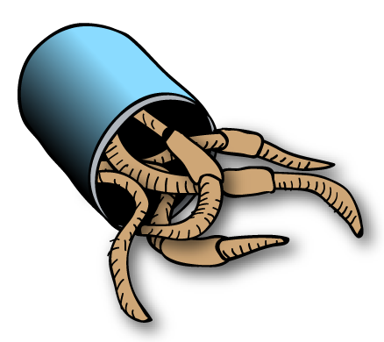
Where we began
Image source:Wikimedia Commons
It can’t just be us losing out on grant dollars… can it?
Do we even know what’s here? And how much of it there is? Where it is?
How on earth will we manage it?
And pay for it?

Slide 3
So we started talking to people
Conversations are (mostly) free.
But not always successful at first
  On campus or consortially
We found our allies…and applied for a grant together.

Slide 4
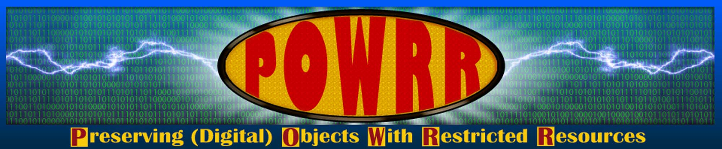
We got funded!
…but not quite how we expected to be…

Slide 5
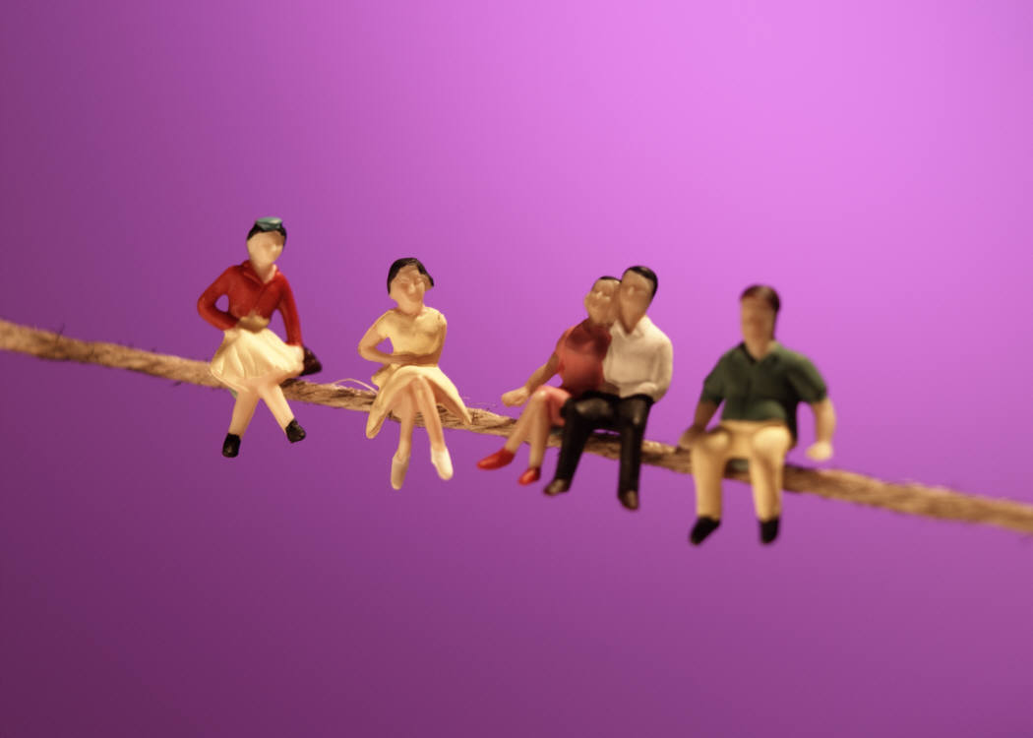
“Doing digital preservation”
… in public …
…without a net.

Slide 6
We aren’t terribly ambitious…
Educate ourselves, our faculty, and our administrators
Survey! Self-study/case study!
Tool evaluation grid & DP tool/service testing
Institutional communication plans and sample policies to share on our wiki
Workshops, webinars, and conferences, oh my
White paper (our actual IMLS deliverable)

Slide 7
Our work became more timely when we weren’t looking…
IL Open Access to Research Articles Act (which includes digital preservation in its wording)
The Fair Access to Science and Technology Research Act (FASTR)
Data Management Plan requirements from federal funding agencies
New administrators on several project campuses
Major data loss(es) at project institution(s)
Notes:
Data loss of anthropologist at NIU

Slide 8
What do (and don’t) we know?
Begin with the library. Then campus:
  How much data?
  What kinds of formats?
  Will we keep all of it? Where?
Do we have a plan? A policy? A plan for a policy?
Do our faculty even know that this is a thing? Campus IT? Administrators?

Slide 9
Roadblocks ahoy!
“You need to get IRB approval”
“We can’t even afford test tubes”
“You'll need a virtual machine for that”
“You just need to run a Python script”
“You don’t have access to that server”
“All that’s just on the internet, it’ll always be there…”
“There’s a hiring freeze on campus”

Slide 10
Embrace “good enough”
Most of us will not be TRAC certified. And that is okay
Good enough digital preservation is cheaper than not having it:
  Lost grant dollars
  Lost institutional history
We routinely make choices for paper; why not digital?

Slide 11
Institutional arguments we should (already) be making
Digital preservation is mission critical institutionally and requires funding as such.
Digital preservation is affordable with sufficient planning.
Digital preservation is included in the OARAA. We are required to address it.
Digitization (and ContentDM, and the internet…) is NOT digital preservation.
Advocate now for future budget cycles

Slide 12
We can help
Policies, communication & education plans
Tool selection info at your fingertips
Workshops for your practitioners
Models for collaborative funding
Aimed at institutions with restricted resources

Slide 13
Digging deeper…so you don’t have to
Right now: testing a limited subset of tools to see how they work together across institutions with different setups.
We’re going to tell you what’s easiest to use and how well it works out of the box.
Testing generally by end users, to identify roadblocks.

Slide 14
What are we testing?
Processing Tools:
  Archivematica
  Curator’s Workbench
Storage & Cloud Services:
  DuraCloud
  Internet Archive
  MetaArchive
How well our processing tools work with storage/cloud services

Slide 15
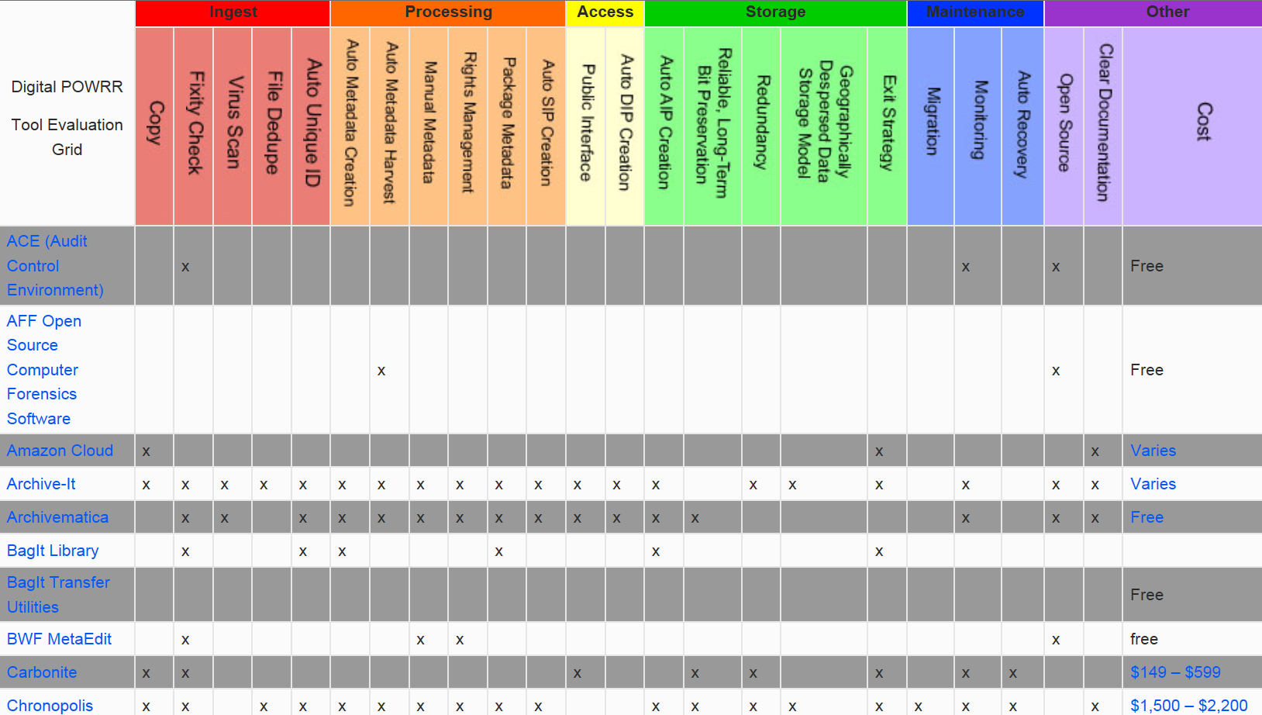
Not Enough? Tool grid! http://digitalpowrr.niu.edu/tool-grid/
Notes:
Based on OAIS reference model

Slide 16
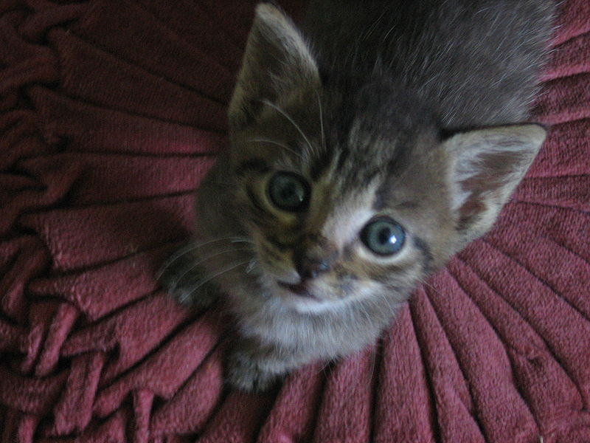
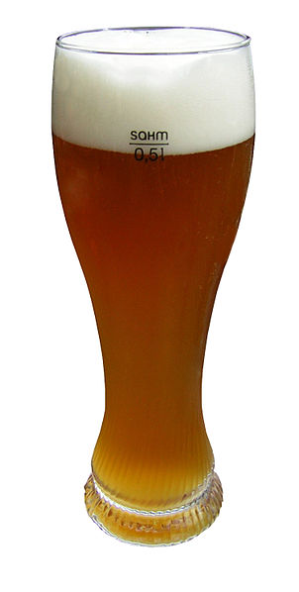
A note about the word “free”
NOT
Open source software requires resources to install, maintain, and improve it.

Slide 17
POWRRful Lessons
Explosion in theory and practice from 2008-present
We do not have technology problems, we have selection problems
DP is not “just” a library/archive problem
Stubbornness is a virtue

Slide 18
POWRRful Lessons
DP is everyone’s job: this cannot be done by hiring in one person who “knows new tech”
Collaborative models = better chances of success and funding (we’re on it!)
We’ll come to your campuses on request to share these lessons
  Relevant committees (such as OARAA, which includes digital preservation. Did we mention that?)

Slide 19
What’s next?
White paper via IMLS (Spring 2014)
Digital POWRR Wiki http://powrr-wiki.lib.niu.edu/index.php/Main_Page
Hitting the road: Workshops, presentations, and more!
Tool recommendations, collaborative DP models and policies to share, and implementation plans

Slide 20
http://digitalpowrr.niu.edu
Questions?

