Slide 1
The SFX knowledgebase:
techniques, problems, solutions
Kathy Varjabedian
Los Alamos National Laboratory
Research Library, Los Alamos, NM

Slide 2
SFX KB weekly update reports
HTML vs. text format
How to review
Problems and wider issues

Slide 3
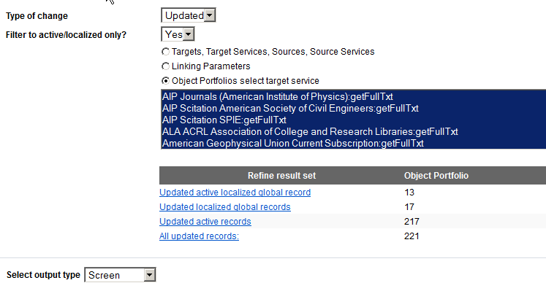
HTML reports
Can look at one target service, or select all
Gives breakdowns of the results set, which may or may not be useful
Notes:
Can click through to KB Manager
Breaks up information in many pieces
Can’t combine with previous updates for a target

Slide 4
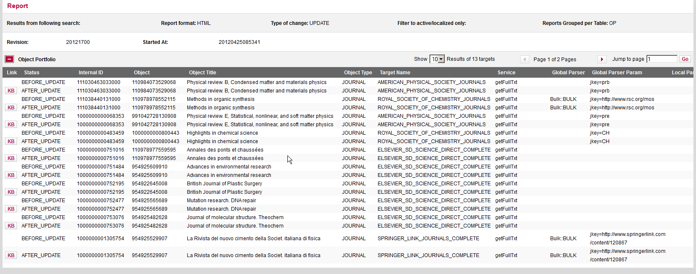
PRO
KB button links to that OP
for testing/editing
Global & local thresholds
appear next to each other
CON
List is not sorted or sortable
Screens very wide; hard to read
Can’t annotate with what you’ve done or need to do
Notes:
Screenshot at full width of wide monitor; still can only see half of table; scrolling right enough to see the global threshold, can’t see the title any more

Slide 5
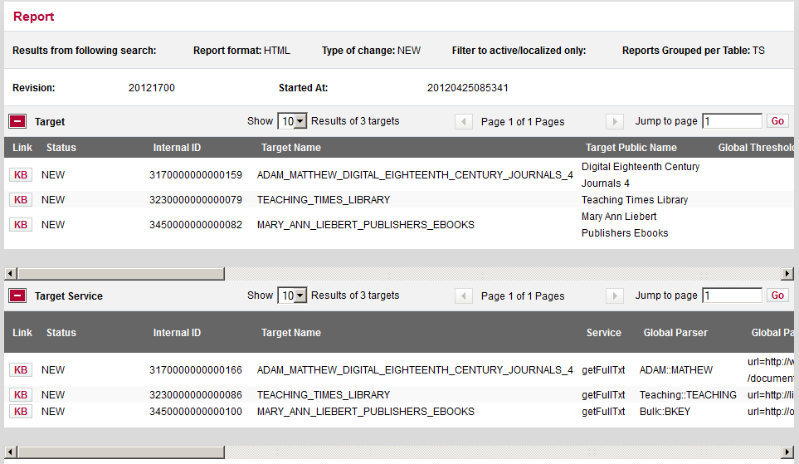
Target/Target Service reports, short, html version may be useful

Slide 6
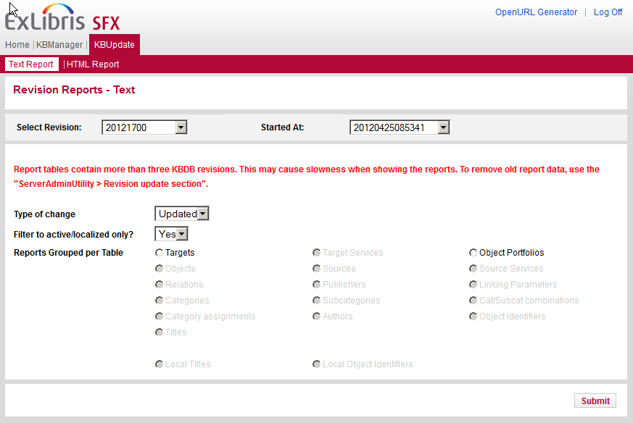
Text Reports
Notes:
Request report: New, Updated, Deleted
Use “Filter to active/localized only?” filter for updated and deleted
Submit, save .txt file

Slide 7
Target/Target Service
Look at update document from ExLibris
Target/TS new or deleted: May be important if a platform change, or a new collection that you need
Target changes: usually just change in name or public name, adding description.
Target Service changes: Generally no action needed, but may want to test to make sure linking still works.
Source/Source Service: very rare

Slide 8
Deleted Object Portfolios
Focus on subscription titles, skim free ones
Detective work:
Search title in KB, see if you have it activated elsewhere. Check publisher website where it has been available.
Was it transferred to another publisher? Moved to another target? Does the New report have a new OP for this title? Still available? You may need to add local OP or activate a different OP
May have associated maintenance in catalog/ezproxy/etc. if your access is gone or moved

Slide 9
Example: OP deleted and added
Corrosion still works at this location – need to activate on another OP
New OP added in same update - different target, same URL and coverage

Slide 10
New Object Portfolios
Sort by target, then title
Scan for additions to your subscription packages
Watch ACTIVE/INACTIVE column – if target is set for Autoactivate, no further action in KB needed
If not auto-activated, test access at publisher site, and activate as needed.
Scan for free titles of interest and activate as desired
(Maintenance in catalog, ezproxy, etc.)

Slide 11
Object Portfolios changed
Download .txt, open in Excel with import wizard, selecting columns and changing from General to Text format (so that Excel can handle the long numbers)
Sort by target
Modify for ease of use:
- color local data; move local threshold column next to global threshold column
- highlight cells which were changed - insert NOTES column - columns: adjust width or hide as desired

Slide 12
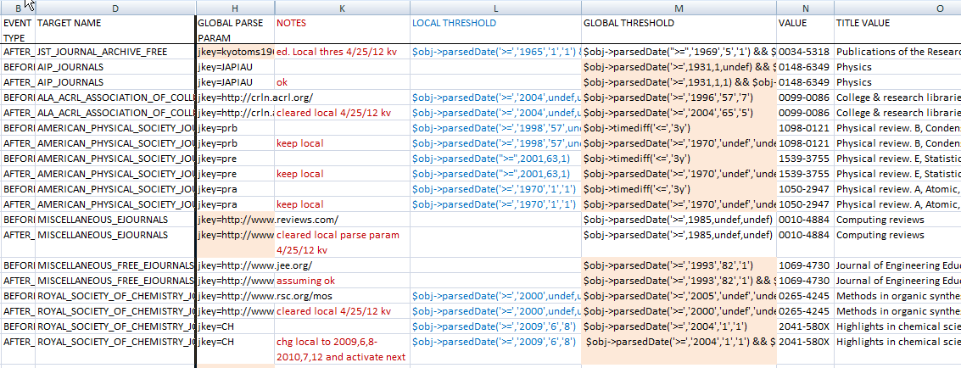
Text report in excel
Notes:
Notes are useful for successive changes, e.g. Computing Reviews changed parse param 4 times in 2 months. Search TITLE VALUE with “Find All” and easily see activity for that title.

Slide 13
Divide
Split out major publisher packages
Copy & paste the lines from weekly report into ongoing spreadsheet by publisher, inserting the update number in the first column, e.g. 20121600
New, Updated, and Deleted worked on together
Designated staff member builds expertise in quirks of specific licensed packages, the vendor’s website, multiple targets.
Copy & paste remaining lines into New, Updated and Deleted sheets.

Slide 14
Prioritize
Use judgment on what changes are worth your time to review
Large changes in coverage: handle first.
Test to see if change matches what you have access to; add a local threshold if needed.
Example: ASME adds backfiles that require additional purchase and your library hasn’t purchased those years; add or keep local threshold matching your access.
Minor changes, e.g. linking level – usually for information only, no action required

Slide 15
Small threshold changes
issue numbers added or dropped $obj->parsedDate('>=',1931,1,undef) && $obj->parsedDate('<=',1936,7,undef)
$obj->parsedDate('>=',1931,1,1) && $obj->parsedDate('<=',1936,7,12)
issue numbers changed slightly – e.g. JSTOR moving wall covers more issues
threshold opened up: $obj->parsedDate('==',2011,1,undef) $obj->parsedDate('>=',2011,1,undef)
Global threshold now matches your local threshold; clear local.

Slide 16
Parse param changes
new URL: test access, if doesn’t work right add local parse param. May need to check ezproxy
ID number changes, e.g. on IEEE conference proceedings – OK
Additions like uis=1234-1234 usually OK, may want to test

Slide 17
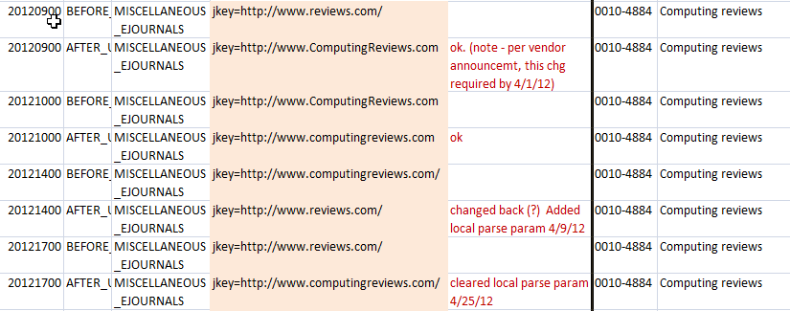
Example: parse param change
Computing reviews changed URL four times in two months

Slide 18
Trouble spots
Global threshold is closed
May indicate a title change; see if there is an OP for the next title, check its activation and threshold
May indicate stopped publication
May indicate was transferred to another publisher: see if you have access elsewhere that you need to activate
May require cataloging changes (close pub dates, add 780/785 tags, etc.)
Notes:
When titles are transferred, you may find that access to some years is lost; sometimes need to contact content provider about perpetual access

Slide 19
Subscription vs. open access
Lines are blurring
Prefer to activate on separate targets, for ease of identification and better statistics
Increasingly mixed in with subscription titles in KB - e.g. SPRINGER_LINK_JOURNALS_COMPLETE and SPRINGEROPEN_FREE
- RSC titles that are free for first year or two
Open Access models where single articles or issues are OA; currently no way to handle activation at that level of precision

Slide 20
Explosion of open access
Requires judgment calls on what is worth activating.
For DOAJ, have chosen to selectively activate
- subject in scope
- indexed in key databases (used JISC Academic Database Assessment Tool, www.jisc-adat.com/)
- reputation of publisher (see Jeffrey Beall’s List of Predatory, Open-Access Publishers)

Slide 21
Multiple targets and “New” titles
Often one title will have many OPs available for the same publisher – makes for long and confusing SFX menus.
Display Logic sometimes helps: e.g. if have Highwire, don’t show Highwire Free.
Display logic doesn’t help for AZ list when targets cover different spans of years. e.g. a subject backfile and current and complete
We activate on one target/publisher when possible.
Be alert when update adds same title to several targets; not always added in the same weekly update; know your policy for which target to use for a given publisher.

Slide 22
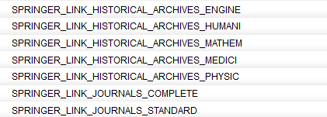
Examples of multiple targets
1996-present pre-1996 backfiles all years (mostly)

Slide 23
Title changes
When publishers/vendors put successive title changes on one web page under the latest title:
very difficult to find and access related titles
the vendor files loaded into KB have wrong thresholds for the current and previous titles
previous titles may not even have OPs; if you add an OP, you usually have to add a parse param to enable correct linking (depending on the target)

Slide 24
Handling title changes in KB updates
Having the correct title and ISSN for a given span of years and volumes is essential for OpenURL linking
Our policy is to have the years published for a given title/ISSN on that title
KB changes to successive titles often involve adding (or removing) a title and editing thresholds
Background in serial cataloging is helpful
Notes:
Sometimes vendor screens are so unhelpful, only the titles/ISSNs in header/footer on article pdfs verifies which title belongs with which vol/issue
Sometimes only looking at catalog record in a library catalog/OCLC or Ulrichs enables you to untangle the title changes

Slide 25
Extent of linking problems
Trainor and Price found that links failed nearly a third of the time (29 percent). (Library Technology Reports 46, no. 7 (2010).
Wakimoto, Walker, and Dabbour found that 20% of the full-text link options were erroneous. If include cases where content was not presented on the target (landing) page, 35% (Journal of Academic Librarianship 32, no. 2 (2006): 133.)

Slide 26
Three main causes
Cause
source OpenURL errors
knowledge base inaccuracies
target URL translation errors (Content providers need to improve website presentation)
Who’s working on it
IOTA
KBART
PIE-J

Slide 27
Some history
United Kingdom Serials Group (UKSG) 2007 report on Link Resolvers and the Supply Chain - Documented the frequency of linking errors due to inaccurate, incomplete, and inconsistent metadata.
- Noted lack of understanding among content providers

Slide 28
Re content provider understanding
NFAIS issued Best Practices for Publishing Journal Articles in 2009.
Aimed at publishers.
Journal title changes mentioned briefly, recommended to notifying the A&I database. No mention of link resolvers.
Notes:
For “retrieval” their only recommendation was the use of DOIs.
For “metadata” section, says use ISSN.

Slide 29
KBART (Knowledge Bases and Related Tools) Working Group
created Jan 2008 by UKSG and NISO
published recommended practice for exchange of holdings metadata to KB developers (Jan 2010)
Specifies 16 metadata fields, and guidelines for common metadata problems for journals, including title changes.
Endorsers are listed
Education
Phase 2 focusing on the more advanced, complex issues
http://www.niso.org/workrooms/kbart
Notes:
Recommended practice benefits everyone in the supply chain:
Provider can send same format to all link resolvers Link resolvers get easier-to-load and more accurate data
Libraries get more accurate data
Users get better links
File specs – columns in tab-separated file. Easy to apply
KBART info on UKSG site and NISO site; NISO more current
Phase 2 including open access content, e-books, conference proceedings, metadata for consortia.

Slide 30
PIE-J (Presentation and Identification of E-Journals)
NISO Working Group, their charge is “To develop a Recommended Practice that will provide guidance on the presentation and identification of e-journals, particularly in the areas of title presentation and bibliographic history, accurate use of the ISSN, and citation practice…”
http://www.niso.org/workrooms/piej
Notes:
Also an ISO standard for journal practice, being revised to cover e-journals

Slide 31
Knowledge base data quality
KB data comes primarily from vendor data loads
“We are continually adding quality assurance measures, which include a variety of tests and checks at multiple stages, … automatic and manual” (Yisrael Kuchar, SFX-MetaLib Product Manager, SFX list, 2/6/12 )
What level of quality control is possible/feasible?
Could Ex Libris provide notes on reasons for changes? Would save a lot of detective work
Goes back to the supplier chain: content providers play a crucial role
Notes:
“Changes in the KnowledgeBase originate from multiple sources. Primarily they are based on vendor input, through automatic and manual loads that are run on regular basis, and information we glean from press announcements, web pages and topical listservs. We also change the data when we receive relevant information from customers.” (Yisrael Kuchar, SFX-MetaLib Product Manager, SFX list, 2/6/12 )

Slide 32
Selected references
Regina Romano Reynolds and Cindy Hepfer, “In Search of Best Practices for the Presentation of E-Journals,” Information Standards Quarterly 21, no. 2 (2009): 20.
Rapple, Charlie. "Knowledge bases: improving the information supply chain." Learned Publishing 21.2 (2010): 110-15.
Glasser, Sarah. "Broken Links and Failed Access." Library Resources & Technical Services 56.1 (2012): 14-23.

