Slide 1
Beta Desk

Slide 2
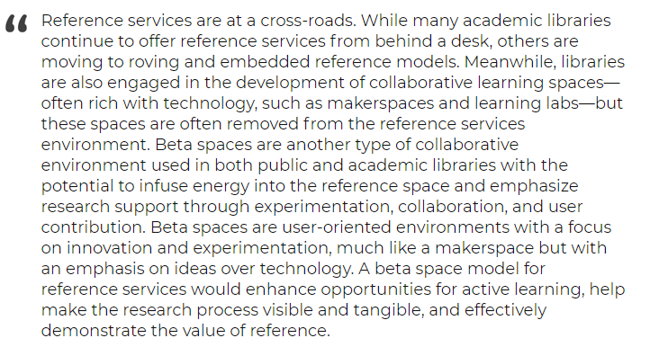
Synopsis –
"Beta Spaces as a Model for Recontextualizing Reference Services in Libraries"
by Madelynn Dickerson
In the Library with The Lead Pipe
5/18/2016

Slide 3
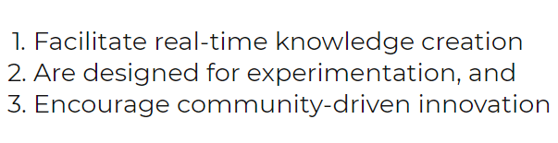
Beta Space Themes –
“Making Room for Innovation”
by Jeff Goldenson & Nate Hill
Library Journal
5/16/2013

Slide 4
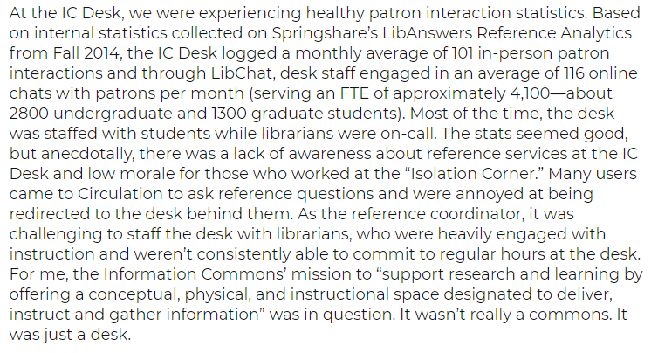
Aha Moment

Slide 5
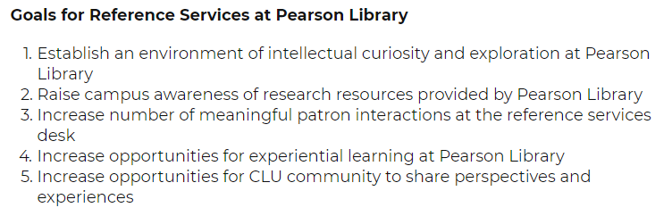
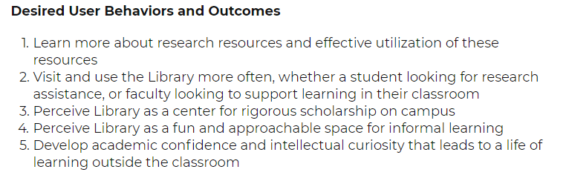
Info Commons to
Collaborative Research Commons

Slide 6
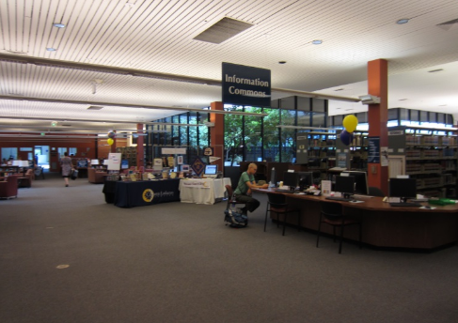
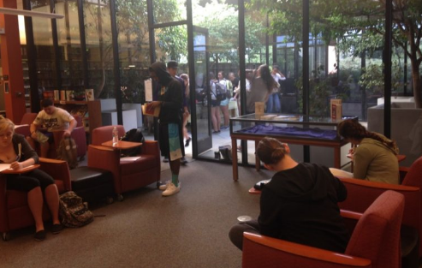
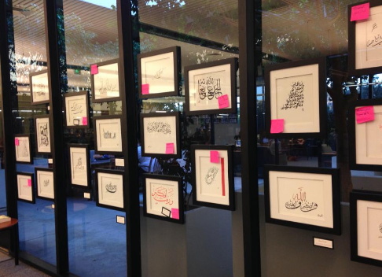

Slide 7
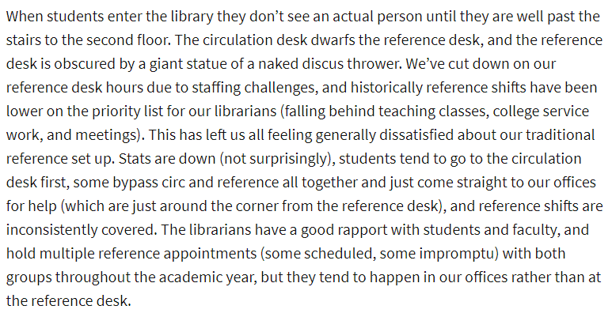
A Reference Redo
by Veronica Arellano Douglas
ACRLog
1/16/2017

Slide 8
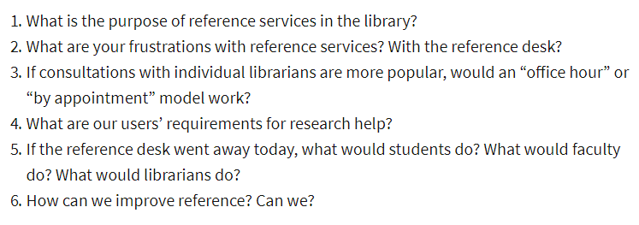
Questions

Slide 9
What is the purpose of reference?
Education
Collaboration
Listening
Sharing

Slide 10
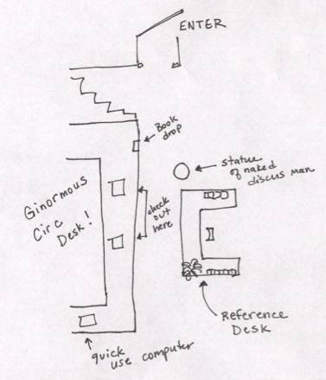
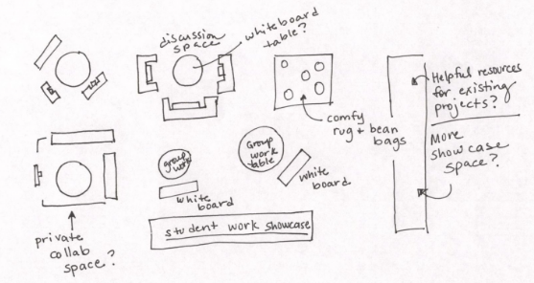
The Space
Reality
Concept

Slide 11
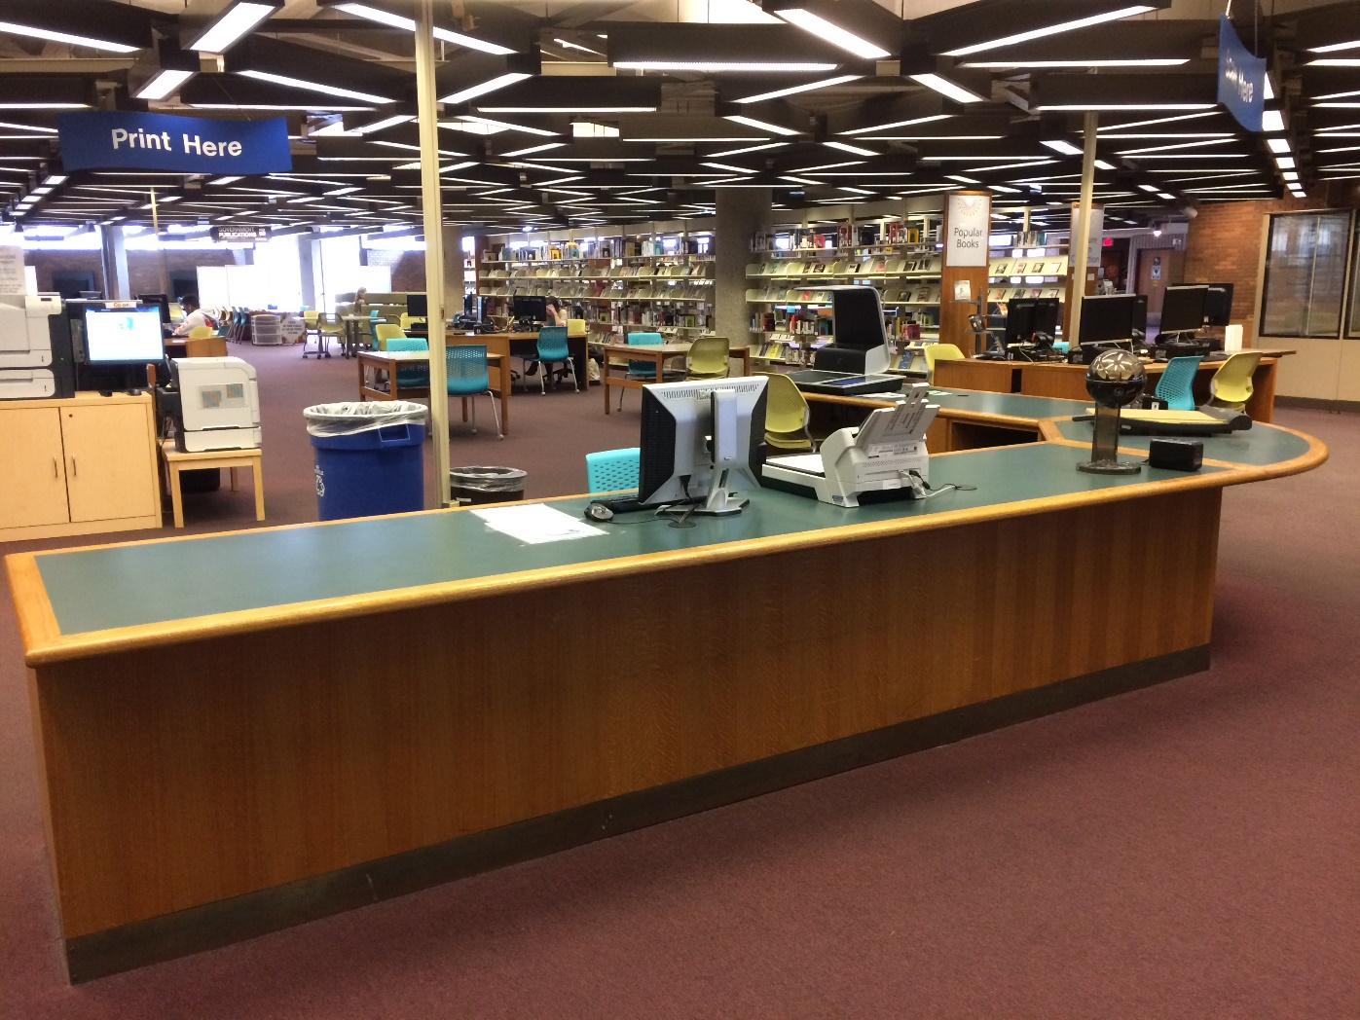
Brookens - Original Reference Desk

Slide 12
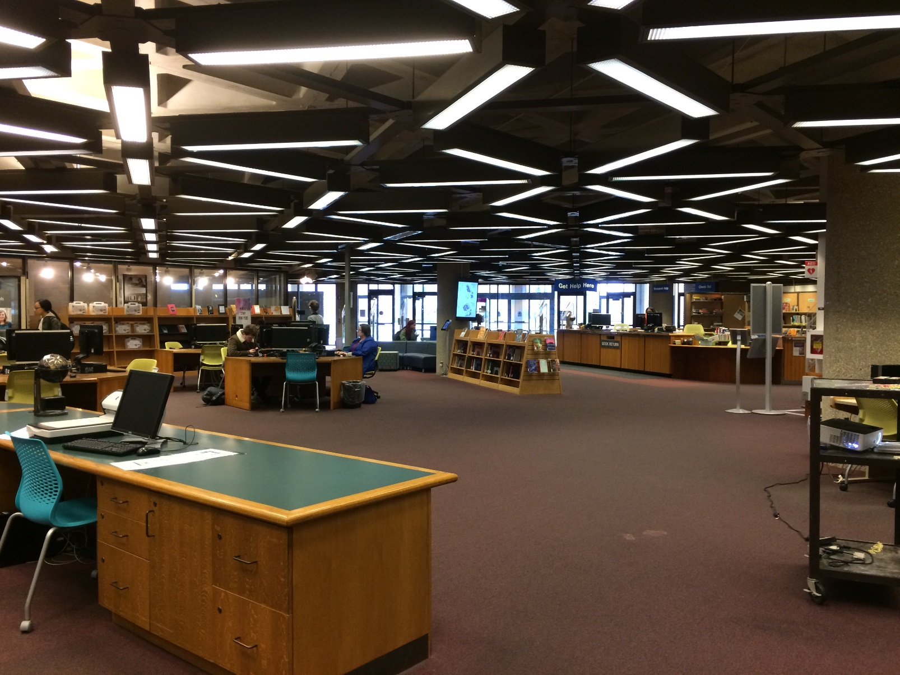
View to Circulation

Slide 13
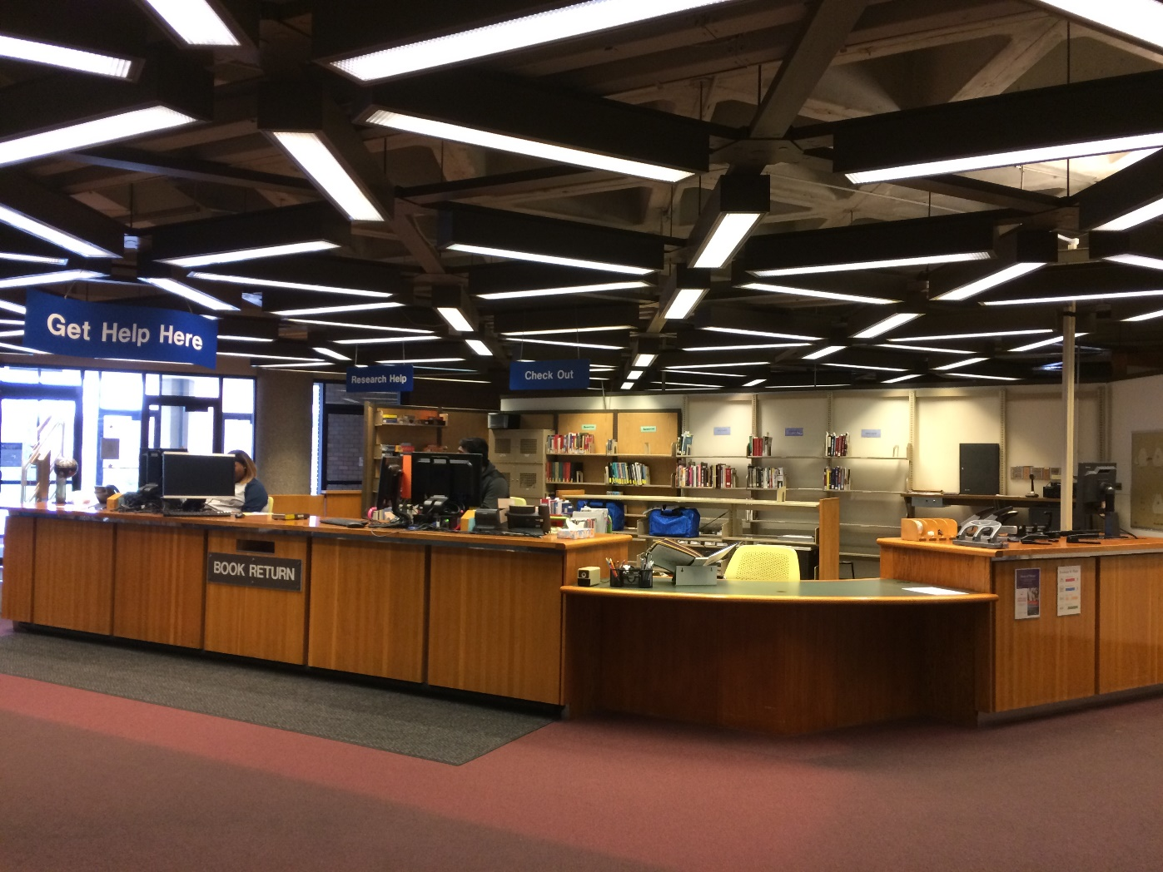
Reference Desk #2 / Shared Desk #3

Slide 14
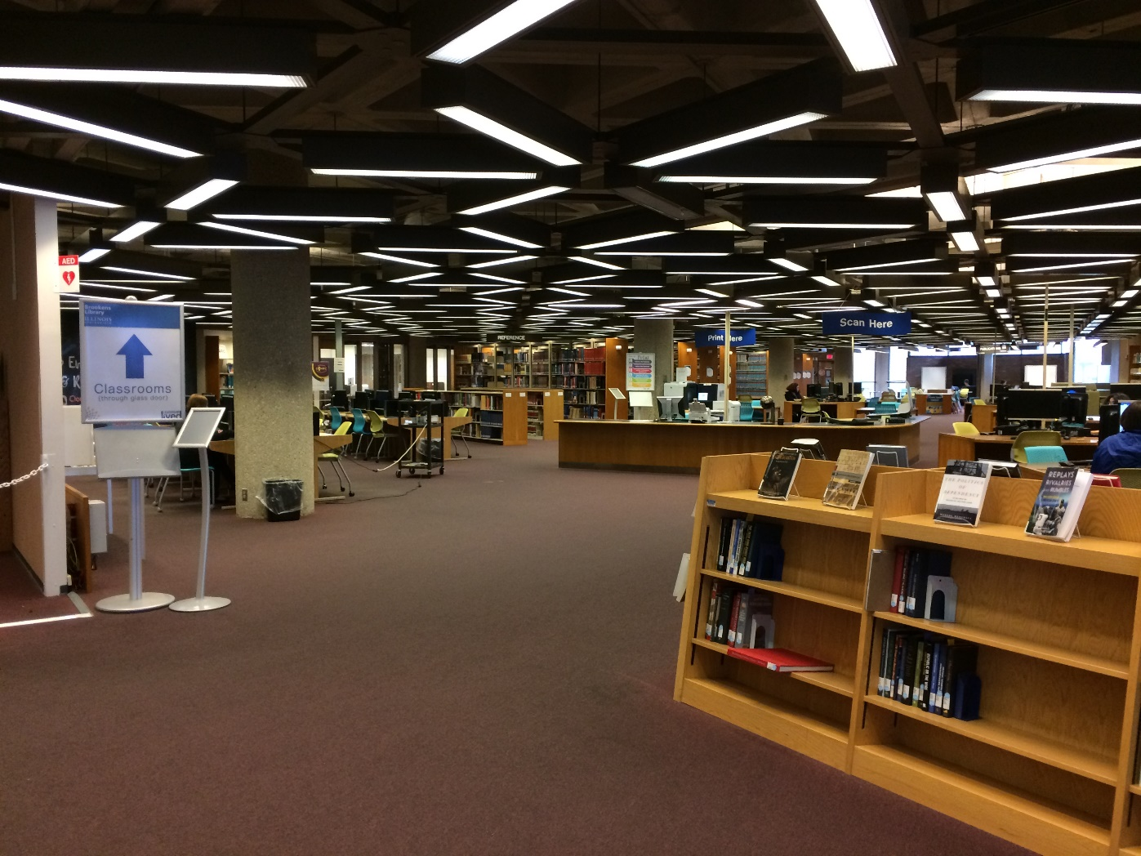
View desk to librarian offices

Slide 15
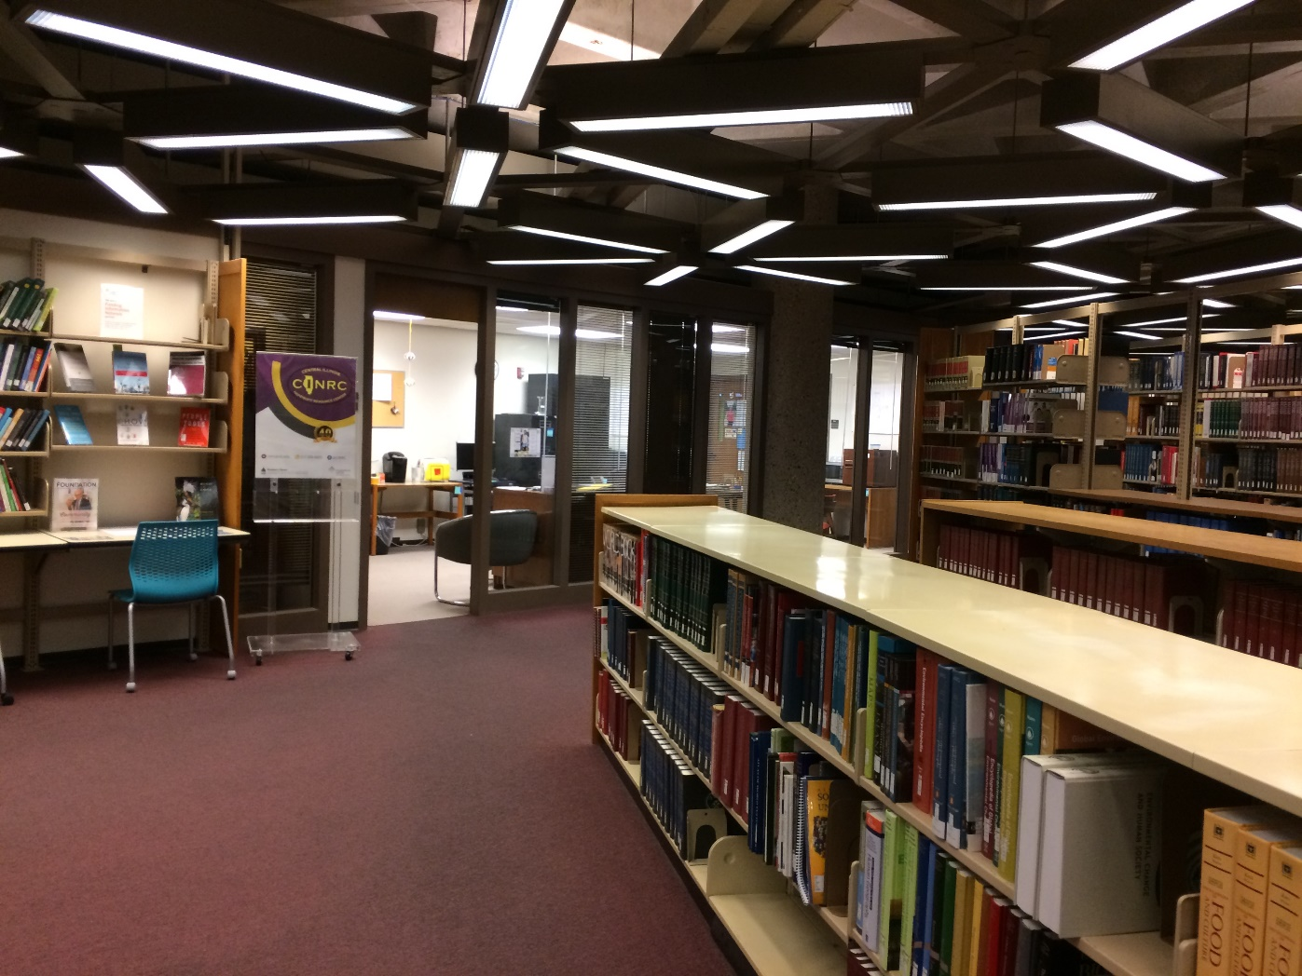
Beta Desk Zone

Slide 16
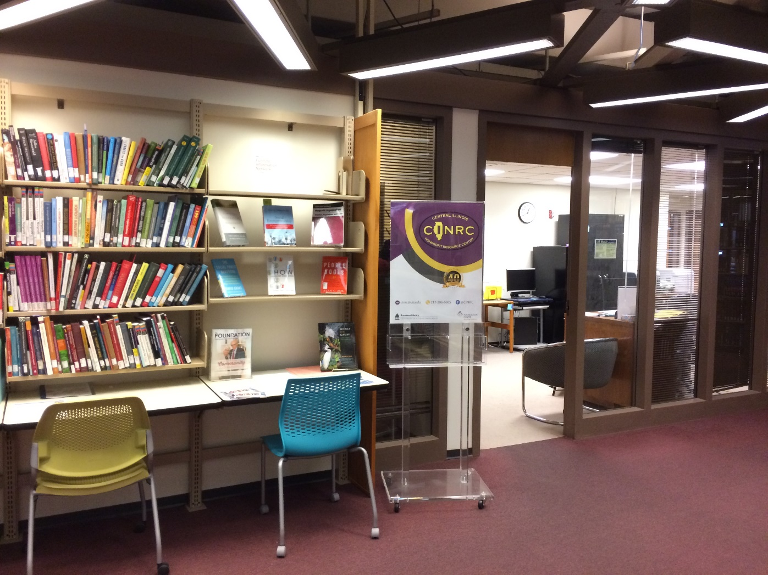
Display Wall

Slide 17
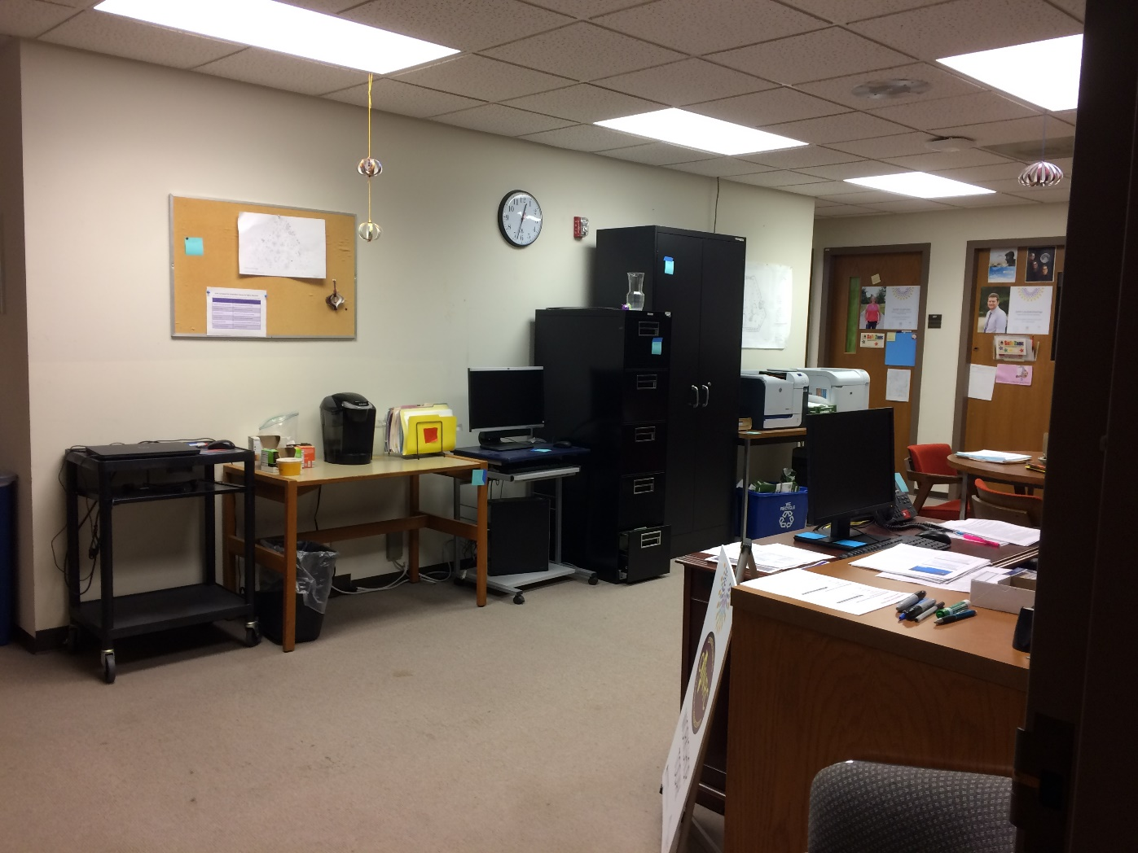
Collaborative Work

Slide 18
Sources
Bandyopadhyay A, and Boyd-Byrnes M.K. “Is the Need for Mediated Reference Service in Academic Libraries Fading Away in the Digital Environment?” Reference Services Review, vol. 44, no. 4, 2016, pp. 596–626., doi:10.1108/RSR-02-2016-0012.
Bunnett, Brian, Andrea Boehme, Steve Hardin, Shelley Arvin, Karen Evans, Paula Huey, and Carey LaBella. “Where Did the Reference Desk go? Transforming Staff and Space to Meet User Needs.” Journal of Access Services, vol. 13, no. 2, 2016, pp. 66-79. doi:10.1080/15367967.2016.1161517.
Dickerson, Madelynn. “Beta Spaces as a Model for Recontextualizing Reference Services in Libraries.” In The Library With The Lead Pipe, 18 May 2016,
http://www.inthelibrarywiththeleadpipe.org/2016/reference-as-beta-space/.
Douglas, Arellano. “A Reference Redo.” ACRLog: Blogging by and for Academic and Research Librarians, 16 Jan. 2017, http://acrlog.org/2017/01/16/a-reference-redo/.
Goldenson J, and Hill N. “Making Room for Innovation.” Library Journal, vol. 138, no. 9, 2013, pp. 26–28, https://lj.libraryjournal.com/2013/05/future-of-libraries/making-room-for-innovation/#_.
Kenney, Brian. “Where Reference Fits in the Modern Library: Today’s Reference User Wants Help Doing Things Rather than Finding Things.” Publisher’s Weekly, 11 Sept. 2015,
https://www.publishersweekly.com/pw/by-topic/industry-news/libraries/article/68019-for-future-reference.html.
Thorpe C. “Engaging with Our Communities: Future Trends and Opportunities for Reference Services.” Journal of the Australian Library and Information Association, vol. 66, no. 4, 2017, pp. 406–415., doi:10.1080/24750158.2017.1359993.

