Slide 1
Critically Evaluating AI-Powered Discovery Tools
Margaret Heller - DePaul University Libraries
Allan Berry - Loyola University Libraries
Notes:
Intro slide:
Margaret starts
Allan finishes

Slide 2

Introduction
Library AI tools are coming online,
and more yet will come.
Lots of opportunities! And some risk!
How do we know when to turn on AI?
How can we decide what systems are appropriate or effective?
What questions should we be asking?
Will this all turn out OK?
Notes:
Allan Slide
[read slide, then move below]
Libraries have emerged as voices to take stock of these systems; people even outside of libraries are starting to look to us for guidance.
As Fiona Bradley reminds us, Libraries have been using AI tools for some time now:
textual analysis (NLP)
document conversion (OCR)
discovery algorithms, like the Primo VE Research Assistant
topic modelling
We’ll consider a case study in this talk, specifically the Primo Research Assistant. But mostly we’re interested not in evaluating a single tool, but considering strategies for the tools of the future.
For example, for the Research Assistant and for many others, a host of questions follow closely behind:
What specific library problems does this tool purport to solve?
What frameworks have emerged to evaluate tools like this?
Which frameworks are most appropriate for academic libraries?
How can we employ these frameworks?
—
Image source: ChatGPT / DALL-E, retrieved 2025-04-14. Prompt: "A warm, inviting modern academic library with a cozy atmosphere. Features include lower ceilings, soft ambient lighting, natural materials like wood and stone, and shorter bookshelves arranged to create private reading nooks. Includes comfortable armchairs, small group study tables, reading lamps, and large windows letting in natural light. The design avoids sterile or authoritarian architecture, focusing instead on human-scale spaces, touches of color, indoor plants, and artwork. The space feels relaxed, intellectually stimulating, and personal."
. “Evaluating AI Literacy in Academic Libraries: A Survey Study with a Focus on U.S. Employees.” College & Research Libraries 85, no. 5 (2024). https://doi.org/10.5860/crl.85.5.635.
Mannheimer, Sara, Natalie Bond, Scott W. H. Young, Hannah Scates Kettler, Addison Marcus, Sally K. Slipher, Jason A. Clark, Yasmeen Shorish, Doralyn Rossmann, and Bonnie Sheehey. “Responsible AI Practice in Libraries and Archives: A Review of the Literature.” Information Technology and Libraries 43, no. 3 (September 23, 2024). https://doi.org/10.5860/ital.v43i3.17245.
“AI: A Museum Planning Toolkit.” Museums + AI network, February 11, 2020. https://themuseumsai.network/toolkit/.
Bradley, Fiona. “Representation of Libraries in Artificial Intelligence Regulations and Implications for Ethics and Practice.” Journal of the Australian Library and Information Association 71, no. 3 (July 3, 2022): 189–200. https://doi.org/10.1080/24750158.2022.2101911.

Slide 3
Evaluation Points of View
Critical approaches to AI have been emerging from various quarters
State actors
  Canada adopted the world’s first national AI strategy in 2017.
  Others have since.
Silicon Valley
  Anthropic and others have spent substantial resources on AI ethics, although lagged recently behind feature development spend
Academic institutions
  Have released policies for general use
Industry sectors
  Various economic sectors have separately released approaches and frameworks,
  e.g. healthcare, finance, engineering
Library institutions
  Starting to happen within academic library / GLAM contexts, e.g. ACRL
Notes:
Allan slide
Thankfully, approaches and frameworks to evaluate AI are emerging from several quarters:
States and countries - have been working on this for a few years
Within Silicon Valley itself - have been some efforts, e.g. from Anthropic
Within Academic Institutions - in some cases have provided blanket guidance, if not policy
Different industries - have come up with frameworks tuned to their needs
and now Libraries themselves
A burgeoning computer science literature has grown around the responsibilities inherent in engineering these tools, AI explainability, and “AI Safety”. While for Silicon Valley, ethical considerations have seemed lately to take a backseat to launching toward what they call Artificial General Intelligence (AGI), the ethics folks are still around, producing more grounded, practical frameworks for dealing with AI.
This includes libraries, which have increasingly begun releasing our own guidance and frameworks, now percolating into the literature. In this talk we’ll give an overview of some aspects of this emerging field, and dig into some relevant examples.
—
Bradley, Fiona. “Representation of Libraries in Artificial Intelligence Regulations and Implications for Ethics and Practice.” Journal of the Australian Library and Information Association 71, no. 3 (July 3, 2022): 189–200. https://doi.org/10.1080/24750158.2022.2101911.
e.g. Australian Human Rights Commission. (2021). Human rights and technology. https://tech.humanrights.gov.au/sites/default/files/2021-05/AHRC_RightsTech_2021_Final_Report.pdf
Hendrick, Rachel. “Evaluating Generative AI Resources: Separating the Tools from the Toys - Choice 360,” November 13, 2024. https://www.choice360.org/libtech-insight/evaluating-generative-ai-resources-separating-the-tools-from-the-toys/
Buhl, Marie Davidsen, Ben Bucknall, and Tammy Masterson. “Emerging Practices in Frontier AI Safety Frameworks.” arXiv, 2025. https://doi.org/10.48550/ARXIV.2503.04746.
An example of a paper for similar evaluation but at the level of Silicon Valley for actual AI developers. There’s a lot of these out there.
Dieber, Jürgen, and Sabrina Kirrane. “A Novel Model Usability Evaluation Framework (MUsE) for Explainable Artificial Intelligence.” Information Fusion 81 (May 1, 2022): 143–53. https://doi.org/10.1016/j.inffus.2021.11.017.
LIME: Local Interpretable Model-Agnostic Explanations, is an open-source framework designed to explain the decisions made by machine learning models.
Frameworks like this can be very technical, and potentially ancillary to library needs
Libraries can perhaps help to inflect approaches in the future, to encourage them to be human focused (rather than, say, for bureaucrats

Slide 4
ACRL: AI Competencies for Academic Library Workers
Building a conceptual structure for evolving critical AI evaluation along key axes.
To engage with this as a practice, even if we don’t really want to!
Dispositions
Curiosity and experience
Experimentation, and grace in failure
Multiple perspectives
Evidence-based judgment
Keep humans at the center
Maintain conversation
Competencies
Knowledge & Understanding
Analysis & Evaluation
Use & Application
Ethical Considerations
“...learning about AI involves entering an ongoing scholarly conversation, not a finished one”
Notes:
Allan slide
To get us thinking about what an evaluative framework might do, here is an important recent example, broadly applicable to academic libraries.
The ACRL AI Competencies framework, [currently working toward release], is kind of a meta-framework for approaching AI at a foundational level. It’s not really intended to help evaluate individual tools directly, but rather to guide institutions or departments toward thinking long-term about how to build capacity for thoughtful engagement with AI: Something you can return to as tools emerge and staff roles evolve.
This framework is structured into two main parts, that is dispositions and competencies. Dispositions are like the attitudes that shape how folks might approach AI in a library setting: more about orientation than expertise:
Curiosity and experience building – the idea is for library staff to remain open-minded regarding new tools, and to get hands-on experience with the tools to understand what they actually do, and how they behave.
Libraries should experiment, with the understanding that not everything will work. That’s part of the process. Institutions need to recognize that not all AI efforts will bear fruit, or will proceed in fits and starts.
We should Include multiple perspectives – recognizing that AI impacts people in various ways, and that diverse viewpoints give a fuller picture of these tools
Our decisions should be based on evidence, empirically, that is what a tool actually does in context, instead of relying on assumptions or marketing hype
We need to keep humans at the center of our discussion: it’s too easy to consider this tech in some kind of isolation.
Let’s maintain our conversation over the long haul – to treat AI as a moving target that requires ongoing discussion. Adoption is not a one-time decision.
Competencies are the concrete knowledge areas and skills that a staff member has—an understanding of how AI works, how to evaluate its use in library contexts, how to apply it to tasks, and how to think through questions that come up along the way. Within the framework, competencies are presented as an hierarchical set of topics, organized into four broad buckets:
Knowledge & Understanding – to acquire a working grasp on how these systems function in practice
Analysis & Evaluation – to assess these tools in context: what they’re good at, what they might miss, and what trade-offs they bring
Use & Application – to try out AI in workflows where it makes sense, while keeping an eye on fit, maintenance, and actual outcomes
Ethical Considerations – to think through issues like bias, privacy, transparency, labor—not as afterthoughts, but as part of the implementation process
The idea is that these two pieces—dispositions and competencies—can be used to help guide institutional conversations about AI. They don’t offer a checklist or policy, but they do suggest a way to think about staff readiness and long-term planning.
A quote from the framework: “Recognize that learning about AI involves entering an ongoing scholarly conversation, not a finished one”
—
ACRL AI Competencies for Library Workers Task Force. “AI Competencies for Academic Library Workers (Draft 5 March 2025).” Accessed March 7, 2025. https://www.ala.org/sites/default/files/2025-03/AI_Competencies_Draft.pdf
This will overlap with ACRL Framework for Information Literacy in Higher Education
“healthy skepticism and ongoing assessment”
Kind of a list of good ideas, without always a specific means of addressing them
Dispositions
The attitudes and mindsets library workers should cultivate—such as curiosity, adaptability, critical evaluation, and ethical awareness.
We need to be curious and willing to try and learn from success and failure
“Recognize that learning about AI involves entering an ongoing scholarly conversation, not a finished one”
Open to good as well as bad
Competencies of note
Build an understanding through experience: Follow news and try new tools
Explain the risks and benefits
use AI in your job
“Promote fairness in use of data and design of AI systems”--how are we to do that?
Understand data is biased, but this doesn’t promote fairness.
Expert disagreement
Policies and regulations HIPAA and FERPA - this is a big one for academic libraries
“Identify features, functions, and capabilities of AI tools necessary for library services
connected to your job.”
Risks of using in teaching
Understand training sources and algorithms
Learn how to create effective prompts--what about teaching these?
Privacy

Slide 5
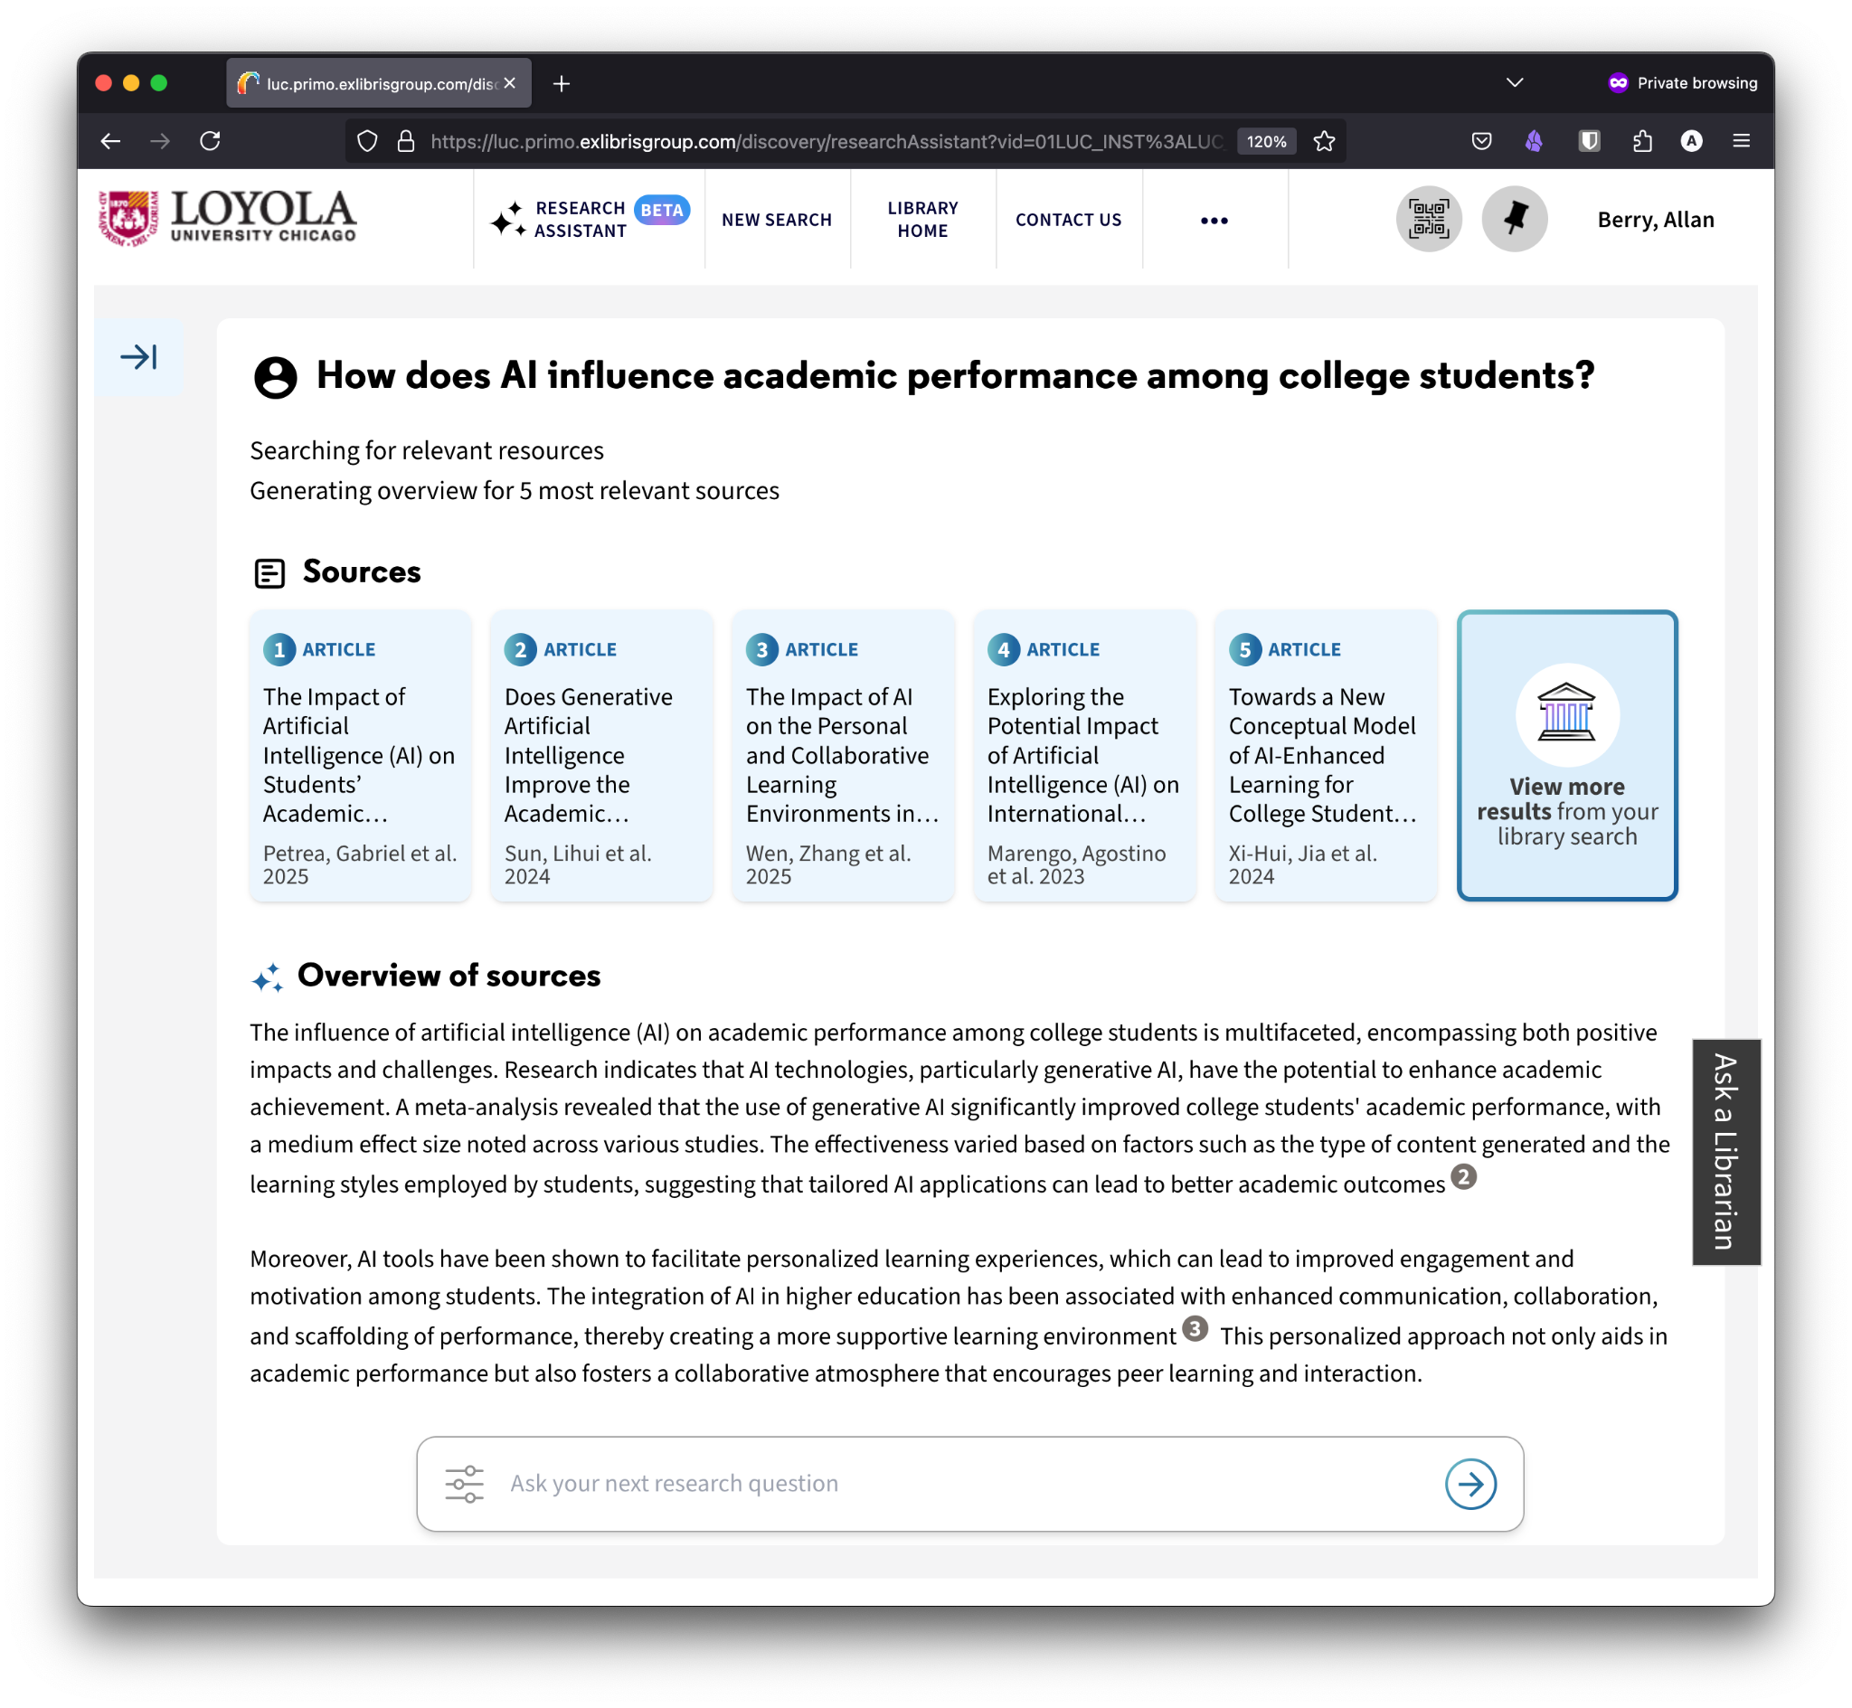
Case Study: Ex Libris’ Primo VE Research Assistant
An AI-driven tool built into Primo, suggesting search terms, resources, and topic overviews based on user research questions.
Notes:
Margaret will move down later in the talk
Lead into demo
cite the usability test
“at this point: this is what this is, we’ll talk about evaluation / usability test a little later in the presentation”
Some folks may not have seen this before.
The Primo Research Assistant is a conversational AI tool built into Ex Libris’ Primo VE, designed to help users explore research questions using natural language. It is intended to provide concise summaries drawn from the library's indexed materials.
Allows users to ask research questions without crafting system-oriented prompts, e.g. sophisticated boolean operations
Translates natural language behind the scenes into boolean prompts
Delivers responses with citations
Integrates with Primo VE
Note that Libraries can test the tool in a controlled “Test View” before enabling for users
DEMO

Slide 6
What is the purpose of a library catalog, and resource discovery in general?
Notes:
Allan Slide
A warm up exercise to put us in a critical frame of mind
Need to return to first principles
Ask for audience feedback in the chat
time minute or two

Slide 7
Purpose of a catalog, and resource discovery in general?
Which specific aspects does the Primo Research Assistant, for example,
purport to enhance?
Potential answers?
Assembles disparate sources and
formats in a single place?
Guides users to relevant materials?
Helps staff to help patrons?
Inventory control, collection management?
Supports an institutional mission?
Facilitate resource sharing among institutions?
Notes:
Margaret slide
As our collections grow, it becomes harder for humans to actually know what’s in the collection. We keep needing to make technology that obscures the volume and makes it manageable. Now we have billions of items indexed, tools like the Research Assistant may feel more manageable to students or novice researchers. But for librarians it may feel difficult because it lacks the kind of transparency and nuance we know exists.
Let’s look at this from multiple perspectives.
—
Jaillant, Lise, and Arran Rees. “Applying AI to Digital Archives: Trust, Collaboration and Shared Professional Ethics.” Digital Scholarship in the Humanities 38, no. 2 (May 31, 2023): 571–85. https://doi.org/10.1093/llc/fqac073.

Slide 8
Applying AI Evaluation Frameworks
Notes:
Margaret slide
Note that we are only focusing on a tool in the presentation that focuses on an end user use case, but these could be equally used for internal library processes such as metadata editors or computer vision assistants. There are some frameworks that are more aimed at archival or museum processes which are linked at the end, and we can learn a lot from these as well. Learning and establishing a trusted rubric will be helpful as new tools come out. We’ll show three, and do a deep dive into one.

Slide 9
Informal Evaluation
As a committee we reviewed the tool and held a webinar for CARLI members
Text came from abstract and descriptions, based on marketing language in some cases rather than professional cataloging or descriptive work.
Summaries exclude full text, it’s a cursory/shallow dive into a subject.
Long strings of Boolean OR phrases show limitations.
Language is authoritative despite not being expert level or allowing for education [this was changed later]
Includes resources to which users may not have access, and excludes non-indexed or non-allowed vendor data (JSTOR, Elsevier, etc.)
Local special collections not included.
Committee’s consensus was to wait for improvements.
Notes:
Margaret slide
When the CARLI Primo VE/Discovery committee first reviewed the Primo Research Assistant there were a few big takeaways just as we looked at it, in an earlier phase.
—
King, Charlene. “Primo Research Assistant: User Testing and Feedback.” The Open University, 2025. https://doi.org/10.21954/OU.RO.00103099.

Slide 10
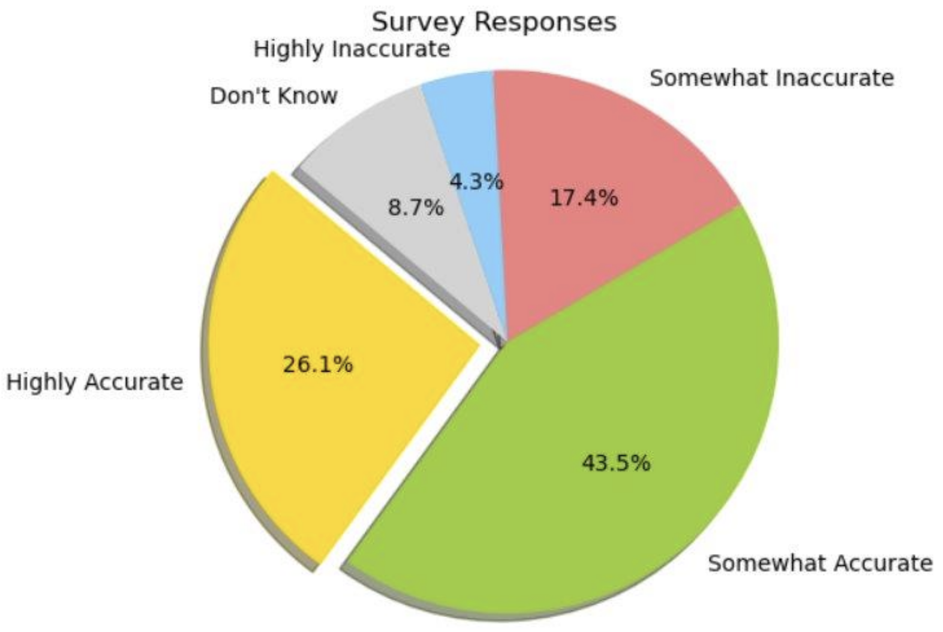
Case Study: Ex Libris’ Primo VE Research Assistant
Open University performed limited usability testing of the Research Assistant earlier this year, to mixed results.
n=28 (faculty/staff)
Summary: Useful tool with clear potential—but concerns around access, accuracy, and student learning must be addressed before public release.
Notes:
Margaret Slide
King, Charlene. “Primo Research Assistant: User Testing and Feedback.” The Open University, 2025. https://doi.org/10.21954/OU.RO.00103099.
Note that we were not doing any user testing. A user experience study by the Open University found that expert users generally found the results accurate and sources of average to high quality, but concerns that results are presented as fact, rather than framing it properly as a search assistant. The user experience overall was poor due to results not always being available and confusion between natural language in the Research Assistant and booleans in the catalog.
Positives:
~70% found responses accurate and relevant
“Related Questions” feature praised for expanding inquiry
Key Issues:
Many sources lacked full-text access
Misleading records (e.g., book reviews posing as books)
Risk of over-reliance on AI: undermines research skills
Lack of transparency in content scope (CDI limitations)

Slide 11
LibTechInsights: Separating the Tools from the Toys
Results should be transparent and traceable to the original source.
The tool should make existing research workflows efficient and not contain wrong answers or hallucinations.
Results should not replace researcher analysis or critical thinking skills.
Tools should have strong privacy policies and not use researcher data inappropriately.
https://www.choice360.org/libtech-insight/evaluating-generative-ai-resources-separating-the-tools-from-the-toys/
Notes:
Margaret slide
In putting together this talk, we wanted to assess a few frameworks that others have put together, and are starting with this nice simple one from Choice’s LibTechInsights. It has four areas to think about : transparency, efficiency, analysis, and privacy
In addition, work with vendors that understand library data, preference research assistants that are more aligned with academic integrity, understand the intended audience (novice researchers? faculty?), what is the actual performance, and does it fit into the library’s collection offerings otherwise?

Slide 12
Leo S. Lo: Practical Ethics for Librarians
1. Identify the Ethical Dilemma
  define the ethical issue and its implications.
2. Gather Information
  Collect relevant facts, perspectives, and policies
3. Apply the AI Ethics Checklist
  Evaluate the situation from ethical principles.
  Privacy, Fairness, Transparency, Accountability, Sustainability
4. Evaluate Options & Trade-offs
  list any potential benefits and risks of each approach
5. Make a Decision & Document It
  ensure transparency by recording a rationale.
6. Implement & Monitor
  Controlled roll-out, track impact, and gather feedback.
7. Follow the AI Ethics Review Cycle
  Continuously re-assess and refine strategies to maintain ethical alignment.
  Have an “emergency pause” policy.
Notes:
Margaret Slide
Leo Lo presented this set of 7 steps at the Rochester Regional Library Council. His AI Ethics Checklist is Privacy, Fairness, Transparency, Accountability, Sustainability. We see this as a useful cycle to follow.
—
Lo, Leo. “Beyond Black & White: Practical Ethics for Librarians – Navigating Generative AI Thoughtfully.” Presented at the Rochester Regional Library Council, February 2025.
https://www.linkedin.com/posts/leoslo_7-steps-ethical-ai-decision-making-framework-activity-7293618272787120128-ulCJ?utm_source=share&utm_medium=member_desktop&rcm=ACoAAAPGfO8BThdvkIvu8Cmj9MbyW-K1YKkspGo

Slide 13
Viewfinder: A toolkit for values-driven AI in libraries & archives
IMLS-funded project to support ethical and responsible adoption of AI tools
A discussion based toolkit focused on empathy and reaching out
to unrepresented voices
Choose a scenario, identify values for different stakeholders, and compare.
Values
Privacy and Consent
Fiscal Responsibility
Alignment
Education
Care
Human-Centeredness
Trust
Social Responsibility
Service Quality
https://www.lib.montana.edu/responsible-ai/
Notes:
Margaret Slide
The Viewfinder is a toolkit that I had some experience with while it was in development. As a committee a small subgroup worked through this to understand more about we and our communities might view the Primo VE research assistant.
This tool is based around clarifying your own values in reaction to a tool, and understanding how others may also view the tool, and finding what is most important among everyone.

Slide 14
Viewfinder Results
Stakeholder perspectives for ourselves (5 total):
Librarian (3), Library IT (1), Library administrator (1)
Values selected roughly in order by most important:
Trust
Service Quality (everyone chose this)
Care
Privacy and consent
Fiscal Responsibility
Education
Notes:
Margaret Slide

Slide 15
Viewfinder Results
Other stakeholders (empathy) (5 total):
Researcher (2), Software Developer (1), Faculty Member (1), Archives Staff (1)
Values selected roughly in order by most important:
Service Quality
Education
Trust (everyone chose this)
Human-centeredness
Care
Privacy and consent
Alignment
Notes:
Margaret Slide
Trust appears in both sets, our own and the “other” stakeholders. Service quality is really important in both cases as well.

Slide 16
Viewfinder results
Reflections
As ourselves, we are more institutionally focused and thinking about risk management. As “others” we are more focused on specific outcomes.
Social care and responsibility flows from service quality for us.
(This may not be universal!)
We don’t have any student viewpoints, real or imagined, in our assessment. We need to have undergraduate and graduate students, and perhaps other university staff.
The scope of use of a tool needs to be well-defined, documented, and iteratively reexamined.
Implications for collection development if AI-friendly sources keep getting pushed. What about primary sources or archival material?
Values should be documented publicly. We are accountable for harms ultimately, but can let users know what they are using and why we thought it was acceptable.
Notes:
Margaret Slide
Note what perspectives aren’t included--this discussion was among 5 people.

Slide 17
Considerations/Recommendations when Choosing a Tool
Notes:
Allan slide

Slide 18
Evaluative Criteria: Getting Started
Build a rubric for your own institution and compare it with a tool’s documentation and outputs.
Examples:
Does the tool fit our mission?
  Is it ethical?
  Is is transparent?
Is its output accurate? Can results be repeated?
What are its biases?
  Do prompts for different domains or backgrounds, elicit results of similar quality?
Analyze the vendor’s motive and product roadmap
Notes:
Allan Slide
In the next few slides, we’ll share a synthesis of the various topics and practices from the various frameworks; some of this is common sense, but we felt it useful to collect it together.
Once you are building a rubric for your institution, here are some example questions you might include:
Once we have started working with the new AI tool, we can move forward with a critical evaluation.
Does the tool fit your mission?
Like, in the case of the Primo VE Research Assistant, does it actually improve discovery within your context?
I’ll expand more on transparency and ethics in later slides.
Is the tool’s output accurate?
AI tools often show a distinct lack of repeatability. This can be a problem for actual scholarship.
What are its biases?
LLMs get trained on data from the internet, a media scape not well known for inclusivity.
Note that I didn’t ask “Does the tool have any biases?”; instead, we all have implicit biases one way or another, and as a tool made by humans, AI will too. The goal is to see the biases, and hopefully counteract them, perhaps with thoughtful contextual cues.
Analyze vendor motive and roadmap
Why specifically was this product released? If the product is by a for-profit company, what is the tool’s profit mechanism? Usage? Data? Prestige?
Remember a lesson we have learned from social media, if the product is free, then you are the product.
Do they specify a support roadmap? Do they have clear data use guidelines?
—
Hendrick, Rachel. “Evaluating Generative AI Resources: Separating the Tools from the Toys - Choice 360,” November 13, 2024. https://www.choice360.org/libtech-insight/evaluating-generative-ai-resources-separating-the-tools-from-the-toys/.
Jaillant, Lise, and Arran Rees. “Applying AI to Digital Archives: Trust, Collaboration and Shared Professional Ethics.” Digital Scholarship in the Humanities 38, no. 2 (May 31, 2023): 571–85. https://doi.org/10.1093/llc/fqac073.
Weaver, Kari D. “The Artificial Intelligence Disclosure (AID) Framework: An Introduction.” College & Research Libraries News 85, no. 10 (November 5, 2024): 407. https://doi.org/10.5860/crln.85.10.407.

Slide 19

Evaluative Criteria: Institutional Considerations
A brilliant AI tool can fail if it ignores context.
Audience & values
  Who’s the tool really for?
Alignment with policy
  Is it a good fit?
Budget and staffing
  Can we afford to implement it and maintain it?
Collection coverage
  Does it have any blind spots?
Governance and direction
  Can we support this tool together?
Notes:
Allan Slide
In particular, an institution should ensure that a tool fits well into its institutional context. Does it mesh well with policies that your college or library have in place? In this, an ultimate goal may be to maintain the trust your patrons have placed in your institution over time. This may be the riskiest aspect of a new tool, because you don’t want the tool, in its inevitable hallucinations, to misrepresent who you are, or what collections you have available.
Who’s the tool really for? Consider your stakeholders, inline with the Viewfinder toolkit from before. You might even draft some formal personas, and consider the tool with them in mind.
Does the tool fit your professional policies and ethics? ACRL’s AI Competencies remind library workers to champion human agency, equity, and continual reflection. Your institution may have a complementary set of ethics to take into account.
What about cost? Will you be able to run the tool well into the future?
For example, Leo Lo’s national survey indicates that staff feel only ‘modestly’ prepared for AI and want structured training: in other words, this is a hidden cost of implementation.
Will the tool cover the content you actually own, or only a subset of your collection, or even represent content your patrons cannot access? It might be a good idea to double-check index coverage before the first patron sees it.
How can we steer and tune the tool? These tools change over time, so planning on long-term governance becomes crucial for continued institutional buy-in.
Ideally, we get multiple people into the room for these decisions. Jaillant and Rees show that stakeholder mistrust can evaporate when archivists, IT, and researchers share ethics and iterate together. Build that cross‑functional ‘care team’ and schedule regular tune‑ups, not just a launch party.​
—
Image:
Responsible AI in Libraries and Archives. “Responsible AI - MSU Library | Montana State University.” Responsible AI in Libraries and Archives, 2025. https://www.lib.montana.edu/responsible-ai/.
King, Charlene. “Primo Research Assistant: User Testing and Feedback.” The Open University, 2025. https://doi.org/10.21954/OU.RO.00103099.
Lo, Leo. “Evaluating AI Literacy in Academic Libraries: A Survey Study with a Focus on U.S. Employees.” College & Research Libraries 85, no. 5 (2024). https://doi.org/10.5860/crl.85.5.635.

Slide 20

Evaluative Criteria: Transparency
A responsible AI tool really should:
Show its work
  model name, training data, date, purpose
Provide a paper trail
  version history & changelogs
Provide citations
  inline links / highlights for each answer
Specify rules for data-reuse
  no silent retraining on our patrons or content
Vendors should be held to a high standard.
Notes:
Allan Slide
Practically, any AI tool should be transparent during use. It should divulge the model used to collect its data, when it was trained, and what it’s supposed to do. If we expect students to cite sources, we have to expect the tools we use to do the same.
A summary without evidence can strain credulity: Inline citations or highlighted passages let users verify the model’s output, and help them to catch hallucinations before they spread.
Kari Weaver posits that models should provide a nutrition label for LLMs, perhaps the tools themselves, or our instances of them, should explicitly say which models they use, their carbon footprint, audit trail, training dates, etc. Then we can pass this information on to our patrons, and when data isn’t readily available, to lobby vendors for this information. This isn’t common at the moment, but it’s something to ask for.
—
Image, ChatGPT / DALL-E, retrieved 2025-04-14. Prompt: “A seamless, high-end black box with no visible lid, hinges, or seams, placed on a pure white background with no shadows or vignette. The box has a smooth matte or glossy metal finish and a sleek, futuristic appearance. On the top center, there's a circular LED light glowing with a rainbow gradient (representing artificial intelligence). Lighting is even and neutral to keep the white background perfectly clean.”
Weaver, Kari D. “The Artificial Intelligence Disclosure (AID) Framework: An Introduction.” College & Research Libraries News 85, no. 10 (November 5, 2024): 407. https://doi.org/10.5860/crln.85.10.407.

Slide 21

Evaluative Criteria: Social Responsibility
AI is a socially transformative technology,
so let’s keep our society in mind.
Look for disclosures from vendors:
Bias audits
Privacy for patron data
Copyright for creators
Environmental impact & future‑proofing
Test for Usability & Accessibility
can all of our users use this technology?
would they want to?
Notes:
Allan Slide
And again, since these tools change over time, bias evaluation shouldn’t happen only once during the project kickoff. Build bias checks into your evaluation, and keep and continue to run them as your collections—and the AI models—evolve.
Ideally, vendors will provide a disclosure specifying:
the model, its training data, and any known biases or limitations, so that hidden skew does not pass unchallenged.​ This is recommended by the Artificial Intelligence Disclosure (AID) Framework.
it would disclose whether and how patron data will be retained or used, and whether the model draws content from copyright-safe sources. If the tool wants to learn from patron queries or licensed articles, it should ask for consent.
It would also disclose the carbon footprint of the model
In my experience these disclosures, when they exist, are usually pretty paltry. But we can lobby for them, and if enough of us expect them, then perhaps vendors will eventually comply.
Finally, test with real humans. Dieber’s usability framework warns that what looks ‘intuitive’ to tech staff can baffle novices or assistive‑tech users. Run sessions with both ends of the spectrum and fix friction points early.​
—
Img source: https://unsplash.com/photos/person-in-white-long-sleeve-shirt-holding-white-book-B30XL_m3fso
Bradley, Fiona. “Representation of Libraries in Artificial Intelligence Regulations and Implications for Ethics and Practice.” Journal of the Australian Library and Information Association 71, no. 3 (July 3, 2022): 189–200. https://doi.org/10.1080/24750158.2022.2101911.
Cieko, Brendan. “AI Sees What? The Good, the Bad, and the Ugly of Machine Vision for Museum Collections.” The Museum Review 5, no. 1 (April 23, 2020). https://themuseumreviewjournal.wordpress.com/2020/04/23/tmr_vol5no1_ciecko/.
Dieber, Jürgen, and Sabrina Kirrane. “A Novel Model Usability Evaluation Framework (MUsE) for Explainable Artificial Intelligence.” Information Fusion 81 (May 1, 2022): 143–53. https://doi.org/10.1016/j.inffus.2021.11.017.

Slide 22
Practical Application
Envision your needs,
and stick to them
Try lots of things
Lobby vendors for updates and changes
Document your decisions, and continue to iterate
  These systems will continue to change, and we have to as well
Tactics for getting useful information
  Get an overview, then make smaller, targeted queries.
  learn to engineer chat prompts
  (for now)
    input modulation
    evolving tactics
    The more complex the prompt, the lower the quality
Notes:
Margaret slide
Most salient takeaway for our audience
distillation of talk
Maybe we start with a small pilot, to gauge user satisfaction, compare it against known best practices for transparency, and keep thorough records.
If the feature underperforms or poses ethical concerns, we can deactivate it—or push vendors to address those issues.

Slide 23
Future Directions: how will GLAM AI look in 5 years?
non-library research assistants (e.g. ChatGPT researcher)
AI shifts from simple search to context-based knowledge creation
Greater adoption of generative, multimodal tools
Rising tension between personalization and privacy
Potential vendor dominance, marginalizing local customization
Evolving regulations driving new ethical and data governance standards
Notes:
Margaret Slide
In five years we may see integrated AI that does more than currently
They say AGI is coming
More and more integration into software products, hardware, services
Future of AI may not be about writing prompts, and there are some more complexities about verifiability that may get better.

Slide 24
Questions for Discussion
How should we advocate for our own needs as librarians?
How should we determine user needs, and advocate for them?
Will it always be feasible to turn these features off?
  What happens when tools aren’t opt-out,
  or users expect search interfaces to have AI?
Knowing what we know now about the effect of ubiquitous smartphones on society (ex: teen mental health), what safeguards would we wish AI tools had ten years the future?
Notes:
Questions for group (10 mins or so)
Vendors will provide these features, but it’s up to us whether we use them.
But at some point, perhaps our users will get so used to them, and then to expect them?
Do we need to make sure we advocate for changes now, before these systems are ubiquitous?

Slide 25
Selected Sources
ACRL AI Competencies for Library Workers Task Force. “AI Competencies for Academic Library Workers (Draft 5 March 2025).” Accessed March 7, 2025. https://www.ala.org/sites/default/files/2025-03/AI_Competencies_Draft.pdf.
Bradley, Fiona. “Representation of Libraries in Artificial Intelligence Regulations and Implications for Ethics and Practice.” Journal of the Australian Library and Information Association 71, no. 3 (July 3, 2022): 189–200. https://doi.org/10.1080/24750158.2022.2101911.
Cieko, Brendan. “AI Sees What? The Good, the Bad, and the Ugly of Machine Vision for Museum Collections.” The Museum Review 5, no. 1 (April 23, 2020). https://themuseumreviewjournal.wordpress.com/2020/04/23/tmr_vol5no1_ciecko/.
Dieber, Jürgen, and Sabrina Kirrane. “A Novel Model Usability Evaluation Framework (MUsE) for Explainable Artificial Intelligence.” Information Fusion 81 (May 1, 2022): 143–53. https://doi.org/10.1016/j.inffus.2021.11.017.
Heller, Margaret. “FEATURE - Frameworks for Analyzing the Use of Generative Artificial Intelligence in Libraries.” Informed Librarian Online, January 2025. https://www.infotoday.com/cilmag/dec24/Heller--Frameworks-for-Analyzing-the-Use-of-Generative-Artificial-Intelligence-in-Libraries.shtml.
Hendrick, Rachel. “Evaluating Generative AI Resources: Separating the Tools from the Toys - Choice 360,” November 13, 2024. https://www.choice360.org/libtech-insight/evaluating-generative-ai-resources-separating-the-tools-from-the-toys/.
Ho, Karen. “This Is How AI Bias Really Happens—and Why It’s so Hard to Fix | MIT Technology Review,” February 4, 2019. https://www.technologyreview.com/2019/02/04/137602/this-is-how-ai-bias-really-happensand-why-its-so-hard-to-fix/.
King, Charlene. “Primo Research Assistant: User Testing and Feedback.” The Open University, 2025. https://doi.org/10.21954/OU.RO.00103099.
Lo, Leo. “Beyond Black & White: Practical Ethics for Librarians – Navigating Generative AI Thoughtfully.” Presented at the Rochester Regional Library Council, February 2025. https://www.linkedin.com/posts/leoslo_7-steps-ethical-ai-decision-making-framework-activity-7293618272787120128-ulCJ/
———. “Evaluating AI Literacy in Academic Libraries: A Survey Study with a Focus on U.S. Employees.” College & Research Libraries 85, no. 5 (2024). https://doi.org/10.5860/crl.85.5.635.
Mannheimer, Sara, Natalie Bond, Scott W. H. Young, Hannah Scates Kettler, Addison Marcus, Sally K. Slipher, Jason A. Clark, Yasmeen Shorish, Doralyn Rossmann, and Bonnie Sheehey. “Responsible AI Practice in Libraries and Archives: A Review of the Literature.” Information Technology and Libraries 43, no. 3 (September 23, 2024). https://doi.org/10.5860/ital.v43i3.17245.
Responsible AI in Libraries and Archives. “Responsible AI - MSU Library | Montana State University.” Responsible AI in Libraries and Archives, 2025. https://www.lib.montana.edu/responsible-ai/.
Weaver, Kari D. “The Artificial Intelligence Disclosure (AID) Framework: An Introduction.” College & Research Libraries News 85, no. 10 (November 5, 2024): 407. https://doi.org/10.5860/crln.85.10.407.

Slide 26
Suggestions for additional reading
“AI: A Museum Planning Toolkit.” Museums + AI network, February 11, 2020. https://themuseumsai.network/toolkit/.
Buhl, Marie Davidsen, Ben Bucknall, and Tammy Masterson. “Emerging Practices in Frontier AI Safety Frameworks.” arXiv, 2025. https://doi.org/10.48550/ARXIV.2503.04746.
EDRM. “AI Ethics & Bias.” Accessed April 2, 2025. https://edrm.net/edrm-projects/analytics-and-machine-learning/ai-ethics-bias/.
Es, Shahul, Jithin James, Luis Espinosa-Anke, and Steven Schockaert. “RAGAS: Automated Evaluation of Retrieval Augmented Generation.” arXiv, September 26, 2023. https://doi.org/10.48550/arXiv.2309.15217.
Holmes, Samuel, Anne Moorhead, Raymond Bond, Huiru Zheng, Vivien Coates, and Michael Mctear. “Usability Testing of a Healthcare Chatbot: Can We Use Conventional Methods to Assess Conversational User Interfaces?” In Proceedings of the 31st European Conference on Cognitive Ergonomics, 207–14. BELFAST United Kingdom: ACM, 2019. https://doi.org/10.1145/3335082.3335094.
Jaillant, Lise, and Arran Rees. “Applying AI to Digital Archives: Trust, Collaboration and Shared Professional Ethics.” Digital Scholarship in the Humanities 38, no. 2 (May 31, 2023): 571–85. https://doi.org/10.1093/llc/fqac073.
Johnson, Daniel. Machine Learning, Libraries, and Cross-Disciplinary Research: Possibilities and Provocations. University of Notre Dame, 2020. https://doi.org/10.7274/r0-wxg0-pe06.
Lin, Dawei, Jonathan Crabtree, Ingrid Dillo, Robert R. Downs, Rorie Edmunds, David Giaretta, Marisa De Giusti, et al. “The TRUST Principles for Digital Repositories.” Scientific Data 7, no. 1 (May 14, 2020): 144. https://doi.org/10.1038/s41597-020-0486-7.
Manchester, Eileen J. “Introducing the LC Labs Artificial Intelligence Planning Framework | The Signal.” Webpage. The Library of Congress, November 15, 2023. https://blogs.loc.gov/thesignal/2023/11/introducing-the-lc-labs-artificial-intelligence-planning-framework.
Prem, Erich. “From Ethical AI Frameworks to Tools: A Review of Approaches.” AI and Ethics 3, no. 3 (August 2023): 699–716. https://doi.org/10.1007/s43681-023-00258-9.
Šumak, Boštjan, Maja Pušnik, Ines Kožuh, Andrej Šorgo, and Saša Brdnik. “Differences in User Perception of Artificial Intelligence-Driven Chatbots and Traditional Tools in Qualitative Data Analysis.” Applied Sciences 15, no. 2 (January 10, 2025): 631. https://doi.org/10.3390/app15020631.
Tabassi, Elham. “Artificial Intelligence Risk Management Framework (AI RMF 1.0).” Gaithersburg, MD: National Institute of Standards and Technology (U.S.), January 26, 2023. https://doi.org/10.6028/NIST.AI.100-1.
Wagner, Cassie. “Research Guides: AI: Guidelines for SIUC Faculty.” Accessed February 7, 2025. https://libguides.lib.siu.edu/ai-resources/faculty-guidelines.
Library Connect Academy https://www.elsevier.com/librarian/library-connect-academy
Notes:
target: ½ dozen resources

Slide 27
Thanks to:
The CARLI Primo VE Discovery Committee (PVDEC)
Ingrid Mason, Marcus Winter (University of Brighton): AI4LAM Google Group
ACRL Framework still accepting responses - extended through April 16
https://www.ala.org/sites/default/files/2025-03/AI_Competencies_Draft.pdf
brief four question survey form
Questions?
Margaret Heller mheller4@depaul.edu @margaretheller.bsky.social
Allan Berry aberry6@luc.edu bsky: @allanberry.com
Notes:
Allan: add social

