Slide 1
Share your experiences!
https://tinyurl.com/45t3hjs2
Throughout the presentation, feel free to share what your institution does for:
Welcome Week
Events throughout the year
Finals Week
We will discuss your ideas at the end!

Slide 2
Welcome Week

Slide 3
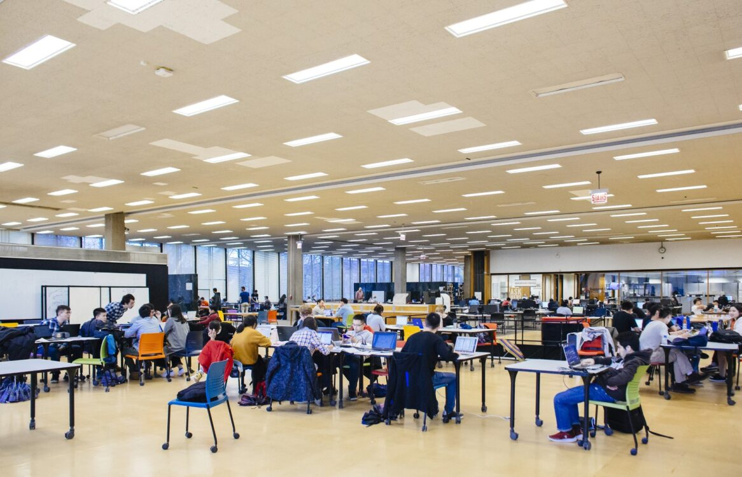
Illinois Institute of Technology and Galvin Library
Private, non-profit, STEM-focused
Located in Bronzeville neighborhood, Chicago, IL
Bachelor's- PHD program
Fall 2025 enrollment: 7,502, representing 117 countries
Paul V. Galvin Library
Main Library at Illinois Tech
Illinois Institute of Technology. (n.d.). Quick facts. https://www.iit.edu/about/rankings-and-recognition/quick-facts

Slide 4
Library Open House
Since Fall 2023, Galvin Library has hosted Open House during Welcome Week
Designed to help students:
  Explore the library and its resources
  Connect with peers and library staff
  Create a positive feeling associated with the library
Notes:
Add an open house poster
Starting college can feel overwhelming, and the library plays a vital role in helping students feel connected from the start. In addition to orientation activities, Galvin Library hosts an annual Open House during Welcome Week as a drop-in event for both new and returning students. The Open House highlights the library as a welcoming, inclusive space where students can explore, connect, and feel at home on campus.

Slide 5
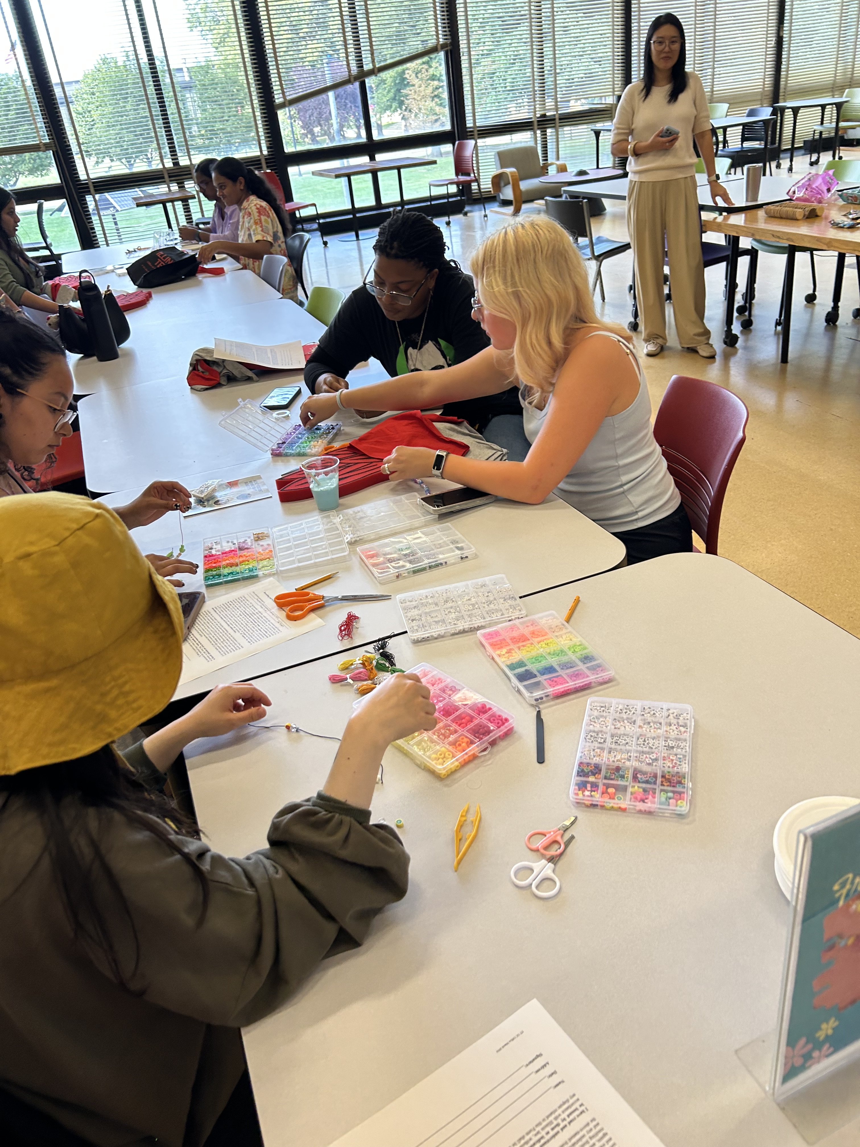
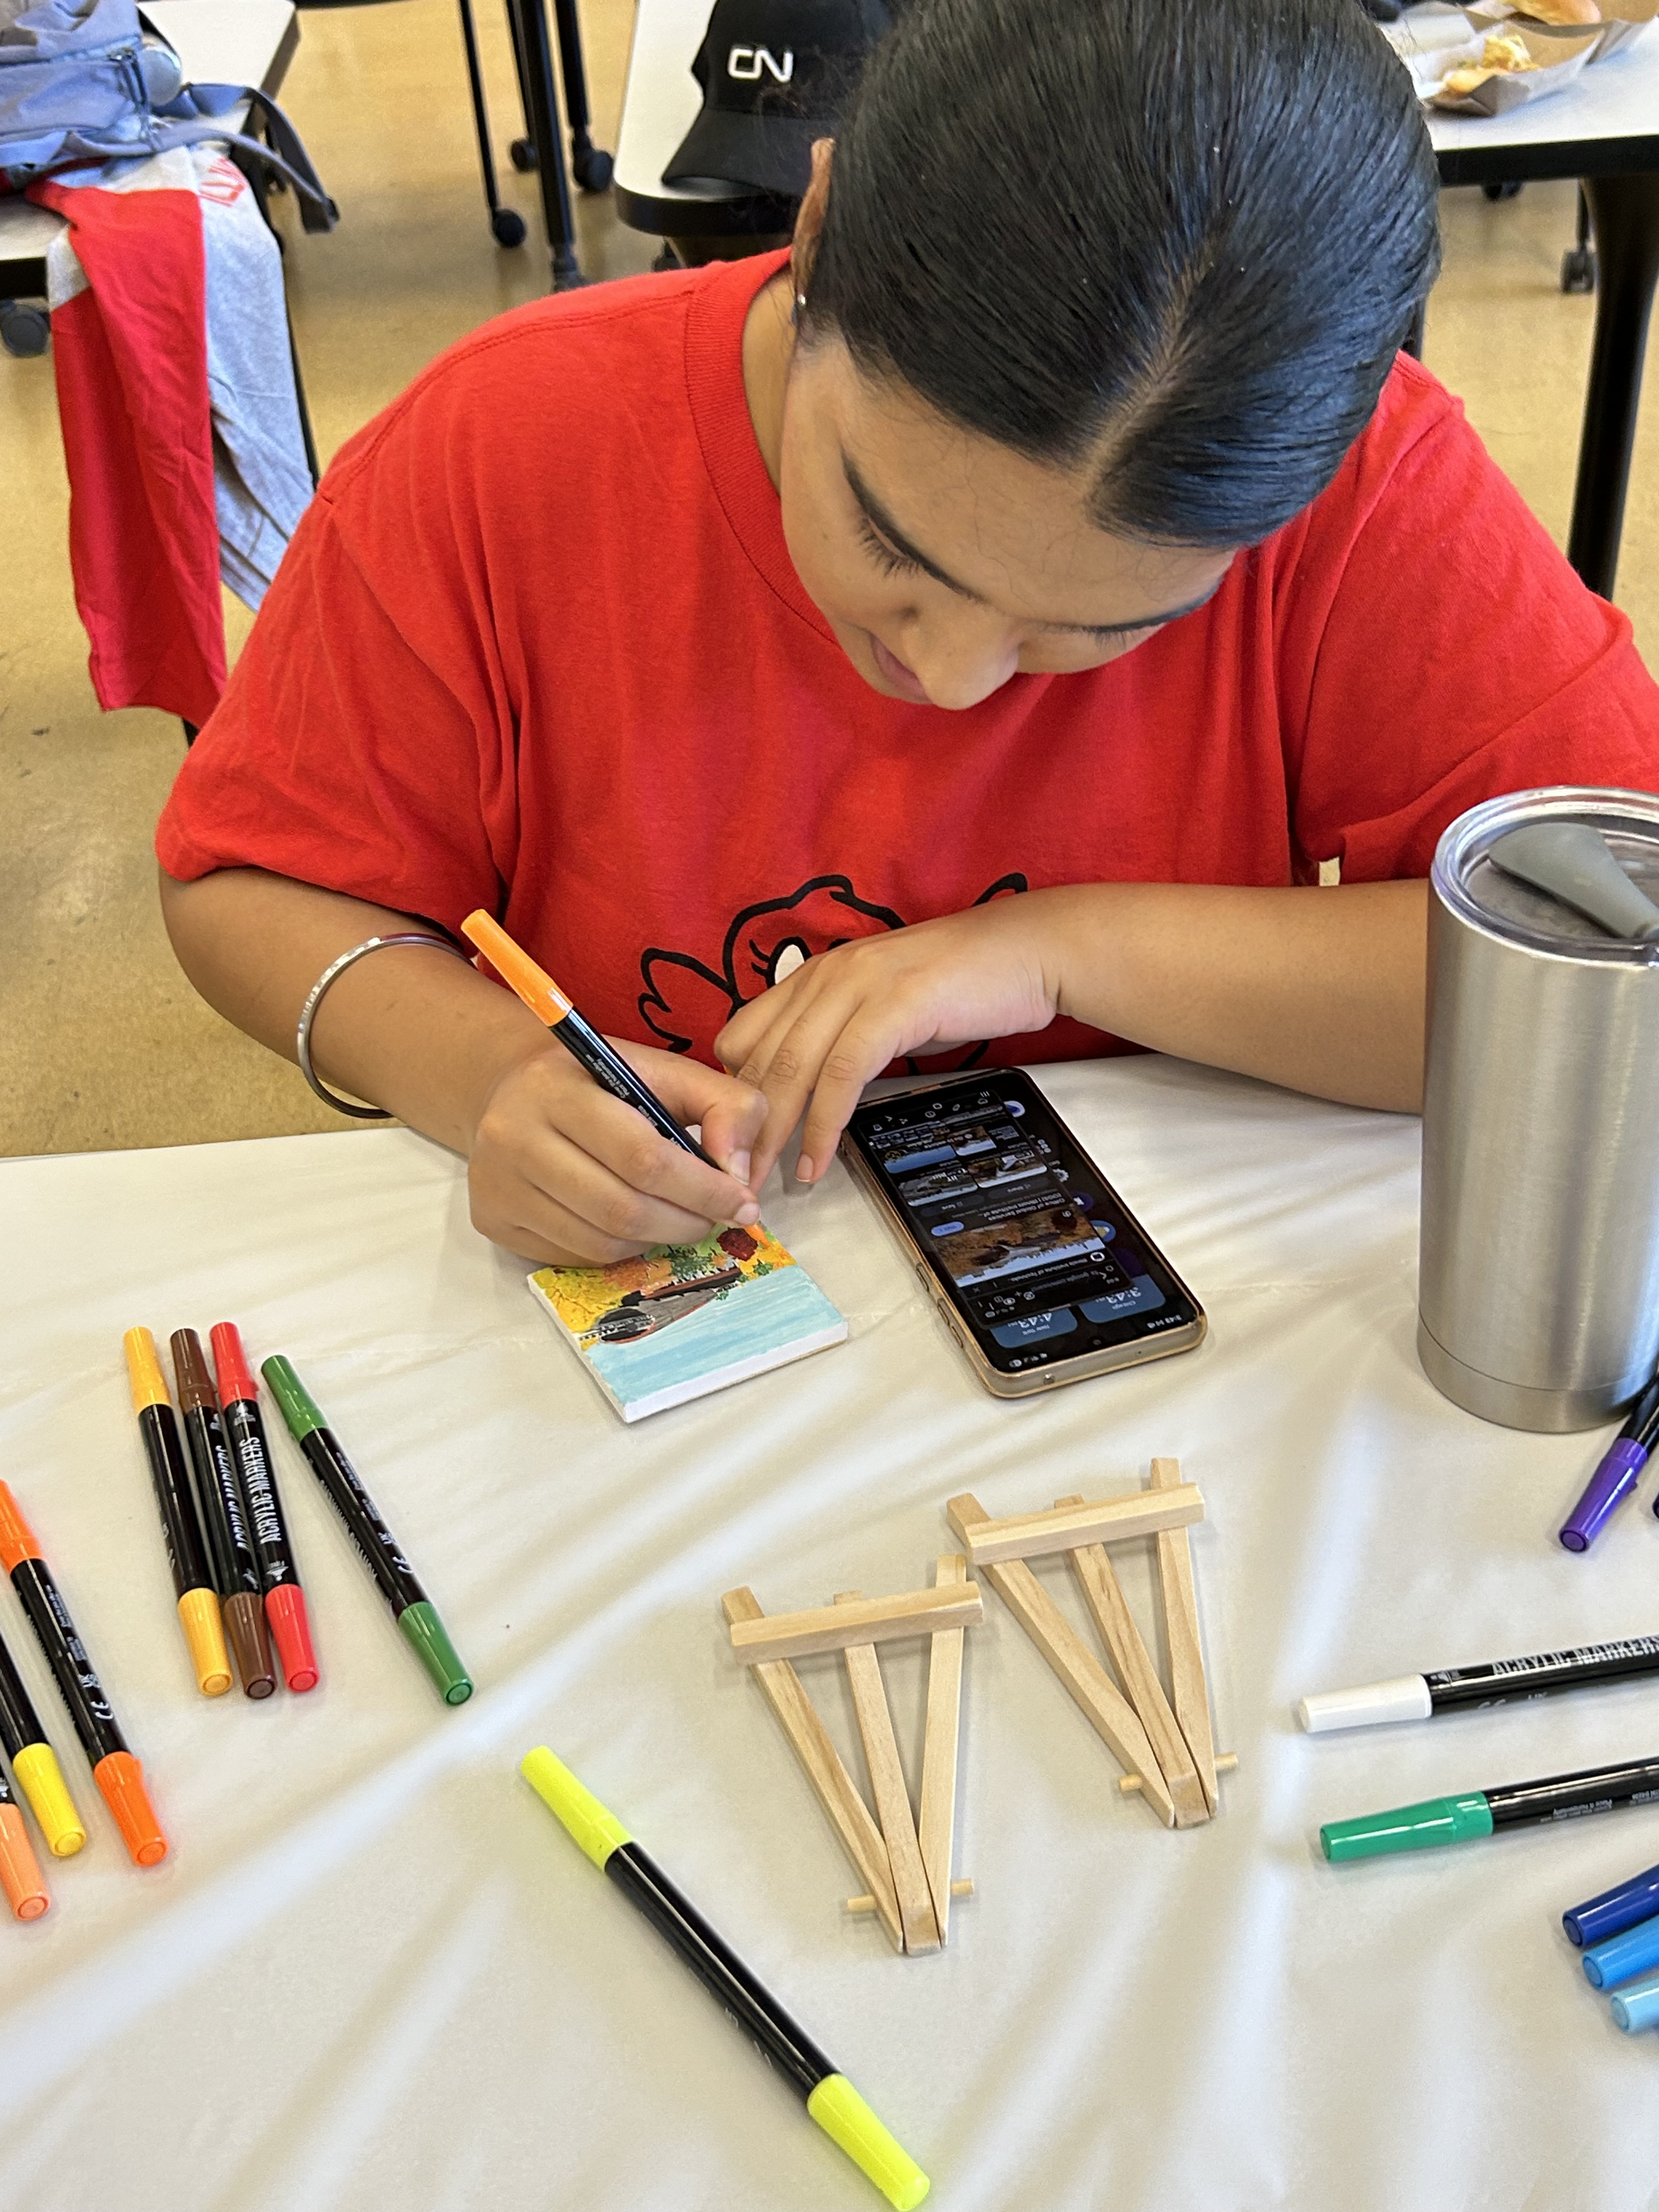
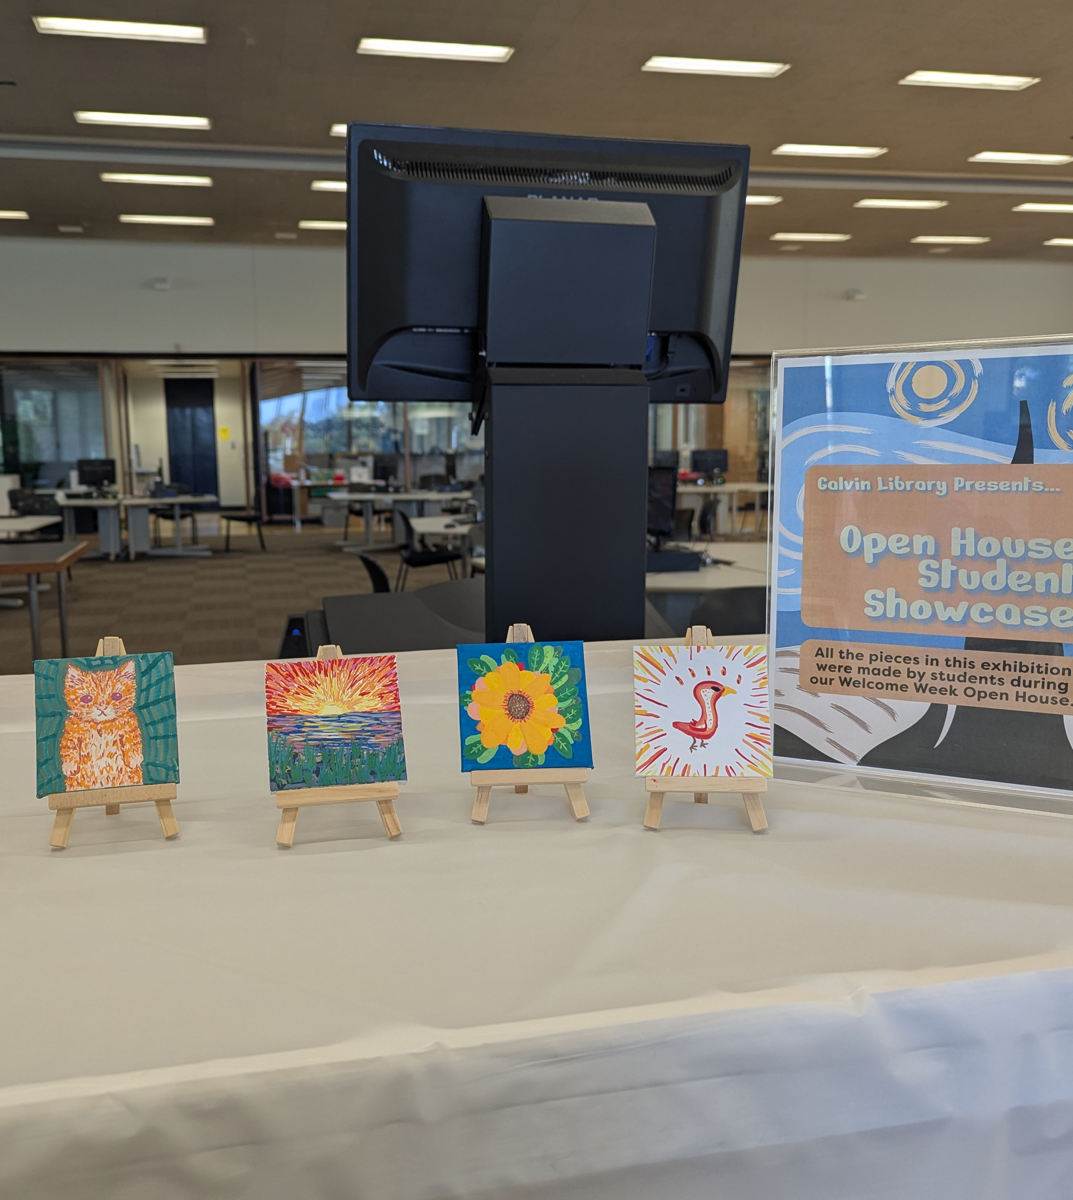
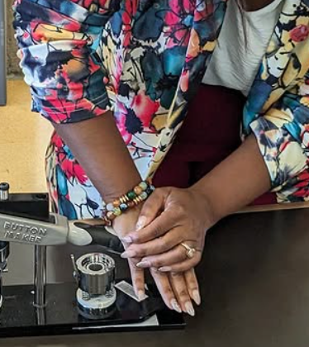
Open House Activities
Guided tours & information sessions
DIY rock painting & miniature canvas painting
Friendship bracelet making
Pronoun pin-making
Library scavenger hunt mystery game
Notes:
Add photos

Slide 6
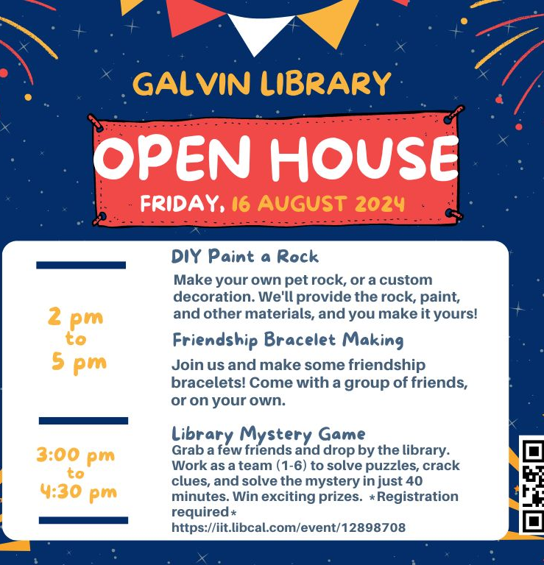
Event Promotion
Internal:
  Library social media (Facebook and Instagram)
  Signage posted in the library
  Library News Story posted on the library website
  Local library monitors
External:
  Illinois Tech’s twice-weekly newsletter
  Signage brought to new student orientation events
  University event site
  Office of campus life newsletter
New Student Orientation

Slide 7
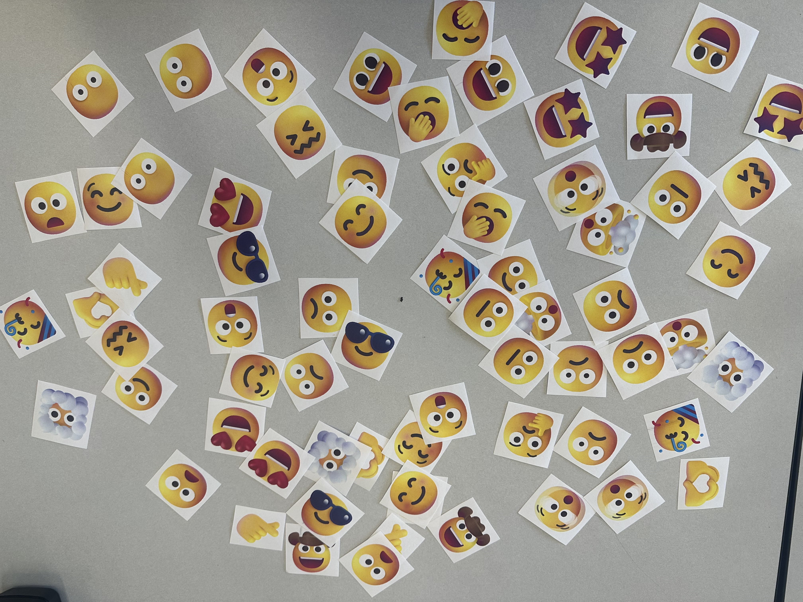
Assessment
Attendance
  2023: 174 students (4 hours)
  2024: 100 students (3 hours)
  2025: 43 students (1.5 hours)
Feedback (2025)
  Emoji Wall: 90% of emoji responses were positive ☺♥
  Mad Libs Feedback Form: students highlighted favorite parts and requested additions
Notes:
Takeaway: Crafts are effective low-barrier engagement activities that help students feel comfortable and welcomed
Takeaway: Feedback will inform future tours to enhance engagement and student experience
Overall Impact
Positive student experience
Increased comfort and familiarity with library spaces
Strengthened sense of belonging and connection

Slide 8
Share! https://tinyurl.com/45t3hjs2
Post your Welcome Week activity ideas!

