Slide 1


A Tale of Two Libraries
Choosing Where to “Live”: How Advocating for Library Neighbors Makes a Difference
Carolyn Ciesla
Director, A.C. Buehler Library
carolyn.ciesla@elmhurst.edu

Slide 2

Academic Library #1
Suburban community college
PBI
1,970 FTE (F22)

Slide 3
Academic Library #1
Problem: campus police station was right at entrance.

Slide 4

Academic Library #1
Result: complete breakdown of communication
Result: removal of large amount of workspace
Result: distrust of administration
Result: police “in” library
Result:

Slide 5
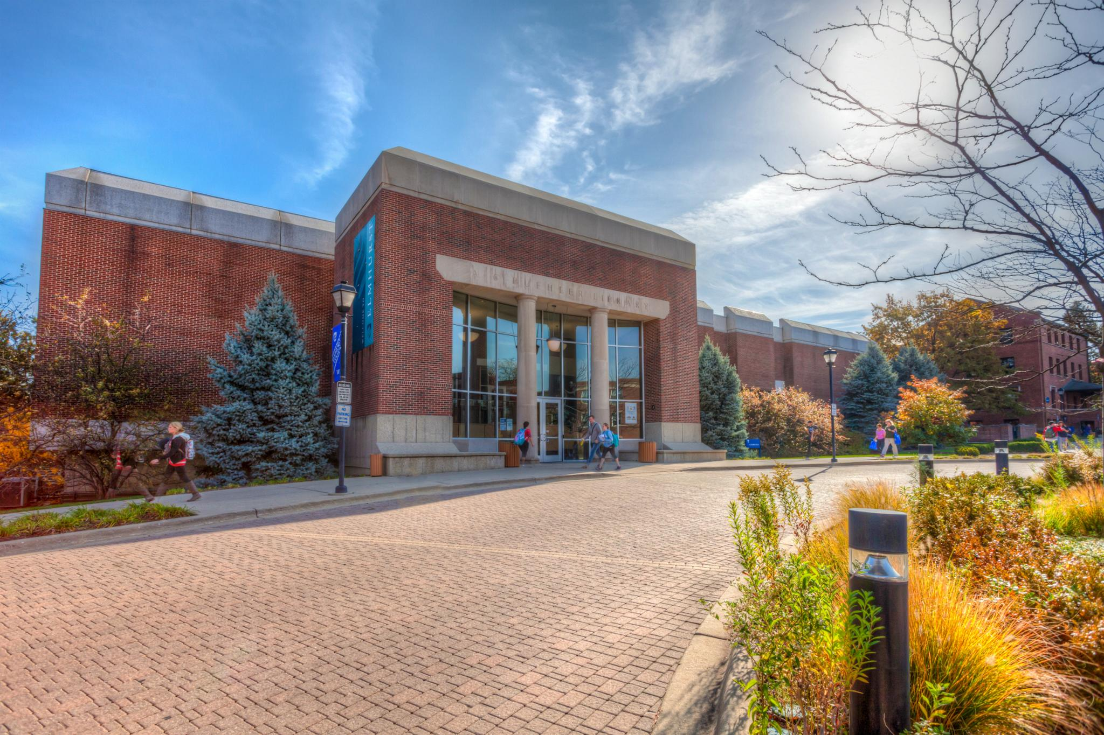
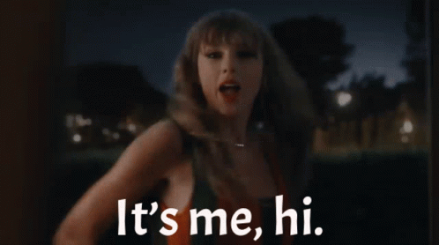
Academic Library #2
Suburban private university
HSI
3,306 (2021)

Slide 6
Academic Library #2
Problem 1: Admissions received “new” space
Problem 2: Creation of Learning Center

Slide 7
Academic Library #2
2017: Center for Professional Development
2019: Learning Center
2020ish: Honors Program

Slide 8
Academic Library #2
Result: distrust of administration, from library on up
Result: need to protect space at all costs
Result: decrease of collaboration

Slide 9
Academic Library #2
New plan:
  space will always be an issue
  build relationships with current neighbors
  think strategically
  invite new neighbors
  have options for existing space

Slide 10
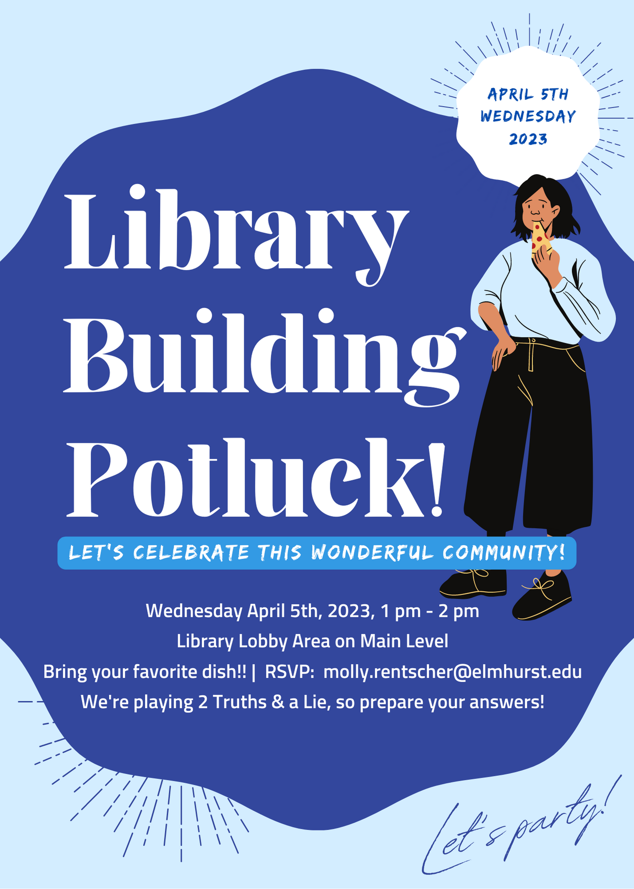
Academic Library #2
2. build relationships with current neighbors

Slide 11
Academic Library #2
  think strategically
  invite new neighbors
  have options for existing space
2023: Center for Scholarship and Teaching
  From uncomfortable teaching lab to modern collab space
2024: Center for Global Engagement?
  From call center to inclusive work area with prayer space

Slide 12


