Slide 1
It’s a Beautiful Day in the Neighborhood
Creating Community in Shared Spaces

Slide 2
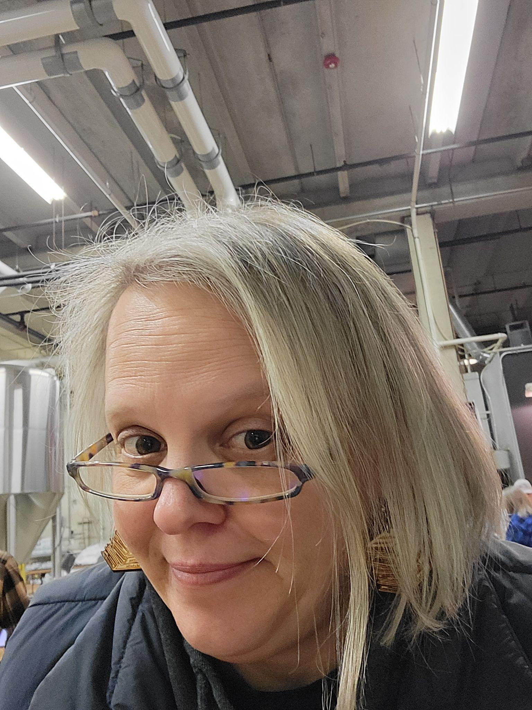
Michelle
Boule Smith
Director of Library Services
North Central College
mlboulesmith@noctrl.edu

Slide 3
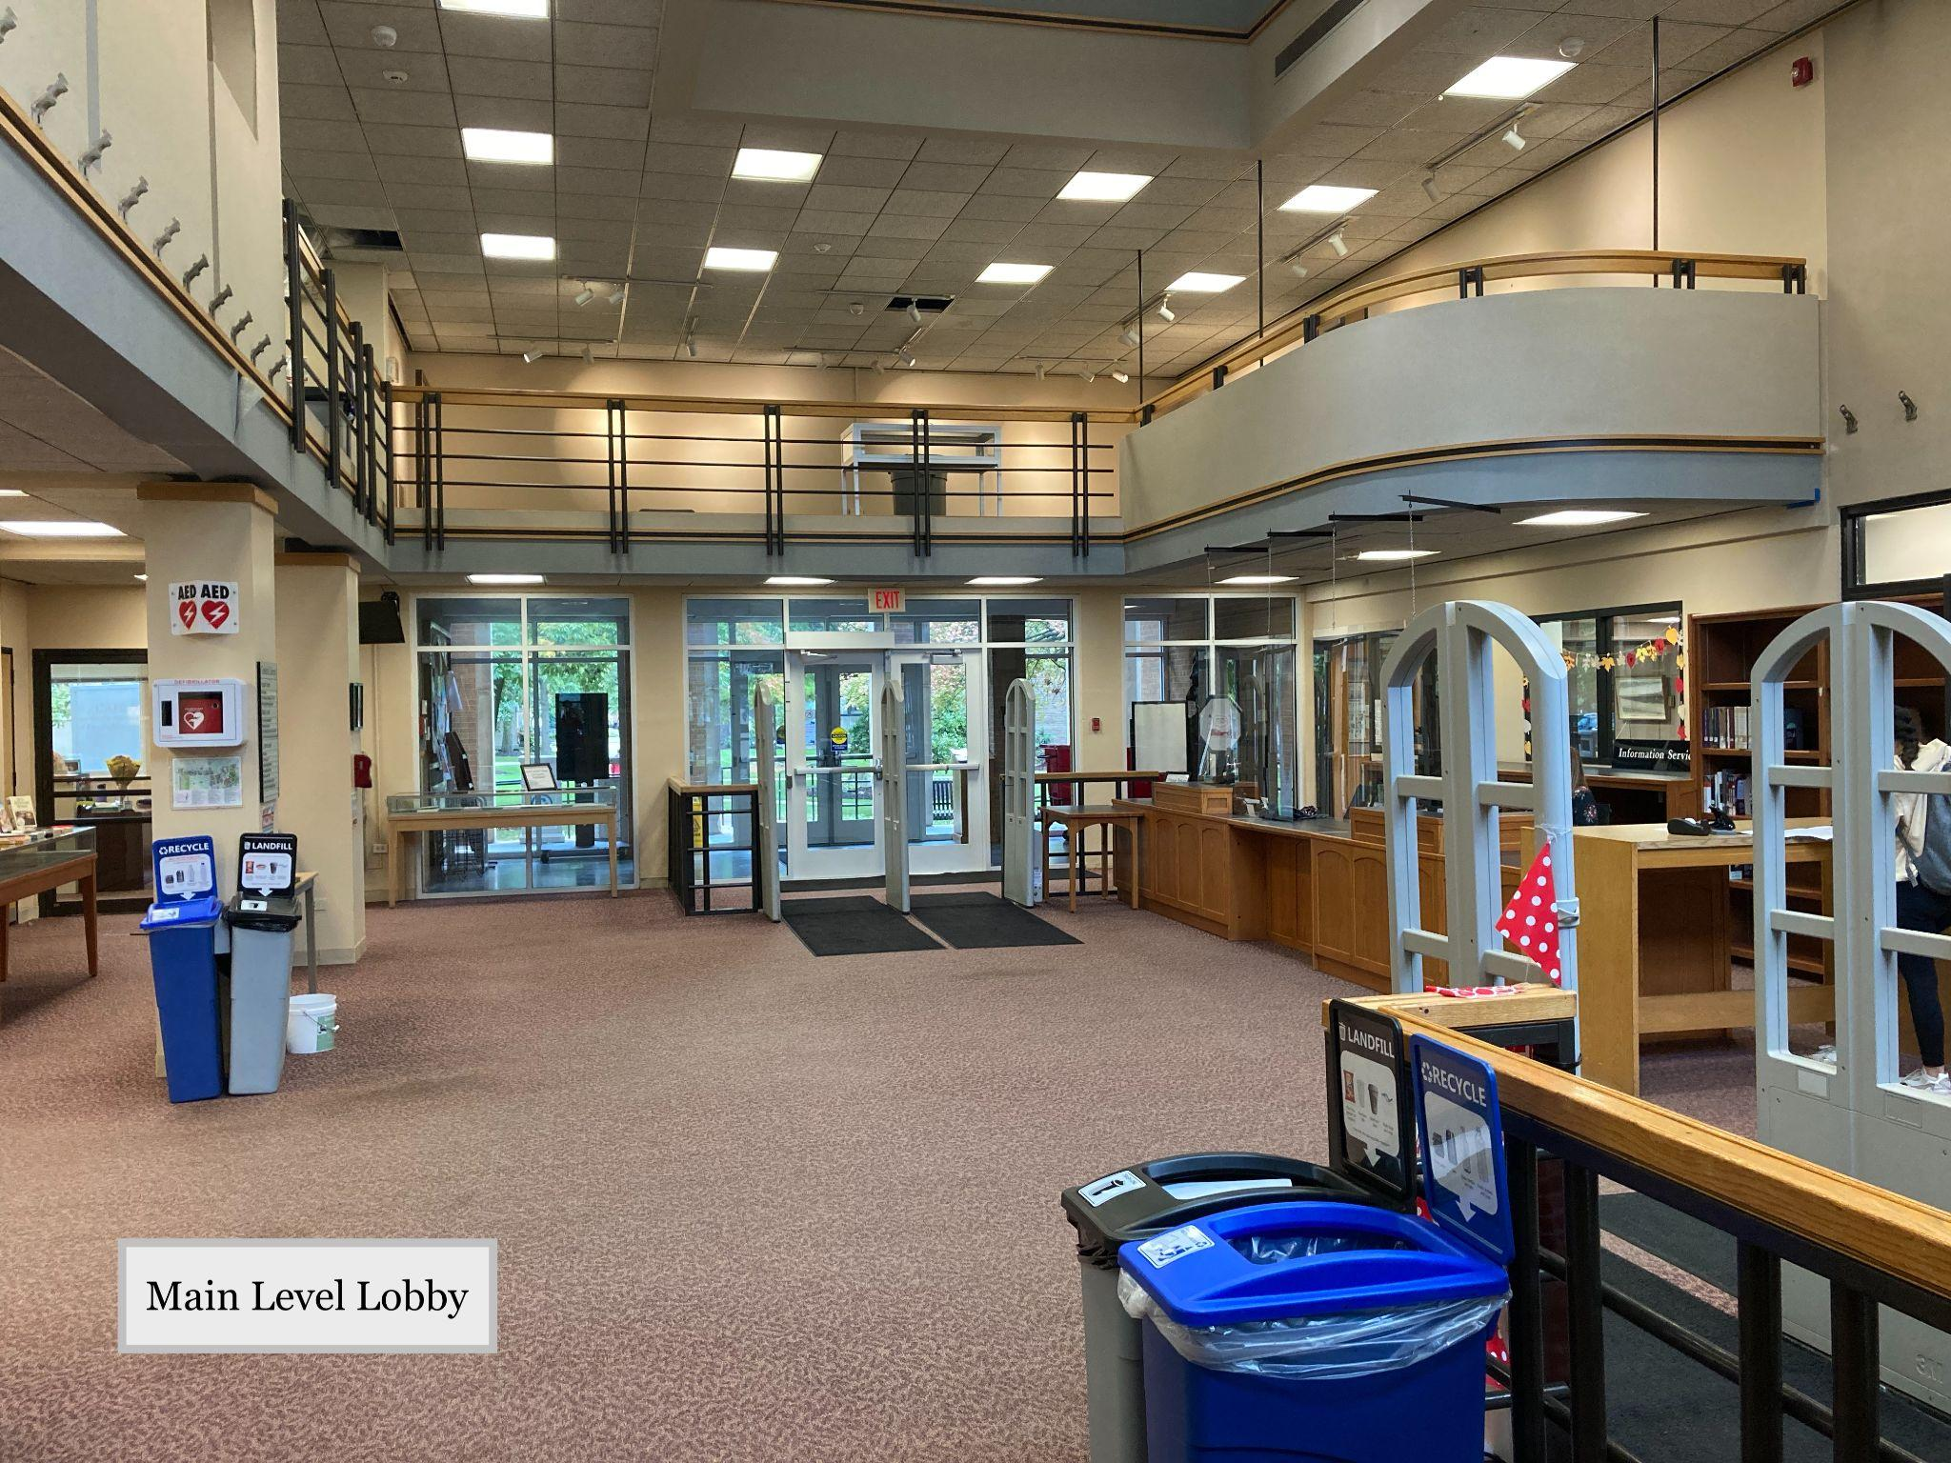
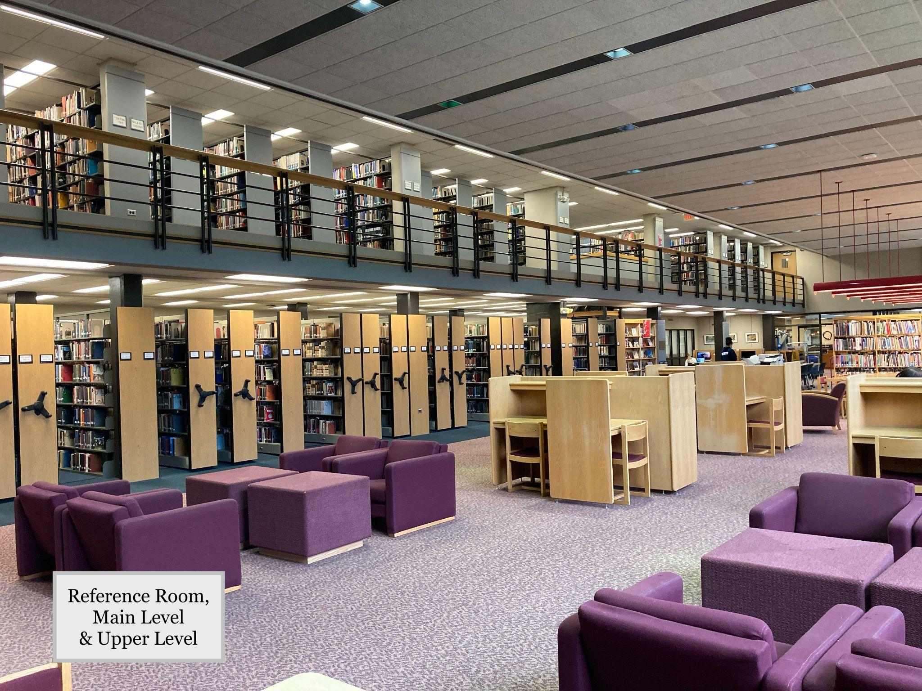
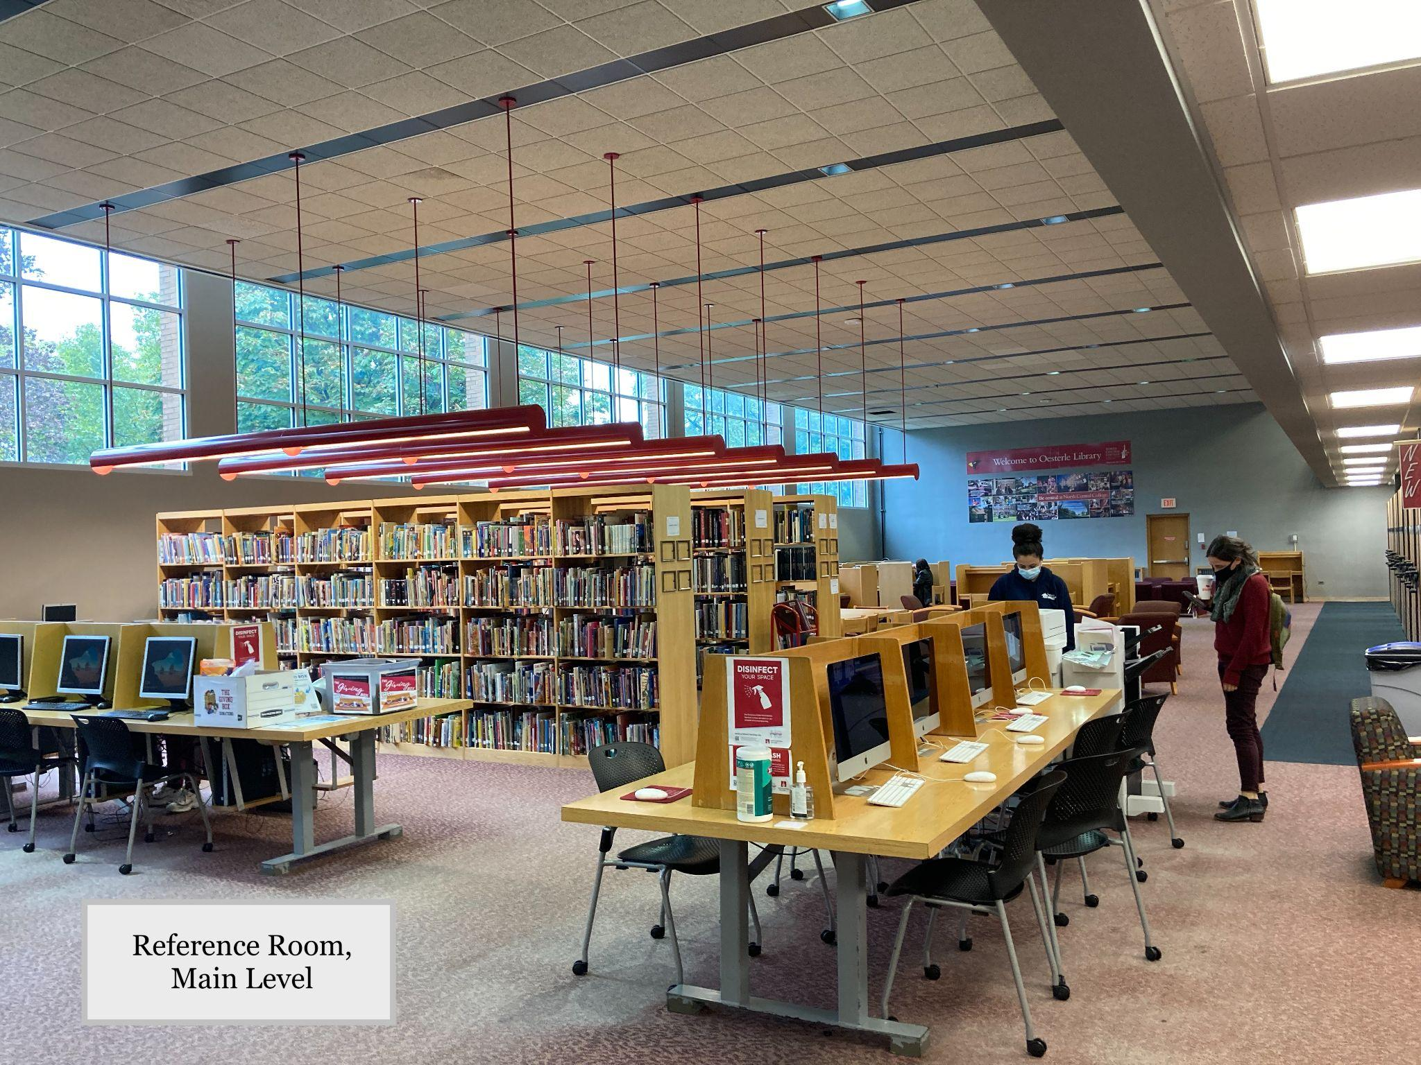
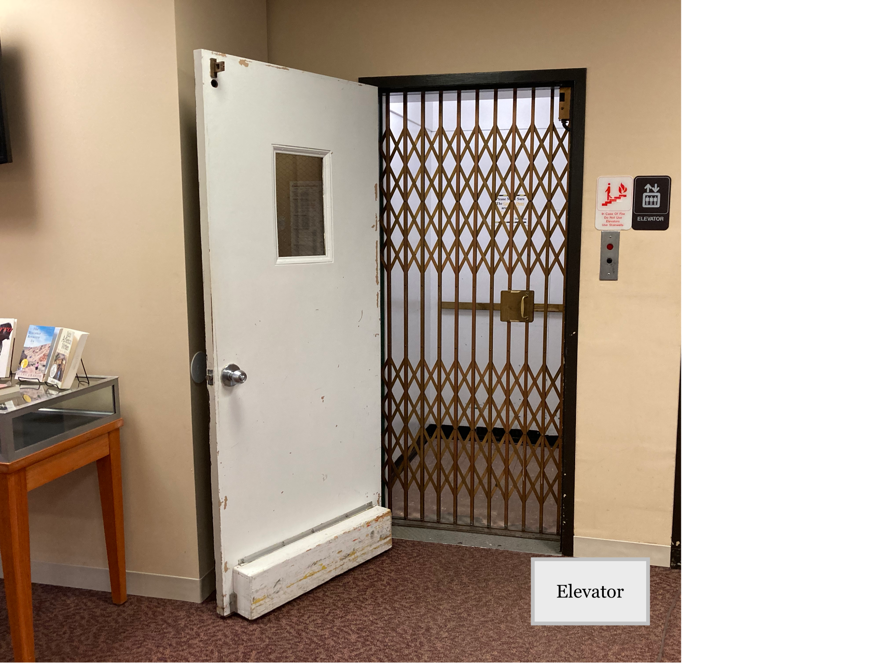
Before

Slide 4
The Learning Commons at North Central College brings together services for students and faculty, research and educational resources, and collaborative spaces that promote creativity, learning, and access.

Slide 5
Welcome to the
Neighborhood

Slide 6
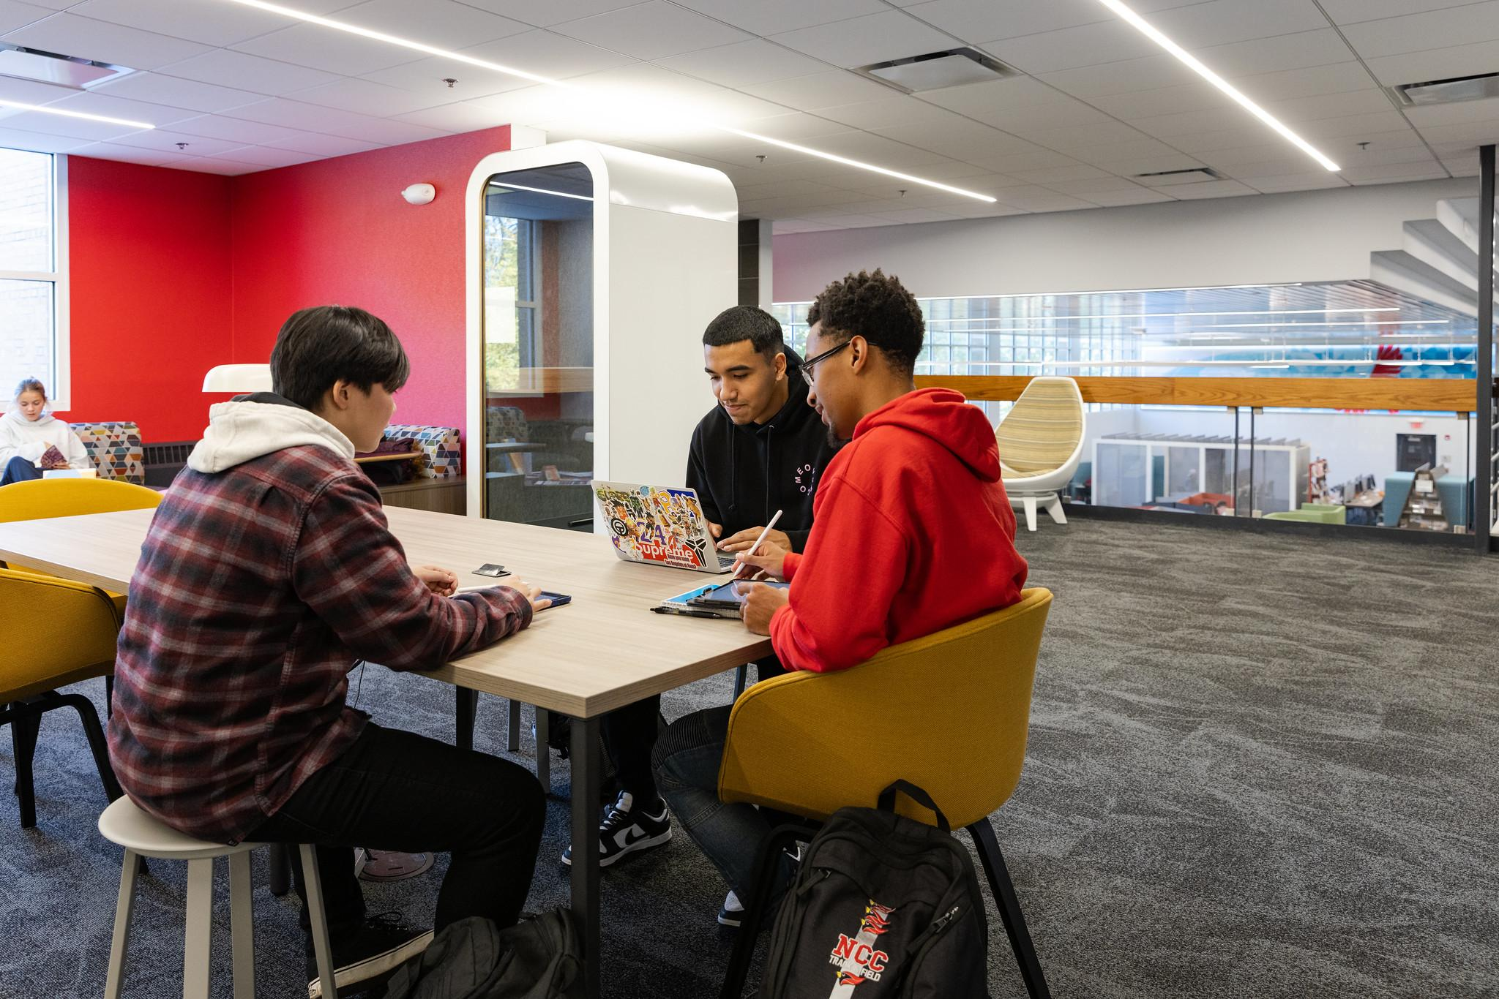
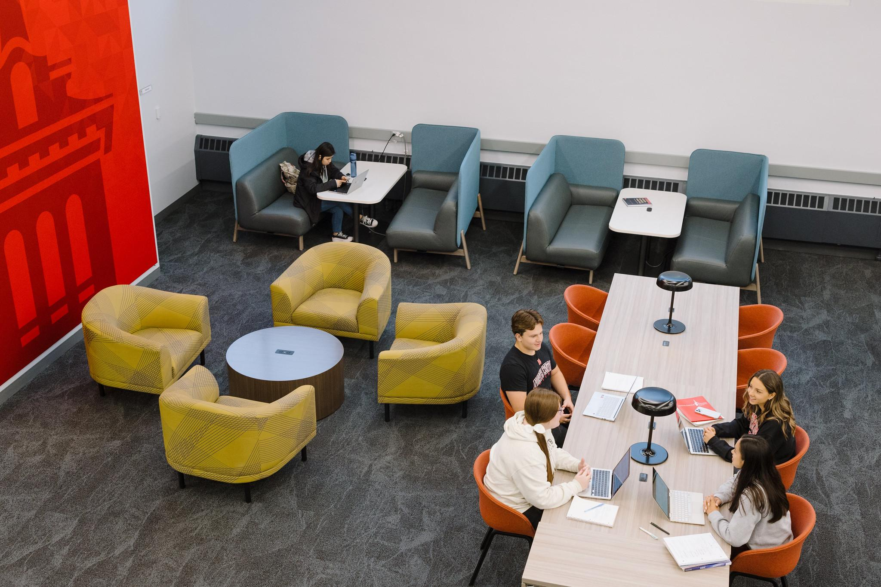
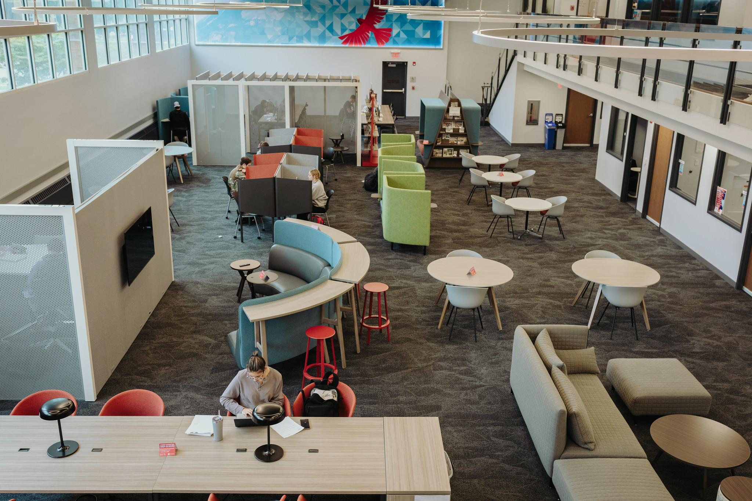
After

Slide 7
NCC Learning Commons
Oesterle Library
Student Success
Writing Center
Speaking Center
Career and Professional Development
Center for the Advancement of Faculty Excellence
Language Resource Center

Slide 8
Small Town Main Street
Tone
Purpose
Action
Set a tone of positivity, collaboration, and caring
Have a shared sense of purpose
Be the driving force of positive change

Slide 9
HOA
It’s not about territory. It’s about impact.
Best use of resources
Policies
Spaces

Slide 10
Building Community
Block parties
NextDoor
Casseroles
Listening
01
02
03
04
Communication
(that’s a hotdish for you midwesterners)
Allow neighbors to talk to each other and problem solve
This is supposed to be fun

Slide 11
Get Off My Lawn
Space issues
Differences of Purpose
Be nice

Slide 12
Mending Fences

Slide 13
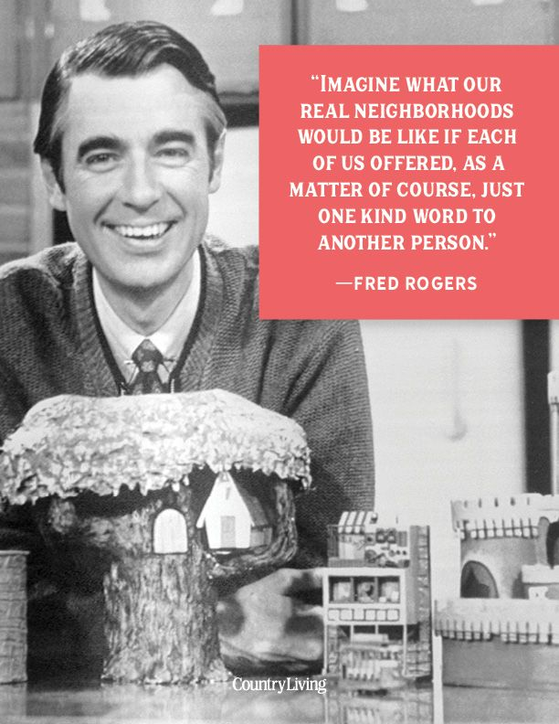
We’ll leave the light on for you.

