Slide 1


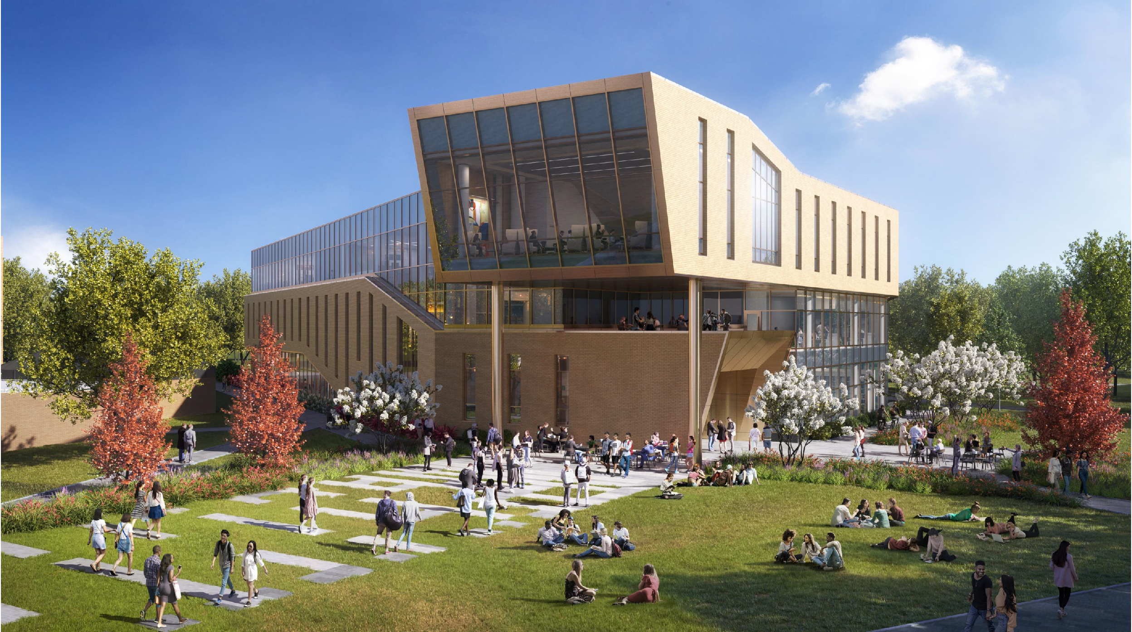
s
Getting to a Commons Goal: Designing the New Library Commons at the University of Illinois Springfield
Pattie Piotrowski
Sarah Sagmoen
Stephanie Davis Kahl
Zoom’s live transcript is available on the Show Captions menu.
Notes:
<Set Skype to Busy/Presenting>
<NS: Give presenters co-host permissions>
<NS: Watch for access issues (RT and email)>
<Ice breaker>
<Start recording>
<Stephanie: Welcome>
Hello everyone, Stephanie Davis Kahl, University Librarian at Illinois Wesleyan University, and I’m joined by presenters Pattie Piotrowski and Sarah Sagmoen for this second session of our Shared Spaces Series: “Getting to a Commons Goal: Designing the New Library Commons at the University of Illinois Springfield.”
A few reminders:
Please ensure your microphones are muted.
We are recording the program today and will share the recording afterwards.
Questions and comments are welcome throughout the program via the chat box or by unmuting. If you are unmuting, please also share your video if you are able. It helps those of us who benefit from lip reading.
The Show Captions icon at the bottom of the Zoom window will display subtitles at the bottom of your screen. Select the icon’s arrow menu to view the full transcript.
<Speaker introductions>
Pattie Piotrowski is University Librarian and Dean of Library Instructional Services for Brookens Library at University of Illinois Springfield, and currently sits on the Board for the Consortium of Academic and Research Libraries in Illinois (CARLI). She joined Brookens Library in 2016.
Sarah Sagmoen is the Director of Learning Commons and User Services at University of Illinois Springfield. She has been at UIS since 2009.
At this time, I’d like to hand the presentation over to our wonderful presenters. Thank you all so much for being with us today!
<Program>
<Stephanie: Thank yous>
Thank you Pattie and Sarah for taking time to share your experiences designing the New Library Commons at the University of Illinois Springfield. Also, thank you to everyone for joining this webinar and sharing your questions and comments.
Attendees will receive an email afterwards with links to a survey as well as where the recording will be made available.
Have a wonderful rest of your day everyone!

Slide 2
Overview
Capitol Development Board Project
Announced in June of 2019
2020
Funds released for design
Architects selected
Early 2021
Design started

Slide 3
Brief Project Description: Construct a new building to house the Library and collections, Center for Academic Success (CAS), Information Technology Services (ITS Client Services), and faculty resources such as the Center for Online Learning Research and Service (COLRS), the Center for Innovative and Engaged Teaching and Learning (CIETL), and the School of Professional and Continuing Education (SCOPE). The new building would require approximately 90 faculty and staff offices (Library 25, CAS 35, ITS 15, and COLRS 15) as well as space to accommodate student employees. COLRS units will need appropriate classroom and laboratory space, ITS will need secure storage and repair facilities as well as a Help Desk area, CAS’s Testing Center will need dedicated computers and quiet space, and the Library will need shelving/collection space, as well as a main service desk. Students and the community will be provided an exploration space (makerspace), and areas for quiet, reflective study and active, collaborative group work. The facility will house tutoring spaces, conference rooms, 30 seat computer labs/classrooms, collaboration space and exploration space (makerspace) for both high-tech activities – 3D printing, vinyl cutters, robotics, etc. – and low-tech reflective study and collaborative group areas. Lastly, the building auditorium space for 100.
Notes:
The original plan as submitted received state approval June 20
Building Committees
Controlling expectations
Compromises

Slide 4
Overview
Original Announcement:
Units:
Library
Information Technology Services
Center for Online Learning Research & Services
Center for Academic Success and Advising
50,000 square feet
750,000 volume collection
100 person auditorium
Makerspace
Classrooms/computer lab
Group study
Quiet Study

Slide 5
Overview
Where we landed:
Units:
Library
Information Technology Services
Career Development Center
Center for Academic Success and Advising
68,000 square feet
88,000 volume collection
200 person classroom
Makerspace
Classrooms/computer lab
Group study
Quiet Study

Slide 6
Space Analysis
Planned and launched a space analysis
Fall 2019 Worked with ITS to analyze use of computers, wifi routers, and printers
2020 Robust headcounts to be conducted hourly

Slide 7
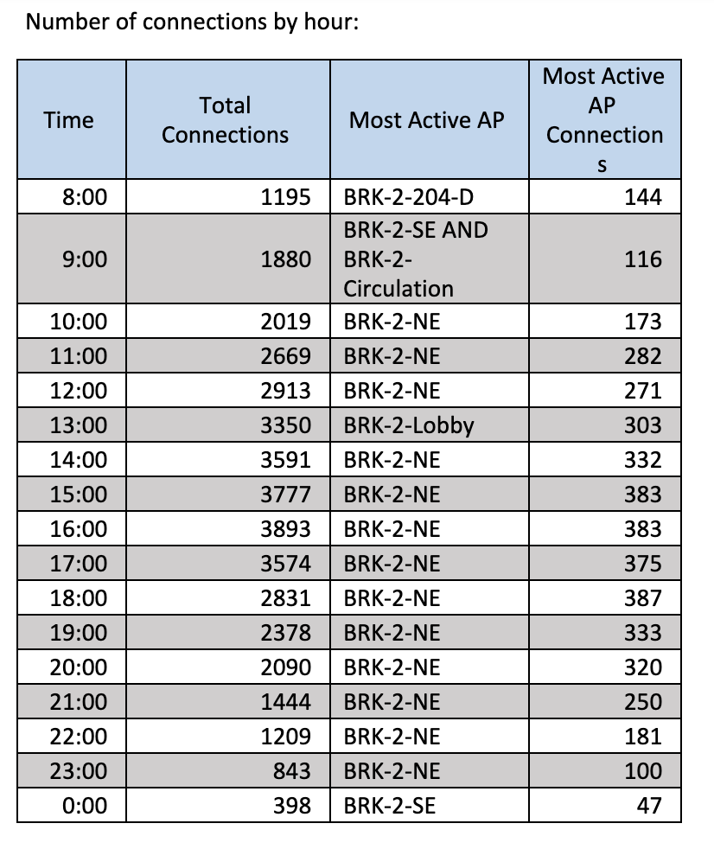
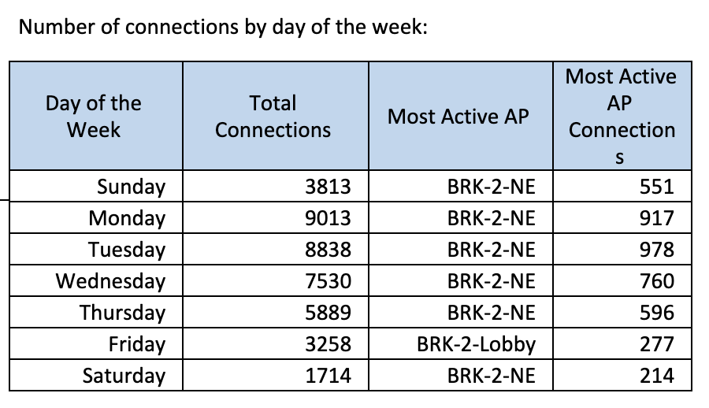
Space Analysis

Slide 8
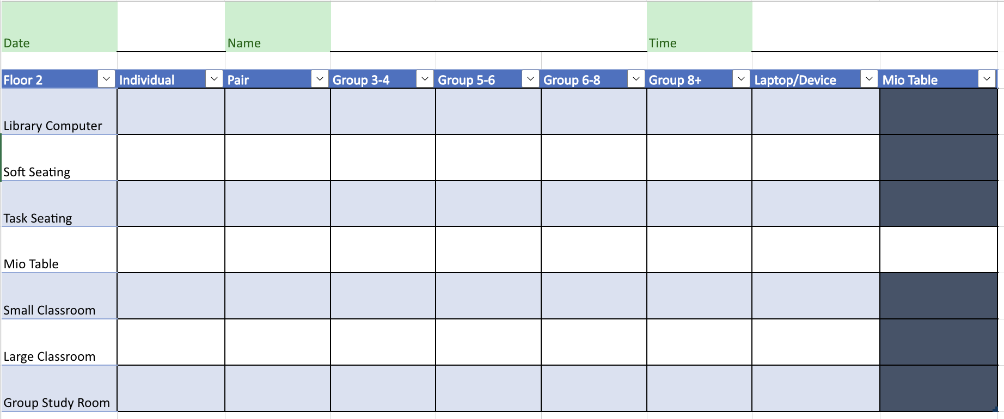
Space Analysis

Slide 9
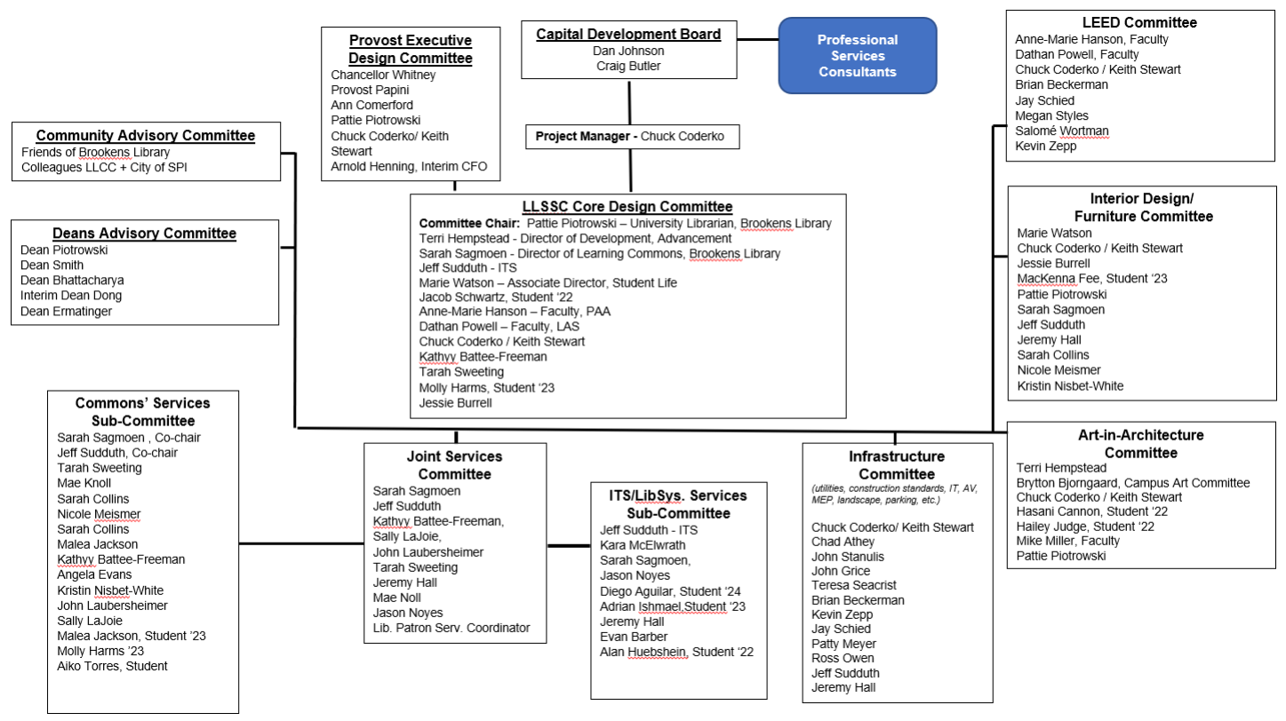
Committees

Slide 10
Committees

Slide 11
Early Conversations
Programming: the research and decision-making process that identifies the scope of work to be designed.
Challenges:
Focused on current services, spaces, and operation
Each department's meeting was held separately
Notes:
Programming: Led by the architects and incredibly siloed. Focused more on what we currently have instead of conversations about future needs or how units would work together.

Slide 12
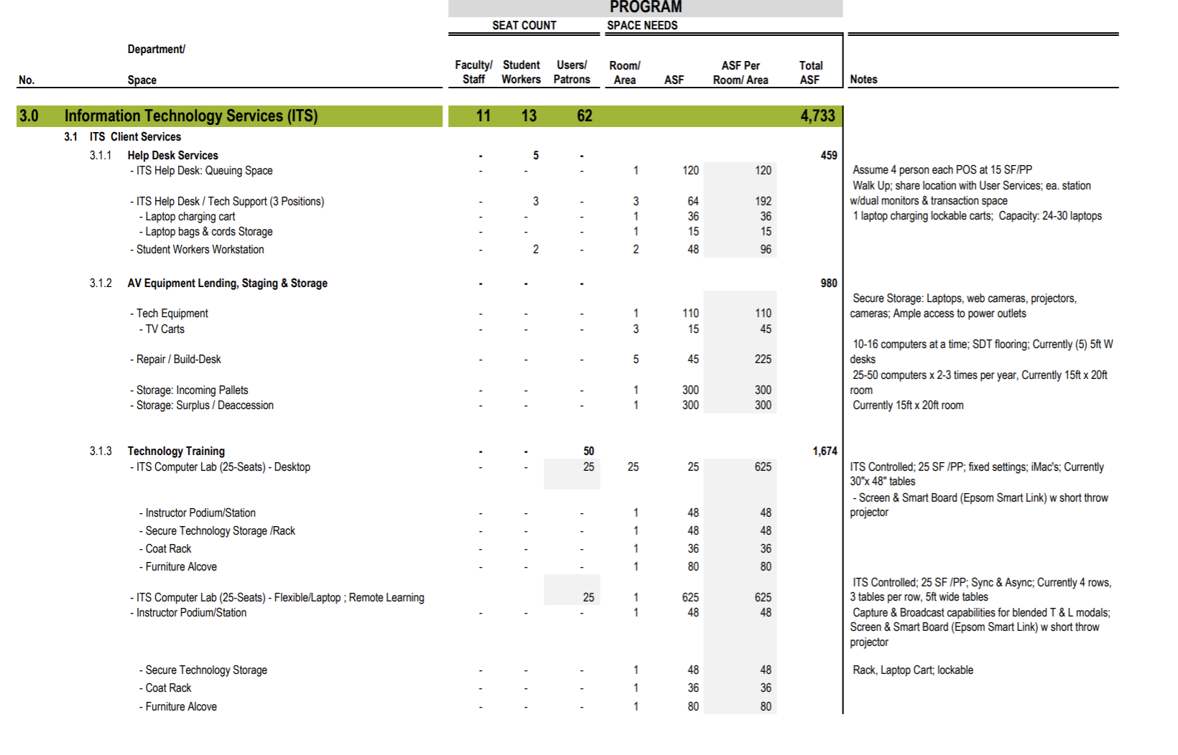
Program Analysis

Slide 13
Early Conversations
Creating a Vision Statement:
The Library Commons brings together student-focused campus units to provide high-impact services that facilitate student retention and success. Here we offer a unique learning experience, student support, programming, connection, and growth. The Library, Information Technology Services, Center for Academic Success and Advising, and Career Development Center create spaces and services that assist students in navigating their lifelong personal and professional journeys.
Services Inventory:
Tier 1: Quick transactional services
Tier 2: Drop-in services, basic to intermediate skill levels
Tier 3: Advanced assistance, formal instruction workshop, appointments/consultations
Notes:
Architect wrote a vision; we wrote our own Vision
Services inventory and service point mapping

Slide 14
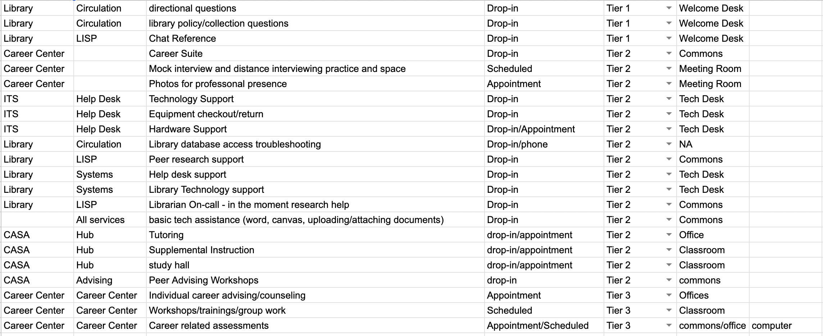

Slide 15
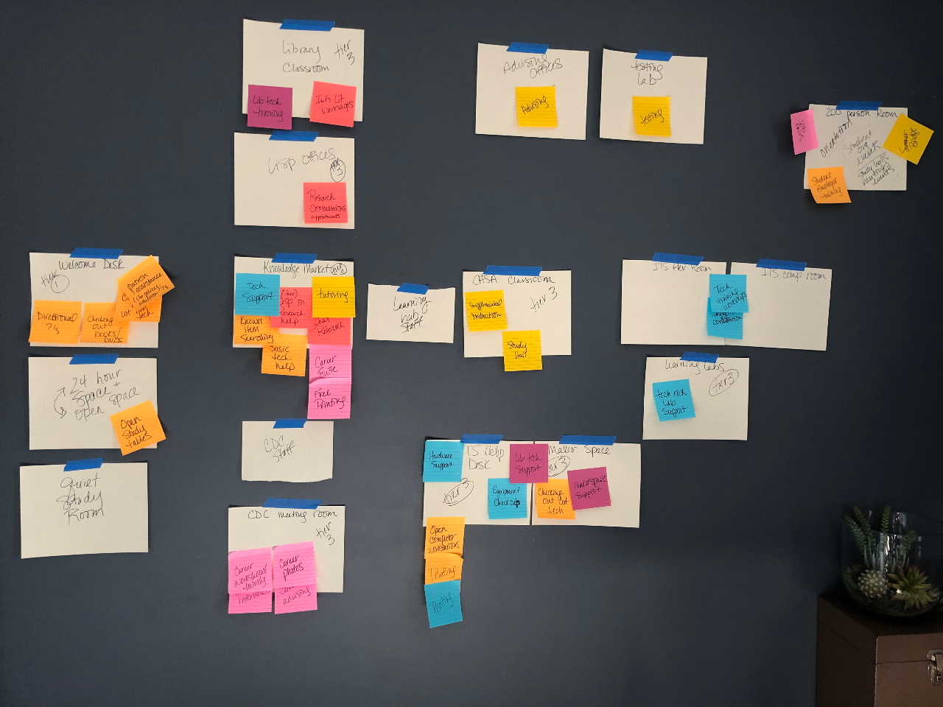

Slide 16
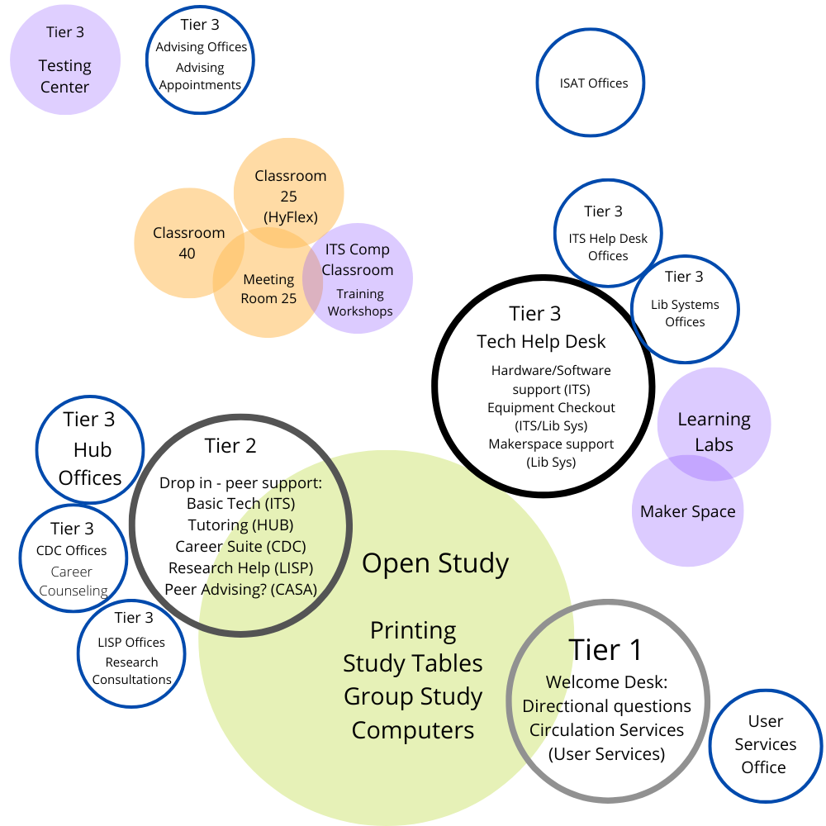
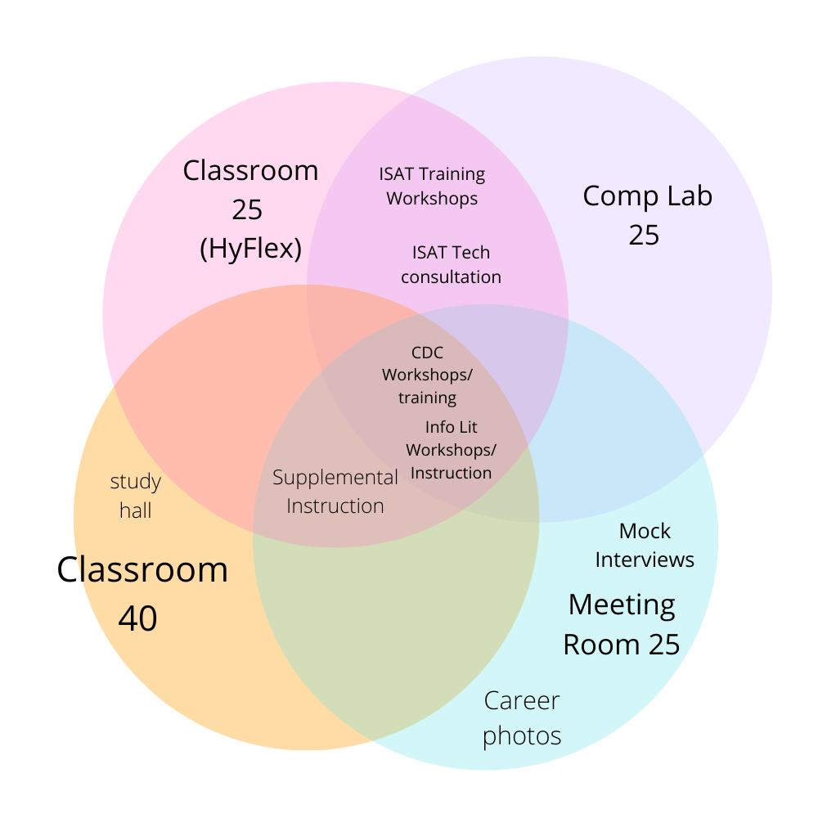

Slide 17
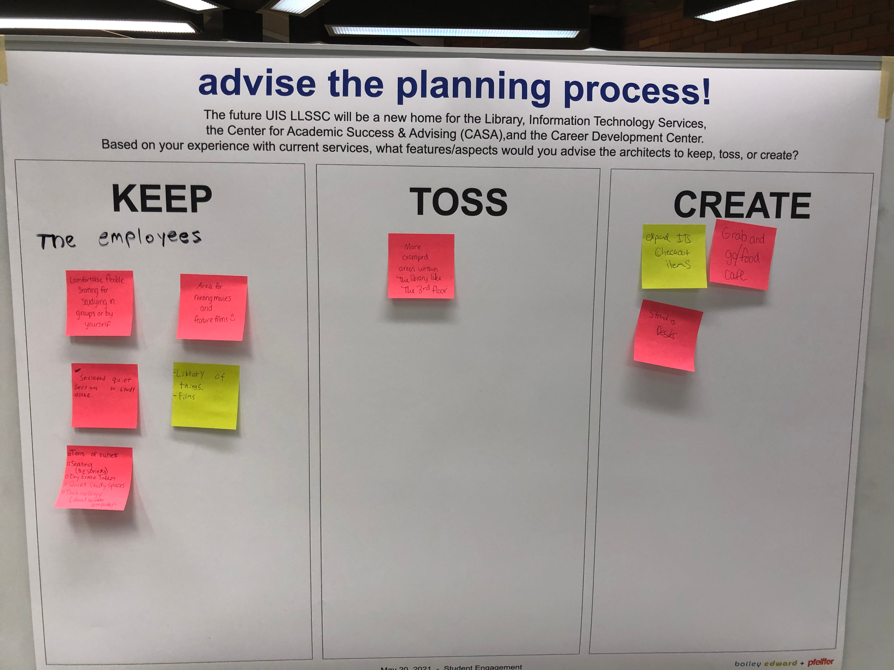

Slide 18
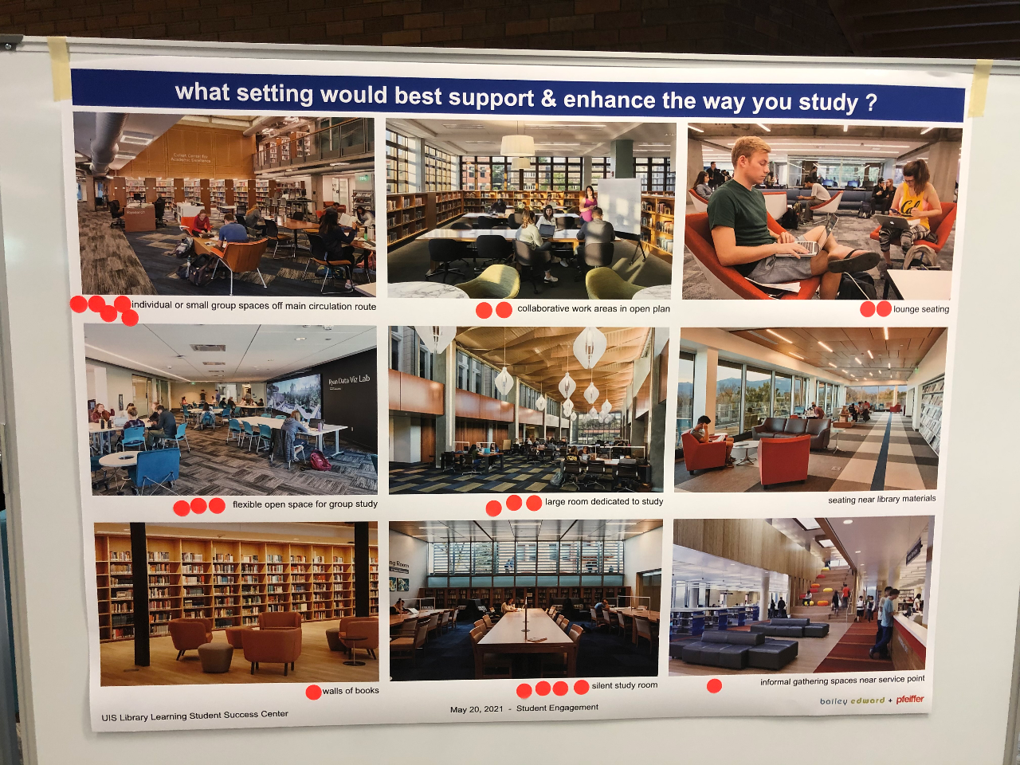

Slide 19
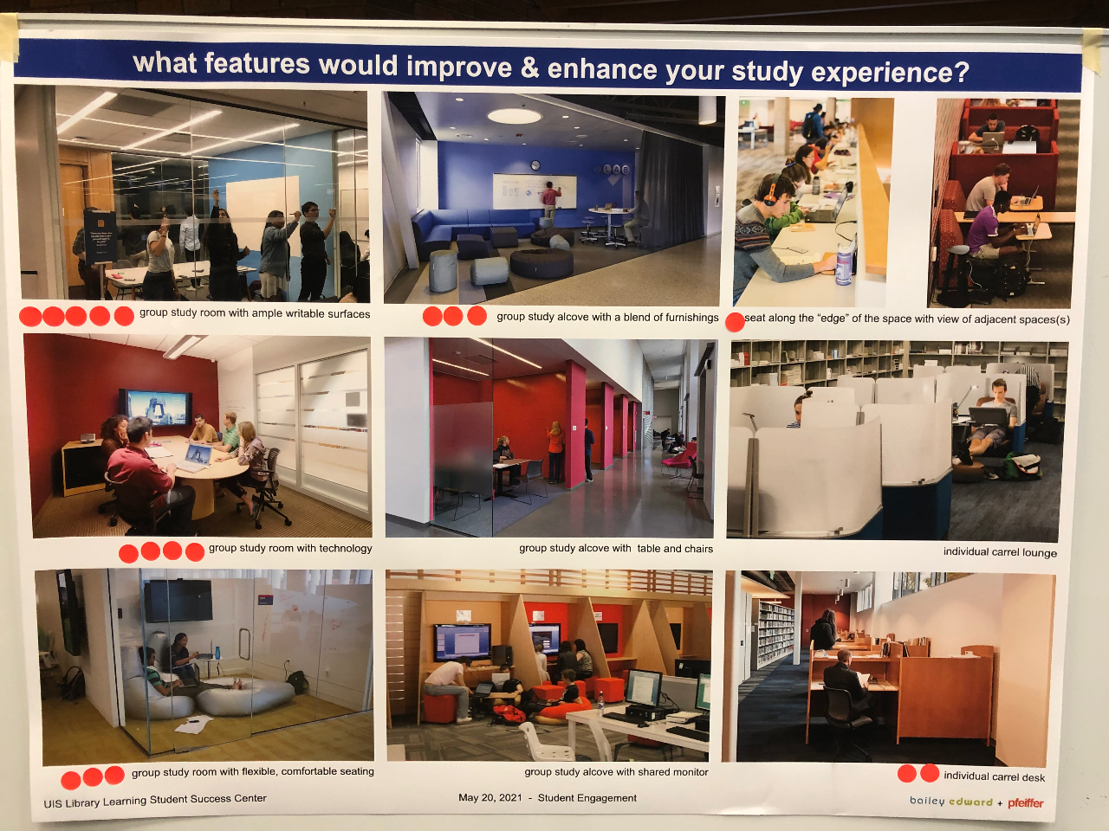

Slide 20
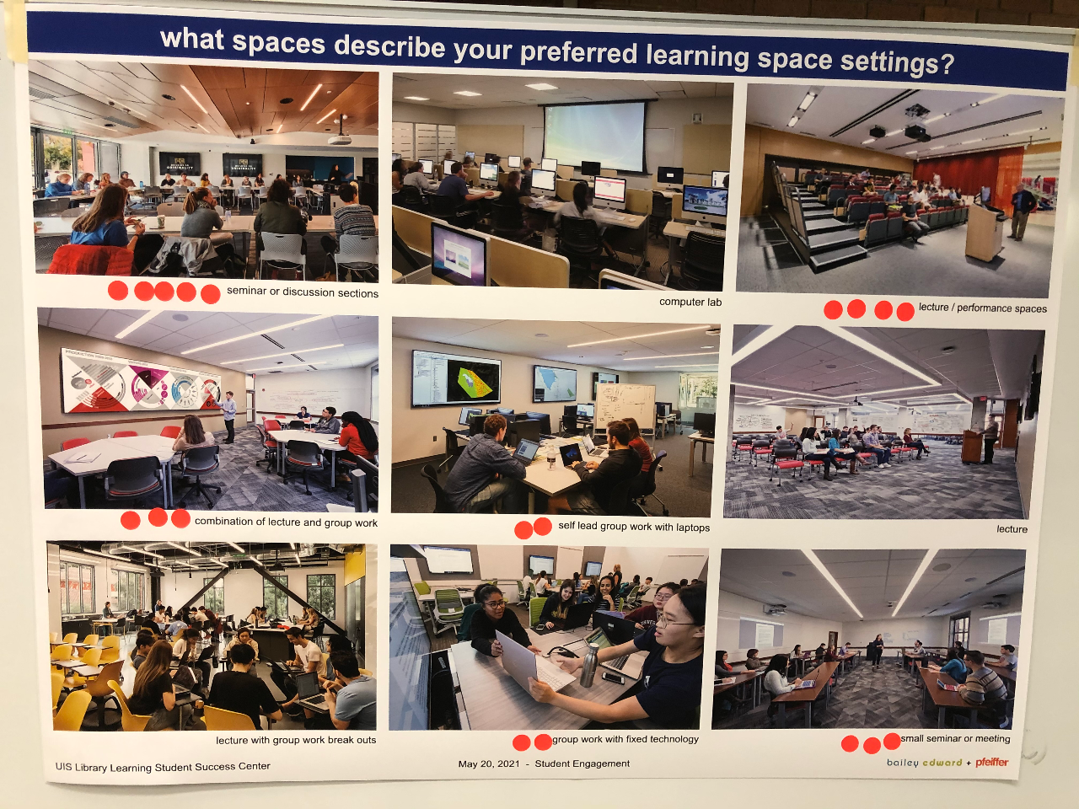

Slide 21
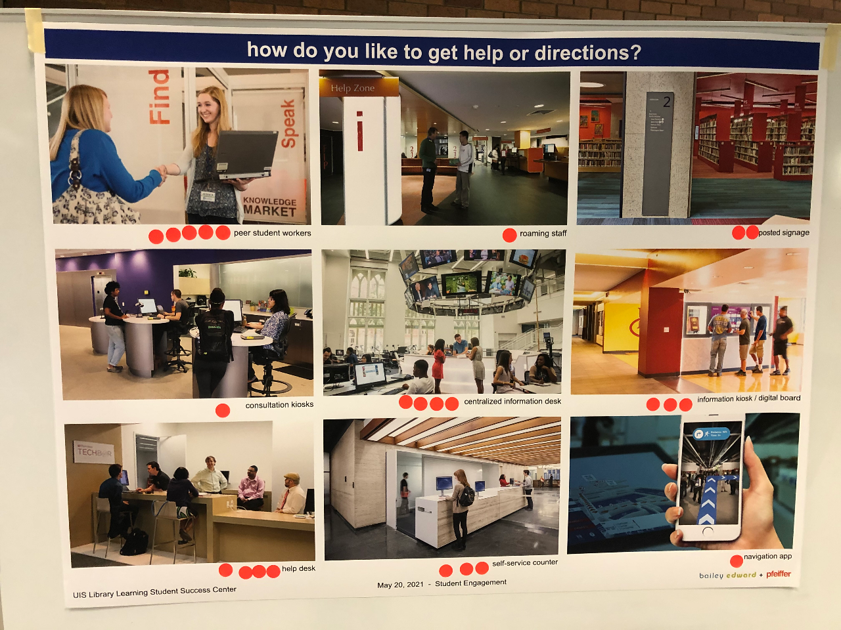

Slide 22
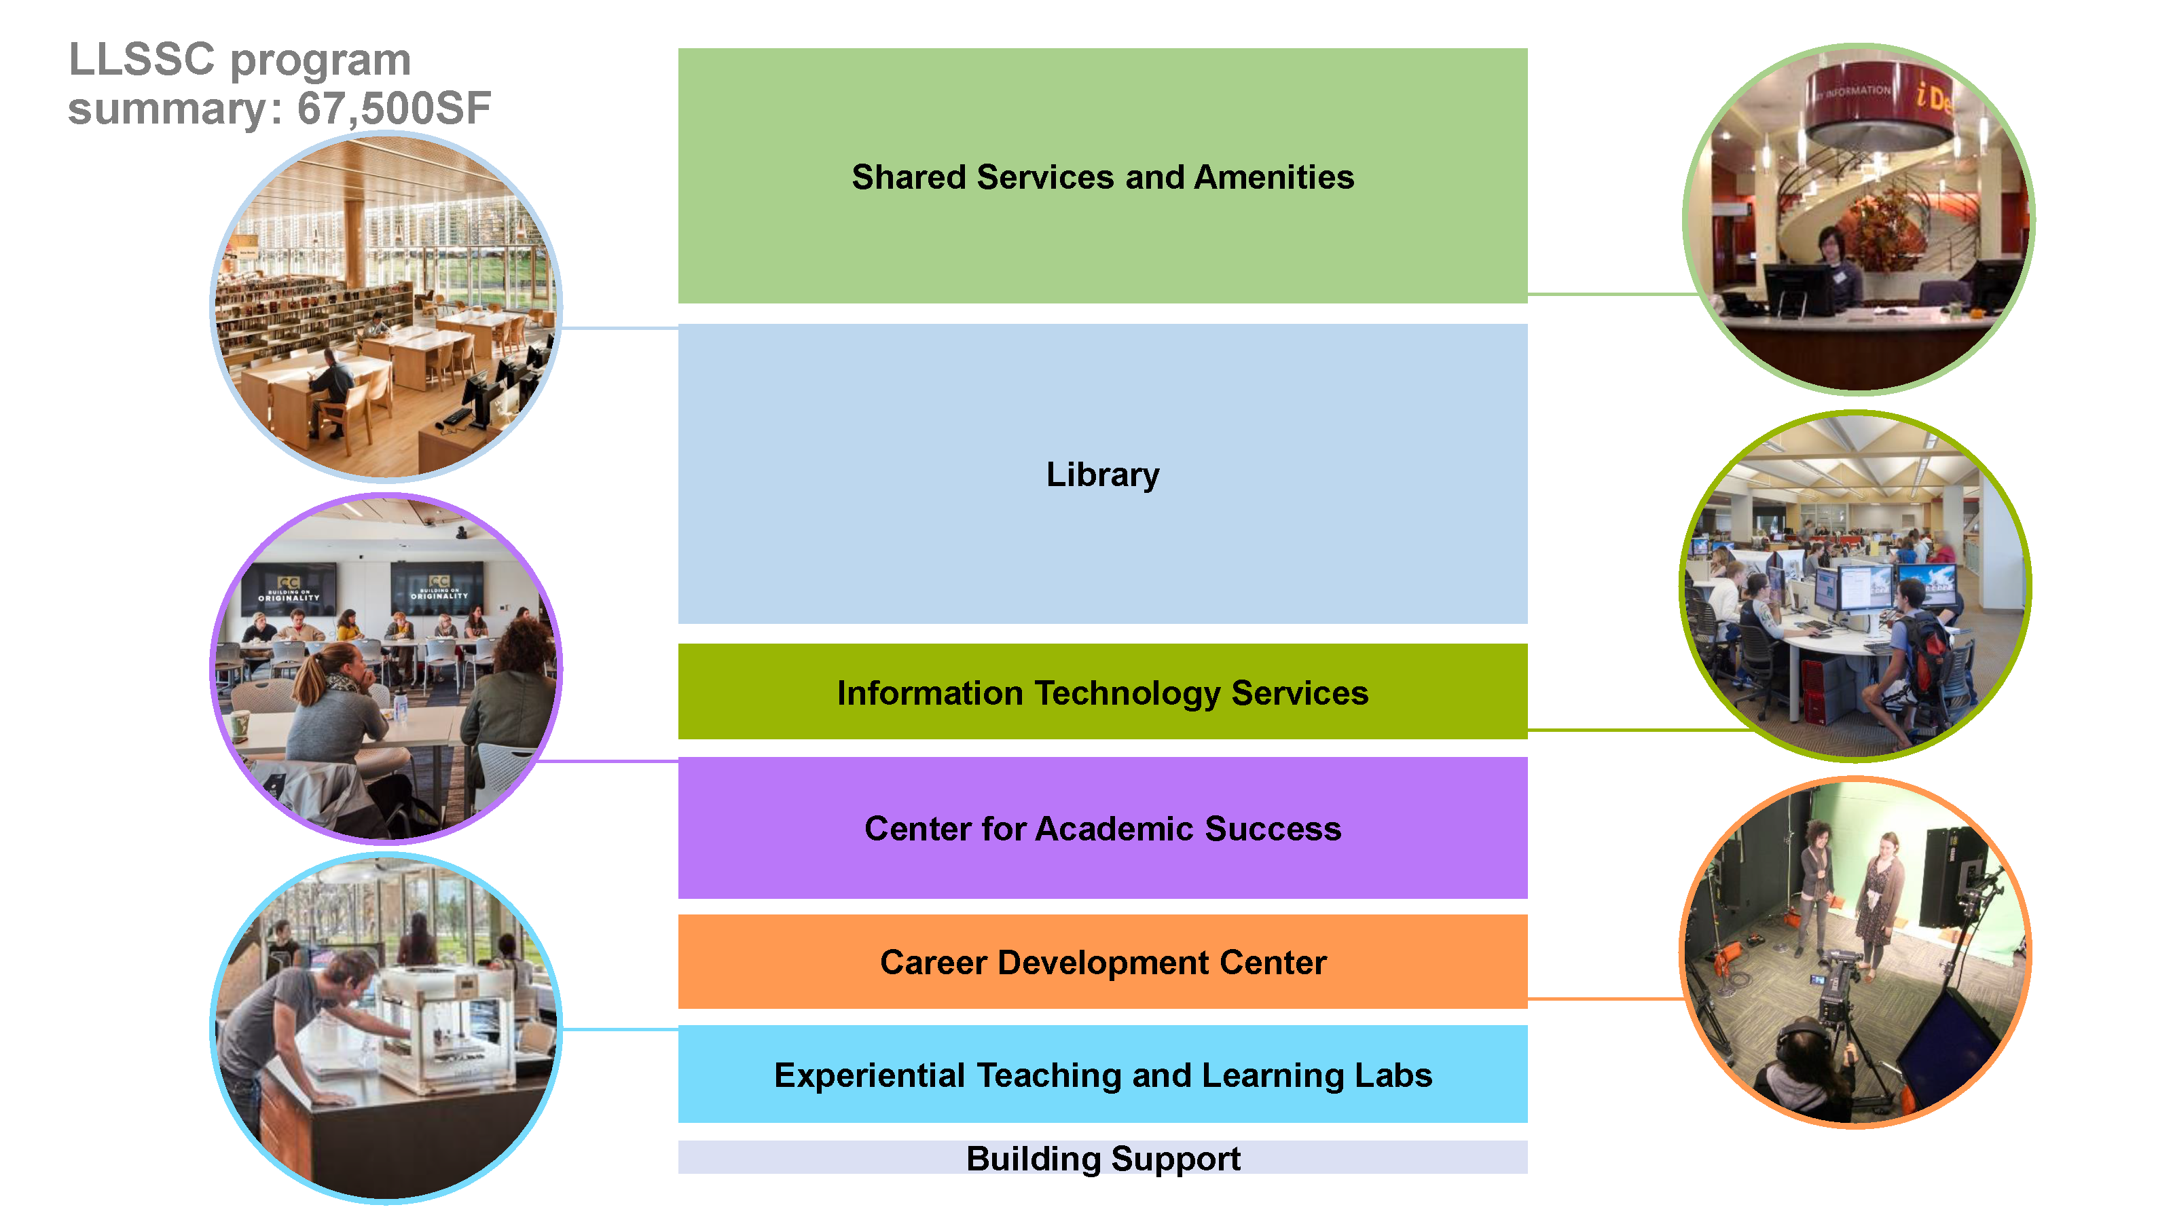
”Owning” the Building
Notes:
Why we own the building – current building and tenants -communication and maintenance, service and student training
Meeting with Student Union
MOUs and service contracts

Slide 23
Owning the Building
Expectation
Seamless experience for students
Our offer to the units
Oversee all open spaces
Work with Facilities and Campus Police
Manage Access points (card readers)
Admin booking systems (spaces and appointments)
Meeting with Student Union
Memos of Understanding

Slide 24
Working on the Drawings
Track Everything:
Don’t assume that requests made in meetings will make it to the drawings
Comments and follow through process
Large decisions are made by the Core Committee
Page by page review requires a smaller group
Notes:
Don’t assume that requests made will make it to the drawings
Comments and follow through process

Slide 25
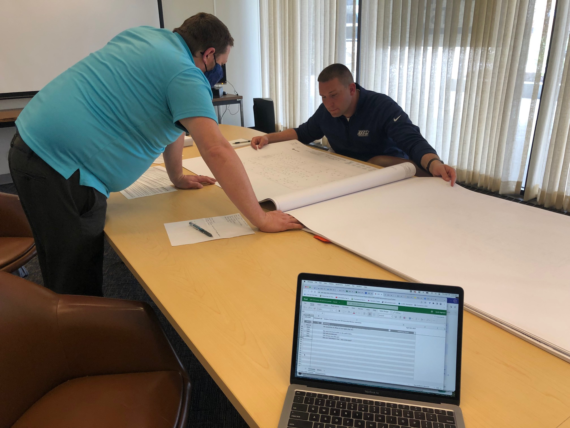
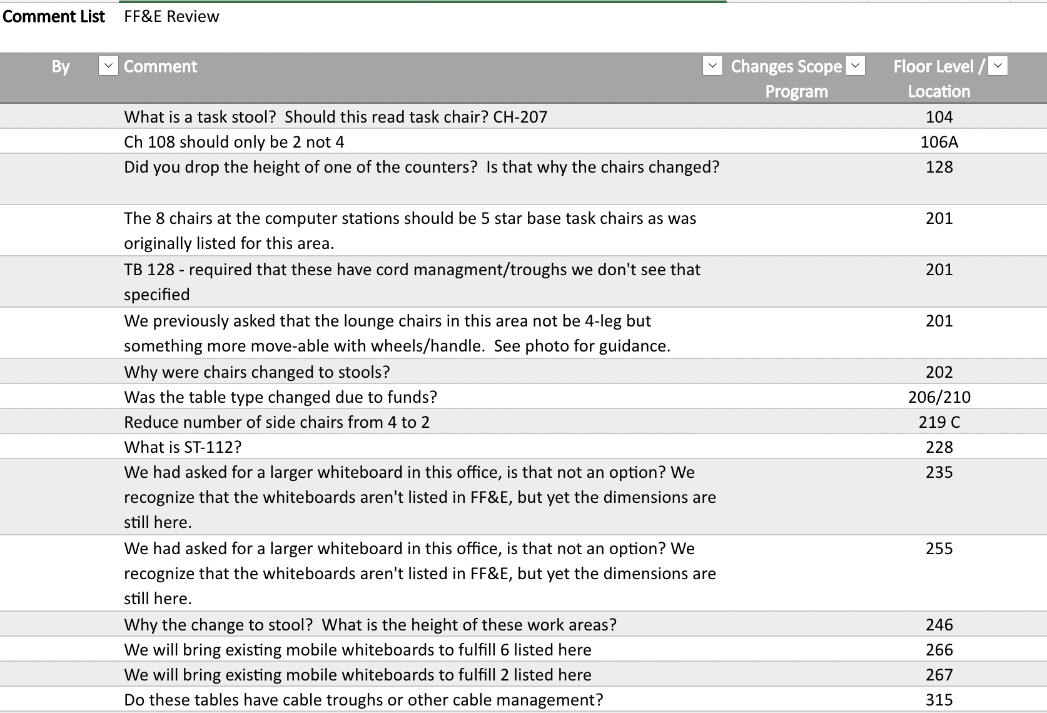
Reviewing Drawings

Slide 26
What we’re doing now
Weeding
While smaller collections have been weeded over the years, our general collection has not. The new building has a quarter of the collection space as the new building.
Waiting and Hoping
Bid process
Notes:
Weeding
If the building doesn’t come to pass, the weeding still needed done.
Operations planning with other units – budgets, employees, maintenance – what is shared and what is per unit

Slide 27
Next Steps
Internal reorganization
Redefining positions and creating new ones as needed
Refining Services and Operations
Writing Memos of Understanding (MOU)
Service Philosophy
Pilot Joint Events and Services
Appointment Booking/Room Booking software
Card Swipe Access Planning and Admin
Budget
Creating a fund for the building
Reallocation of funds – public computers/classroom tech
Notes:
Internal reorganization – AUL for operations and planning, overlap between ITS and Library Systems
Joint Services and operations

Slide 28
What We Learned:
Have internal conversations prior to meeting with architects
Make sure committees have the people who run operations/services
Have clearly defined roles for core team
  What requires the whole committee?
  Who is facilitating internal conversations?
  Who is reviewing drawings and tracking comments?

Slide 29
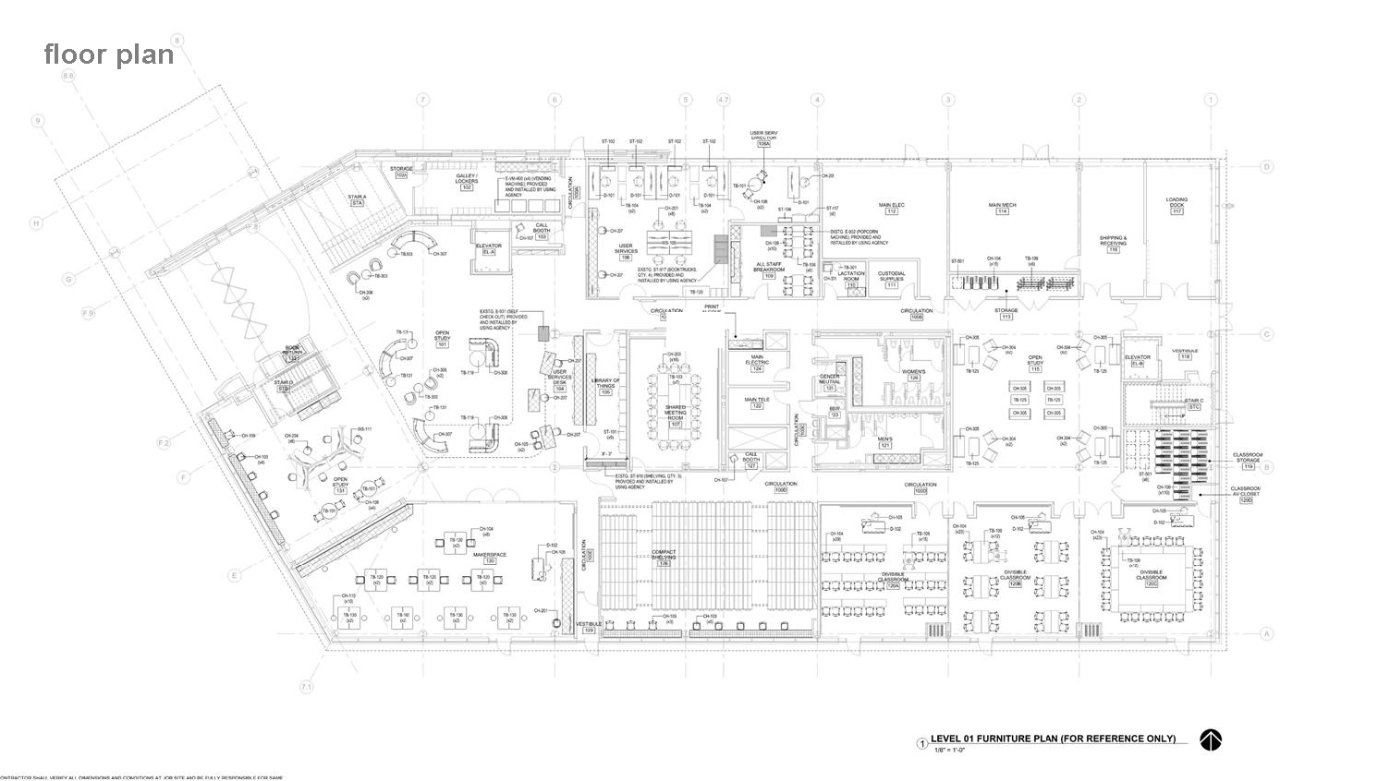
1st Floor

Slide 30
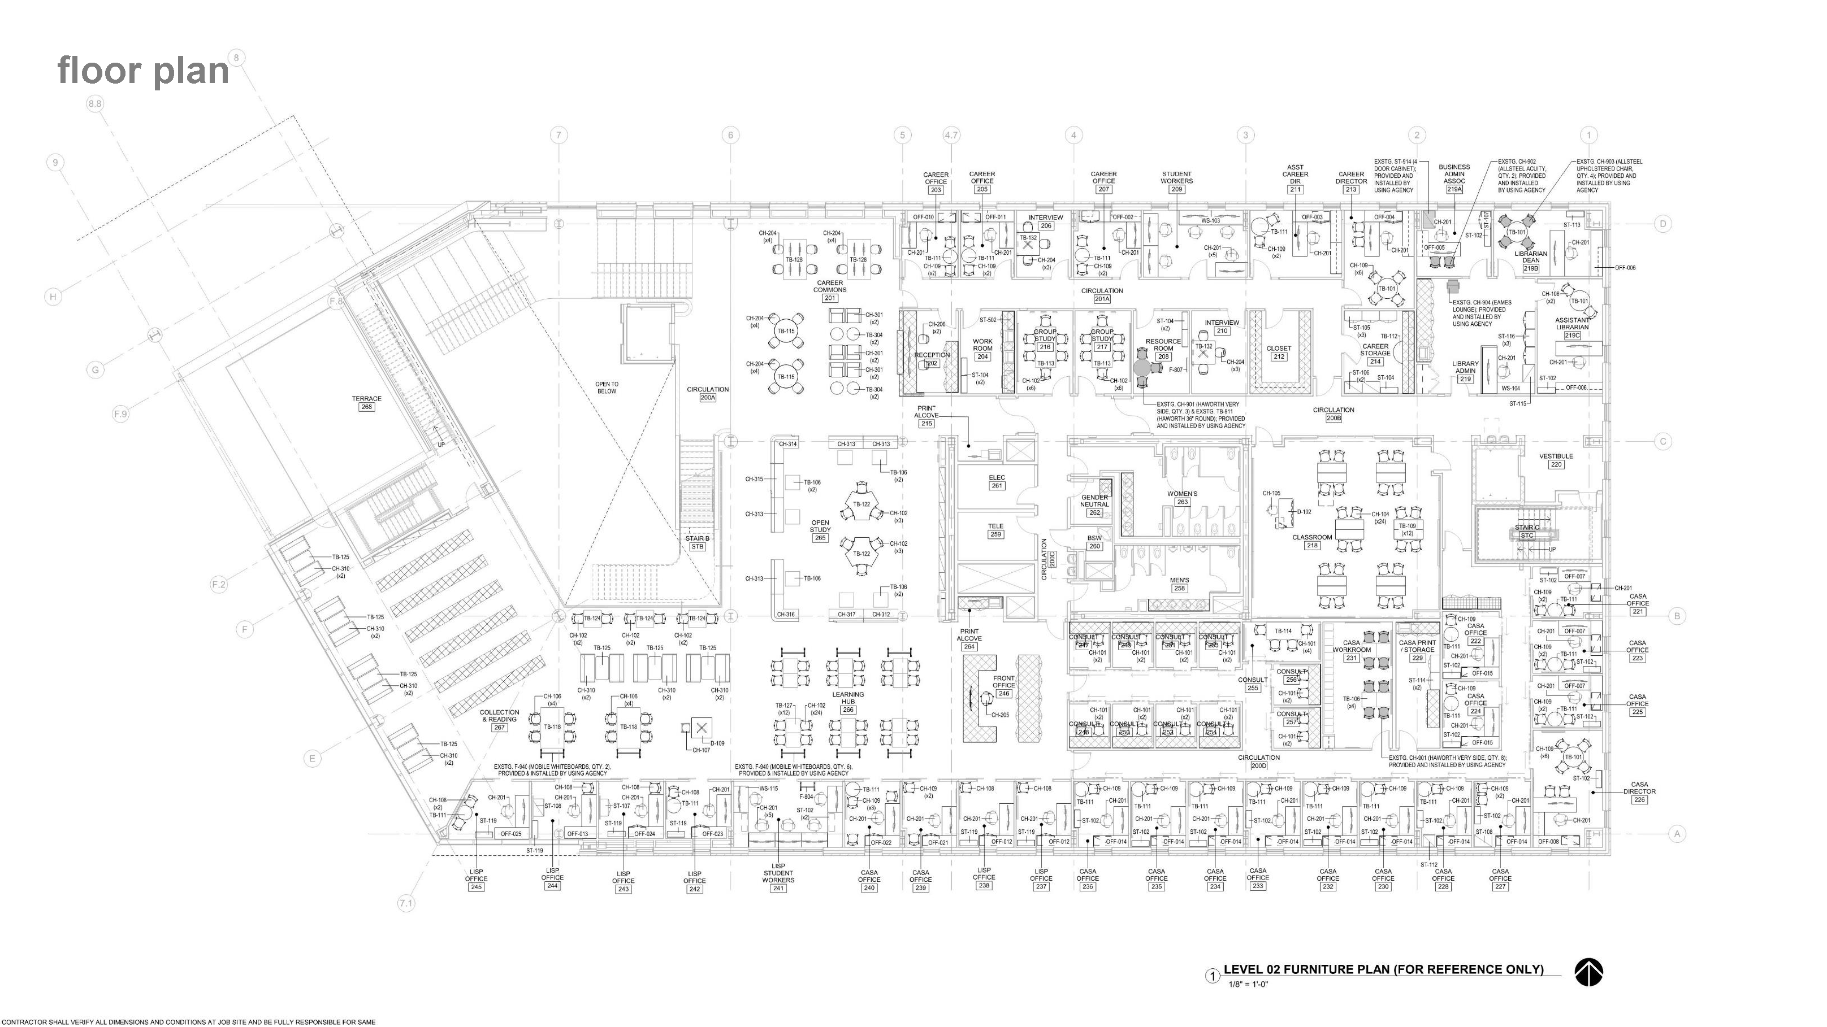
2nd Floor

Slide 31
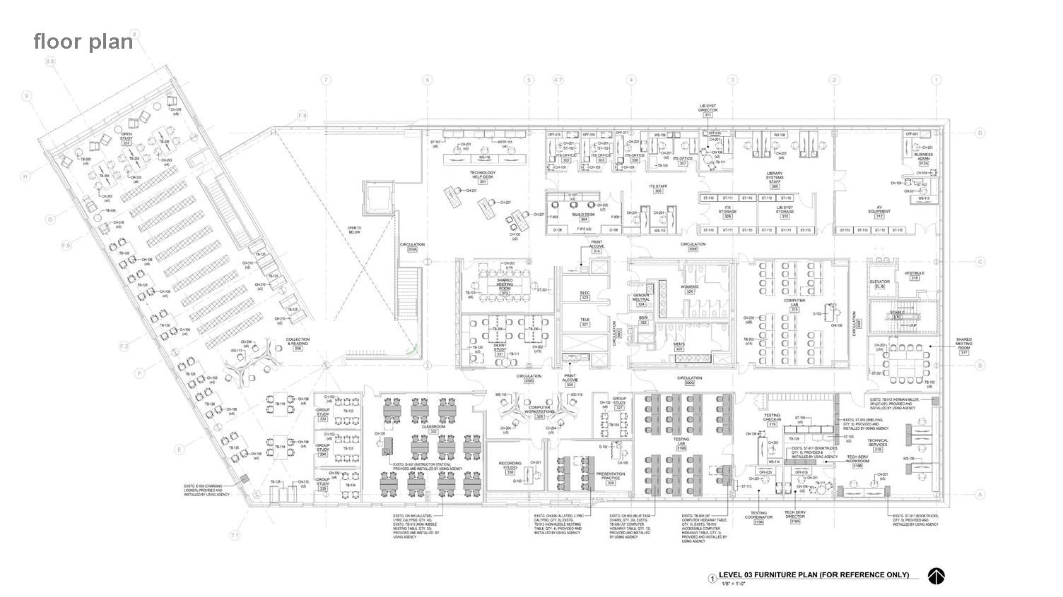
3rd Floor

Slide 32
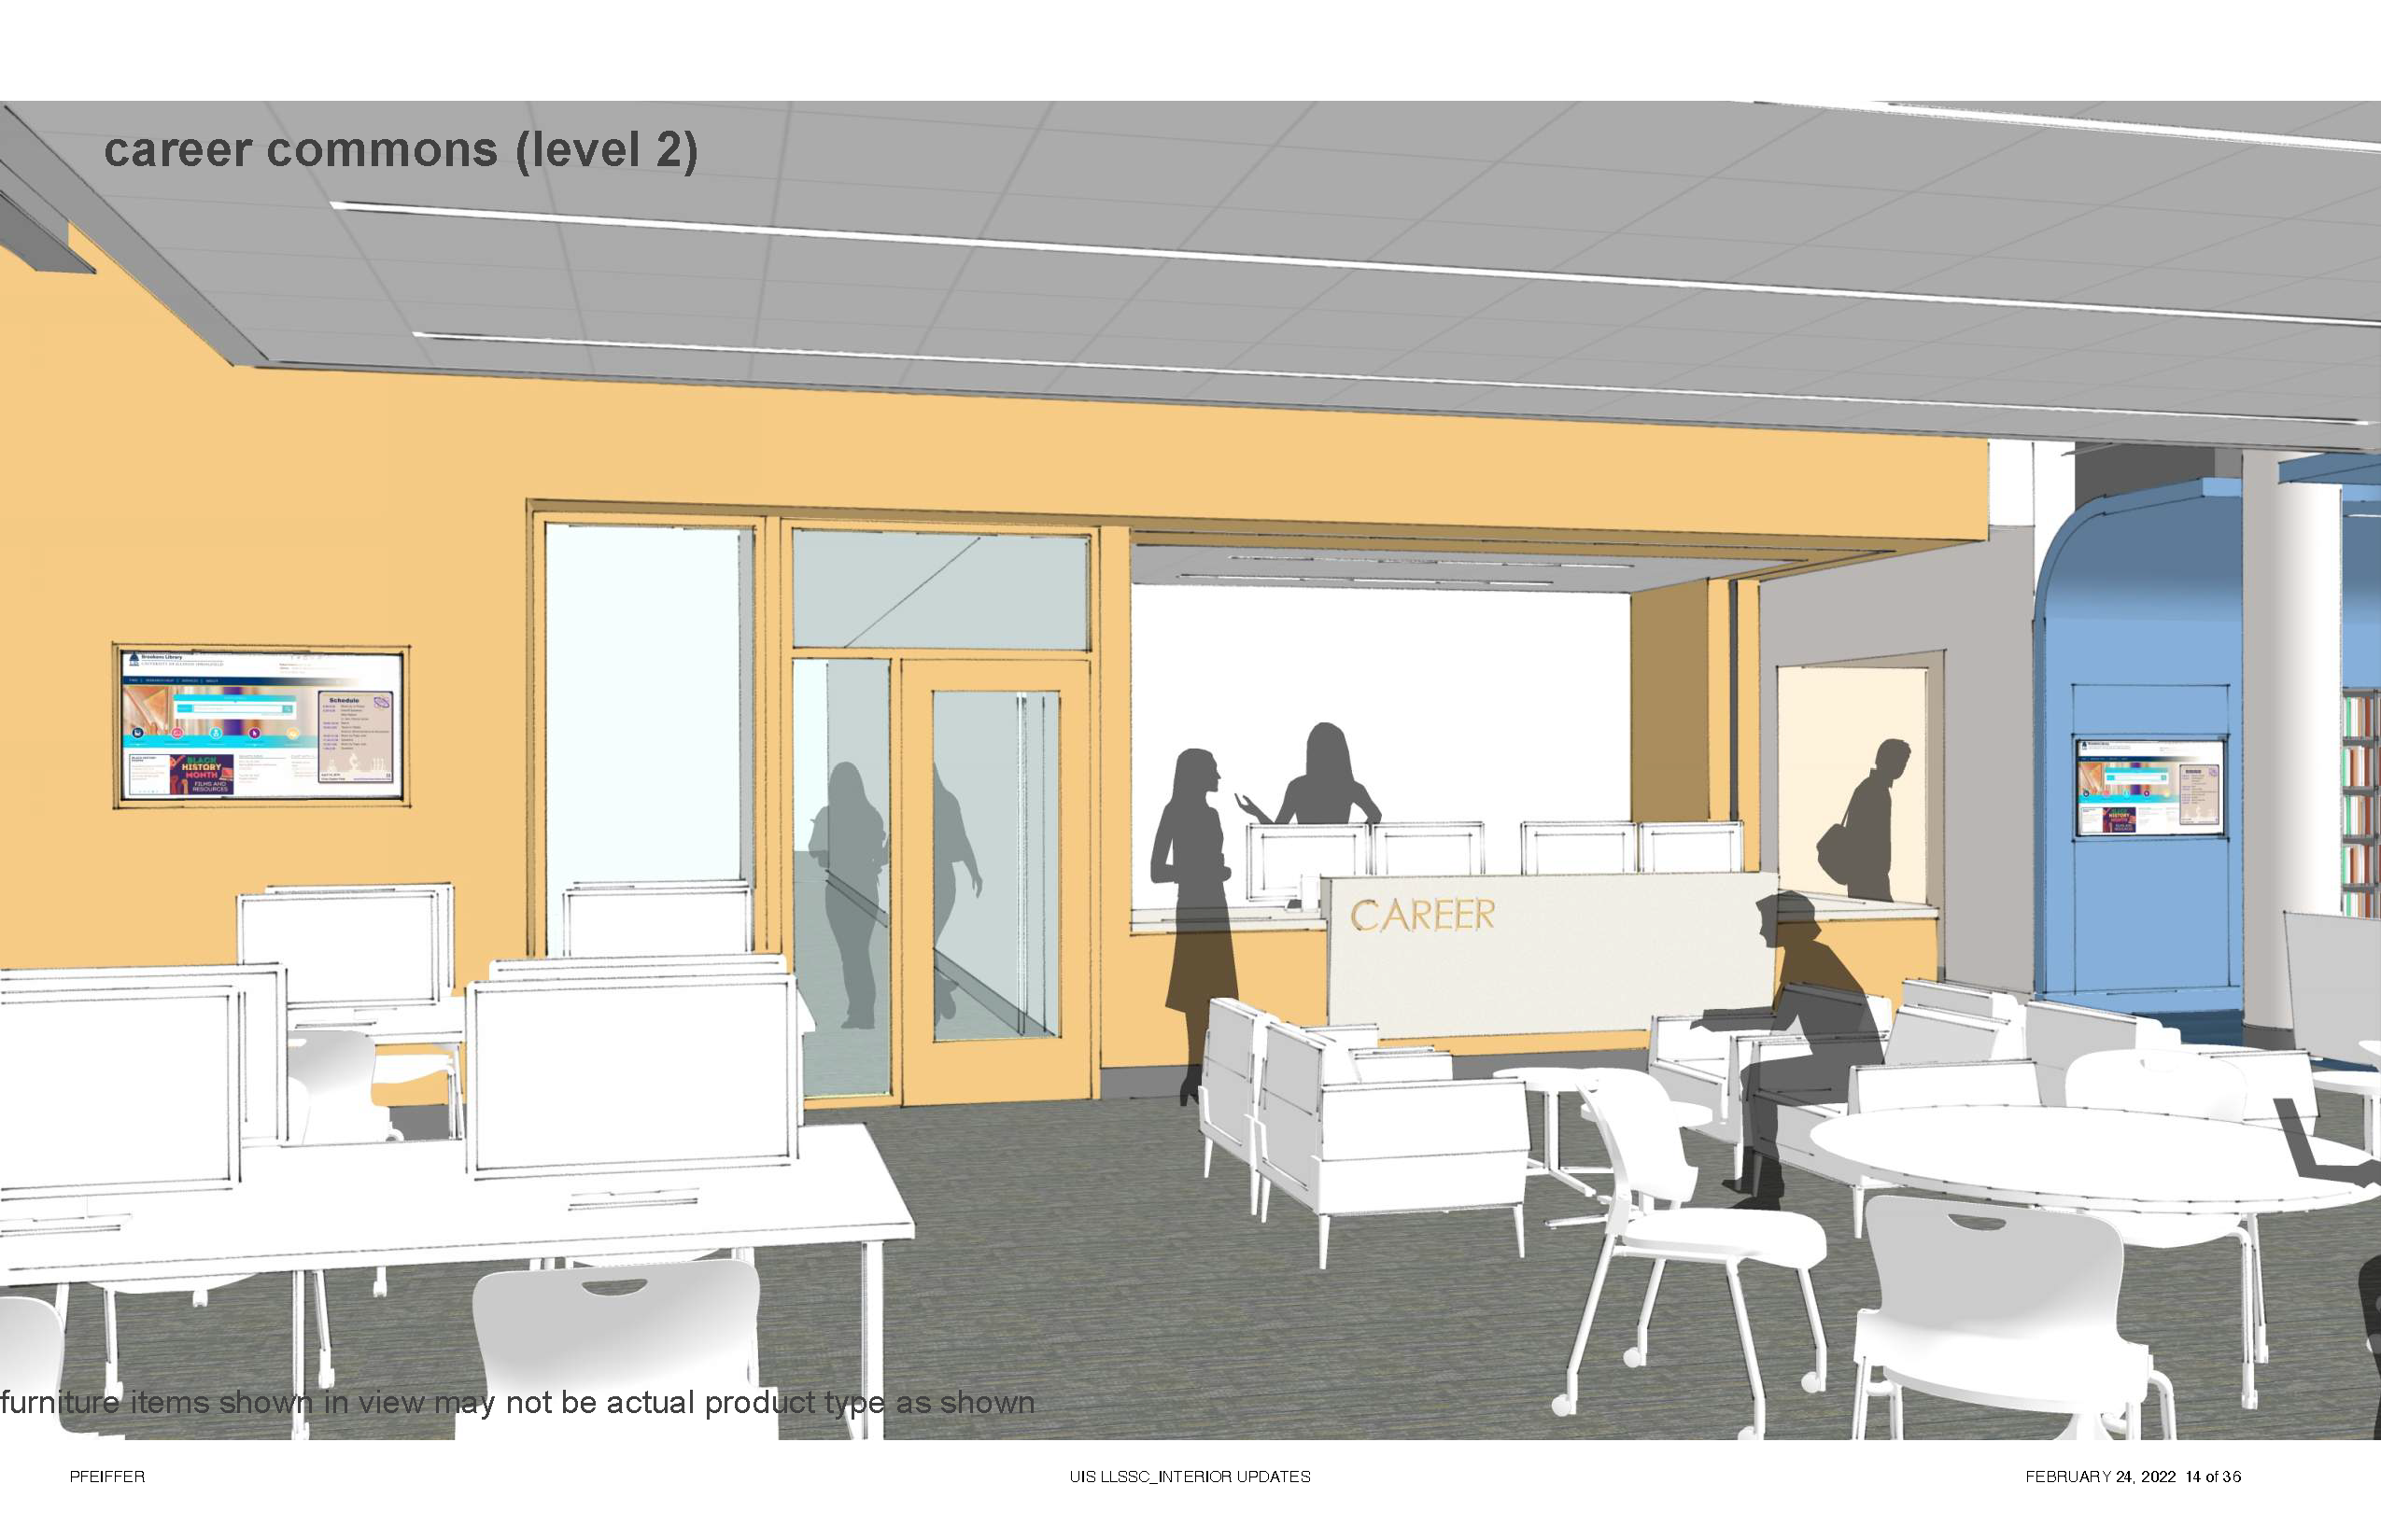
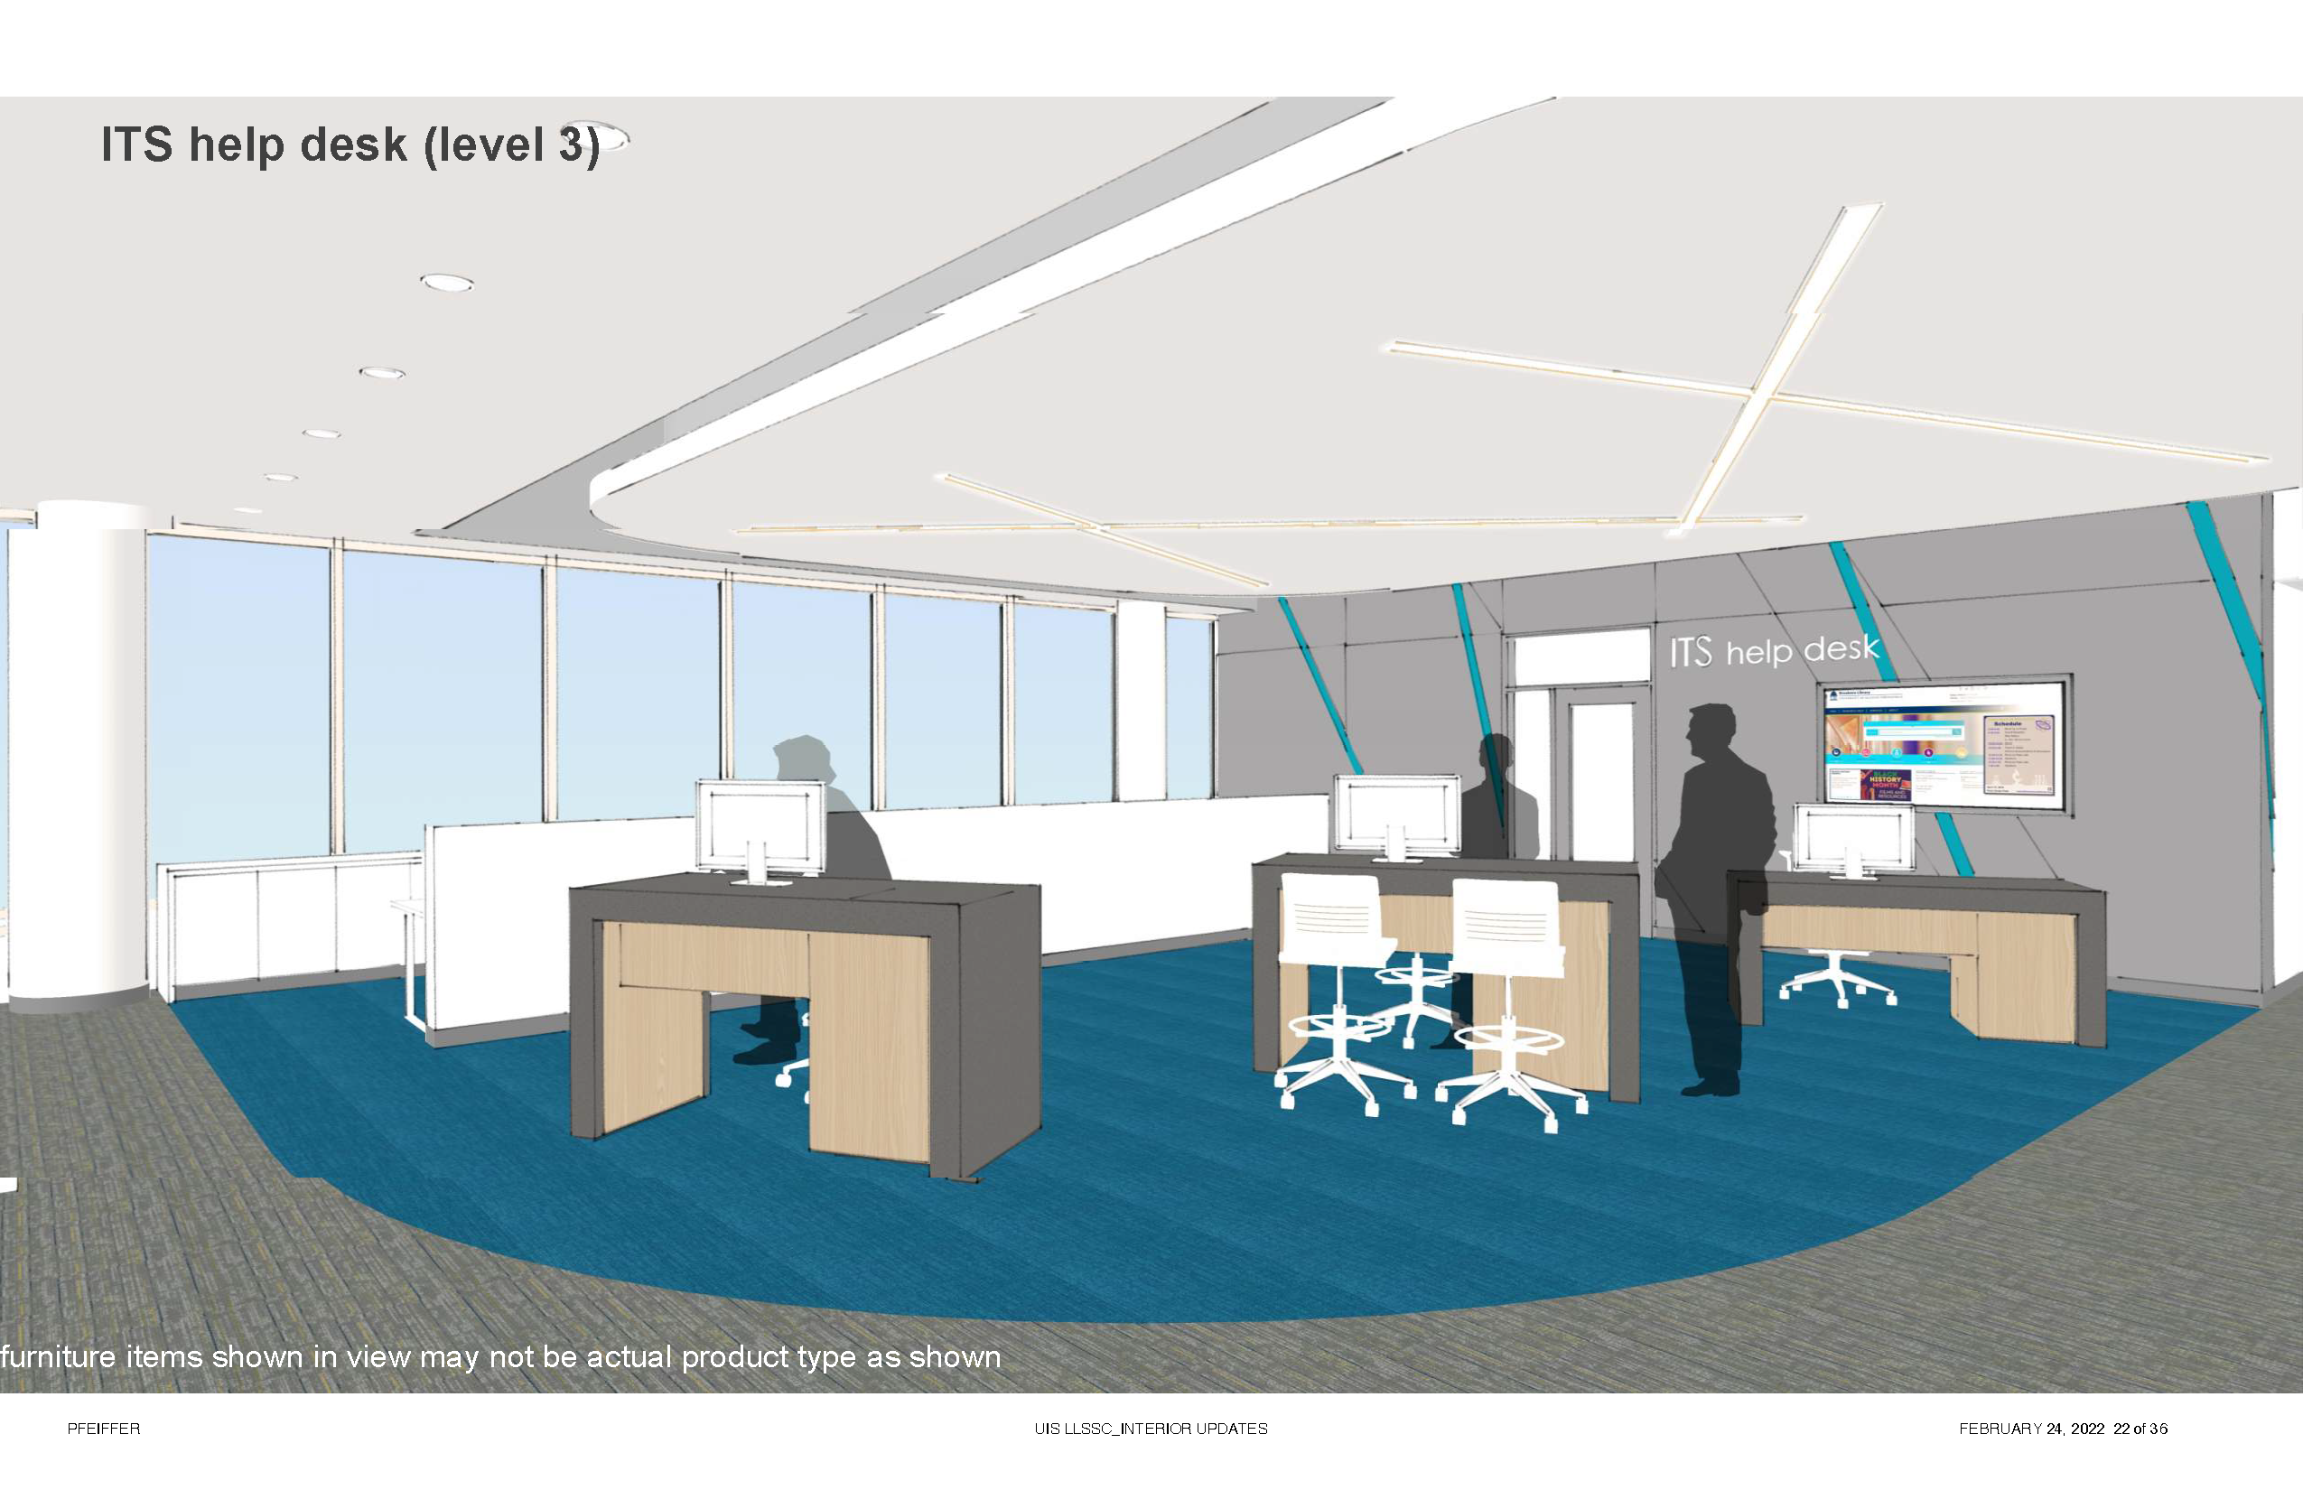
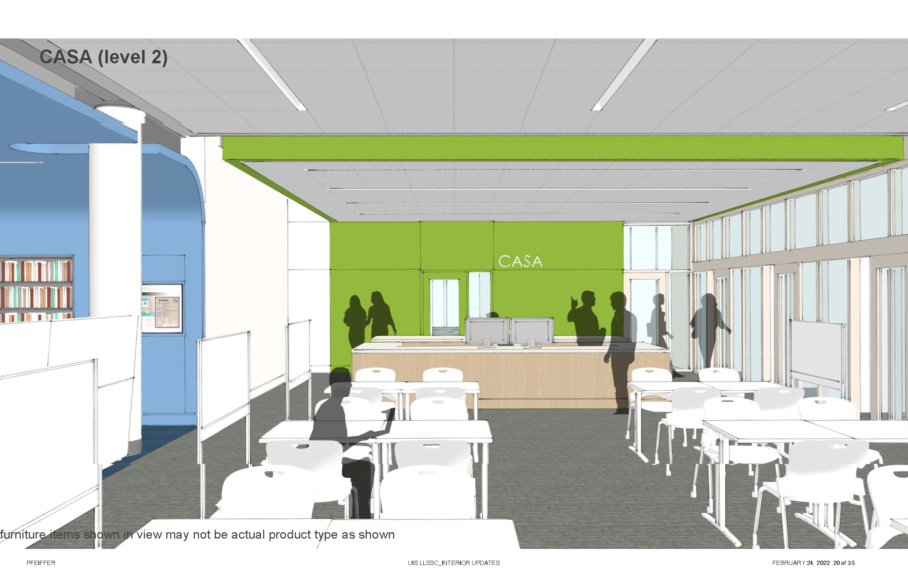
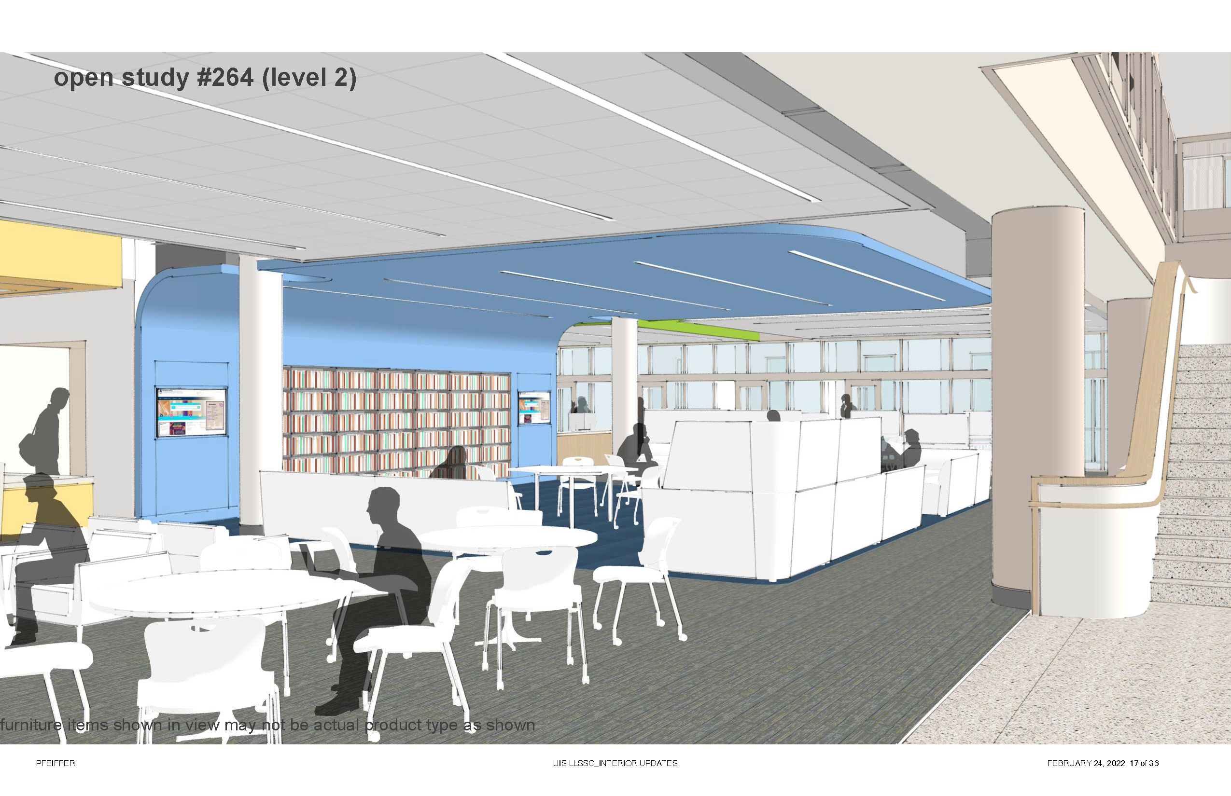

Slide 33
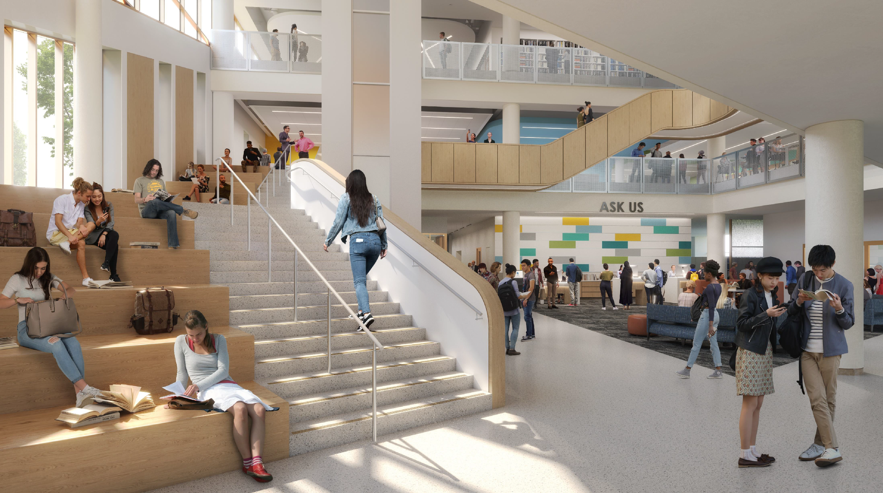

Slide 36
