Slide 1

The Before and After: Returning to Work with COVID Restrictions Still in Place
Joan Schuitema
CARLI PDA Series
January 19, 2022

Slide 2
INTRODUCTION
Welcome to the Beta variant of this presentation!
COVID is profoundly transforming organizational culture
  Links between societal issues and organizational culture have always existed
    Shifts resulting from the pandemic:
      Working in an office with other people —> working at home with technology
      Office chat —> Zoom
      Focus on creativity and productivity —> focus on safety and resilience

Slide 3
INTRODUCTION
  According to Spicer (2020), environmental jolts can cause reactions such as:
    Defensiveness, especially if threatened by repressed anger and/or fear
    Hypocritical behavior
    Overacting in thoughtless ways
    Radicalized internal cultures
  Such reactions can derail an internal change process

Slide 4
INTRODUCTION
  Parallel pandemic of physiological disorders (e.g.s: sleep, stress, depression, etc.)
  Conflict between what helps us stay safe and what is causing psychological issues
  How do we navigate shifting seas in the workplace during the pandemic?

Slide 5
OUTCOMES
Identify major psychological work-related issues that have surfaced during the pandemic
Explore the challenges in overcoming them as we move forward
Discover tools to address these challenges so as to improve the workplace experience

Slide 6
MAJOR PSYCHOLOGICAL ISSUES
Continued isolation
Loss of workplace traditions and rituals
Depleted spiritual wellbeing

Slide 7
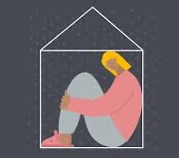
CONTINUED ISOLATION
COVID as the “Loneliness virus” (Çetin, 2021)
Workplace loneliness has been described as the perceived lack of quality relationships employees have in the workplace. (Wright, Burt & Strongman, 2006, p.60)
  Time spent with colleagues and the frequency of rich human interaction are decreasing with the pandemic even as we return to the office (Çetin, 2021)
Stay safe vs. stay healthy

Slide 8
CONTINUED ISOLATION
Physical issues:
  Reduced physical activity/exercise
  Musculoskeletal issues
  Disturbed sleep patterns

Slide 9
CONTINUED ISOLATION
Additional stressors:
  Alienation
    Work alienation refers to a state where employees are disengaged from work due to decreased levels of meaning and increased levels of isolation. (Hirshfeld & Feild, 2000)
      Example: Wrong conceptionalization and understanding of technology can bring alienation (Heidigger, 1954)
  Zoom fatigue

Slide 10
CONTINUED ISOLATION
Additional stressors:
  Organizational identification in terms of status (Waters et al., 2021)
  Blurring of work/home time
  The importance of the unimportant
    Casual conversation
    Lunch dates, dog therapy day, etc.

Slide 11
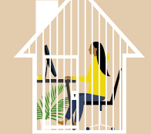
CONTINUED ISOLATION
New hybrid model
  Will need to reshape conventional ways of working where employees can enjoy benefits of working remotely and enjoy benefits of working together again (Çetin, 2021, p.174)
  Consider ongoing training
  Continual process

Slide 12
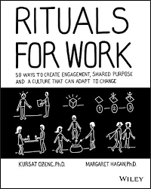
LOSS OF WORKPLACE TRADITIONS AND RITUALS
Organizational cultures are the signs and symbols, shared practices and underlying assumptions of an organization (Meyerson and Martin, 1987)
How to build a collective culture while separated from each other?

Slide 13
LOSS OF WORKPLACE TRADITIONS AND RITUALS
Don’t under-estimate the power of local traditions and rituals
  Most often associated with celebrations within the organization
  Which should be kept, transformed, discarded?
  Their loss is often accompanied by grief

Slide 14
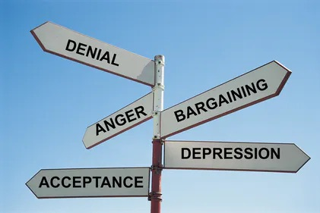
GRIEF
Stages of grief
Ignore at your own risk!

Slide 15
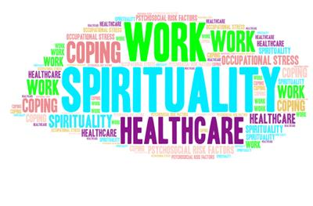
SPIRITUAL WELLBEING
“Spiritual well-being can be defined as a positive state where individuals experience ‘a sense of identity, wholeness, satisfaction, joy, contentment, beauty, love, respect, positive attitudes, inner peace and harmony, and purpose and direction in life’ through the integration of positive cognitions regarding the self, others and the environment”
(Gomez & Fisher, 2003, p.1976)

Slide 16
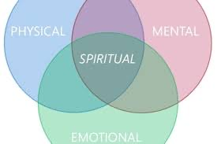
SPIRITUAL WELLBEING
Relationship of body/mind/spirit
Spiritual component is often ignored as taboo
  Doesn’t belong in the workplace
  Separation of church and state
True for organizational health as well as individual health

Slide 17
SPIRITUAL WELLBEING
Meaning-making
  Individuals seek meaning/sense of calling in their work
  Source of one’s passion
  Validated by community
  Work satisfaction is directly and significantly tied with life satisfaction (Çetin, 2021)

Slide 18
SPIRITUAL WELLBEING
Three components of workplace spirituality (Ashmos & Duchon, 2000)
  A sense of community where people feel connected with others
    Teams, patrons, supervisors, academy, professional organizations, etc.
    Direct link to loneliness
  Meaningful and purposeful work that creates a calling
  Inner life that employees can express and can stamp into their work

Slide 19
SPIRITUAL WELLBEING
Seldom able to be replicated in a digital environment
Leaders should implement policies for fostering spirituality (Ghadi, 2017)
  It is important to trigger some form of reflectivity (Spicer, 2020)
  Supporting feelings of inclusion and cohesion can enhance the spiritual wellbeing of employees (Ashmos & Duchon, 2000)
  Excellent way to learn more about diverse cultures

Slide 20
IMPROVING THE WORKPLACE ENVIRONMENT
This pandemic environment will be ongoing
Enhancing and supporting psychological capacities and resources of the employees during and after this demanding period can augment the efficacy and mitigate the adverse effects of the pandemic. (Çetin, 2021)
In this ongoing environment, loneliness, alienation, and wellbeing problems continue to escalate and effective attention to these issues must become part of establishing and maintaining a healthy and productive work environment. (Çetin, 2021)

Slide 21
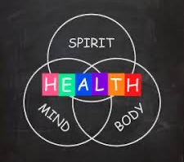
IMPROVING THE WORKPLACE ENVIRONMENT
Individual vs. corporate body
Emphasis has been of safety of the body
Next, on the mind in terms of problem solving to keep services running, do our jobs, etc.
Very little attention to the spirit
  Requires same intent and team effort as does body & mind

Slide 22
IMPROVING THE WORKPLACE ENVIRONMENT
Encourage at the individual level
  Revisit “Redefining Self-Care in the midst of a global pandemic”
    PDA Series 1/12/21 and 1/19/21 (https://www.carli.illinois.edu/professional-development-alliance)
    Excellent resource for tools

Slide 23
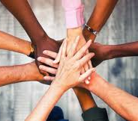
IMPROVING THE WORKPLACE ENVIRONMENT
At the workplace level
  Organizations are responsible for the health and wellbeing of their employees. During this demanding process, they need to both adapt policies for protecting their employees from the virus and also save them from the negative externalities of these policies (Bouziri et al., 2020).
  Requires intentionality and community effort
  Use of “Positive Psychology” as a tool

Slide 24
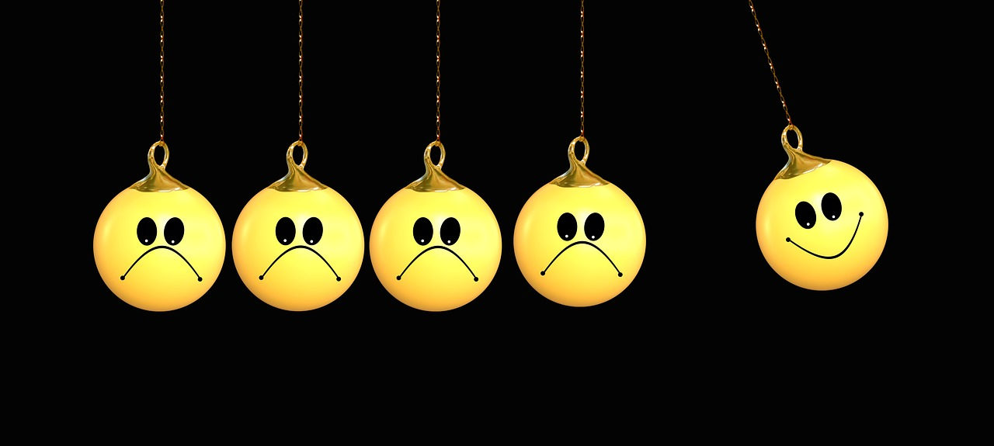
IMPROVING THE WORKPLACE ENVIRONMENT
POSITIVE PSYCHOLOGY

Slide 25
POSITIVE PSYCHOLOGY
“Positive psychology is a scientific approach to studying human thoughts, feelings, and behavior, with a focus on strengths instead of weaknesses, building the good in life instead of repairing the bad, and taking the lives of average people up to “great” instead of focusing solely on moving those who are struggling up to “normal.” https://positivepsychology.com/what-is-positive-psychology-definition/
It is NOT about ignoring emotions of pain, trauma, etc.
  If emotions are exiled, any attempt to use this approach will be derailed

Slide 26
POSITIVE PSYCHOLOGY
Primary concepts: (Waters et al., 2021)
  Positive psychology adopts a strengths-based, generative and pro-social view of human capacities
  Proponents believe that positive psychology plays a role in helping the people cope (i.e., buffer against distress and bolster mental health) with COVID-19 and grow through this crisis (i.e., build new capacities)

Slide 27
POSITIVE PSYCHOLOGY
  Primary concepts
    Focuses on positive processes that help individuals recover and rebuild from adversity (e.g., mental toughness, resilience, hardiness, meaning, compassion, forgiveness, and post-traumatic growth)
    Suggests that individuals can endure high levels of distress during this medical pandemic and yet still experience positive mental health (i.e., feeling good, functioning well and doing good)

Slide 28
POSITIVE PSYCHOLOGY
9 topics in positive psychology that support people through a pandemic: meaning, coping, self-compassion, courage, gratitude, character strengths, positive emotions, positive interpersonal processes and high-quality connections.
3 kinds of interactions:
  Buffering: helps reduce stress (e.g. self-compassion buffers suffering)
  Bolstering: maintains mental health (e.g., character strengths that could be used in new ways)
  Building: strengthens one’s psychological resources & capabilities (e.g., high quality connections)

Slide 29
IMPROVING THE WORKPLACE ENVIRONMENT
How to use positive psychology tools
  Use by individuals as desired
  Use within the organization
    Possible support groups that explore the institutional strengths that have been built during the pandemic that enable it to move forward
      Support groups do not require a therapist (as do therapy groups)

Slide 30
IMPROVING THE WORKPLACE ENVIRONMENT
Re-purpose the “Tree of Contemplation”
  “Tree of Workplace Wellness”
  Rename the branches
  Lends itself well to group work

Slide 31
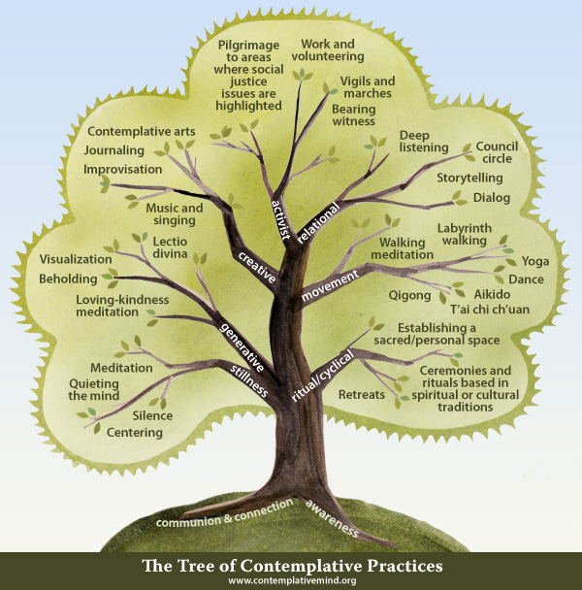

Slide 32
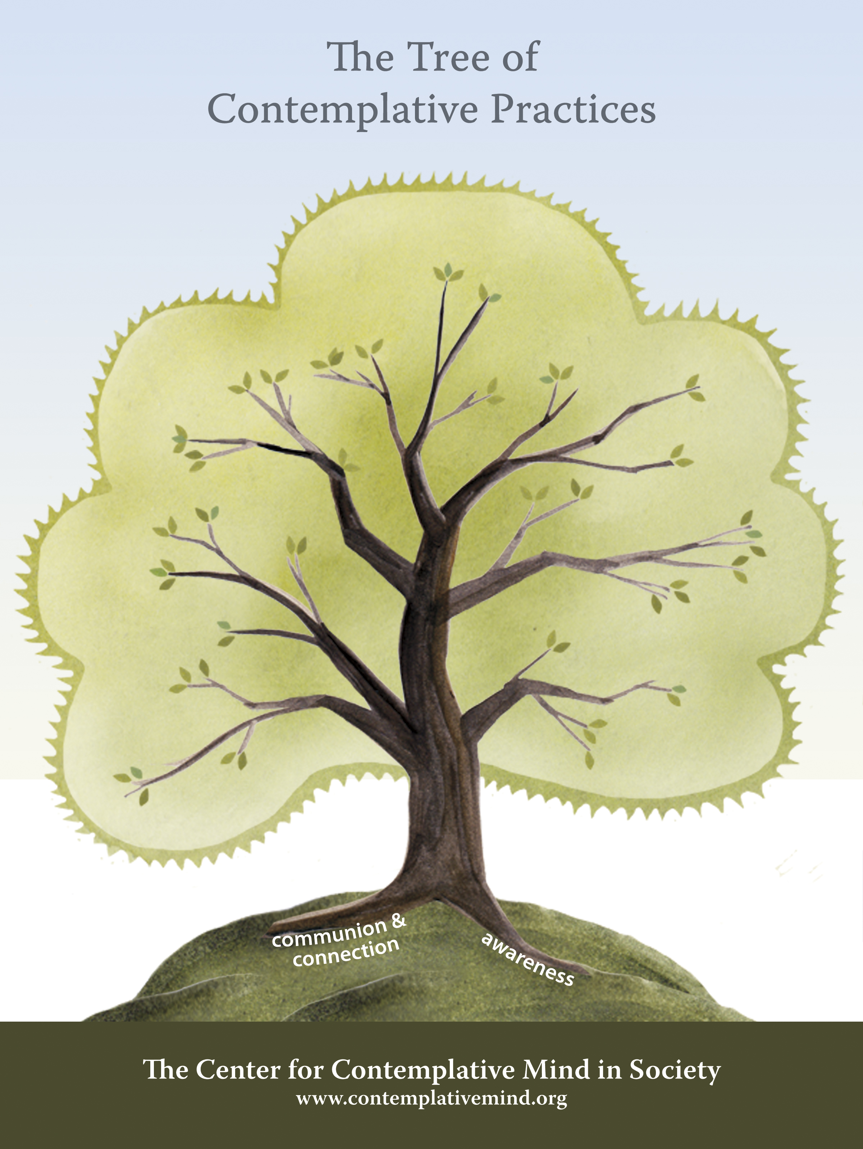

Slide 33
REVIEW
Identified major psychological work-related issues that have surfaced during the pandemic
  Isolation, Loss of workplace rituals & traditions, & depleted spiritual wellbeing
Explored the challenges in overcoming them as we move forward
  Not a “one-and-done” project
  Needs to be done at the corporate level as well as individually
  Requires intentionality and teamwork

Slide 34
REVIEW
Discovered tools to address these challenges so as to improve the workplace experience
  Positive psychology
  Tree of workplace wellness
Investing in the psychological capital of employees can also serve as a useful policy to carry the organization out from the pandemic safe and successful with their members. (Çetin, 2021)

Slide 35
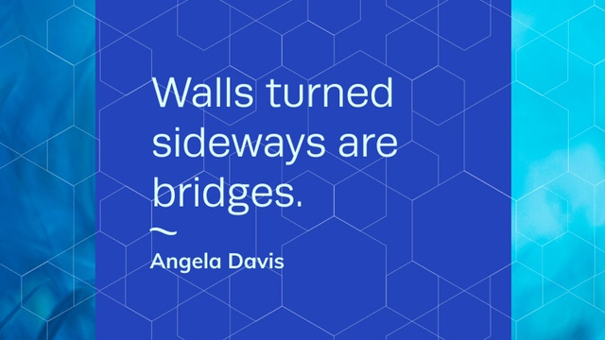

Slide 36

Joan Schuitema
j_schuitema@msn.com
773-255-9026

