Slide 1
Open Illinois: Advancing Statewide OER Efforts
“Starved Rock State Park” photo by Tom Shockey
is licensed under CC BY 2.0

Slide 2
Consortium of Academic and Research Libraries in Illinois
130 member libraries
Public universities: 13
Community colleges: 39
Private, research, and special: 78
CARLI member libraries serve 90% of Illinois higher education students, faculty, and staff.

Slide 3
Program Focus
"Stacked Stones" by Photographing Travis is licensed under CC BY 2.0.
Building expertise and cross-institutional collaborations
Continuing Education
Open Illinois Hub
Illinois SCOERs

Slide 4
Continuing Education
"Stacked Stones" by Photographing Travis is licensed under CC BY 2.0.
Website
https://www.carli.illinois.edu/products-services/collections-management/open-ed-resource-overview
OER Course
Faculty Workshop

Slide 5
Continuing Education
"Stacked Stones" by Photographing Travis is licensed under CC BY 2.0.
CARLI OER Email List
Scholarships
OEN Certificate in OER Librarianship
OER Office Hours

Slide 6
Continuing Education
"Stacked Stones" by Photographing Travis is licensed under CC BY 2.0.
Open Illinois Hub
Advanced Topics
2-part Open Pedagogy Series
https://www.carli.illinois.edu/professional-development-alliance
Programs Supporting Illinois SCOERs https://www.carli.illinois.edu/illinois-scoers-workshops
FY23 Outreach to Students and State Leaders

Slide 7
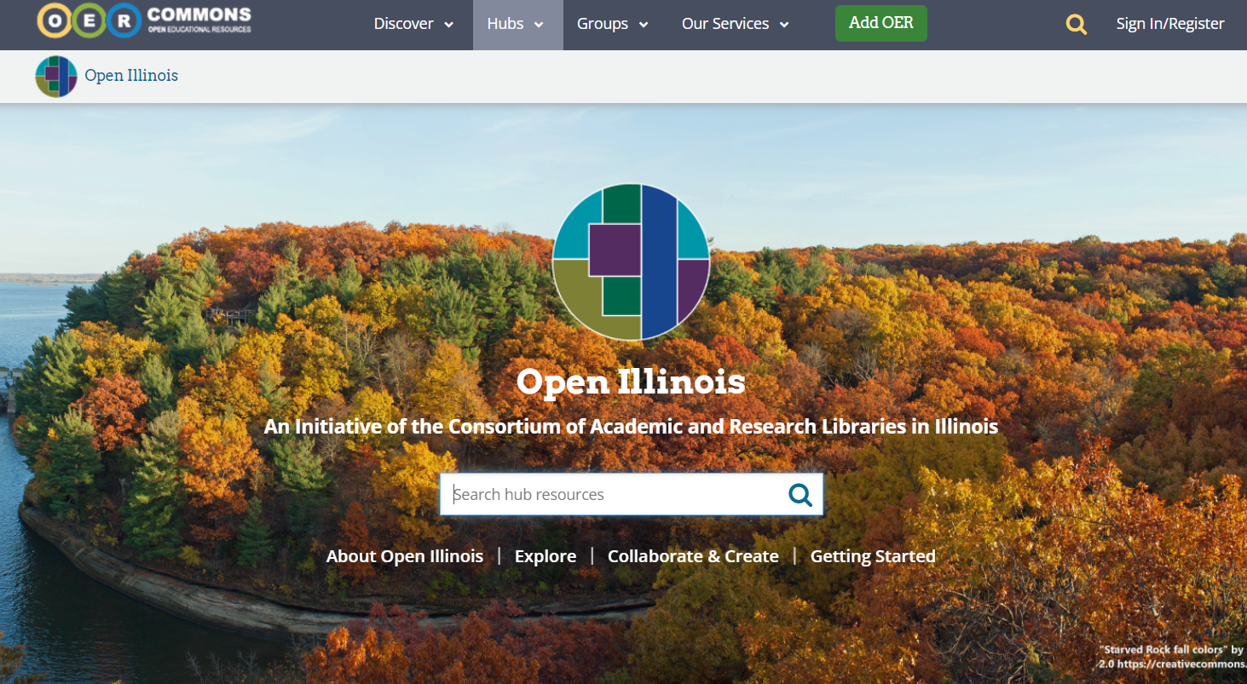
Open Illinois Hub on OER Commons
https://www.oercommons.org/hubs/openillinois

Slide 8
Why OER Commons?
Why OER Commons?
Unique combination of features including:
Searching/Repository/Authoring
Allows for statewide branding as well as institutional branding
Collaboration Space
Reasonable pricing for features (paid by CARLI)

Slide 9
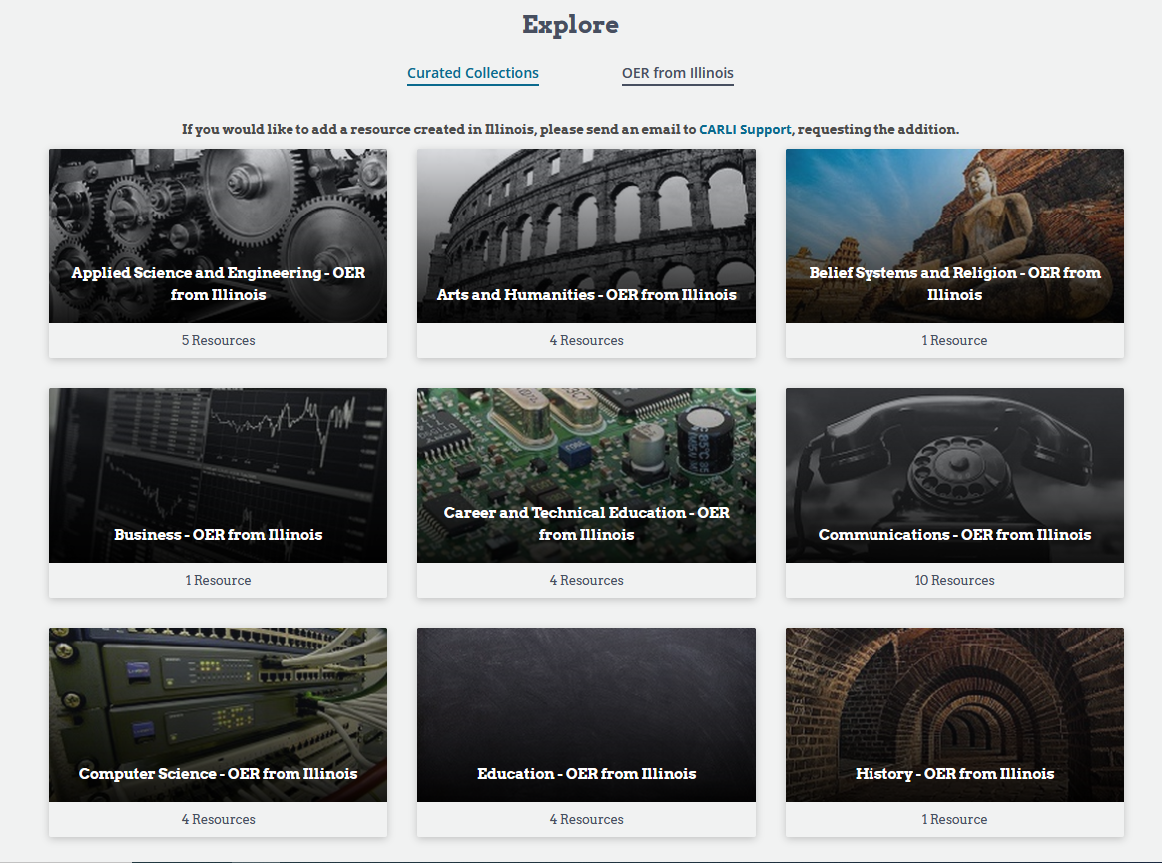
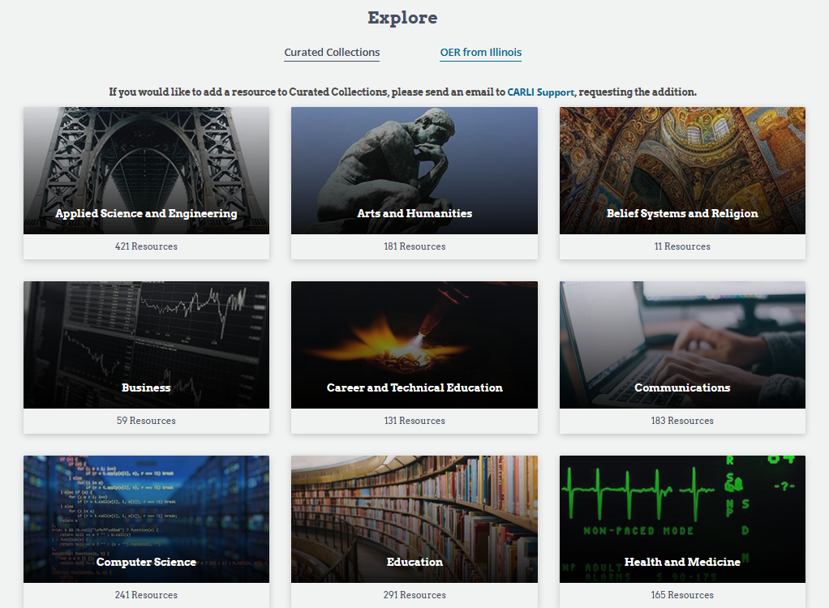
Explore – OER from Illinois

Slide 10
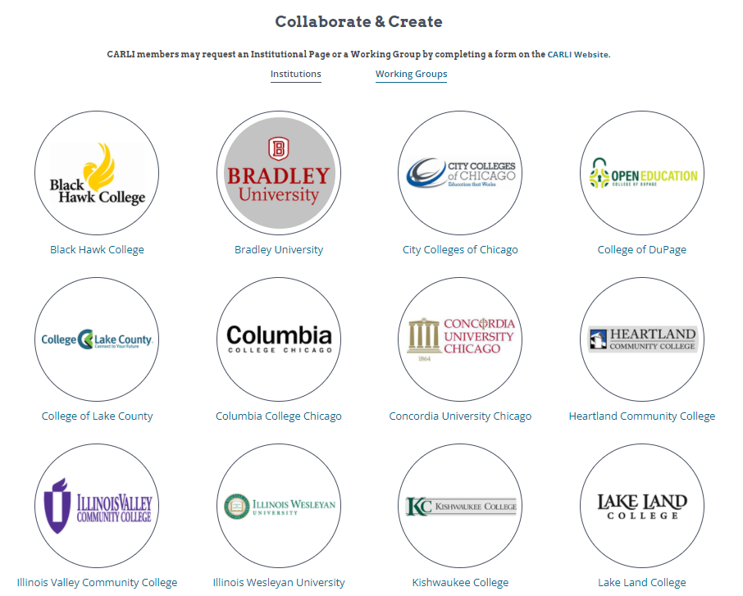
Collaborate & Create - Institutions

Slide 11
Why the Open Textbooks Pilot Program?
Approached by our members
Able to work at scale
Able to insure statewide participation
Illinois SCOERs
FIPSE

Slide 12
Goals and objectives
Eliminate textbook costs for high-enrollment courses in the focus area in CARLI member institutions
Improve student learning outcomes by increasing the use of open-source materials by including personal learning experiences
Develop local expertise about OER and ancillaries creation, publishing, dissemination, adoption, and use
Create a scalable OER model that can be replicated across multiple disciplines and institutions

Slide 13
True statewide collaboration
Partners include:
Illinois Board of Higher Education
Illinois Community College Board
Illinois Department of Commerce and Economic Opportunity
Illinois Library Association
University of Illinois Division of Disability Resources and Educational Services
University of Illinois Press
Illinois Secretary of State/Illinois State Library
Health Sciences Librarians of Illinois
CARLI’s OER Committee
CARLI’s member institutions

Slide 14
Eligibility
CARLI Governing Members
Application teams (“workgroups”) can include institutions that are not CARLI Governing Members
Workgroups must include:
One librarian/library staff member who will serve as sub-grant coordinator
At least one subject matter specialist or author
One instructional designer
One 3D printing coordinator
One copyright coordinator
One accessibility coordinator
One proofreader
One industry/sector representative
This Image by International Livestock Research Institute is licensed under CC BY-NC-SA 2.0

Slide 15
Thanks to CONGRESS and ED/Fund for the Improvement of Postsecondary Education
Illinois SCOERs
Competitive sub-awards available in the focus area:
The Human Condition: Care, Development, and Lifespan
A minimum of eight peer-reviewed OER textbooks/ancillary materials will be developed
One of several FIPSE grants who initially received partial funding and later made whole

Slide 16
Round One
Nine Subgrant Awards
Thirteen institutions
Statewide representation
Round Two

Slide 17
Nine Round One Subgrant Awards
Chemistry
Roosevelt University, DePaul University, and Harper College,
“Development and Implementation of Open-Access Problems and Activities for Health-Focused Chemistry Courses”
Nursing/Health
Illinois Central College, “Nurse Assistant Training OER”
University of Illinois Chicago, “Advancing Open Educational ReSources and Visual Pedagogy for DIverRse StudEnts: ASPIRE”
University of Illinois Urbana-Champaign Carle College of Medicine and Knox College, “The Female Reproductive System and Women’s Health Through a Multidisciplinary Lens”
Psychology
City Colleges of Chicago, Olive-Harvey College, “Institutional Strategies for Increasing Student Success: Equity and Open Educational Resources”
Morton College, “Diverse Approach to Language Development”
University of Illinois Springfield, “The Psychology of Exceptional Children”
Physical Therapy
Southern Illinois University Carbondale, “Anatomy and Physiology for Allied Health Professions”
Public Administration
National Louis University, “Cultural Humility in Public Administration”

Slide 18
Model for Promoting OER Creation
Get the word out about the grant
Interviews and email campaign
Workshops
Walk potential applicants through the application process
Instructional Design, 3D printing, Accessibility, Copyright/Creative Commons
Foster collaboration
Slack channel
MeetGreetCollaborate
Weekly office hours
Answer questions, offer guidance
Support for applicants prior to award
Meet individually with each sub-grant team to discuss progress

Slide 19
What have we learned?
Practicalities
Regularly offering a variety of educational programs about OER must be supported and maintained
Changing the paradigm for educational materials is intensive
Looking to the future as part of the present
Logistics
Communication with membership is key
Team-based implementation has been very helpful
Moving forward
Continue to apply what we learn to future efforts
Working for state-based legislative initiatives

Slide 20
“Starved Rock State Park”
photo by Tom Shockey
is licensed under CC BY 2.0
Thank you!
Elizabeth Clarage
Michele Leigh
Nicole Swanson
Contact us:
support@carli.illinois.edu
This presentation is created by the Consortium of Academic and Research Libraries in Illinois is © 2022
by the Board of Trustees of the University of Illinois System and is released under a CC-BY 4.0

