Slide 1


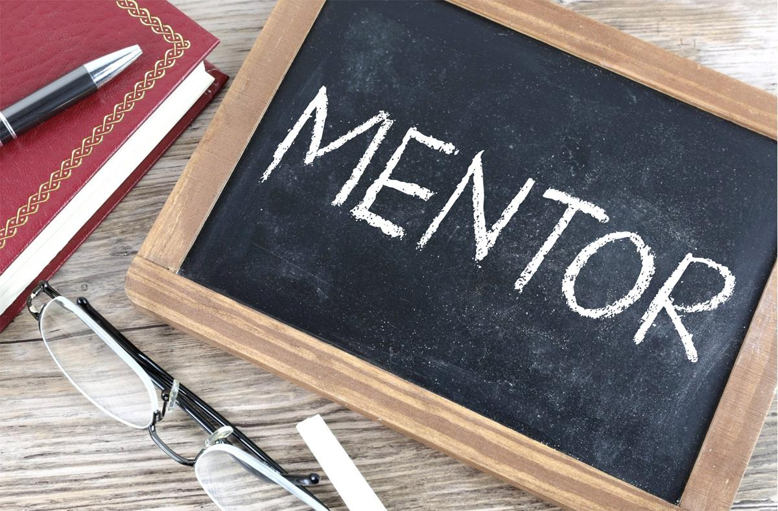
Giving a Hand Up:
Why Mentorship Matters
Tammie Busch and Susan Howell
Mentor by Nick Youngson
CC BY-SA 3.0 Alpha Stock Images
Zoom’s live transcript is available on the Show Captions menu.

Slide 2
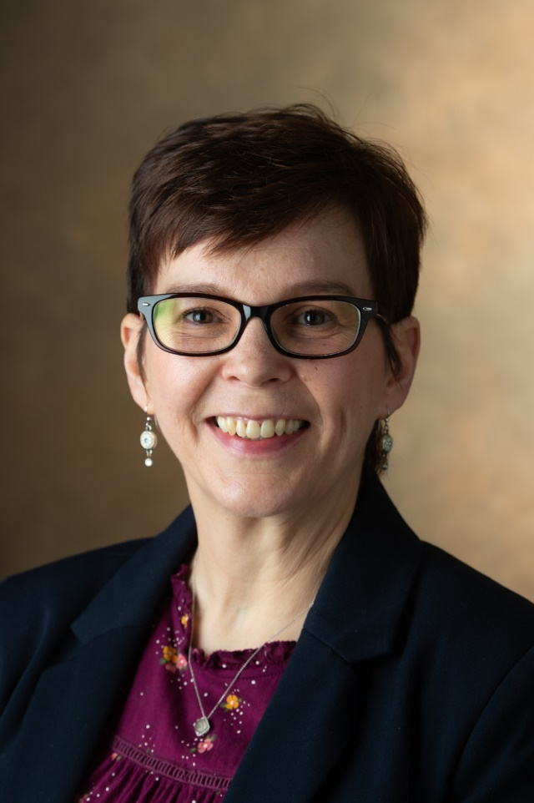
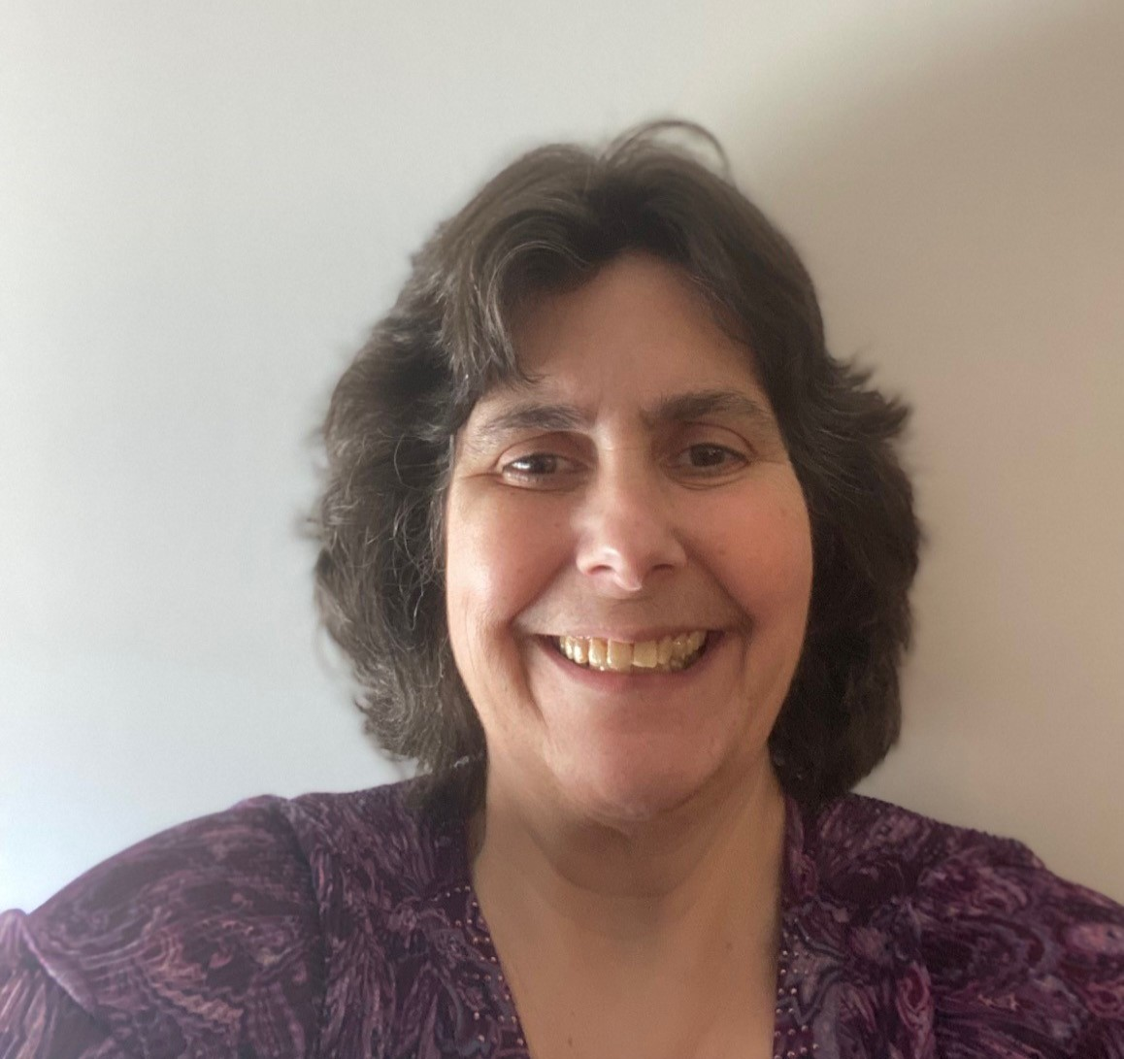
Introductions
Tammie Busch
Asst. Prof., Catalog & Metadata Librarian
Southern Illinois University Edwardsville
Susan Howell
Asst. Prof., Cataloging & Metadata Librarian
Southern Illinois University Carbondale

Slide 3

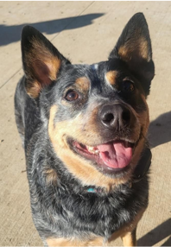
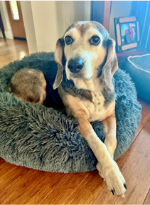
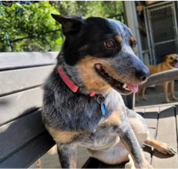
Backstory
Sadie Howell
Ellie Howell
Nancy Busch

Slide 4
The Experiences of Tenure-track Librarians Who Supervise: A Balancing Act
In what ways do the responsibilities of tenure-track librarians who supervise staff impact the amount of time they are able to devote to the requirements of tenure?

Slide 5

What we learned
Focus group participants felt more successful when provided mentorship with both supervision duties and getting started with scholarship.

Slide 6

What is a mentor?
a trusted counselor or guide
Wooden Man With Question Mark Speech Bubble by christianchan/Adobe Stock

Slide 7

Benefits of Mentorship

Slide 8
Benefits of Mentorship
Helps new tenure track librarians be successful and can have long lasting effects in higher levels of job satisfaction later.
“Participation in mentorship programs involves valuable help with professional, often tenure related activities on the part of mentees, such as publishing peer-reviewed articles and joining national organizations. Program benefits also included less tangible effects such as increased understanding of institutional culture and improved communication and time management skills, all of which are crucial for librarians pursuing tenure.” (Goodsett & Walsh (2015)

Slide 9

Four themes that emerged:
Gives new tenure track librarians a start with research, scholarship, and service.
Gives new tenure track librarians a good start on their path towards attaining tenure.
Gives new tenure track librarians someone to talk to and get advice from.
Can offer support to help develop management and supervisory skills.

Slide 10

Tenured Focus Group Participant #2 on research
“I moved into a tenure track position and had no idea what to do and I'm the only cataloger. I would have loved to have had some sort of mentorship or collegial support in terms of, you know, writing. We have a bunch of reference librarians who co-author papers all the time. I didn't have that opportunity, and I really wished that I could have somehow been connected with somebody to get me started on that process.”

Slide 11
Mentorship helps new librarians get started with research by
Stay
Stay focused on a research agenda.
Recommend
Recommend topics for publication.
Share
Share publication opportunities.
Offer
Offer advice about balancing obligations.
Help
Help construct timelines.
Help
Help with editing.
Collaborate
Collaborate with the mentee on research projects.

Slide 12
Research Committees
Share calls for papers and presentations.
Disseminate information about grant funding.
Share information about resources on campus.
Offer informational sessions.
Opportunity to meet others.

Slide 13
Support & Collaboration
“Having a mentor program may be indicative of a supportive, conducive environment in general.” (Vitz & Poremski )
“Research can only benefit from conversation, collaborations and the development of intellectual communities between generations of diverse and unique academic librarians.” (Sassen & Wahl)

Slide 14

Roadmap to tenure
"Help you get through the red tape, help you fill out the right forms, help you stay on track.”
“A better mentor program [would provide a] less vague roadmap toward tenure. What is really expected instead of, 'Just do as much as you can.'”
“I was given no direction on what your portfolio should look like.”

Slide 15

Confidant... what our participants had to say:
“It’s nice that we can have a conversation and talk not only about our work components, but also about what other issues they’re seeing along the way.”
“I find that my faculty mentor is incredibly supportive and someone who I can always reach out to and be very candid and frank with.”

Slide 16

Support for supervisors
“No one in technical services in our library wants to be a supervisor, even though we all are. I wish that we had a bigger mentor program at our university. They didn’t like supervising, so I had to figure out all that stuff on my own.”

Slide 17

How To Find a Mentor
Creator: GOCMEN | Credit: Getty Images/iStockphoto

Slide 18
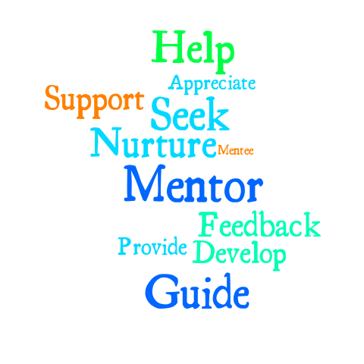
Types of Mentoring
Formal mentoring relationships are arranged and supported by the library or other organization.
Informal mentoring relationships occur outside of organized programs and may develop spontaneously.
Both situations provide guidance, advice, feedback, and support.
This Photo by Unknown author is licensed under CC BY-NC-ND.

Slide 19
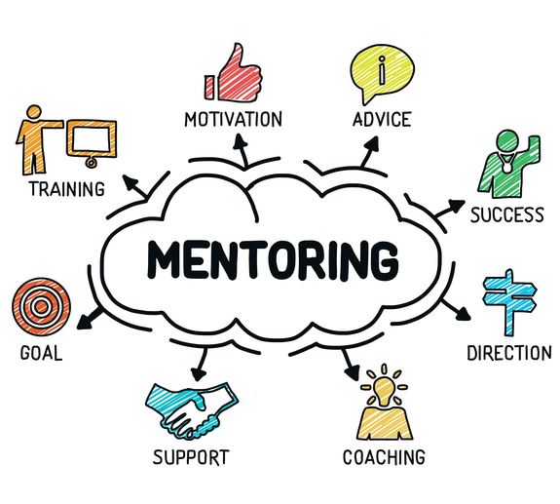
Traditional mentoring is typically a relationship between a senior and junior employee.
Outside of this model, other examples of mentorship programs include group mentorship, reverse mentorship, team mentorship, and mentoring up.
Regardless of the model, "programs are more likely to be successful if plans are well-defined, feedback is sought from participants, and programs are modified in response to feedback (Sassen and Wahl, 2014).”
This Photo by Unknown author is licensed under CC BY-NC-ND.

Slide 20

Formal Mentorship in Libraries
Strothmann and Ohler (2011) found that formal mentoring programs in libraries are widely recommended in literature but were reported to be available by only 22.2% (n=199) of their survey respondents.
Goodsett and Walsh (2015) found that more than half (60%, n = 96) of their respondents indicated that their library did not have a formal or informal mentoring program beyond new librarian training.
Things might be different at an R1 university. Couture, Gerke, and Knievel (2020) reported that 80.11 % (n = 270) of respondents indicated that their libraries provide formal mentoring.
This Photo by Unknown author is licensed under CC BY-NC-ND.

Slide 21




Professional Organization Mentorship
Individual libraries can provide closely tailored support, but professional library organizations are uniquely positioned to reach a wider swath of librarians.... This may be vital for librarians who have fewer opportunities or who have diﬃculty ﬁnding informal mentors or collaborators in their own libraries (Ackerman 2018).

Slide 22

What did our focus group participants say about formal mentoring?
“I think for me it was the ability to participate outside my library activities and committees and get more involved in ALA and ACRL and the cataloging groups statewide that were going to really help me not only with maybe finding mentors or colleagues … but also keep me abreast of national trends and what was going on in cataloging.”
This Photo by Unknown author is licensed under CC BY-SA-NC.

Slide 23
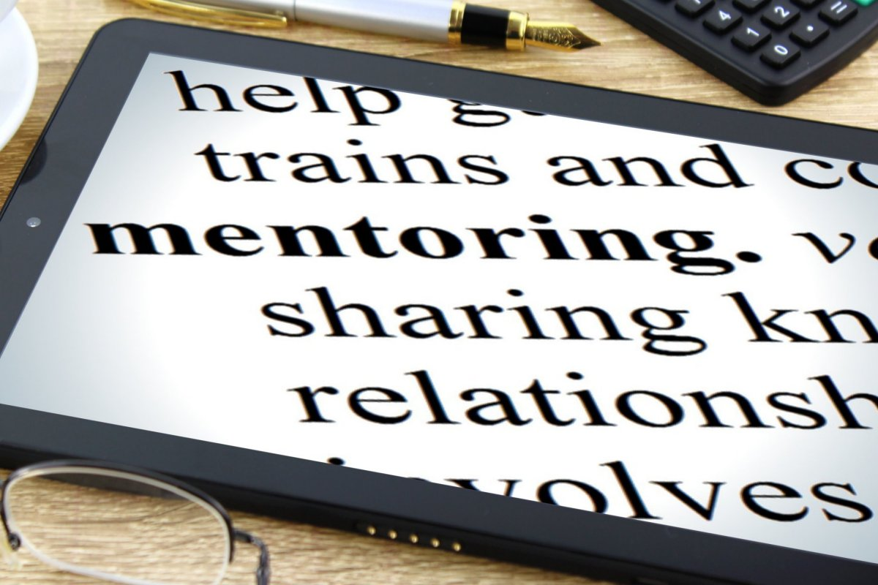
Informal Mentorship
“Informal mentorship is a supportive relationship that offers benefits commonly associated with formal mentorship. It does not require long-term commitment or clear goal setting, a specific hierarchical relationship between mentor and mentee, or for contact to occur over a specific medium. It does require two people who are willing to work together in a mutually acceptable way to address the concerns of the mentee, and to share relevant knowledge, expertise, and wisdom (James, Raynor, and Bruno, 2015).”
This Photo by Unknown author is licensed under CC BY-SA.

Slide 24
What did our focus group participants say about informal mentoring?
“... we organized programs and talked, had sort of peer mentoring …. The fact that we were able to have these discussions and to organize programs and do peer mentoring meant that we were actually, I think, quite supported.”
This Photo by Unknown author is licensed under CC BY-SA-NC.

Slide 25

How To Be a Mentor
Single red toy pawn figure in opposition to a group of yellow figures by MichaelJayBerlin/Can Stock Photo

Slide 26
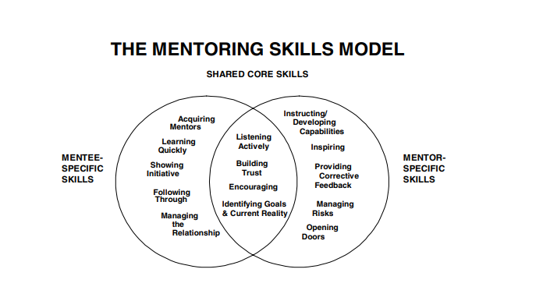
Phillips-Jones, L. (2003). Skills for successful mentoring: competencies of outstanding mentors and mentees. CCC/The Mentoring Group. https://my.lerner.udel.edu/wp-content/uploads/Skills_for_Sucessful_Mentoring.pdf

Slide 27
Mentoring Competency Assessment (MCA)
A self-reflective 26-item skills inventory that enables mentors and mentees to evaluate six competencies of mentors: maintaining effective communication, aligning expectations, assessing understanding, addressing diversity, fostering independence, and promoting professional development.
Mentee MCA for Self-reflection: https://uwmadison.co1.qualtrics.com/jfe/form/SV_cZ5jT2DdKYxE66V?Q_JFE=qdg
Mentor MCA for Self-Reflection: https://uwmadison.co1.qualtrics.com/jfe/form/SV_5jMT4fhemifK01n?Q_JFE=qdg

Slide 28
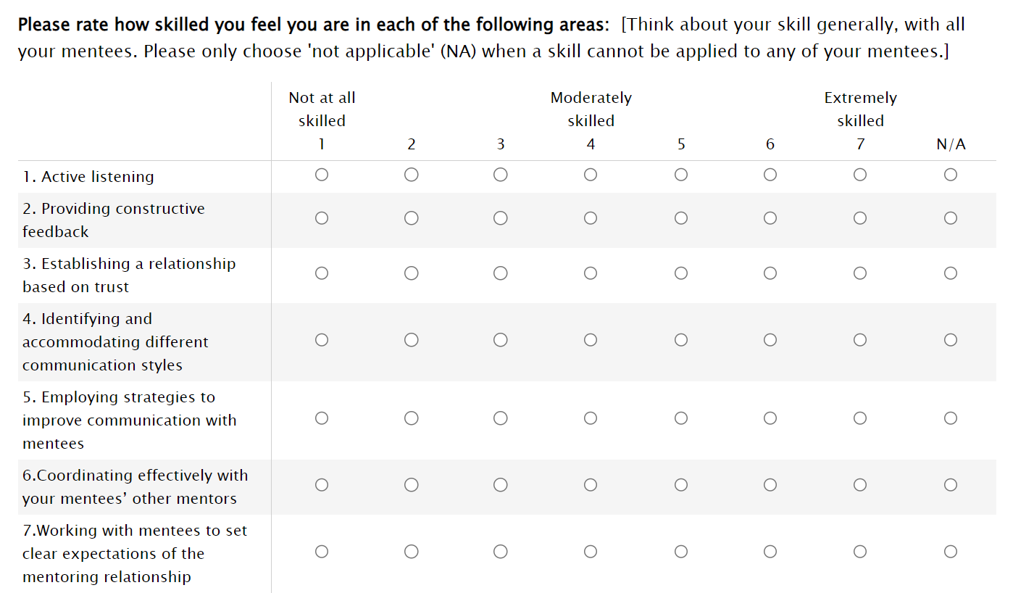

Slide 29
Focus Group Final Words
GOOD MENTORSHIP:
“It's always important to actively mentor. I always look for signs that one of my paraprofessional staff would be a good professional librarian. We benefit when they go through that kind of training, even it if means they don't stay with us as long."
NOT GOOD MENTORSHIP:
“I have tenure and I struggled so you need to get through your own struggle.”
This Photo by Unknown author is licensed under CC BY-SA-NC.

Slide 30

Seize the moment.
Opportunities abound for mentors and mentees.

Slide 31

In what ways have you received or provided mentorship?
This Photo by Unknown author is licensed under CC BY-NC-ND.

Slide 32
Your Responses:
TAG | FORMAL/ INFORMAL | NUMBER
Student mentoring | Informal | 3
Peer mentoring | Informal | 2
Cohort mentoring | Informal | 2
Staff mentoring | Informal | 2
Networking | Informal | 2
New hires | Informal | 1
Library professional organization | Formal | 1

Slide 33
Your experiences:
"I started a networking group for library Administrative Assistant professionals."
"A person in a mid-level role demonstrating call-out and call-in behavior when folks higher on the organizational chart do something problematic. This has served as a model for lower-level personnel to see how they too can speak up as well as show that leaders are open to apologizing, reconsidering, learning more, etc. (or not, unfortunately)."
"Cohort mentoring takes the form of activities, professional development, and social gatherings."

Slide 34
"I receive mentorship through an innovative program offered through the Wisconsin Library Association ALA Chapter. I am a public library employee looking for full time work in the library field and my mentor happens to be a director of a library system (2 counties, about 24 libraries). She helps in many ways, reviewing resumes and cover letters to general advice. I observed her lobby at Library Legislative Day. Also, the WLA offers training called LDI-Leadership Development Institute with mainly library director participation. I am not a library director, but I learned a lot of great communication and organizational information and it is a great way to network also."

Slide 35
References
Cambridge Advanced Learner's Dictionary & Thesaurus © Cambridge University Press. (n.d.). Mentor. In Cambridge Advanced Learner's Dictionary & Thesaurus. Retrieved October 16, 2023, from https://dictionary.cambridge.org/us/dictionary/english/mentorship
Fleming, M., House, S., Hanson, V. S., Yu, L., Garbutt, J., McGee, R., Kroenke, K., Abedin, Z., & Rubio, D. M. The mentoring competency assessment: Validation of a new instrument to evaluate skills of research mentors. Academic Medicine: Journal of the Association of American Medical Colleges, 88(7), 1002-1008, July 2013. | DOI: 10.1097/ACM.0b013e318295e298
Goodsett, M., & Walsh, A. (2015). Building a strong foundation: Mentoring programs for novice tenure-track librarians in academic libraries. College & Research Libraries, 76(7), 914-933.
Heady, C., Fyn, A. F., Kaufman, A. F., Hosier, A. & Weber, M. (2020) Contributory factors to academic librarian turnover: A mixed-methods study. Journal of Library Administration, 60(6), 579-599. DOI: 10.1080/01930826.2020.1748425
Hughes, C. (2018). A change of pace: Successfully transitioning to tenure-track librarianship. Library Leadership & Management, 32(4).
James, J. M., Rayner, A., & Bruno, J. (2015). Are you my mentor? New perspectives and research on informal mentorship. The Journal of Academic Librarianship, 41(5), 532-539.
Larson, L. R., Duffy, L. N., Fernandez, M., Sturts, J., Gray, J., & Powell, G. M. (2019). Getting started on the tenure track: Challenges and strategies for success. SCHOLE: A Journal of Leisure Studies and Recreation Education, 34(1), 36-51.
Rooney, M. P. (2010). The current state of middle management preparation, training, and development in academic libraries. The Journal of Academic Librarianship, 36(5), 383-393.
Sassen, C., & Wahl, D. (2014). Fostering research and publication in academic libraries. College & Research Libraries, 75(4), 458-491.
Strothmann, M., & Angie Ohler, L. (2011). Retaining academic librarians: by chance or by design? Library management, 32(3), 191-208.
Vilz, A. J., & Poremski, M. D. (2015). Perceptions of support systems for tenure-track librarians. College & Undergraduate Libraries, 22(2), 149-166.

Slide 36
Questions? Comments?
Contact Information
Tammie Busch
Assistant Professor, Catalog & Metadata Librarian
Southern Illinois University Edwardsville
tabusch@siue.edu
Susan Howell
Assistant Professor, Cataloging & Metadata Librarian
Southern Illinois University Carbondale
showell@lib.siu.edu

