Slide 1

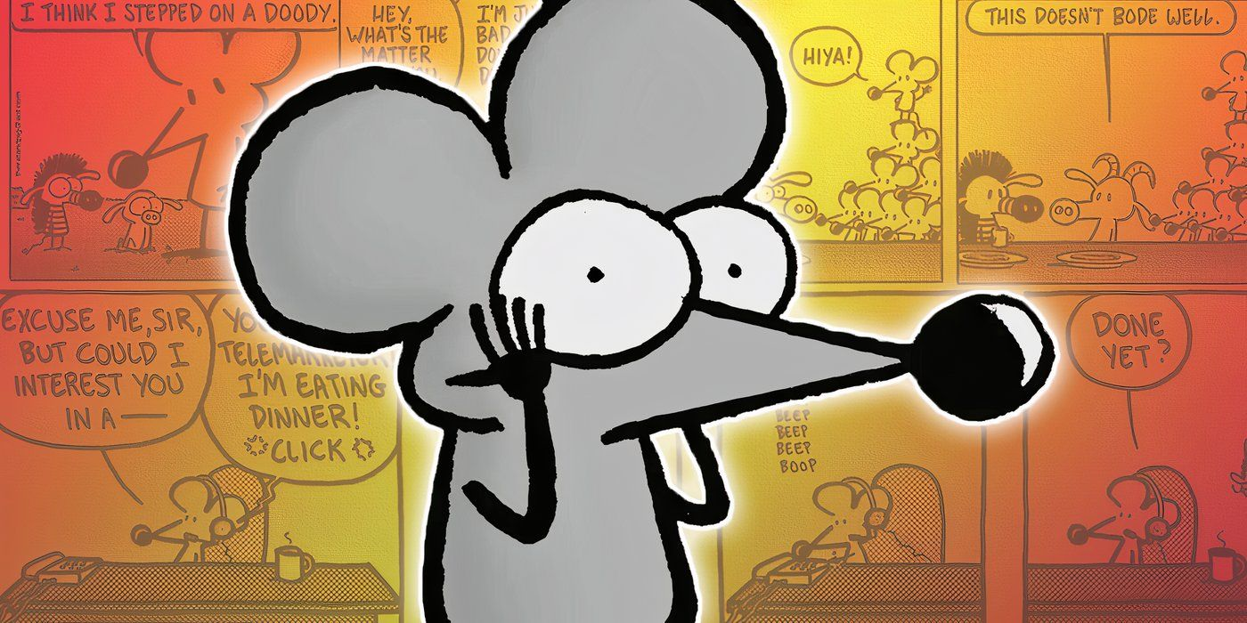


ADA Title II Toolkit for Libraries
Accessible Documents and Emails
Mark McCarthy, MSIM, IADP, CPWA
Zoom’s live transcript is available on the Show Captions menu.
BG: Pearls Before Swine by Stephan Pastis

Slide 2

Agenda
What defines disability?
Language perspectives
The meat and potatoes: Word
Headings
Lists
Images
Readability
Oh my!
Securing documents and PDF discussion
Accommodation statements
Specific Qs to A
Summary
Wrap-up/Q&A

Slide 3
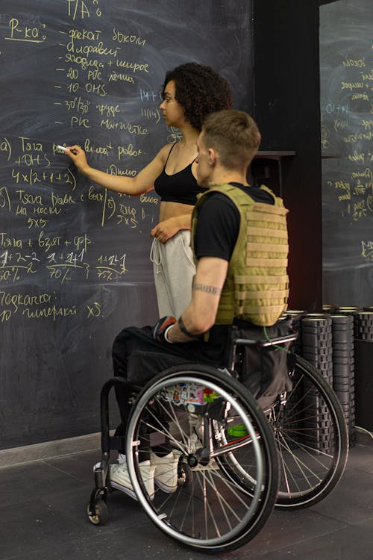
Disability?
The ADA defines a person with a disability as a “person who has a physical or mental impairment that substantially limits one or more major life activities, a person who has a history or record of such an impairment, or a person who is perceived by others as having such an impairment. [It] does not specifically name all of the impairments that are covered.”
Likely more people than you think live with disabilities!
About 16% of the world’s population – that’s 1.3 BILLION people – live with a disability.
That’s more than the entire population of Europe, and only a little less than all of China!
The CDC estimates about 29% of Americans – almost 1 in 3 – live with a disability. That’s 10x the size of NYC, and this number is probably low!
Disabilities can be mixed and matched or taken à la carte!
Disabled folks are the worlds’ majority minority.
It’s not a bad word!
Photo via Anna Shvets on Pexels

Slide 4
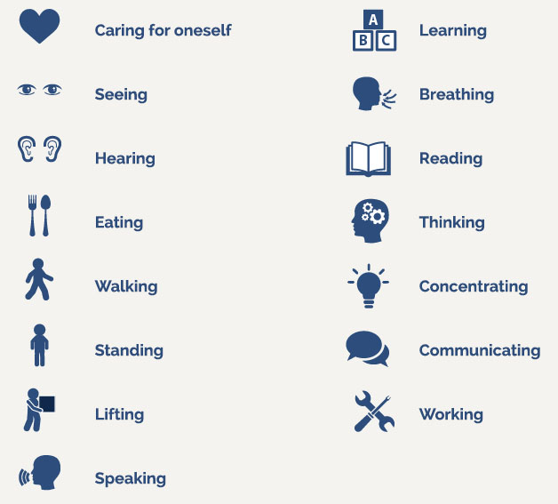
Major life activities?
Major life activities, or activities of daily living, can include things like, but are not limited to:
Self-care
Eating
Hearing
Seeing
Walking
Speaking
Thinking
h/t Lindsay Haitz
Photo via The CP Lawyer, 2021

Slide 5
Person-First Language
Person with a disability
Individual with _____ (e.g., epilepsy, psychiatric disability, intellectual disability, mental illness, etc.)
Person who is ____ (e.g., deaf, blind, hard of hearing)
Individual who uses a ____ (e.g., wheelchair, cane, walker)
Person who has _____ (e.g., depression, anxiety, ADHD)
H/t Lindsay Haitz

Slide 6
Identity-First Language
Some individuals prefer Identity-First language
Disabled Person
Deaf Person (Big D refers to Deaf culture, little d refers to medical condition of deafness)
Autistic Person
Some things to think about…
There will always be exceptions;
Ask if you are in a position to ask (“May I ask about…?”);
When referring to a broad community use default language most commonly used by members of the community (not parents or allies);
Pay attention to how the person refers to themselves;
Ask how they would like to be referred to.
This is a lot like, and intersects with, interacting with queer folx!
H/t Lindsay Haitz

Slide 7
Word is Powerful!
Word can do a LOT, maybe more than you thought!
Headings
Lists
Image support
Formatting and styling
Security, or the illusion of…
This presentation is great reference material!
(I apologize in advance for the coming deluge of Microsoft terms…)

Slide 8
Headings
Headings are important for a variety of reasons.
Provides a sight-dependent user the means to quickly scan and chunk a page.
Gives a screen reader user (remember not all of them are blind) the ability to quickly jump between them via keyboard.
Gives everyone access to Word’s Navigation Pane, allowing quick parsing of long documents.
There are 6 heading levels to use, Heading 1 only being used once. * In most standard cases. It can sometimes be used twice.

Slide 9
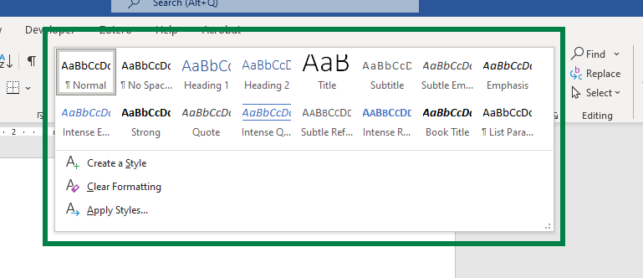
Awesome, how do I use headings?
When in Word:
Find your Ribbon at the top of the window.
Under the Home tab of the Ribbon, find the Styles pane.
Select the heading you want to use!
Feel free to restyle it with different (contrasty) colors or different (legible) fonts.
More heading levels will appear as you use them!
Note: For access improvements, don’t use the other styles options – they do not provide the same meaning as H1-H6.
Notably, the “Title” style used to (may still) appear in a PDF as an H4. Don’t ask why.

Slide 10
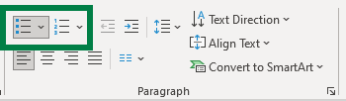
Lists
You may be more familiar with lists, since Word nudges you to use them.
Unordered lists (like this one, with bullets) are useful for information where the order doesn’t matter.
Think about ingredients for a recipe.
Ordered lists (with numbers) are useful where order matters.
Think about the steps to a recipe.
Chunks up information, making it easier to parse and read than if it was in a narrative format.

Slide 11
Can I see an example?
Sure! Here’s the same content, in paragraph form.
You may be more familiar with lists, since Word nudges you to use them. Unordered lists (like this one, with bullets) are useful for information where the order doesn’t matter. Think about ingredients for a recipe. Ordered lists (with numbers) are useful where order matters. Think about the steps to a recipe. Chunks up information, making it easier to parse and read than if it was in a narrative format.

Slide 12
Images
Feel free to use images in your documents! Just a few things:
Does your image contain text? Make sure it’s legible and contrasty, or (better) written out in the document.
Does your image have a meaning, or is it just for fluff?
If it has meaning, it needs alternative text! Right-click your image or access it from the Selection Pane, choose Edit Alt Text, and include your description.
Think about how and what you would describe to someone on the phone.
If it is for fluff, it’s decorative! Same steps as before but check the Mark as Decorative checkbox.
This goes for shapes (like the lines and shapes in this presentation) too.

Slide 13


Logos
Logos are informative! They mean something.
Use alt text to describe the first instance of your logo.
You don’t have to describe them in detail, generally just what they convey.
You might describe this as “University of Illinois System wordmark”
Similarly, this would be “US Centers for Disease Control and Prevention logo”
Subsequent logos can be marked as decorative.

Slide 14
Logos, con’t
Context still matters! Some logos may be very descriptive. For instance:
“An incomplete sphere made of large, white jigsaw puzzle pieces. Each puzzle piece contains one glyph from a different writing system, with each glyph written in black.”
However, this has no context on its own in this case. We would use “Wikipedia logo” in this presentation.

Slide 15
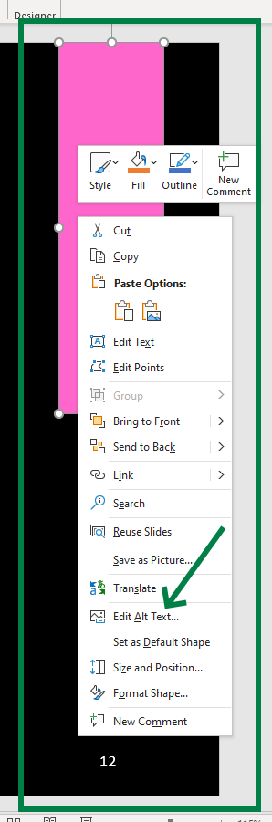
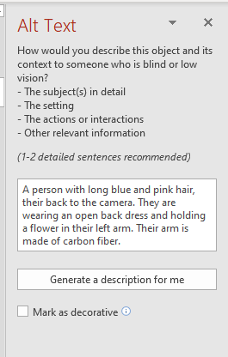
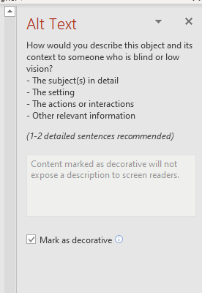
How to describe an image
Find the image you’d like to describe,
Right click, or access via the selection pane, and choose “Edit Alt Text”
Use your desired method!
Note: Do not rely on Word’s automatically generated text. It’s gotten better than it used to be, but is generally not accurate enough to be relied on. It can be a good starting point.

Slide 16
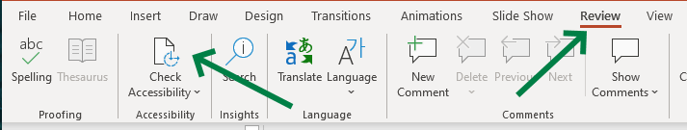
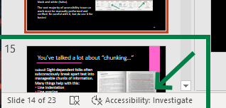
Use the Accessibility Checker!
Since Office 365 came onto the scene, Office software includes an accessibility checking tool! BUT: it’s very basic. It can,
check some color contrast issues,
remind you about describing images,
remind you about reading order,
and a few other select tasks.
Computers are remarkably inept at solving most accessibility issues, unless they’re black and white (ha ha – contrast joke).
The vast majority of accessibility issues or work must be manually performed and verified. Be careful with it, but do use it for basics!
To use it:
Find the Review tab of your Ribbon.
Select “Check Accessibility.”
It can also be clicked on inside the bottom status bar.

Slide 17
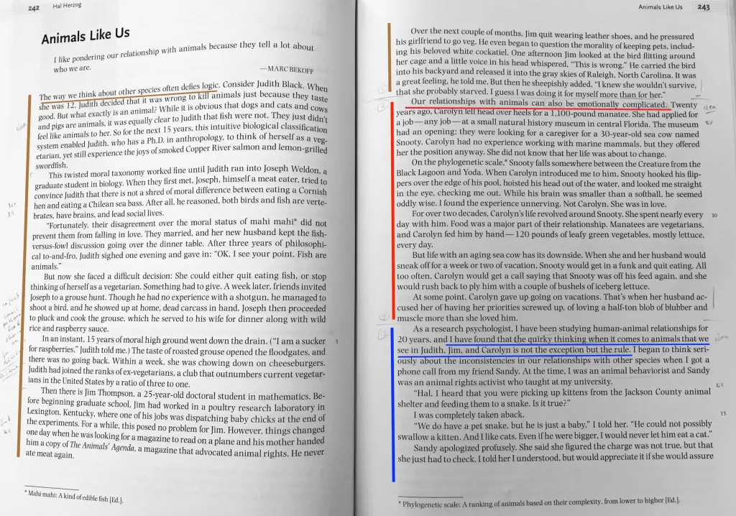
You’ve talked a lot about “chunking…”
Indeed! Sight-dependent folks often subconsciously break apart text into manageable chunks of information. Many things help with this:
Line indentation
Line spacing
Headings
Font size
Font face
Sentence length
Photo via Dr. Eric Drown @ University of New England

Slide 18
Chunking, now I’m getting it…
Here are some tips to help! Especially if your documents will be printed and displayed. vs. accessing the Word document directly.
Use Tabs* to indent your lines.
Try to break apart paragraphs logically.
Use 1.5 (or greater) line spacing.
Keep line lengths to about 70 characters, with some error depending on font size.
*Using Tabs vs. Spaces can be very helpful if someone is accessing your document on a computer, if they have particular settings they use. (This matters more in programming, but good to know anyway.)

Slide 19

A quick note on PDF “security…”
“I use PDFs because they’re more secure!”
“PDFs look nicer.”
“PDF is my favorite acronym.”
I’ve heard it all. PDFs are no more, and perhaps less, secure than Word documents. PDFs are a printer’s (both the profession and 80s hardware) format and were more important before modern word processors existed.
They are almost always less accessible and can take up to an hour per page to make accessible – even by experts.
In short, PDFs SUCK! (Yes, they have a place, but I’m biased today.) (This video is educational I promise.)
Use a DOCX instead. (You can use PDFs if you really want, but that’s another presentation altogether.)
BG via Linus Tech Tips

Slide 20
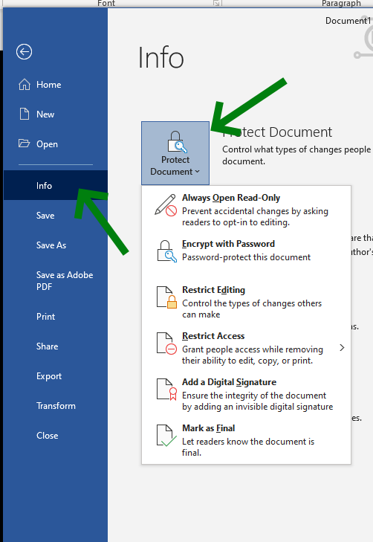
OK smart guy, how do I secure a DOCX?
Word provides many options for restricting access, editing, and more. Under the Info menu in the File tab:
Click Protect Document,
Choose Open Read Only, Mark as Final, Restrict Editing, or Restrict Access.
These all do different things, but if you are concerned about security, Restrict Editing or Access may be the most useful. Word provides explanations for each of these as you use them.
Note: Whether a PDF or DOCX, text can almost always be copied out, or formats modified, by intrepid nefarious individuals.
Note: Some of these options work best with a password.

Slide 21
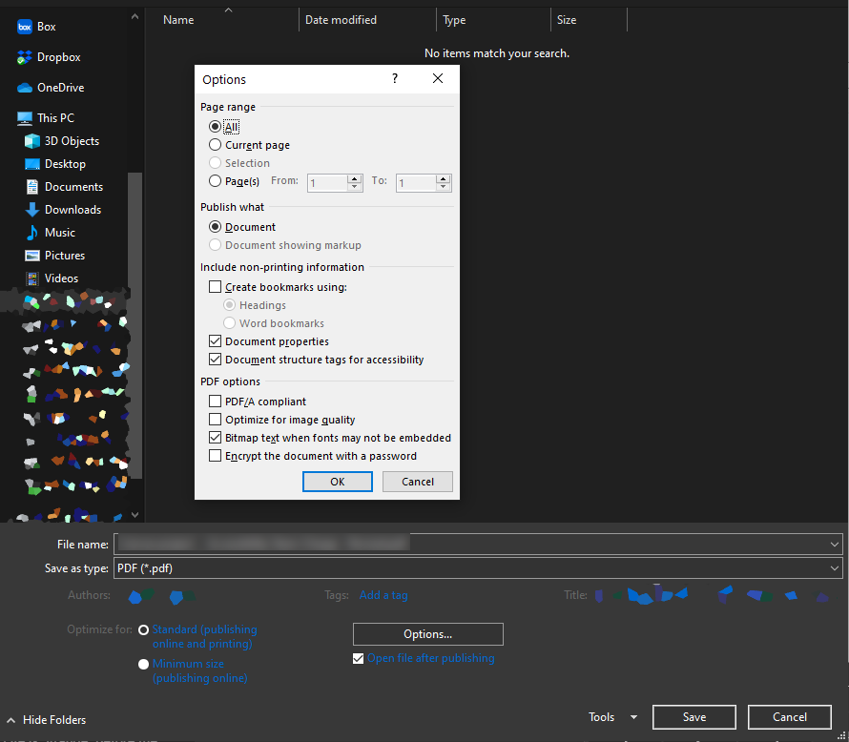
But I need, nay, crave PDFs!
There are times where you must use them, so make sure to produce them the best you can!
Open your File menu,
Choose Save As… then More Options…
NEVER use Save as Adobe PDF
Options… again, then check
Create bookmarks using: [headings]
Document properties
Document structure tags for accessibility
Finally, title and save your document.
This should result in a reasonably but imperfectly accessible PDF.
But please, use a DOCX whenever possible.

Slide 22
So, what about emails?
By and large, all the same rules apply!
This will all vary by email client.
Use lists and headings where available.
Give images appropriate alt text (or describe them).
Make sure links describe where they’re going (no “click here”s.)
Avoid sending ONLY images of text/fliers.
Avoid using tables to line up or lay out information.

Slide 23
On Accommodation Statements
You may not always need them for your documents, but it is good practice to include them in places where documents may be accessed, or on the bottom of flyers, etc.
“If you require any accommodations to more fully participate in this event, please email Gillian Anderson at scully@illinois.edu.”
For questions about accessibility or to request accommodations please contact (name) at (email, phone).
All participants are welcome. If you need disability-related accommodations, please call (number).
May not just be related to disabilities!

Slide 24
In summary:
Word can do a lot!
Use headings, lists, and good formatting
Make sure any images used are described or marked decorative
Use the accessibility checker! Word and PowerPoint provide this in the Review tab of the Ribbon.
But don’t rely on it! It’s only good at basic things.
Restrict your documents as you need.
Make sure you consider alternate formats and needs – try to avoid PDFs.
Provide accommodation statements where necessary!

Slide 25
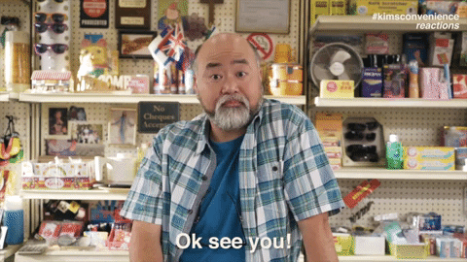
Call me beep me!
Mark McCarthy
Lead Accessibility Engineer
Administrative Information Technology Services
University of Illinois System Office
217-300-3408 | mcmccar2@uillinois.edu
Want more? I’ve got some friends for you!
Interacting with Customers with Disabilities with JJ Pionke (formerly @ UIUC Library)
PDF Accessibility Basics with Christy Blew
Microsoft provides a plethora of Office Accessibility Support resources
UIUC CITL Word Accessibility Guide / UI System Office Word Accessibility Guide
Want to be certified in some accessibility basics (or advanced…s)?
Look into UIUC’s IADP program (I’m an instructor!) or IAAP’s various offerings!
Kim’s Convenience, CBC TV

