Slide 1



ADA Title II Toolkit for Libraries: Accessible PowerPoints and Presentations
BG: Calvin and Hobbes, Bill Watterson
Mark McCarthy, MSIM, IADP, CPWA
9/25/25
Zoom’s live transcript is available on the Show Captions menu.

Slide 2
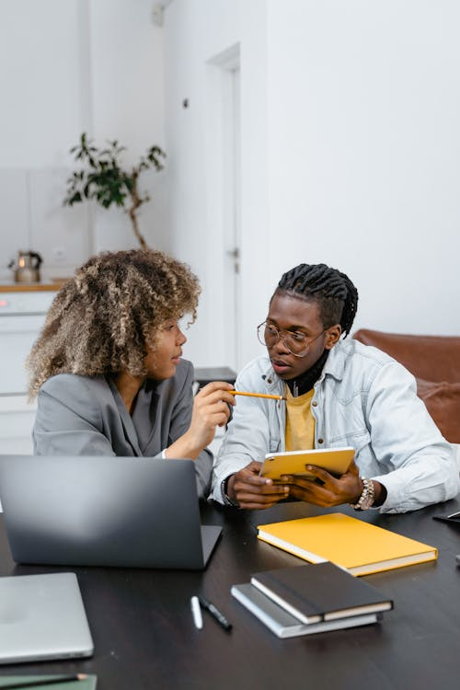
Agenda
What defines disability?
Language perspectives
The meat and potatoes: PowerPoint
Accessible file tips
Accessible presenting/conferencing tips
Wrap-up/Q&A

Slide 3
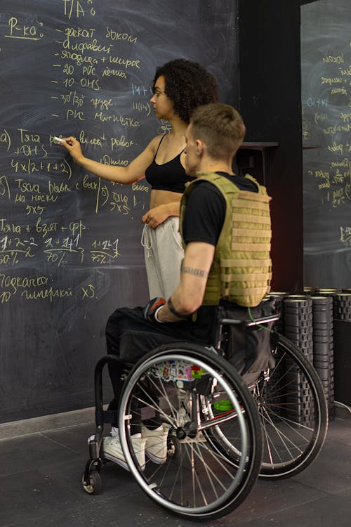
Disability?
The ADA defines a person with a disability as a “person who has a physical or mental impairment that substantially limits one or more major life activities, a person who has a history or record of such an impairment, or a person who is perceived by others as having such an impairment. [It] does not specifically name all of the impairments that are covered.”
Likely more people than you think live with disabilities!
About 16% of the world’s population – that’s 1.3 BILLION people – live with a disability.
That’s more than the entire population of Europe, and only a little less than all of China!
The CDC estimates about 29% of Americans – almost 1 in 3 – live with a disability. That’s 10x the size of NYC, and this number is probably low!
Disabilities can be mixed and matched or taken à la carte!
Disabled folks are the worlds’ majority minority.
It’s not a bad word!

Slide 4
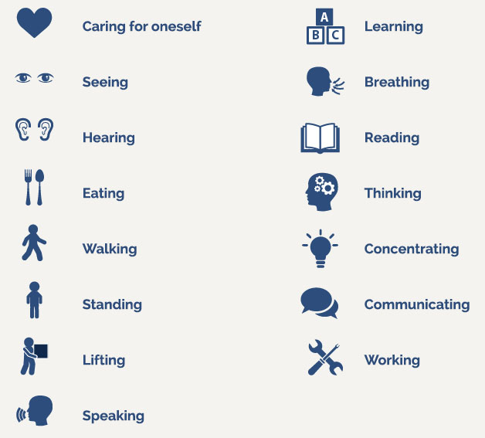
Major life activities?
Major life activities, or activities of daily living, can include things like, but are not limited to:
Self-care
Eating
Hearing
Seeing
Walking
Speaking
Thinking
h/t Lindsay Haitz
Photo via The CP Lawyer, 2021

Slide 5
Person-First Language
Person with a disability
Individual with _____ (e.g., epilepsy, psychiatric disability, intellectual disability, mental illness, etc.)
Person who is ____ (e.g., deaf, blind, hard of hearing)
Individual who uses a ____ (e.g., wheelchair, cane, walker)
Person who has _____ (e.g., depression, anxiety, ADHD)
h/t Lindsay Haitz

Slide 6
Identity-First Language
Some individuals prefer Identity-First language
Disabled Person
Deaf Person (Big D refers to Deaf culture, little d refers to medical condition of deafness)
Autistic Person
Some things to think about…
There will always be exceptions;
Ask if you are in a position to ask (“May I ask about…?”);
When referring to a broad community use default language most commonly used by members of the community (not parents or allies);
Pay attention to how the person refers to themselves;
Ask how they would like to be referred to.
This is a lot like, and intersects with, interacting with queer folx!
h/t Lindsay Haitz

Slide 7
Slide Titles
Slides’ titles are similar to headings in Word and other linear documents.
Use a unique title for each slide.
Multiple slides on the same topic could be numbered, use ”continued,” etc.
”Slide Titles, 2” or “Slide Titles con’t” for instance.
Keep them short and to the point
Makes for easier navigation

Slide 8
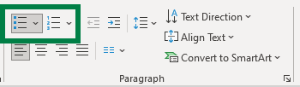
Lists
You may be more familiar with lists, since Word nudges you to use them.
Unordered lists (like this one, with bullets) are useful for information where the order doesn’t matter.
Think about ingredients for a recipe.
Ordered lists (with numbers) are useful where order matters.
Think about the steps to a recipe.
Chunks up information, making it easier to parse and read than if it was in a narrative format.

Slide 9
Can I see an example?
Sure! Here’s the same content, in paragraph form.
“You may be more familiar with lists, since Word nudges you to use them. Unordered lists (like this one, with bullets) are useful for information where the order doesn’t matter. Think about ingredients for a recipe. Ordered lists (with numbers) are useful where order matters. Think about the steps to a recipe. Chunks up information, making it easier to parse and read than if it was in a narrative format.”

Slide 10
Images
Feel free to use images in your documents! Just a few things:
Does your image contain text? Make sure it’s legible and contrasty, or (better) written out in the document.
Does your image have a meaning, or is it just for fluff?
If it has meaning, it needs alternative text! Right-click your image or access it from the Selection Pane, choose Edit Alt Text, and include your description.
Think about how and what you would describe to someone on the phone.
If it is for fluff, it’s decorative! Same steps as before but check the Mark as Decorative checkbox.
This goes for shapes (like the lines and shapes in this presentation) too.

Slide 11
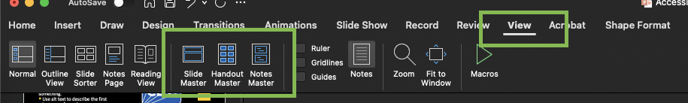
Backgrounds and Designs
Try your best to do all your backgrounds and designing in the Slide Master.
This keeps everything in the “background,” not exposed to AT users.
Less work to keep a consistent look for style.
You can change colors, designs, link styles, bullets, spacing, and more.
Same interface cross-OS.
To open your master slide design:
Find the View tab of your Ribbon.
Select Slide Master.

Slide 12


Logos
Logos are informative! They mean something.
Use alt text to describe the first instance of your logo.
You don’t have to describe them in detail, generally just what they convey.
You might describe this as “University of Illinois System wordmark”
Similarly, this would be “US Centers for Disease Control and Prevention logo”
Subsequent logos can be marked as decorative.

Slide 13
Logos, con’t
Context still matters! Some logos may be very descriptive. For instance:
“An incomplete sphere made of large, white jigsaw puzzle pieces. Each puzzle piece contains one glyph from a different writing system, with each glyph written in black.”
However, this has no context on its own in this case. We would use “Wikipedia logo” in this presentation.

Slide 14
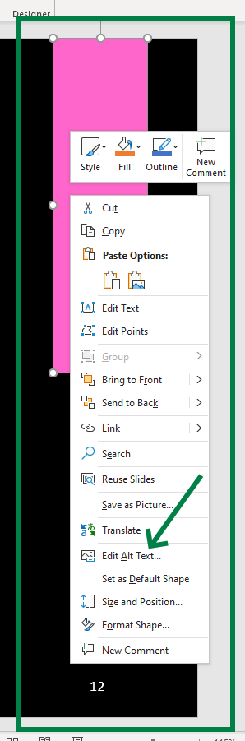
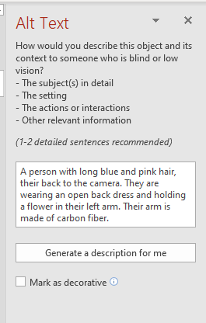
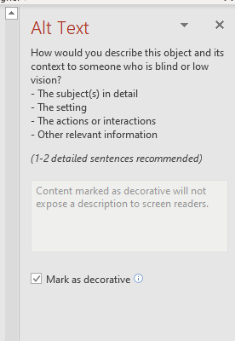
How to describe an image
Find the image you’d like to describe,
Right click, or access via the selection pane, and choose “Edit Alt Text”
Use your desired method!
Note: Do not rely on Word’s automatically generated text. It’s gotten better than it used to be, but is generally not accurate enough to be relied on. It can be a good starting point.

Slide 15
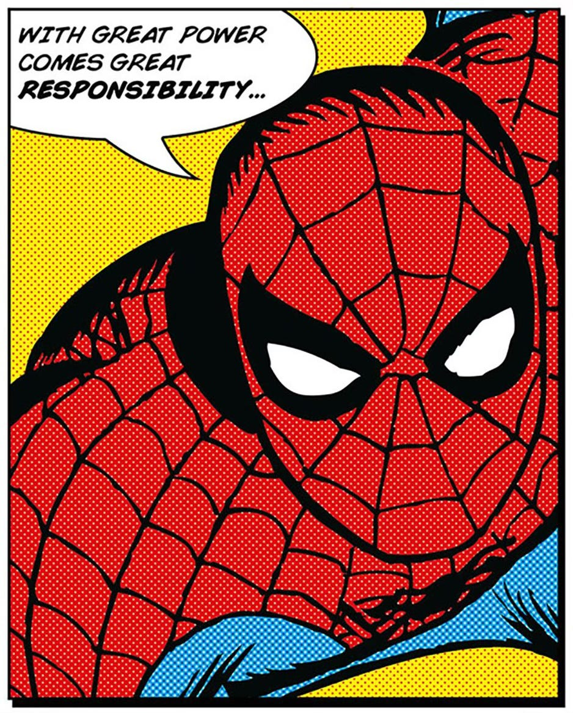
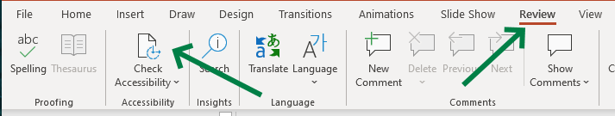
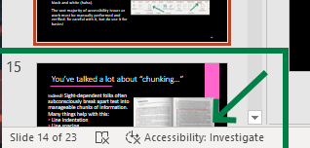
Use the Accessibility Checker!
Since Office 365 came onto the scene, Office software includes an accessibility checking tool! BUT: it’s very basic. It can,
check some color contrast issues,
remind you about describing images,
remind you about reading order,
and a few other select tasks.
Computers are remarkably inept at solving most problems, never mind accessibility ones, unless they’re black and white (ha ha – contrast joke).
The vast majority of accessibility issues or work must be manually performed and verified. Be careful with it, but do use it for basics!
To use it:
Find the Review tab of your Ribbon.
Select “Check Accessibility.”
It can also be clicked on inside the bottom status bar.

Slide 16
Animations and Movement
Try to resist the temptation to make presentations flashy and sparkly!
Keep things simple - beneficial for folks with motion sickness, vertigo, cognitive disabilities.
Easier to construct – win/win!

Slide 17
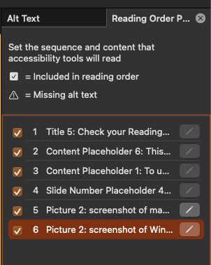
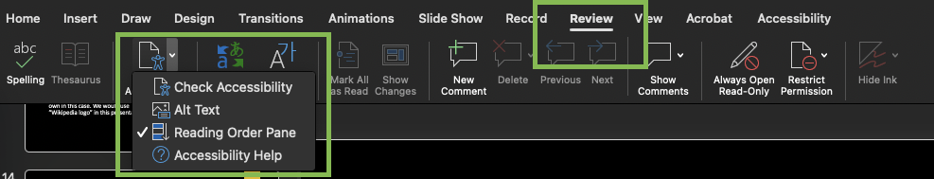
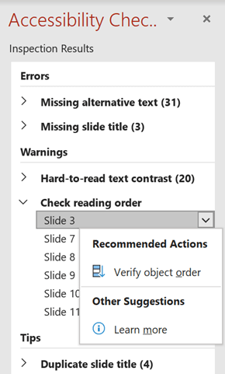
Check your Reading Order
This is the order a screen reader will navigate through your slides.
May not necessarily be in the same visual order.
To use it:
macOS
Find the Review tab of your Ribbon.
Select the “Check Accessibility” menu.
Select Reading Order.
Windows
Find the Review tab of your Ribbon OR select “Check Accessibility” from the status bar.
Select “Check reading order” from the “Warnings” category.

Slide 18
Most of this sounds like Word…
Yep! Office apps in general have many of the same features and facets. You can use many of the same lessons you’ve learned for Word with PowerPoints.

Slide 19

A quick note on PDF “security…”
“I use PDFs because they’re more secure!”
“PDFs look nicer.”
“PDF is my favorite acronym.”
I’ve heard it all. PDFs are no more, and perhaps less, secure than Word (or PowerPoint) documents. PDFs are a printer’s (both the profession and 80s hardware) format and were more important before modern word processors existed.
They are almost always less accessible and can take up to an hour per page to make accessible – even by experts.
In short, PDFs SUCK! (Yes, they have a place, but I’m biased today.) (This video is educational I promise.)
Use a DOCX/PPTX instead. (You can use PDFs if you really want, but that’s another presentation altogether.)
BG via Linus Tech Tips

Slide 20
PowerPoints: What Can We Do?

Slide 21
Someone needs help SEEING 👀
Provide useful alt text for photos and charts.
Export to a readable format (e.g., PPTX).
Ensure you’re using contrasty colors.
Send materials out beforehand.
Set up good, “priority” seating.
Use large font sizes, easy to distinguish font faces.
Check your hardware!
Some projectors will wash out colors, create “halos”, have old lamps/dead LEDs, etc.

Slide 22
Someone needs help HEARING🦻
Use a platform that provides captioning and enable it.
Consider real-time captioning for events!
Ensure any videos used are captioned.
Arrange for Assistive Listening Devices (e.g., hearing loops) if needed.
Provide adequate space for speakers AND interpreters.
Use PowerPoint’s subtitling only if you MUST.
Set this up and double check before you present – it’s very finnicky!

Slide 23
When captioning is required 💬
Required when an accommodation request is made for captioning,
A pre-existing accommodation is defined for one or more people attending the meeting or webinar, and/or,
When an event would be considered a public event, where those with disabilities may attend without registering.
Captioning helps much more than just poor hearing!
Note: Auto-captioning is not a replacement for Live Captioning.
h/t Leslie Sherman @ College of Education

Slide 24
Someone needs help UNDERSTANDING 🧠
Provide useful alt text for photos and charts.
Use simple language when able.
Provide handouts, and/or copies of your slides as far in advance as possible.
Allow plenty of time for questions!

Slide 25
Someone needs help with SPACE👩‍🦽👨‍🦼 🦯
Keep lots of space between aisles/chairs.
Set up easy, good line of sight seating.
Allow enough time for breaks between sessions.
Check into accessibility of facilities beforehand.
Provide physical/facility info ahead of time.

Slide 26
What About Actually Presenting Them??

Slide 27
Some general Tips and Etiquette
Tips for Accessible Virtual Meetings: At a Glance [CC] by Microsoft
Do not require video for participants.
Ask all participants to identify themselves before speaking.
Encourage speakers to use their video when speaking.
Use simple presentation themes.
Encourage speakers/presenters to give a visual description of themselves if hey like (more so for any remote presentations).
Speak clearly, with simple language.
Prepare for multiple modalities.
Include remote attendees in your presentations
Repeat questions, include relevant environmental info, ask attendees to wait for mics, etc.
h/t Leslie Sherman @ UIUC College of Education
Notes:
https://www.youtube.com/watch?v=dLCz7RLhM-E

Slide 28
Before a Meeting
Keep your video conferencing software up to date.
Provide an agenda and slides before the meeting if possible.
Include in meeting/webinar invitations a way for people to request accommodations.
Determine which live captioning method to use.
Request CART or ASL interpreters as early as possible to ensure availability (usually 2 weeks’ notice or more in most cases).
Make sure materials you are sharing have good color contrast.
Designate a co-facilitator to monitor the chat.
h/t Leslie Sherman @ UIUC College of Education
Notes:
Video Conferencing software is in high demand since the Stay at Home orders began and the software is changing quickly. If there is an issue with a software now, it may be fixed in the next release, so keep your software updated.
Following Meeting Best Practices can make a meeting more accessible, too. For example, providing an agenda, having a moderator and sharing your slides ahead of time.
Meetings may be one on one or in various sized groups, it is best to include in your meeting invitation a welcoming way for someone to let you know that they may need an accommodation. This accommodation may vary from needing an ASL interpreter or captioning to needing any slides with a dark background and light font.
While live captioning is a WCAG 2.0 requirement, captions can be distracting for some attendees, including some individuals with certain processing issues. When possible, enable auto-captions by default for all meetings and let attendees turn them on in their individual clients. Announce to participants that auto-captioning is available should they wish to turn the feature on.

Slide 29
During the Meeting
Enable auto-captioning when possible and notify attendees of its availability.
Avoid using built-in PowerPoint subtitle feature (unless necessary/physically presenting).
Orient participants to Mute, Raise Hand, Chat, and CC features.
Ask participants to mute their microphones.
Ask participants to state their name before speaking.
Describe key points of the visual information.
Repeat questions asked via Chat before answering them.
h/t Leslie Sherman @ UIUC College of Education

Slide 30
Captioning Options
Live captioning
Auto captioning
Lower quality, 90-95% accurate (1 error per sentence)
TypeWell™
96-98% accurate, transcript is “meaning for meaning” (1 error per paragraph)
CART (Communication Access Realtime Translation)
High quality with ≥98% accuracy (1 error per page)
Used for most campus-wide events
Closed Captions
Open Captions
Why Human Captioning? with Mirabai Knight [CC], A11yNYC
h/t Leslie Sherman @ College of Education
Notes:
Closed Captioning
Turn on /off
DIY Captioning class
Open Captions
On for everyone

Slide 31
Chat Tips
Designate a co-facilitator to monitor the chat.
Use Chat feature sparingly and not for side conversations (tempting though it is).
Note: If someone mentions it is too “noisy” or they are using a screen reader, Zoom provides some customization options for assistive tech.
h/t Leslie Sherman @ UIUC College of Education
Notes:
Mark
https://support.zoom.us/hc/en-us/articles/360048870451-Using-screen-reader-alerts

Slide 32
On Accommodation Statements
It is good practice to include them in places where documents may be accessed, on the bottom of flyers, etc.
“If you require any accommodations to more fully participate in this event, please email scully@instituion.org.”
“For questions about accessibility or to request accommodations please contact Gillian Anderson at gands@insitution.org or 999-555-0123.”
“All participants are welcome. Participants are encouraged to request accommodations as early as possible. Please call Gillian at 999-555-0123 or… .”
May not just be related to disabilities!
Ensure the person set up for contact knows they may be contacted and what to do if so.

Slide 33
More Physical Tips
Give people venue information early and in detail.
Transportation
Mass transit options, closest parking, accessible parking available, etc.
Restrooms and locations (may include an area for service animals).
Single use/gender agnostic options?
May include details like carpeting, automatic doors, amenities, etc.
Set up designated “quiet” areas.
Limit distractions.
Provide ample signage in large, easy to read fonts.
Consider the projection hardware when designing slides.

Slide 34
Resources
DRES Interpreting & Live Captioning Request Information
Zoom Accessibility website
Zoom screen reader related customizations
Meeting on a Level Playing Field, US DoJ Civil Rights Division
Hosting Accessible Online Meetings, University of Washington
Accessible Virtual Meetings, Deque
Best Practices for Inclusive Virtual Meetings, Keith Hays
Best Video Conferencing Apps and Software for Accessibility, The Big Hack

Slide 35
Even More Resources
Accessible Presentation Tips, Dax Castro & Chad Chelius (PDF)
PowerPoint tips, presenting tips, design tips, even more!
(Requires sign-up, but you can request only his materials – no spam. ☺ I have a handout for you, too!)
Meeting/Conference/Training Accessibility “Checklist”, W3C
Guidance on Accessible Remote Meetings, W3C
Accessible [Physical] Conference Planning Guide, SIGACCESS
Accessible [Virtual] Conference Planning Guide, SIGACCESS
Accessible PowerPoint Tips, Microsoft
“ “ UIUC CITL, System Office

Slide 36
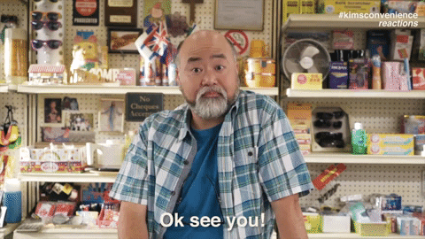
Call me beep me!
Mark McCarthy
Lead Accessibility Engineer
Administrative Information Technology Services
University of Illinois System Office
217-300-3408 | mcmccar2@uillinois.edu
Want more?
Word Accessibility Basics [CC]
Interacting with Disabled Folks, Just Ask, UIAccess
PDF Accessibility Basics [CC], DRES’ Christy Blew
Crutches and Spice, a blog by the renowned Imani Barbarin
Andrew Gurza, an award winning speaker/advocate 🌈x♿
Want to be certified in some accessibility basics (or advanced…s)?
Look into UIUC’s IADP program (I’m an instructor!) or,
the International Association of Accessibility Professionals’ various offerings!
Kim’s Convenience, CBC TV

