Slide 1
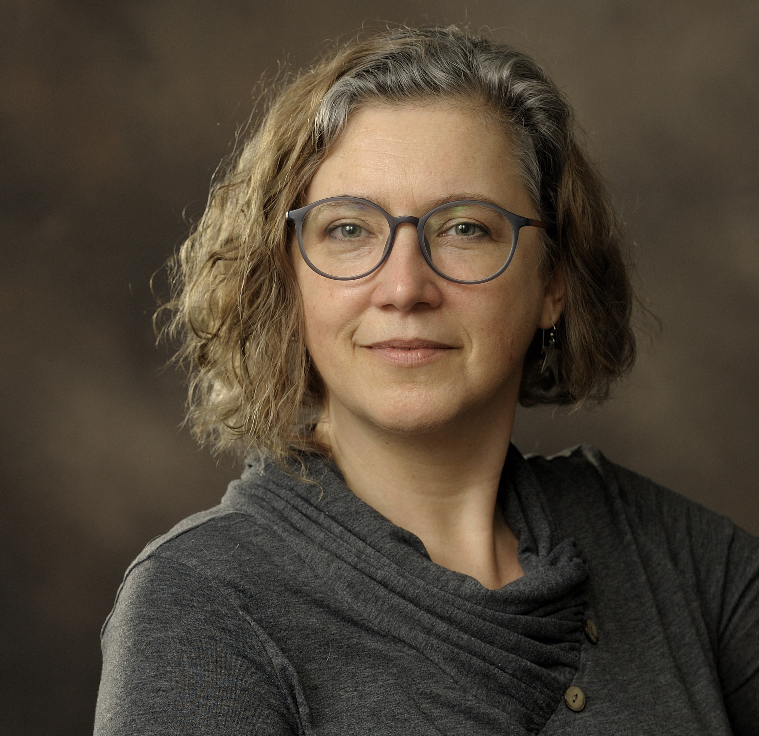
New Directors’ Institute May 25, 2023
Library Storytelling with Data

Slide 2
Contents & Agenda
Storytelling, data storytelling, and critical data storytelling
DSTL & obstacles
Evidence & arguments
Story structures
New: tone & tactics for audiences
Questions? More resources!

Slide 3
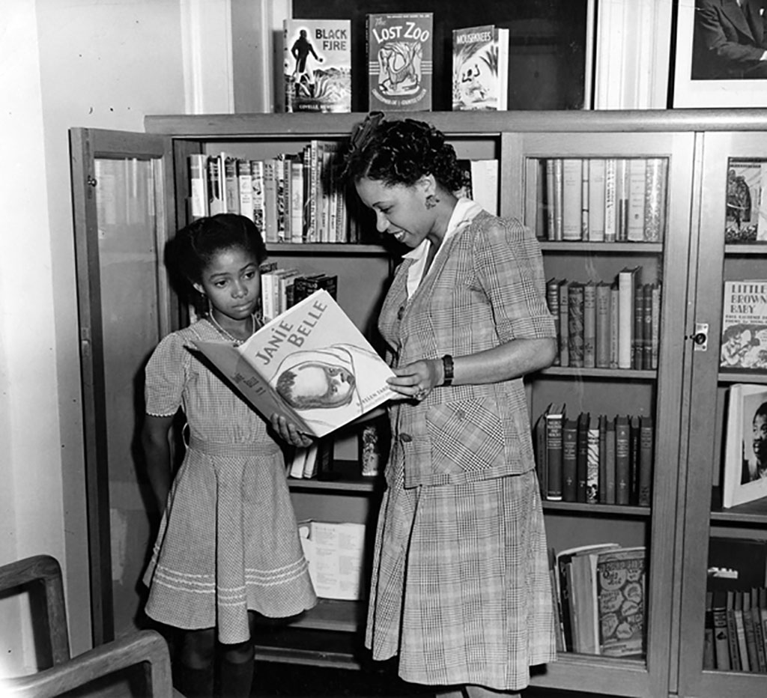
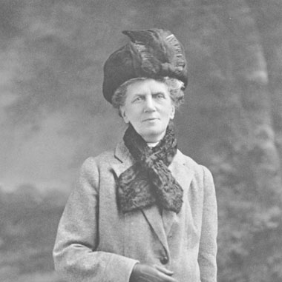
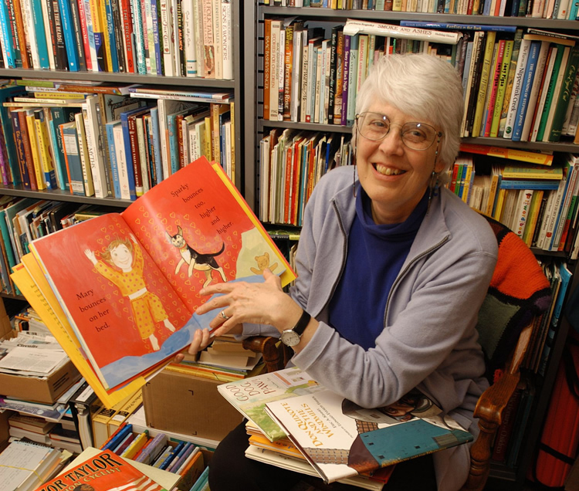
130 Years of LIS Storytelling
Augusta Baker, first to hold the position of Storytelling Specialist at the New York Public Library, emphasized the story rather than the storyteller,
“who is, for the time being, simply a vehicle through which the beauty and wisdom and humor of the story comes to the listeners.” (Baker & Greene, 1977)
Caroline Hewins, Reading of the Young reports (1882-1898) Betsy Hearne, ethics of folktale retelling in children’s books
3
Notes:
Trust between teller and audience

Slide 4
Consulting
Notes:
Story as fundamental information form
Storytelling as fundamental information dynamic

Slide 5
Data Storytelling
Courses in ethical and accurate information communication, situated in a world of burgeoning data and new storytelling challenges. We take on those challenges directly, acknowledging the flexibility of expression available in data and story while being honest.
Co-created by Dr. Kate McDowell and Dr. Matt Turk. Other co-instructors include Dr. Jill Naiman, Dr. Sharon Comstock, and doctoral students Courtney Richardson, Andy Zalot, and Morgan Lundy.
Notes:
Information and emotion together

Slide 6
Comfort levels: data, story, both?
Notes:
Data, story, or both?

Slide 7
Notes:
Neuroscience of storytelling
connects us, we like it, activates our brains in complex ways
https://www.onespot.com/blog/infographic-the-science-of-storytelling/
From the infographic "The Science of Storytelling," by OneSpot.

Slide 8
Notes:
Not a delivery of story from teller to audience
Emerges between
Roles can shift or switch, teller becomes listener
Triangle, several things:
Dynamic, story emerges between teller and audience. So practice.
Six relationships. For example, audience can see the teller’s relationship to the story. True whether it’s a data story or a culturally fake/authentic story, audience is aware

Slide 9
Data Storytelling means any presentation of data using narrative strategies in story form

Slide 10
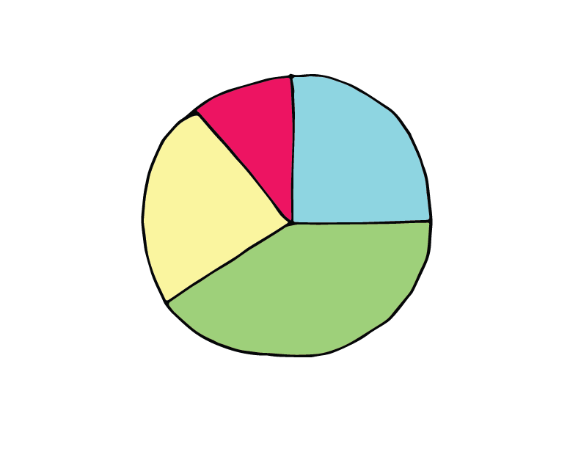
Notes:
Data to teller-our first goal

Slide 11
Notes:
The bigger goal: data to teller to teller. Retelling.
We need to tell stories that sustain beyond the moment of first telling.
How will we know? We check in with audiences, especially practice audiences.
Ask: What did you hear, ask them to tell it back to you

Slide 12
Water conservation & new river stories

Slide 14
Critical Data Storytelling means advocating with stories based on data to make change toward equity and social justice

Slide 15
Critical data storytelling is inspired by
W.E.B. Du Bois, W.E.B. Du Bois’s Data Portraits: Visualizing Black America : The Color Line at the Turn of the Twentieth Century
Catherine D’Ignazio and Lauren F. Klein, Data Feminism

Slide 16
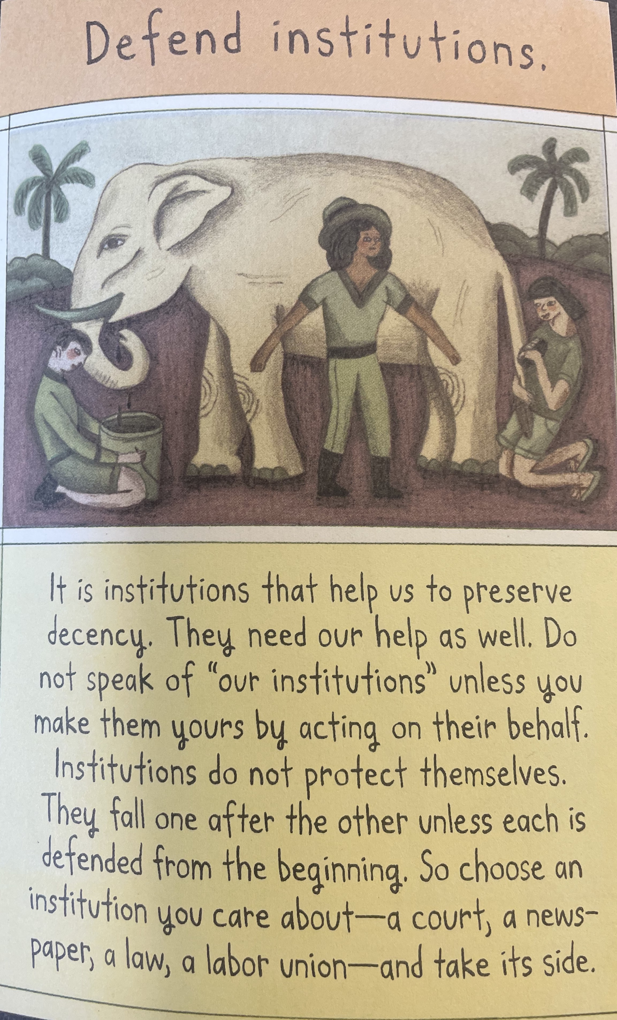
Notes:
From On Tyranny: Twenty Lessons from the Twentieth Century by Timothy Snyder (graphic edition)

Slide 17
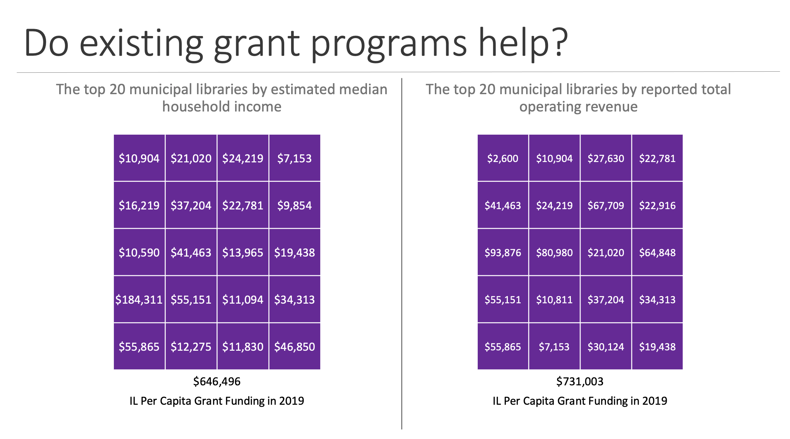
Notes:
Excerpt from one student who did a study of data about economic disparities between libraries

Slide 19
Social Justice Storytelling: A Pedagogical Imperative Kate McDowell and Nicole A. Cooke
The Library Quarterly 92, no. 4 (October 2022): 355–78.
https://doi.org/10.1086/721391
Notes:
Beth Patin at Syracuse, epistemicide, the harm of preventing future generations from knowing
Francesca Polletta, It Was Like a Fever: Storytelling in Protest and Politics
Lee Anne Bell, Storytelling for Social Justice

Slide 20
Excerpt from A universal social justice stance for LIS curricula:
All humans have an inherent worth and deserve information services that help address their needs.
People perceive reality and information in different ways, and in different contexts. This needs to be acknowledged.
The provision of information is an inherently powerful activity.
Distributing information is, in itself, a political act.
(Cooke and Sweeney 2017, 36–40)

Slide 21
Notes:
From Welch, W. (2009). Who Owns the Story? Storytelling, Self, Society, 5(1), 1–22.

Slide 22
DSTL or “distill”

Slide 23
Library data needs story before storage

Slide 24
Obstacles for Librarians
Qualitative Data Sources | Primary Obstacles Identified
Interviews | Fear of data, too little time, lack of story strategies
Questionnaire | Tools, training, connecting to audience, lack of time
Ranking Exercise | Time consuming, data are misread, data are not used, narrow focus on “the number”
Workshop Discussions | Data collected but not used, unclear how to tell the story of the library, unsure how to tell stories

Slide 25
Two kinds of obstacles
1. Emotions and attitudes
Fear of data
Fear of story
2. Time, tools, and training
“Library Data Storytelling: Obstacles and Paths Forward” Public Library Quarterly summer 2023 (in press)
Notes:
Love of narrative as a strength creates potential for a stories-first approach that broadly motivates librarians to richly engage with data. Data on its own can seem abstract and impersonal, while storytelling with data implies a connection between teller and audience.
Too little time (need for efficient tools and templates)
“Can gather data, but I don't have time to synthesize and tell the story. Library small; staff cover operating functions.”
Fear of “story”
“I think this is very difficult for librarians, because it is like creating fictionalized non-fiction. It feels awkward.”
Fear of “data”
“We don’t even use the word data in our workshops (for librarians), because they won’t come.”

Slide 26
Data Storytelling Toolkit for Librarians
IMLS-funded, Laura Bush 21st Century Librarian program
with co-PI Matt Turk and RA Xinhui Hu
Toolkits for easy data storytelling for common data uses in libraries
Public
Community college

Slide 27
Planning for DSTL
Phase 1: Identify obstacles to data storytelling, conduct a survey, and recruit Core Design Team (CDT) participants.
Phase 2: Create the DSTL demo. CDT joins a series of online workshops to give structure input on the DSTL design elements.
Phase 3: Coming fall 2023! Pilot data storytelling toolkit through publicly advertised 1-hour introductory and 2- hour workshops of up to 80 online participants. (6 months)

Slide 28
Evidence
Arguments
Story Structures

Slide 29
Evidence

Slide 30
Examples: Library data as evidence
Local data
Community demographics
Community surveys: school district, park district, regional food bank, etc.
Service/program user surveys
Comparative data
State or national agencies’ reports for comparative trends
Other institutions’ published reports, trends or snapshots

Slide 31
What kinds of data do you have as evidence?

Slide 32
Notes:
https://elearning.ala.org/local/catalog/view/product.php?productid=269

Slide 33
Arguments

Slide 34
Five Classic Arguments
Understand the real needs
Serve the real needs
Compare well with similar institutions
Build on existing strengths
Address deficits

Slide 35
Connecting Five Classic Arguments and Evidence
Understand the real needs of communities
Local community demographics, surveys
Serve the real needs of communities
Local community demographics or surveys
Service/program user surveys
Compare well with similar institutions
State or national reports
Other institutions’ reports
Build on existing strengths
Evidence of strengths: (comparative) usage rates or uptake, feedback, community surveys
Address deficits
Comparative data, surveys, trends
Notes:
Local data
Community demographics
Community surveys: school district, park district, regional food bank, etc.
Service/program user surveys
Comparative data
State or national agencies’ reports for comparative trends
Other institutions’ published reports, trends or snapshots

Slide 36
Arguments & Story Structures
Arguments | Stories
Understand the real needs of communities | Discovery
Serve the real needs of their communities | Continuity or Transformation
Keep up with other institutions | Continuity or Transformation
Build on existing strengths | Transformation
Identify and address deficits | Transformation

Slide 37
Story Structures

Slide 38
Notes:
Data to teller-our first goal

Slide 39
Notes:
The bigger goal: data to teller to teller.
We need to tell stories that sustain beyond the moment of first telling.
How will we know? We check in with audiences, especially practice audiences. Ask: What did you hear, ask them to tell it back to you

Slide 40
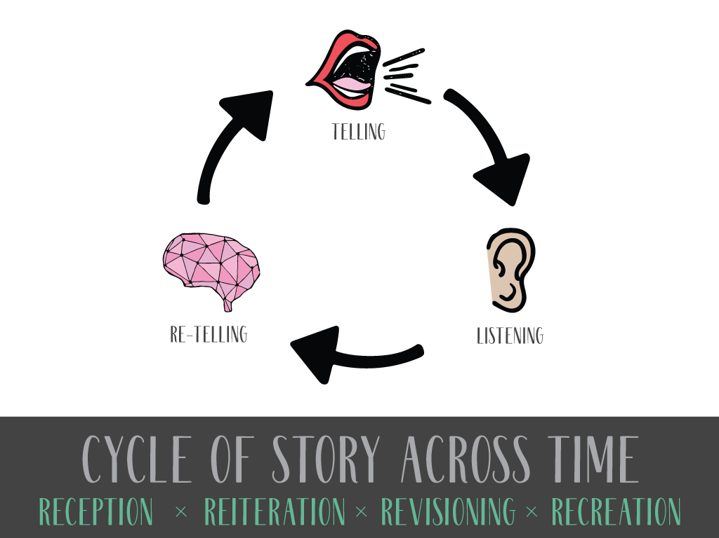
Notes:
Stories that LAST
Good leaders tell stories and listen, changing roles as needed,
But they help the group collaboratively define a collective story
That is good enough to be retold on its own, that stands up to scrutiny, and ultimately stands the test of time.
I’m interested in stories that have lasted. Folklore, hundreds and thousands of years

Slide 41
1. Continuity
2. Transformation
3. Discovery

Slide 42
Narrative Structure​ | Emotional Impact​ | Originating theory​
Transformation​ | Awe at transformation, joy of watching a hero triumph​ | Joseph Campbell’s The Hero With a Thousand Faces​
Continuity​ | Stability and resilience despite challenges, reassurance of continuity​ | Tsvetan Todorov’s Structural Analysis of Narrative (with A. Weinstein)
Discovery​ | Mystery, suspense, intrigue and satisfaction of coming to understanding​ | Roland Barthes’ S/Z​
Barthes, R. (1974). S/Z (1st American ed.). Hill and Wang.
Campbell, J. (1949). The Hero with a Thousand Faces. In The Journal of American Folklore (Vol. 63). https://doi.org/10.2307/537371
Tzvetan Todorov & Arnold Weinstein. (1969). Structural Analysis of Narrative. NOVEL: A Forum on Fiction, 3(1), 70–76. https://doi.org/10.2307/1345003

Slide 43
Notes:
(15 MINUTES) 3 structures. First one: Equlibrium. Find trouble? Good, now find the resolution.
Equilibrium, continuity, recovery from disturbance

Slide 44
Notes:
Still pool, big splash, still pool again.
Think “despite the challenges of Covid, we sustained service to people without homes or jobs in our computer lab. Here’s what we learned, here’s what we did. Example: installed software to allow librarians to control computer remotely, to help with filling out housing or job applications & maintain 6 ft distance.”
Feeling is that of a still pool, disrupted, and then still again.

Slide 45
Notes:
Hero’s journey, story of transformation, overcoming obstacles
Think awe, amazing accomplishments. Superhero stuff. Think
“how the library helped one person get a job so they could stop living in their car and rent an apartment.” Reaction should be “wow, the library can do that?”
One person’s story may be “anecdata” or it may be inspirational to help make sense of data. But focusing on one person can help to overcome the phenomenon of numbness when we are flooded

Slide 46
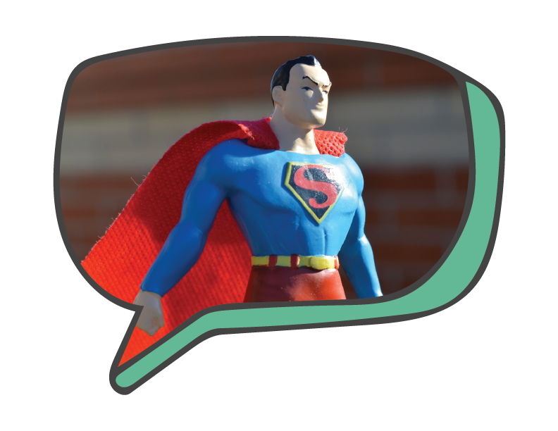
Notes:
Only danger: Superheroes, not most of us. Breaks trust.
Feeling should be that of awe.

Slide 47
Notes:
Leading an audience through information. Revealing more as you go.
Enigma, story of exploration and discovery. Learning, exploring data, coming to understand something complex, difficult, mysterious
Mystery and Revelation
Primary mystery: “Why are you telling me this now?”

Slide 48
Notes:
Feel is that of a detective adventure
Think questions and answers, suspense and resolution

Slide 49
inquiry
uncertainty
data
question
information
mystery
solution
Notes:
Think
“We knew there were children without library cards, but we didn’t know how many, so we used census data and then conducted a survey to find out more about how many, where they live, and what the barriers are. Here’s what we found out and here’s what we’re doing next.”

Slide 50
Notes:
Remember: circle, mountain, flashlight
Leave you with three resources, two books and one project to keep an eye out for in future
Multiple discomforts in this process, including owning our role as expert interpreters of library data. Encourage you!

Slide 51
NEW Tone and Tactics

Slide 53
Audiences Have Attitudes

Slide 54
The Core Design Team
40 librarians from public and community college libraries
From across the United States
Participants in collaborative workshops from 2022-2023
No more than 10 hours for the year

Slide 55
Tone
Transparent, open.
Tactics
Build trust.
Don’t overestimate sympathy of audience or take it for granted.
Make sure messaging is repeated or echoed.
Tone
Model calm demeanor in face of aggressive manner.
Don’t take it personally. Stay on message.
Recognizing that aggression is a demonstration of fear; how can we turn fear into common strength?
Tactics
Find a point of agreement--what is one thing we can agree on?
Active listening and acknowledge concerns/validating them as a person/reframe-restate what you are hearing in a positive way
Tone
Transparent and open.
Model calm demeanor in face of aggression.
Tactics
Don’t overestimate audience sympathy or take it for granted.
Find a point of agreement.
Active listening and acknowledge concerns/validating them as a person/reframe-restate what you are hearing in a positive way
What is the actual issue?

Slide 56
Polarized
Tone
Calm, nonreactive.
Establish a shared language with those involved in the decision-making from the outset.
Ask questions:
Why is this happening?
Why has this issue been chosen?
What are our goals?
Tactics
Connect goals with community/patron needs. It's not personal. It's not "Librarian XYZ'" agenda, but a response to a real need.
Research counterarguments/ popular misinformation, and provide evidence/stories that address misconceptions.
Focus on winning over the voting majority. Stay the course. This may require consistent reinforcing of message.
Notes:
Weekend conference, students planned and advertised without telling school administration. Rumors were flying.

Slide 57
Process for DSTL User
Choose the argument of the story (one of five options)
Evidence to support this argument (explore, analyze, and choose type)
Local community (surveys, census, school district, municipal)
National comparisons (census, Benchmark, Project Outcome, PLS data from IMLS)
Select attitude of audience (board, administration, public) about this topic
Select narrative strategy
Data
Idea for sources of data with links
Big projects: Benchmark, Project Outcome, PLS data from IMLS
Census data
Other suggested local sources to explore (school board data, municipal data, etc.)
Specific example of budgets for staff
Input: data; output: comparative/trend data viz
Examples of similar success stories

Slide 58
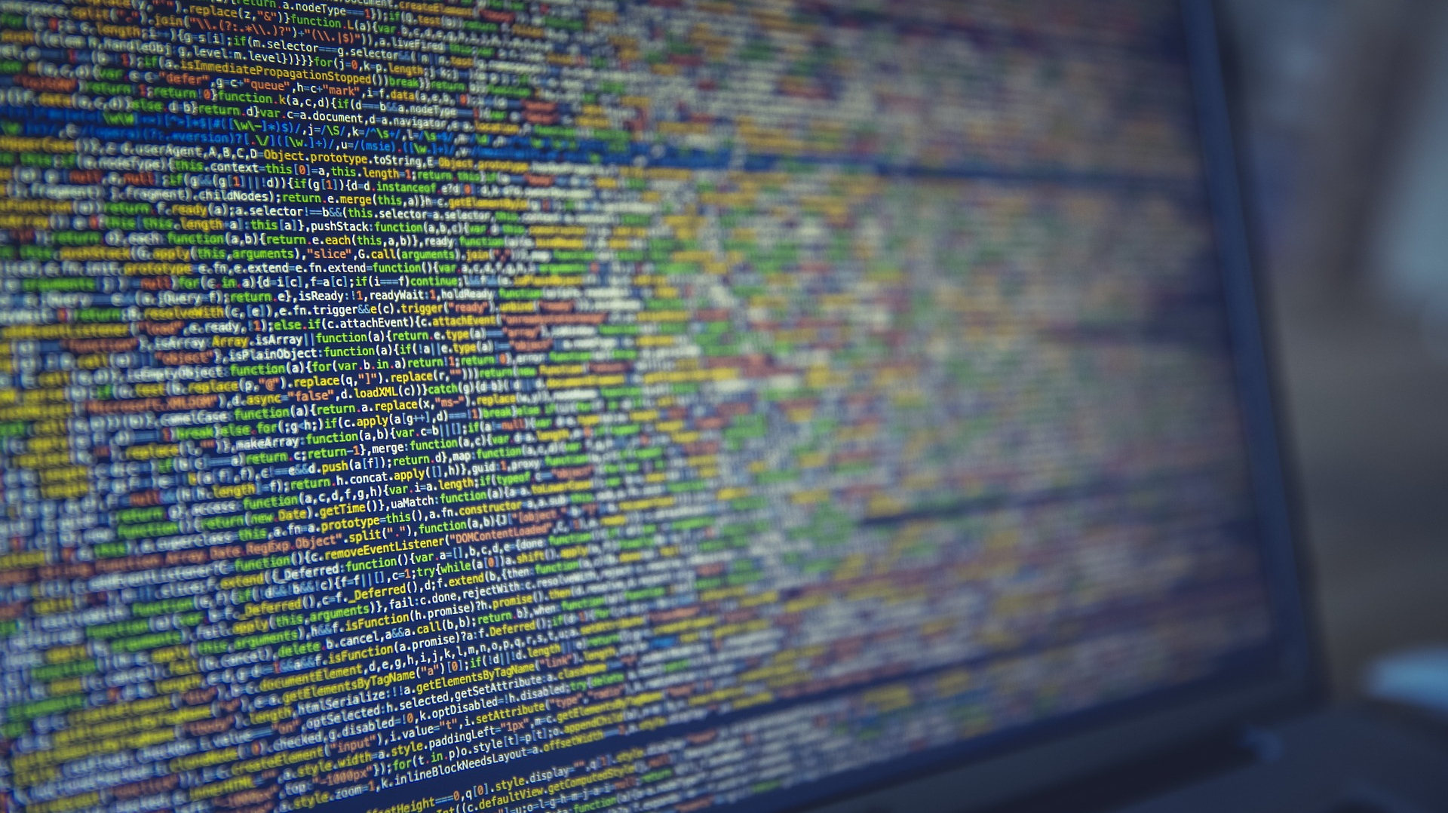
Long Term Vision
The long-term vision is to cultivate data storytelling expertise as a signature expertise of our field, so that when communities have data storytelling needs, they are met at libraries and by librarians.

Slide 59
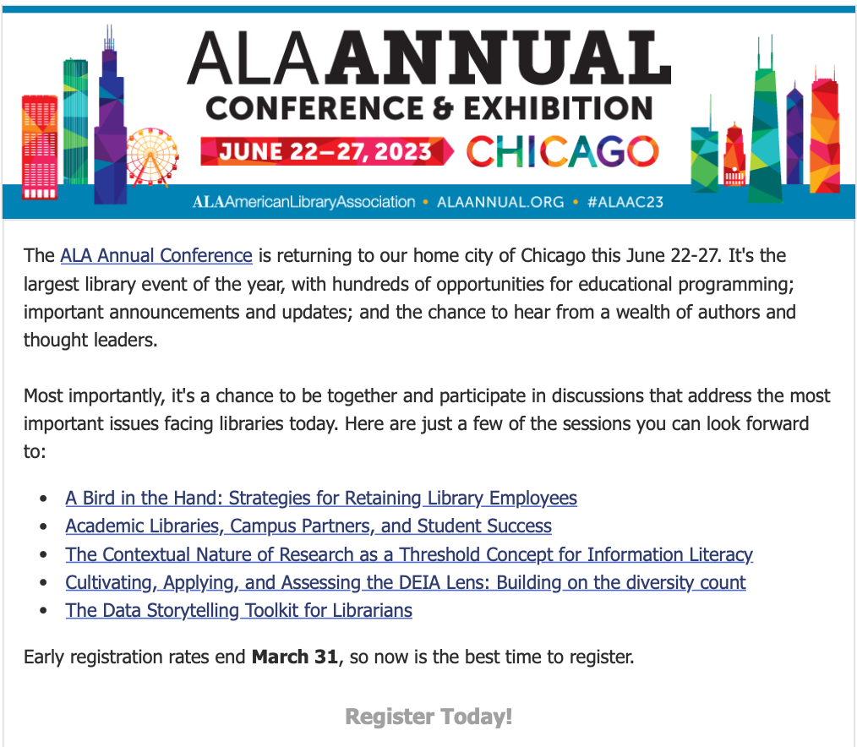

Slide 60
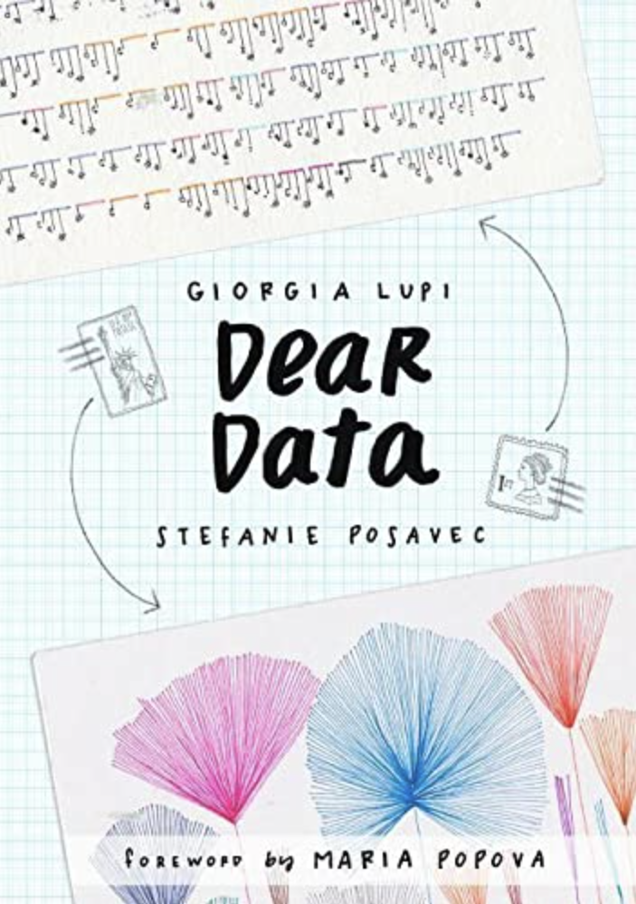
Dear Data: Visual Strategies for Developing Stories
Anything can be measured, objects to experiences and beyond
Full of creative hand-drawn data visualization

Slide 61
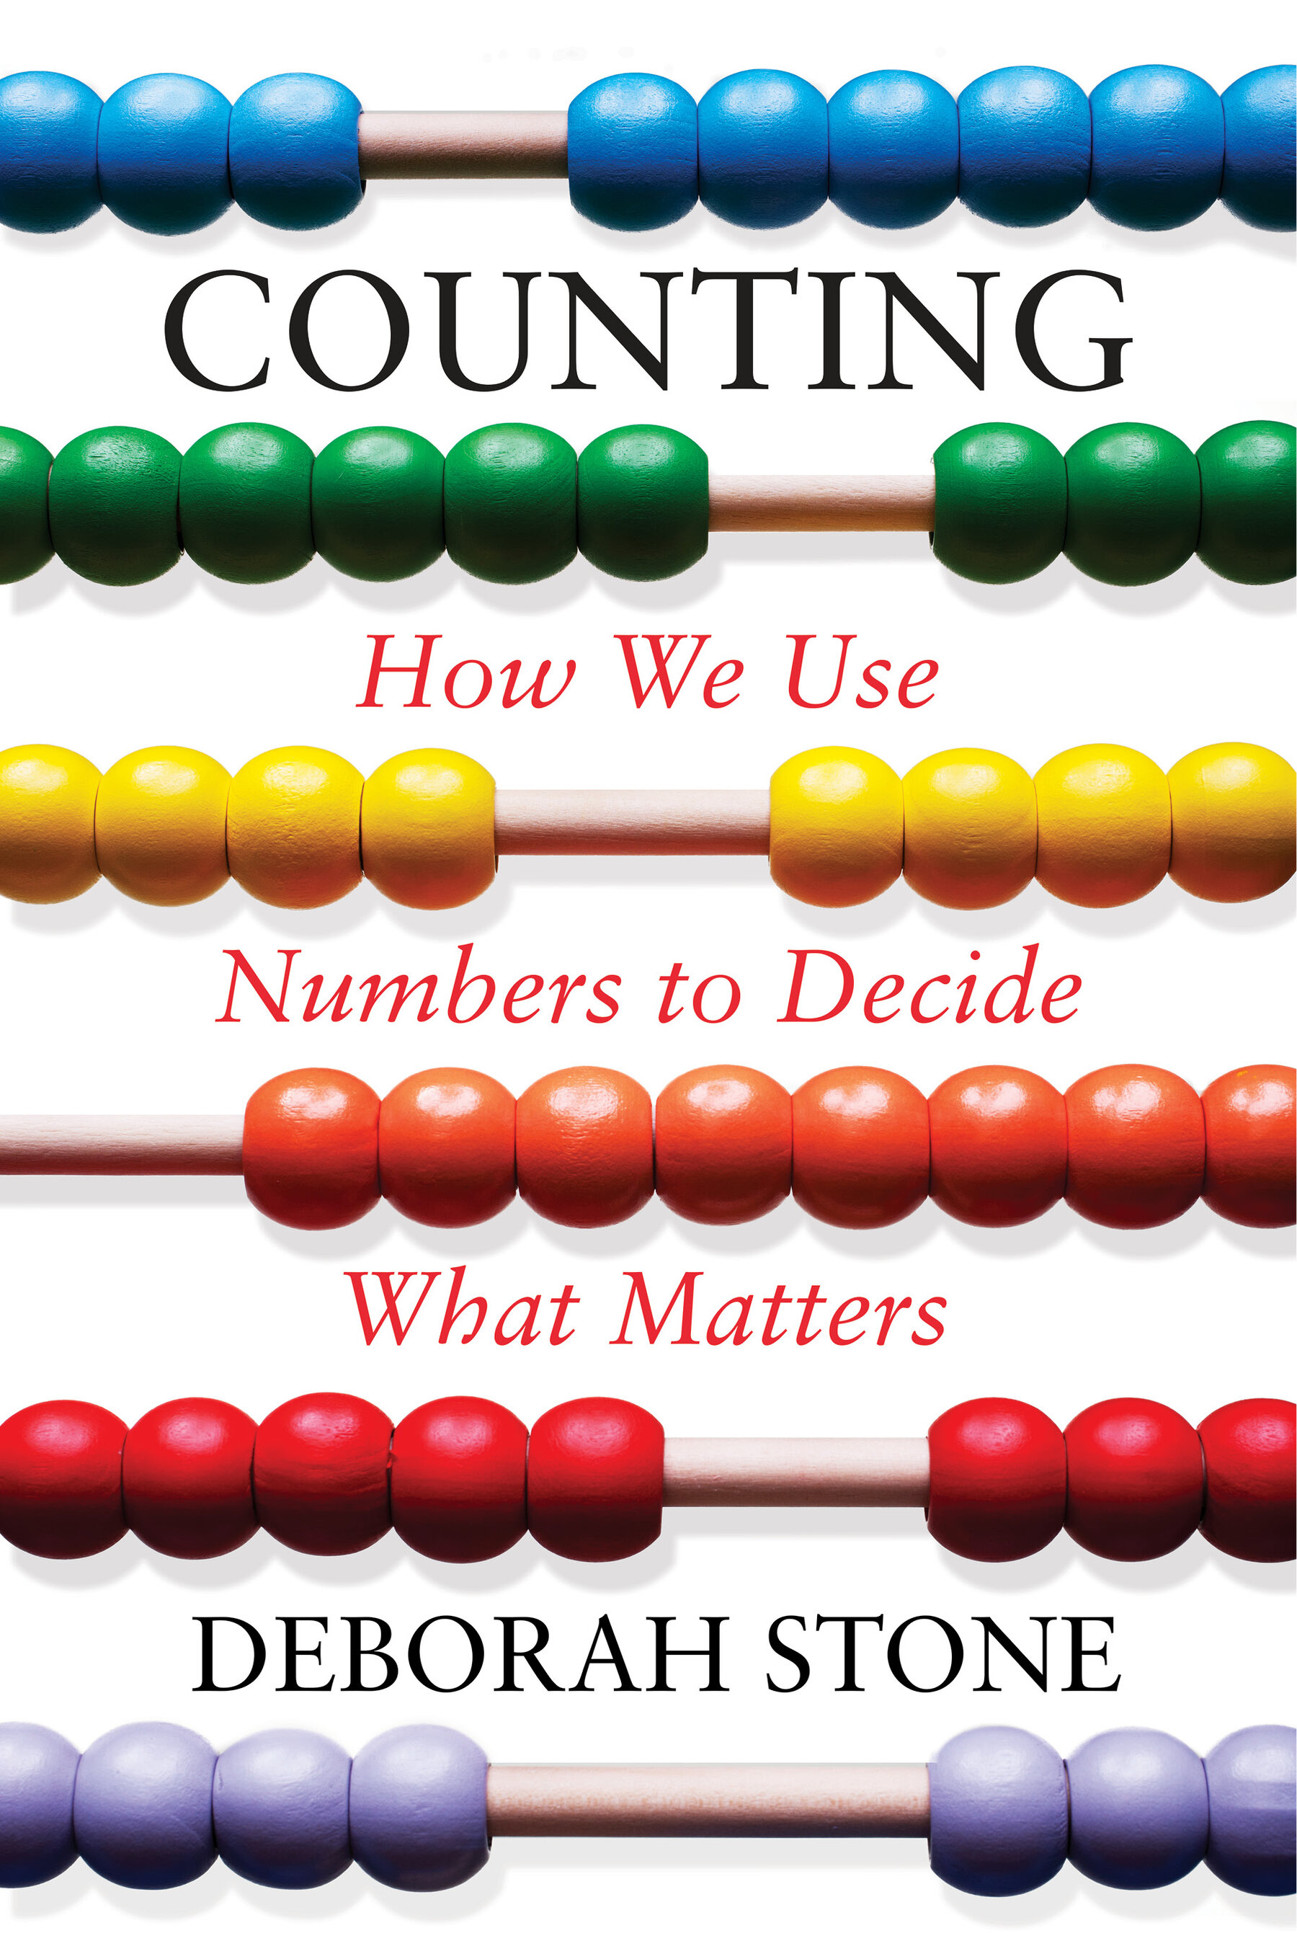
Counting and What Counts
Numbers are not more real than other kinds of data
“Counting is a lot like being a judge. Before we can count up ‘somethings’ we have to decide what counts as a something.” (p. 179)
Finding ways to measure value requires both creativity and integrity

Slide 62
Questions? Thank you!
kmcdowel@Illinois.edu
Twitter @katenarrative or @uiucdstl
https://www.linkedin.com/in/kate-mcdowell-86130122/
https://uiucdstl.wixsite.com/uiucdstl

Slide 63
References
Baker, A., & Greene, E. (1977). Storytelling: Art and technique. Bowker.
D’Ignazio, Catherine. Data Feminism. <strong> Ideas Series. Cambridge, Massachusetts: The MIT Press, 2020.
Du Bois, W. E. B. W.E.B. Du Bois’s Data Portraits: Visualizing Black America : The Color Line at the Turn of the Twentieth Century. First edition. Amherst, Massachusetts: The W.E.B. Du Bois Center at the University of Massachusetts Amherst, 2018.
Lupi, G. (2016). Dear Data (Princeton Architectural Press edition.). Princeton Architectural Press.
McDowell, K. (2021). Storytelling wisdom: Story, information, and DIKW. Journal of the Association for Information Science and Technology, 72(10 (Special Issue: Paradigm Shift in the Field of Information)), 1223–1233. https://doi.org/10.1002/asi.24466
Million, Dian. “Felt Theory: An Indigenous Feminist Approach to Affect and History.” Wicazo Sa Review 24, no. 2 (2009): 53–76.
Stone, Deborah. (2020). Counting: How We Use Numbers to Decide What Matters. Liveright.
Tuck, Eve, and K. Wayne Yang. “Decolonization Is Not a Metaphor.” Decolonization: Indigeneity, Education & Society 1, no. 1 (September 8, 2012). https://jps.library.utoronto.ca/index.php/des/article/view/18630.
Welch, W. (2009). Who Owns the Story? Storytelling, Self, Society, 5(1), 1–22.

Slide 64
Image credits
“How Storytelling Affects the Brain” From the infographic "The Science of Storytelling," by OneSpot, https://www.onespot.com/blog/infographic-the-science-of-storytelling/
Caroline Hewins, University of Illinois Archives, The American Library Association Archives, https://archon.library.illinois.edu/ala/index.php?p=digitallibrary/digitalcontent&id=2791
Betsy Hearne, Storytelling from Fireplace to Cyberspace conference, Betsy Hearne
Augusta Baker, New York Public Library, https://www.nypl.org/blog/2021/03/01/nypls-augusta-braxton-baker-fighting-stereotypes-and-developing-diverse-collections
Other photographs from Pixabay, creative commons license
Illustrations by Hilary Pope, graphic designer

Slide 65
More by Kate McDowell and Collaborators
McDowell, Kate. Book Stories: 20 Years of Library Book Plate Celebrations. College & Research Libraries, January 4, 2023. https://doi.org/10.5860/crl.84.1.49. (open access)
McDowell, K. and Cooke, N. (2022, October). Storytelling and Social Justice: A Pedagogical Imperative. The Library Quarterly. (HTML version free until 1/1/23: https://doi.org/10.1086/721391
McDowell, K. (2021, October 19). Storytelling as information part 1: The S-DIKW framework. Information Matters. https://informationmatters.org/2021/10/storytelling-as-information-part-1-the-s-dikw-framework/ (open access)
_____. (2021, October 19). Storytelling as Information Part 2: Future S-DIKW Research. Information Matters. https://informationmatters.org/2021/10/storytelling-as-information-part-2-future-s-dikw-research/
McDowell, K., & Miller, D. (2021). Great storytelling: Best practices for advancement. Journal of Education Advancement & Marketing, 6(3), 257–267.
McDowell, K. (2020). Storytelling, Young Adults, and Three Paradoxes. In A. Bernier (Ed.), Transforming Young Adult Services, second edition (2nd ed., pp. 93–109). American Library Association-Neal Schuman.
McDowell, K. (2009). Surveying the Field: The Research Model of Women in Librarianship, 1882–1898. The Library Quarterly, 79(3), 279–300.

Slide 66
Collaborator Acknowledgements
Colleagues Nicole Cooke, Kyungwon Koh, Jennifer Burek Pierce, Sara Schwebel, Jodi Schneider, and Ben Grosser
Xinhui Hu (RA for the DSTL project), co-PI Matt Turk, and the entire 40-person Core Design team for DSTL
The AIVC team at Illinois and PAHO, including Ian Brooks, Kevin Leicht, Rebecca Kyser, and more

