Slide 1
Intentionally Recruiting for Diversity in Librarianship: Reflections on a Year Later
"St Louis Central Library" by Jonathan Cutrer CC BY 2.0
Zoom’s live transcript is available on the Show Captions menu.
Notes:
<Set Skype to Busy/Presenting>
<Give presenters co-host permissions>
<Watch for access issues (RT and email)>
<Ice breaker>
<Start recording>
<NS - Welcome>
Hello everyone, I’m Nicole Swanson at CARLI, the Consortium of Academic and Research Libraries in Illinois and I’m joined by presenters Tammie Busch, Calvin Carson, Lora Del Rio, Jacob Del Rio, Elizabeth Kamper, Shelly McDavid, and Simone Williams for this Professional Development Alliance event “Intentionally Recruiting for Diversity in Librarianship: Reflections on a Year Later.”
This amazing Southern Illinois University Edwardsville team is in year two of their wonderful Diverse Librarianship Career Training and Education Program, and in just a minute we will all get to hear how year two is going!
First, a few reminders:
Please ensure your microphones are muted.
We are recording the program today and will share it with attendees afterwards.
Questions and comments are welcome throughout the program via the chat box or by unmuting. If you are unmuting, please also share your video if you are able. It helps those of us who benefit from lip reading.
The Show Captions icon at the bottom of the Zoom window will display subtitles at the bottom of your screen. Select the icon’s arrow menu to view the full transcript.
At this time, I’d like to hand the presentation over to our wonderful presenters. Thank you so much for being with us today!
<Speakers give introductions>
<Program>
<Nicole: Thank yous>
Thank you for Tammie, Calvin, Lora, Jacob, Elizabeth, Shelly, and Simone for sharing an update on year two of the Diverse Librarianship Career Training and Education Program! Also, thank you to everyone for joining and sharing your questions and comments.
I will be sending an email shortly with links to a survey as well as where the recording will be made available.
Have a wonderful rest of your day everyone!

Slide 2
Intentionally Recruiting for Diversity in Librarianship:
Reflections on a Year Later​
Tammie Busch, Calvin Carson, Jacob Del Rio, Lora Del Rio, Elizabeth Kamper,
Shelly McDavid, Simone Williams

Slide 3
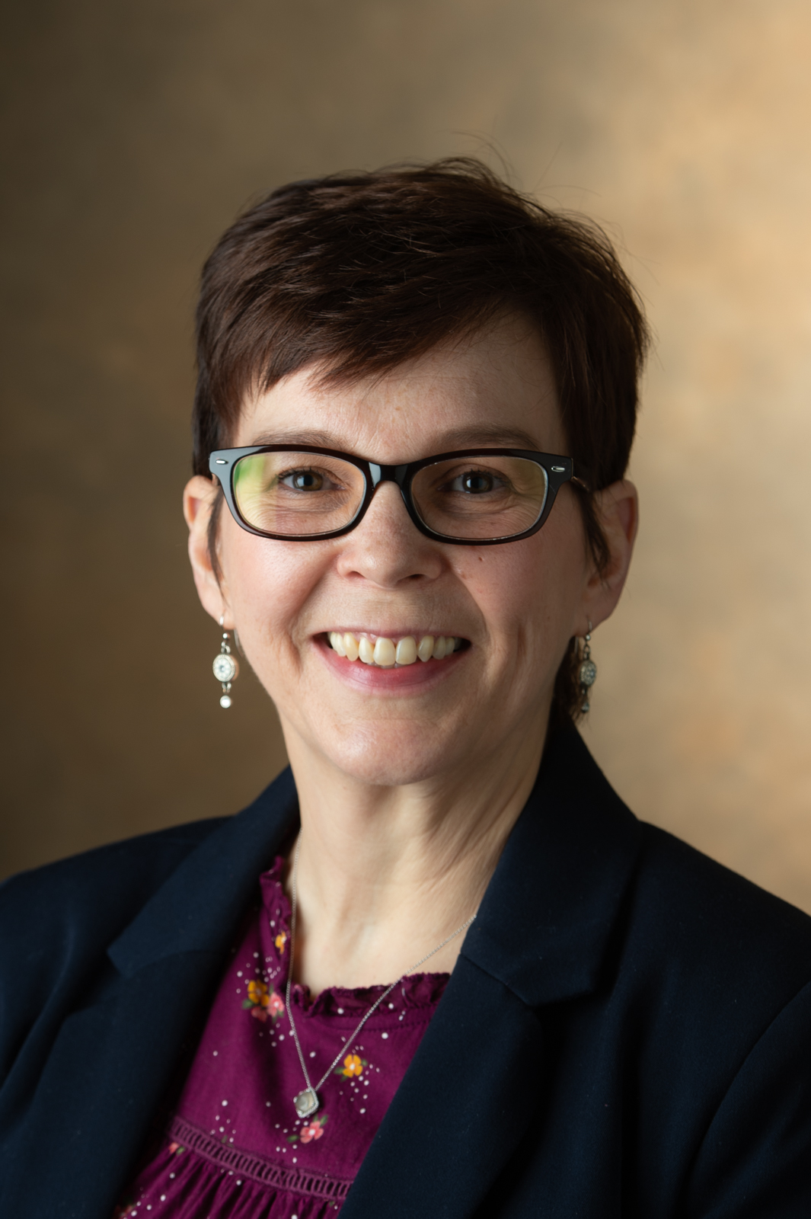
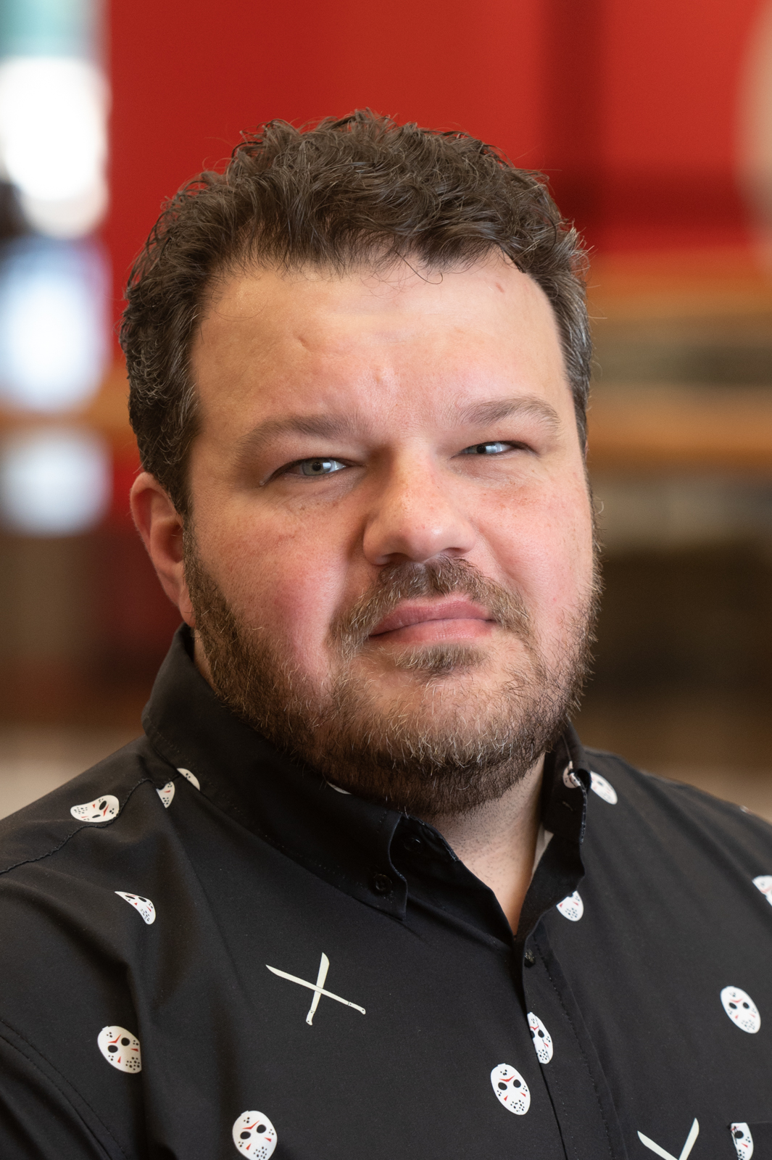
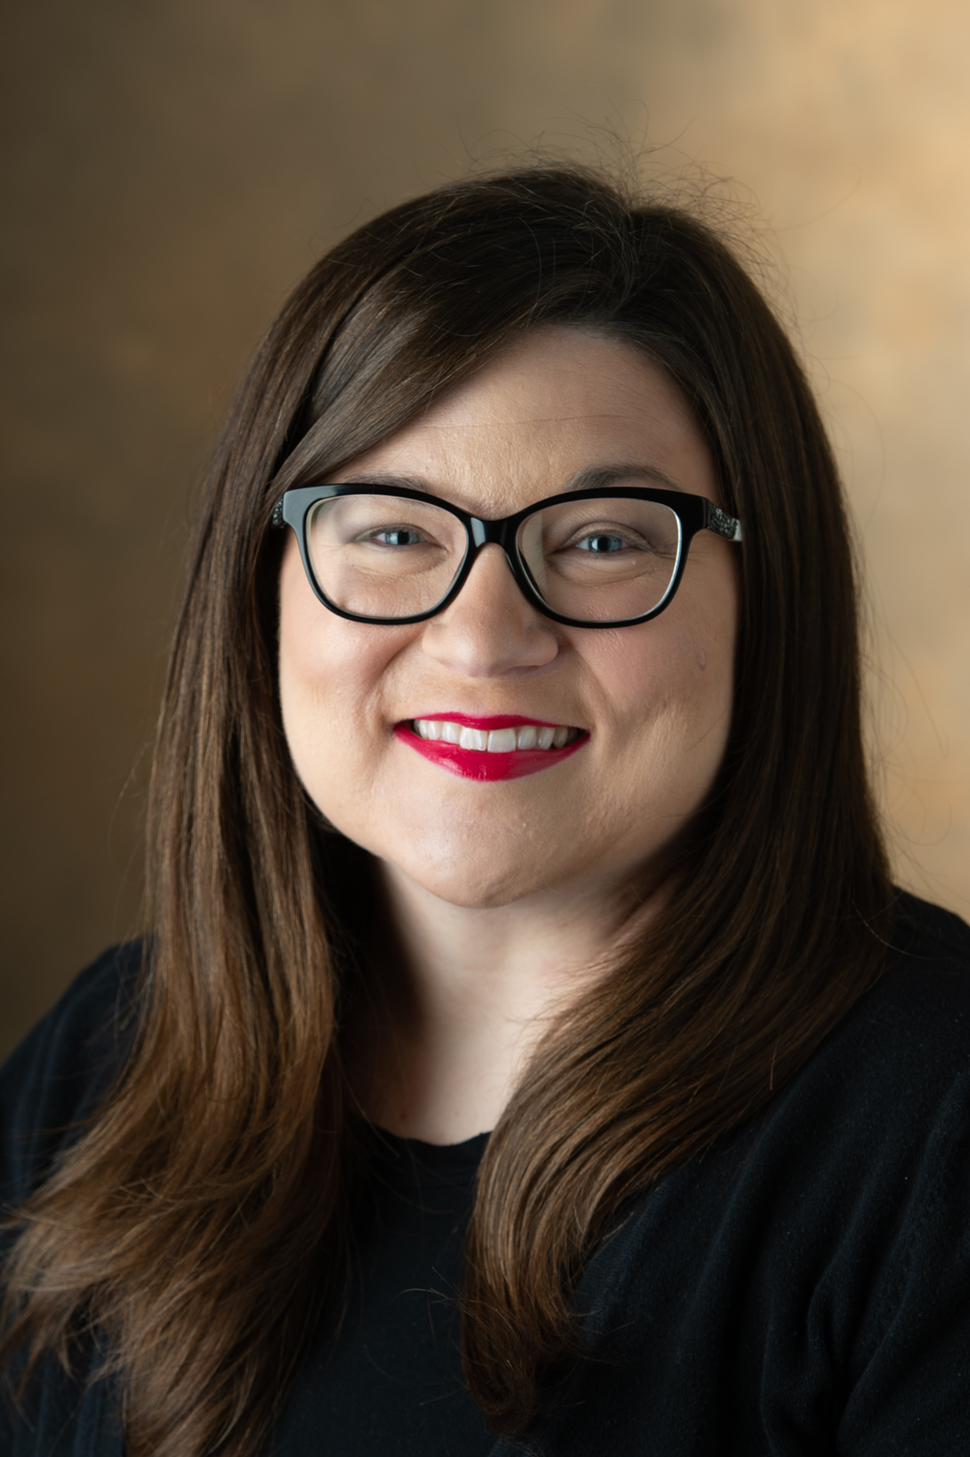
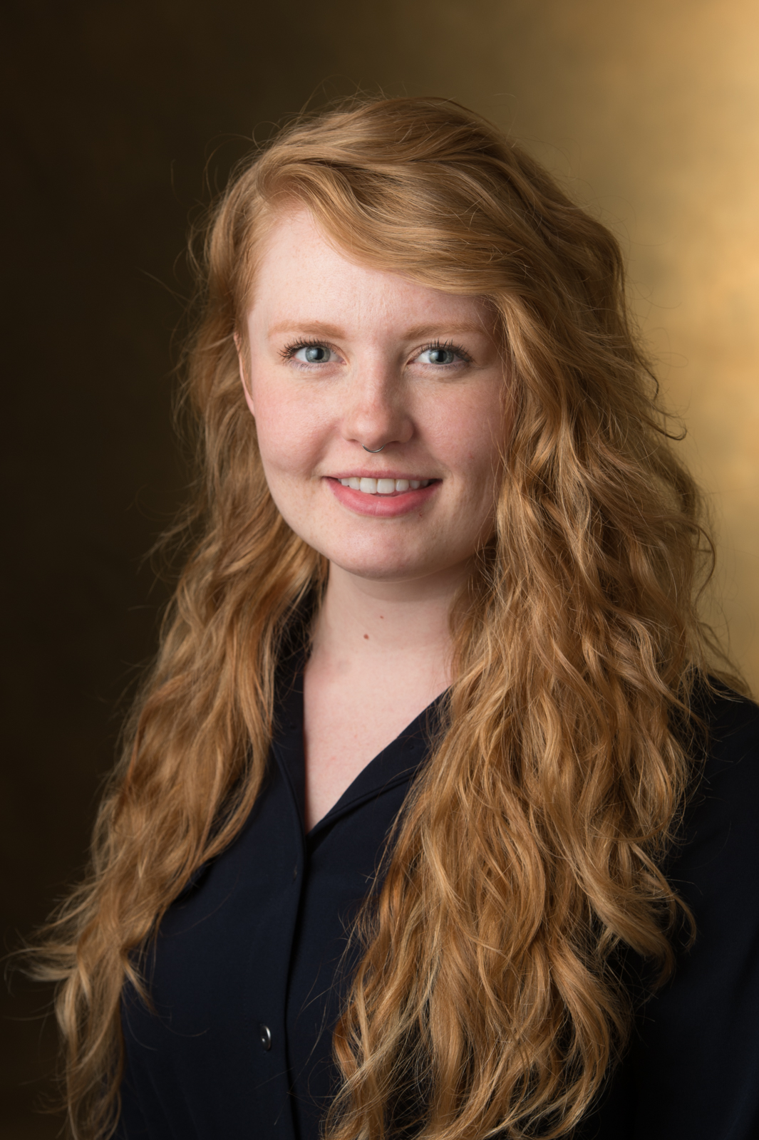
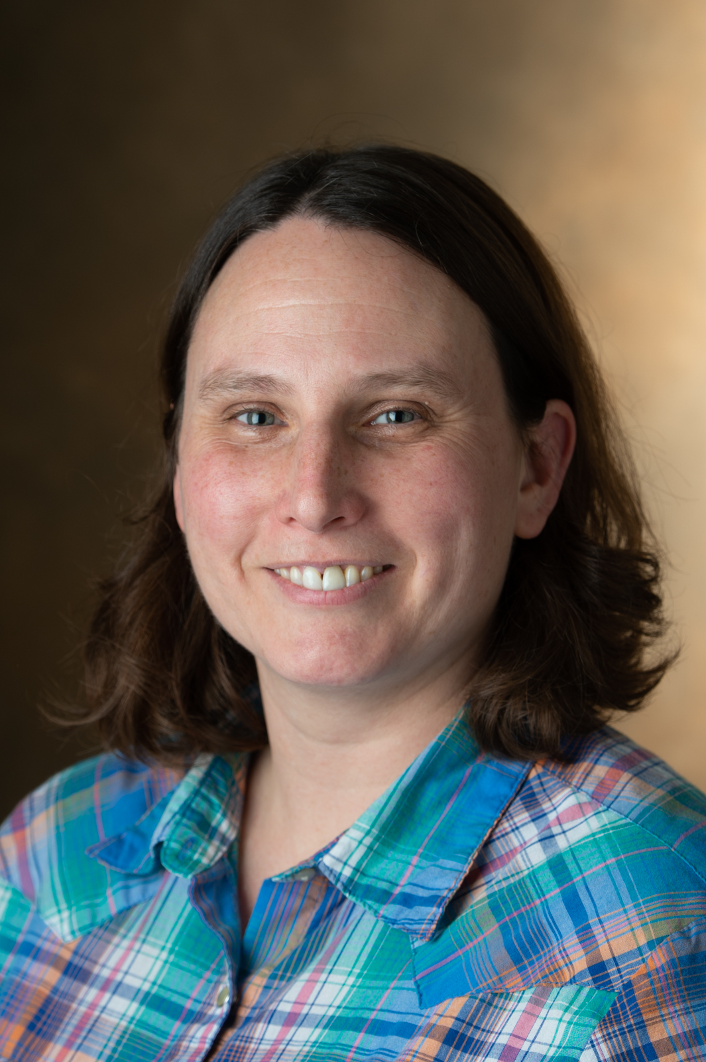
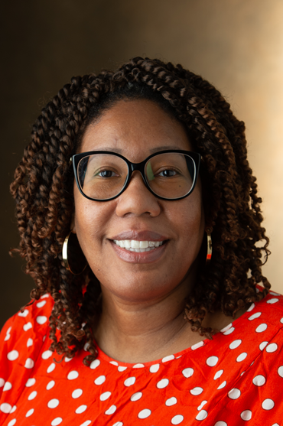
Introductions
Tammie Busch
Asst. Prof
Catalog & Metadata
Librarian
Jacob Del Rio
Asst. Prof
Electronic Resources Librarian
Lora Del Rio
Assoc. Prof
Humanities Librarian
Elizabeth Kamper
Asst. Prof.
Information Literacy Librarian
Shelly McDavid
Asst. Prof
STEM Librarian
Simone Williams
Asst. Prof
Diversity &
Engagement Librarian

Slide 4
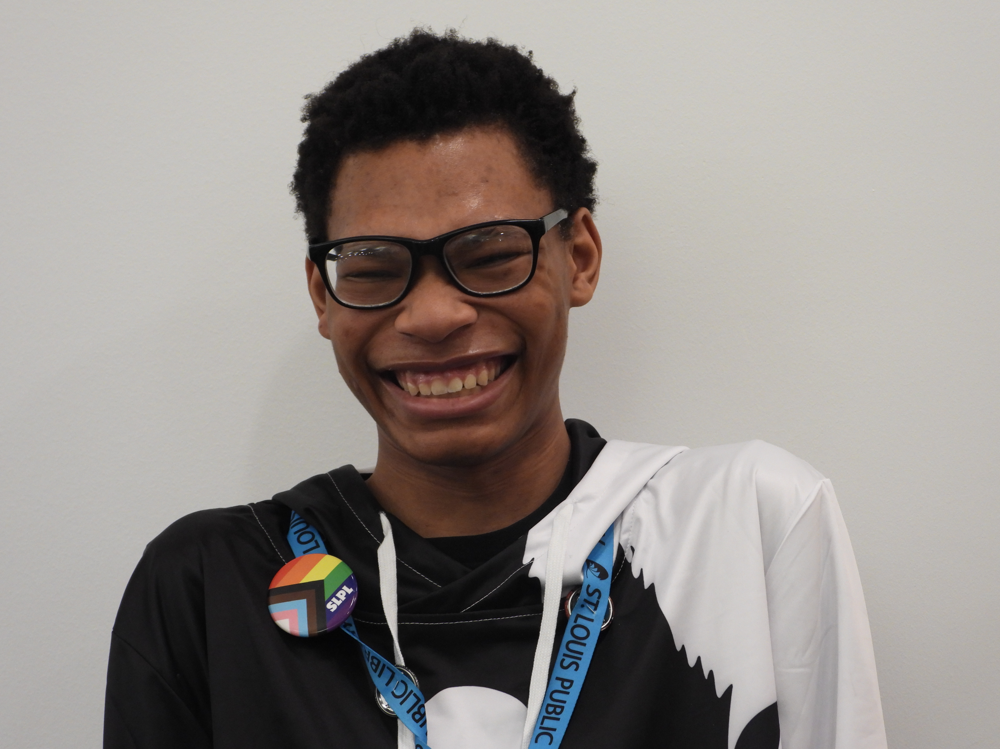
Special Guest
Calvin Carson
Diverse Librarianship Career Training and Education Program Participant
Sumner High School Senior

Slide 5
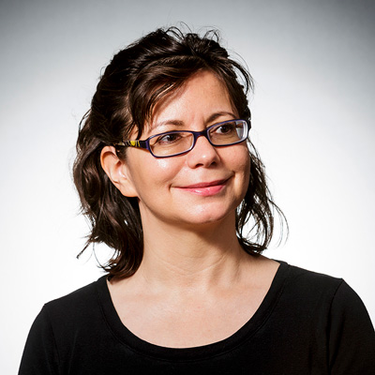
Key Project Consultant
Denice Adkins, Ph.D., MLS
Professor, School of Information Science & Learning Technologies, University of Missouri
Project Evaluator, Diverse Librarianship Career Training and Education Program

Slide 6
Lack of Diversity in Librarianship
How do we share the value of a career in LIS within diverse communities?

Slide 7
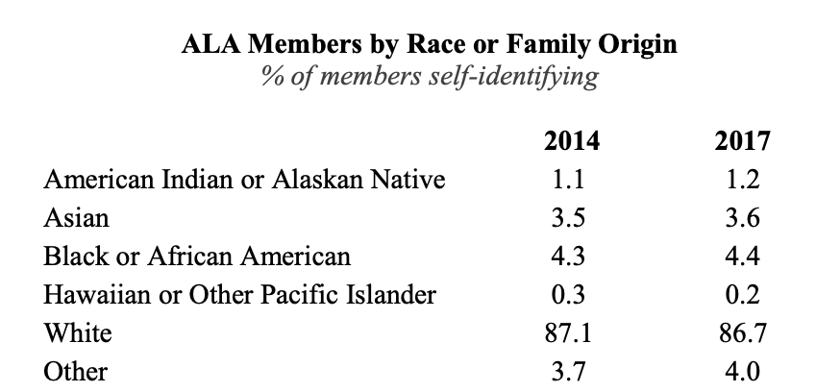
2017 ALA Member Survey: Demographics Survey

Slide 8
Recruiting a Diverse Workforce
IMLS Positioning Library and Information Science Graduate Programs for 21st Century Practice
“...recruiters need to go where diverse populations already are. It is important to consider early – perhaps as early as middle school and high school – how to expose students to the value of careers in LIS.”
- IMLS Positioning Report
https://www.imls.gov/sites/default/files/publications/documents/imlspositioningreport.pdf

Slide 9
Answering a Call to Action
SIUE Diverse Librarianship Career Training and Education Program

Slide 10
Goals:​
Recruit two cohorts of five high school seniors from diverse and underrepresented backgrounds​
Partner with library/cultural organizations​
Mentor cohort students; encourage them to pursue library careers​
Cohort students attend ALA Conference​
Develop & Disseminate Toolkit

Slide 11
What is CTE?
Career & Technical Education
Programs similar to ours (within and outside of librarianship)
Inclusive Internship Initiative
Mentoring in Medicine

Slide 12
Program Evolution
What we have learned over the past two years

Slide 13
Year One Growing Pains
Obstacles:
award notification
recruiting
parental involvement
delayed start
students may not engage or be interested in the program like expected
paying students through grant
Lessons Learned:
support from IMLS
recruiting students AND parents
begin recruitment in spring
generational differences
be aware that students may not go into the profession after program participation
be flexible to help educate cohort students if interested in other career paths

Slide 14
Year Two Growing Pains
Obstacles:
recruiting
transportation
paying students through grant
students may not engage or be interested in the program like expected
students may not meet program expectations
“employee” versus “volunteer”
Lessons Learned:
begin recruitment in spring
workplace proximity to high school
clear guidelines on paycheck timeline
students need diverse, engaging work
clear and comprehensive documentation
disciplinary decisions should be a decision of all involved (mentor, teacher, and workplace supervisor)
support workplace partners

Slide 15
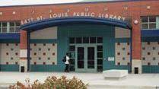
Partners: Planning
East St. Louis School Public Library
SIUE East St. Louis Learning Resource Center
East St. Louis School District 189 Career and Technical Education (CTE) Programs

Slide 16
Julia Davis Branch
St. Louis Public Schools, College and Career Readiness Department, Career and Technical Education (CTE)
ILA Board DEI Subcommittee
Partners: Cohort 3

Slide 17
About the Program
The nuts and bolts of what we do

Slide 18
Mentorship
What is a mentor in DLCTE?
A library professional who has knowledge and experience relevant to the work students are doing at partner libraries.
Can be an investigator on the grant team. We have also explored neighboring public librarians acting as mentors.
Not necessarily a librarian at the host location where students are working.
Why do we need mentors in CTE?
Mentorship helps stop the "leaks" in the library services career pipeline

Slide 19
Mentorship
Finding Mentors
Try to find a mentor for each student in potential co-hort
Look to library community partners (public librarians) for additional mentors
Mentor Duties
Teaching Curriculum
Advising Students through early librarianship
Checking In / Assessing Wellness
Ensuring Safety
Timesheets and other paperwork submissions
Chaperoning (conferences, travel, etc) Working

Slide 20
Mentorship
Best Practices in Mentorship
Set up more than one channel for communication
When first meeting in person, confirm contacts with a text message or test e-mail
Don't let project director be a mentor
Struggles in Mentorship
Finding the right questions for substantial communication

Slide 21
Calvin Carson: Introduction
Calvin Carson is a senior in high school at Sumner High School in St. Louis, MO, and a participant in the IMLS grant funded program, the Diverse Librarianship Career and Training Education, where he participates in the program curriculum and works at the Julia Davis Branch of the St. Louis Public Library.
He is currently a member of the Sumner High School Student Government, the Sumner High School Debate team, and a Senior Editor in Chief for the Sumner High School newspaper: the Sumner Society.
His interests include law enforcement, community trust, and safety on online applications. He is also an active community manager for an animal rescue subreddit.

Slide 22
Program Reflection
What have you learned from working at the library?
How has this experience impacted you?

Slide 23
Curriculum
For Cohort 1, grant team created a two-part, 8-unit curriculum
After feedback, it was reorganized and condensed into a three-part, 7-unit curriculum
Included ALA Annual Conference
Mentors deliver curriculum in teams of two

Slide 24
Curriculum
Goals for Curriculum:
Familiarize students with basic internship competencies
Deliver information about each library mentor’s field of expertise
Provide a foundational education in of libraries that students can apply to their work

Slide 25
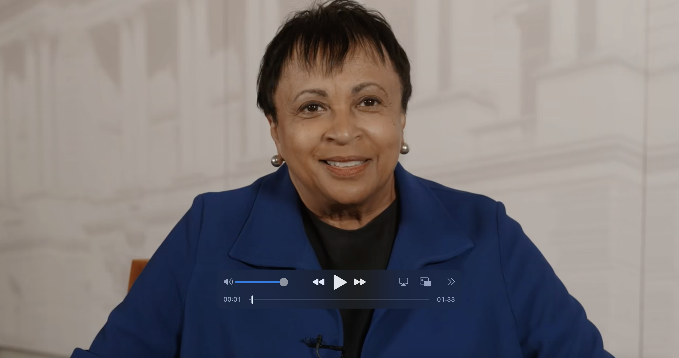
22/23 Curriculum Plan
Part 1: Competencies & Communication
Unit 1: Orientation & Internship Competencies
Unit 2: Communication & Teamwork
Part 2: All About Libraries
Unit 3: Introduction to Libraries
Unit 4: Reference and Information Literacy in Libraries
Unit 5: Circulation, Cataloging, & Access
Unit 6: Technology Services and Digital Libraries
Part 3: ALA Summer Institute
Unit 7: Careers in Library & Information Services
Dr. Carla Hayden provided a video of support for introduction to libraries

Slide 27
Assessing our Recruiting and Retention Practices
Assessing our strategies for recruiting a diverse workforce – what to do, what not to do
ALA Recruiting for Diversity
Building rapport, fostering belonging, and supporting the diverse people we’ve worked so hard to recruit for our organizations

Slide 28
Assessment – What we've learned
Assessment has primarily focused on the success of the program, that is accomplished by all members of the team working toward the program goals.​
Survey’s
Satisfaction for all stakeholders (mentors, CTE teachers, workplace partners, and cohort students participating in the program)
Curriculum Evaluation
Focus Groups
Pre and post program – held to measure student readiness for starting program and college readiness, as well as overall program successes and potential improvements
Notes:
Program Goals
Recruit two cohorts of five high school seniors from diverse and underrepresented backgrounds
Partner with library/cultural organizations
Mentor cohort students; encourage them to pursue library careers
Cohort students attend ALA Conference
Develop & Disseminate Toolkit

Slide 29
Future of the DLCTE Program
Short-term
Program extended for a third year due to COVID contingency
Long-term:
Sustaining the benefits of the program via a toolkit
Goal #5 in the grant proposal: “Develop and disseminate a toolkit that includes a curriculum of librarianship for students and library staff that emphasizes leadership training, racial equity, racial justice, inclusion, and culturally responsive education.”
Notes:
Program Goals
Recruit two cohorts of five high school seniors from diverse and underrepresented backgrounds
Partner with library/cultural organizations
Mentor cohort students; encourage them to pursue library careers
Cohort students attend ALA Conference
Develop & Disseminate Toolkit

Slide 30
DLCTE Toolkit
Creating a replicable program

Slide 31
Developing the Toolkit
Lora Del Rio's Spring 2023 Sabbatical Focus
Defining Scope & Audience
Choosing a CMS (WordPress)
Support & Collaboration from SIUE IRIS Center/Dr. Meg Smith
Card sorting activity to create sitemap
Content includes: partnerships agreements, a student job description, curriculum, mentorship best practices, program evaluations, assessment data, and other supporting documentation

Slide 32
Disseminating the Toolkit
Creative Commons license to allow others to use and adapt
Publishing the toolkit in SPARK, SIUE's institutional repository
Speaking & writing opportunities

Slide 33
Toolkit: Sneak Peak & User Survey
Explore our toolkit website: https://iris.siue.edu/dlcte/
Take our user survey linked on the homepage to give feedback for us to improve

Slide 34
Questions?
Thank you!

