Slide 1
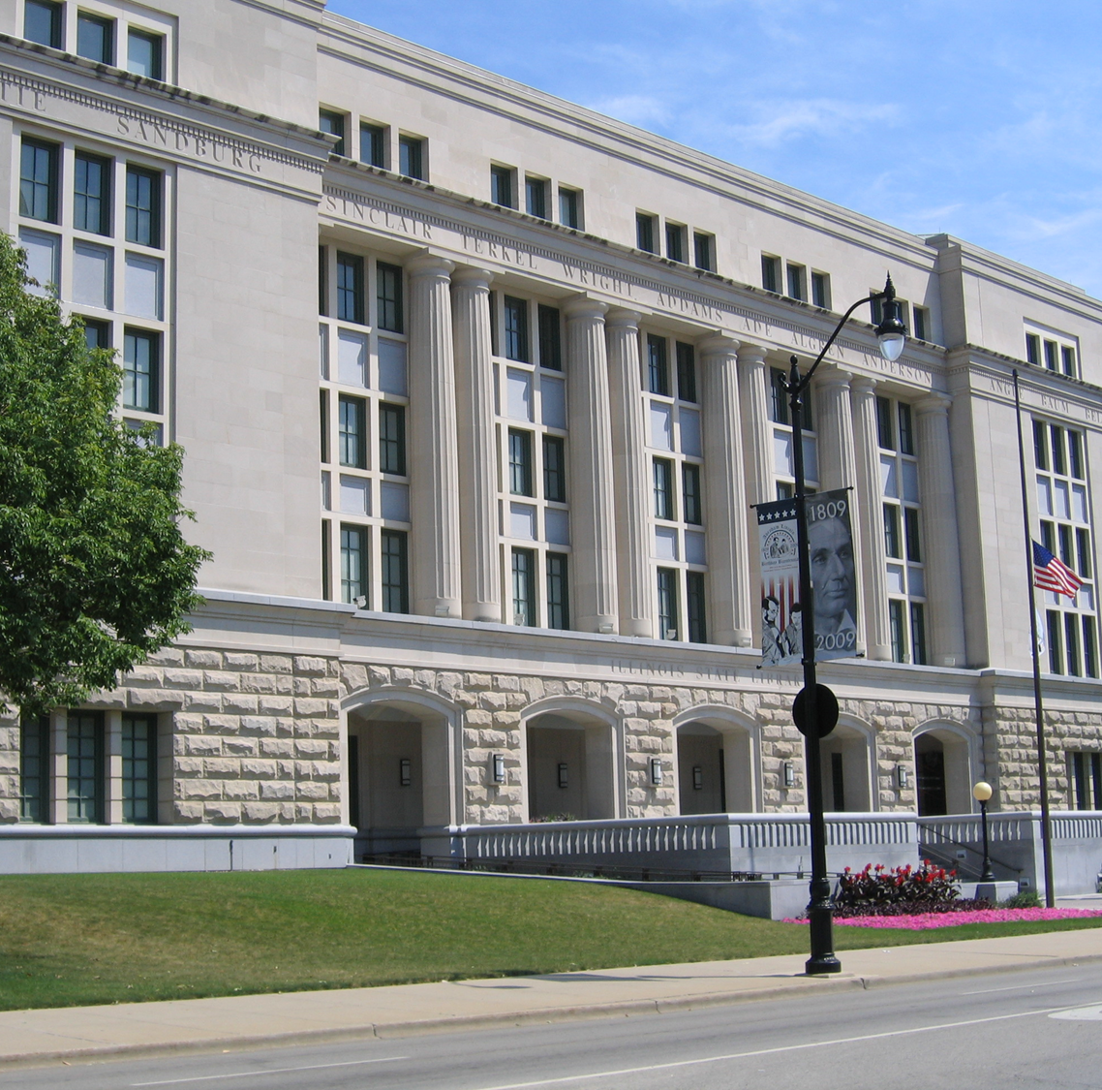
https://www.ilsos.gov/departments/library/home.html
The Illinois State library administers grants for library and literacy service, programs and initiatives.
Access to ideas, resources and information
Through the efforts of Illinois’ academic libraries, public libraries, school libraries, special libraries, regional library systems, literacy agencies, and partnering workplaces
All grants are authorized by 23 ILAC 3035 Illinois State Library Grant Programs

Slide 2
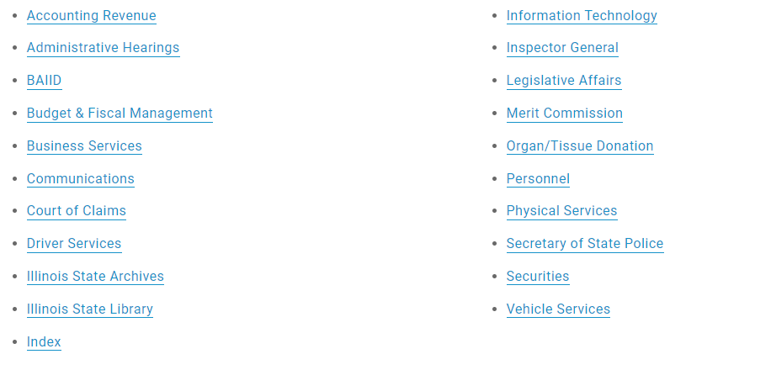
ISL is one of 21 SOS departments

Slide 3
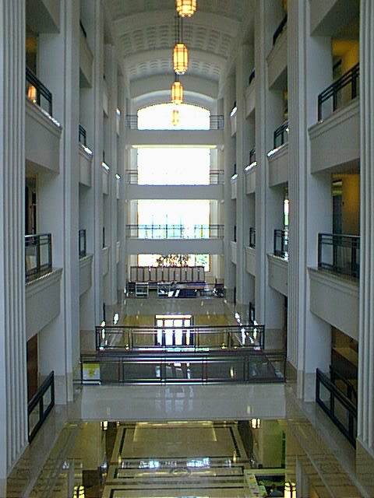
IL State Library: 2 major roles
As a library, serve:
State government employees and elected officials
The blind and physically handicapped
Adults who are at/below 9th grade reading level (literacy services)
Illinois residents
As a government office, foster library and literacy development:
Grants
Resource Sharing

Slide 4
Illinois State Library awards grants
Two sources of funding for Grants:
State Funds from the Secretary of State’s budget
http://www.cyberdriveillinois.com/departments/library/grants/home.html
2) Federal Library Services and Technology Act Funds through the Grants to States Program of the Institute of Museum and Library Services
https://www.imls.gov/
Notes:
Library Services and Technology Act grant funds are provided to the Illinois State Library from the Institute of Museum & Library Services. It’s a population based formula and because IL is the sixth largest state, we currently receive the sixth largest allotment nationwide.
These federal funds are combined with state dollars to maximize use for statewide initiates and grants to libraries.

Slide 5
Who receives Secretary of State - Illinois State Library grants?
Library systems
School libraries
Library consortia
Literacy providers
Academic libraries
Special libraries
Public libraries
BPH providers

Slide 6
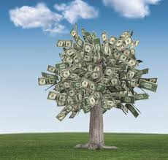
Why apply for grants?
New funding stream
Create new or expanded programs
Collaborate and have a bigger impact
Domino effect

Slide 7
Gather Ideas:
Read
Your Passion
Interests
Borrow ideas from others
Need based
Be able to articulate the results
Have a range of ideas ready:
$5,000
$50,000
$150,000
$500,000

Slide 8
Keep it Simple and Focused
Write to persuade
Be realistic
Be logical
State your case
Include facts and figures to backup your statements
Never assume

Slide 9
Institute of Museum & Library Services https://imls-spr.imls.gov/Public/Projects

Slide 11
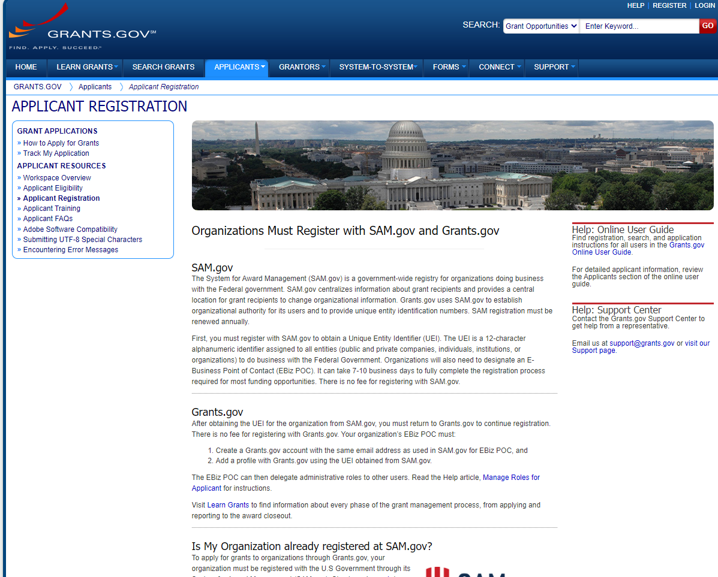
Federal Grants – Is your agency registered?

Slide 12
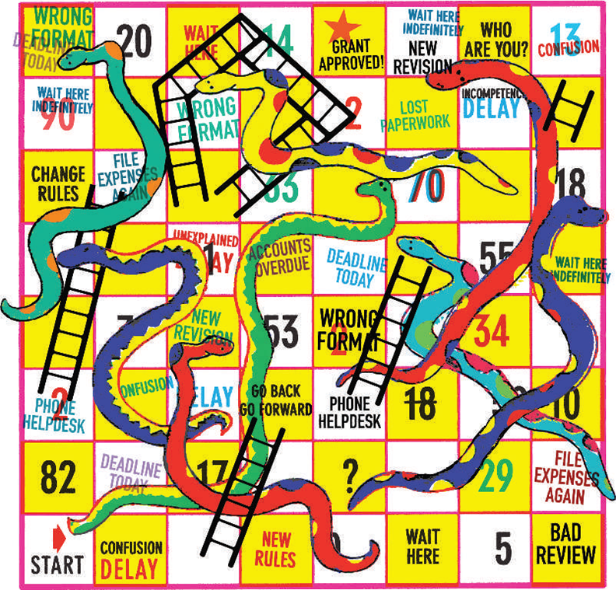
Is your agency eligible?
How will your project achieve the goals listed in the grant announcement?
Be clear
Be concise
Hint – who will benefit?
Image from: Giles J., Research grants: the nightmare before funding. Nature 2005 (437):308-311.
Notes:
A proposal that is clear and concise and addresses as many of the application requirements as possible is likely to receive a higher score than one that does not.

Slide 13
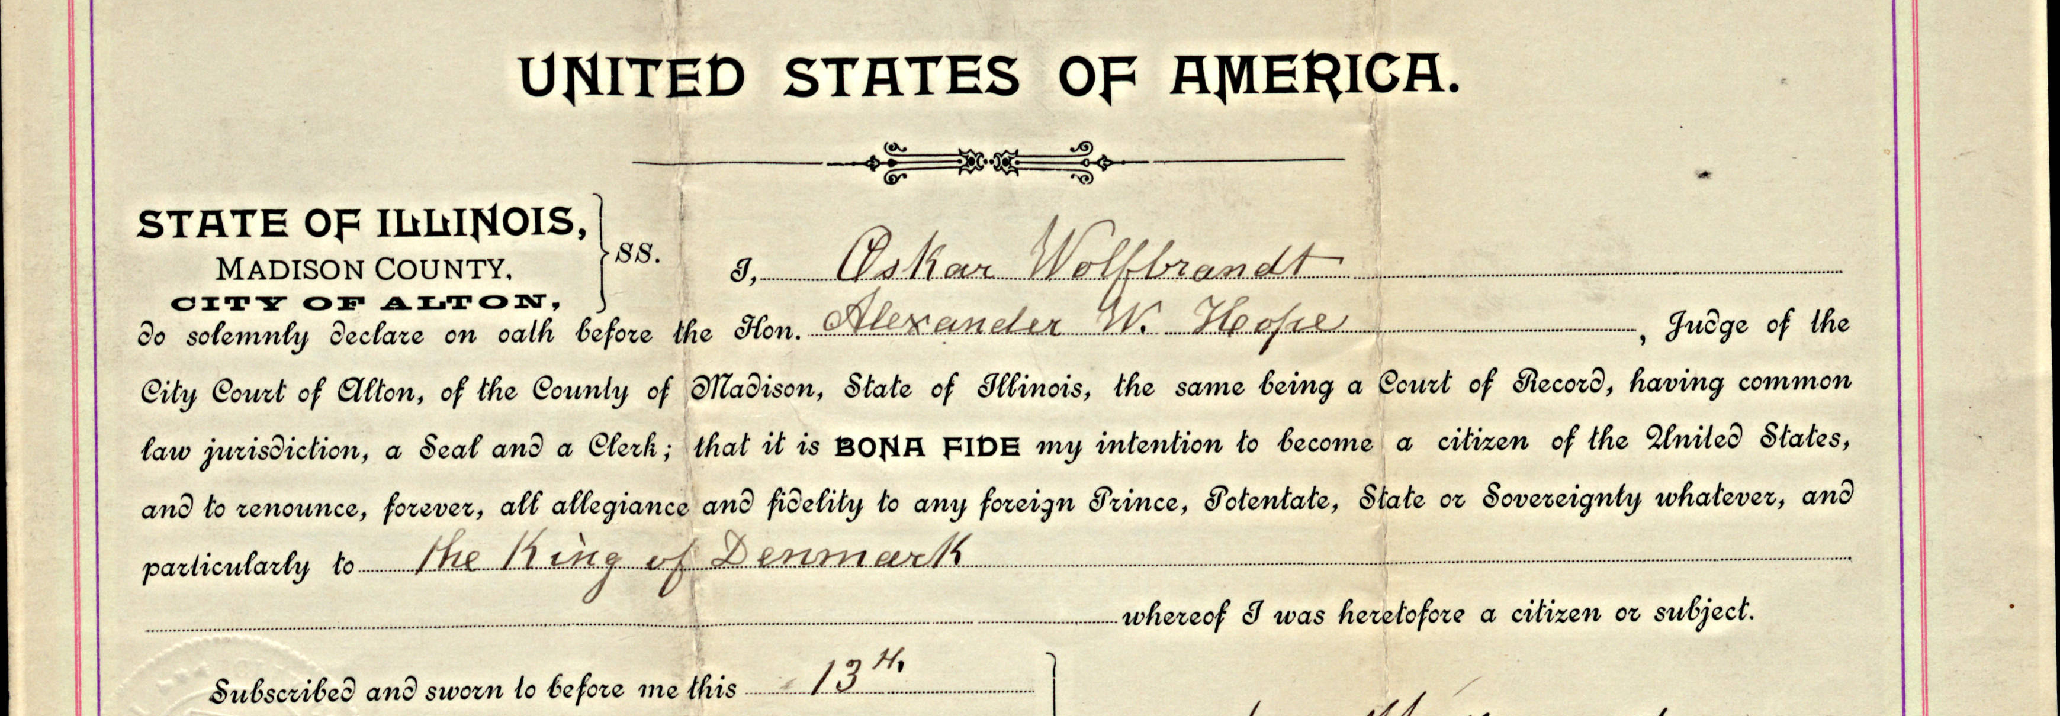
Southern Illinois University Edwardsville - $42,371
Madison County, Illinois Naturalization Records: A Digital Collection of Social and Family History

Slide 14
HB 2789
"The concept of banning books contradicts the very essence of what our country stands for. It also defies what education is all about: teaching our children to think for themselves.”
Alexi Giannoulias, Secretary of State and State Librarian

Slide 15
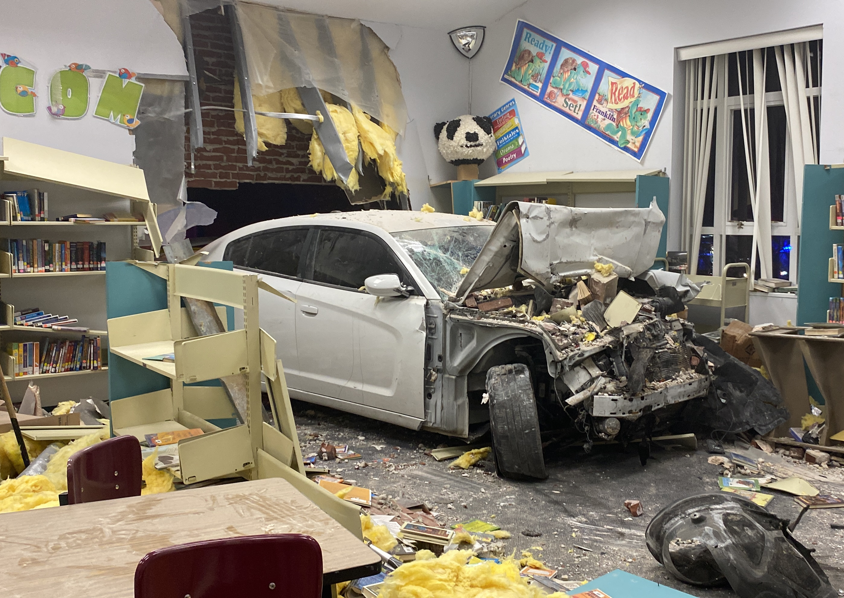
Sometimes things are out of your control.

Slide 16
For a child entering kindergarten this year,
what should their college library look like?
How could academic library services be crafted to meet the needs an incoming Freshman will have in 2032?
How can grants help you get there?

Slide 17
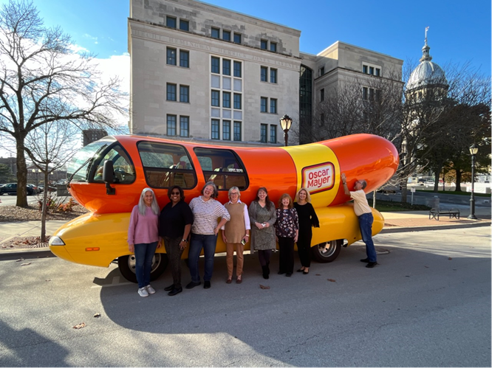
Karen Egan, Associate Director
Grants & Programs, Library Development
Illinois State Library
kegan@ilsos.gov
217-782-7749

