Slide 1
Academic Librarians’ Opinions on Social Justice Advocacy
Judy Brink Drescher
Molloy University
Presented on October 11, 2023, to the
Professional Development Alliance

Slide 2
Problem Statement (why I did it)
At 80%, the field of librarianship is overwhelmingly white, comprised of middle-aged, middle-class females¹
There is a gender and race imbalance within salary and leadership opportunities²
Lack of diversity can impede our ability to support an increasingly diverse student and workforce population⁴
Systemic issues of a dominant narrative pervades libraries and academia
There is difficulty attracting and retaining librarians and staff from culturally marginalized groups³
¹American Library Association (2017). Member demographics study. Schoenfeld, R. C., & Sweeney, L. (2017). Inclusion, diversity, and equity: Members of the Association of Research
Libraries: Employee demographics and user perspectives
²American Library Association (2007). Library directors: Gender and salary.
³Alabi, J. (2015a). Racial microaggressions in academic libraries: Results of a survey of minority and non-minority librarians. The Journal of Academic Librarianship, 41(1), 47–53. https://doi.org/10.1016/j.acalib.2014.10.008
⁴National Center for Education Statistics. (2021). Condition of education: Undergraduate enrollment.

Slide 3
Purpose of the Study
What leads some academic librarians to reflect upon and interrogate their worldview, so they become actively engaged as advocates and social justice allies (SJAs)?
What informs or impedes increased levels of social justice interest and commitment within the profession?
“Allies are people with a genuine desire to create justice. They are individuals from a privileged group who make intentional choices to support or work for the rights of those from the oppressed group.”*
*Goodman, D. J. (2011). Promoting diversity and social justice: Educating people from privileged groups, Routledge. p. 157.

Slide 4
Background
Study served as a partial fulfillment toward an Ed.D.
A two-phase mixed methods approach of surveys and interviews
Emphasis on understanding the WHY
Awarded 2022-2023 Dissertation of the Year!*
*Brink Drescher, J. L., (2022). Toward a transdisciplinary model of social justice in academic librarianship: Promoting critical awareness within advocates and privileged allies. https://digitalcommons.molloy.edu/etd/133

Slide 5
Timeline
Total response n = 156
Final sample n = 113
Phase 1 Quantitative:
Design & Test Qualitrics Survey
Transcribe/Finalize Librarian Narratives and Review with Those Interviewed
Phase 2
Qualitative:
Recruitment & Interviews
Write Discussion
Chapter
Compile/Edit All Chapters
MAR
APRIL
MAY
JUNE
JULY
AUG
SEPT
OCT
NOV
DEC
Launched Survey Across 5 Listservs
Open-ended Question Analysis and Development of Collective Themes
Write Results
Chapter
Dissertation
Defense
Dissertation Published

Slide 6
Population & Sampling
Academic Librarians were the target population
Five Listservs
ACRL Members, Instruction, and Framework Lists
ALA Members List
State University of New York Librarian Listserv (SUNY-LA)
Candidate Criteria for Interviews Informed via the Survey
Volunteer to be interviewed
Interest and commitment determined by the Social Issues Questionnaire (SIQ)*
Answers to Open-ended Questions (OeQs) regarding advocacy
24 volunteers for interview candidate pool
9 approached, 6 agreed
*Miller, M. J., Sendrowitz, K., Connacher, C., Blanco, S. Muñiz de la Peña, C, Bernardi, S., & Morere, L. (2009). College students’ social justice interest and commitment: A social-cognitive perspective. Journal of Counseling Psychology, 56(4), 495–507.

Slide 7
A Mixed-Methods Approach
Quantitative (Survey)
Librarian Profile Survey: 7 closed-ended questions
Personal Demographics: 5 closed-ended questions
Social Issues Questionnaire (SIQ): 5 part/52 questions
Advocacy: 2 closed-ended, 5 Open-ended Questions (OeQs)
Qualitative (Interviews)
Social Justice Ally (SJA) Narratives
Overarching Themes
Integrative (Overlap)
Mixed assessment between OeQs and those Interviewed
Overlap analysis between SJAs and Librarian Advocates
Informed overall Implications for Practice

Slide 8
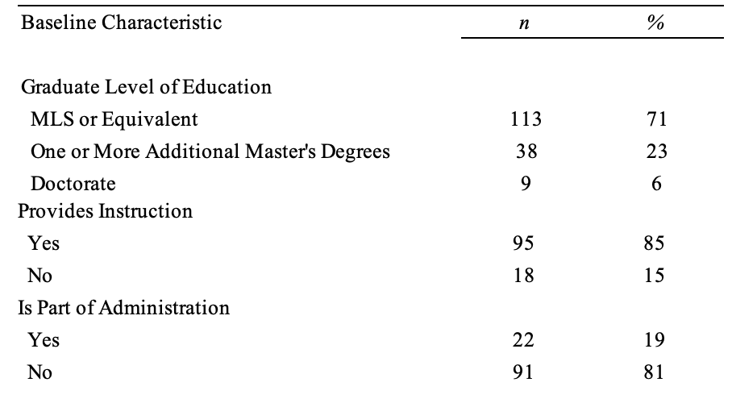
Quantitative Results: Professional Demographics

Slide 9
Quantitative Results: Personal Demographics
4%
12%
83%
80%
5% each: Black, Hispanic, Multi-racial, and All Other Categories
Personal Demographics Summary:
Birth Country: 99% U.S.
First Language: 92% English (U.S.)
Gender: 83% Female; 12% Male; 4% Other

Slide 10
Quantitative Results: Institutional Demographics
17%
27%

Slide 11
Quantitative Results: Advocacy
Social Justice Attitudes

Slide 12
Quantitative Results: Statistical Analysis
RQ1:Does social justice interest (SJI) correlate with social justice commitment (SJC)?
There was a strong positive correlation between SJI and SJC
Social justice interest also significantly predicted commitment
As social justice interest increased, so did commitment

Slide 13
Quantitative Results: Statistical Analysis
RQ2: When considering the independent variables of type of institution, size of institution, years in the profession, highest earned degree, provides instruction, is part of library administration, age, ethnicity, and gender:
Is there a relationship between any of these
characteristics and a) SJI or b) SJC?
Neither social justice interest (SJI) nor social justice commitment (SJC) were statistically significant with any of the nominal or scaled variables of librarian characteristics.

Slide 14
Open-ended Questions (OeQs)

Slide 15
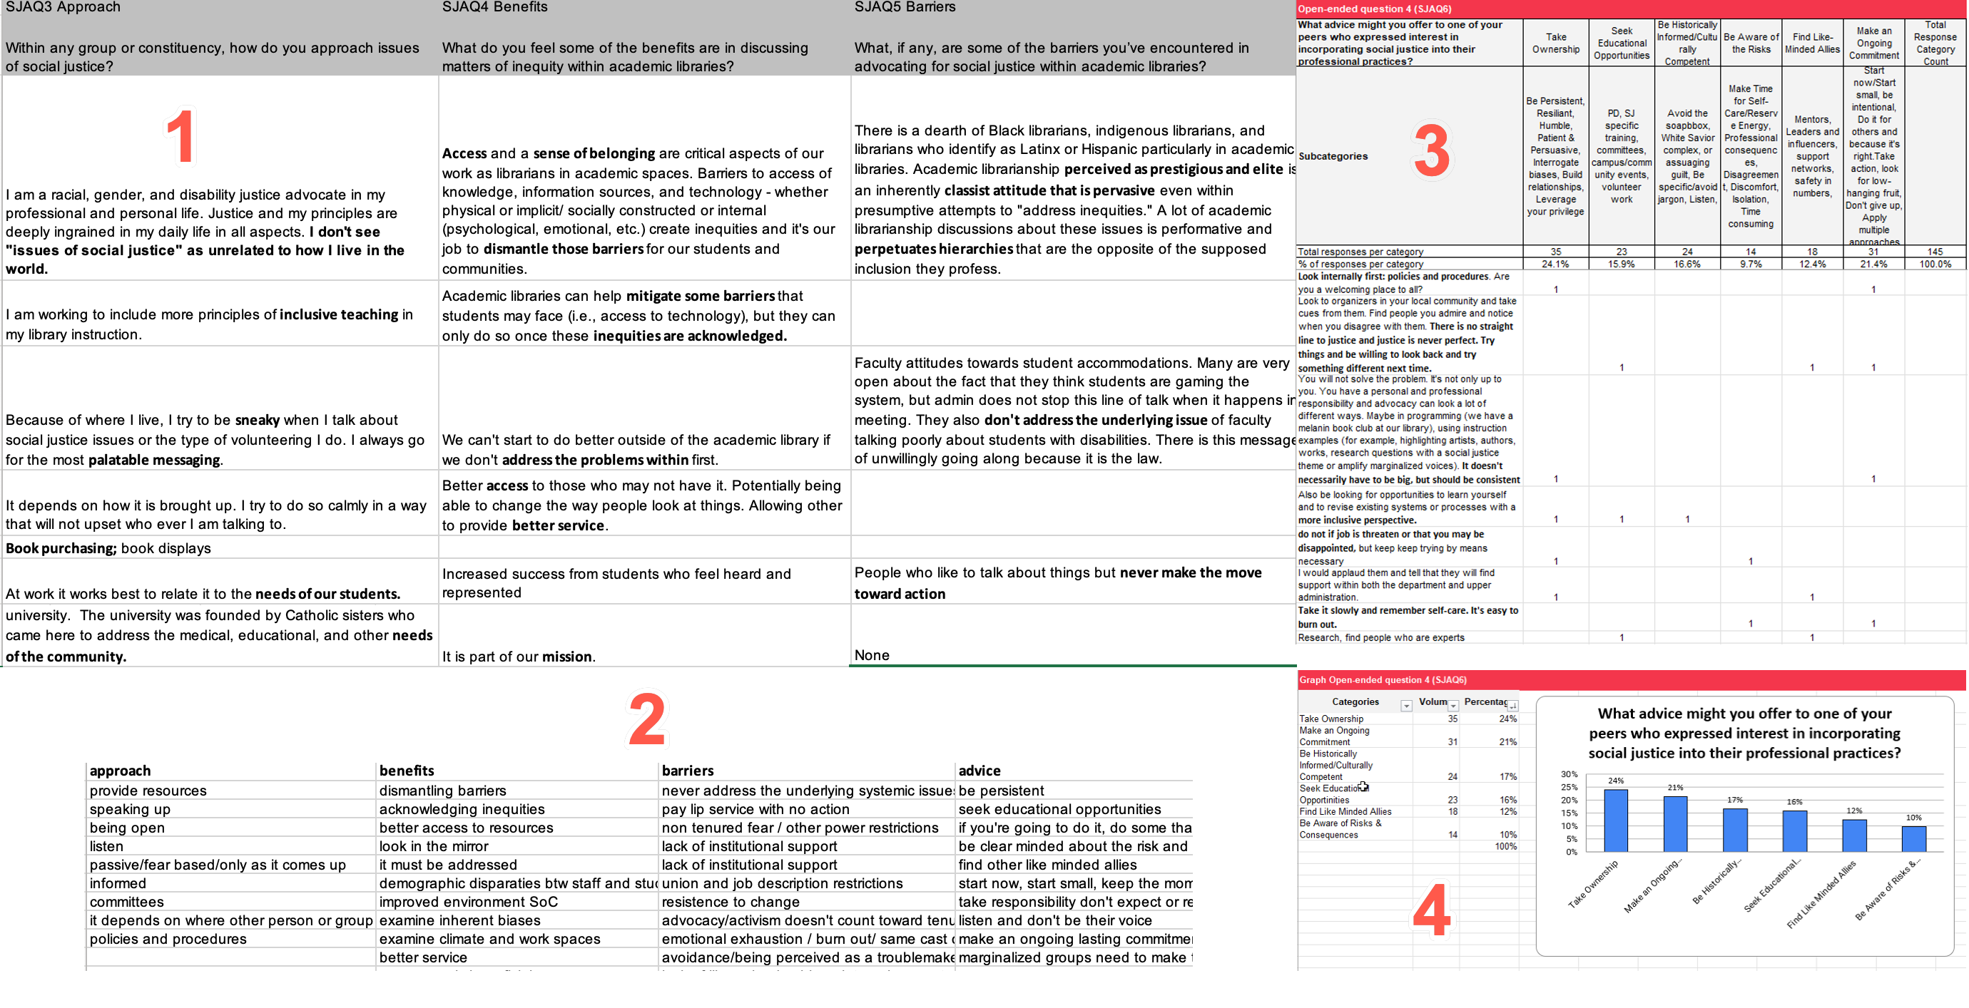
Advocacy Classification Scheme
Template retrieved from: https://www.hotjar.com/blog/analyze-open-ended-questions/#:~:text=Step%201%3A%20get%20your%20data%20into%20the%20template,-1%29%20Export%20the%20data

Slide 16
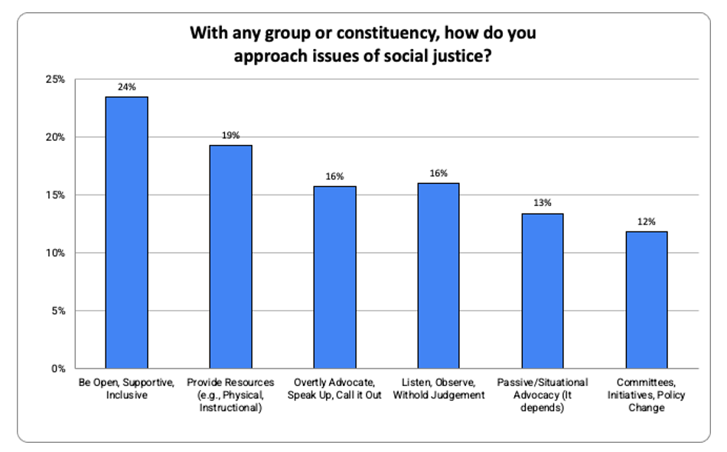
Open-ended Question (OeQ) Results: Question 1

Slide 17
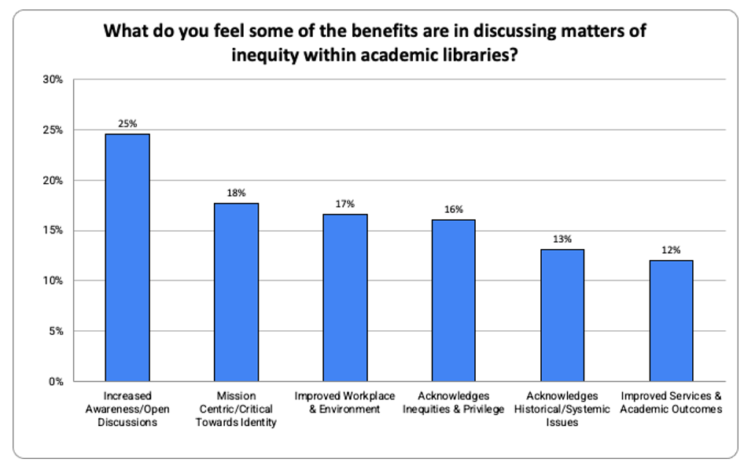
OeQ Results: Question 2

Slide 18
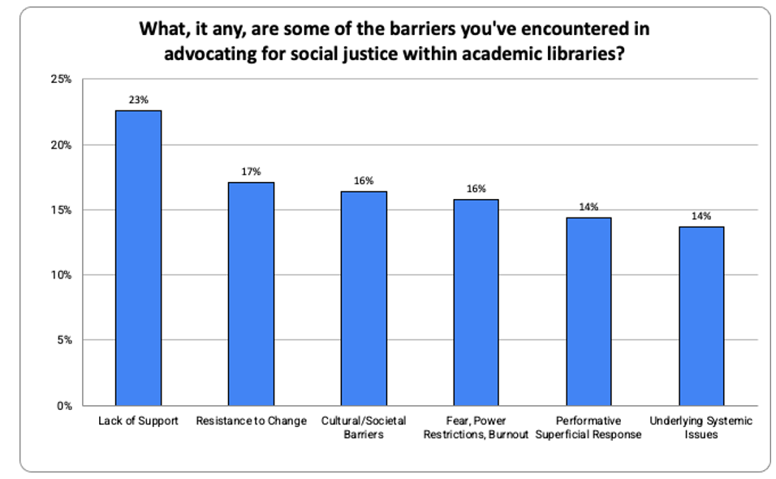
OeQ Results: Question 3

Slide 19
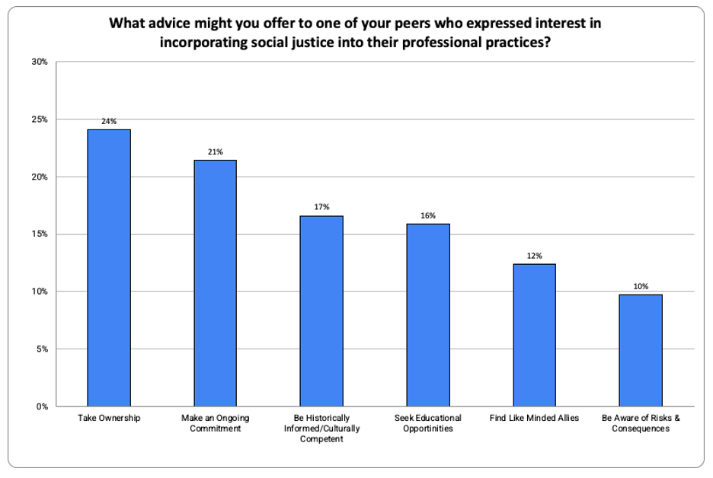
OeQ Results: Question 4

Slide 20
Qualitative Results: Six SJA Narratives
Alisha, a faculty librarian at a community college who serves as part of her library’s leadership. First encounter: Ableism. Focus: ADA accessibility; equitable student support services.
Tracy, an associate librarian who is part of her library’s administration at a small college. First encounter: Classism. Focus: Library specific diversity audit; incorporating DEI into her strategic initiatives.
Shay, who serves at a small university and has only one year in the profession. First encounter: Heterosexism. Focus: Professional development of library personnel in DEI; applying CRT within library pedagogy.
Jennifer, who hails from a mid-sized university and has a combined thirty-five years in library and leadership experience. First encounter: Sexism. Focus: Equitable pay; increasing staff compensation and benefits.
Michael, another seasoned librarian who is part blood American Indian serving at a large institution on a border state. First encounter: Ableism and bullying. Focus: Mentoring disadvantaged groups; National advocacy.
Sydney, a mid-career professional who leverages her position as a instruction librarian to further social justice reform. First encounter: Religious intolerance. Focus: Feminism and gender equality; library outreach.
SJA Demographics:
Professional : 1-45 years of experience, all but one provided instruction; half were part of their library’s administration
Institutional : Geographically dispersed; 3 universities, 2 colleges, 1 community college; 2 with < 20k students, 1 < 10k, and 3 < 5k
Personal : 5 females, 1 male, 26-64 years old, 5 White,
1 American Indian

Slide 21
Qualitative SJA Results
RQ3: What particular lived experiences led academic librarians who are actively involved in social reform to become SJAs?
Environmental
Held significant privilege / Middle-to-upper-middle class households
Strong support systems within family and community
Development of Cultural Competency
Awareness developed during college years
Continuous learning / Professional development
Organizational or National Participation / Committee Work

Slide 22
Qualitative SJA Results
RQ3: What particular lived experiences led academic librarians who are
actively involved in social reform to become SJAs?
Environmental
Held significant privilege / Middle-to-upper-middle class households
Strong support systems within family and community
Educational Development of Cultural Competency
Awareness developed during college years
Continuous learning / Professional development
Organizational or National Participation / Committee Work
Experience as an Outsider
Half of the SJAs identified LGBTQIA+ orientation as a source of isolation
Witnessed or were victims of numerous other ‘isms’
Increased sense of empathy

Slide 23
Qualitative SJA Results
RQ4: What strategies do SJAs describe as having the most impact upon challenging the sociopolitical status quo within their library, institution, and beyond?
Direct Engagement with Underrepresented Groups
Efforts to increase both student and staff engagement
Infusing DEI into instructional pedagogies
Create External Pathways for Students and Staff
Partnering with already established groups
Mentorship
Internal initiatives that lead to advancement

Slide 24
Qualitative SJA Results
RQ4: What strategies do SJAs describe as having the most impact upon challenging the sociopolitical status quo within their library, institution, and beyond?
Direct Engagement with Underrepresented Groups
Efforts to increase both student and staff engagement
Infusing DEI into instructional pedagogies
Create External Pathways for Students and Staff
Partnering with already established groups
Mentorship
Internal initiatives that lead to advancement
Form Alliances with Like-Minded Allies
Increases success of any potential social justice initiative
Seek out influential allies that hold higher levels of authority
Safety in numbers; avoids isolation and burnout

Slide 25
Integrative (Mixed) Results
RQ5: What personal attributes do advocates describe as necessary for enabling librarians to take on a greater social justice advocacy role?
Take Responsibility for Actions and Behavior
Own your privilege
Interrogate your biases
Impact of your privileges over others
Develop the Art of Respectful Listening
Open discussions ensuring all voices are heard
Withhold judgment
Respectful dialog

Slide 26
Integrative (Mixed) Results
RQ5: What personal attributes do advocates describe as necessary for enabling librarians to take on a greater social justice advocacy role?
Take Responsibility for Actions and Behavior
Own your privilege
Interrogate your biases
Develop the Art of Respectful Listening
Open discussions ensuring all voices are heard
Respectful dialog
Withhold judgment
Be Open, Supportive, and Inclusive
Understand perspectives of those less privileged
Be a respectful ally and observe boundaries
Create a safer, more welcoming atmosphere

Slide 27
Integrative (Mixed) Results:
RQ6: What individual, institutional, or societal barriers or challenges do advocates describe as impeding their efforts towards achieving social justice reform?
Performative/Superficial Response
Low hanging fruit, box-checking, all talk no action
Being uninformed or unaware on multiple fronts
Half-hearted DEI initiatives

Slide 28
Integrative (Mixed) Results:
RQ6: What individual, institutional, or societal barriers or challenges do advocates describe as impeding their efforts towards achieving social justice reform?
Performative/Superficial Response
Low hanging fruit, box-checking, all talk no action
Being uninformed or unaware on multiple fronts
Half-hearted DEI initiatives
Lack of Support
Budget restrictions / Lack of funding
Social justice work neither acknowledged nor incentivized
Underlying Systemic Issues
Historical role of libraries and academia
Lack of diversity in staff, faculty, and librarians vs. student population
Inconsistent with HSI status and DEI initiatives

Slide 29
Implications for Practice

Slide 30
Implications for Practice: Support Issues
Academic librarians have a vested interest in social justice work and need support
We need people doing lots of different things. We need grunt work. We need Board members. We need bullhorns. We need bots. We need books. No one person should feel they need to do it all, but every single person has a role to play and can do something. Advocating for social justice is one thing. Being about it is another. Either is fine. Both is better. (Librarian Advocate)
I am so dedicated and stubborn in this regard I cannot retire until I get some staff upgraded! (Jennifer)
Many librarians, including whites, apply their own experiences of being marginalized
For my fellow BIPOC peers I would encourage them to not devote all of their energy to it, because it can be very exhausting to work to change the system while being actively oppressed by the system, and they don't owe any system that energy. (Librarian Advocate)
Knowing this is the environment and knowing this [region] and how I grew up here, I have my pride slides in my window, I openly talk about race. I say race. I say Black and White and Latinx. I say things instead of just diversity, and I have had students, mostly students of color really open up to me. (Shay)

Slide 31
Implications for Practice: Support Issues
There is an overwhelming need for institutional support as opposed to performative activism
When advocating for social justice, people (mostly higher-up faculty and administration) want to settle for safe DEI initiatives that provide a performative display of support. This is hurtful because the positive optics pivot away from real conversations that need to be had to improve inclusion and real social justice initiatives (pay equity, equitable professional development, funding, etc.). (Librarian Advocate)

Slide 32
Implications for Practice: Systemic Issues
Resistance to change within a culture of silence
A barrier that I see is a surface-level interest and discussion around DEI that is not matched by an equivalent amount of action. What work that is done tends to be around individual events and initiatives, rather than on a systemic policy level. Many of our colleagues believe in diversity as long as it doesn't disrupt their way of doing things, and as long as they themselves don't have to change how they think. (Librarian Advocate)
I honestly believe to my core that representation matters. Students need to see, hear up the wazoo, that there are faculty and staff on campus who have similar lived experiences to them. Because if we don’t make that known to students, they’re just going to feel Other. And those of us on the faculty who are Other, need to know that there are people like us, who are by virtue of our lived experiences, wedded to creating societal change. (Tracy)

Slide 33
Implications for Practice: Systemic Issues
Recruitment, hiring, and retention practices for inservice and preservice librarians
It’s not that we don’t try to hire more Hispanics and or other people of color. It’s that they’re not there. Because taking on a bunch of debt for a job that you start at $42,000 a year, that’s really hard to do. You’re coming from privilege if you’re able to do that. I’m 60 years old, I’ve been a librarian for over 30 years, and I am still living paycheck to paycheck. If I had kids, I don’t know what I’d do…If we really want to work on our diversity, inclusion and equity, we have to work on the status of librarians, and get our pay up far enough that [persons of color] won’t look at it and say, it's just not worth it. (Michael)
Literature regarding LIS curriculum and preservice outcomes
Alabi, J. (2018). From hostile to inclusive: Strategies for improving the racial climate of academic libraries. Library Trends, 67(1), 131–146. https://doi.org/10.1353/lib.2018.0029
Jaeger, P. T., Cooke, N. A., Feltis, C., & Hamiel, M. (2015). The virtuous circle revisited: Injecting diversity, inclusion, rights, justice, and equity into LIS from education to advocacy. The Library Quarterly, 85(2), 150–171. https://doi.org/10.1086/680154
Pawley, C. (2006). Unequal legacies: Race and multiculturalism in the LIS curriculum. The Library Quarterly (Chicago), 76(2), 149–168. https://doi.org/10.1086/506955
St. Lifer, E., & Nelson, C. O. (1997). Unequal opportunities: Race does matter. Library Journal, 122(18), 42-46.

Slide 34
Implications for Practice: Lack of Diversity
The need to serve an increasingly diverse student population
Many students come into the library spaces or receive a service from the library, so how we interact with them can greatly impact them on their academic journey, either directly or indirectly. Through an academic library's social justice efforts, students' sense of belonging, academic success, and world knowledge can be increased. Additionally, the faculty and staff that work in the library can have a more healthy work environment, one that fosters care and community and purpose. (Librarian Advocate)
Every time they bring that up, everyone in the library is like, ‘Well, they should answer the phone then.’ …if you’re worried about retention, literally if you just answer the phone, miracles happen. (Alisha)

Slide 35
Implications for Practice: Lack of Diversity
Confront the problem of neutrality (aka: colorblindness)
If we don't talk about it, we won't really grapple with the fact that libraries are not really neutral spaces, as we like to think, and that our services aren't equitable - and if we don't grapple with that, we can't change it. (Librarian Advocate)
My stance on neutrality would be that any presumed neutrality is not actually neutral because it’s probably silencing someone, and that it’s okay to make arguments, but it’s also necessary to listen respectfully and not shut down disagreement. But then, the problem is there are some disagreements that you should shut down because they are really harming someone. That’s where the line is, I think. (Sydney)
I do not believe in library neutrality. I believe by their very existence libraries are not neutral. And librarians who try to hide between content neutrality are hiding behind a wall of straw because neutrality is not possible for multiple reasons. (Michael)

Slide 36
Implications for Practice: Lack of Research
Not Enough Data on Privileged Groups or Allies
Frameworks that seek to simplify and make accessible complicated dynamics never capture the full complexity of the situation or issue. (p. 7)*
Not Enough Data on Sexual Orientation in Libraries
My biggest frustrations are two attitudes. First, we don't need this anymore and second, social justice only includes issues surrounding ethnicity but does not include issues surrounding sex/gender/societal roles and expectations. (Librarian Advocate)
*Goodman, D. J. (2011). Promoting diversity and social justice: Educating people from privileged groups, (2nd ed.). Routledge Ltd.

Slide 37
Tips on Expanding Your Reach
Present results to your peers and colleagues at a national conference
Affords networking opportunities for future research
People in academic libraries are interested in social justice outcomes
Research on gender identity is largely patron based
Emphasis on public libraries or collections, e.g., book bans, diversity audits
Little to no exploration on sexual orientation in any sector

Slide 38
Thank you!
Judy Brink Drescher, MLIS, MBA, EdD
University Librarian
Associate Dean for Learning Services
jdrescher@molloy.edu
Appendix includes data and links for ALA and Ithaka Surveys
Link to full dissertation: https://digitalcommons.molloy.edu/etd/133

Slide 39
Appendix
Excerpts from an ELUNA learns 2021 Presentation: Diversity, Equity, and Inclusiveness in Search Advisory Group Update. On-demand Streaming available via: https://el-una.org/meetings/eluna-events-on-demand-playback/eluna-learns-2021/eluna-learns-dei-diversity-equity-and-inclusion/

Slide 40
Whiteness within the Overall Library Profession
Source: http://www.ala.org/tools/sites/ala.org.tools/files/content/Draft%20of%20Member%20Demographics%20Survey%2001-11-2017.pdf
Notes:
The data shown here represents results from a member survey conducted by the American Library Association in 2014 and repeated in 2017. ALA members can include professional and non- professional staff as well as Library leadership. Respondents could also come from any type of library, be it public, academic, school or specialized entities. In regard to race, you can see whites represent the overwhelming majority and that there was little change between 2014 and 2017. In fact, every group from other categories reported <5%.

Slide 41
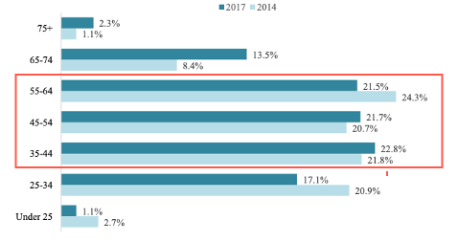
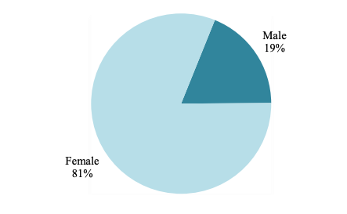
Gender & Age within the Overall Library Profession
ALA Members by Gender
(2014 & 2017)
ALA Members by Age
“As of January 9, 2017, 37,666 current members have participated in this voluntary,
self-selected survey. 74% of current members have participated in the survey.”
Source: http://www.ala.org/tools/sites/ala.org.tools/files/content/Draft%20of%20Member%20Demographics%20Survey%2001-11-2017.pdf
Notes:
These graphs are from the same ALA study and represent gender and age. The gender ratio did not change at all from 2014 to 2017. The visual on the right suggests there also wasn’t too much of a shift in age groups over time, as nearly 2/3s fell between the ages of 35 and 64. Taken collectively, the results of the ALA surveys suggest that the library profession as a whole is largely comprised of white middle-aged females.

Slide 42
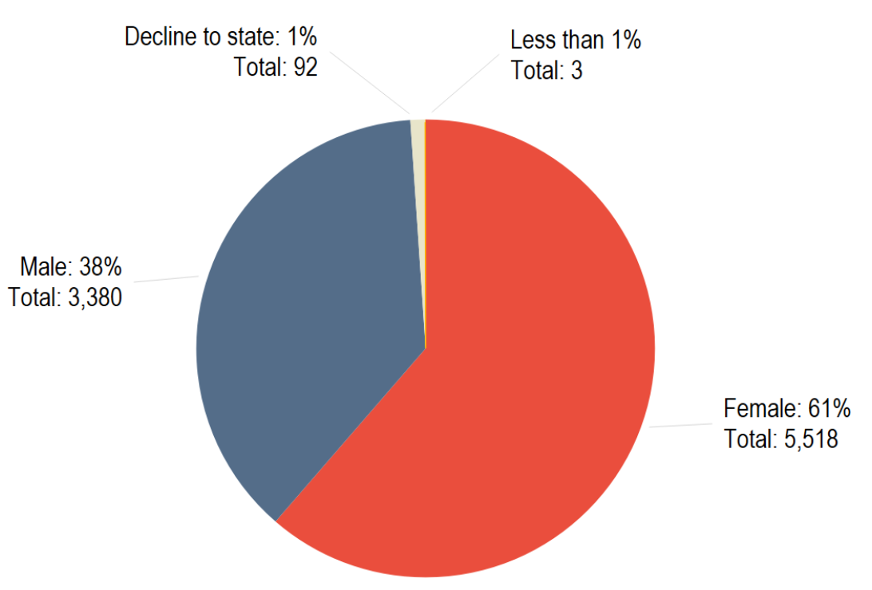
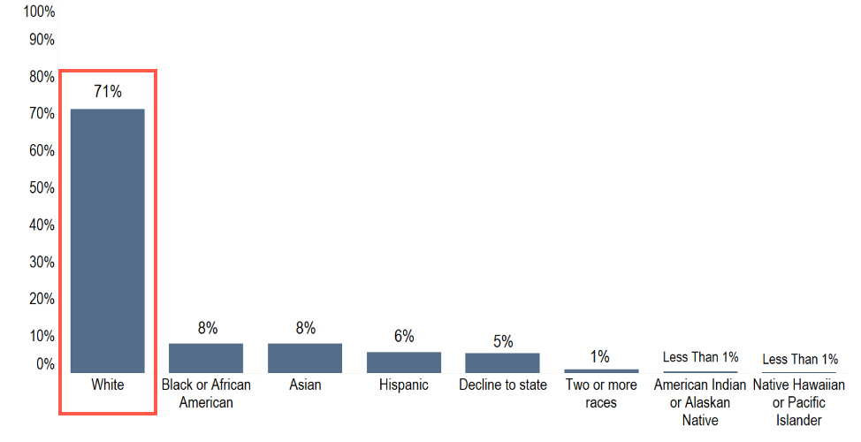
Ithaca S&R 2017 Report on Academic Libraries Inclusion, Diversity, and Equity: ARL Demographics
Gender in the ARL
Race/Ethnicity
Source: https://sr.ithaka.org/publications/inclusion-diversity-and-equity-arl/
Notes:
In a report published that same year, Ithaca S&R was commissioned by the Andrew Mellon foundation to investigate issues of inclusion, equity and diversity specifically within academic research libraries or ARLs. From a gender perspective, males in academic libraries were 20% higher than in the ALA study, which looked at libraries of all types. As for race and ethnicity, while minority groups on the average were nearly doubled from ALA’s numbers, at 71% there is still an exceedingly high representation of Whites overall within academic libraries.

Slide 43
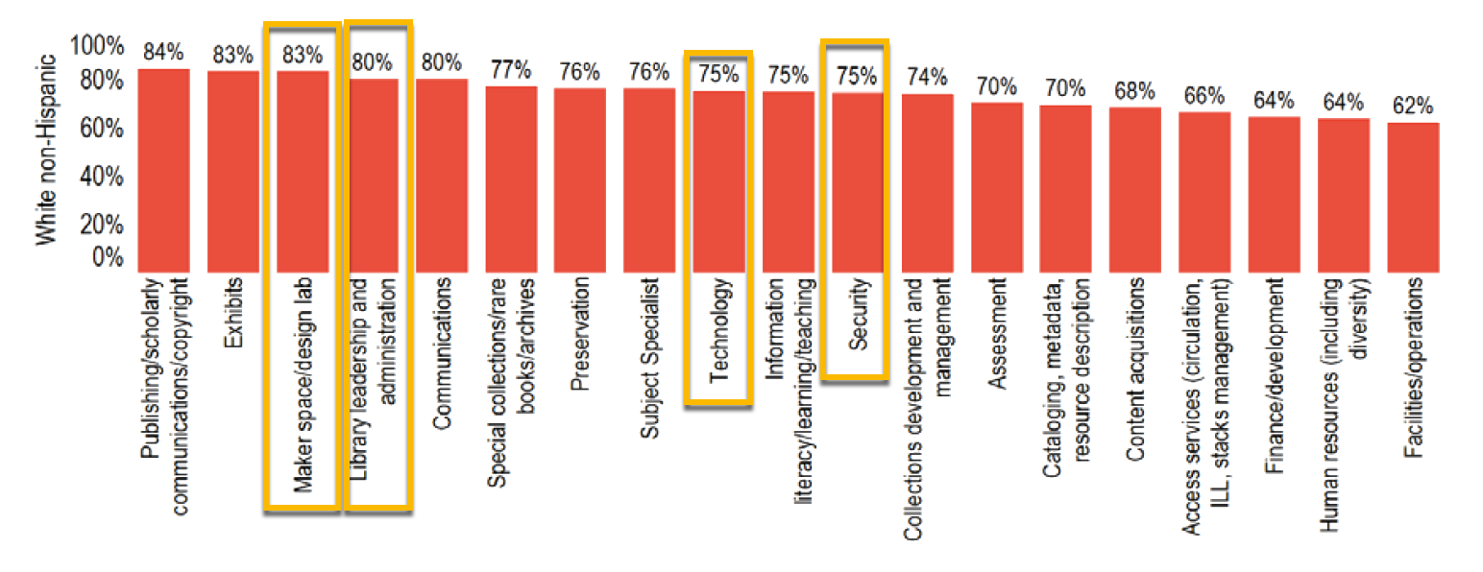
Ithaca S&R 2017 Report Inclusion, Diversity, and Equity: ARL Demographics
Race & Ethnicity by Job Type
Source: https://sr.ithaka.org/publications/inclusion-diversity-and-equity-arl/
Notes:
The disparity across all groups becomes even more evident when examining job types by race or ethnicity, as Whites not only represent ¾’s of the workforce in leadership and technology but are at least above 60% across all job roles. Given that most non-white groups were 8% or less, it is evident there is a substantial under-representation regarding who has a voice in how our library systems are designed and likely, what goes into them.

