Slide 1




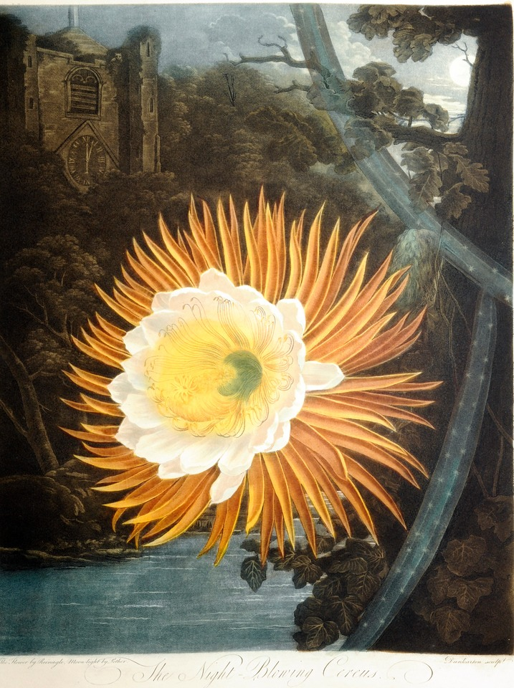
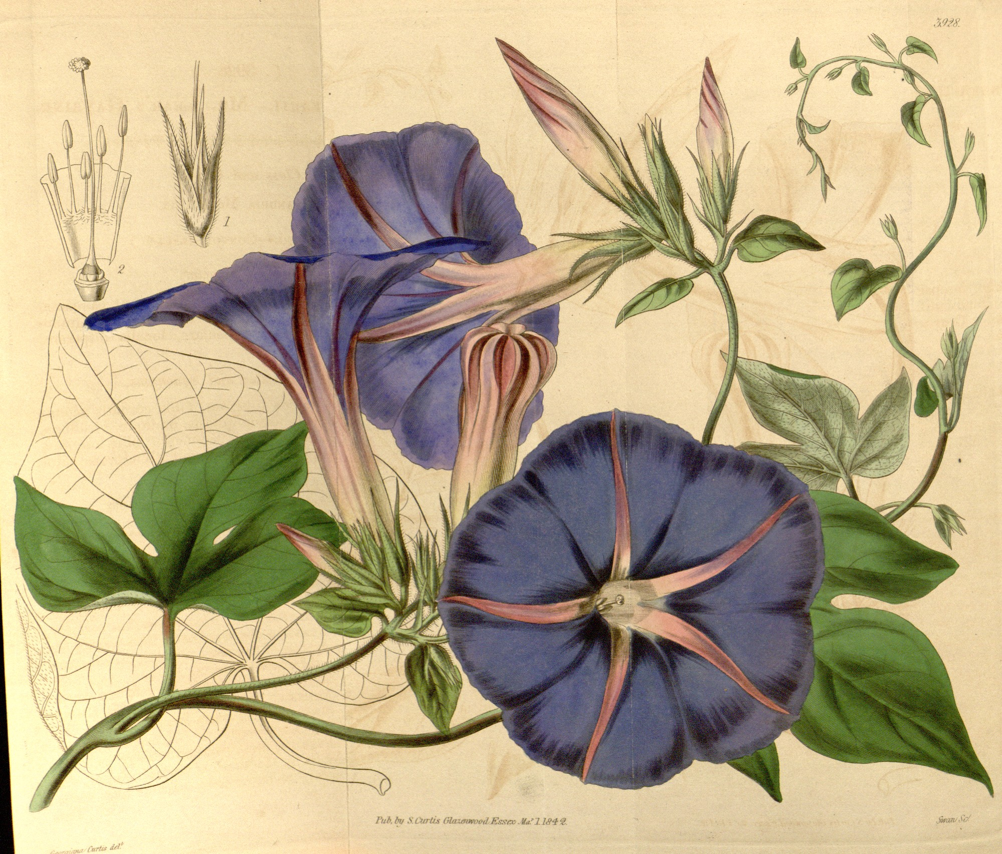
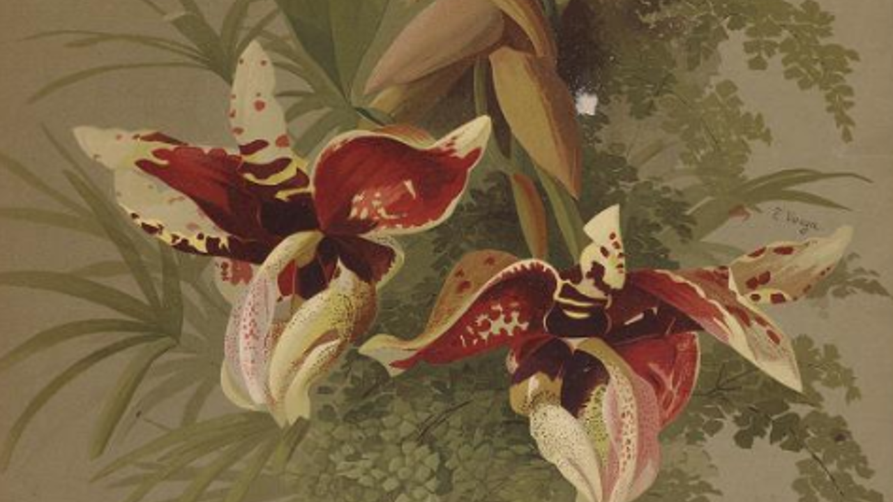
From Concept to Display:
Creating Impactful Library Exhibitions
Melanie Emerson and Leora Siegel
Zoom’s live transcript is available on the Show Captions menu.

Slide 2
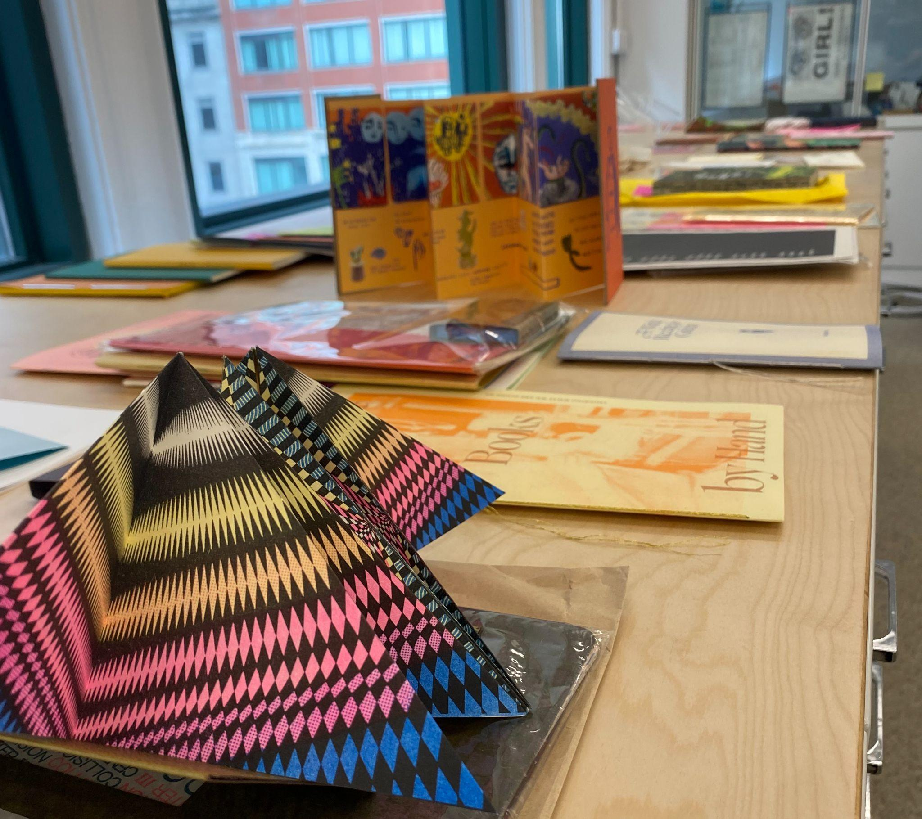
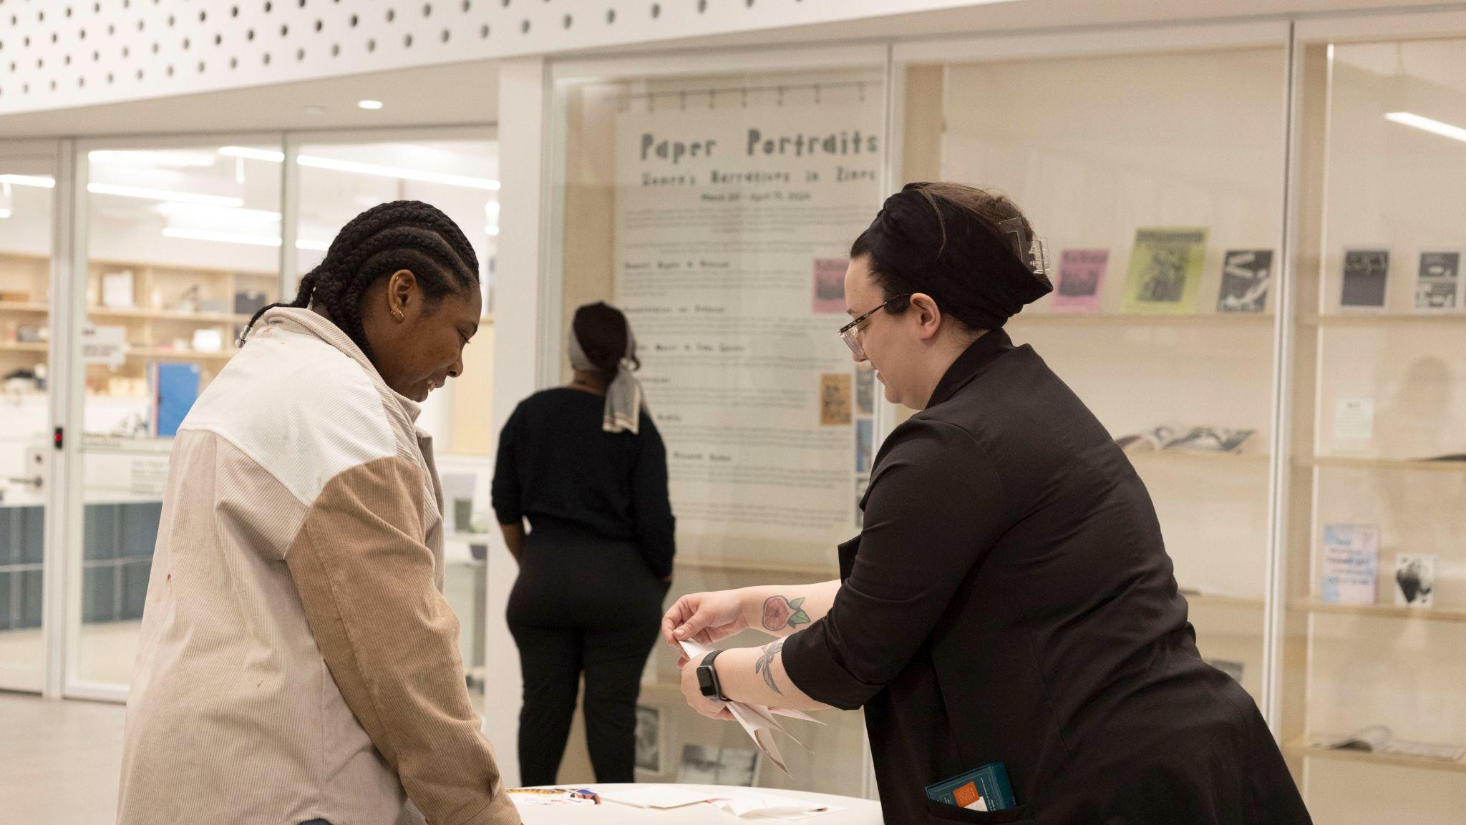
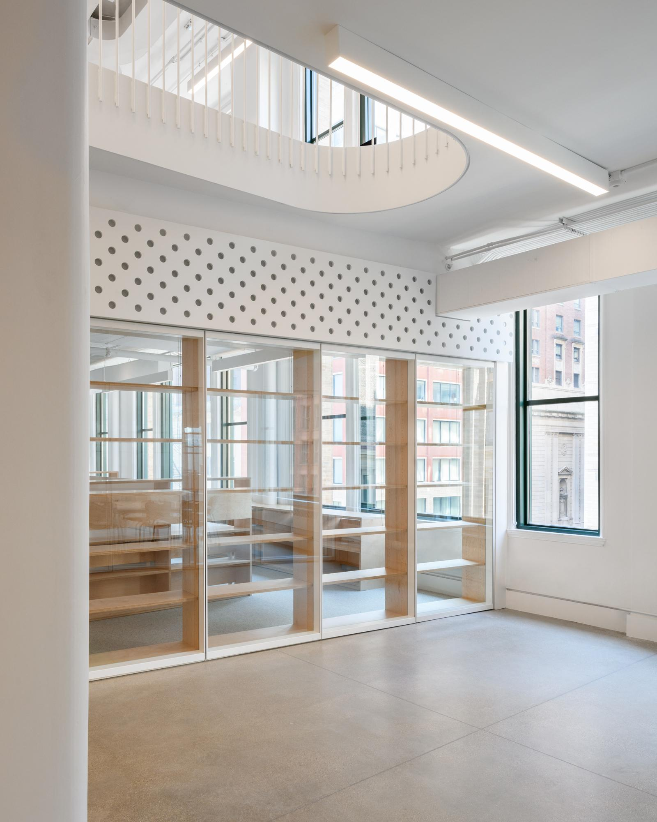
MELANIE EMERSON
Dean of the Library + Special Collections
School of the Art Institute of Chicago
Notes:
Melanie

Slide 3
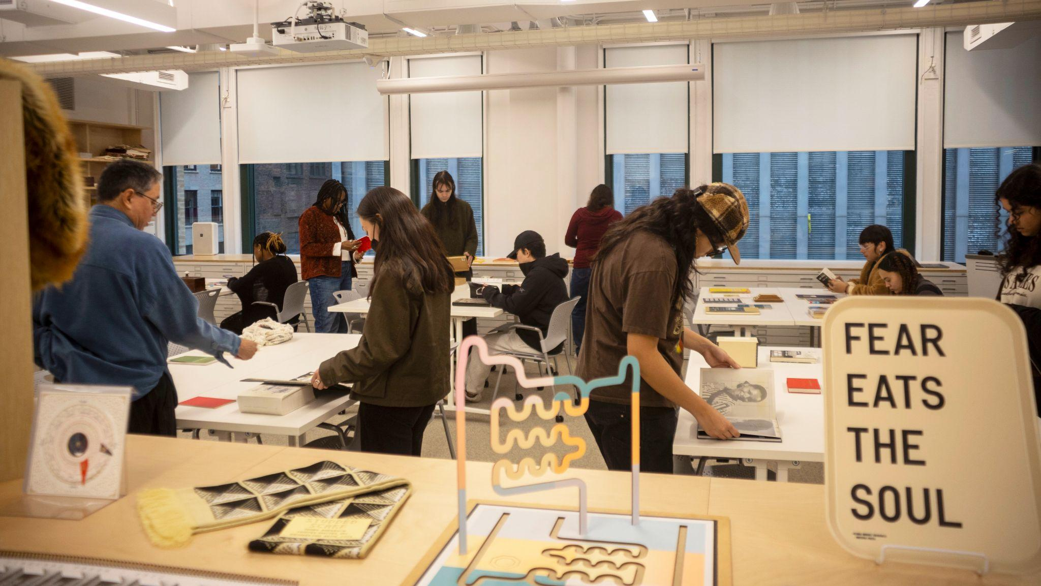
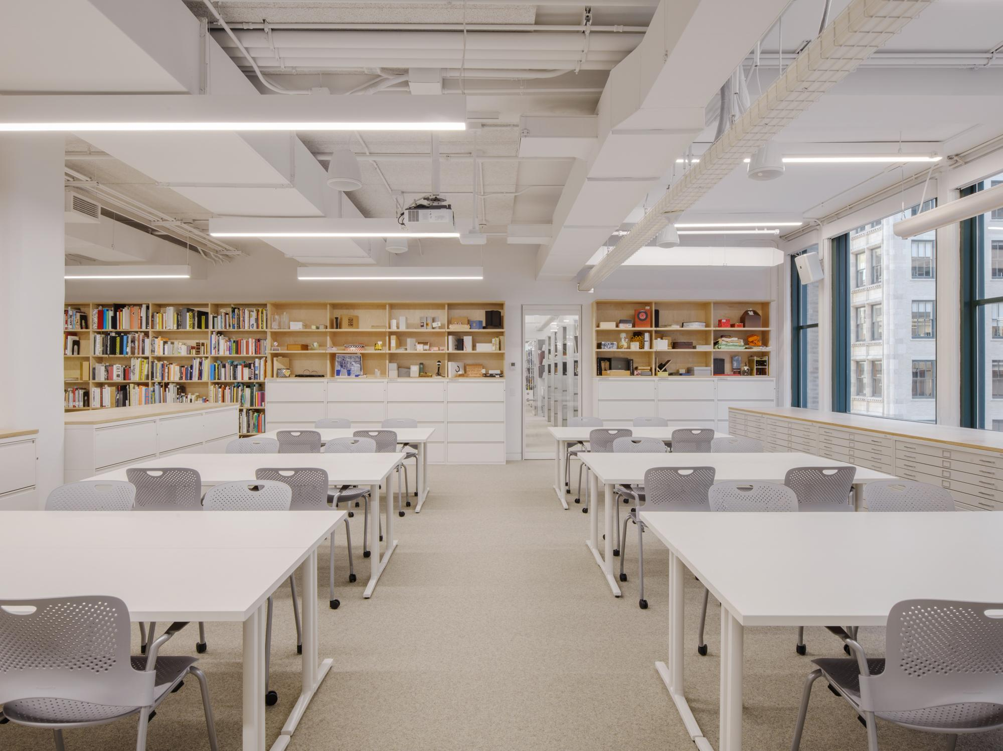
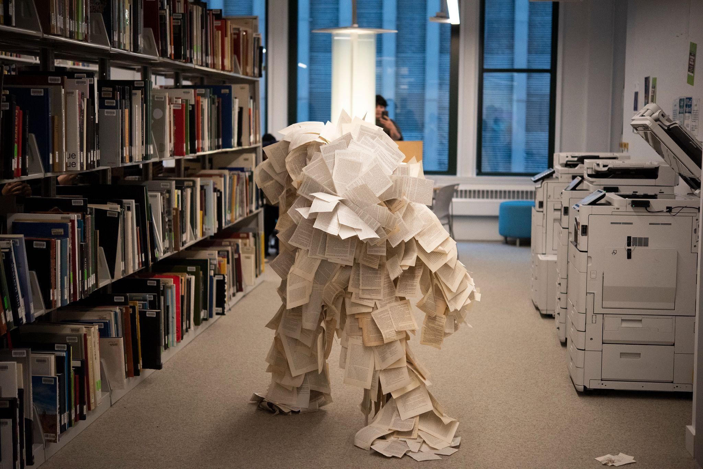
John M. Flaxman Library
Notes:
Melanie
Links: https://docs.google.com/document/d/1VijgDfzXJpHs_powrfndj3x_usudVuYYPHLaLo2w4Gg/edit?tab=t.0#heading=h.oa6qod2ydqbc
Add to chat:
SAIC Library + Special Collections Exhibition Planning Committee:
Holly Dankert, Head of Research + Access Services
Carolyn Faber, Media Collections Librarian
Nick Favela, Access Services Manager (Evening)
Ana Hernandez, Information Literacy Librarian
Danielle Lasker, Joan Livingstone Director of the Textile Resource Center
Emily Martin, Distribution Manager, VDB
Brittan Nannenga, Head of Library Special Collections + Digital Services
Alex O’Keefe, Research + Instruction Librarian
April Sheridan, Special Collections Librarian
Jordan Wright, Public Services Manager, Library Special Collection

Slide 4
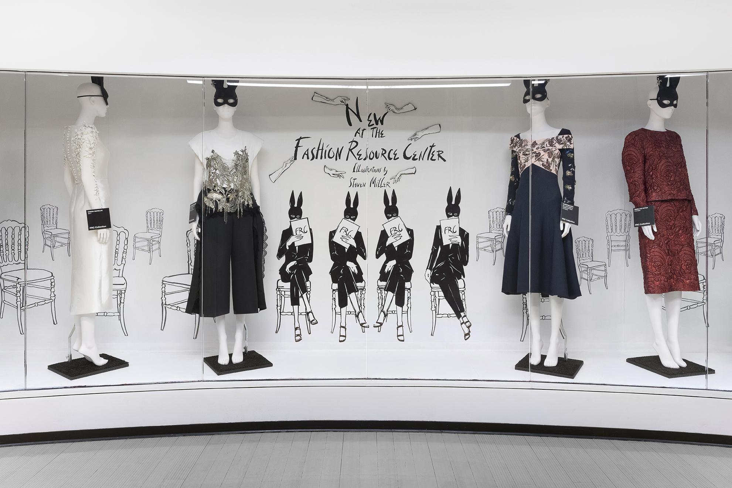
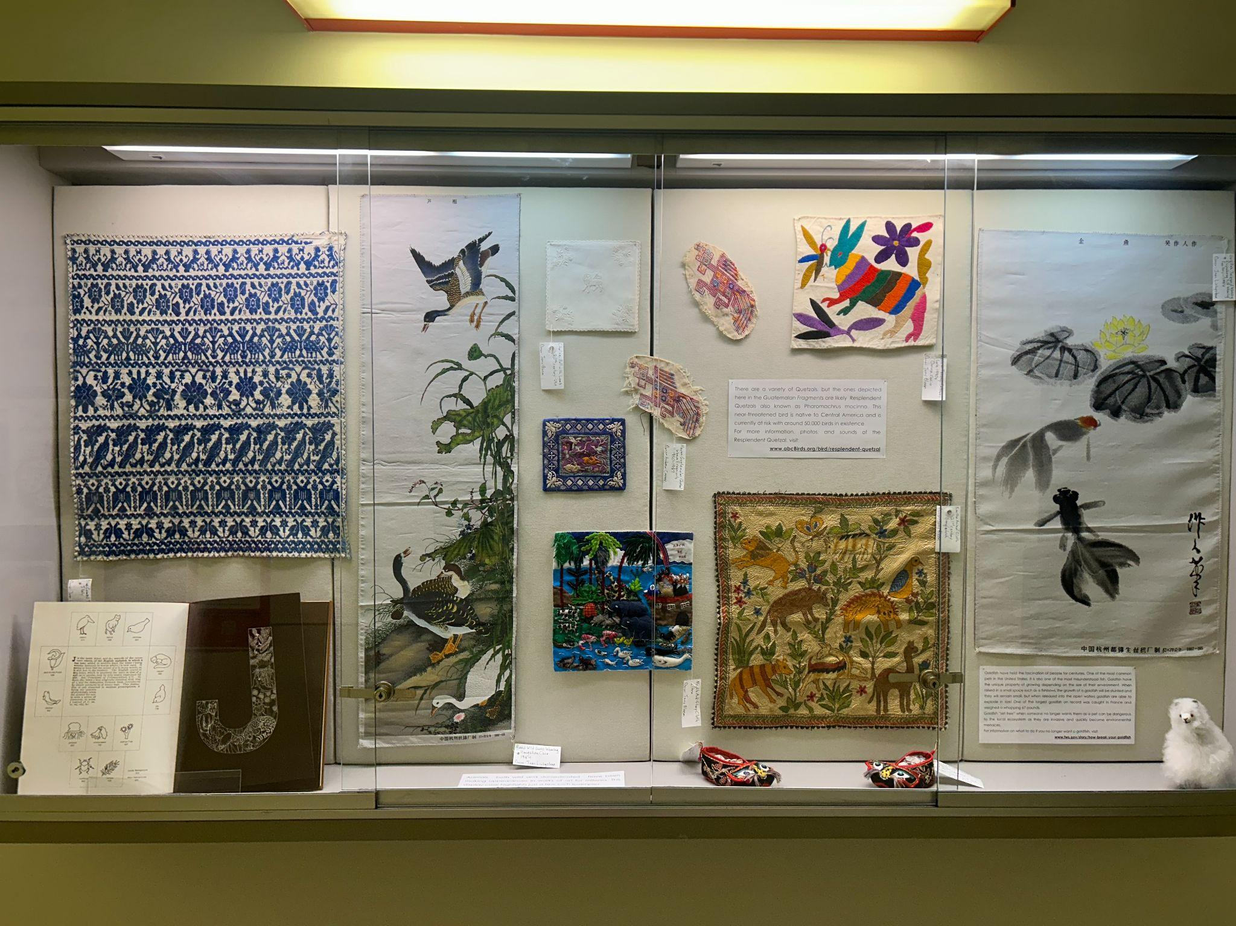
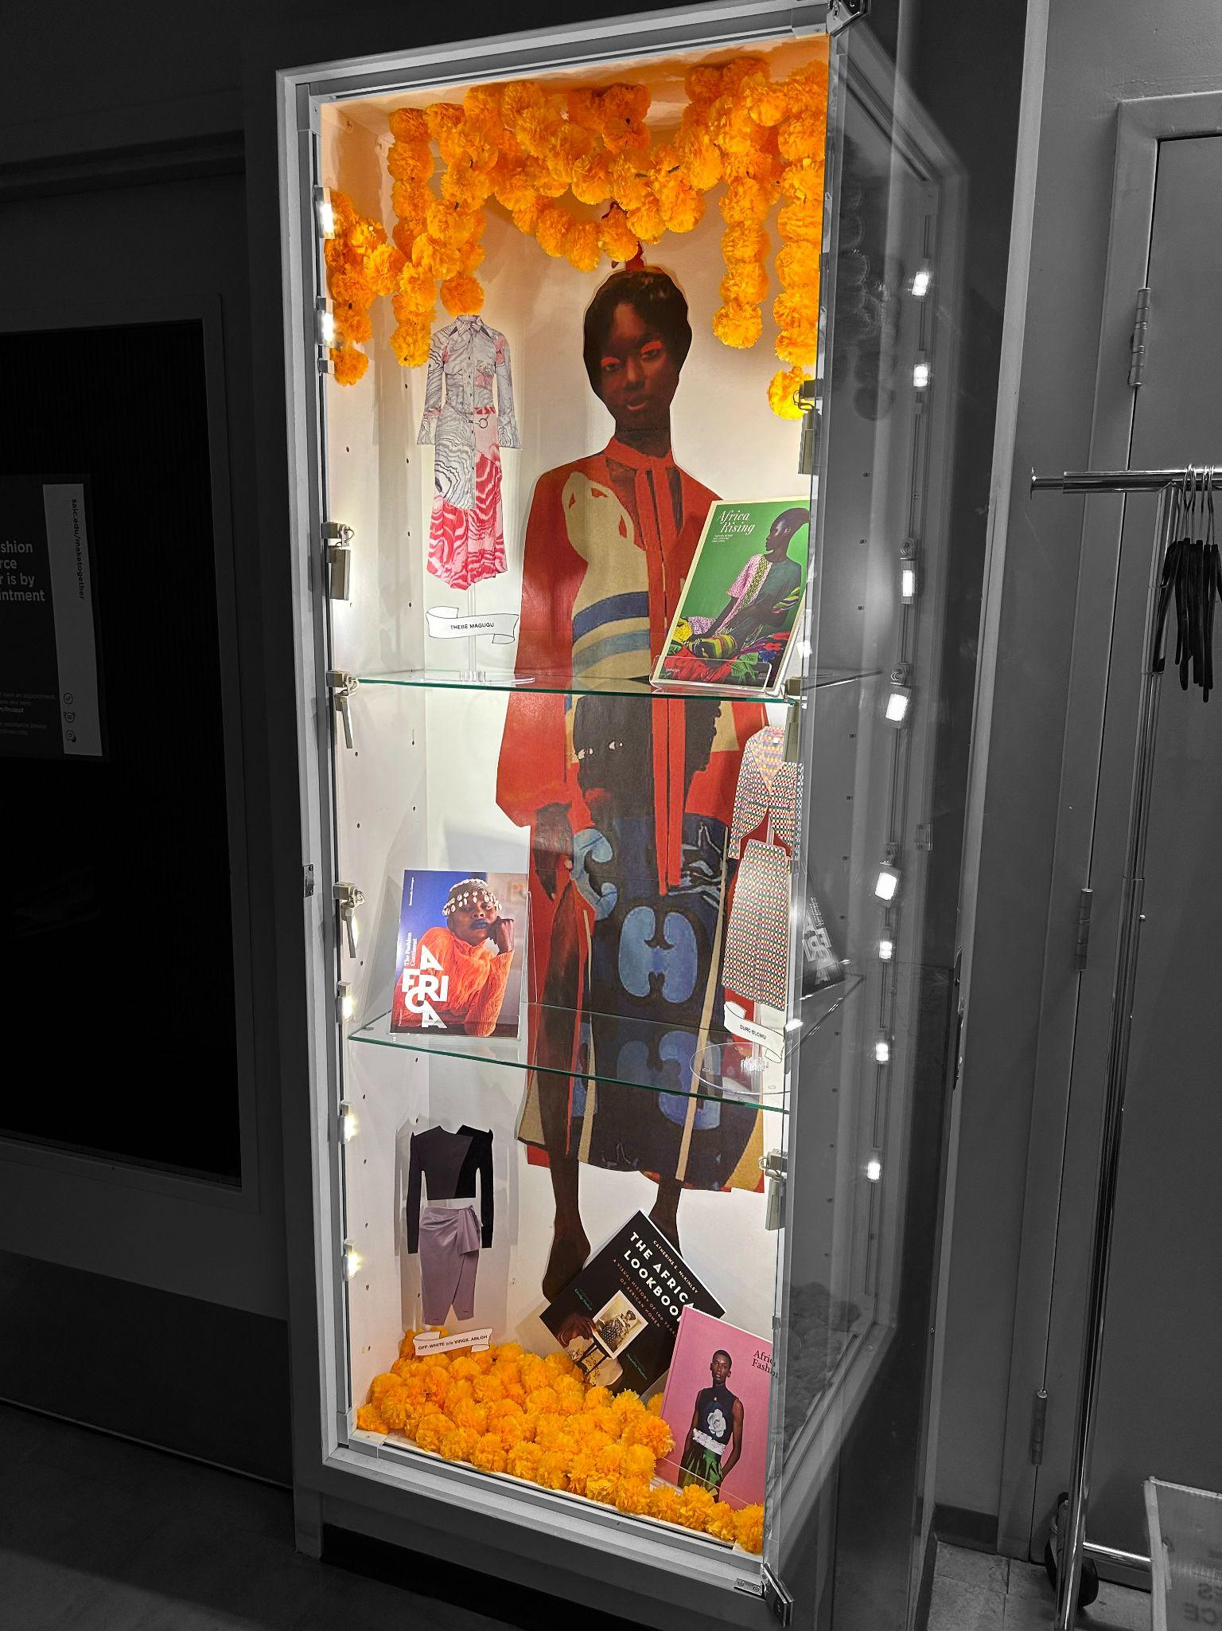
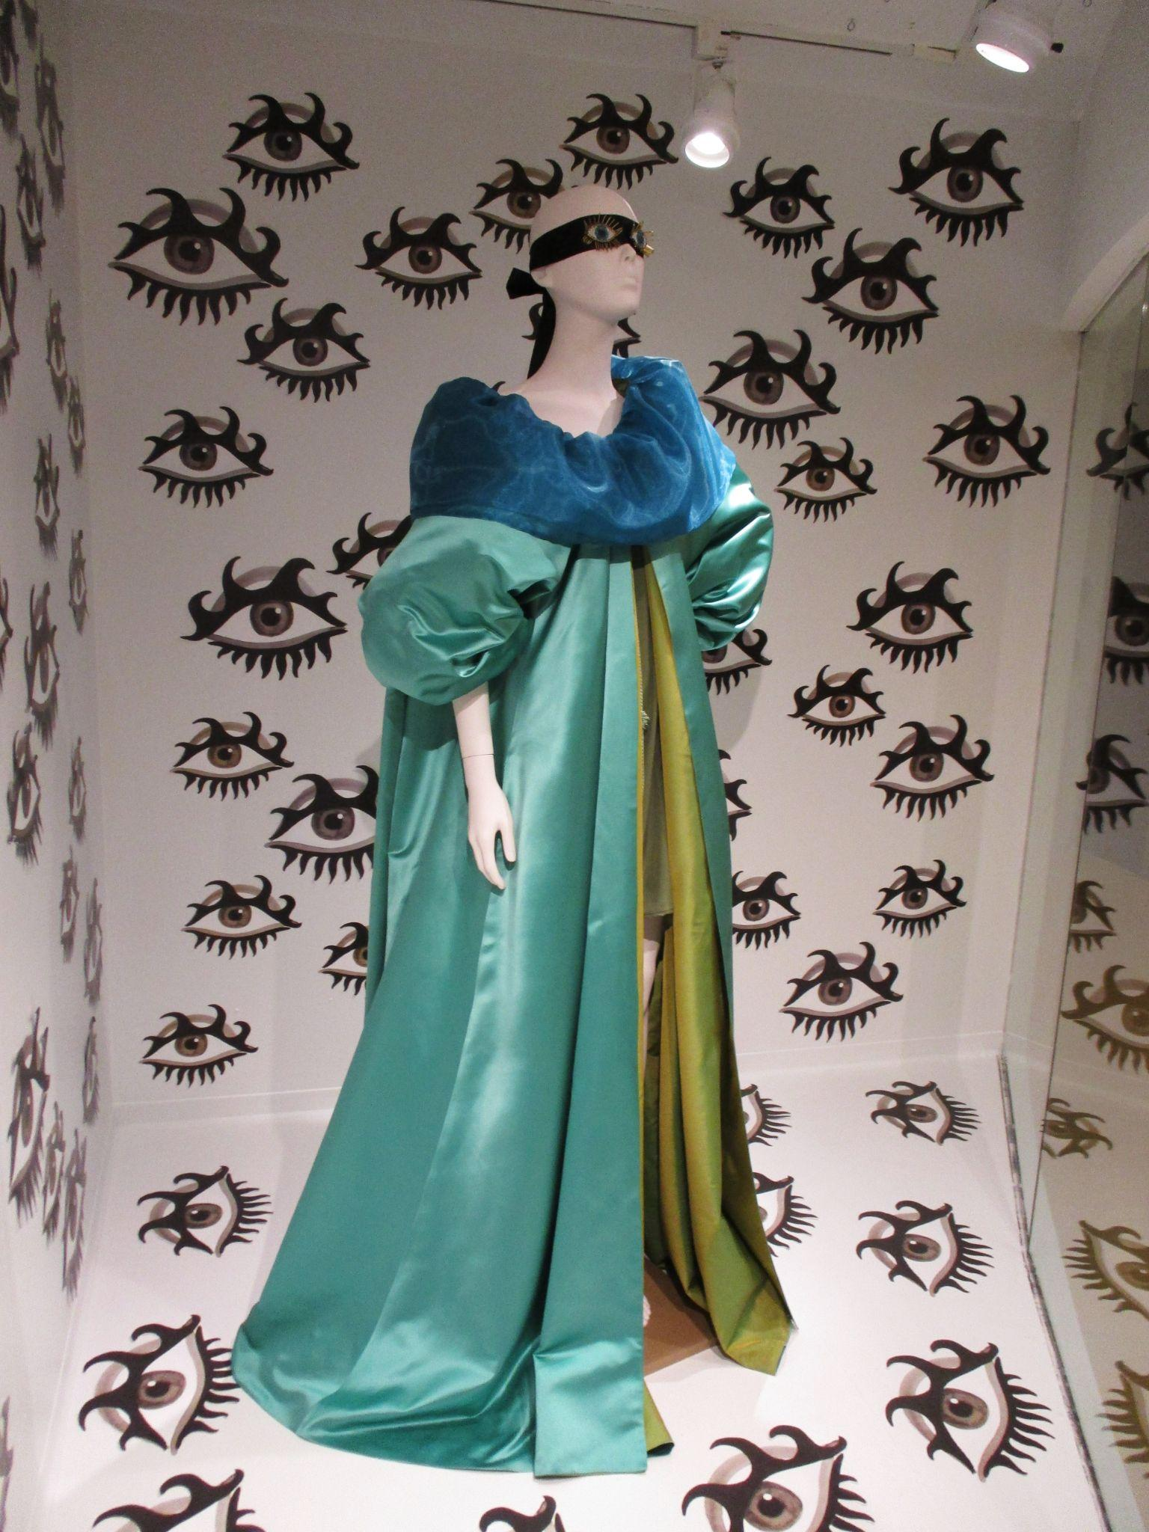
Exhibitions at SAIC’s Fashion Resource Center (FRC) + Textile Resource Center (TRC)
Notes:
Melanie:
Links
Textile Resource Center: https://www.saic.edu/trc
Fashion Resource Center: https://www.saic.edu/frc

Slide 5
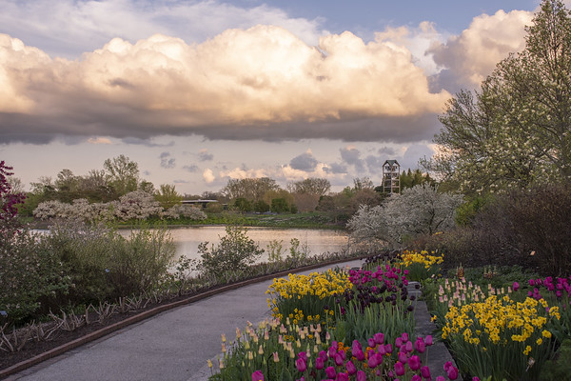
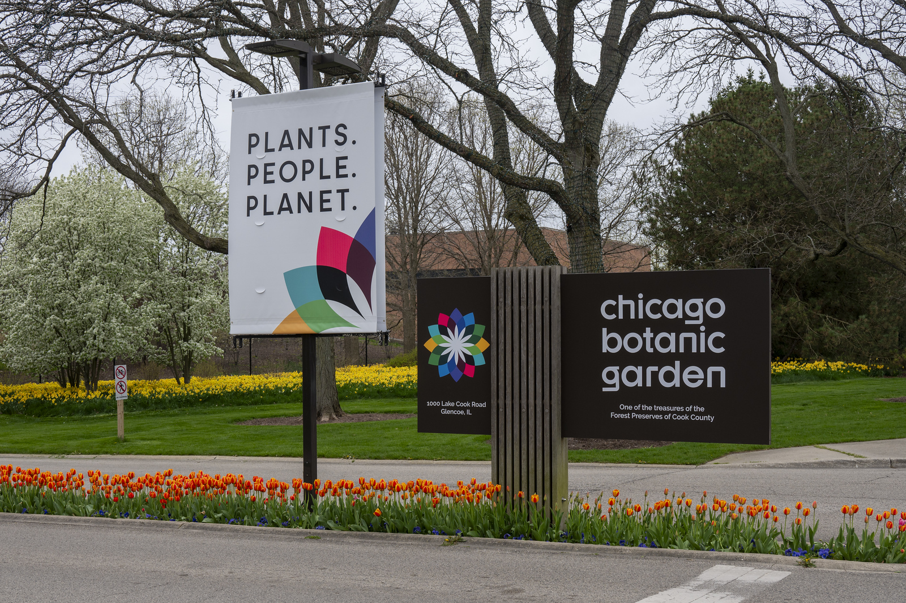
LEORA SIEGEL
Senior Director of the Lenhardt Library
Chicago Botanic Garden
Notes:
Leora

Slide 6
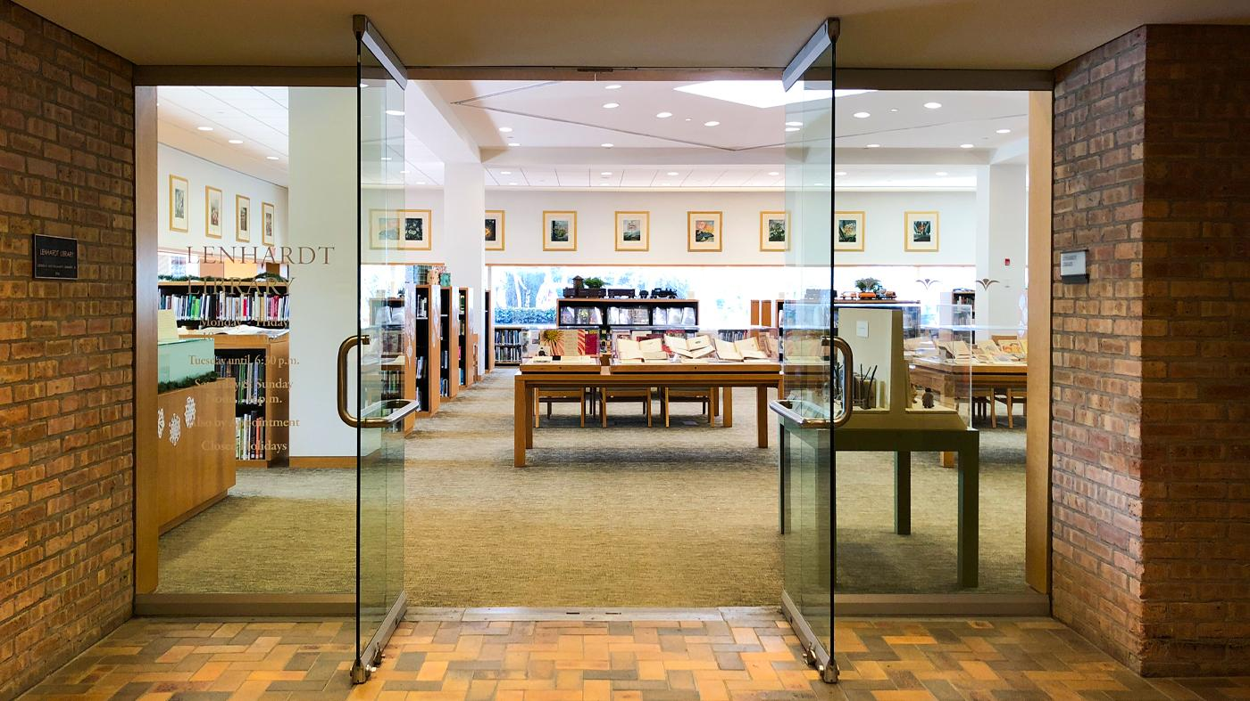
Welcome to the Lenhardt Library
Notes:
Leora

Slide 7
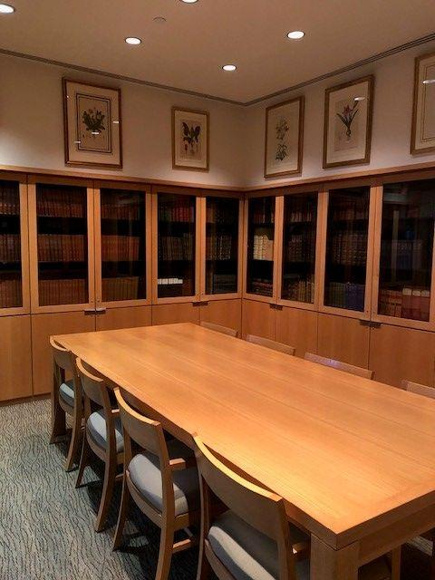
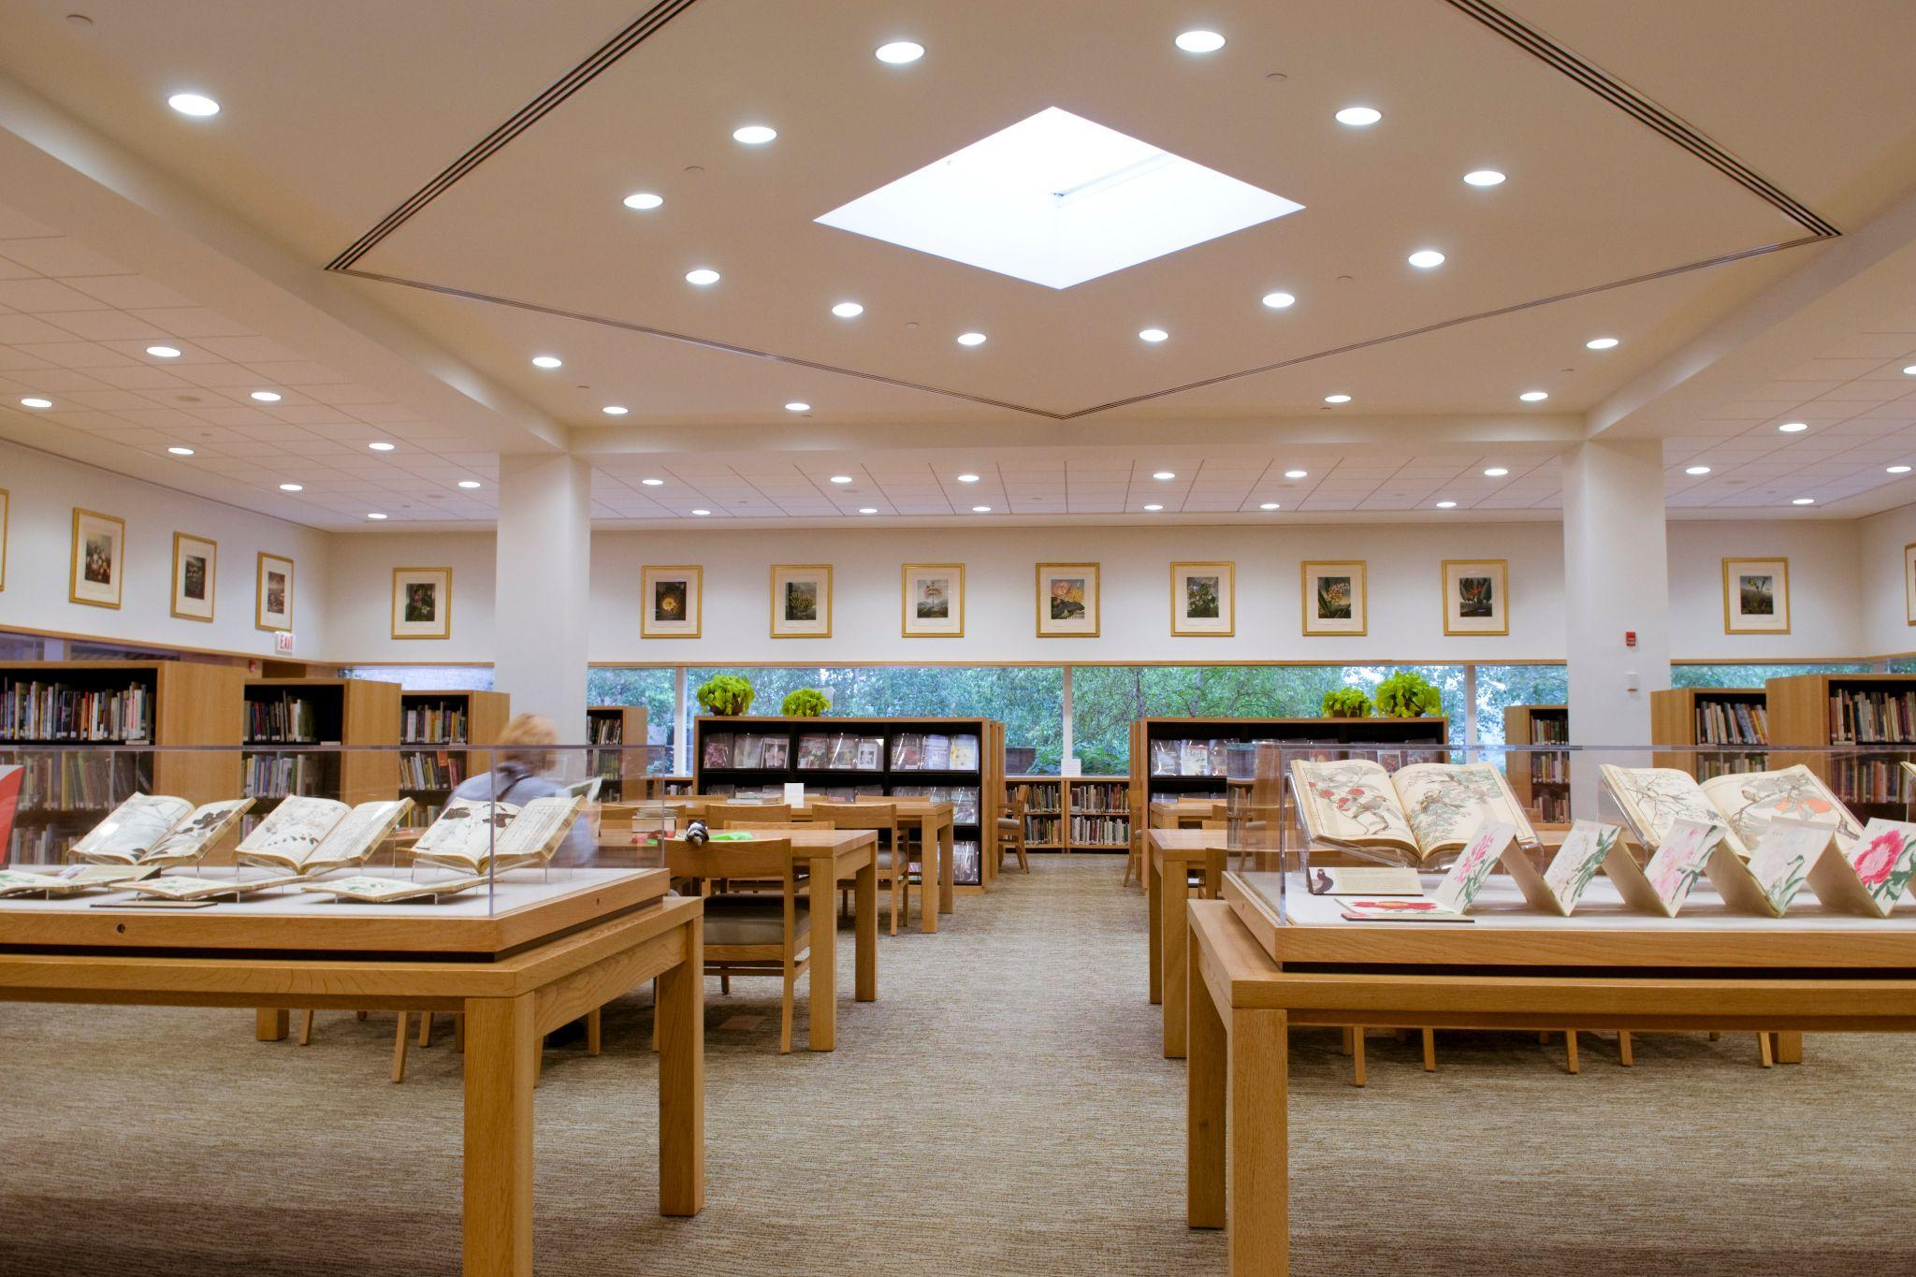
Lenhardt Library of the Chicago Botanic Garden
Notes:
Leora

Slide 8
QUESTION 1:
What are the benefits of creating exhibitions?
Notes:
Nicole [10 minutes, Discussion leader: Melanie]

Slide 9
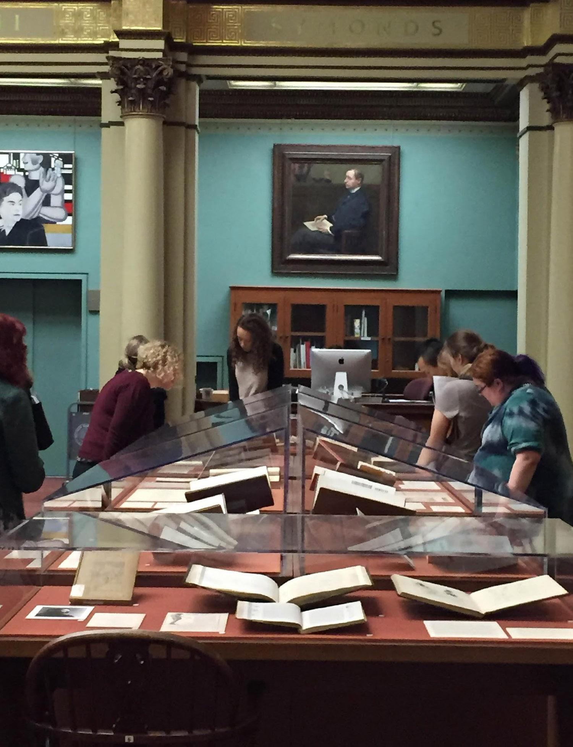
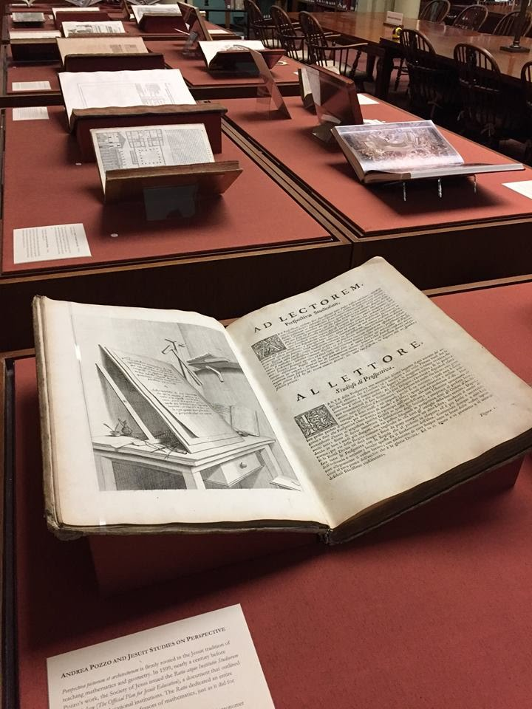
“well-curated displays can transform ‘passive’ library collections into communal spaces of discovery…”
Michelle Maloney, 2012
“They [library exhibitions] invite participation, inspire curiosity, and promote creativity.”
Carol Ng-He & Elizabeth Meinke, 2022
AIC Research Center Exhibitions
Notes:
Melanie
Links:
Cultivating Community, Promoting Inclusivity: Collections as Fulcium for Targeted Outreach:https://doi.org/10.1108/03074801211226364
A History of Library Exhibitions and Their Development: https://www.journals.uchicago.edu/doi/pdf/10.1086/719378

Slide 10
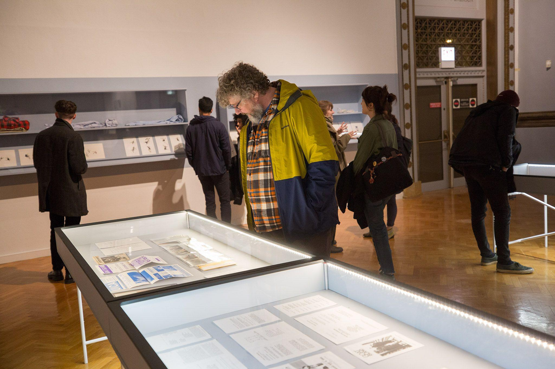
Flaxman Library’s
Goat Island Archive
Chicago Cultural Center, 2019
Notes:
Melanie
links:
Flaxman Library Archival Collections https://www.saic.edu/libraries-special-collections/john-m-flaxman-library/special-collections/archives-other-collections
Exhibition information: https://www.chicago.gov/city/en/depts/dca/supp_info/goat_island.html

Slide 11
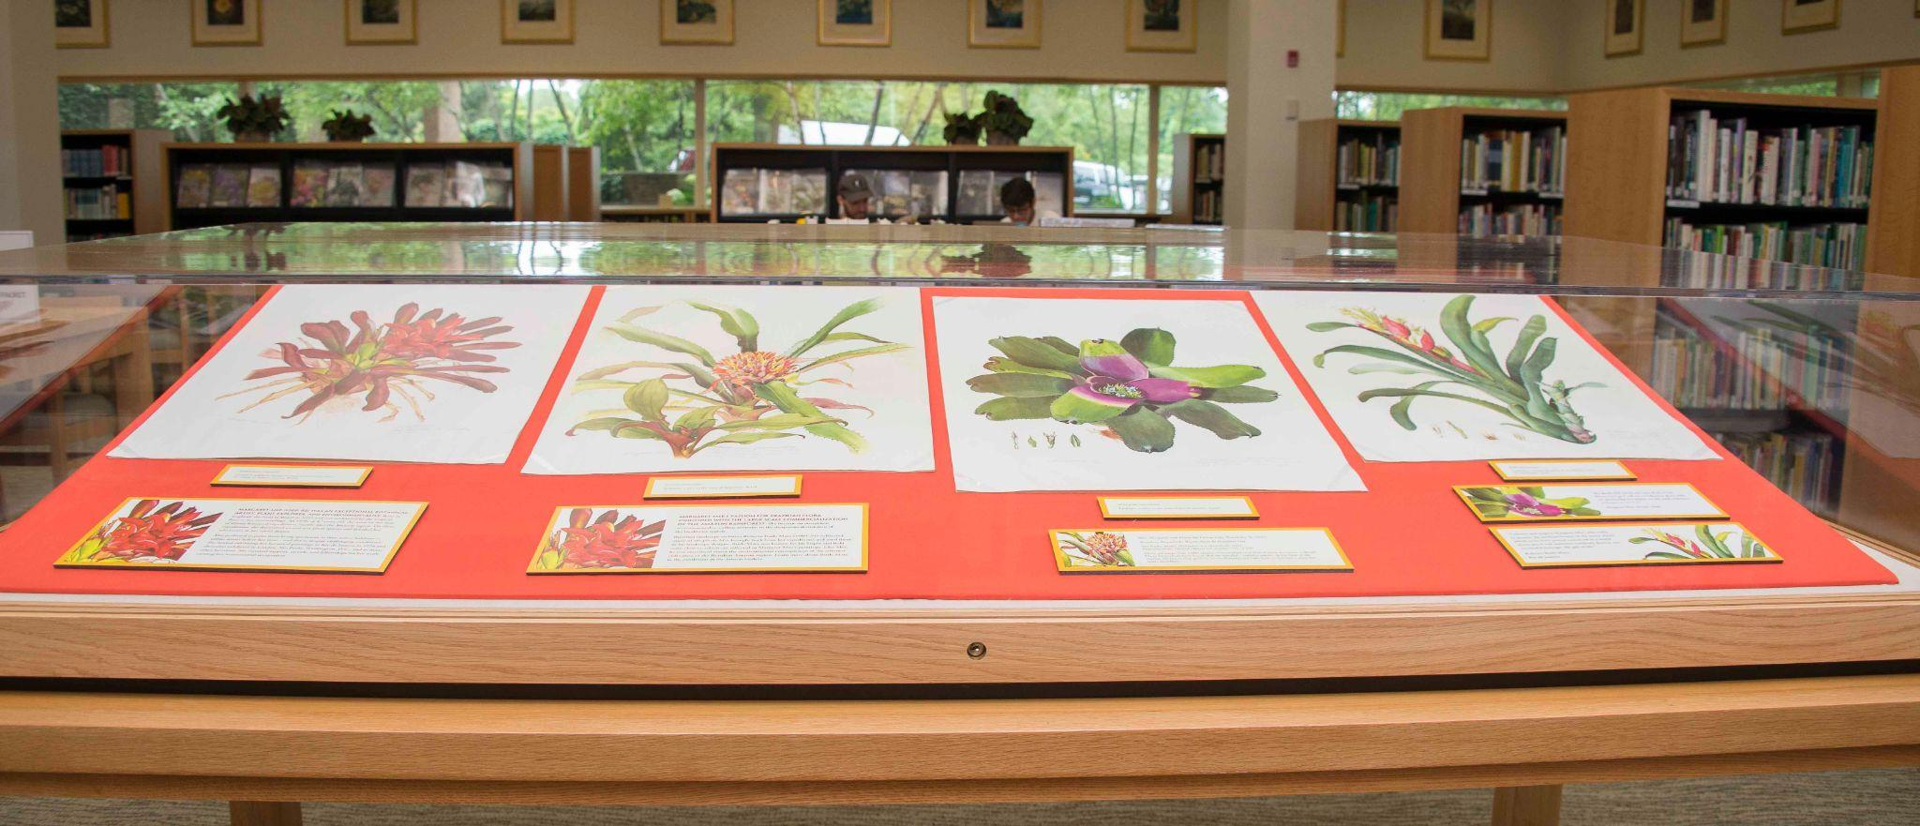
Library exhibitions open up the treasure chest to
engage visually with literature
Library exhibLitions open up the treasure chest
Library exhibitions open up tLibrRYhe treasure chest Library
Notes:
Leora

Slide 12
QUESTION 2:
Could you talk about some of the things that are most essential when preparing exhibitions?
Notes:
[10 minutes, Discussion leader: Leora ]

Slide 13
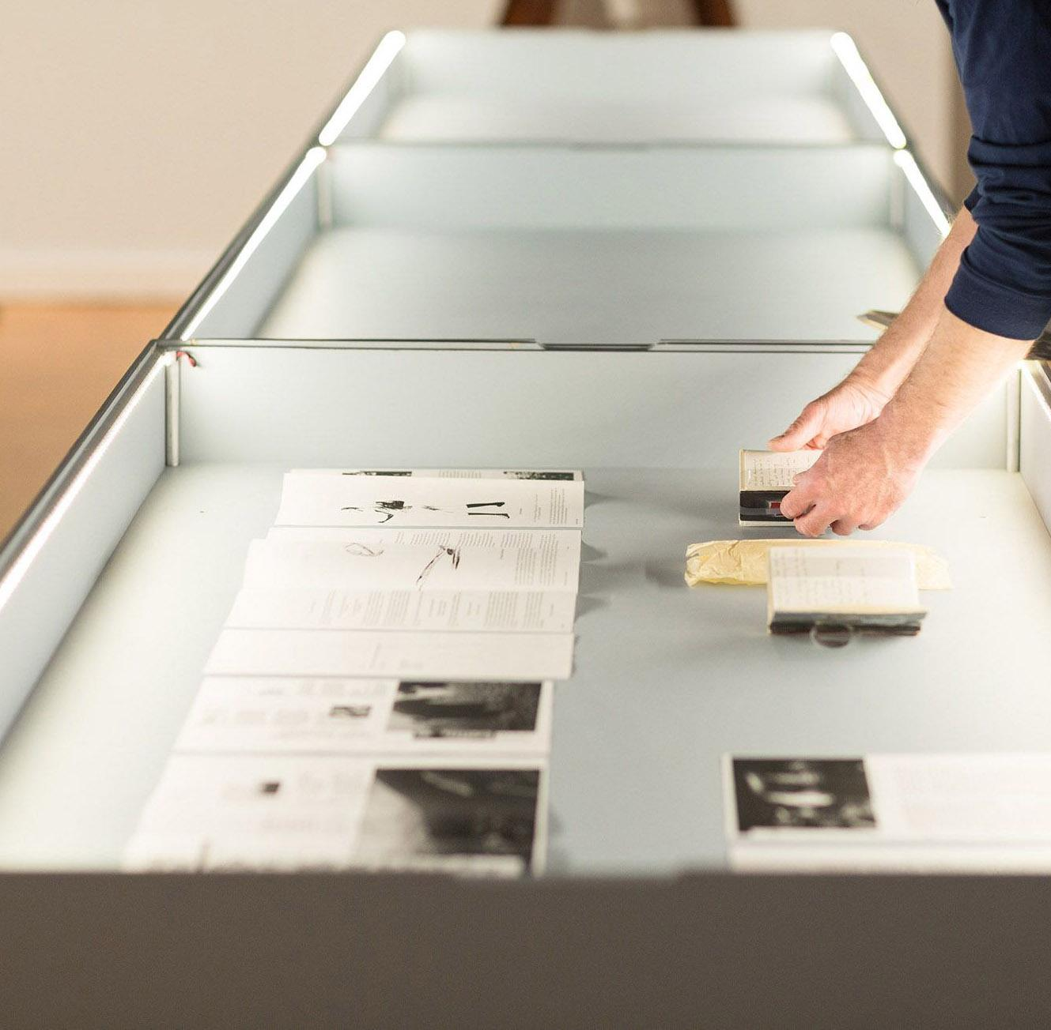
Getting Started
Select theme
Know your audience
Do research with citable sources
Select volumes to tell your story
  Assess if any conservation issues
Notes:
Leora

Slide 14
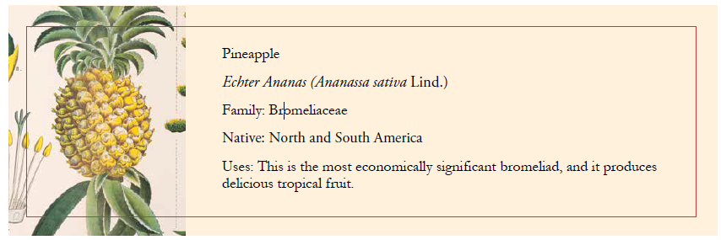
Signage
Write exhibition signs, 50 -100 words
  Case sign, book sign, book citation
Prototype the layout on book mounts with sign placeholders,
  Not too crowded, not too empty
Use large font size
Use QR codes for translations into other languages
Notes:
Leora

Slide 15
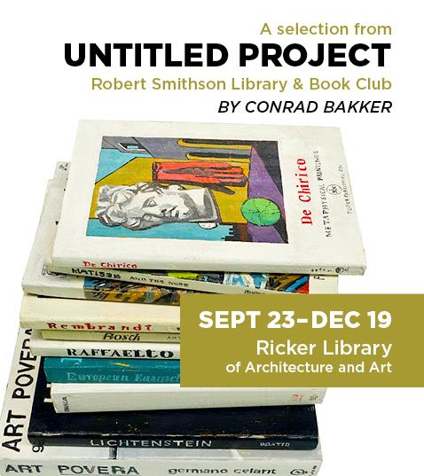
Sign Design
Colorful signs engage and entice to view exhibit
Graphic designer
In-house, use color paper, or textured paper
Angle signs for easier viewing
Notes:
Leora

Slide 16
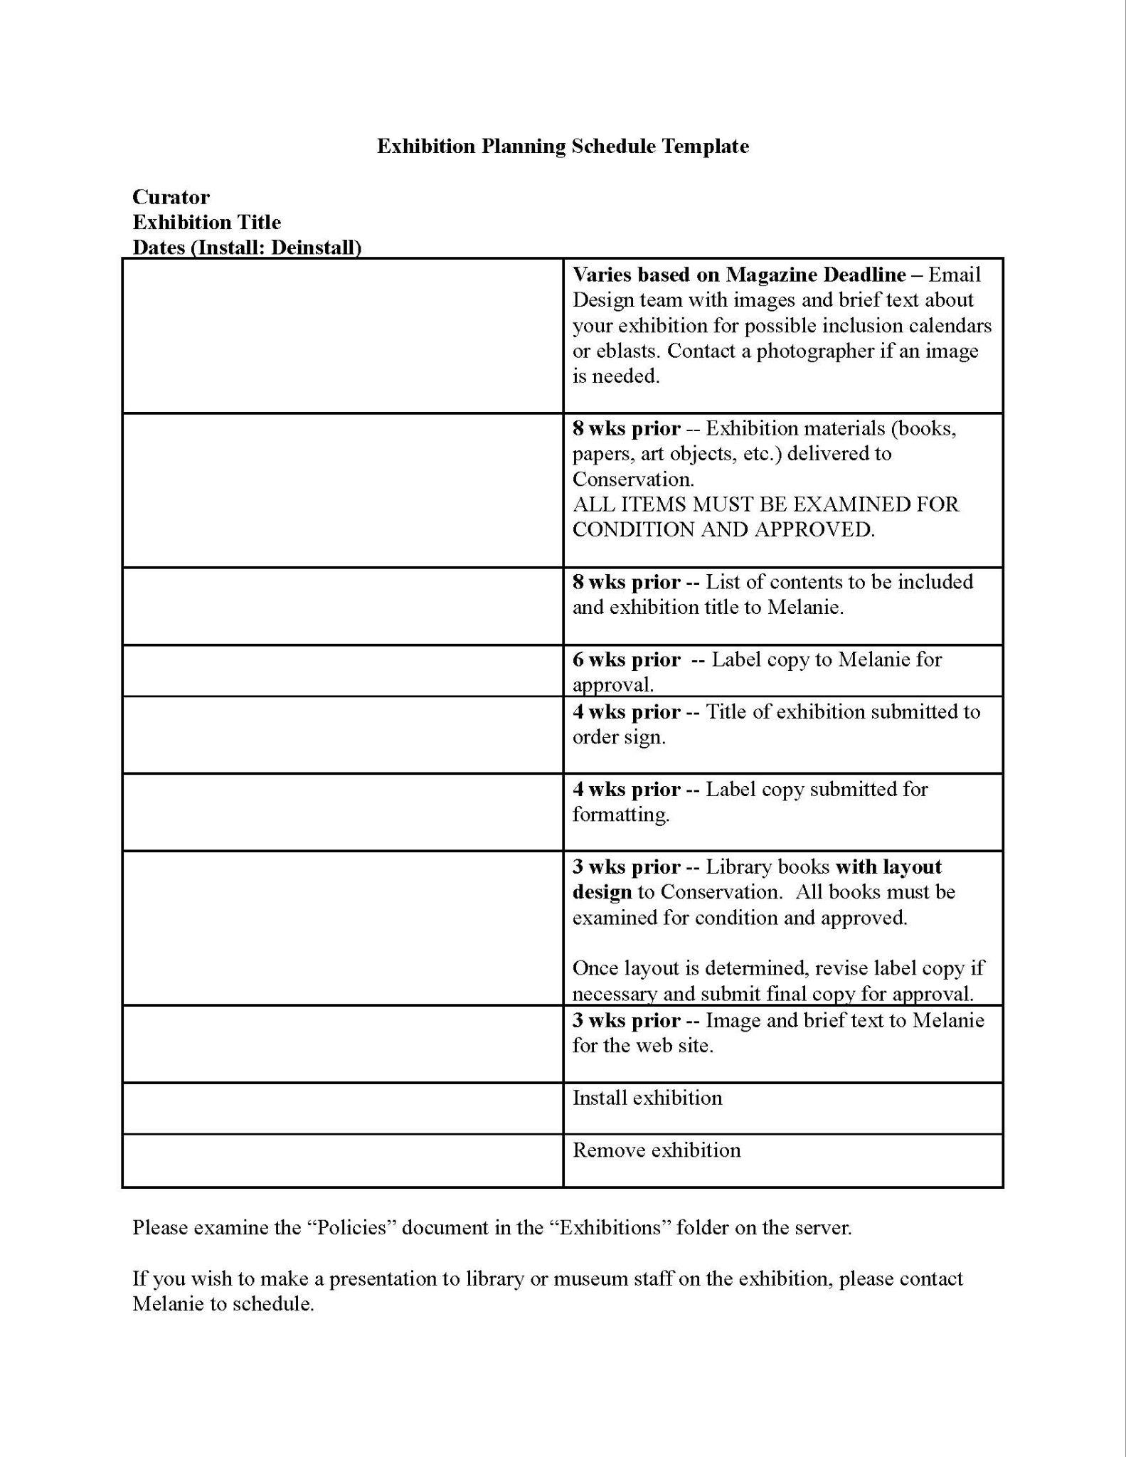
Sample Planning Schedule
Schedule start & end dates and share with a signature image
Take photos, videos for future reference
Connect with Social Media team to amplify on social channels
Share with Development department, Alumni Association, …
If you build it, they will NOT come unless its publicized
Notes:
Melanie

Slide 17
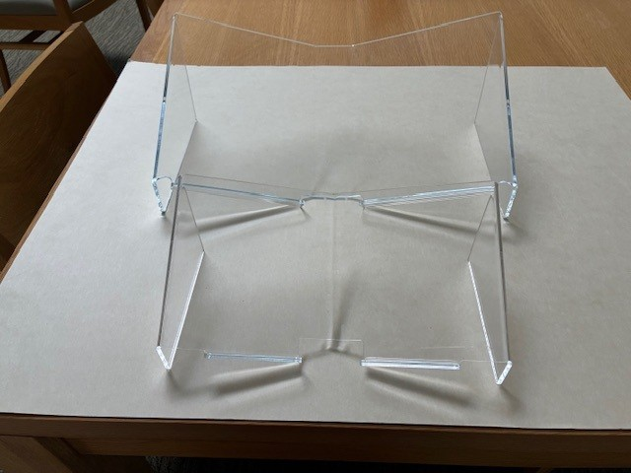
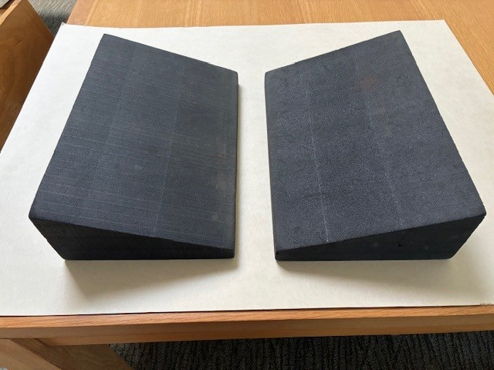
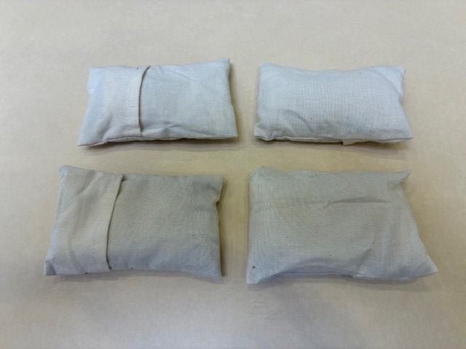
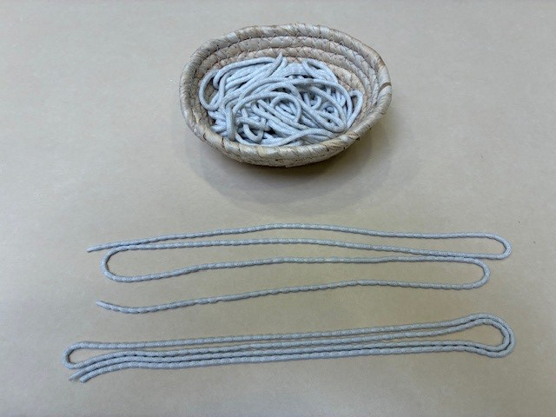
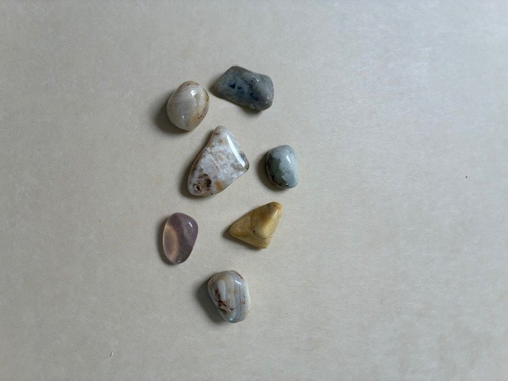
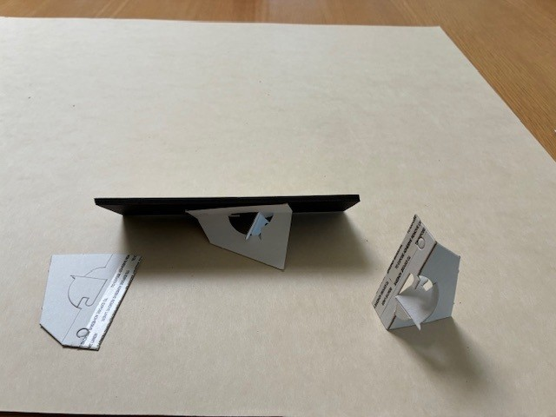
Tools of the Trade
Notes:
Leora

Slide 18
Even more…
Exhibit talks
Weekday, weekend; drop-in or registered; schedule with prof for class
Preservation
Heat, humidity, sunlight, avoid fluctuations
Conservation
12 weeks optimal for rare books
Condition report, before and after
Spreadsheet to track volume & page usage, once in 3 years
Security
Safe, lockable, clean, away from water, kitchen, chemicals
Notes:
Leora

Slide 19
Sources for exhibition objects
Gaylord Archival https://www.gaylord.com/
Hollinger Metal Edge https://www.hollingermetaledge.com/
University Products https://www.universityproducts.com/
Notes:
Leora
Links:
Gaylord: https://www.gaylord.com/
Hollinger Metal Edge https://www.hollingermetaledge.com/
University Products https://www.universityproducts.com/

Slide 20
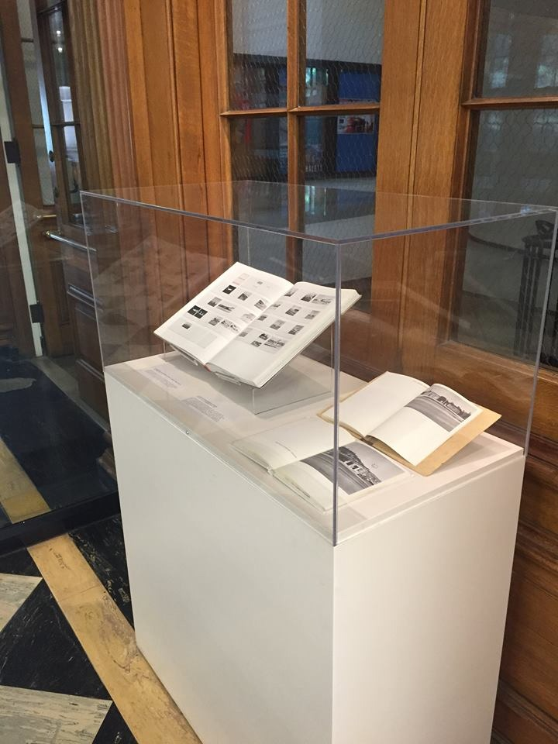
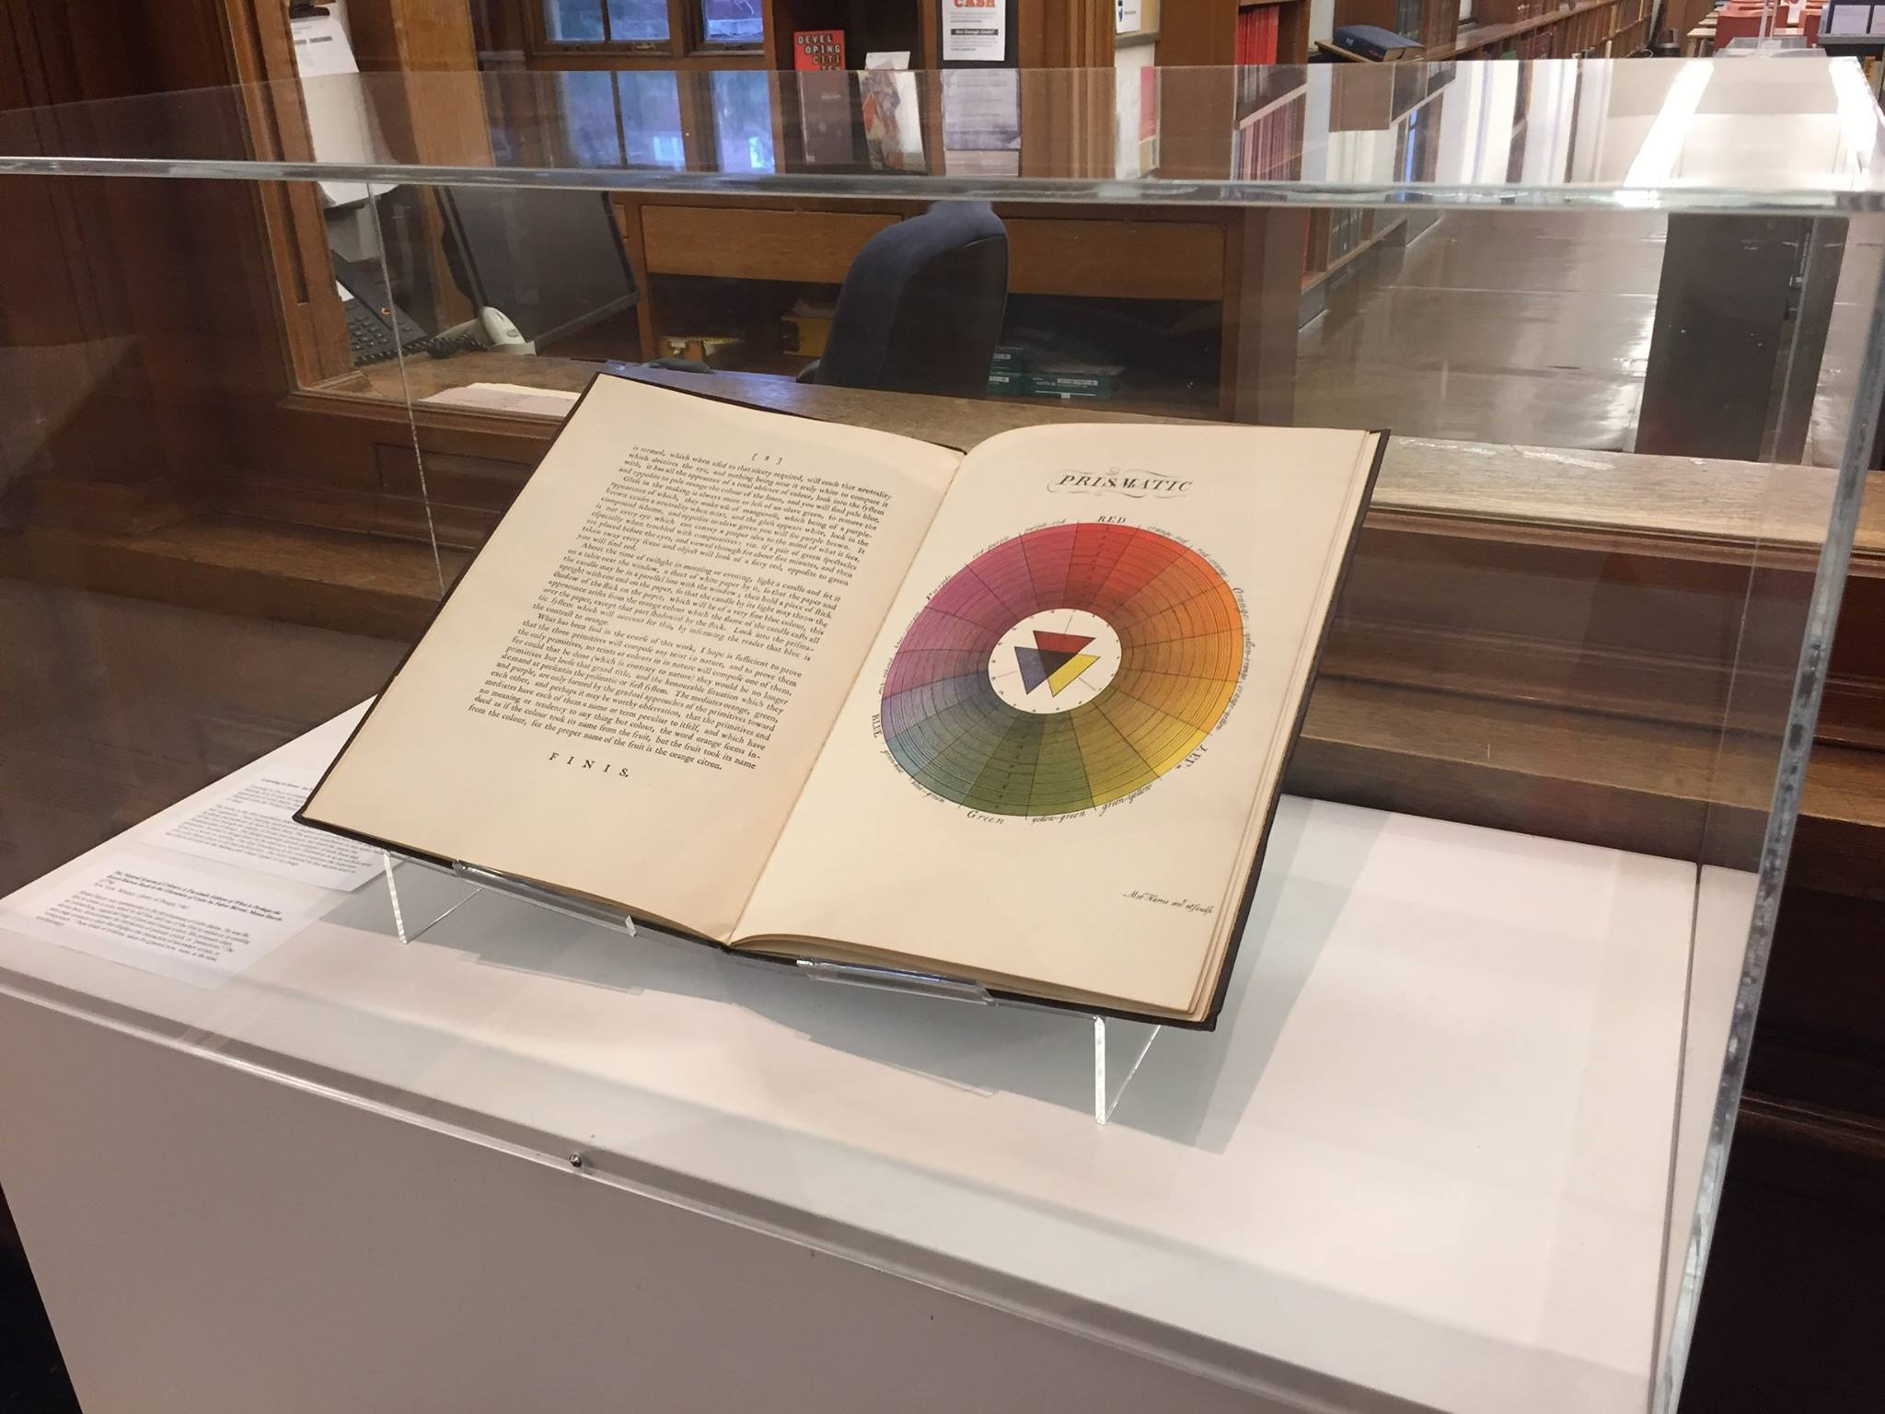
Building an Exhibition Program
Ricker Library of Architecture and Art
Notes:
Melanie

Slide 21
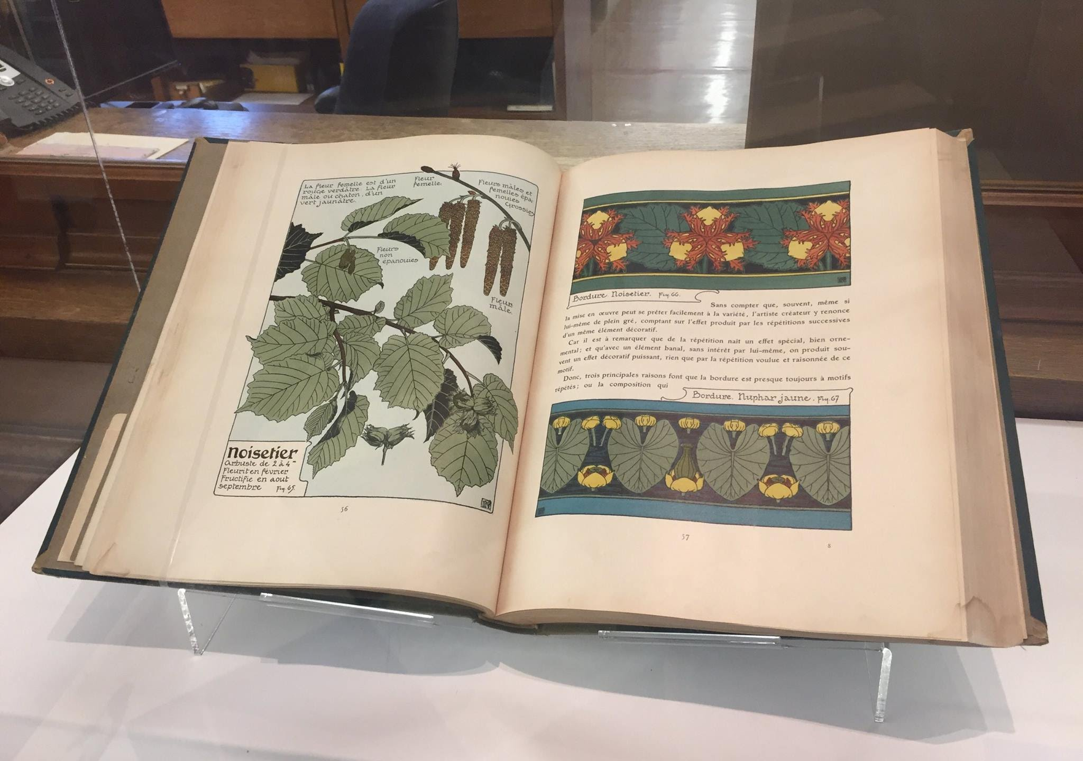
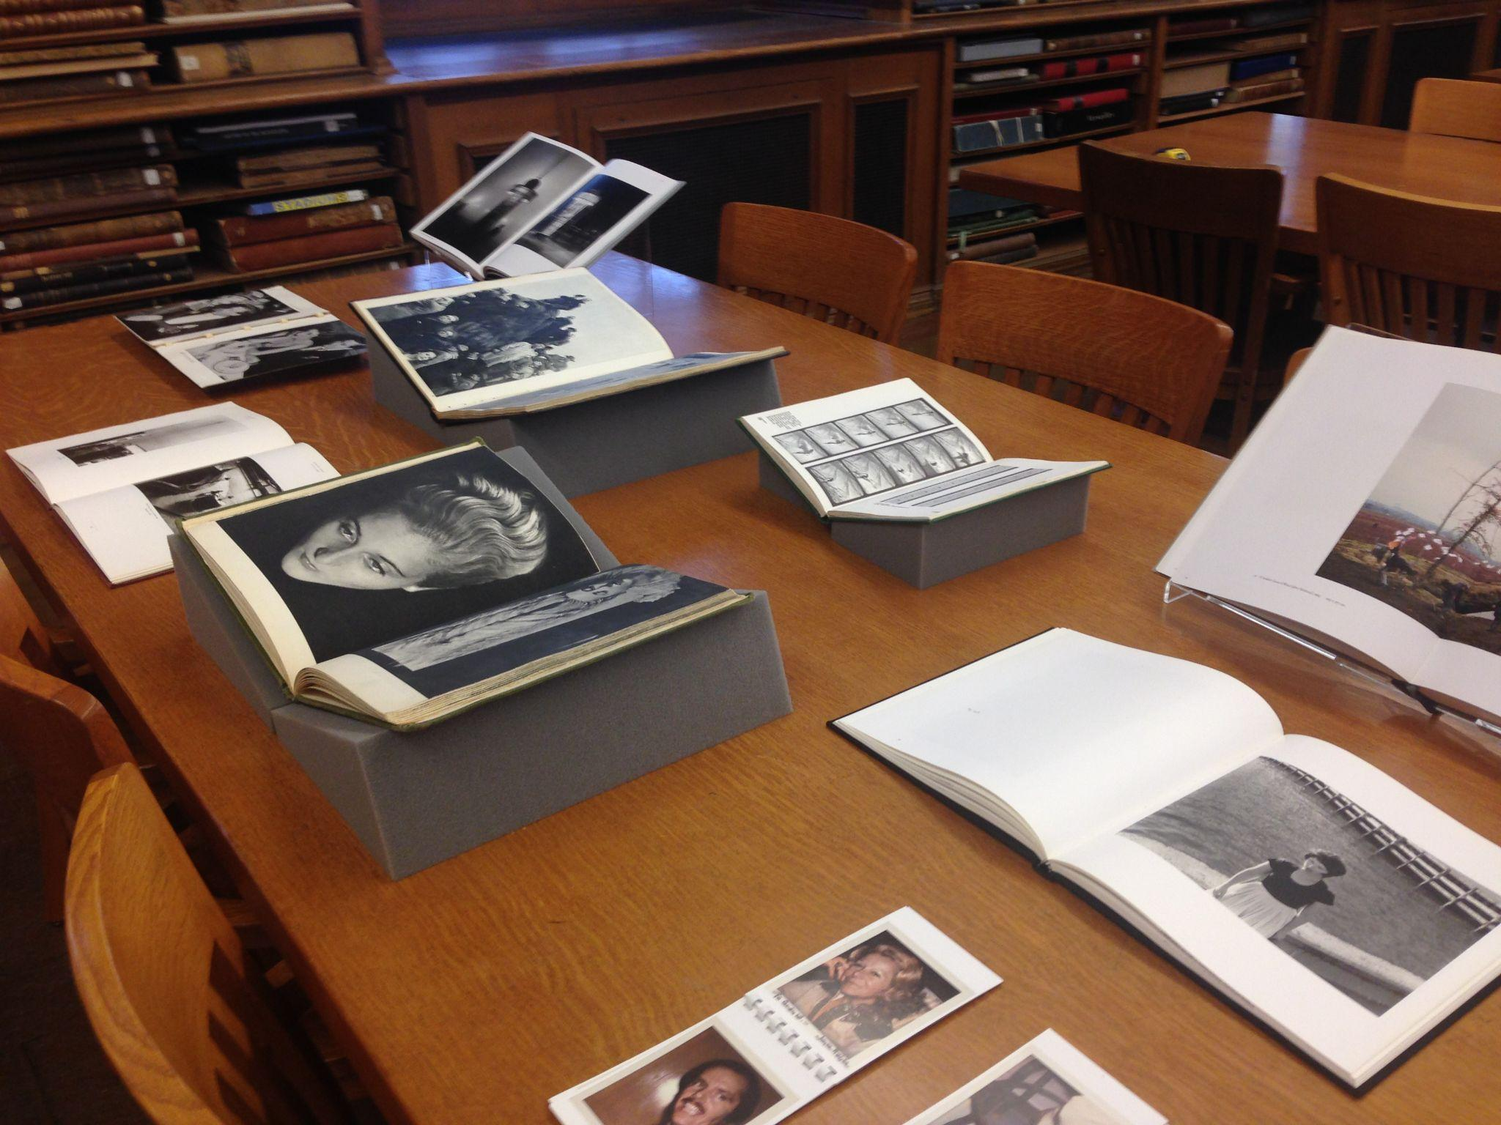
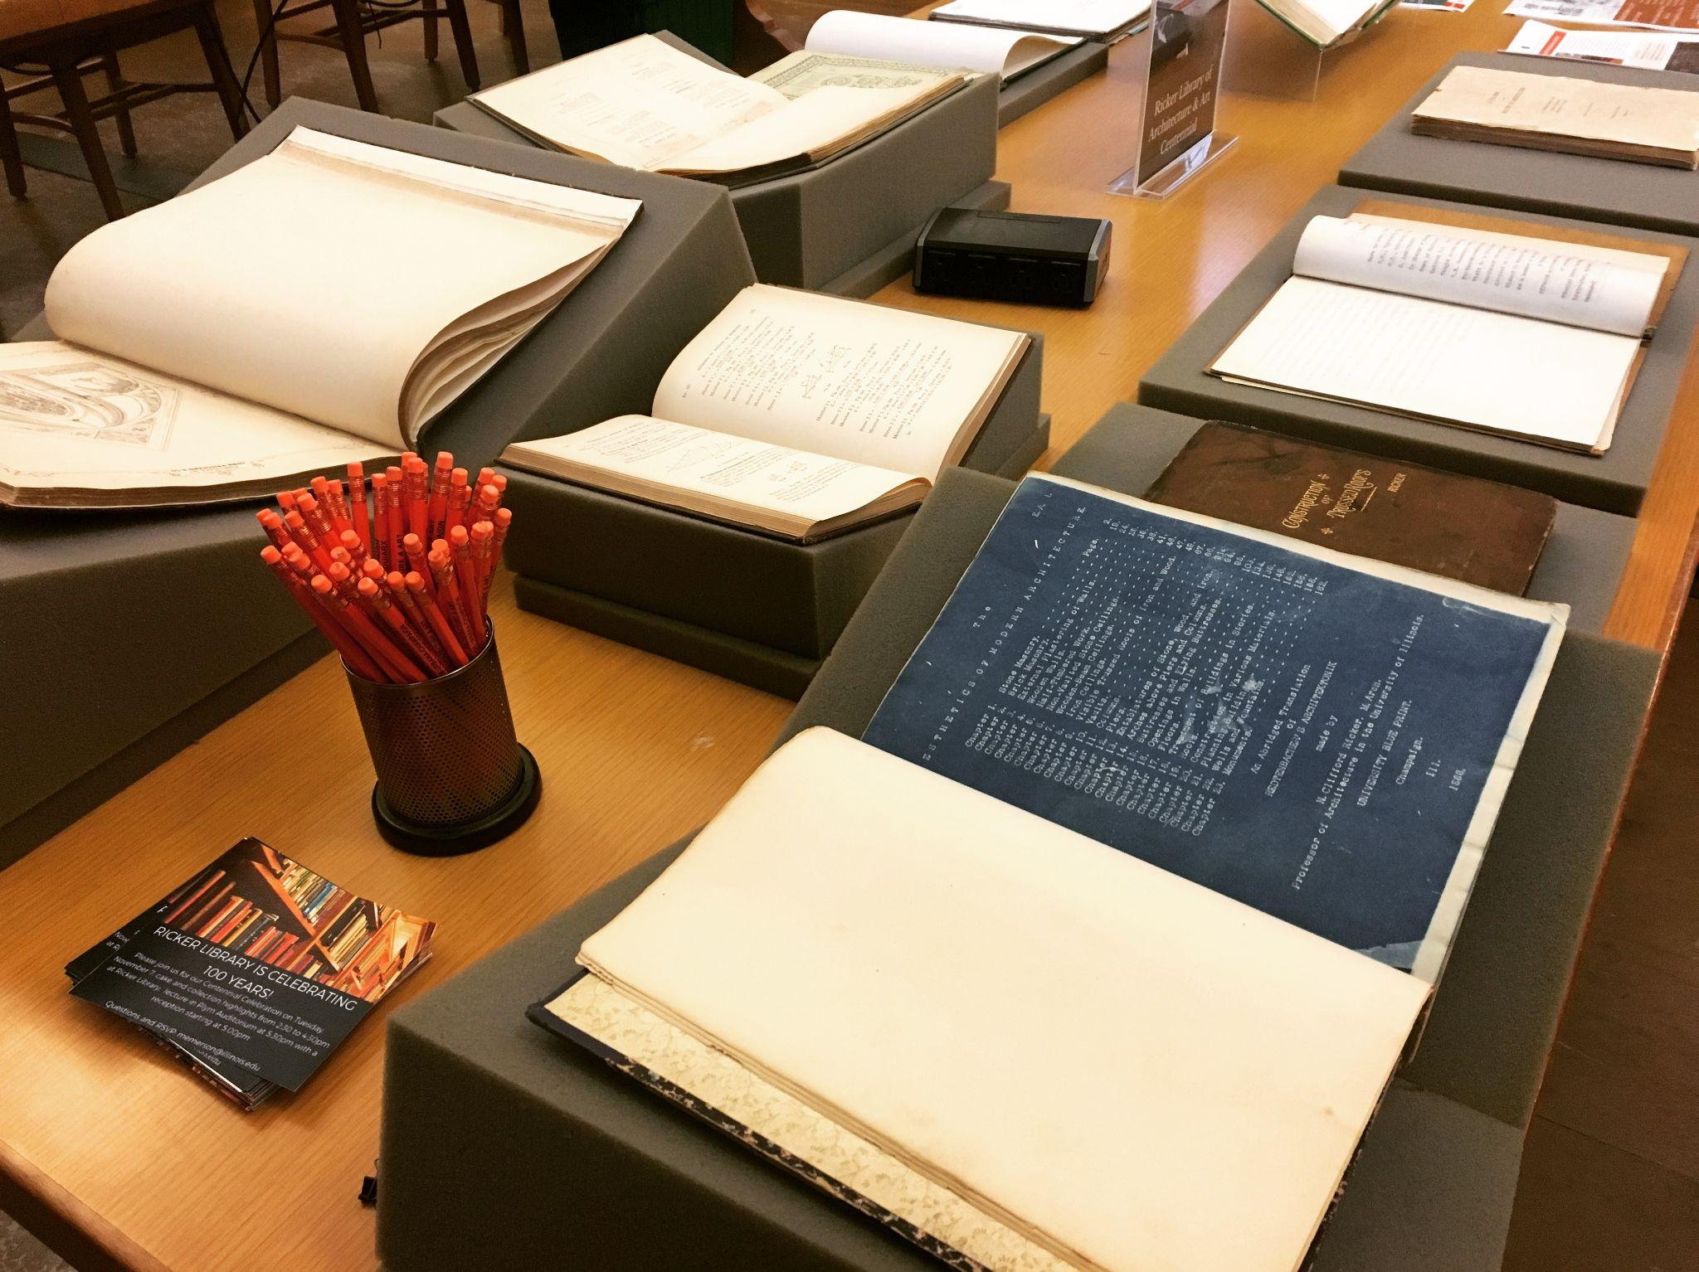
Notes:
Melanie

Slide 22
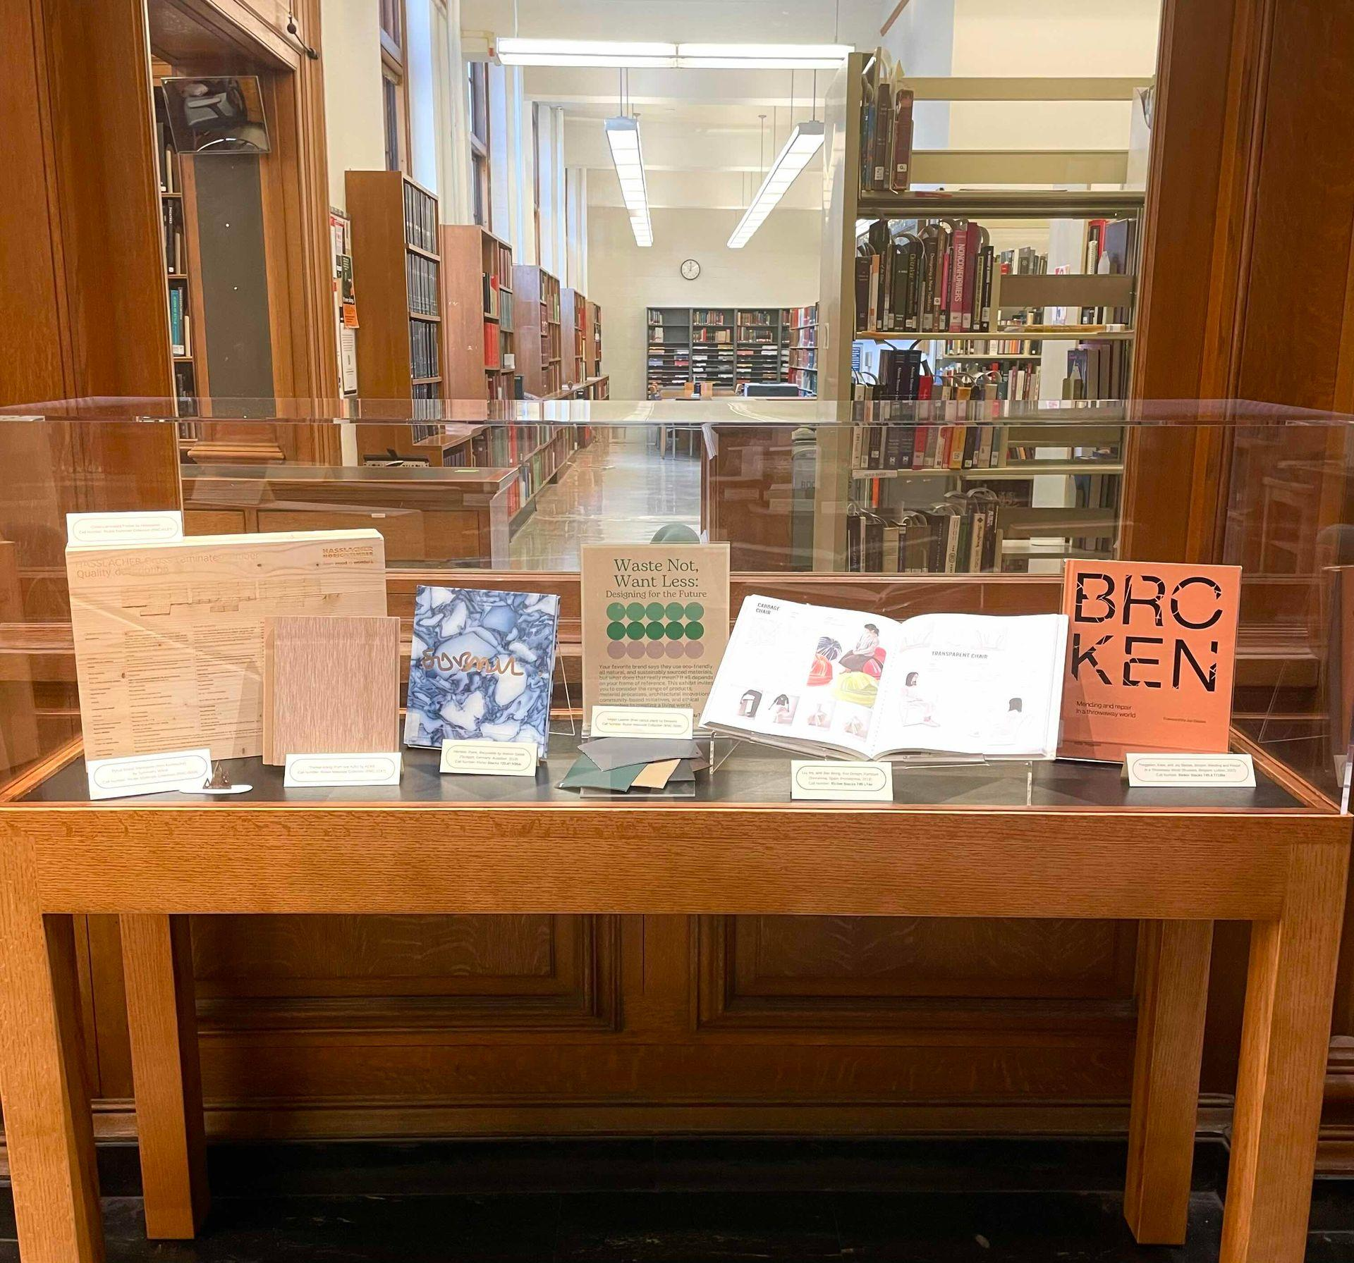
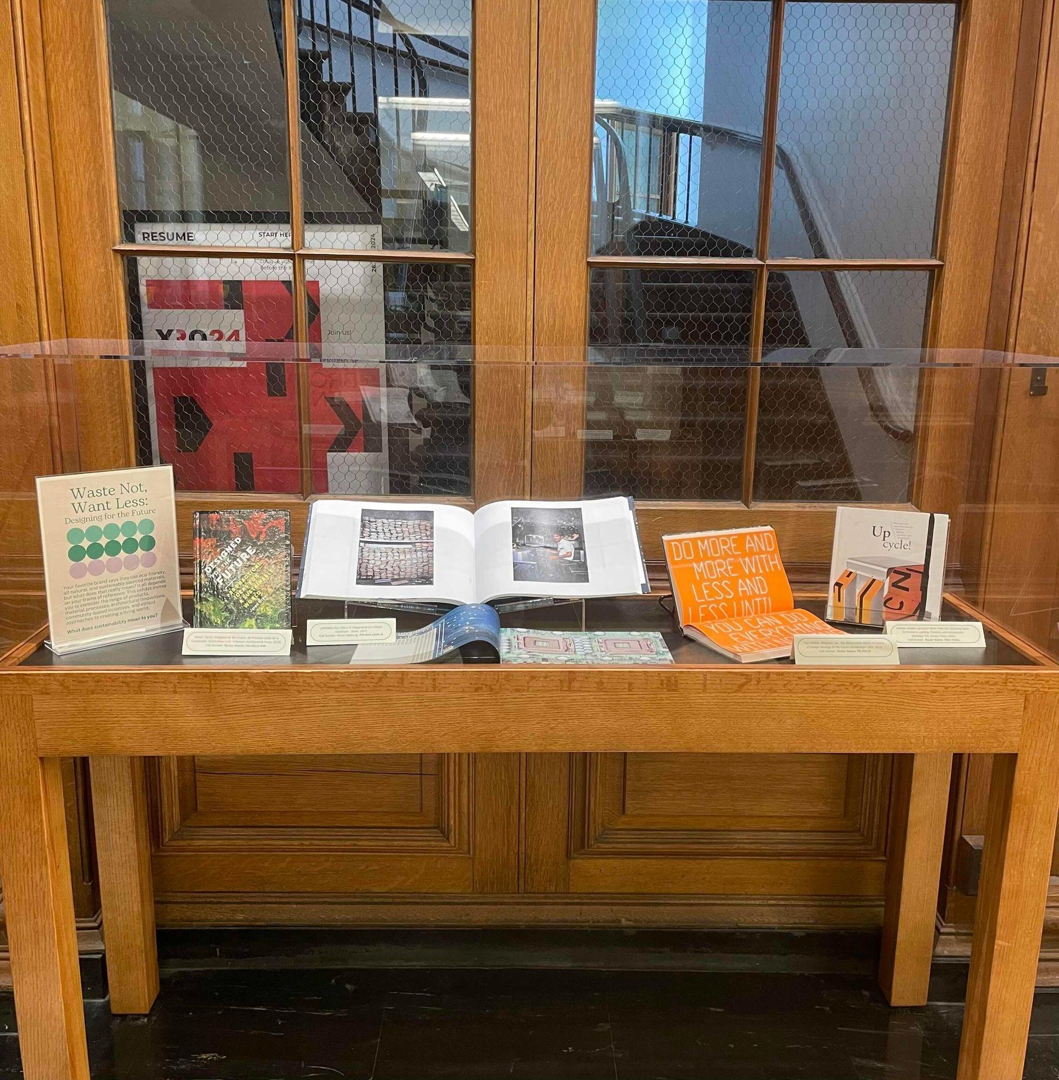
Ricker Library’s New Exhibition Cases
Notes:
Melanie

Slide 23
QUESTION 3:
What are ways you like to collaborate on exhibitions?
Notes:
Nicole [10 minutes, Discussion leader: Melanie ]

Slide 24
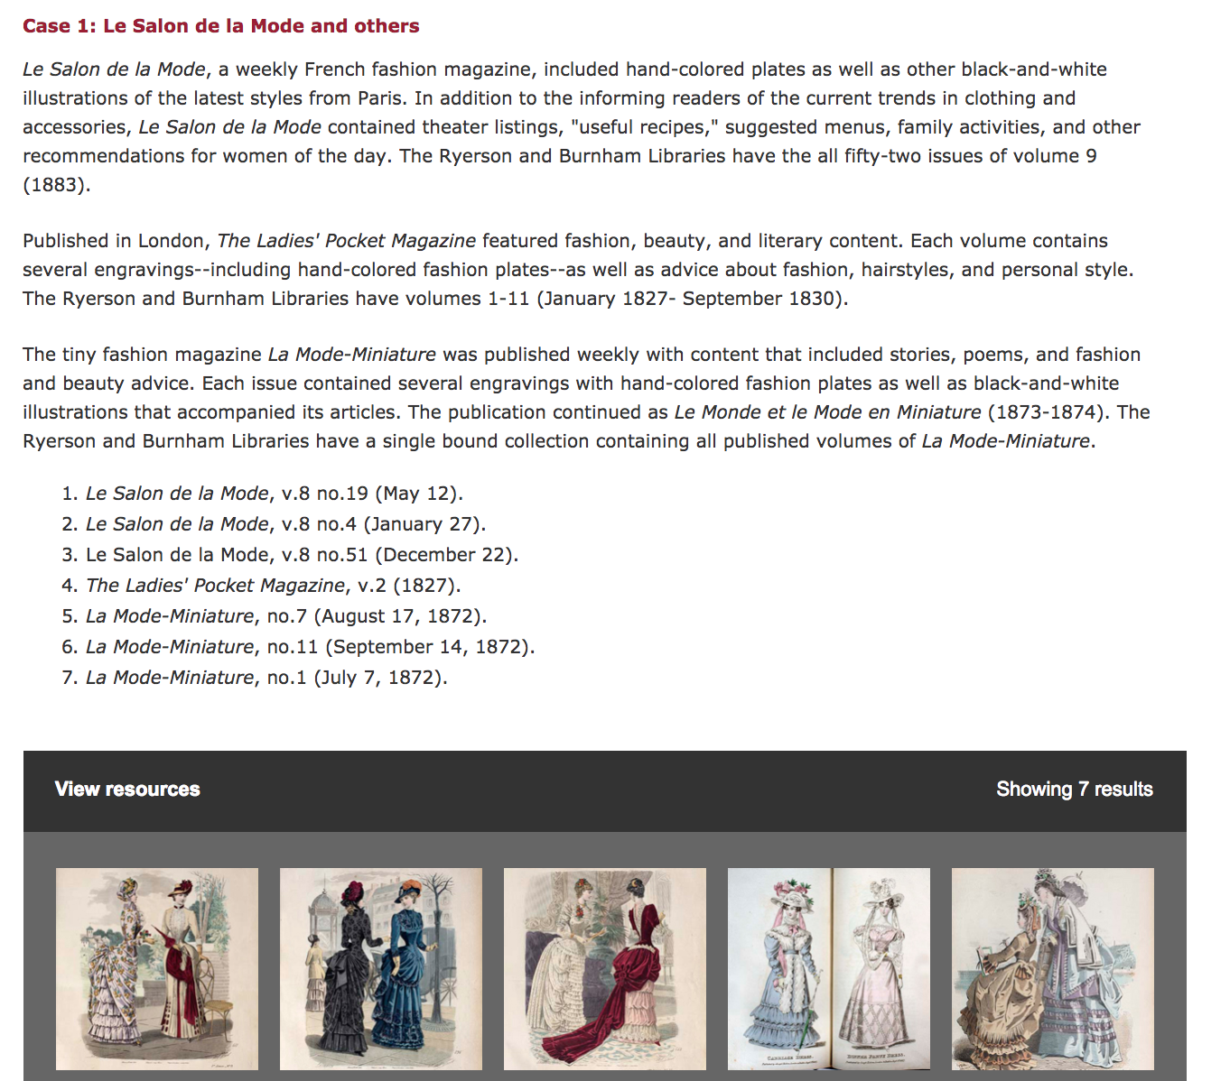
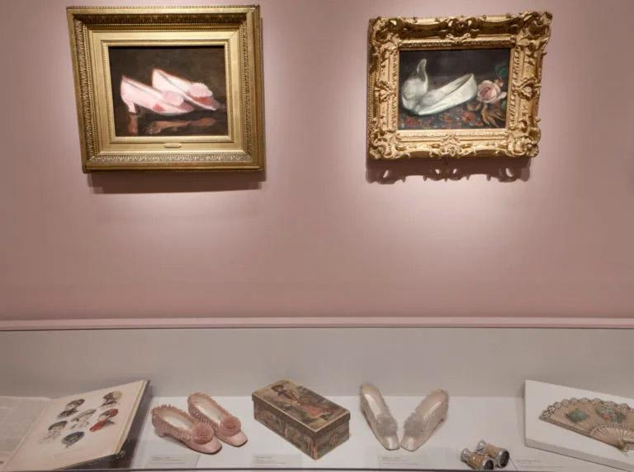
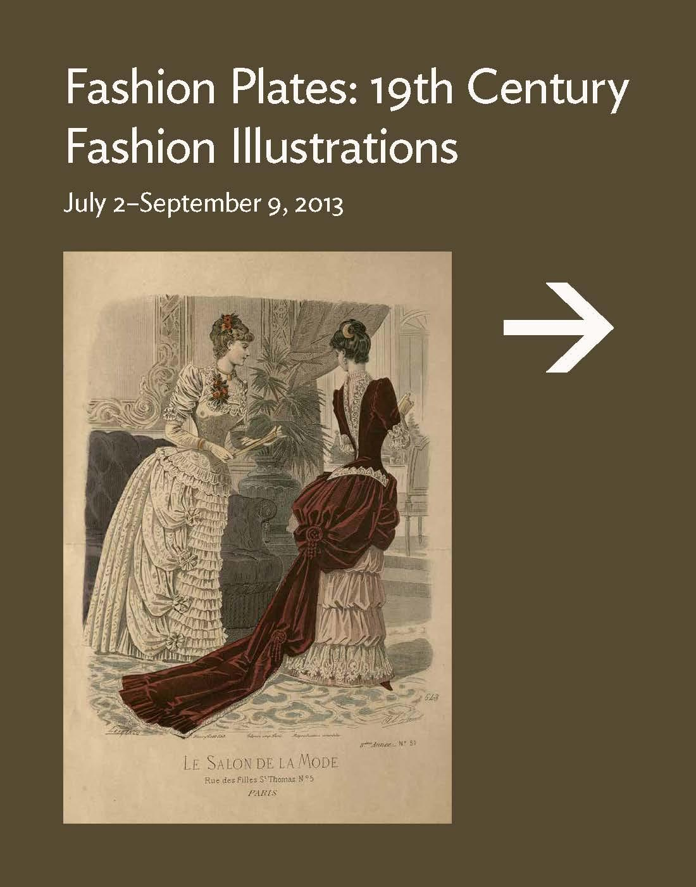
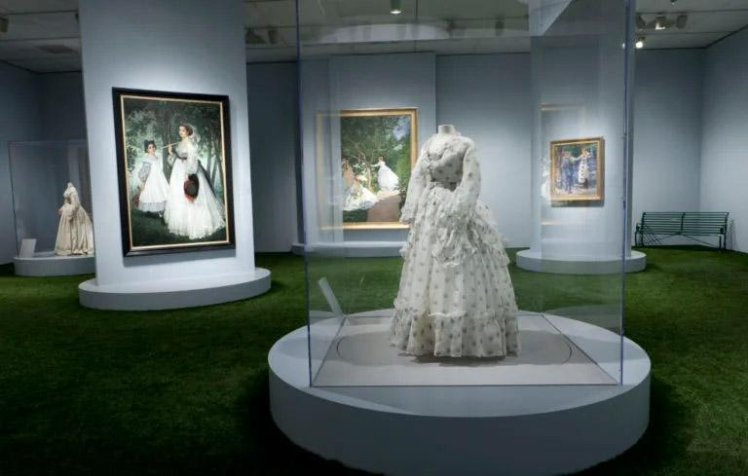
Collaborations at the Art Institute
Notes:
Melanie
Links: Exhibition: https://archive.artic.edu/ryerson/fashion-plates/

Slide 25
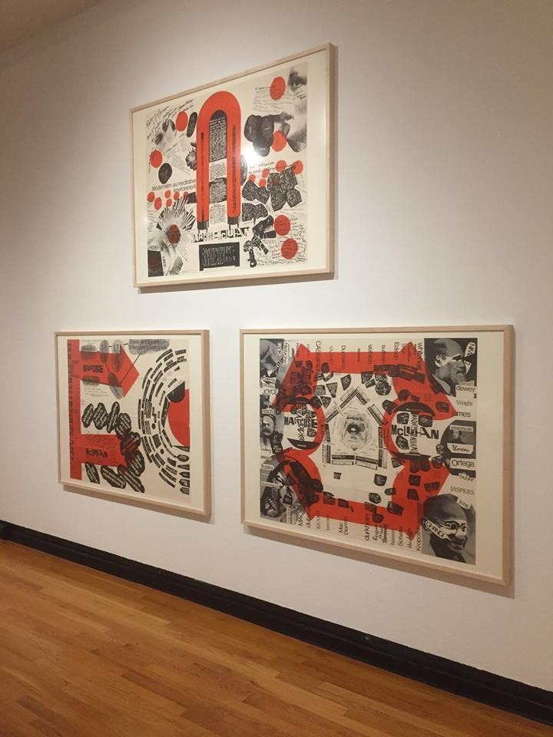
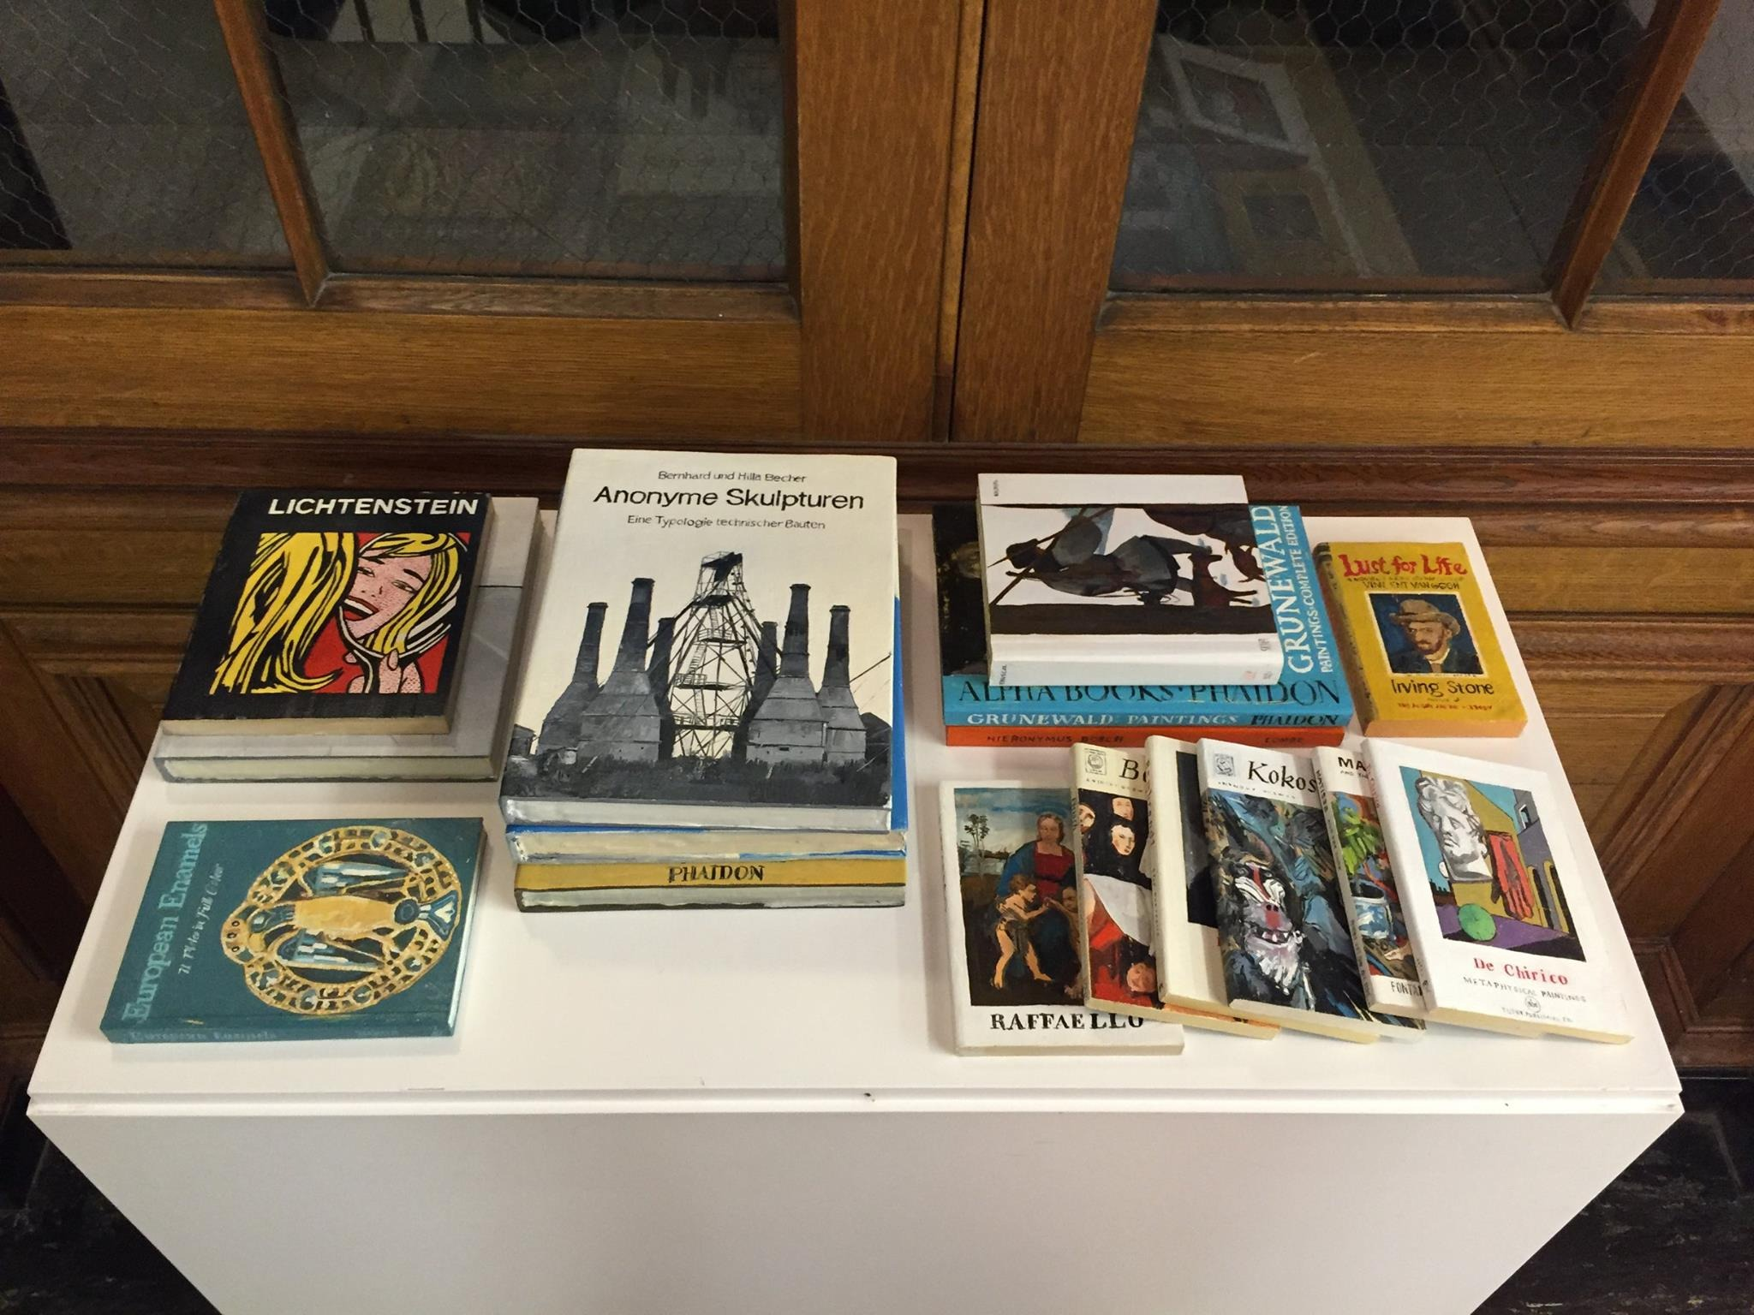
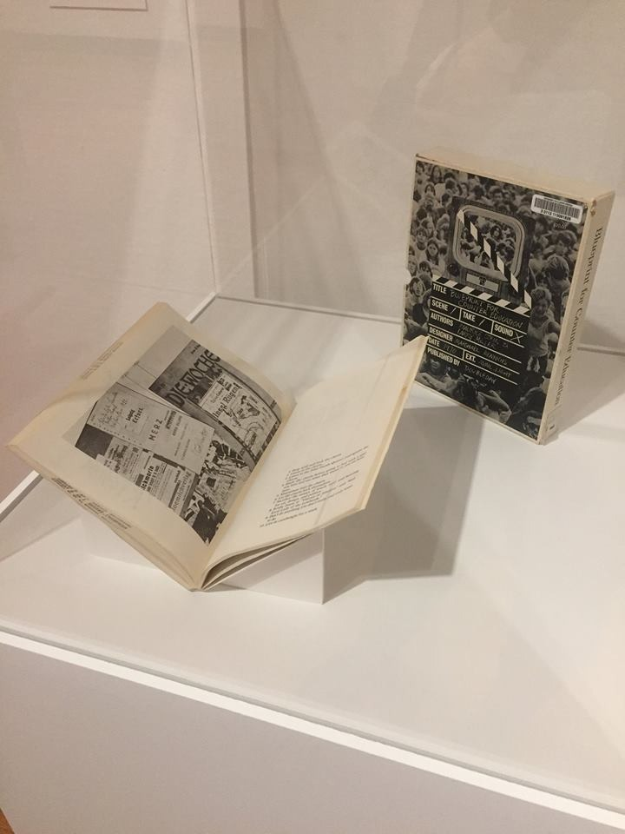
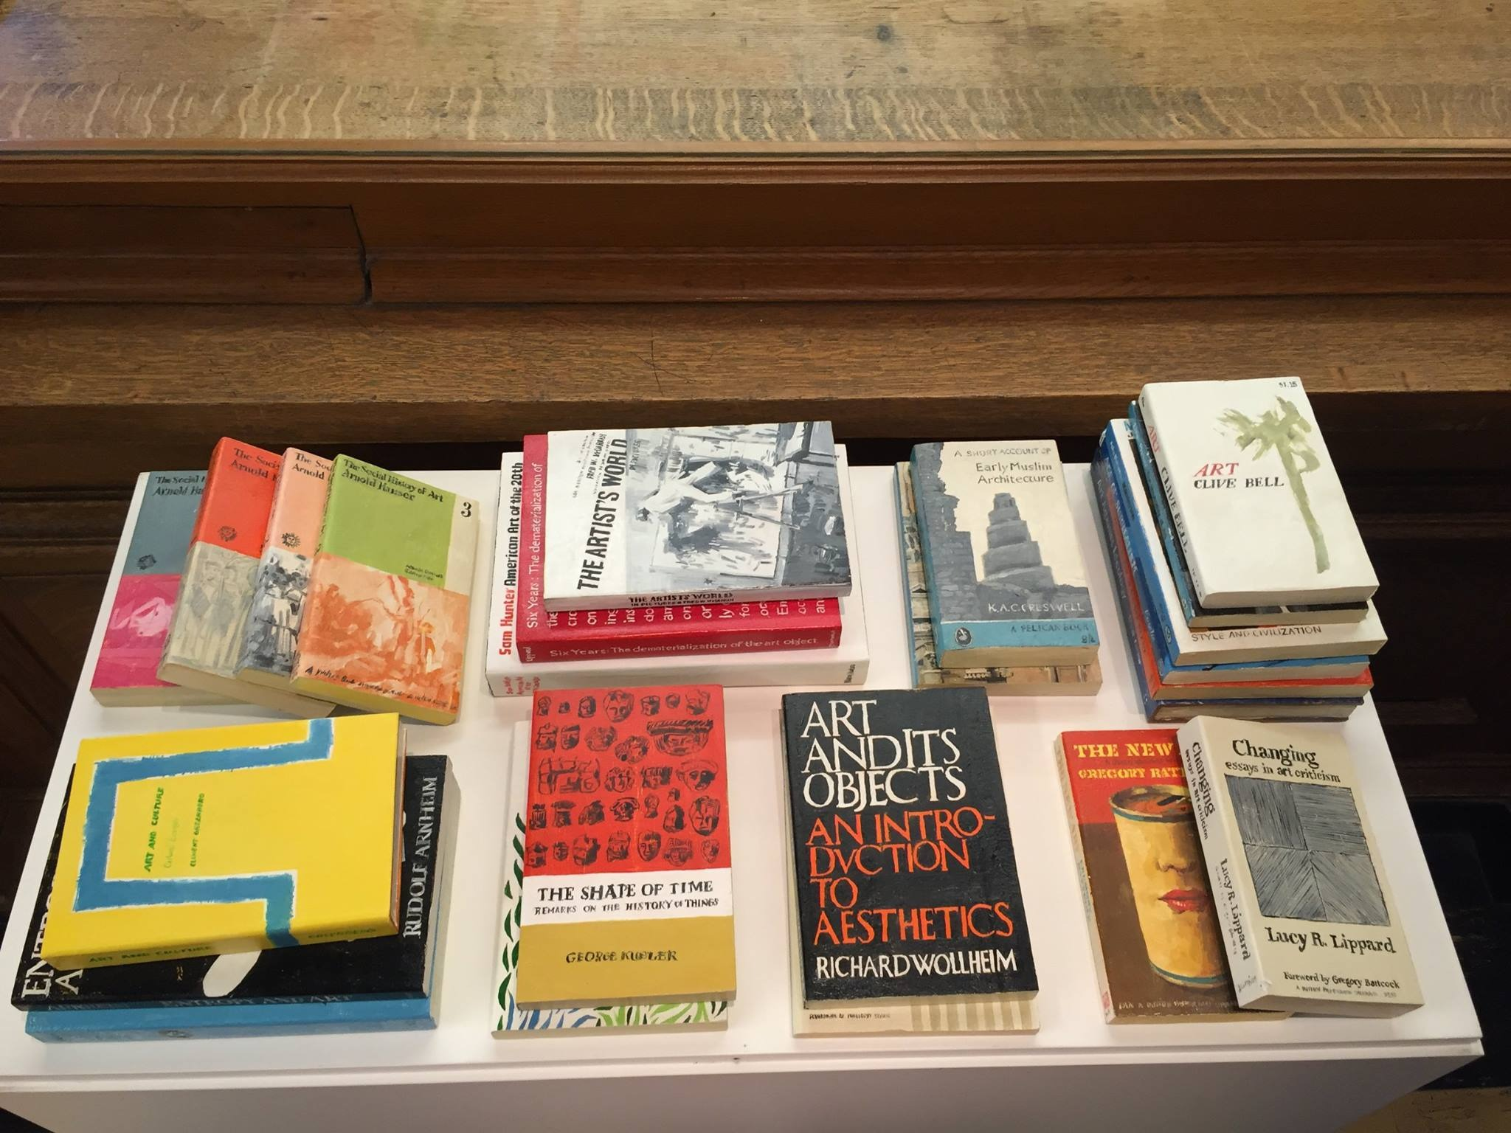
Collaborations at University of Illinois
Krannert Art Museum,
Art + Design Faculty and Students
Notes:
Melanie
Links:
Conrad Bakker’s Untitled Project: Robert Smithson Library & Book Club: https://conradbakker.tumblr.com/post/98321213981/robertsmithsonlibrarybookclub

Slide 26

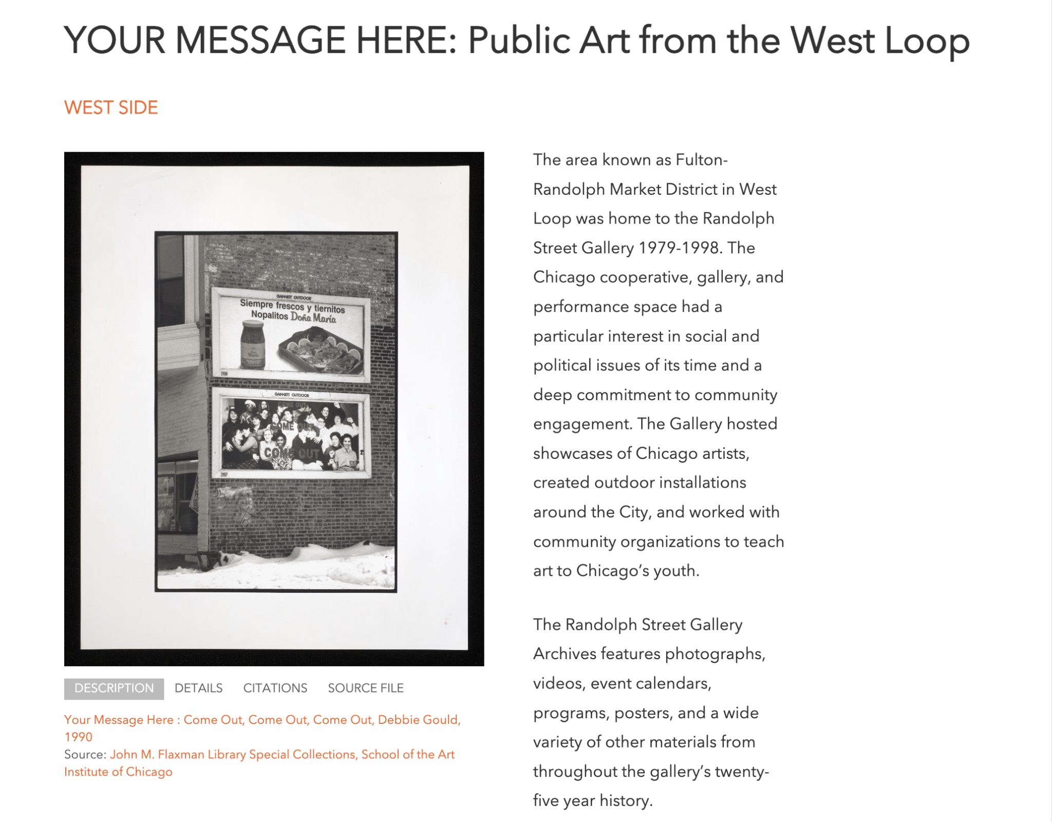
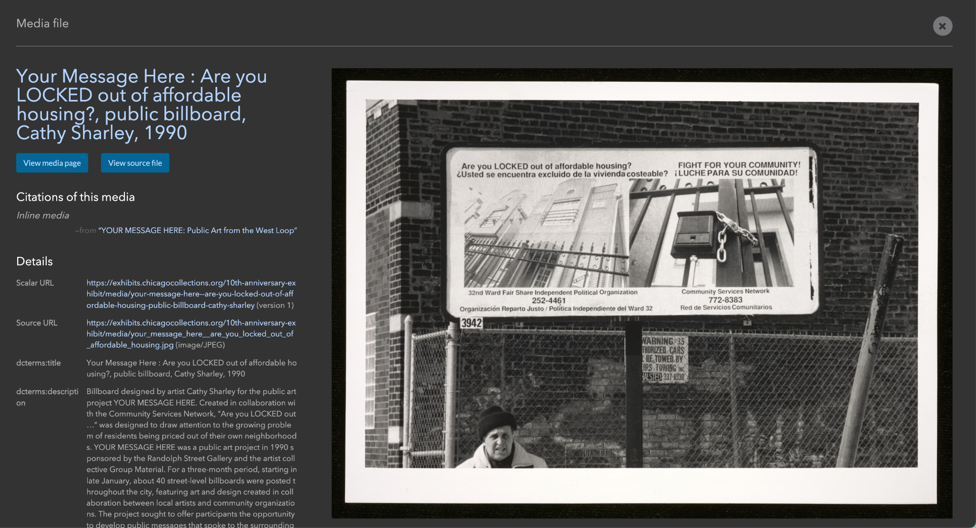
Collaborations with Chicago Collections Consortium
Virtual Exhibitions with Chicago Collections Consortium
Notes:
Melanie
Links:
Chicago Collections Consortium Exhibitions https://exhibits.chicagocollections.org/digital-exhibits/index

Slide 27
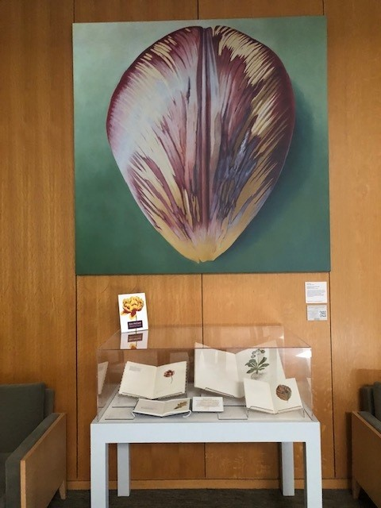



Collaboration with the Driehaus Museum to celebrate Rory McEwen’s artistry
Notes:
Leora

Slide 28


Collaboration with Chicago Botanic Garden Staff for Dia de los Muertos celebration
Notes:
Leora

Slide 29

Collaboration with Chicago Botanic Garden Staff for Dia de los Muertos celebration
Notes:
Leora

Slide 30
QUESTION 4:
Could you talk about some of the challenges you’ve encountered while working on exhibitions?
Notes:
Nicole[10 minutes, Discussion leader: Leora ]

Slide 31



Examples of Library Exhibitions at Chicago Botanic Garden
View of Chicago Botanic Garden Library exhibition
Notes:
Leora

Slide 32



Example of Library Exhibitions at Chicago Botanic Garden
Notes:
Leora

Slide 33

Examples of Library Exhibitions at Chicago Botanic Garden
Notes:
Leora: Herbaria

Slide 34


Examples of Library Exhibitions at SAIC
Flaxman Library Special Colletions Exhibition Cases, before 2023 Renovation
Notes:
Melanie

Slide 35

Examples of Library Exhibitions at SAIC
Flaxman Library Main Collection Exhibition Cases before 2023 Renovation
Notes:
Melanie

Slide 36




Examples of Library Exhibitions at SAIC
Flaxman Library Exhibition Cases, after Renovation
Notes:
Melanie

Slide 37

Currently on view:
Notes:
Leora

Slide 38

Coming this summer:
Notes:
Leora

