Slide 1
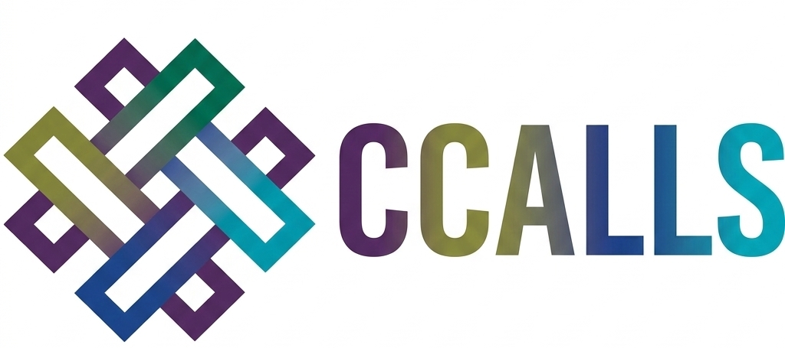

Consortial Collaboration for Academic Library Leadership Success:
Project recap and Design Seminar summary and findings
July 30, 2026
The CCALLS project was made possible in part by the Institute of Museum and Library Services (Grant Number RE-256707-OLS-24).
Notes:
[Debbie]
Hello everyone!
Thank you for joining us today for this webinar where we will recap our CCALLS project, and the summary and findings from the March 2026 Design Seminar.
The CCALLS project was made possible in part by the Institute of Museum and Library Services (Grant Number RE-256707-OLS-24).
I’m Debbie Campbell at CARLI- the current PI on the CCALLS grant, and I’m joined today by Laurie Blandino- CARLI’s current Director.
This session is being recorded and will be posted to the CARLI website.

Slide 2
This slide has no title; it only has a quote.
“CCALLS seeks to develop a strategy for academic library consortia to scale assessment training for academic library workers nationally, based on the successful CARLI Counts program.”
The CCALLS project was made possible in part by the Institute of Museum and Library Services (Grant Number RE-256707-OLS-24).
Notes:
[Debbie]
Overall, the goal of CCALLS, aka, the ‘Consortial Collaboration for Academic Library Leadership Success’ has been to engage U.S. library consortia in a participatory planning process to cultivate a national continuing education program geared towards enhancing academic library workers’ assessment skills.
We seek to develop a strategy for academic library consortia to scale assessment training for academic library workers nationally based on our successful CARLI Counts program.

Slide 3
CCALLS Leadership:
Current PI: Debbie Campbell, Senior Library Services Coordinator, CARLI
Current CARLI Director: Laurie Blandino
Former Co-PI: Lisa Janicke Hinchliffe, retired Professor and Coordinator for Research Professional Development, University Library, University of Illinois Urbana-Champaign
Former PI: Anne Craig, retired Director of CARLI
The CCALLS project was made possible in part by the Institute of Museum and Library Services (Grant Number RE-256707-OLS-24).
Notes:
[Debbie]
If you’ve been at any of the previous CARLI Counts or CCALLS programming, you may have seen our names before.
My now-retired colleagues Anne and Lisa began this process with presentations on CARLI Counts at the ICOLC 2022 Annual Meeting. From those presentations, they heard the question “How can we replicate CARLI Counts in our consortium?” CCALLS was designed to investigate and provide that support.
Anne Craig, Executive Director of CARLI, served as the original Principal Investigator, overseeing project administration and grant management. That PI role was passed to me in 2025 in preparation for Anne’s retirement.
Laurie Blandino, CARLI’s new director, has been a great support of CCALLS, picking up as Director where Anne left off.
Lisa Janicke Hinchliffe, Professor and Coordinator for Research Professional Development, University of Illinois Library at Urbana-Champaign, served as Co-Principal Investigator. Lisa served as the lead curriculum designer and instructor for CARLI Counts and also designed and facilitated the CCALLS Design Seminar.

Slide 4
Gratitude to the Consortia Collaboration Committee:
Atla: Gillian Harrison Cain, Director of Member Programs
ASERL: Elaina Norlin, Professional Development/DEI Coordinator
NCLIVE: Rob Ross, Executive Director; Claire Leverett, Executive Director
OhioNet: Hannah Rosen, Director Member Programs
The CCALLS project was made possible in part by the Institute of Museum and Library Services (Grant Number RE-256707-OLS-24).
Notes:
[Debbie]
We’d also like to thank the former members of the Consortia Collaboration Committee, who advised on the design and implementation of CCALLS.
We were thankful to have these committee members to represent a diversity of consortia types and geographic regions:

Slide 5
CARLI Counts Overview
A continuing education library leadership immersion program based on the highly successful Illinois I-LEAD and ACRL Assessment in Action programs
Prepares librarians to make effective use of research findings on the impact of academic libraries on student learning success for the twin purposes of service development and library advocacy
Participants learn how to use local library data analytics to improve their services and demonstrate their value in competitive campus budgeting processes, accreditation reports, and program reviews
Website: https://www.carli.illinois.edu/products-services/prof-devel/carli-counts
Notes:
[Debbie]
Okay, since CCALLS builds on the foundation of our CARLI Counts program, we will do a very brief overview of that program.
CARLI Counts is based on the highly successful Illinois I-LEAD and ACRL Assessment in Action programs.
It is immersive and team-based.
The curriculum prepares library workers to make effective use of research findings on the impact of academic libraries on student learning and success for the twin purposes of service development and library advocacy.
Participants learn how to use local library data analytics to improve their services and demonstrate their value in competitive campus budgeting processes, accreditation reports, and program reviews.

Slide 6

Goal of CARLI Counts:
Illinois academic librarians will be able to effectively and systematically leverage national and local data in order to communicate impact narratives that convey to stakeholders how their libraries bolster student learning and success.
Notes:
[Debbie]
The goal of CARLI Counts is simple to say, and complex to accomplish.
“Illinois academic librarians will be able to effectively and systematically leverage national and local data in order to communicate impact narratives that convey to stakeholders how their libraries bolster student learning and success.”

Slide 7
General Structure of Participation
CARLI Member Library Applies (December) and After Acceptance Designates a Participant (January)
One Cohort Per Year (15 Months – February to February):
  Each Cohort Comprised of Multiple Teams
  Each Team Comprised of Multiple Participants and One Mentor
  Mentor Team Comprised of Mentors and the Mentor of Mentors
Learning Experiences:
  Mentor Training Workshop (January)
  Two Immersive Workshops (February and July)
  Monthly Webinars
  Monthly Mentor Team Meetings (Led by Mentor of Mentors)
  Weekly Team Meetings (Led by Mentors)
  One-on-One Coaching Sessions (Individuals with Lisa)
  Team Poster Session at CARLI Annual Meeting (November)
  Individual Progress Report and Individual Reflection (February)
Notes:
[Debbie]
This slide covers the basic outline of a CARLI Counts cohort as they work through the program, from application until final report and reflection.
CARLI Counts operates on a 15-month cohort cycle.
Each cohort is organized into multiple teams, each comprising several participants and one mentor, supported by a Mentor of Mentors.
Learning experiences include two multi-day in-person immersive workshops (February and July),
monthly webinars, monthly mentor team meetings, weekly team meetings,
and individual coaching sessions with the lead instructor and facilitator for the program.
Each participant develops an individual assessment project investigating the impact of a library service on student learning and success.
Projects proceed through a structured arc: defining an inquiry question, identifying relevant literature, selecting methods, collecting and analyzing data, and communicating findings.
Deliverables include a team poster presented at the CARLI Annual Meeting and an individual project report.

Slide 8
Summary of CARLI Counts Grant
Laura Bush 21st Century Librarian Program Grant
Four-year project: October 1, 2018-March 31, 2023
  Development and Three Cohorts
CARLI in partnership with:
  University of Illinois Library at Urbana-Champaign
  Lewis & Clark Community College
CARLI Board Allocated Funds to Continue the Program
  Cohort 4 (2023-2024)
  Cohort 5 (2024-2025)
  Cohort 6 (2025-2026)
  Cohort n
This project was made possible in part by the Institute of Museum and Library Services (Grant Number RE-95-18-0084-18)
Notes:
[Debbie]
The first four years of CARLI Counts was made possible in part by an IMLS LB21 grant in partnership with the University of Illinois Library at Urbana-Champaign and Lewis & Clark Community College.
CARLI Counts has completed six cohorts. The first three were conducted under the original IMLS grant; CARLI’s governing board subsequently allocated funds to continue the program. More than 140 library workers from 85 CARLI member institutions have participated to date.

Slide 9
Outcomes of CARLI Counts:
CARLI Counts participants are more confident in their skills and abilities related to service design and library advocacy.
CARLI libraries are better equipped to demonstrate their value to stakeholders.
Notes:
[Debbie]
CARLI Counts produces two core outcomes:
participants are more confident in their skills and abilities related to service design and library advocacy, and CARLI libraries are better equipped to demonstrate their value to stakeholders.
Participants also report increased campus collaboration and greater recognition for their assessment expertise.

Slide 10
Elements of Collective Impact
Shared Goals
Increase awareness of the impact of libraries on student learning and success
Document the impact of libraries on student learning and success
Measure/Monitor the Same Things
Cohorts 1+2: library impact on student learning and success at the local level
Cohort 3: library impact on student learning and success at a state level
A “Backbone”
CARLI – physical and relational
Mutually Reinforcing
Multiple-year project
Cohorts
Teams
Shared Learning
Learning process
Multiple layers and means of communication
Notes:
[Debbie]
The six cohorts have produced important lessons for replication.
The consortium’s role as a “backbone” organization providing structure and sustained support is key to making the program work.
Team-based approaches reinforce mutual learning and accountability.
Sustained engagement over 15 months creates momentum that shorter programs cannot achieve.
Though efforts have been made to encourage others to implement the curriculum, having a developed set of resources is necessary but not sufficient.
Replication requires facilitative expertise, infrastructure, and institutional commitment — not only materials.

Slide 11
CARLI Counts Grant Deliverables
A portfolio of local case studies and team posters.
An evaluation of the collective statewide impact of the program.
A replicable training model for equipping librarians to be campus leaders in assessing library impact on student learning and success supported by an extensive set of OER materials:
https://www.carli.illinois.edu/analytics-and-advocacy-service-development-curriculum-guide
Notes:
[Debbie]
To summarize the CARLI Counts grant with its deliverables- they are:
A portfolio of local case studies and team posters.
An evaluation of the collective statewide impact of the program.
A replicable training model for equipping librarians to be campus leaders in assessing library impact on student learning and success supported by an extensive set of OER materials available on the CARLI website.

Slide 12
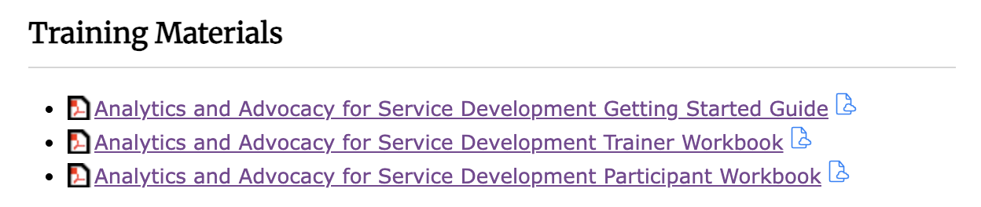
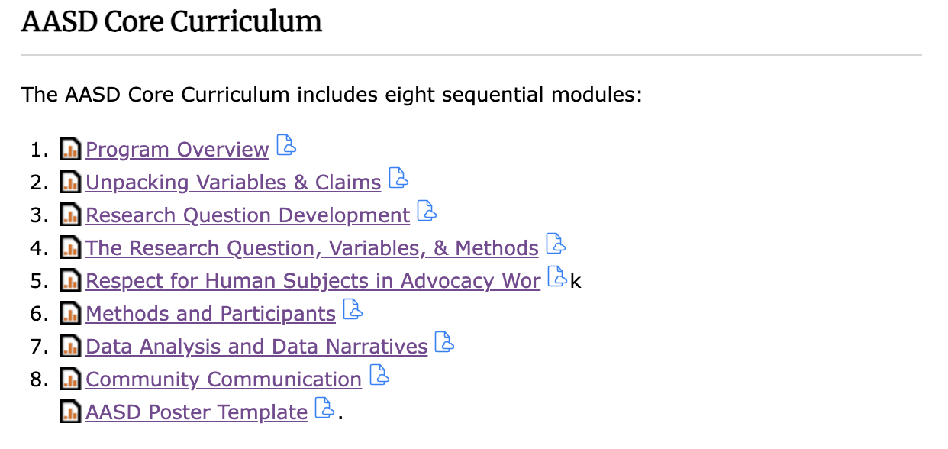
Analytics and Advocacy for Service Development
(AASD)
https://www.carli.illinois.edu/analytics-and-advocacy-service-development-curriculum-guide
Notes:
[Debbie]
The full CARLI Counts curriculum — Analytics and Advocacy for Service Development —
is published as a freely available open educational resources (OER), including a Getting Started Guide, a Participant Workbook, and a Trainer Workbook, all released under a Creative Commons license (https://www.carli.illinois.edu/analytics-and-advocacy-service-development-curriculum-guide).

Slide 13
CARLI Counts to CCALLS
What could one consortium do alone?
What could a group of consortia do together?
Notes:
[Debbie]
With CARLI Counts, we’ve been able to see impact for what one consortium can do alone.
CCALLS brings up the potential for what a group of consortia could do together.

Slide 14
Framing for the CCALLS Conversation
Demonstrating library value is a critical component of library budget proposals, program reviews, and related processes.
Library staff have a skills gap. To improve library services and communicate their value, library staff need to develop assessment skills- from evaluation design through data collection and analysis to telling the story of library impact- and confidence in those skills.
Library consortia are strong community-of-practice infrastructures that enable at-scale collective action to respond to professional development needs.
Notes:
[Debbie]
Let’s add in some additional framing for the CCALLS Conversation.
Demonstrating library value is a critical component of library budget proposals, program reviews, and related processes.
Library staff have a skills gap. To improve library services and communicate their value, library staff need to develop assessment skills – from evaluation design through data collection and analysis to telling the story of library impact – and confidence in those skills.
Library consortia are strong community-of-practice infrastructures that enable at-scale collective action to respond to professional development needs.

Slide 15
CCALLS History
Laura Bush 21st Century Librarian Program Grant
Two-year project: 8/1/2024 - 7/31/2026
CARLI in partnership with:
  University of Illinois Library at Urbana-Champaign
Focus during year 2 was on the Design Seminar- two half-day sessions held adjacent to the ICOLC Annual Meeting in March 2026.
CCALLS supports LB21 Goal 3, Objective 3.1: “Develop training to equip the library and archival workforce to engage in sustained community development.
White Paper: https://www.carli.illinois.edu/sites/files/prof_devel/CCALLS_White_Paper.docx
The CCALLS project was made possible in part by the Institute of Museum and Library Services (Grant Number RE-256707-OLS-24).
Notes:
[Debbie]
Consortial Collaboration for Academic Library Leadership Success (CCALLS) is an IMLS LB21 Planning Grant project (Grant Number RE-256707-OLS-24) led by the Consortium of Academic and Research Libraries in Illinois (CARLI) in partnership with the University of Illinois Library at Urbana-Champaign.
The goal of CCALLS is to engage U.S. library consortia in participatory planning for a national continuing education program to develop academic library workers’ assessment skills, based on the successful CARLI Counts program, utilizing ICOLC meetings as shared infrastructure for convening.
The CCALLS planning grant supported discussion and collaboration. This planning project is a linking piece that builds a space for a participatory design process for collaborative implementation.

Slide 16
Design Seminar Summary – Overview
The CCALLS Design Seminar was held March 14-15, 2026, at the Celeste Hotel in Orlando, Florida, contiguous to the ICOLC Annual Meeting.
The participants were welcomed by Laurie Blandino, Director of CARLI.
The program was facilitated by Lisa Janicke Hinchliffe.
The Design Seminar had 23 attendees, representing 20 consortia.
Notes:
[Debbie]
After a necessary pivot from our initial year 1 plans, year 2 of the grant focused on the Design Seminar, two half-day sessions which were held adjacent to the ICOLC Annual Meeting in March 2026 in Orlando.
The goal of the Design Seminar was for consortia staff to share the discussions that they have had about assessment within their respective consortia and to work towards articulating a recommended approach to cross-consortia assessment training for librarians.
We had 23 attendees representing 20 consortia.
They were welcomed by Laurie Blandino, Director of CARLI.
The program was facilitated by Lisa Janicke Hinchliffe.

Slide 17
Design Seminar Summary – Day 1
Part 1
  The first session framed the problem CCALLS was designed to address: the gap between what academic library workers are asked to demonstrate and the skills and support available to help them do so.
Part 2
  The second session provided a detailed introduction to CARLI Counts- its structure, instructional arc, year-long timelines, activities, and outcomes across the cohorts.
Notes:
[Debbie]
The first session framed the problem CCALLS was designed to address: the gap between what academic library workers are asked to demonstrate and the skills and support available to help them do so.
Participants were invited to share what they are hearing from member libraries — what challenges, opportunities, and needs their members bring to them, and how their consortium is currently responding. Participants across consortia identified consistent member pressures: difficulty making data-informed cases for library budgets, challenges connecting library services to institutional strategic plans, and library staff who feel under-equipped for the assessment work.
The second session provided a detailed introduction to CARLI Counts — its structure, instructional arc, year-long timelines, activities, and outcomes across the cohorts. Day One concluded with further dialogue. Participants completed written feedback cards designed to capture their initial reactions to the program and their questions before Day Two’s curriculum and scaling discussions.

Slide 18
Design Seminar Summary – Day 2
Part 1
  The first session provided an in-depth look at the CARLI Counts OER curriculum, walking participants through the logic model framework, inquiry question development, research methods, the approaches for communicating results, and the participant report template.
Part 2
  The second session engaged participants in structured small-group analysis of models for scaling CARLI Counts through consortial collaboration.
The seminar closed with a presentation of the next steps and an exploration of ways for participating consortia to engage going forward.
Notes:
[Debbie]
Day Two opened with a dialogue session in which participants shared reflections and perspectives. The morning’s next presentation provided an in-depth look at the CARLI Counts OER curriculum, walking participants through the logic model framework, inquiry question development, research methods, the approaches for communicating results, and the participant report template.
The final session engaged participants in structured small-group analysis of models for scaling CARLI Counts through consortial collaboration. Groups evaluated the models using an advantages-and-disadvantages framework and generated a range of near-term entry points that individual consortia could pursue without waiting for a new grant cycle.
The seminar closed with a presentation of the next steps and an exploration of ways for participating consortia to engage going forward.
Participant responses were gathered through two instruments: written feedback cards completed at the close of day one of the Design Seminar, and a written evaluation survey completed online after the event.
The next few slides summarize key themes from submissions across both instruments.
All of these themes can be found in our CCALLS White Paper.

Slide 19
Theme: Enthusiasm for Program and Its Goals
Tone across both feedback instruments was enthusiastic.
Participants identified the core promise of CARLI Counts — helping library workers demonstrate their value through data — as both urgent and compelling.
  “We need this! Our members value the work we do but especially in this climate we need to be able to demonstrate ROI.”
Notes:
[Debbie]
The tone across both feedback instruments was enthusiastic.
Participants identified the core promise of CARLI Counts — helping library workers demonstrate their value through data — as both urgent and compelling.

Slide 20
Theme: Enthusiasm for Program and Its Goals, cont’d
Participants were also energized by the cross-consortia connection the seminar facilitated.
  Having the chance to connect with colleagues from around the country and meeting other folks having the same values were among the mentioned sources of excitement.
Several respondents expressed enthusiasm for the program’s ambition and scale:
  “The long-lasting impact of the program in CARLI Counts - it’s the kind of capacity that I’m in awe of - the scale of this program.”
  “The program is well-designed and reachable - seems replicable.”
Notes:
[Debbie]
Participants were also energized by the cross-consortia connection the seminar facilitated.
Having the chance to connect with colleagues from around the country and meeting other folks having the same values were among the mentioned sources of excitement.
Several respondents expressed enthusiasm for the program’s ambition and scale.

Slide 21
Theme: Capacity and Bandwidth Concerns
The most consistently raised concern- appearing in roughly half of all feedback cards and recurring throughout the follow-up evaluation- was whether library staff and consortia staff have adequate time and support to engage with a program of this scale.
  “We have a lot of schools with 2–5 librarians — this would be good but the time commitment seems daunting.”
  “How to manage commitment post-pandemic when attendance for volunteer projects are declining.”
Notes:
[Debbie]
The most consistently raised concern — appearing in roughly half of all feedback cards and recurring throughout the follow-up evaluation — was whether library staff and consortia staff have adequate time and support to engage with a program of this scale.

Slide 22
Theme: Capacity and Bandwidth Concerns, cont’d
Several respondents also flagged the facilitator and instructor role as carrying a heavy load:
  “The biggest concerns- the lead instructors / the training content of the lead can be challenging and continue to be so.”
  “There may not be enough mentors- ability to reproduce/scale but may have a skilled gap.”
Notes:
[Debbie]
Several respondents also flagged the facilitator and instructor role as carrying a heavy load.

Slide 23
Theme: Capacity and Bandwidth Concerns, cont’d 2
These concerns are not objections to the program’s goals, but they are realistic assessments of the conditions under which participating consortia operate.
They point directly to the design requirements for any viable national model: the program must be structured to be achievable within the actual capacity of participating organizations, and it must address sustainability through design.
Notes:
[Debbie]
These concerns are not objections to the program’s goals, but they are realistic assessments of the conditions under which participating consortia operate.
They point directly to the design requirements for any viable national model: the program must be structured to be achievable within the actual capacity of participating organizations, and it must address sustainability through design.

Slide 24
Theme: Questions about Scalability and Local Application
Participants consistently asked how the CARLI Counts model would translate to other contexts.
Several raised questions about consortium types beyond academic libraries and about data systems compatibility:
  “The focus thus far has been around infrastructure/student success. How might this curriculum translate into other consortia? (e.g. resource sharing, coordinated digitization)”
  “Our members [do not] use the same library systems, so getting data is complicated.”
Notes:
[Debbie]
Participants consistently asked how the CARLI Counts model would translate to other contexts. Several raised questions about consortium types beyond academic libraries and about data systems compatibility.

Slide 25
Theme: Questions about Scalability and Local Application, cont’d
Desired outcomes:
  Take-aways that are locally applicable.
  A framework and tools to build confidence in supporting data work.
  The ability to build consistent data collection across a consortium’s members.
Participants observed that the portfolio of completed CARLI Counts participant projects will help make the case for replication within their own organization.
Notes:
[Debbie]
Desired outcomes expressed by design seminar attendees include take-aways that are locally applicable,
a framework and tools to build confidence in supporting data work,
and the ability to build consistent data collection across a consortium’s members.
Participants observed that the portfolio of completed CARLI Counts participant projects will help make the case for replication within their own organization. The completed projects can serve as concrete examples of what the program produces.

Slide 26
Theme: What Design Seminar Participants Want Next
Across both feedback instruments, participants requested continued engagement, near-term virtual trainings, and discussions of funding pathways.
Multiple respondents specifically asked about next steps for a follow-on grant.
Participants were consistent in wanting any next-step programming to preserve the community and relational dimensions that make CARLI Counts distinctive:
  “I like the idea of using the ready-made curriculum for one-off workshops but I think that misses the camaraderie that CARLI Counts developed among its participants and facilitators.”
Notes:
[Debbie]
Across both feedback instruments, participants requested continued engagement, near-term virtual trainings, and discussions of funding pathways.
Multiple respondents specifically asked about next steps for a follow-on grant.
Participants were consistent in wanting any next-step programming to preserve the community and relational dimensions that make CARLI Counts distinctive.
Now, I’ll pass this along to Laurie to talk about moving forward.

Slide 27
Moving Forward: Overarching Considerations
Capacity must be designed for, not assumed
Relationship-building and in-person engagement are critical
Sustainability must be designed in from the outset
Small-institution access requires intentional design
Existing infrastructure should be leveraged
Notes:
[Laurie]
Five considerations apply no matter what our future model or programmatic approach may be.
Capacity must be designed for, not assumed.
The most consistent finding across all feedback instruments is that library workers and consortia staff are stretched.
Any viable model must be structured to be achievable within the actual capacity of participating organizations.
Relationship-building and in-person engagement are crucial.
Every group identified the human connections built through in-person shared experience as essential to program effectiveness.
Consortial bonding translates to sustained engagement and continued participation beyond formal program structures.
Sustainability must be designed in from the outset.
Trainer turnover, grant dependency, and small-institution capacity constraints all threaten continuity.
Any sustainable model requires a credible path to ongoing operation.
he CARLI Board’s decision to fund CARLI Counts with consortium funds after the initial grant period provides a useful example.
Access for small institutions depends on program design.
The smallest libraries face the greatest barriers to participation in consortia.
Design responses must include practical strategies to enable participation- e.g., surrogates, backfill, campus collaboration, and careful timing of in-person programming- as well as formats that are accessible without extended travel or large time commitments.
Existing infrastructure should be leveraged.
Building on governance structures, member overlap, existing meeting schedules, consortium-level data, and PDA channels reduces the activation energy required and improves sustainability.

Slide 28
Roadmap For Collaborative Implementation from Design Seminar
Near-Term Actions:
webinar series via PDA/ICOLC led by CARLI Counts alumni
pilot OER modules within existing programming
compile a project portfolio
form internal interest groups
organize a virtual follow-up convening
Long-Term Actions:
bring CARLI Counts to member libraries of additional consortia beyond CARLI
preferred structure of Design Seminar participants was a hybrid model of shared in-person sessions and local teams
Notes:
[Laurie]
We’re at the point now where we have two paths to move forward, near-term actions, and long-term actions.
The near-term actions will help to keep the momentum going, and to help set the foundation of creating a national community of practice.
Working towards the long-term actions will help to build national capacity.
The examples of each type of action displayed on this slide were brainstormed and discussed by the Design Seminar participants.

Slide 29
Long Term Actions: Four models for scaling evaluated during the Design Seminar
Centralized national institute. Each participating organization receives participant slots in a centrally-run program, with cross-consortia teams and centralized instruction.
Train the trainer. Each participating organization sends one lead trainer to a national institute; the trainer returns and runs the program locally.
Hub-and-spoke hybrid. Shared in-person sessions and common webinars with a work project carried out by teams inside each consortium.
Fully virtual. All sessions are delivered online.
Notes:
[Laurie]
When thinking about the long-term process of scaling CCALLS to the national level as a cohesive program, the Design Seminar engaged participants in structured small-group analysis of models for scaling CARLI Counts.
Working in small groups, the participants evaluated four models using an advantages-and-disadvantages framework:
Centralized national institute
Train the trainer
Hub and spoke
Fully virtual
The white paper goes into more detail on the advantages and disadvantages determined by the Design seminar participant groups for each of these four models of scaling the CCALLS project nationally. Across those groups, the the Hub-and-spoke hybrid model was the most broadly preferred model.

Slide 30
Near-Term Actions: Why and What
No need to wait for a new grant cycle
Libraries need practical tools now
Possible short-form programming
  30-minute "how I tell a story" webinars
  Data storytelling workshops- using data consortia already have
  Starting with interest- poll first, find where readiness already exists
Leveraging existing structures
  Internal interest groups
  Build on what members already do
  Activating CARLI Counts alumni- as mentors and ambassadors
Notes:
[Laurie]
Alongside the formal model analysis for long-term actions, participants generated a set of ideas for smaller-scale programmatic activity that can begin immediately without waiting for a new grant cycle.
Participants' interest in these options reinforced the urgency: participants described libraries in “survival mode” that need practical tools now, and expressed a desire for takeaways that are locally applicable and immediately usable.

Slide 31
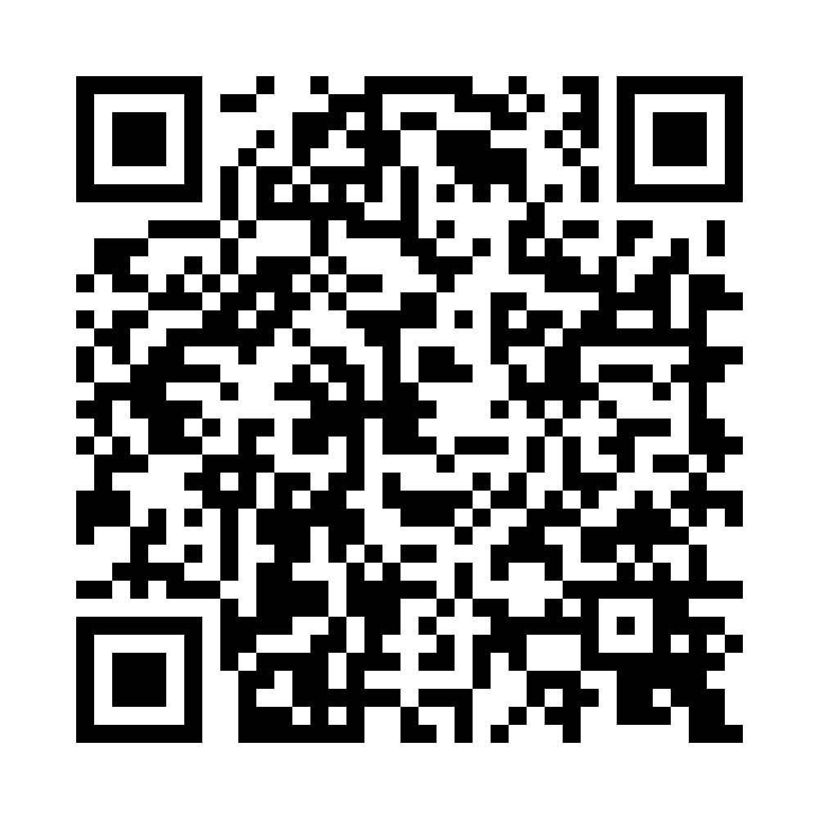
Moving Forward: Continuing to Build Upon the Design Seminar Findings
https://go.illinois.edu/CCALLSSurvey
Notes:
[Laurie]
Now that the CCALLS planning project is coming to a close, we would like your input on what comes next. We’d appreciate your feedback on our survey which asks about three things: what program formats would work for you, what your organization has the capacity to take on, and where your interest is strongest.
We’re showing these questions on these slides so that you can get a quick preview of the types of questions we’re seeking input on, so that we can continue to carry forward the work established by CCALLS, and add continue to add to the input gathered at the Design Seminar as we seek to create a community of practice around developing a strategy for academic library consortia to scale assessment training for academic library workers nationally.
Survey for further input:
Four models for scaling CARLI Counts were evaluated at the Design Seminar. Which would work best for your organization?
Setting aside a full cohort program, which shorter formats would your members actually attend? Select all that apply.
Design Seminar participants said that in-person time is what makes the program work, and also that travel is a barrier. How does that tension resolve for your organization?
Over the next twelve months, what could your organization realistically contribute? Select all that apply.
What is the longest program commitment your member libraries would realistically sustain?

Slide 32
In Summary:
The Design Seminar demonstrated genuine interest, documented need, and a foundation for collaborative implementation.
A potential for a hybrid model and a clear near-term agenda both emerged.
Key challenges were identified: capacity, facilitative expertise, small-institution access, and sustainability.
CARLI Counts demonstrates what is possible- the next step is to scale.
Notes:
[Laurie]
The Design Seminar demonstrated genuine interest, documented need, and a foundation for collaborative implementation.
A hybrid model and a clear near-term agenda both emerged.
Key challenges were identified: capacity, facilitative expertise, small-institution access, and sustainability.
CARLI Counts demonstrates what is possible; the next step is to scale.

Slide 33
Questions and Comments
Thank you!
Questions? Comments?
Debbie: dmcmpbll@uillinois.edu
Laurie: laurieb@uillinois.edu
Notes:
[Laurie]

