Slide 1
Elevator Pitch, or Minute to Win It
Dr. KATE MCDOWELL
CARLI New Directors’ Institute
5/24/23

Slide 2
What is one valuable contribution that you can measure and would like to tell as a story?
Notes:
Examples: Increase due to new service. Increase in use due to new publicity.

Slide 3
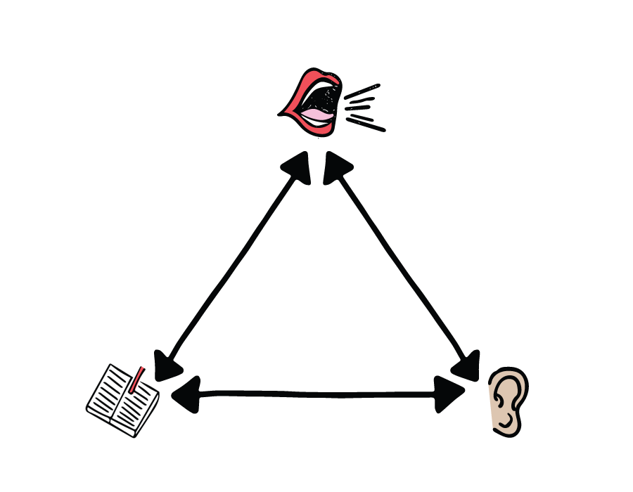

Slide 4
Your pitch? Your audience? Your goal?
Examples and real-time feedback

Slide 5
From The Craft of Research, Booth et al.
Topic:
I am studying
Question:
because I want to find out what/why/how __________
Significance:
in order to help my reader understand
.
Booth, W. C., Colomb, G. G., & Williams, J. M. (1995). The craft of research. Chicago, IL: University of Chicago Press, p. 56

Slide 6
Structures to Launch your Pitch
What, why, how
Topic, question, significance
Challenge/context, action, result
Service, problem it solves, vision

Slide 7
Warming Up
For 10 minutes, in groups of 2-3, try out a quick version of your elevator pitch. Make some notes on content and structure.
We’ll come back, hear a few examples from you, and play with structure.

Slide 8
Playing with structure

Slide 9
Cycle of Story
Telling not only to your audience, but also for your audience’s retelling

Slide 10
Who tells your stories?
Notes:
Hamilton, yes, but also think carefully about who is in the position to hear and retell what you need to have known.

Slide 11
Who is serving as storyteller?
Who tells your stories?
What roles do they have in the organization?
What obstacles are there to those tellers telling your stories effectively?

Slide 12
Quick Polishing
For 10 minutes, in groups of 2-3, try restating your elevator pitch. Make some notes on word choice and order.
Bring at least one example from each group to share with the larger group.

Slide 13
Final Thoughts
“Storytelling polishes stories like editing polishes essays, with the audience serving as editor.”
Kate McDowell, “Storytelling Wisdom: Story, Storytelling, and DIKW” Forthcoming from JASIST in special issue on Paradigm Shift

Slide 14
Dr. Kate McDowell, kmcdowel@illinois.edu

