Slide 1

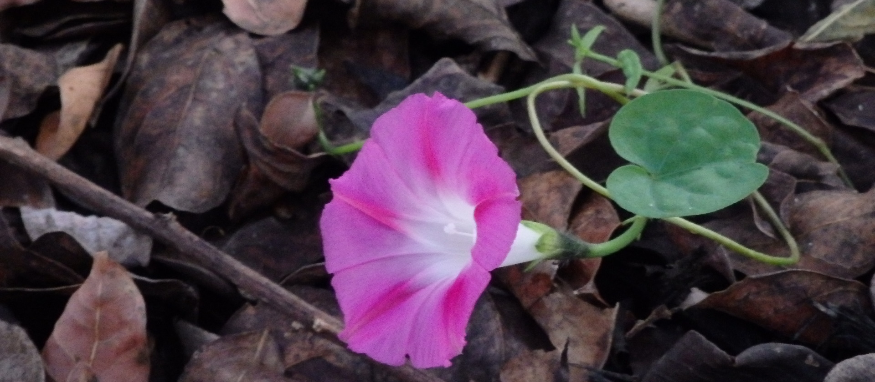
CARLI Libraries and the Pandemic: Changes We’ve Made and How We’ve Pivoted
“Budget” photo by SurveyHacks is licensed under CC BY 2.0
This program is being recorded and Zoom’s Live Transcript is enabled.

Slide 2
Agenda
CARLI Library Transformations Survey Results
Panel Discussion
Attendee Breakouts

Slide 3
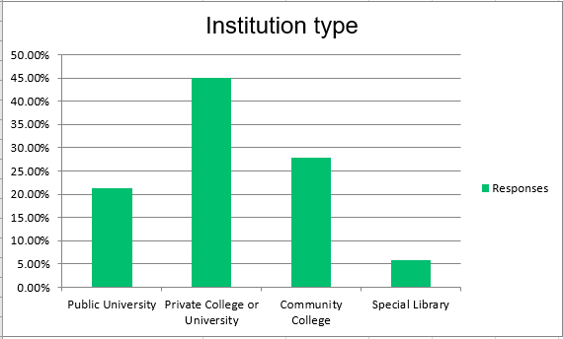
CARLI Library Transformations Survey Results
https://www.carli.illinois.edu/sites/files/files/SummaryIIllinoisLibraryTransformationsSurveyResults.pdf
Notes:
Back in March of 2022 all CARLI members were invited to participate in a Library Transformations Survey that asked how your library has changed as a result of the COVID-19 pandemic. Participants shared up to 3 good changes and innovations that will continue permanently. Participants also shared 3 difficult changes that their library made, and shared changes at the institutional level.
We received 122 responses from 82 CARLI member libraries (67% response).
Shared at the bottom of this slide is a link to a summary report I’ve compiled and linked within that document is a more detailed report.
<add to chat>

Slide 4
Positive changes
Positive Changes
Prioritized electronic resources
Offered remote and hybrid work
Improved physical spaces
Advanced technologies
Expanded circulation offerings
Increased virtual library services
Increased continuing education
Notes:
Responses of positive changes included:
Increased prioritization of electronic resources over physical
Increased virtual library services
Expanded contactless circulation offerings and increased circulation of laptops and other electronics to support online learning
Libraries advanced existing technologies and implemented new systems
They improved physical spaces to be more inviting, accessible, and meet COVID safety protocols
Staff were offered more flexible work policies including remote and hybrid arrangements
Libraries also increased opportunities for skills building that resulted in increased awareness of Diversity, Equity, Inclusion, and Accessiblity and Open Educational Resources.

Slide 5
Difficult Changes
Difficult Changes
Reductions to library budgets
Reduced library services
Repurposed library spaces
Reductions to hours
Low morale
Staffing losses
Notes:
Responses of difficult changes reflected the severe challenges libraries face as a result of the pandemic.
These include:
Reductions to library budgets which significantly impact library operations
Severe staffing losses and unfilled positions
Low staff morale
Reductions to physical library hours and use
Library spaces were repurposed or reduced
Library services were reduced

Slide 6
Institutional responses
Budget concerns in the face of declining student enrollments and student traffic
Concerns robust virtual services and programs will not be recognized
Continuation of flexible work arrangements vary
Library space redesigns with different levels of librarian input
Notes:
Responses of institution level changes varied widely, but a few topics that stood out include:
Concerns about library budgets in the face of declining student enrollments and student traffic on campus
Concerns that new and robust virtual services and programs will not be recognized by administrators who previously focused on physical attendance
The continuation of flexible work arrangements varied by institution
Several library space redesigns are occurring with varying levels of librarian input in the decisions.

Slide 7

Thank you!
Mary Konkel konkel@cod.edu
Sarah Pritchard spritchard@northwestern.edu
Sarah Sagmoen ssagm2@uis.edu
Nicole Swanson support@carli.Illinois.edu
"Beautiful Morning Glory" by Swami Stream is licensed under CC BY 2.0.

