Slide 1


Archives In Action: Empowering Students and Community Volunteers
Liz Bloodworth, Illinois Wesleyan University
Libby Tronnes & Ching Zedric, Bradley University

Slide 2
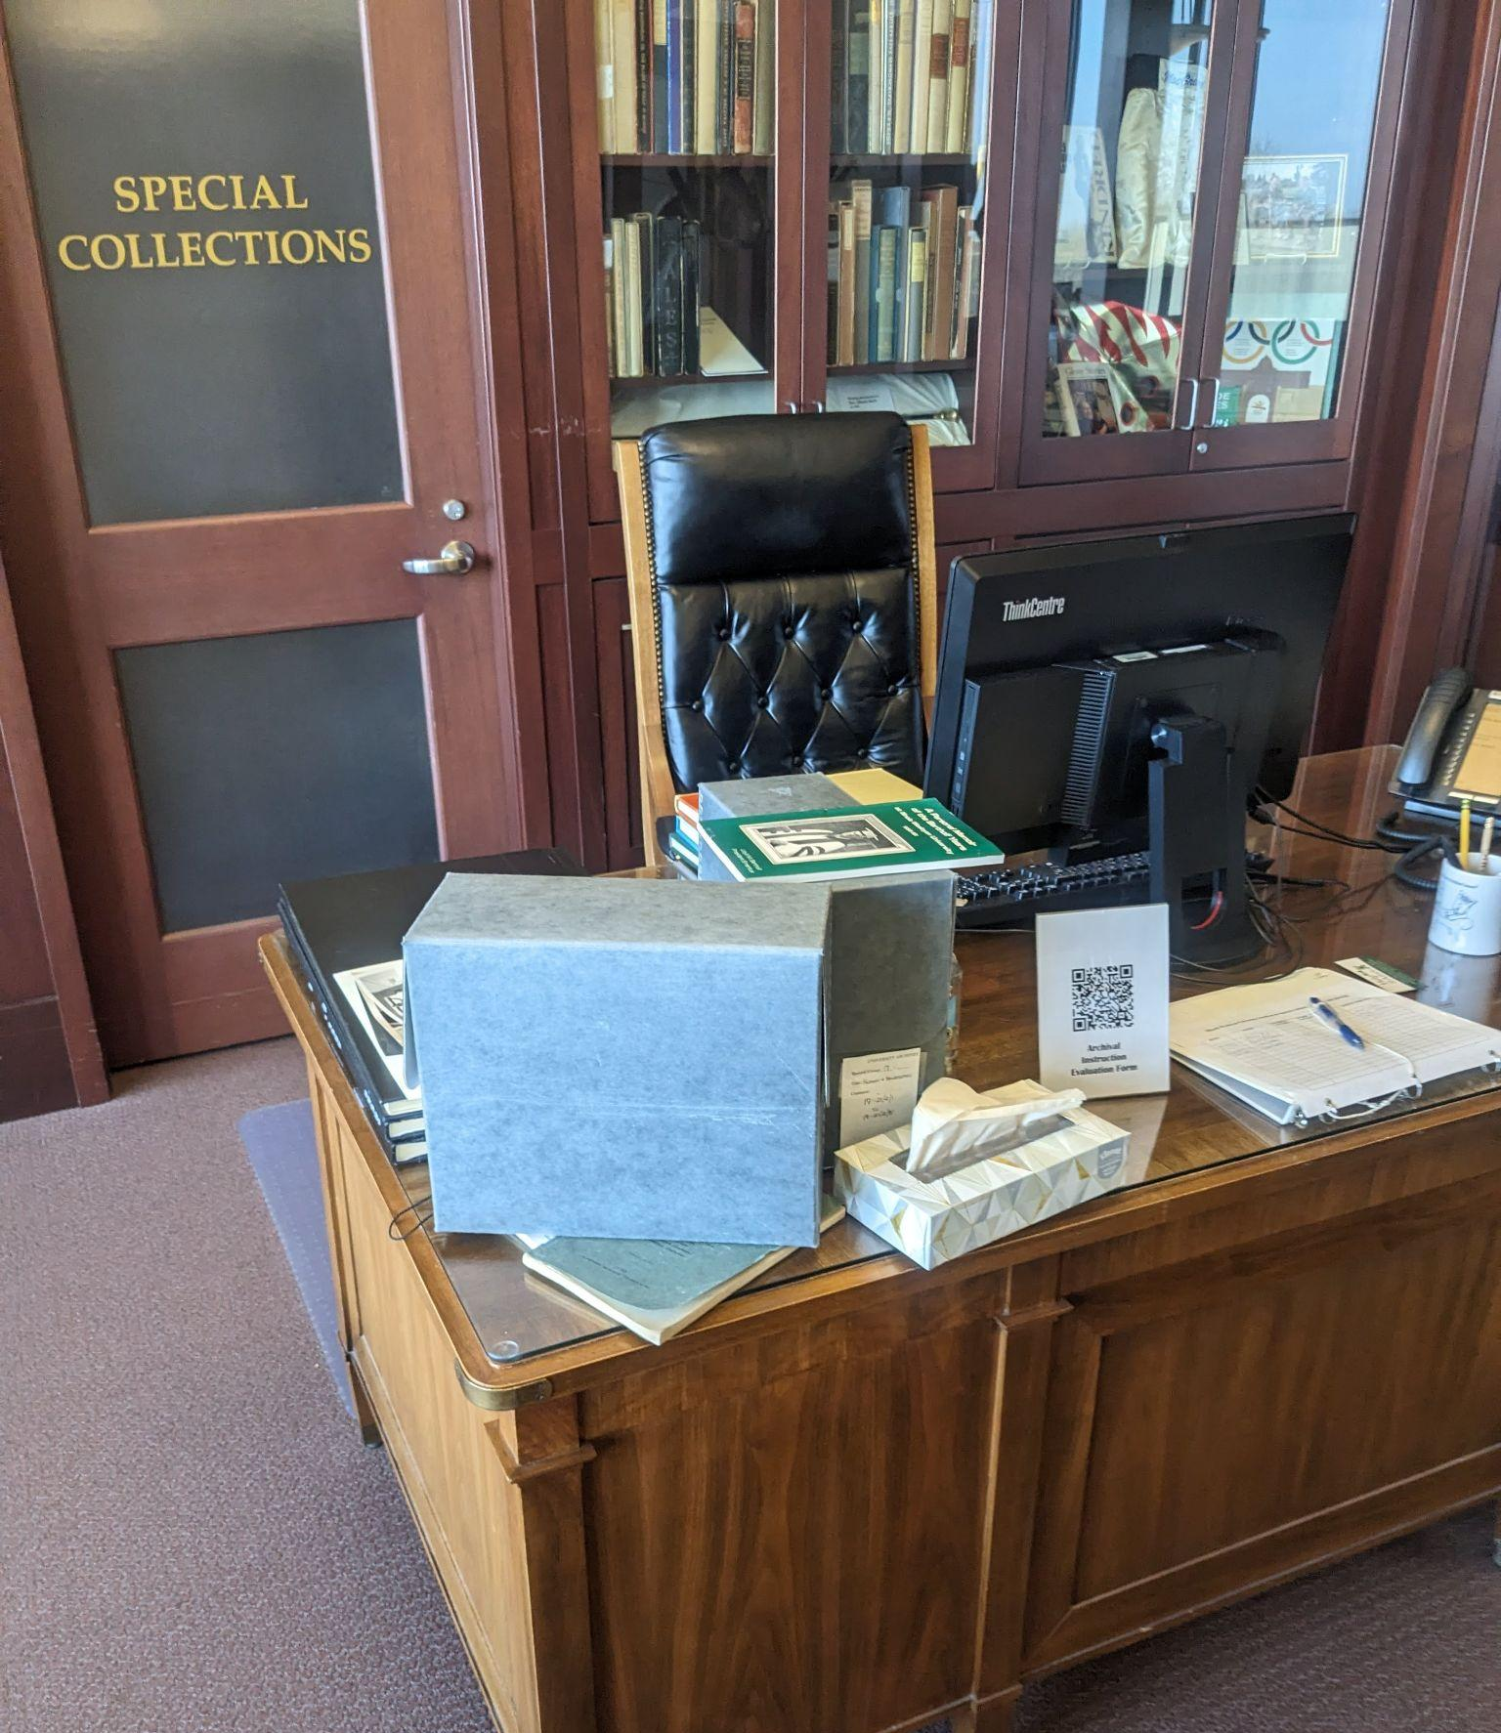
What to Expect
How do students/volunteers & the archives benefit?
The hard part: Setting students up for success
Lessons learned (including common pitfalls)
Q&A

Slide 3
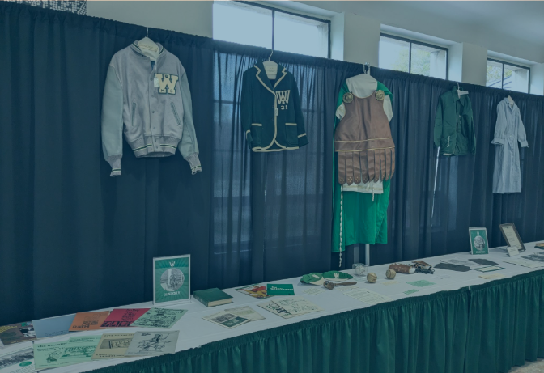
Opportunities or Students,Volunteers & the Archives/Special Collections

Slide 4
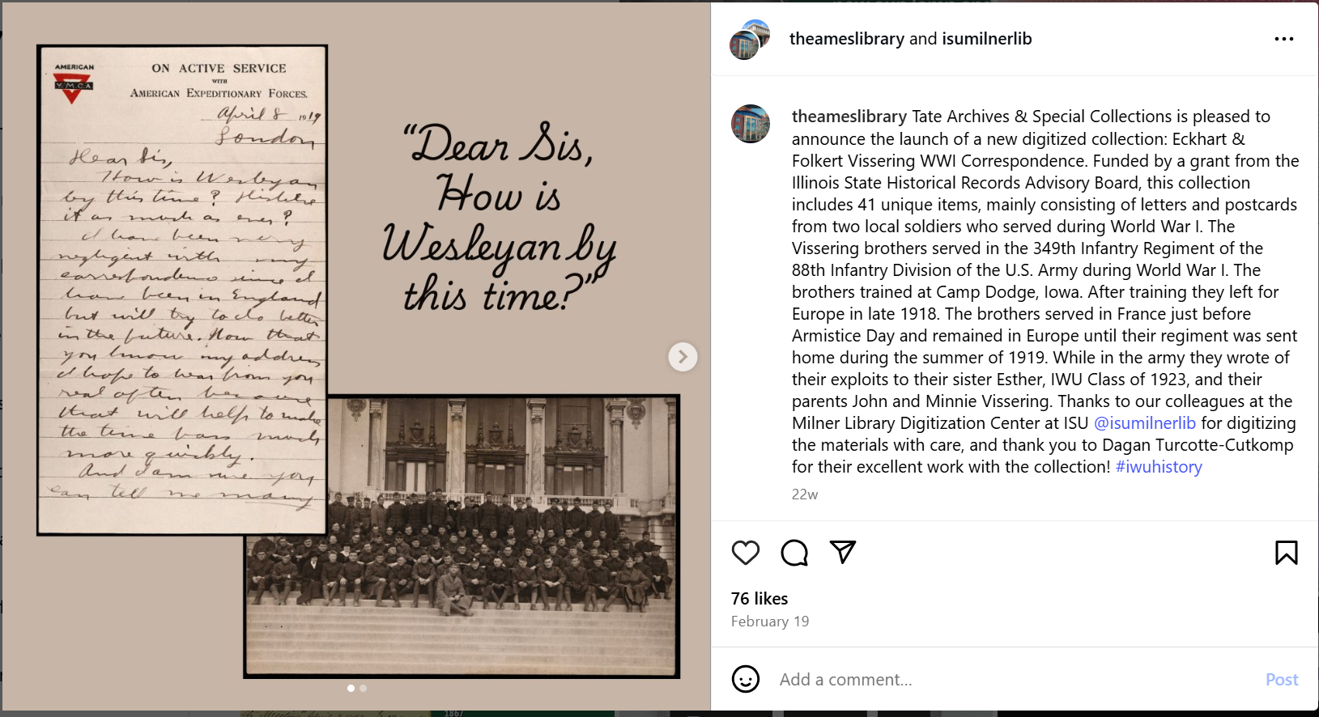
Transcription and Metadata Projects
Notes:
William H. H. Adams Civil War diaries
Vissering brothers WWI correspondence
Campus Art Collection

Slide 5
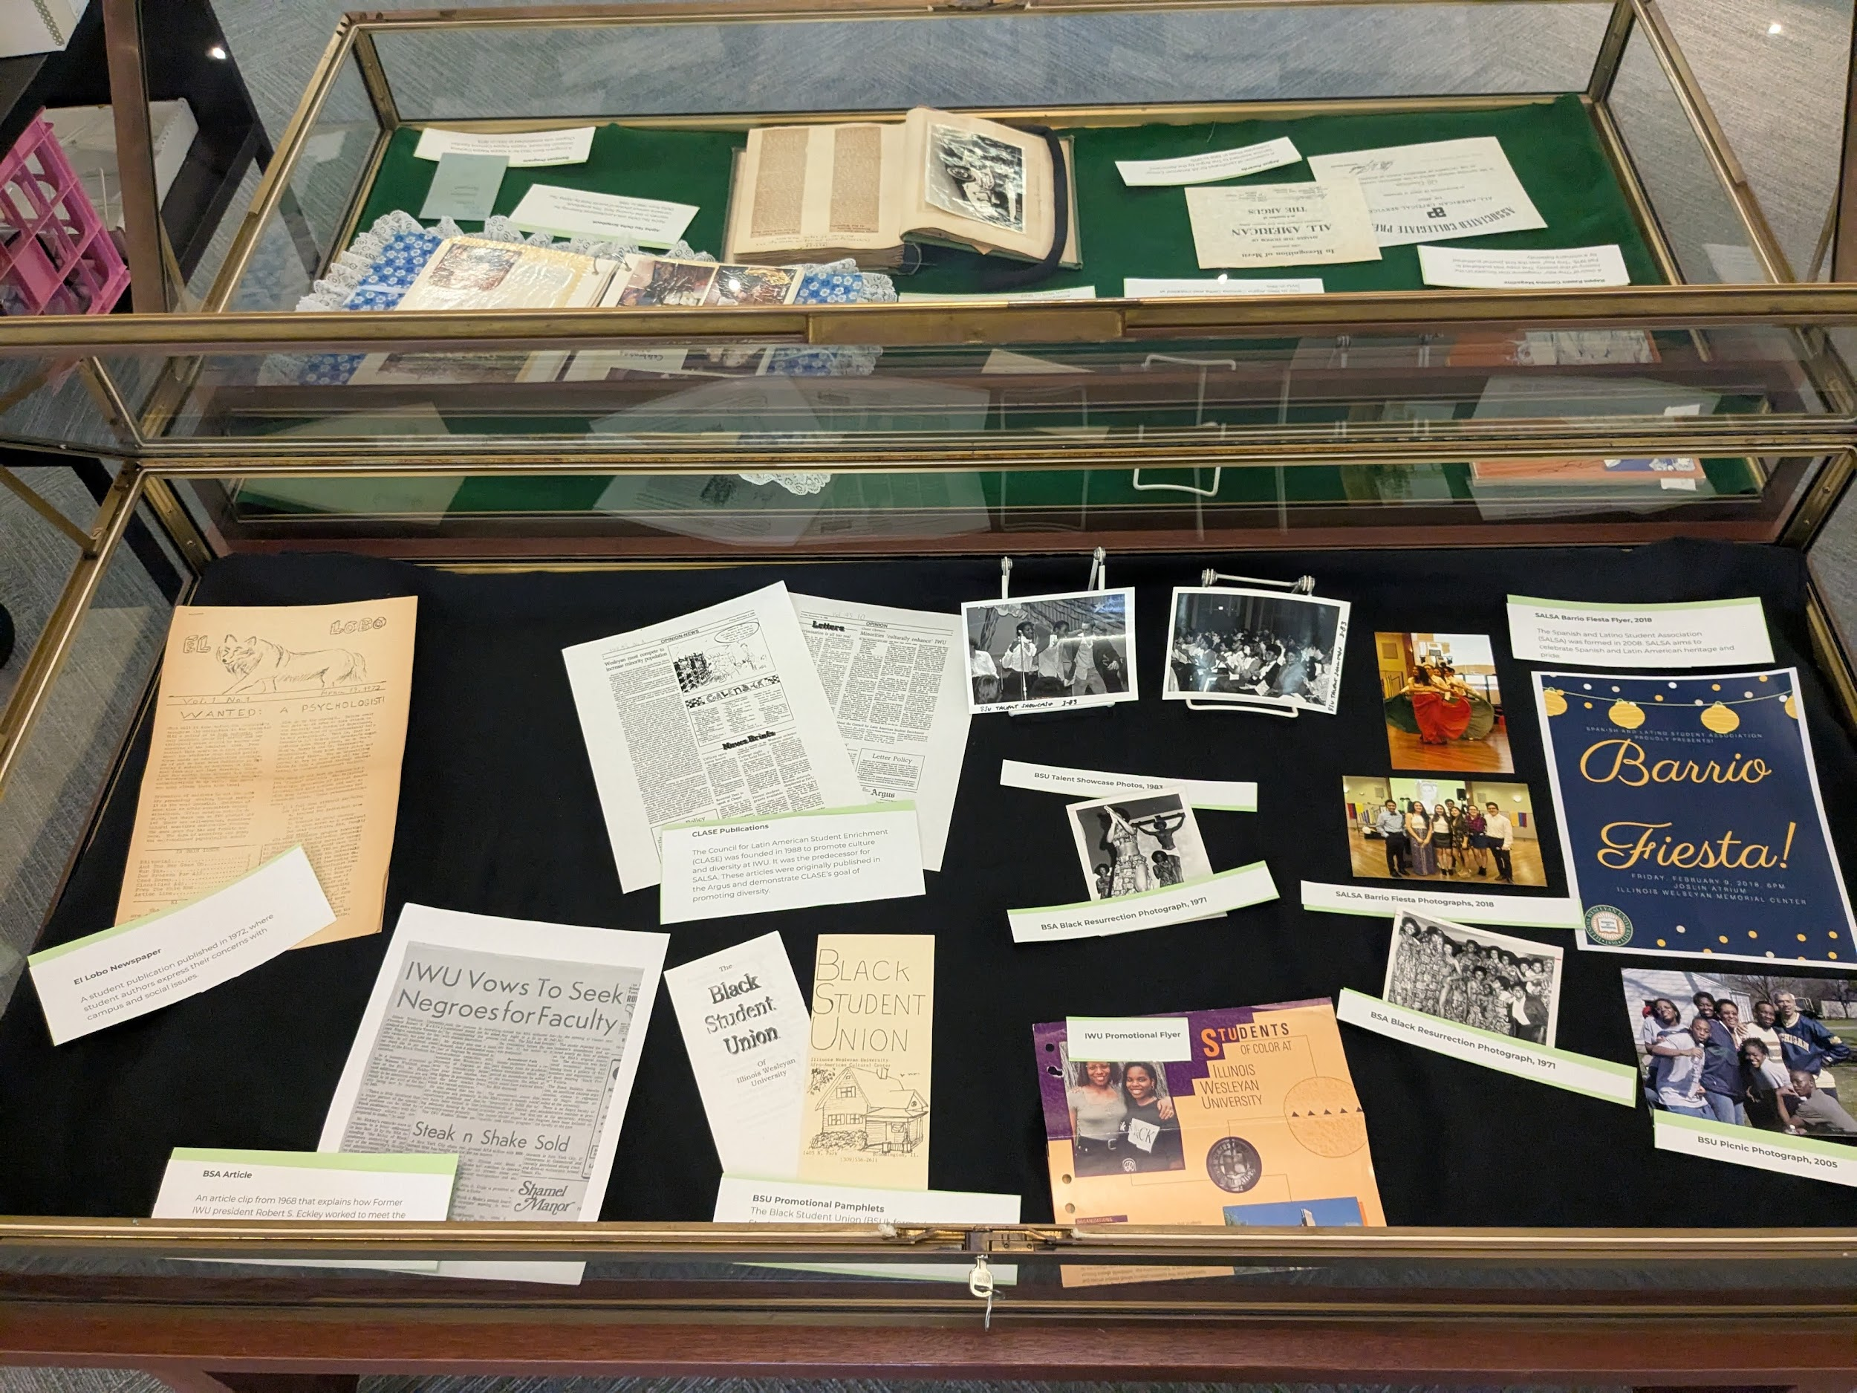
Student
Exhibits

Slide 6
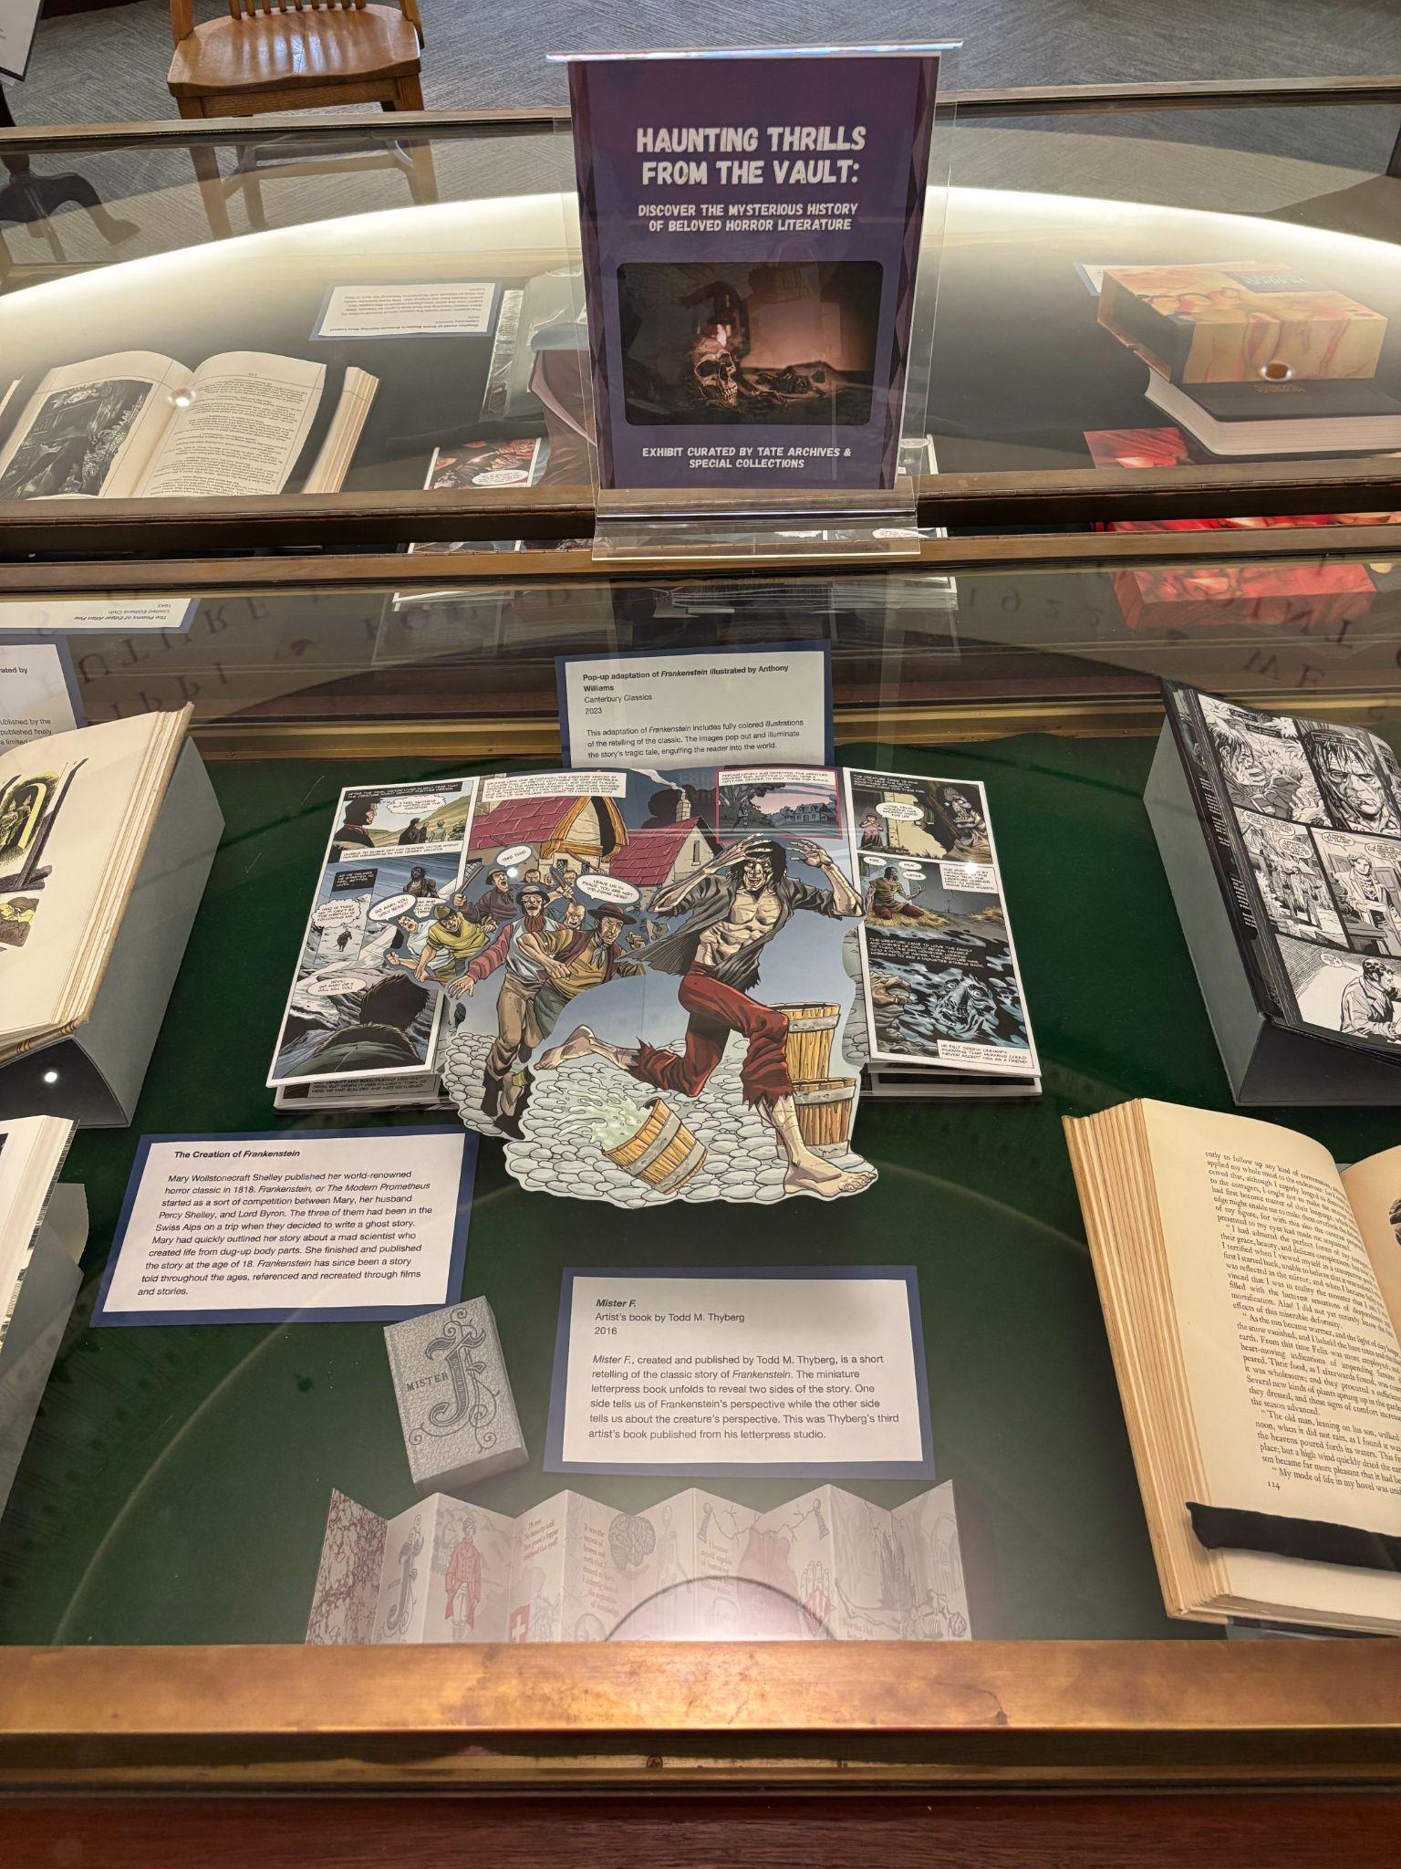
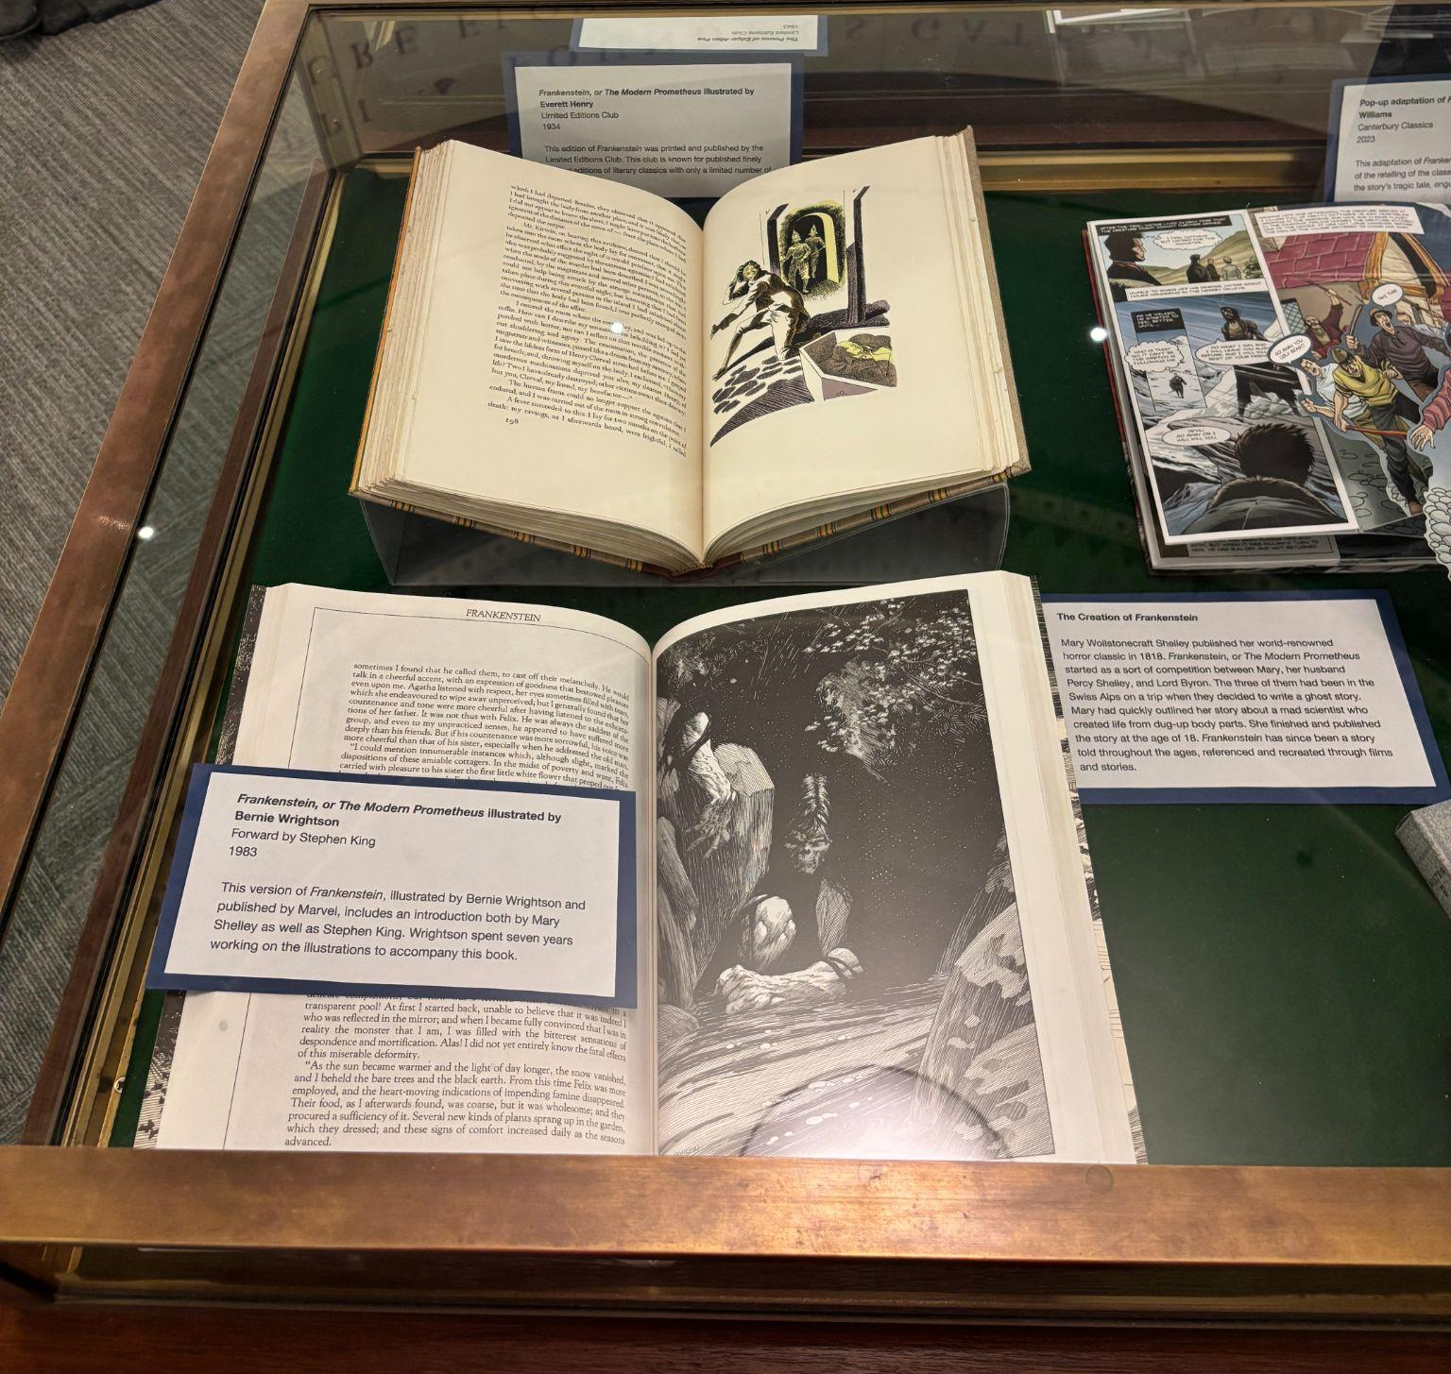
Horror in the Humanities

Slide 7
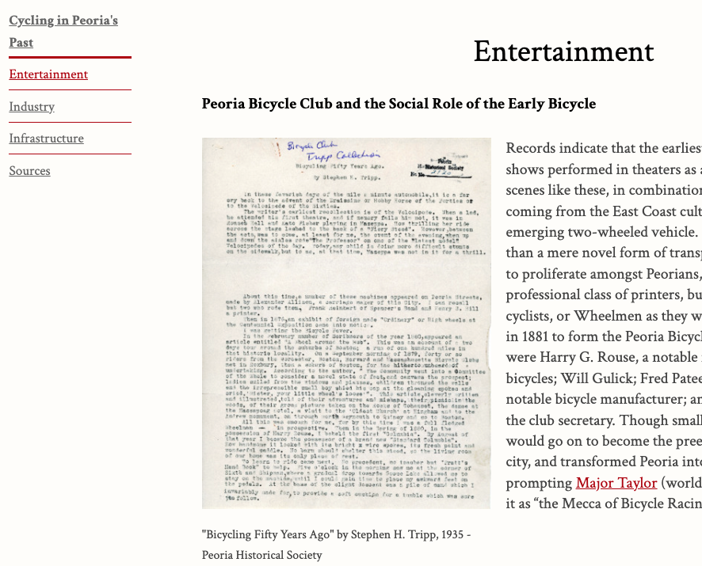
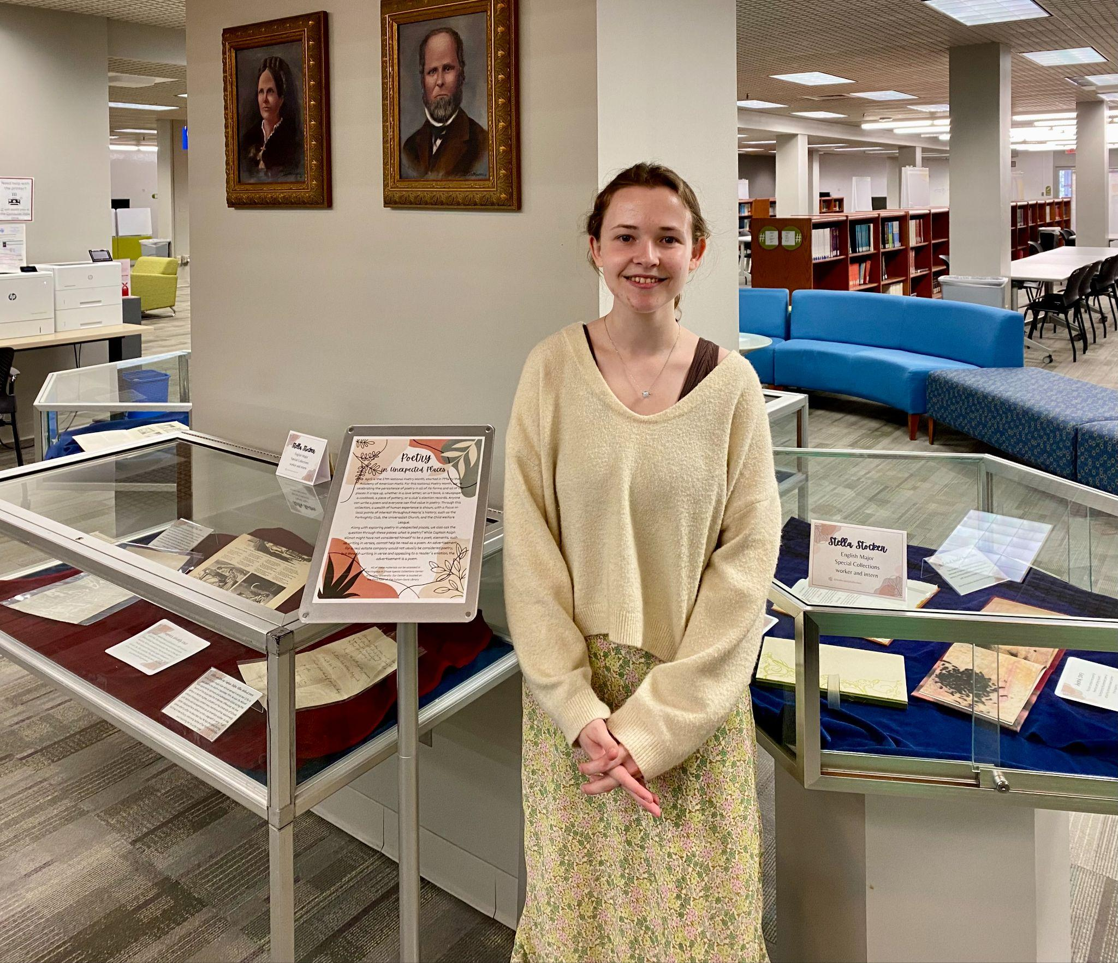
Digital Exhibit on
Peoria’s Bicycling History
Poetry in the Archives

Slide 8
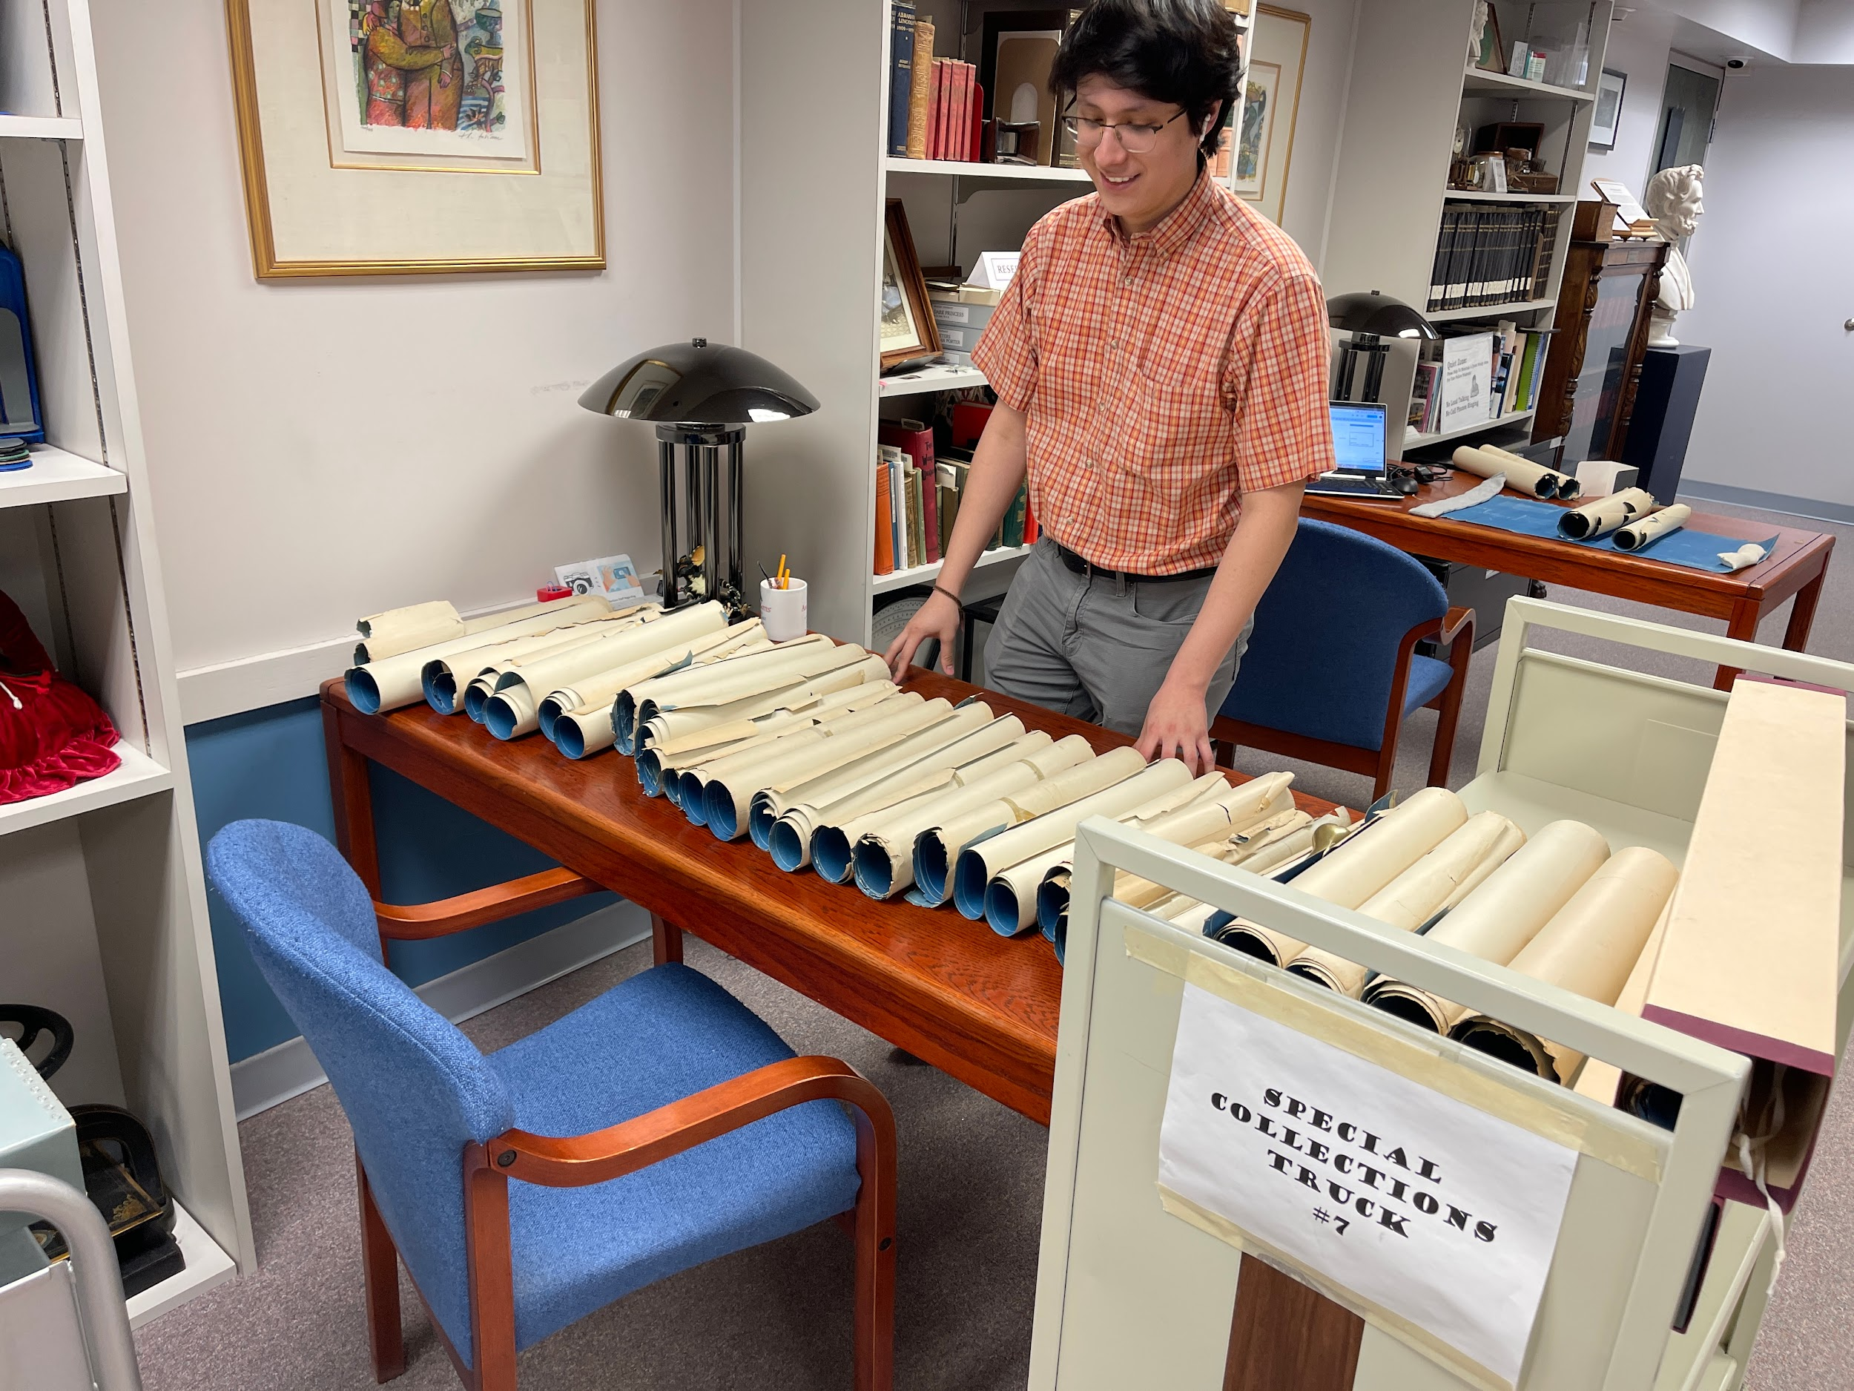
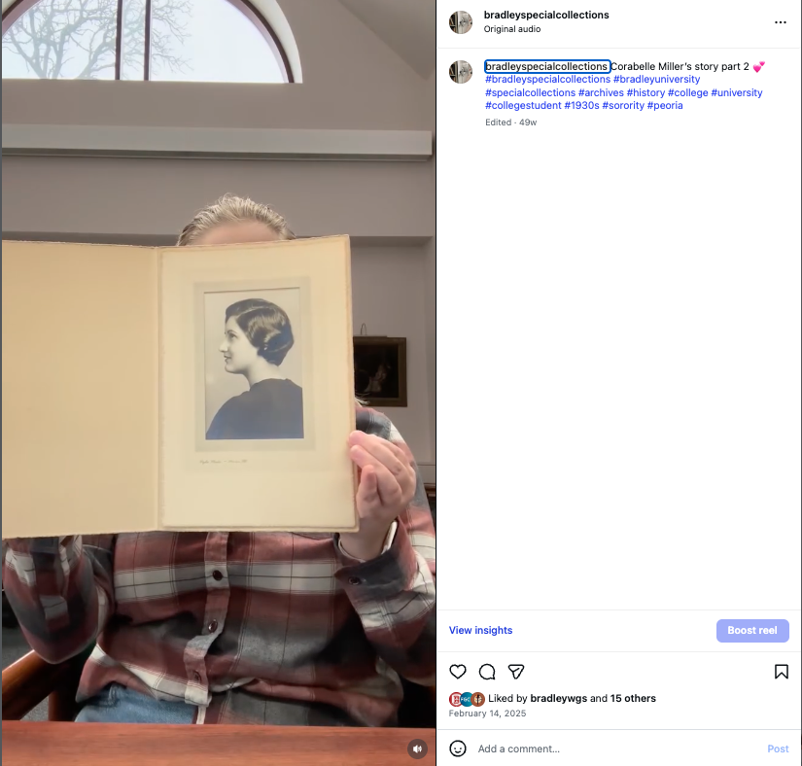
Social Media Intern
Marketing, Journalism Student
( example of Insta post)
Inventorying Blue Prints & Architecture Drawings
Civil Engineering Student
Notes:
Clarabell Miller’s collection of Bradley ephemera, several posts

Slide 9
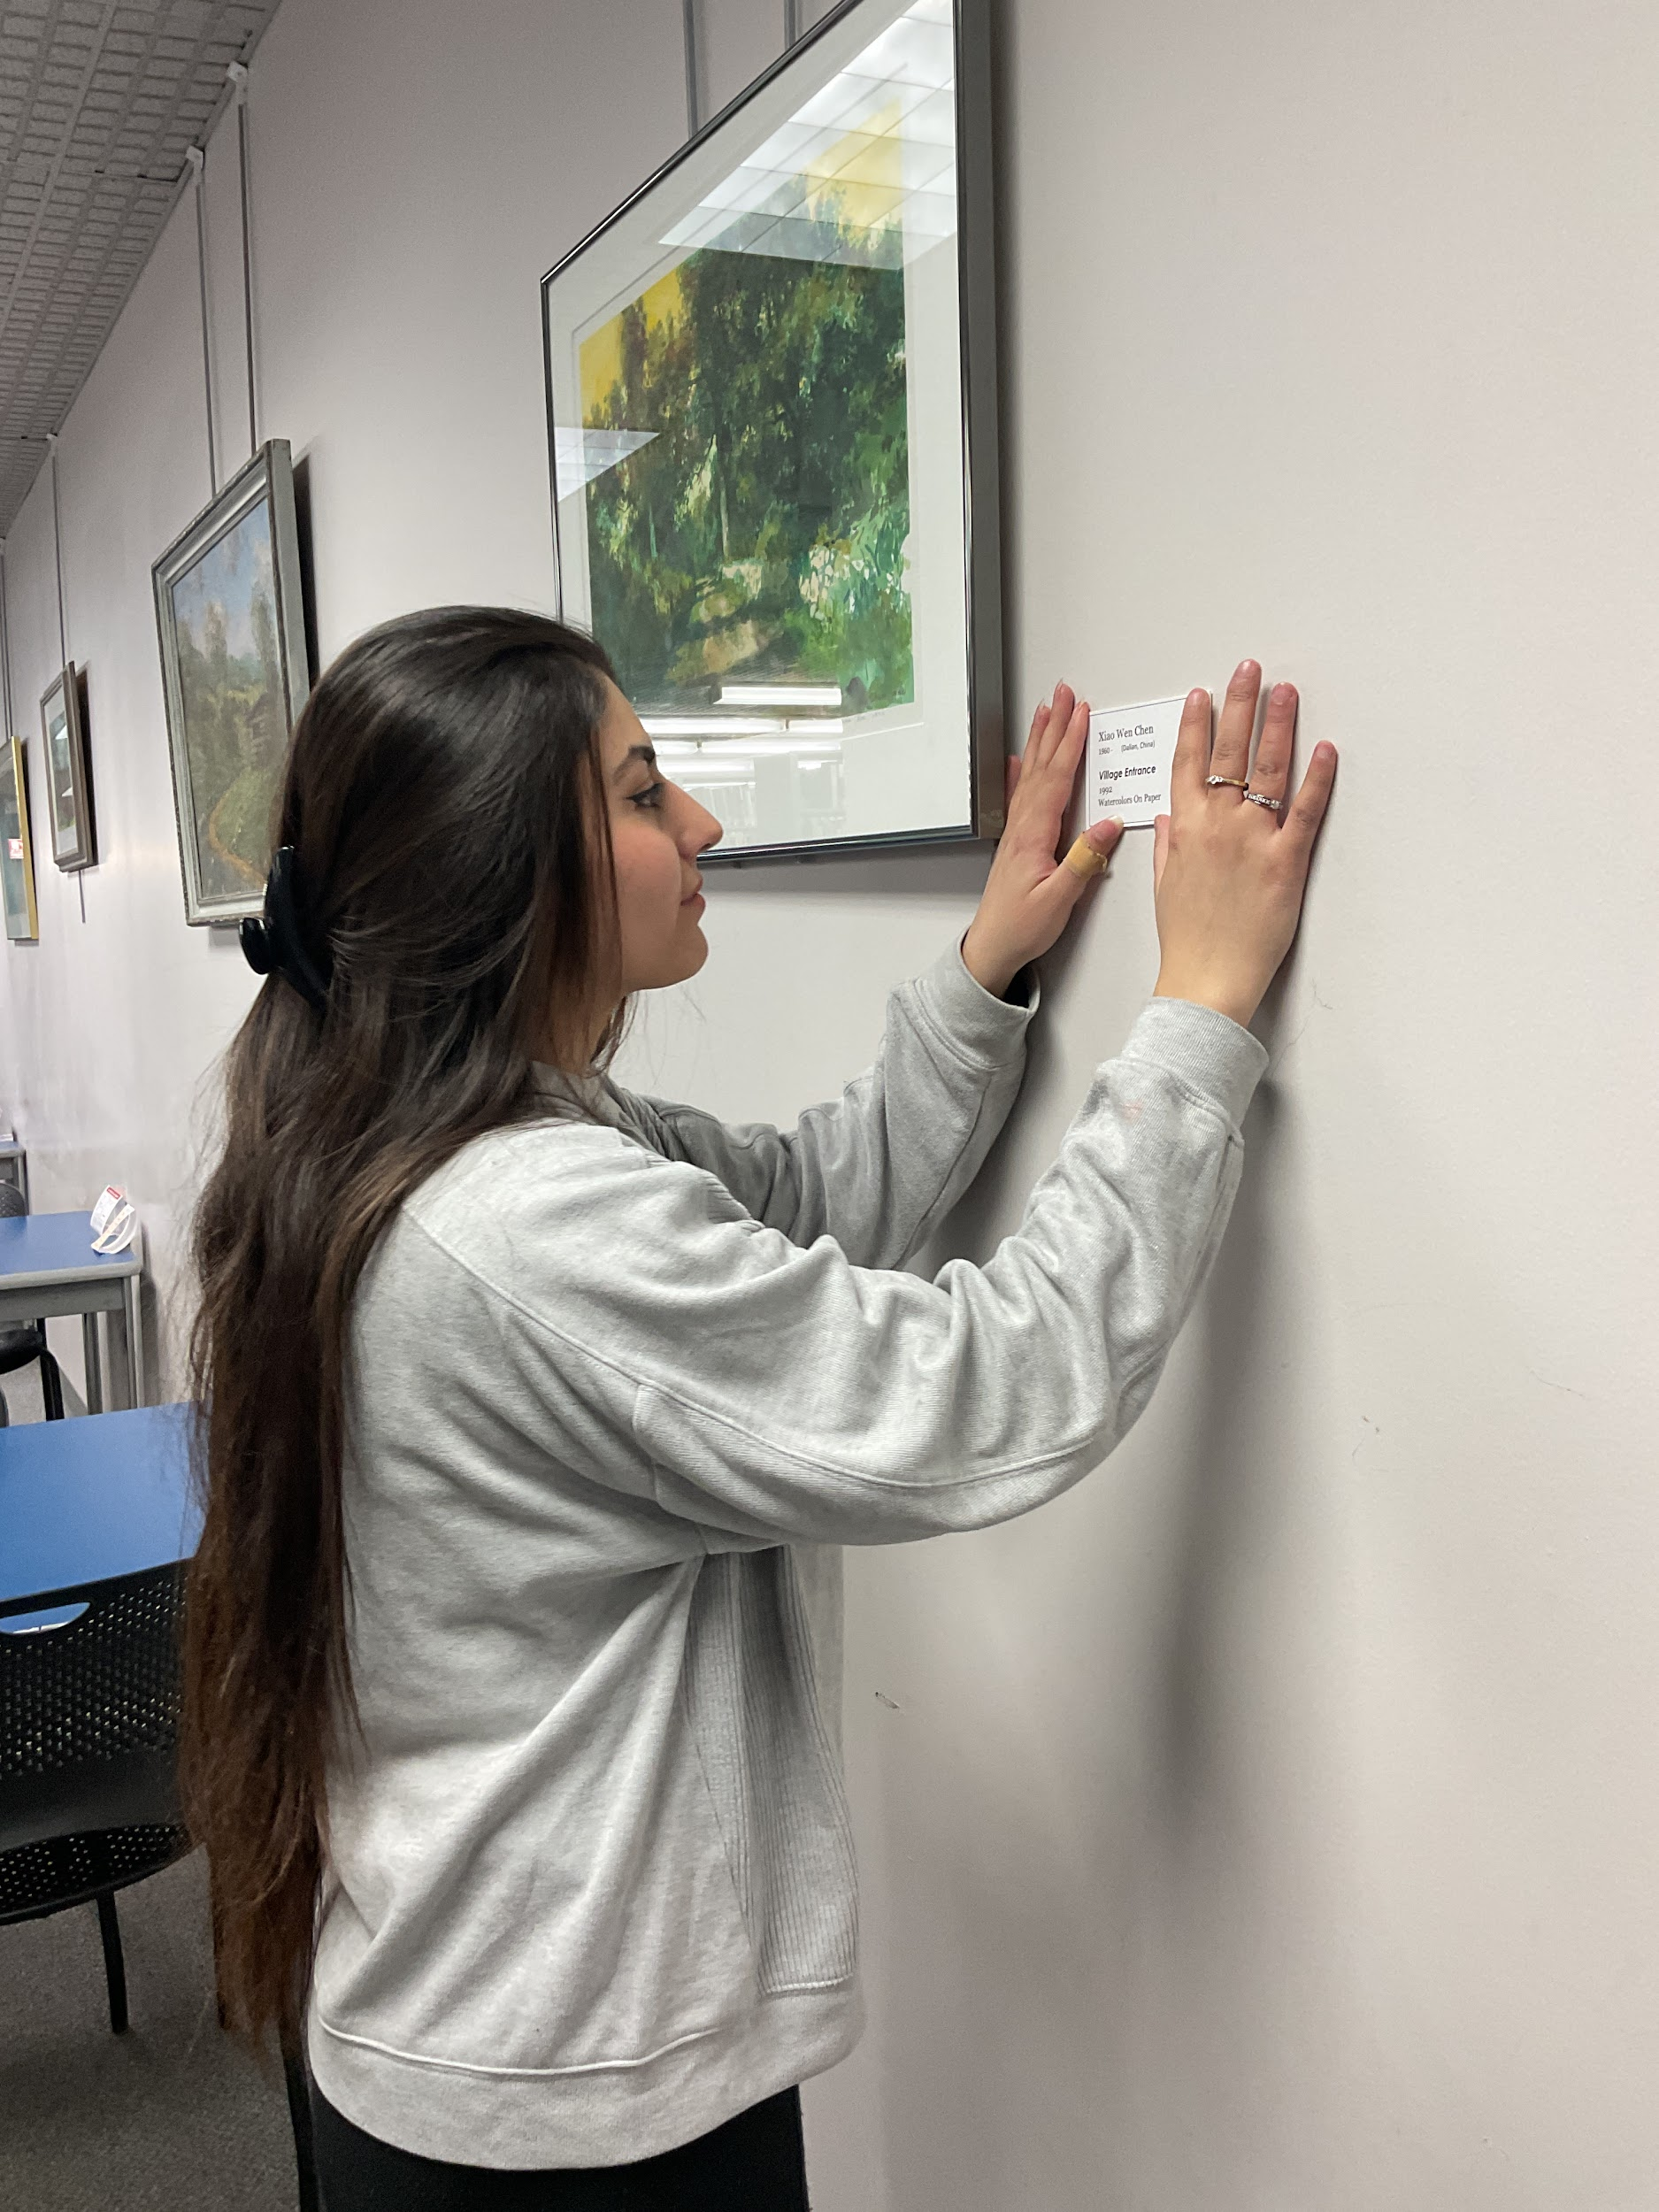

Graduate Student in Art
Researching art collection and making and hanging labels on all four floors of Cullom-Davis Library

Slide 10
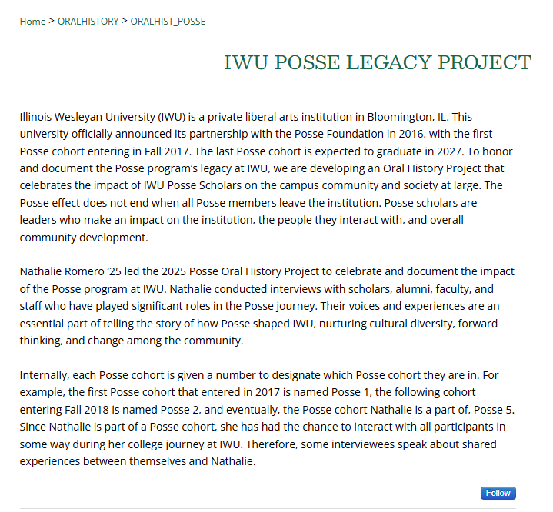
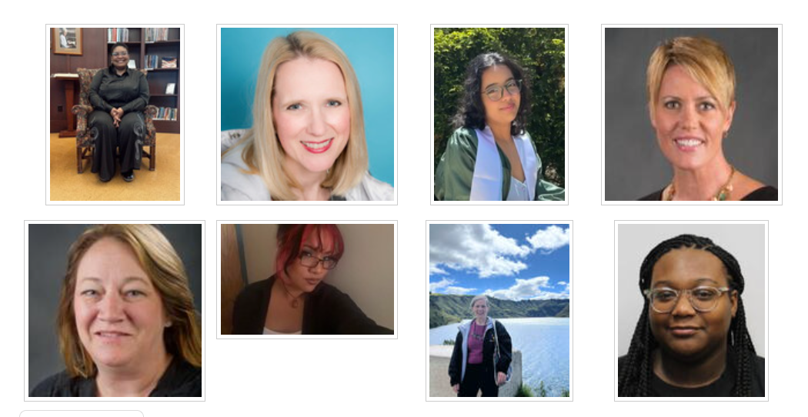
Posse Legacy
Oral History

Slide 11
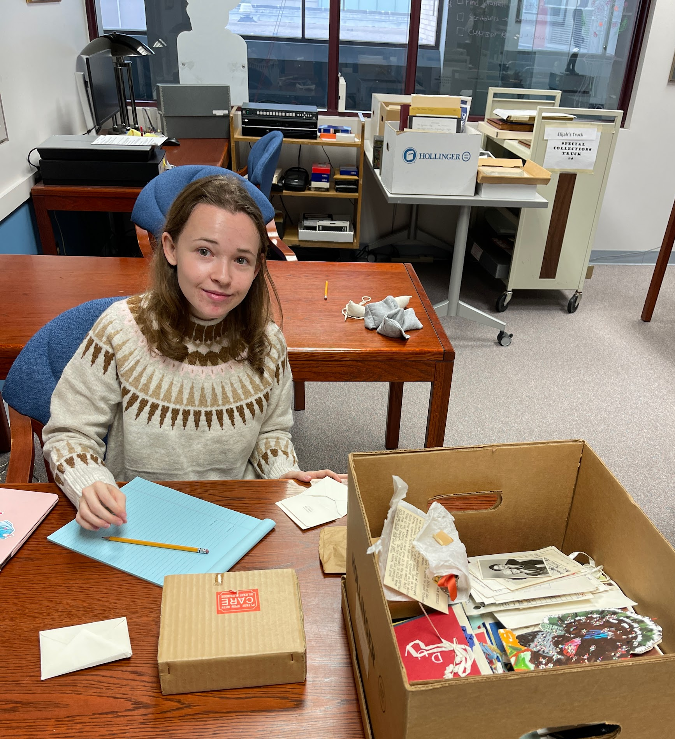
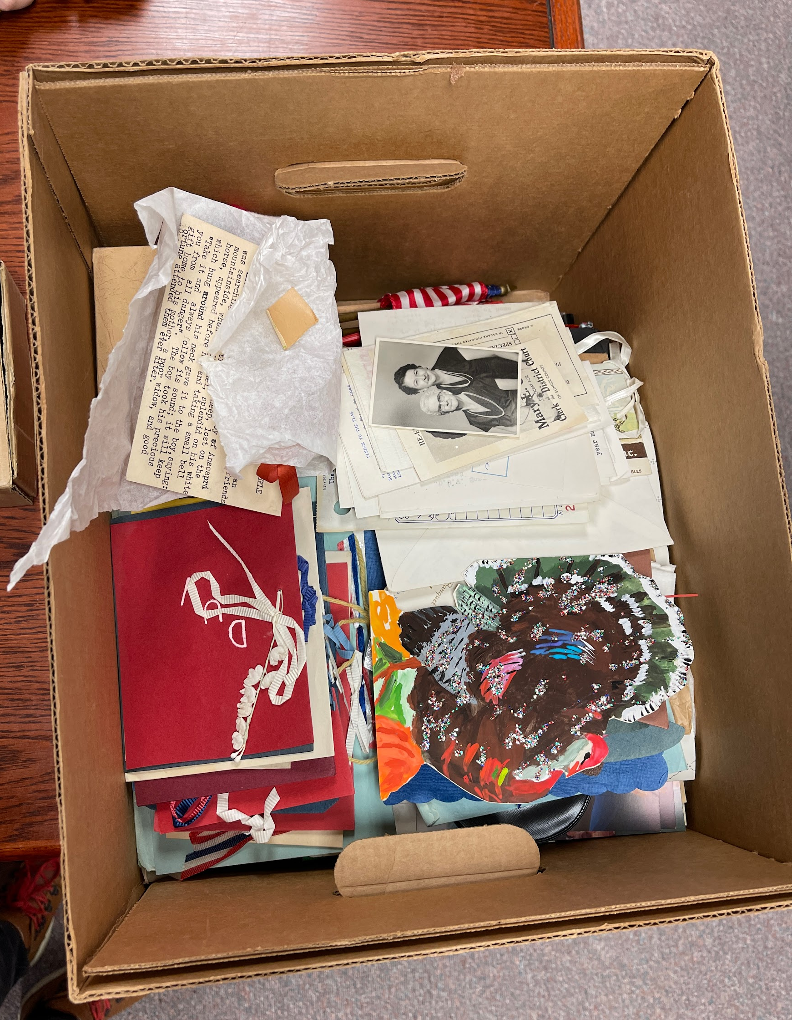
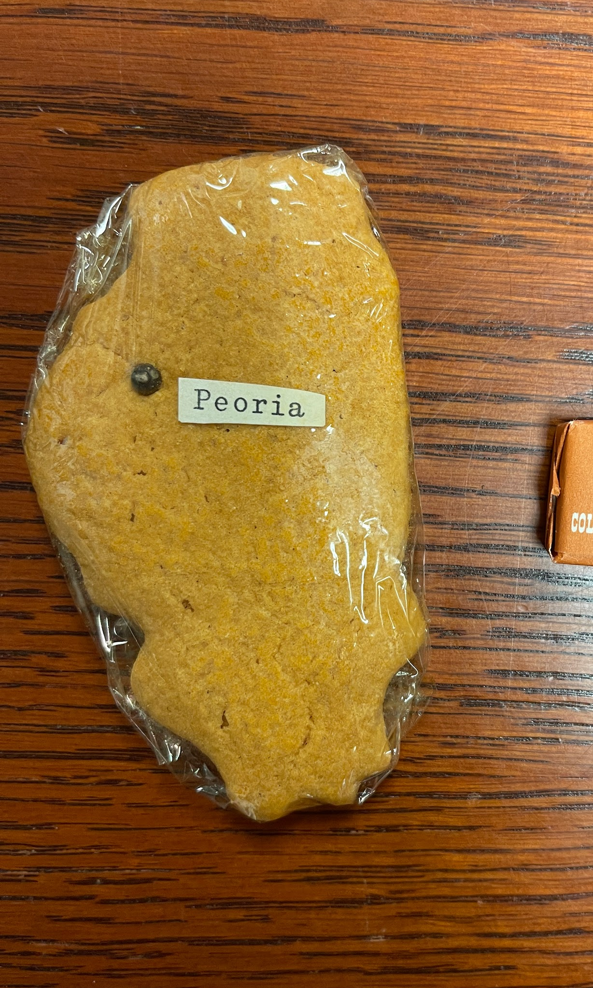
Discovery!

Slide 12
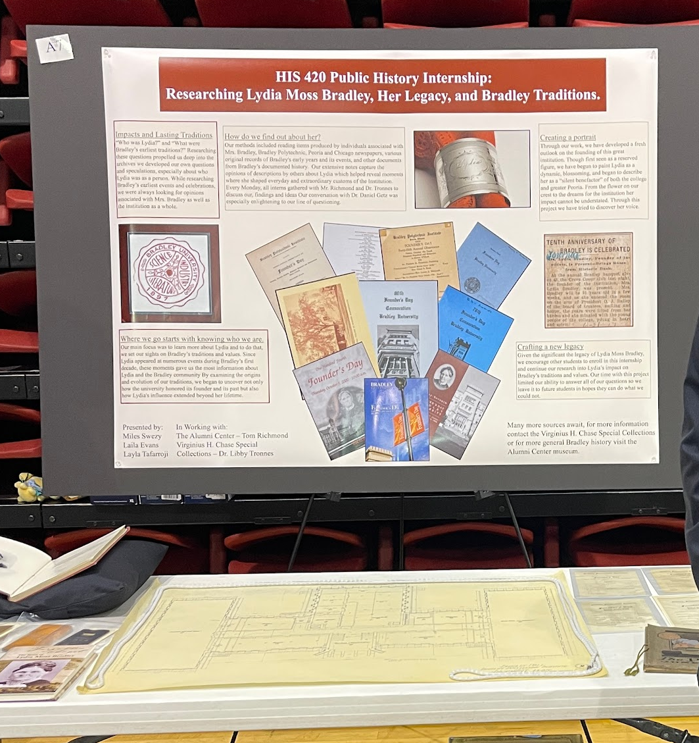
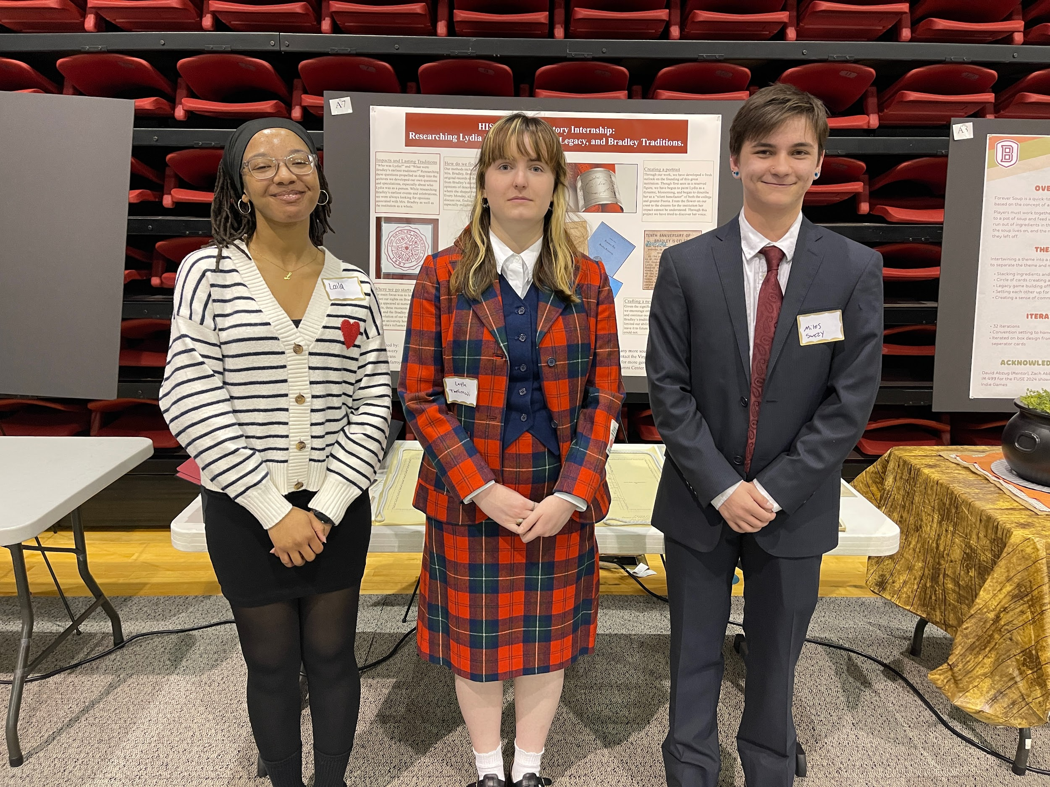
Exhibits & Outreach, Teaching & Mentoring
Bradley Student Expo - HIS 420 Internship Research on BU Traditions and Founder

Slide 13
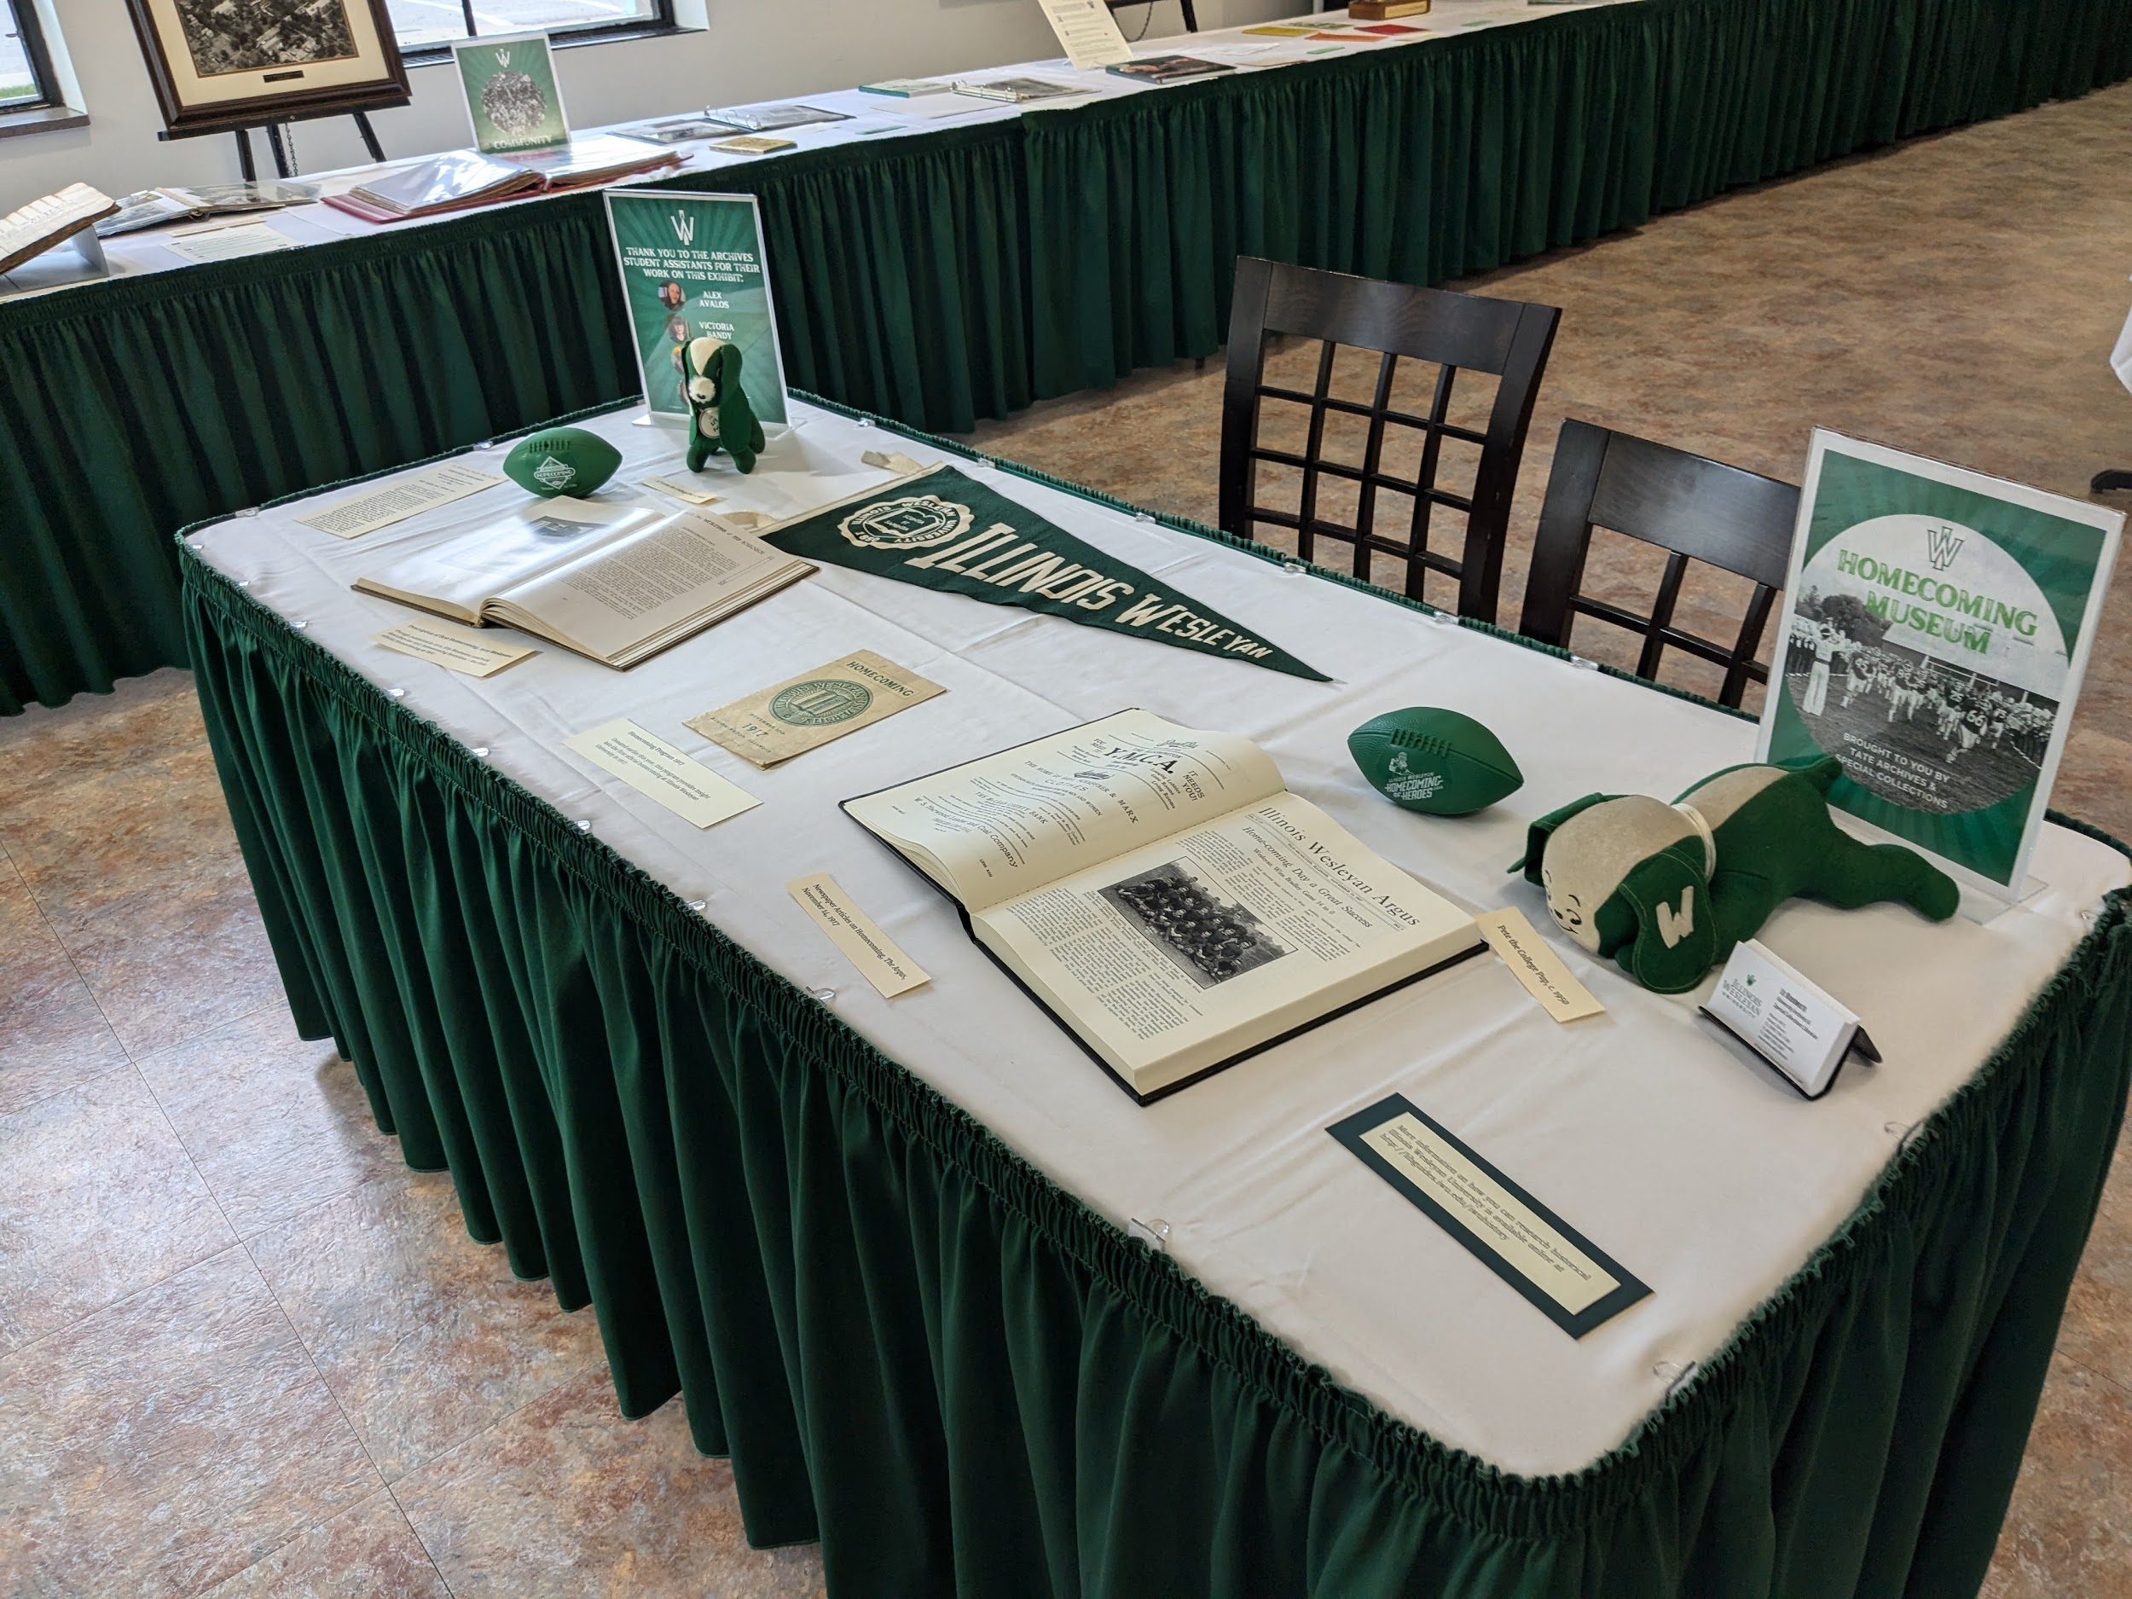
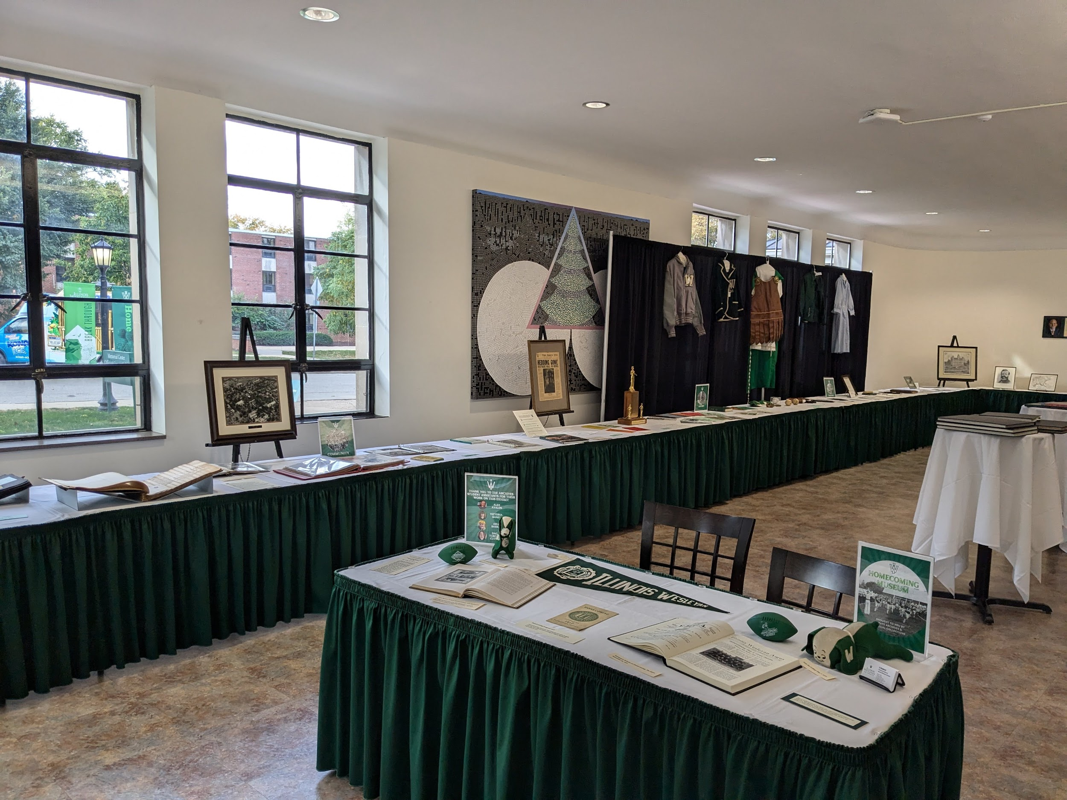
Homecoming Museum

Slide 14
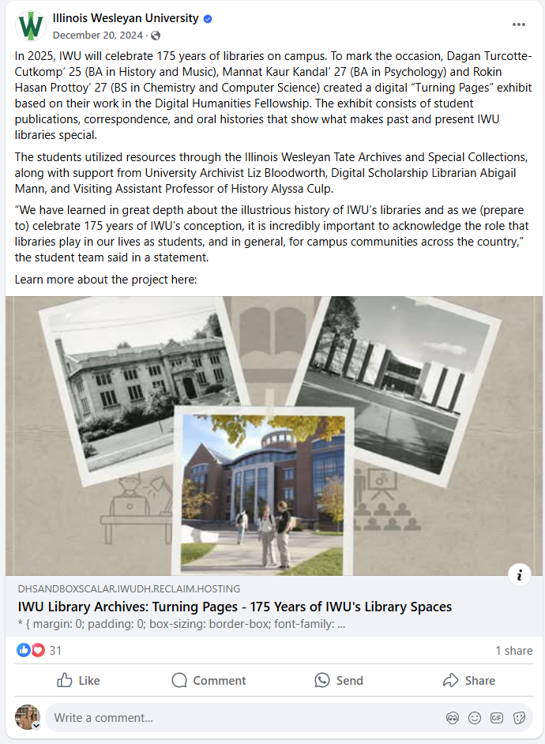
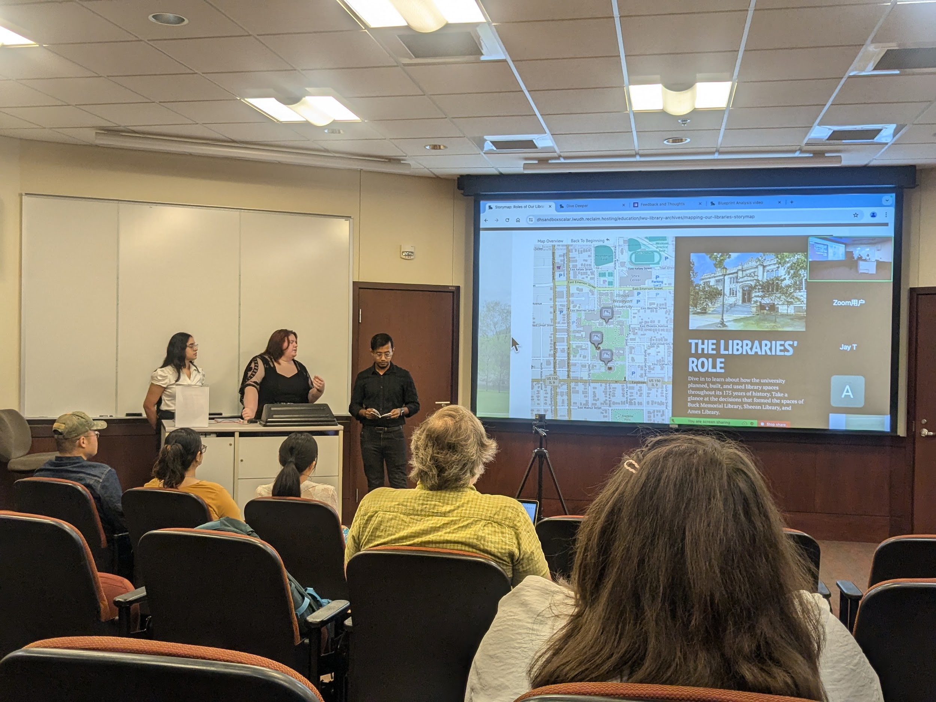
Digital Humanities
Turning Pages Exhibit

Slide 15
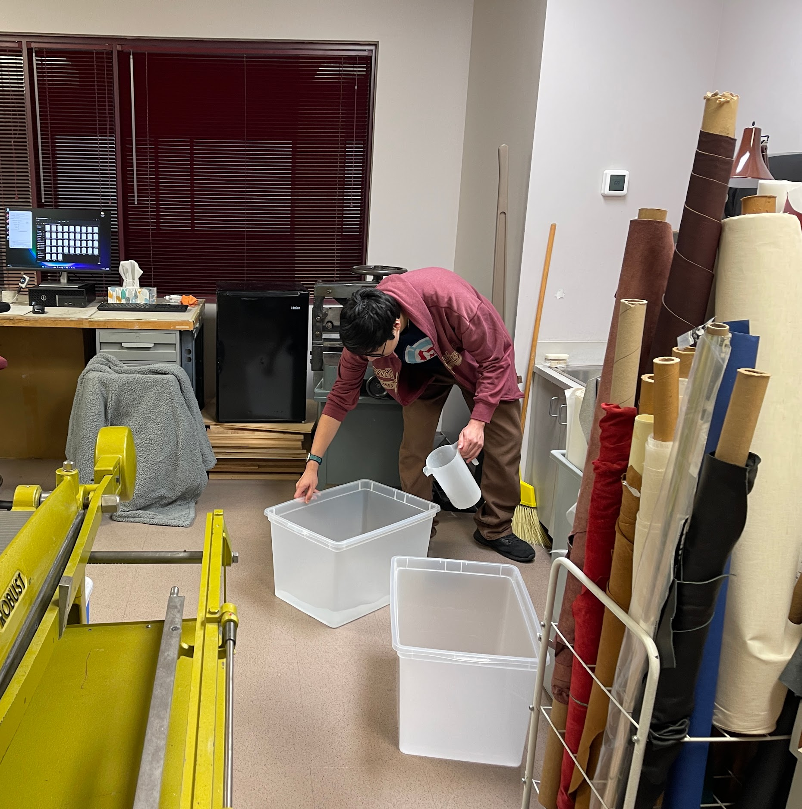
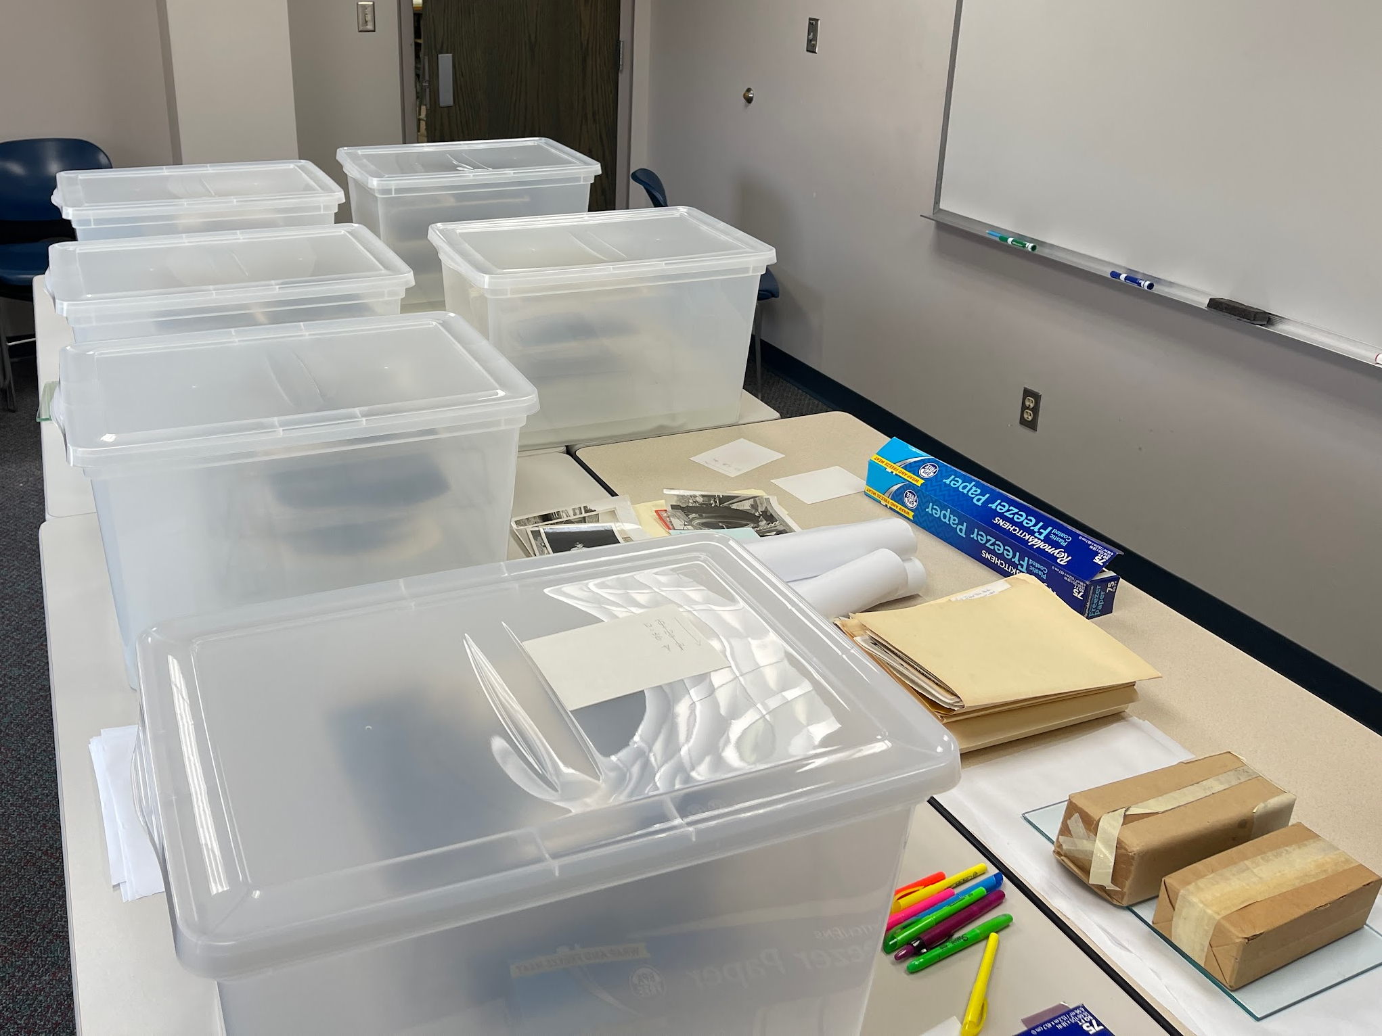
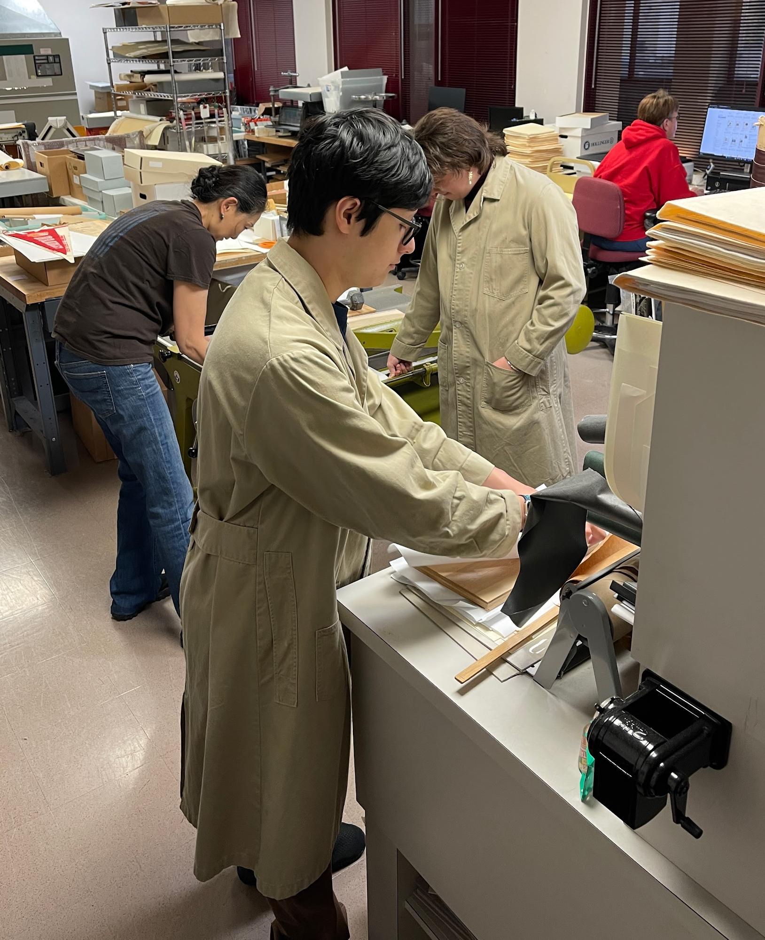
Unexpected
Projects: Humidifying Bins

Slide 16
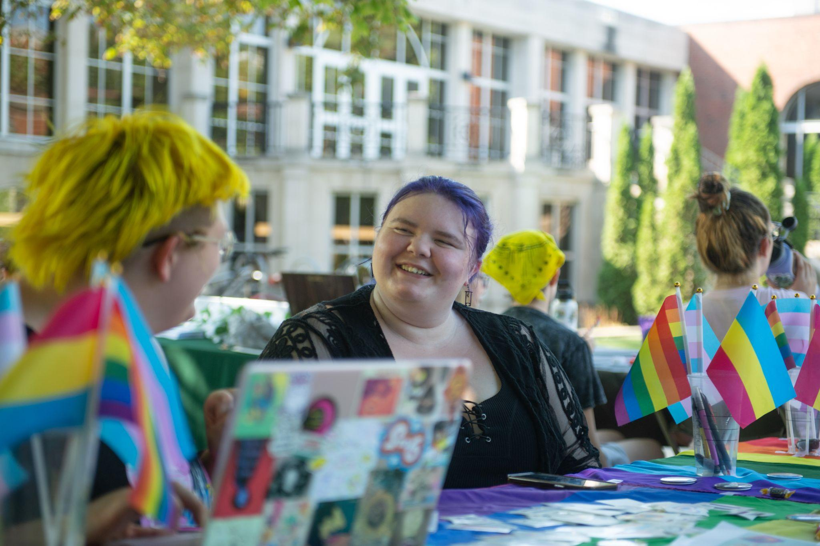
Bonus: Collection Development
RSOs

Slide 17
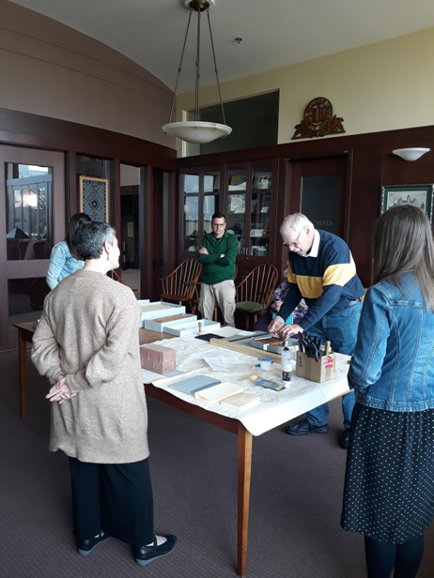
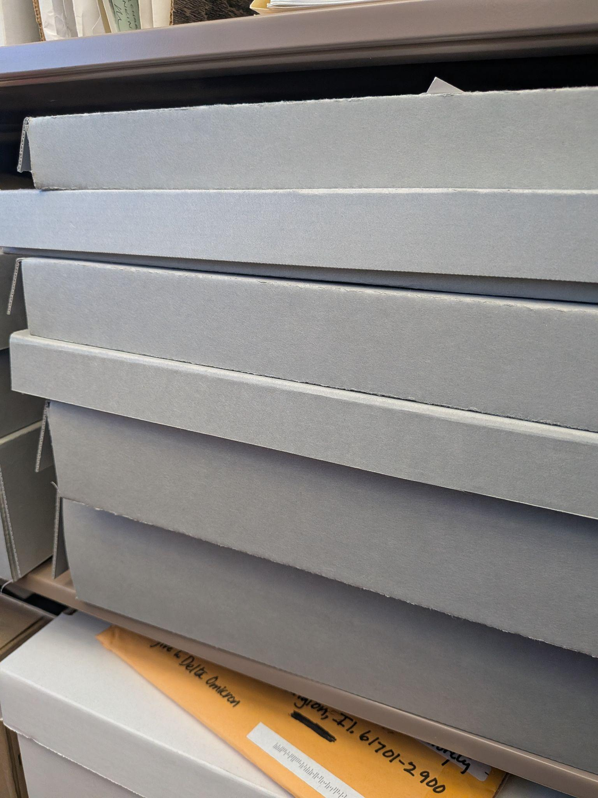
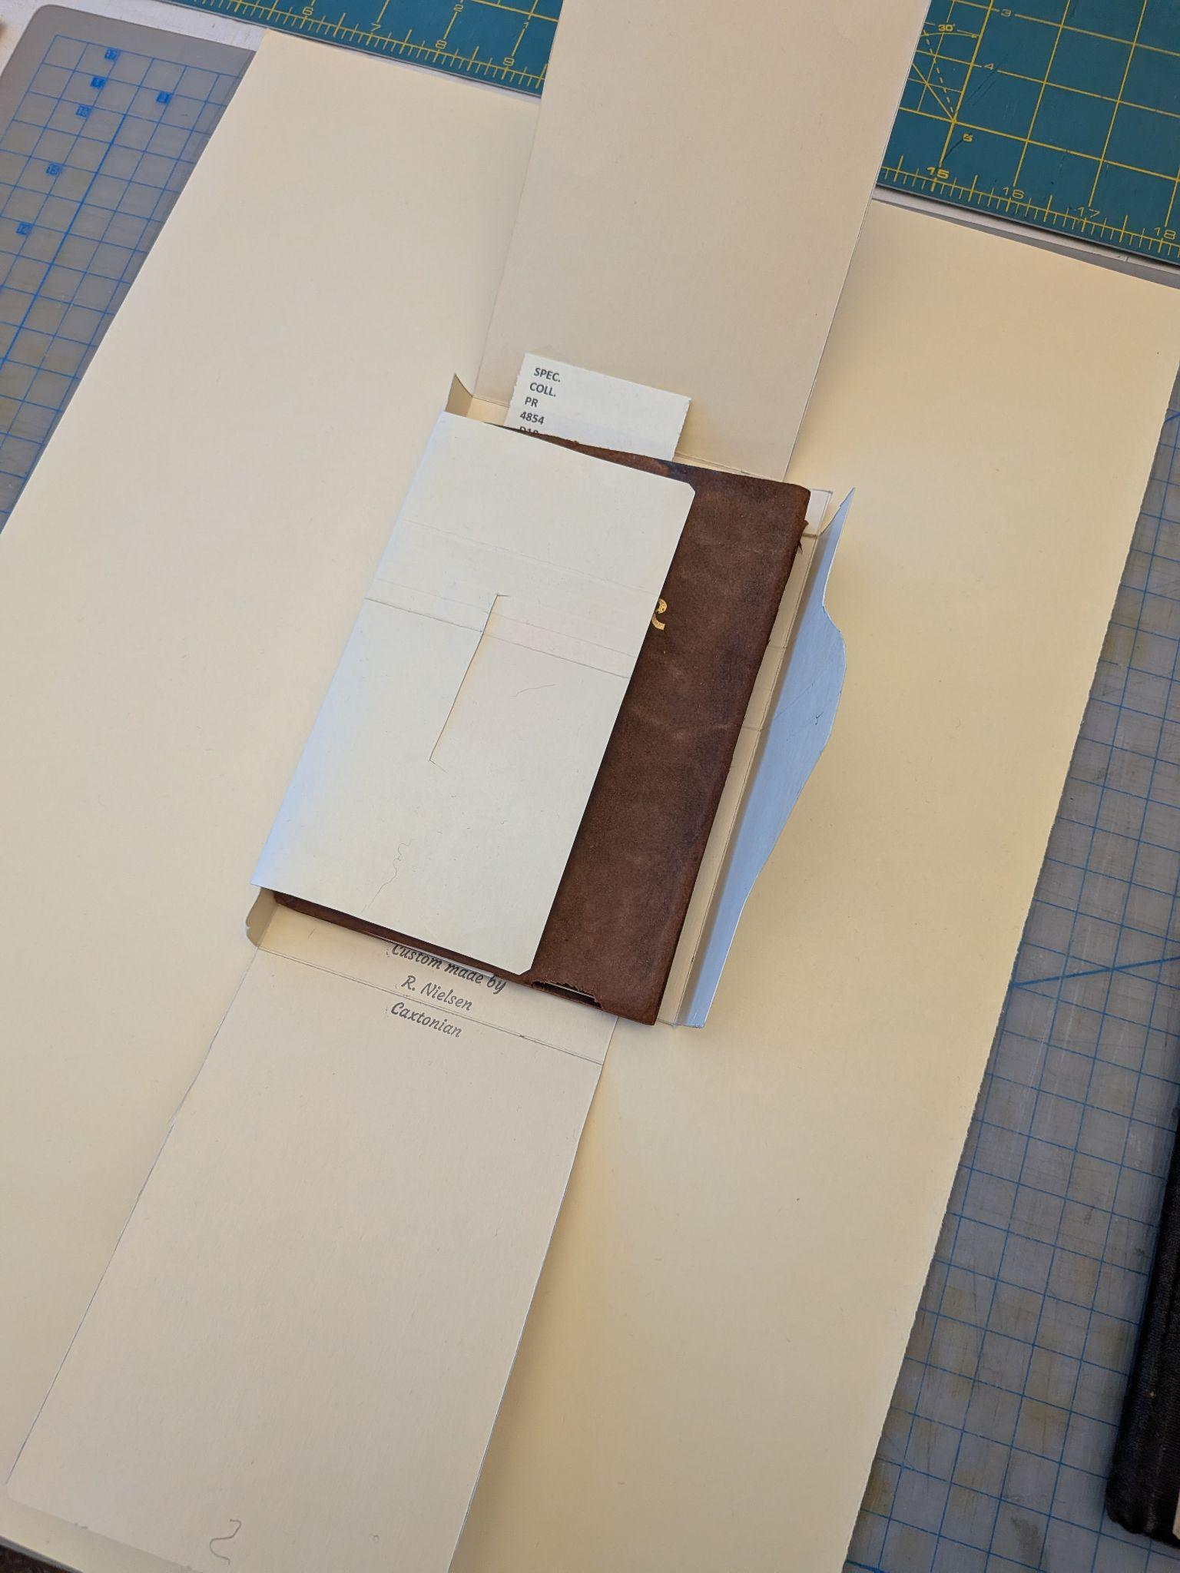
Volunteers!
Preservation

Slide 18
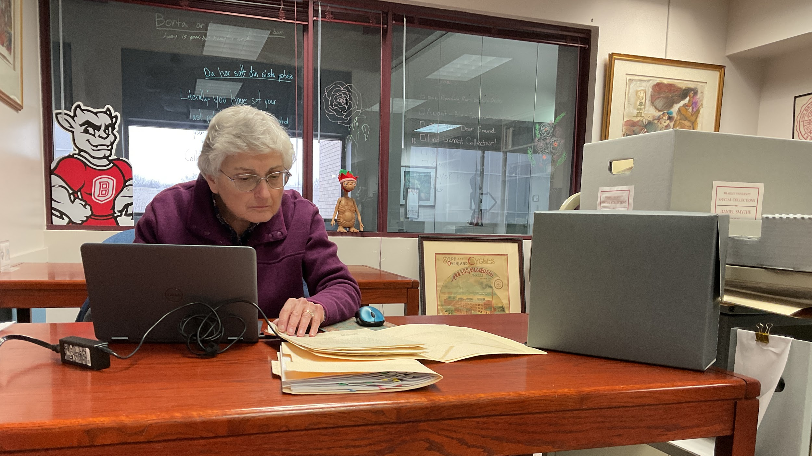
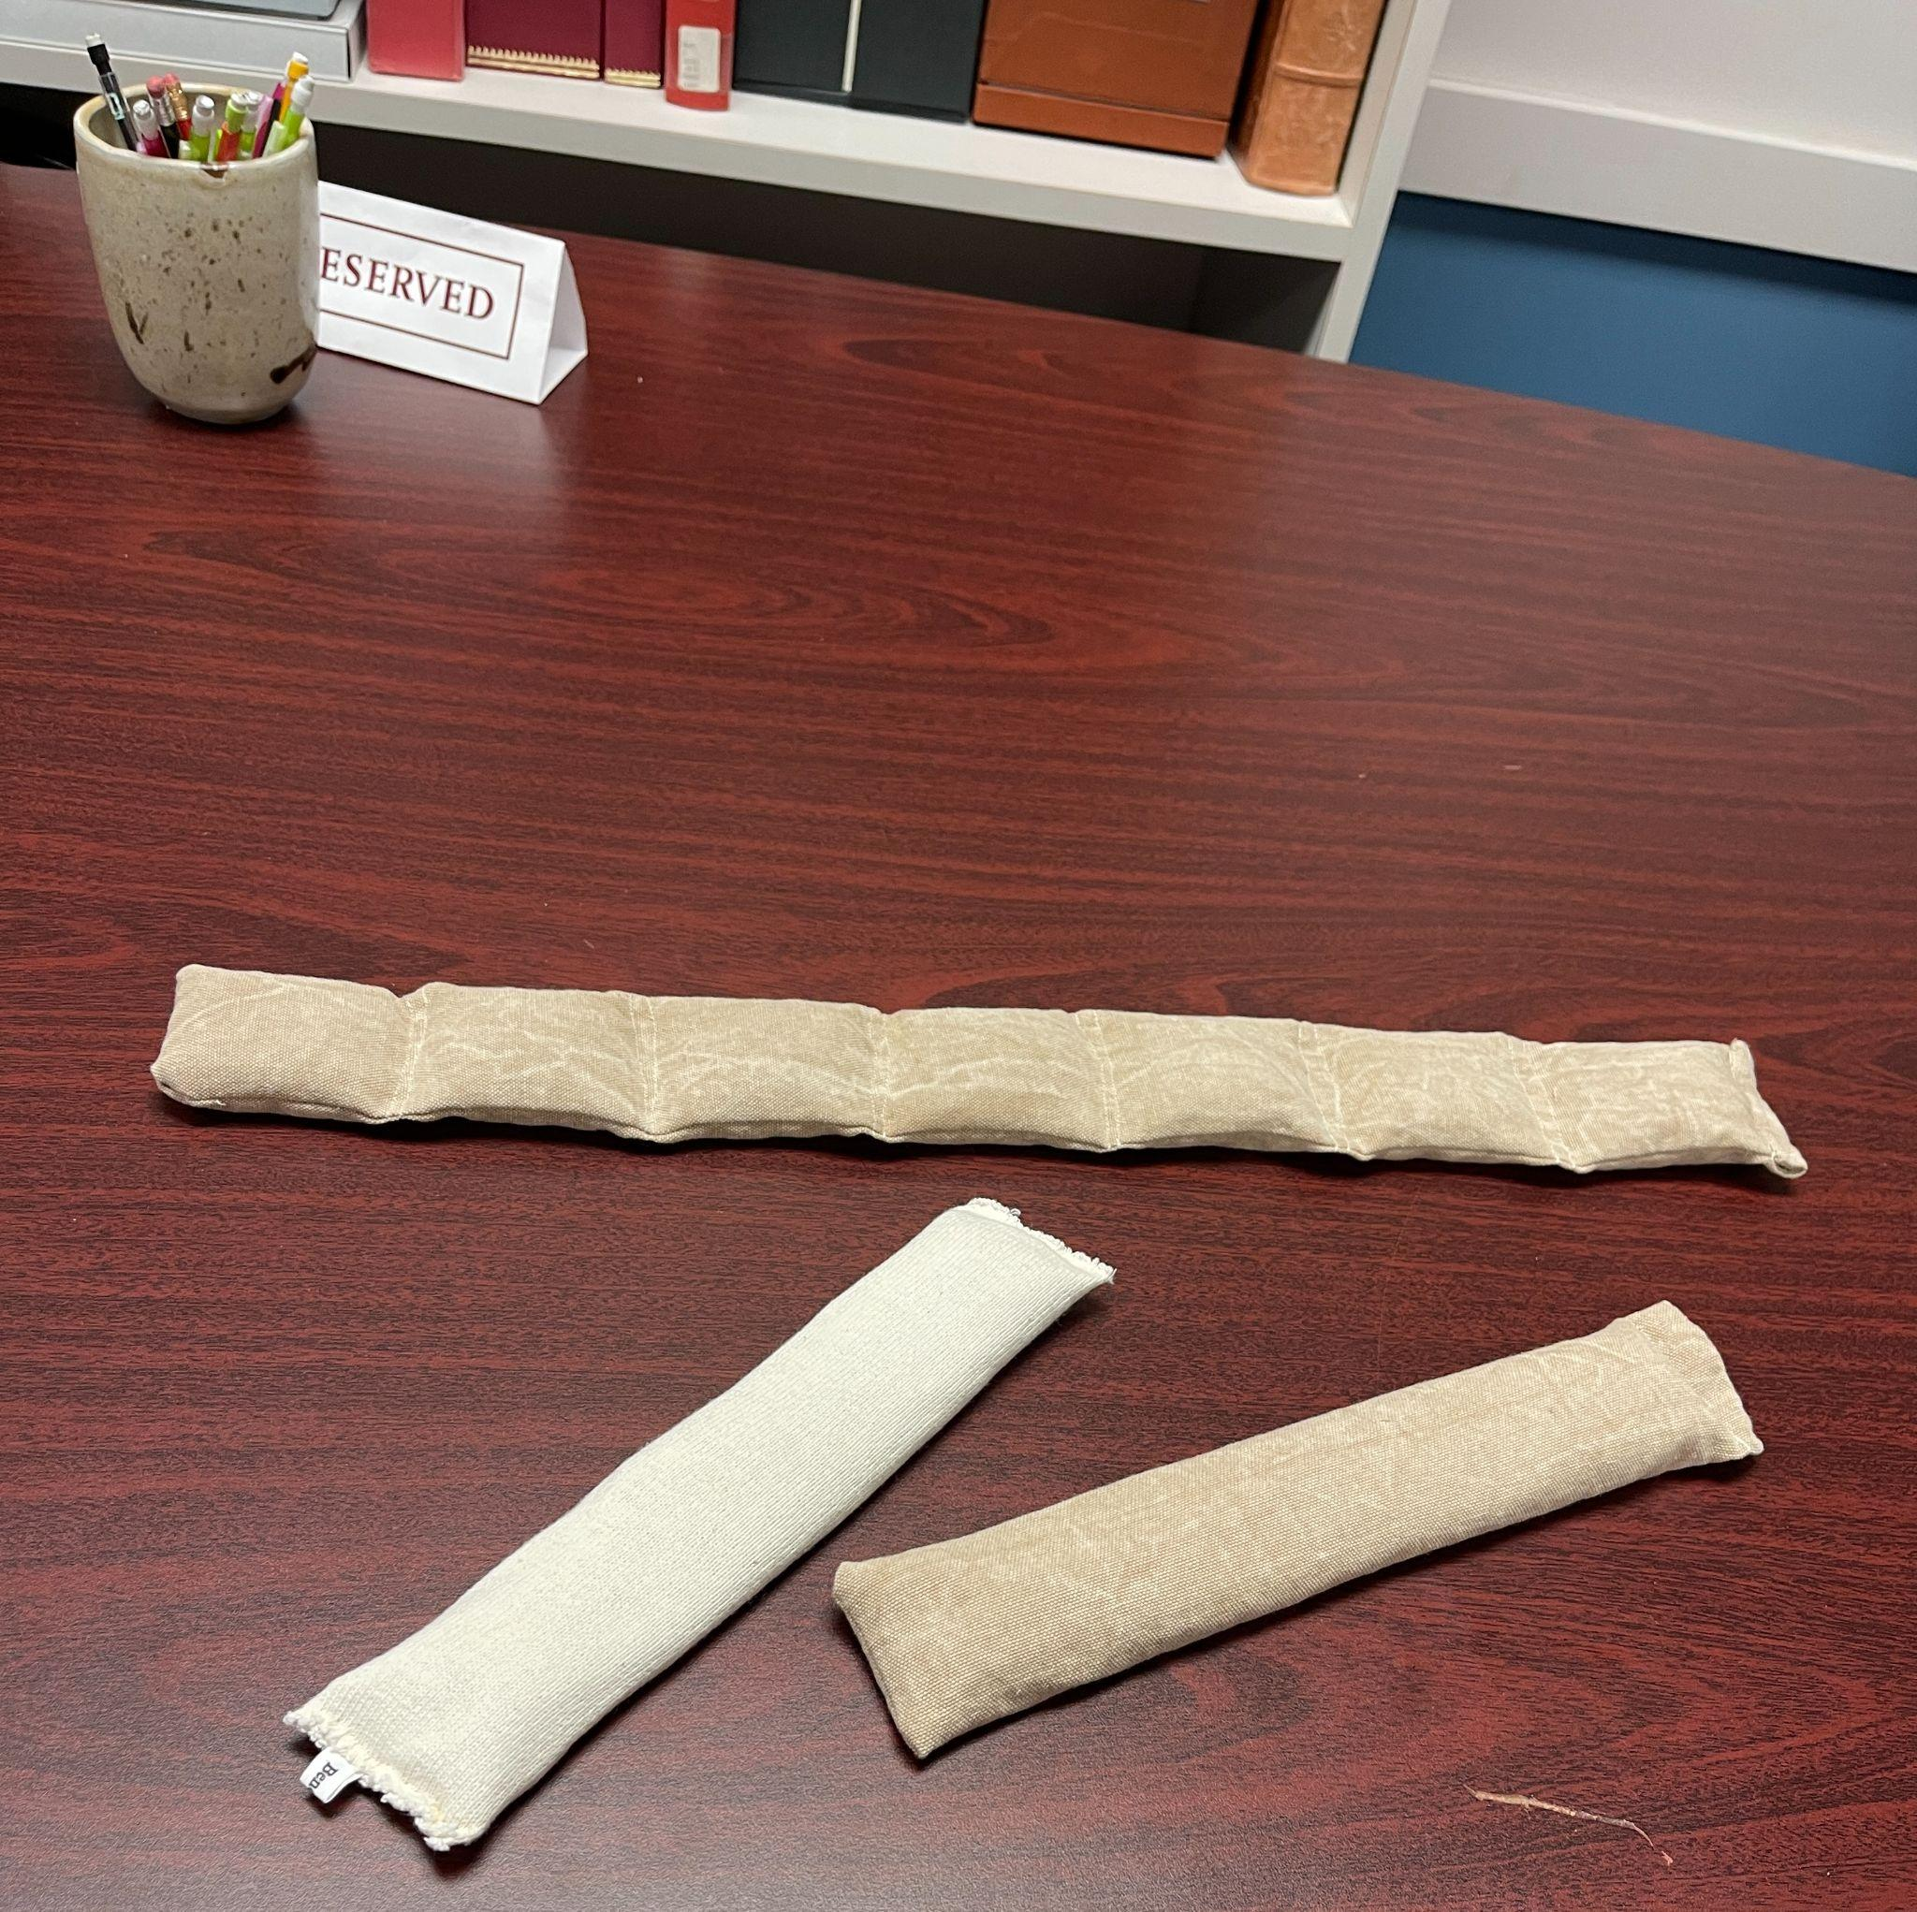
VOLUNTEERS
Have Hidden Talents!

Slide 19
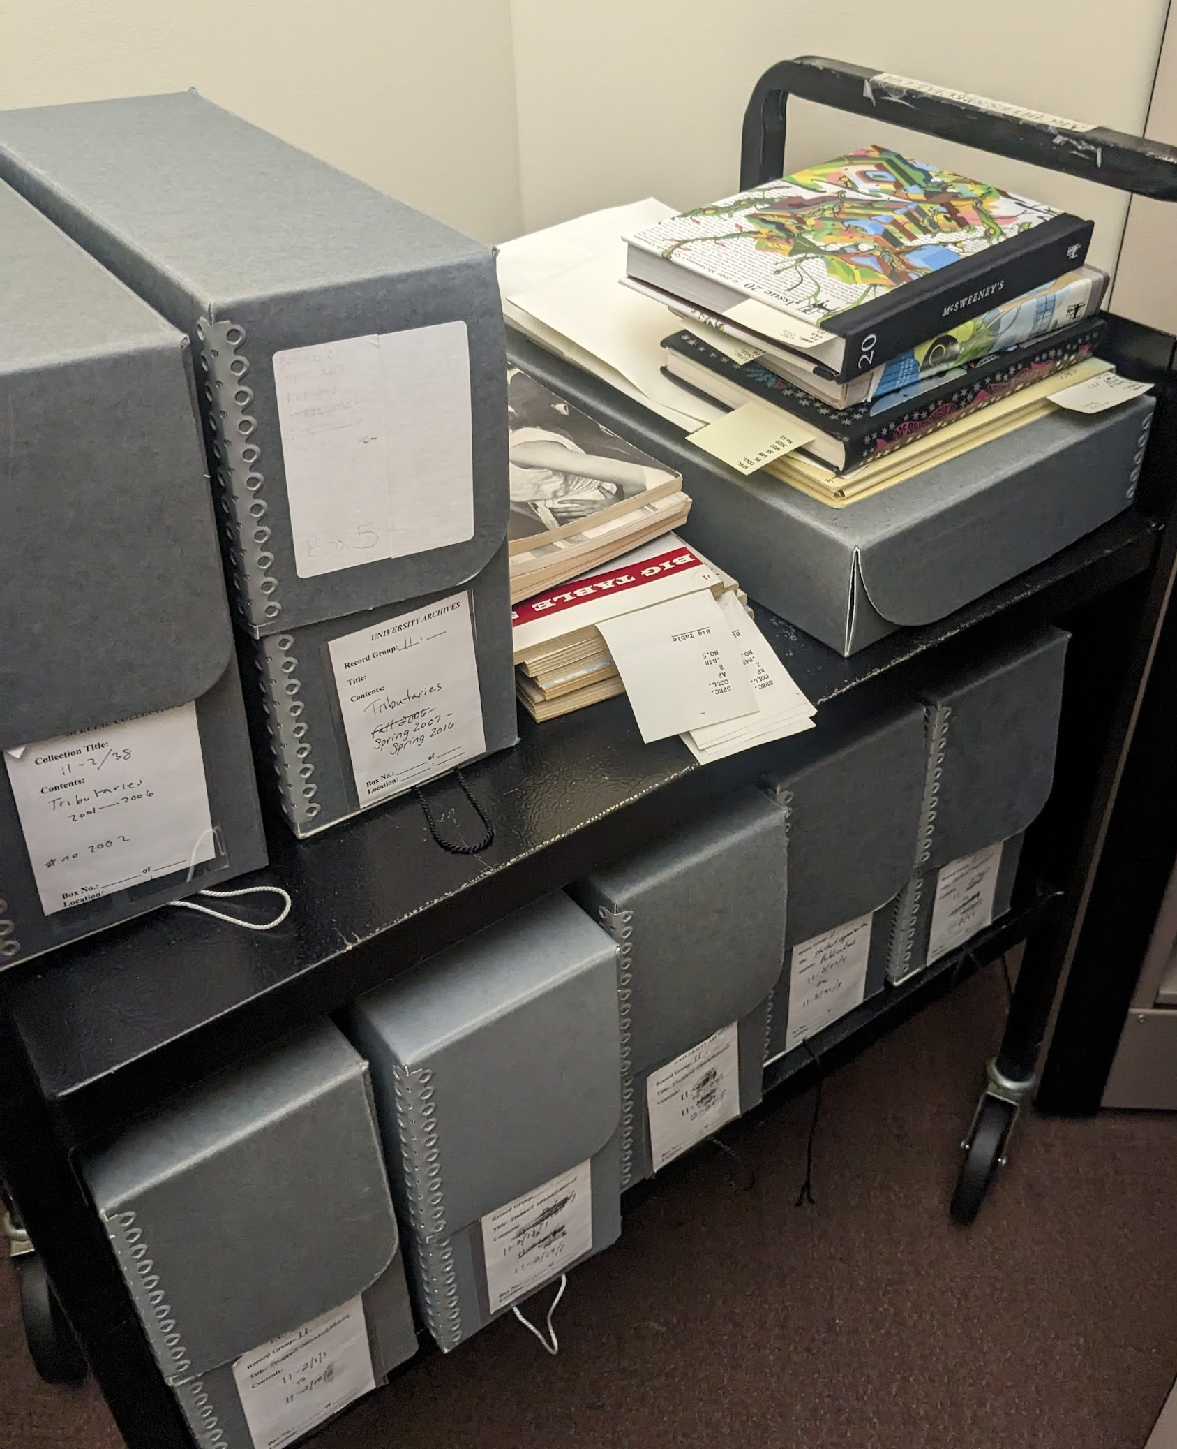
The Hard Part: Training Students & Identifying Projects
Training modules
Combination of supervision and mentoring
Building skills
Coming up with projects: A job in itself
More students, more projects, more problems
Matching students to projects

Slide 20
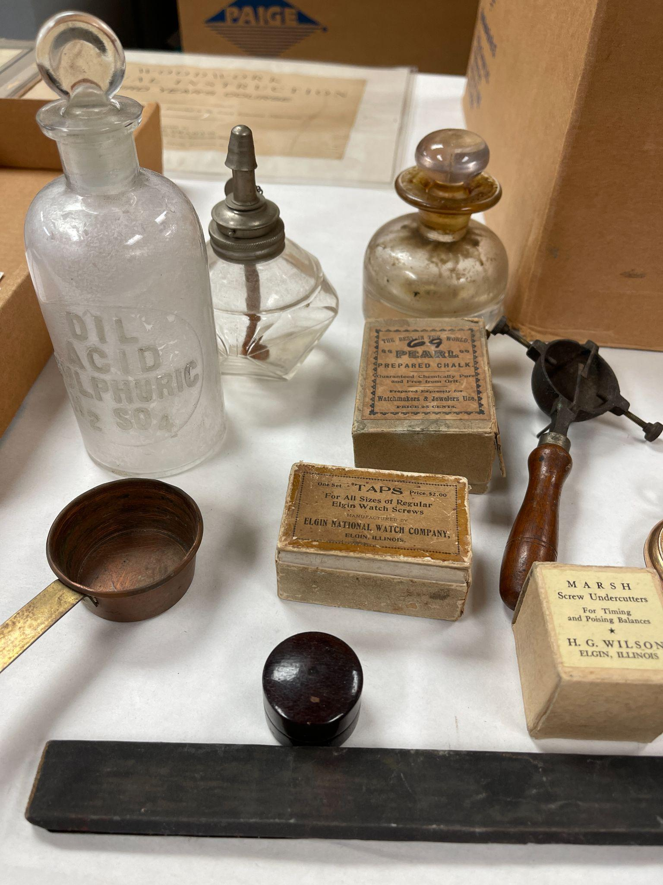
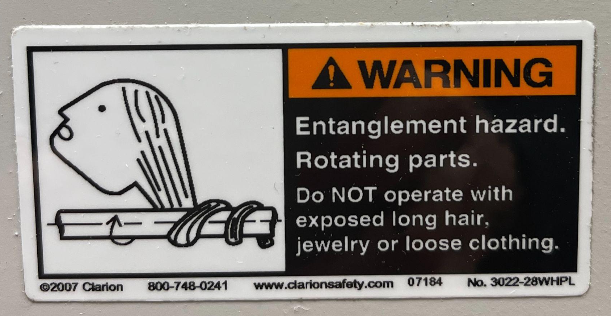
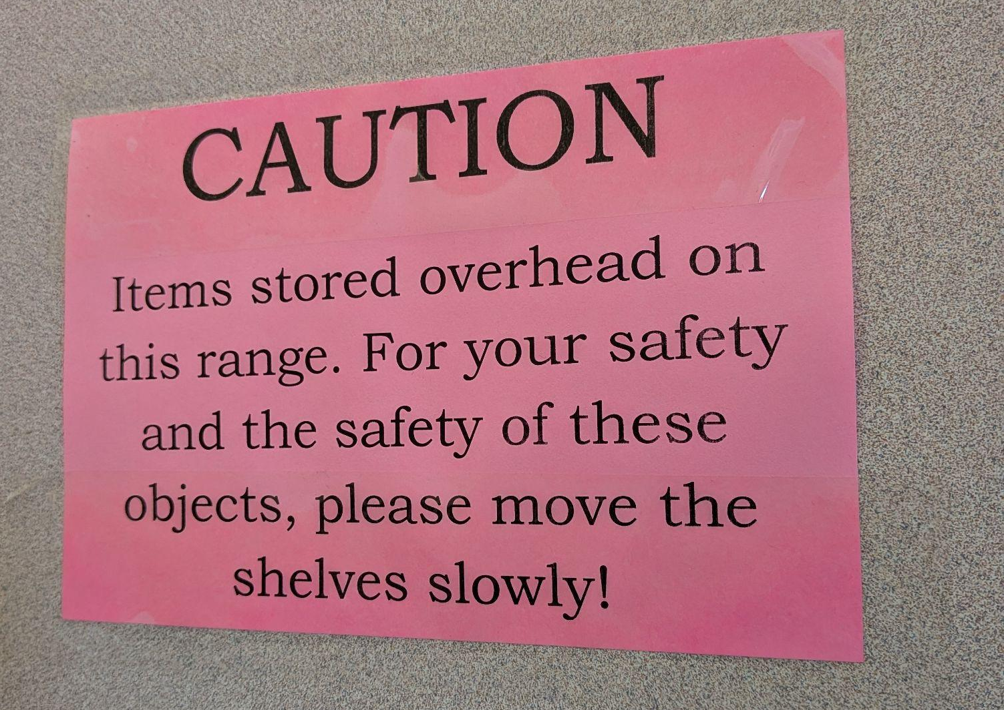
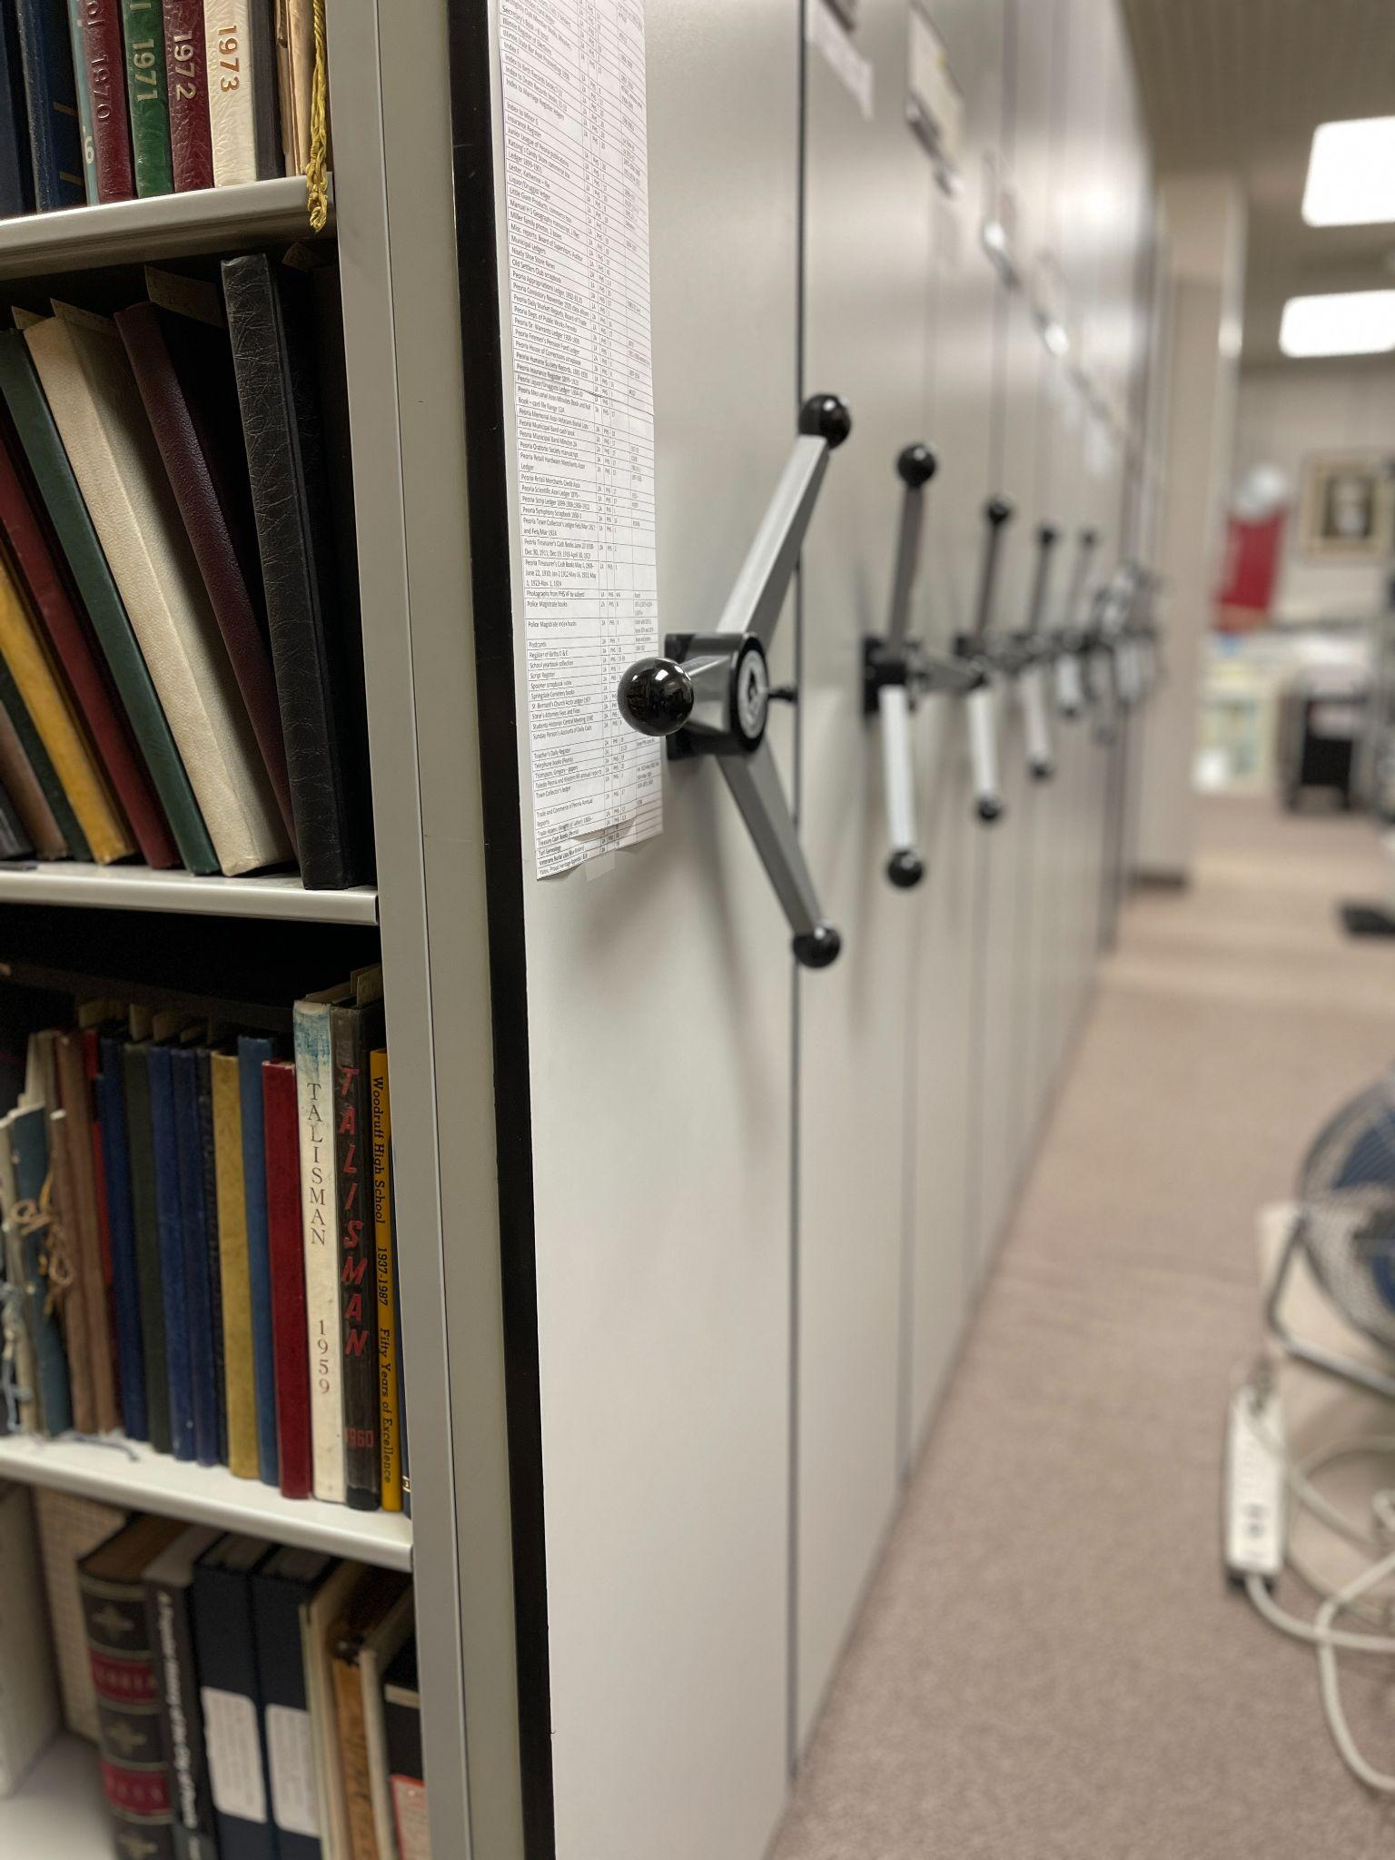
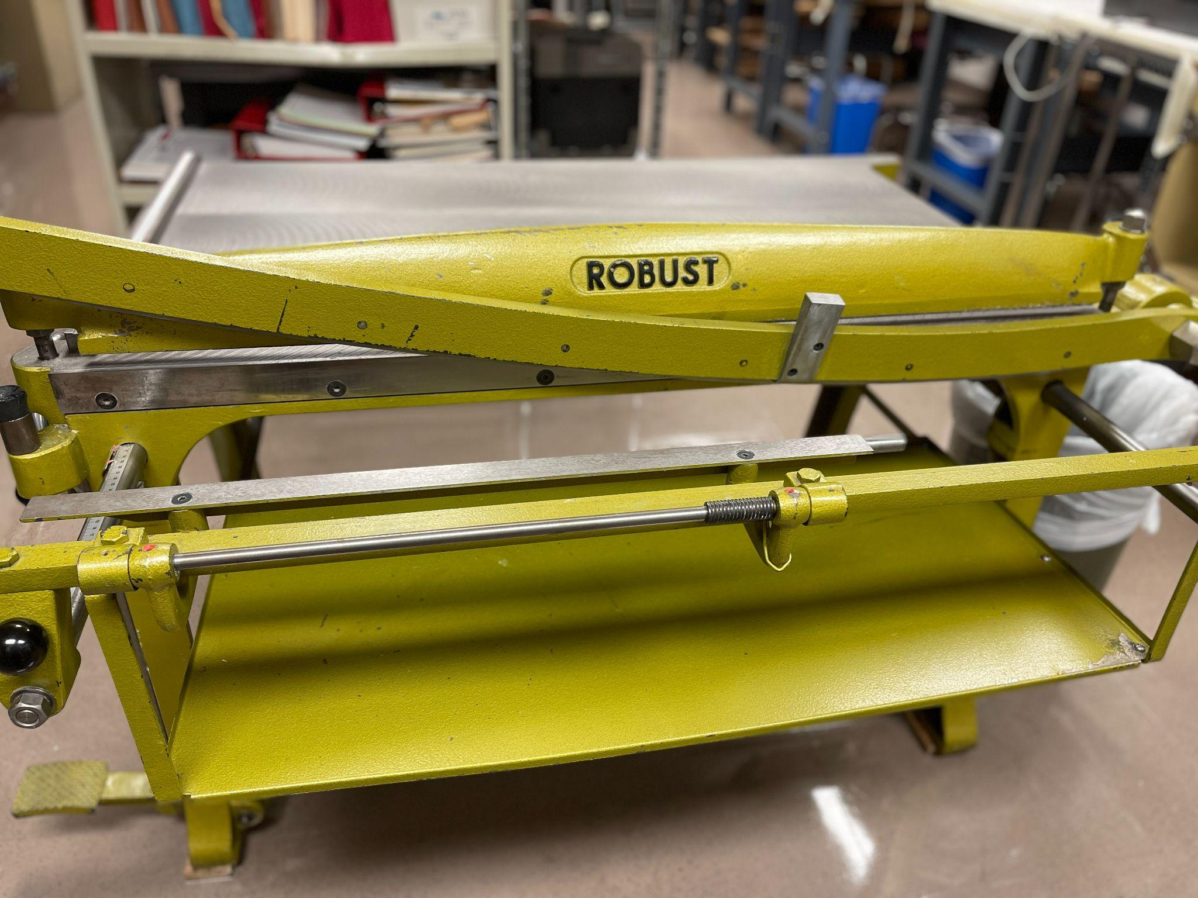
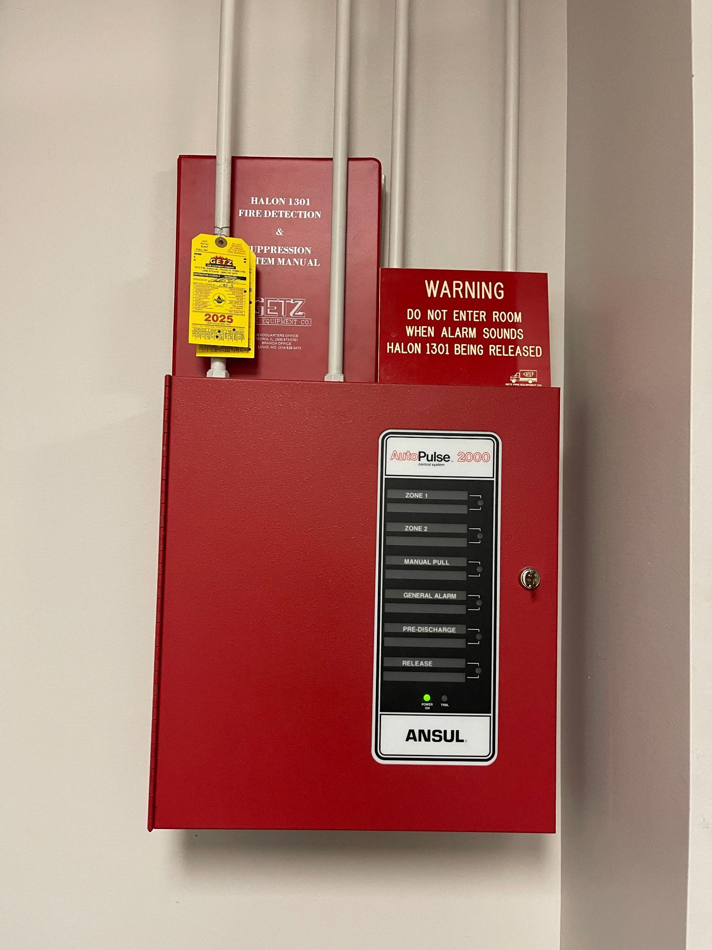
Safety First!

Slide 21
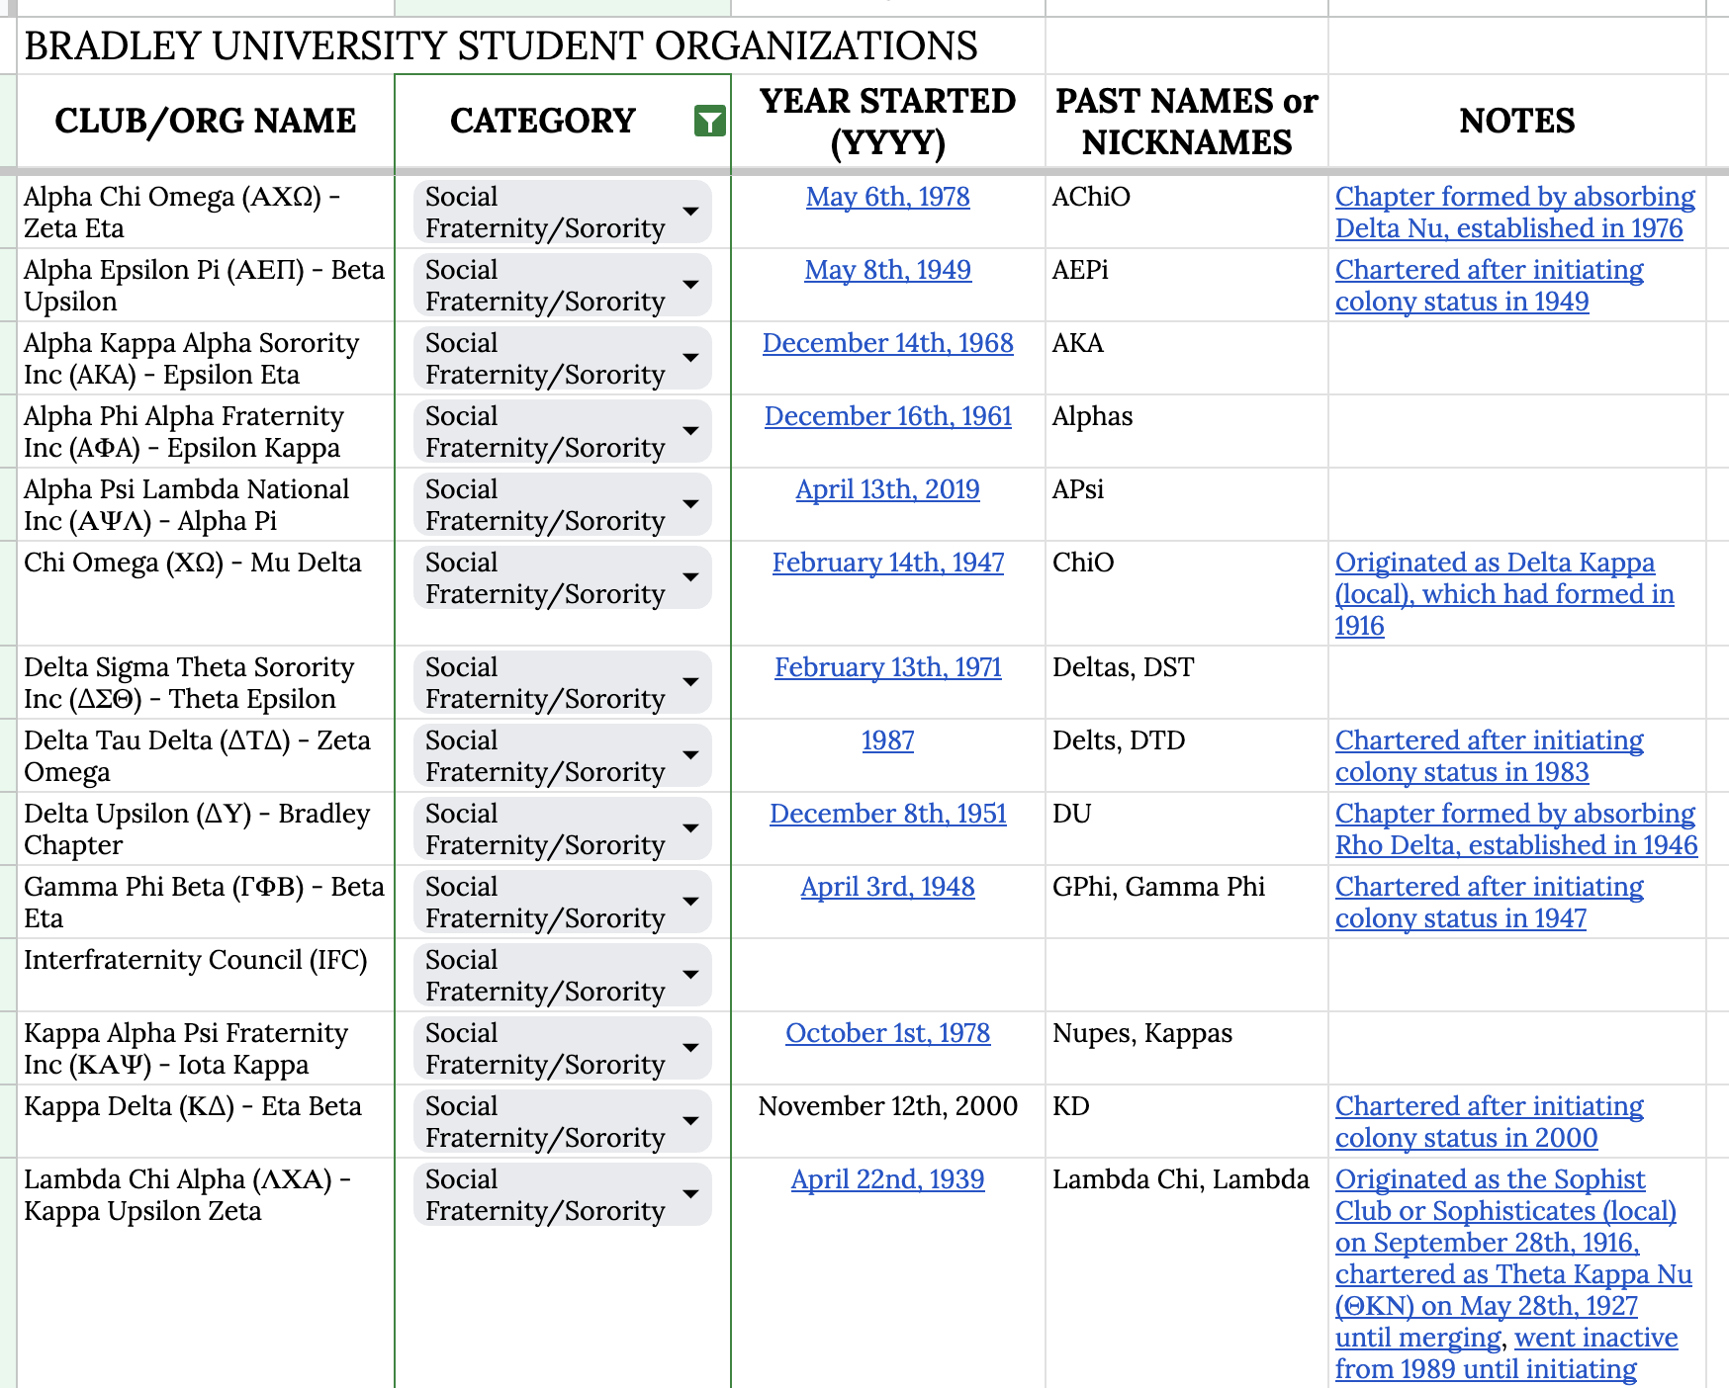
Bradley Student Workers - Training
Schedule Orientation
Address issues relevant to all students
Shared Project Folder
Instructions for the project
worksheet/templates
Check in
Especially early in project
Catch mistakes, gaps in instructions, redirect

Slide 22
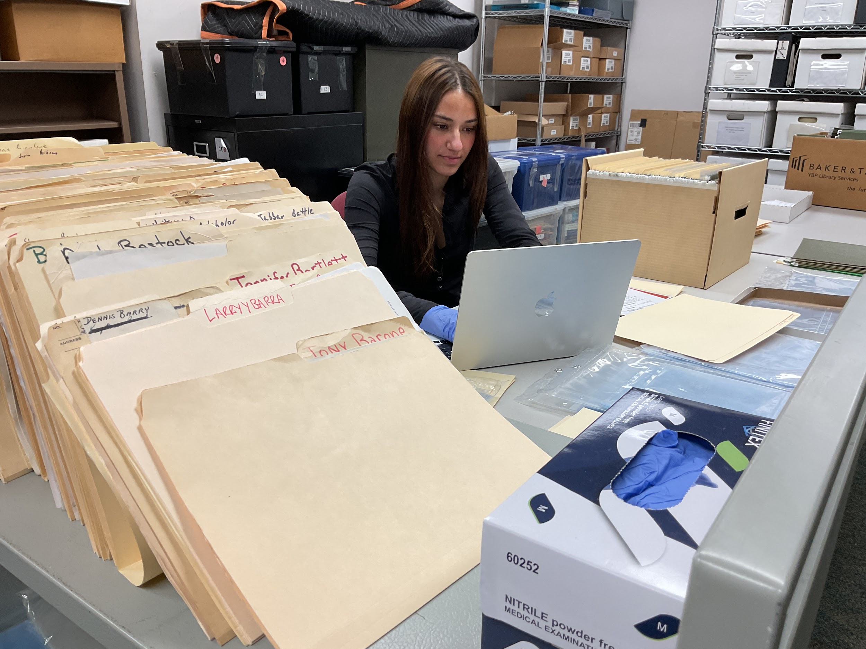
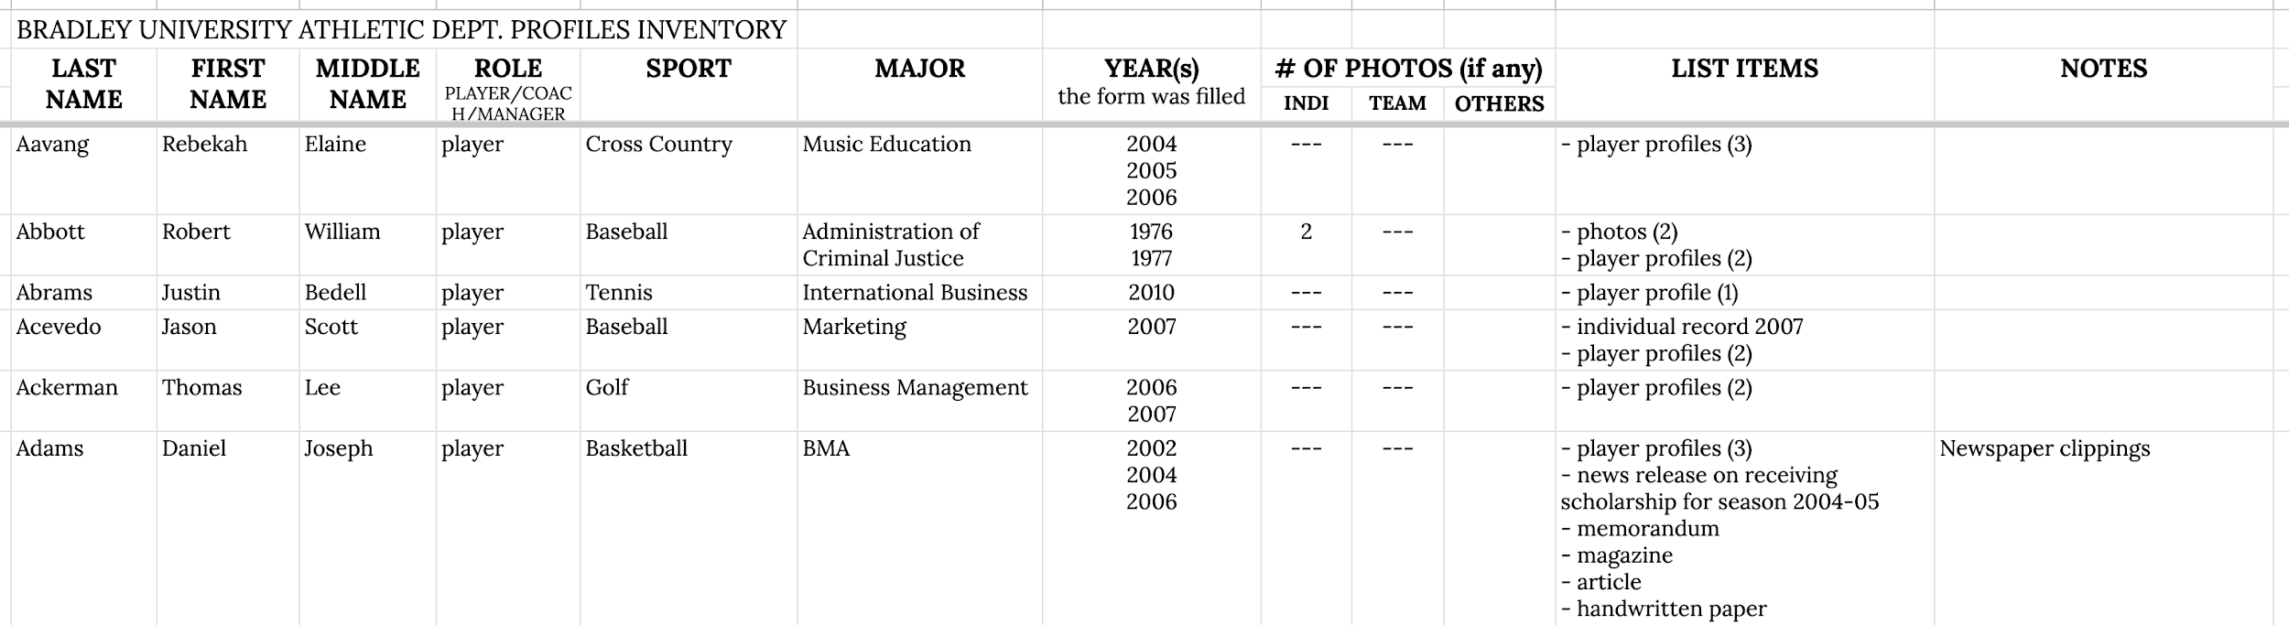
Templates or Worksheets for Students and Volunteers

Slide 23
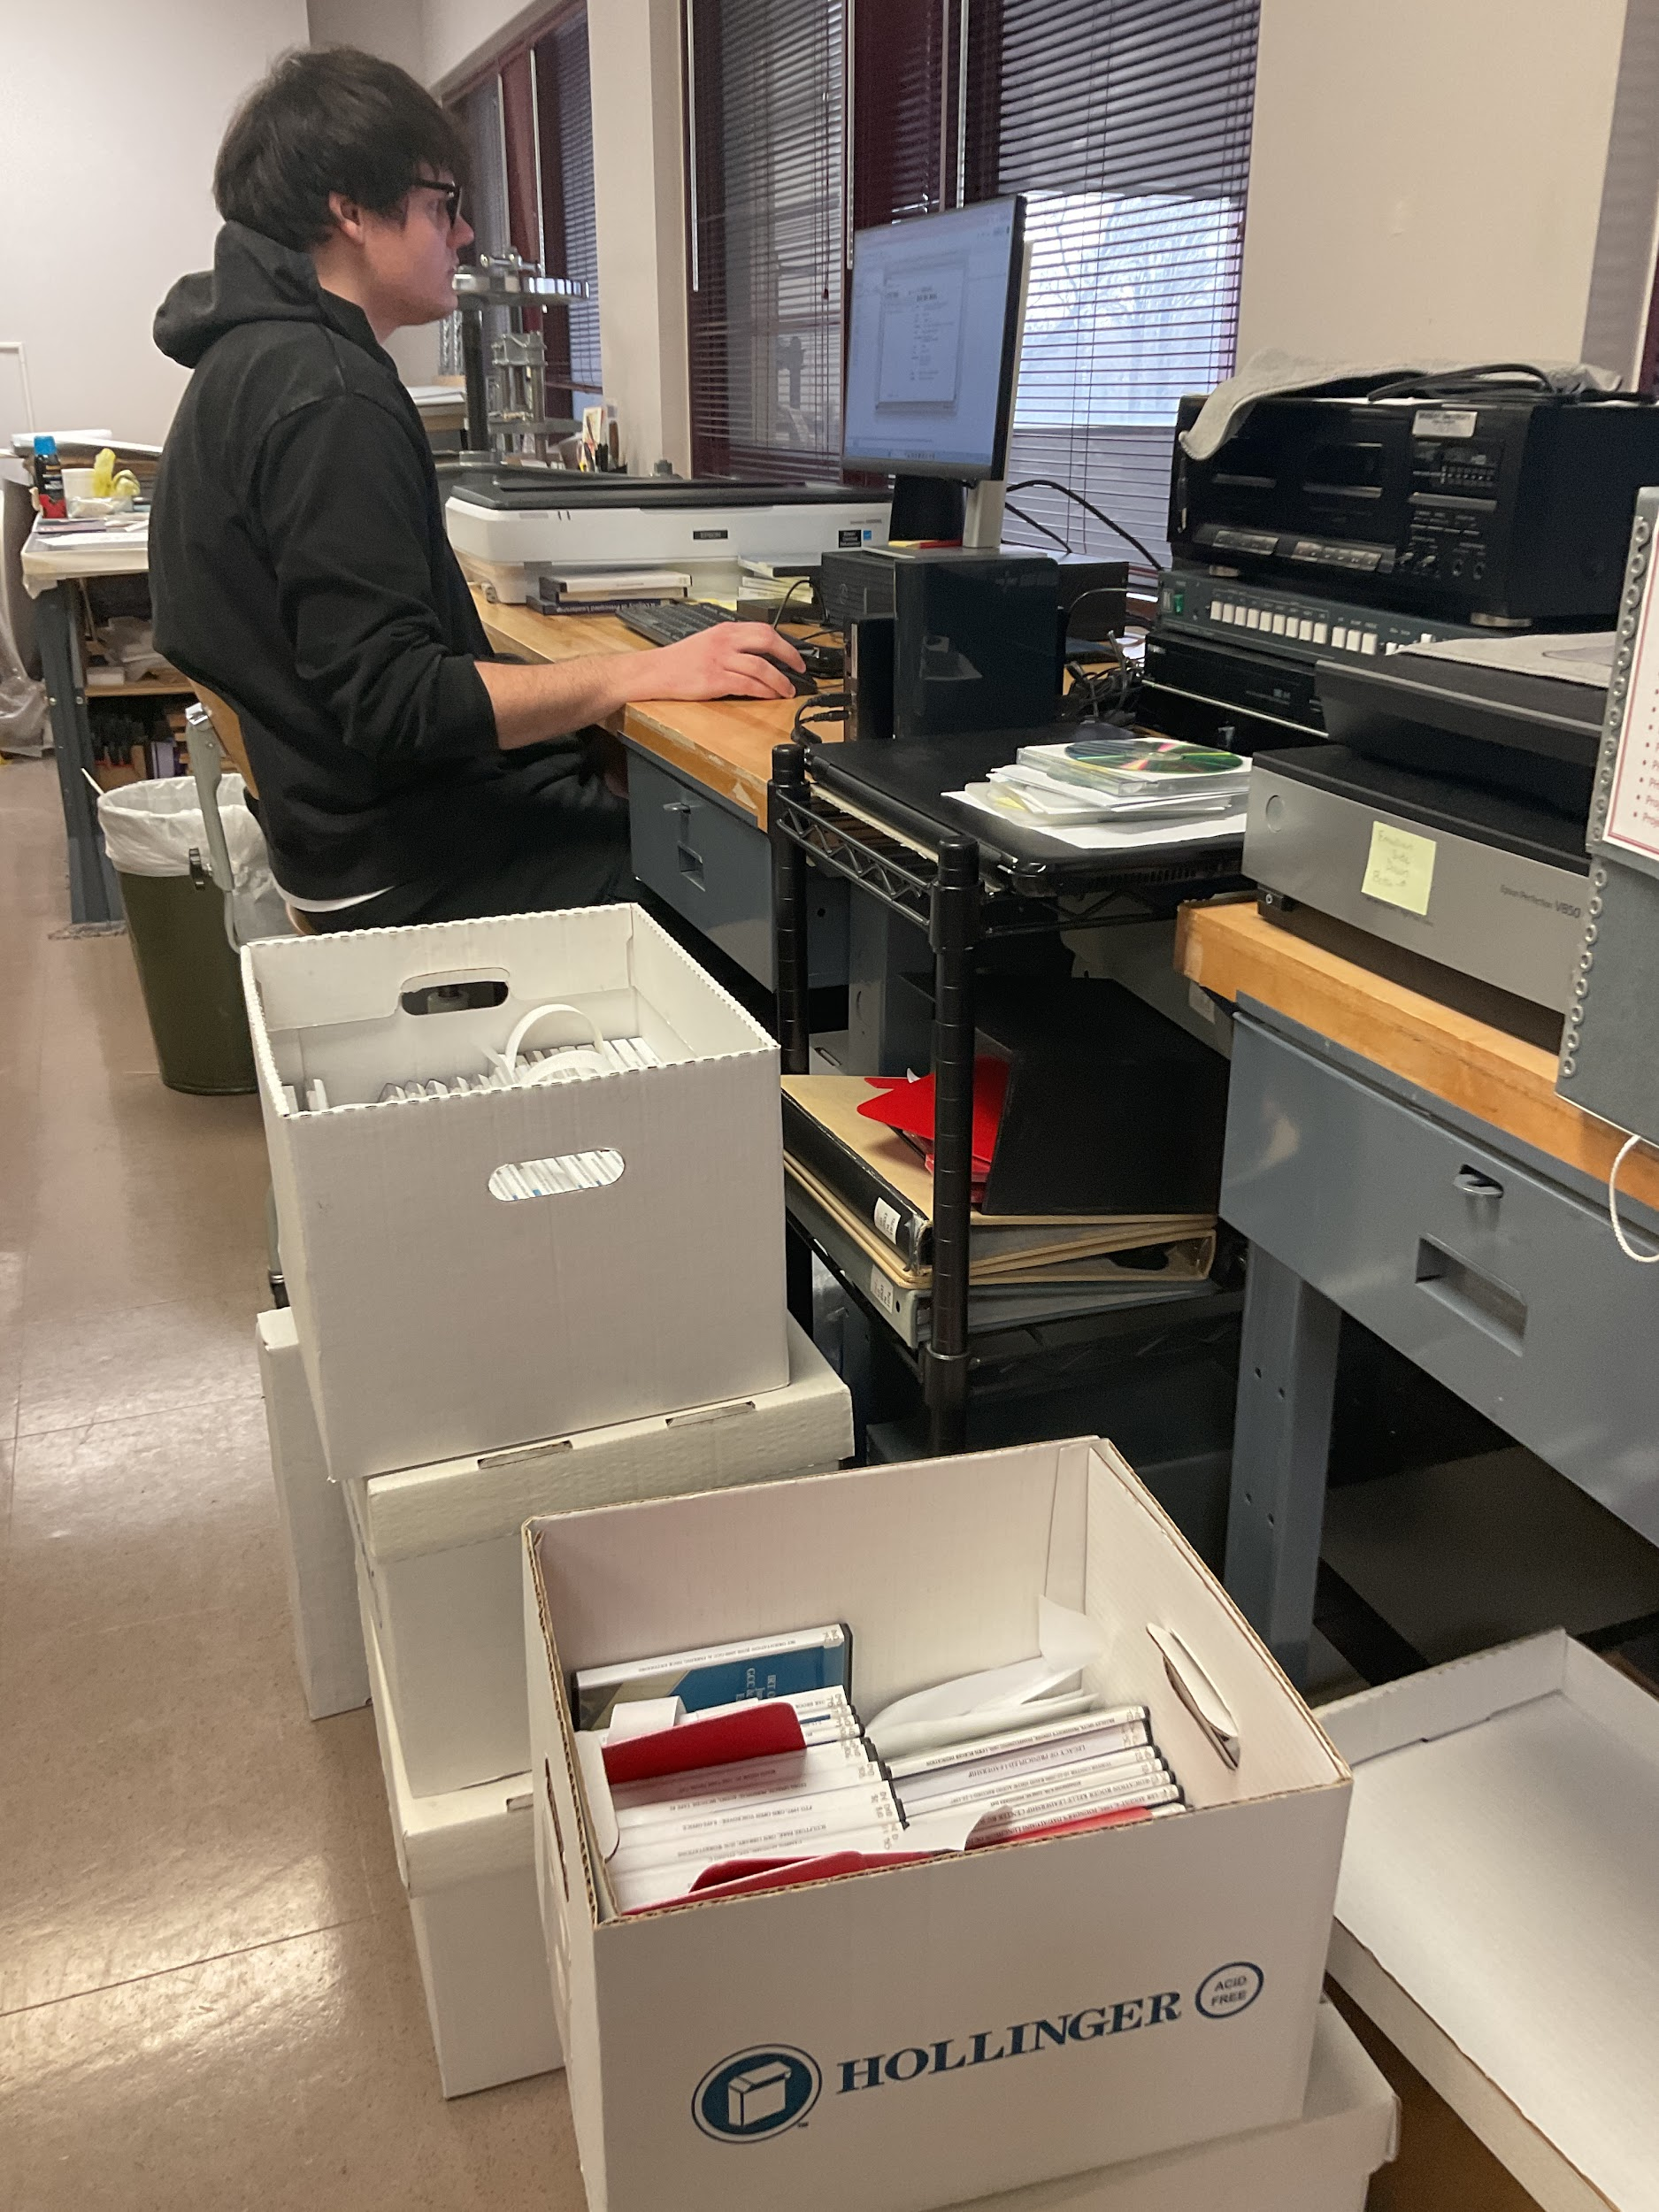
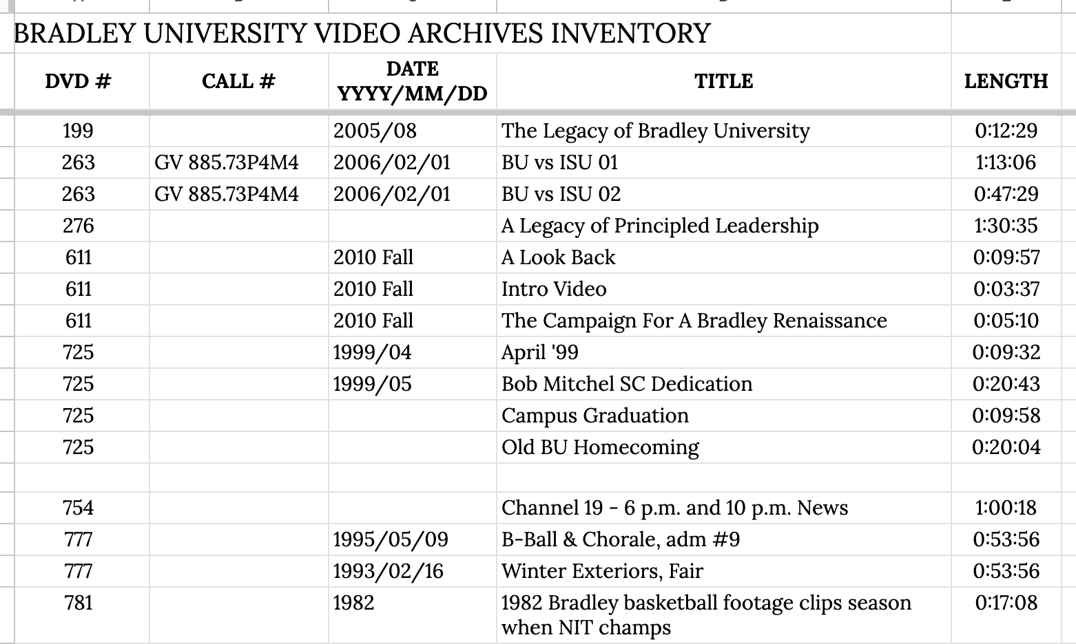
Templates or Worksheets for Students and Volunteers

Slide 24
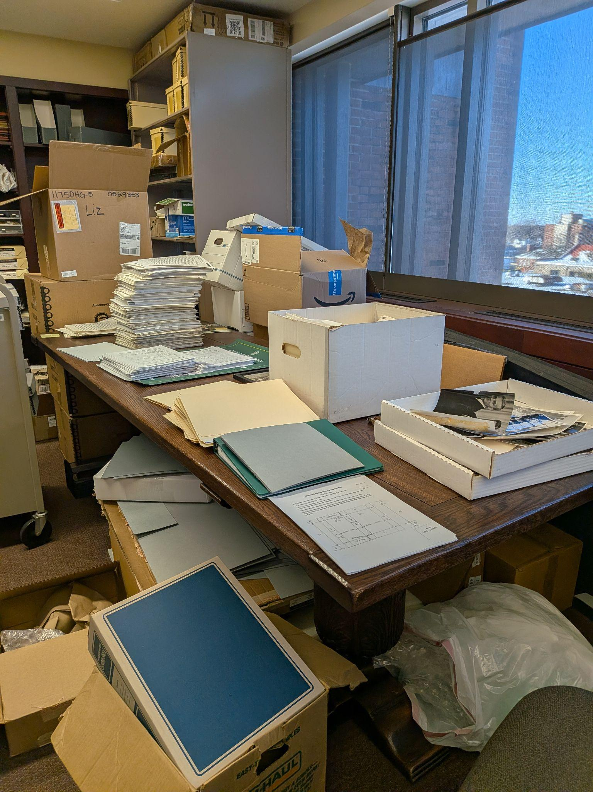

Pitfalls & Lessons Learned
Communication
Knowledge gaps
Rhythm of the semester
More projects = more problems

Slide 25
Other Benefits of Engaging Student Workers & Volunteers
Student Community
Student Knowledge (In the know…)
Each success story worth all the pitfalls

Slide 26
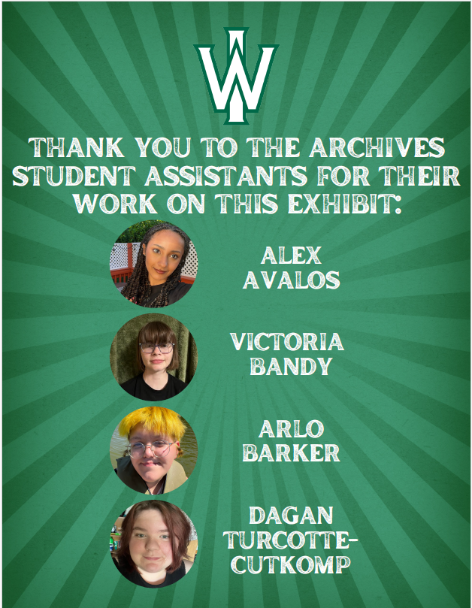
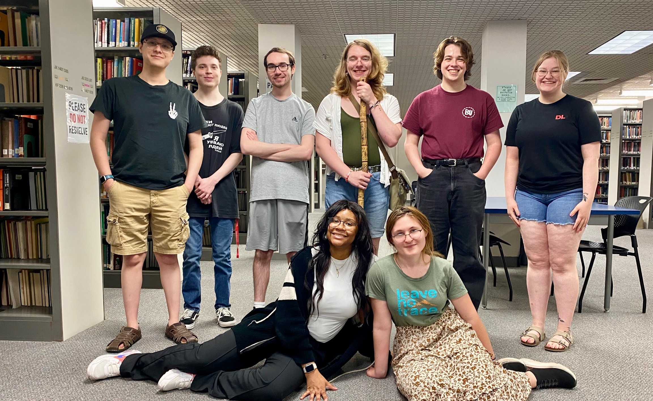
Building Community

Slide 27
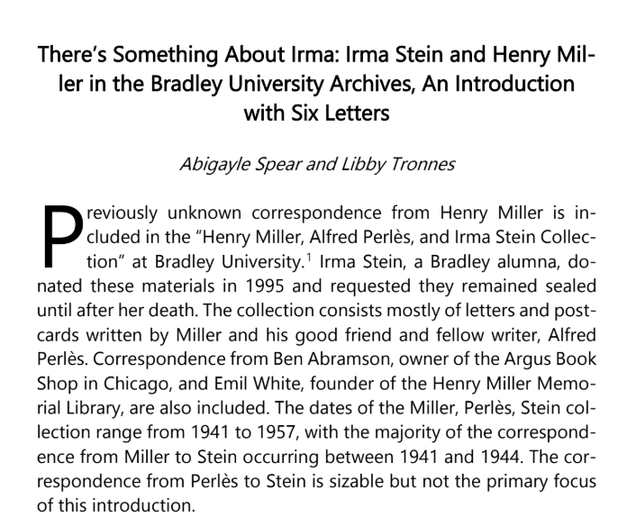
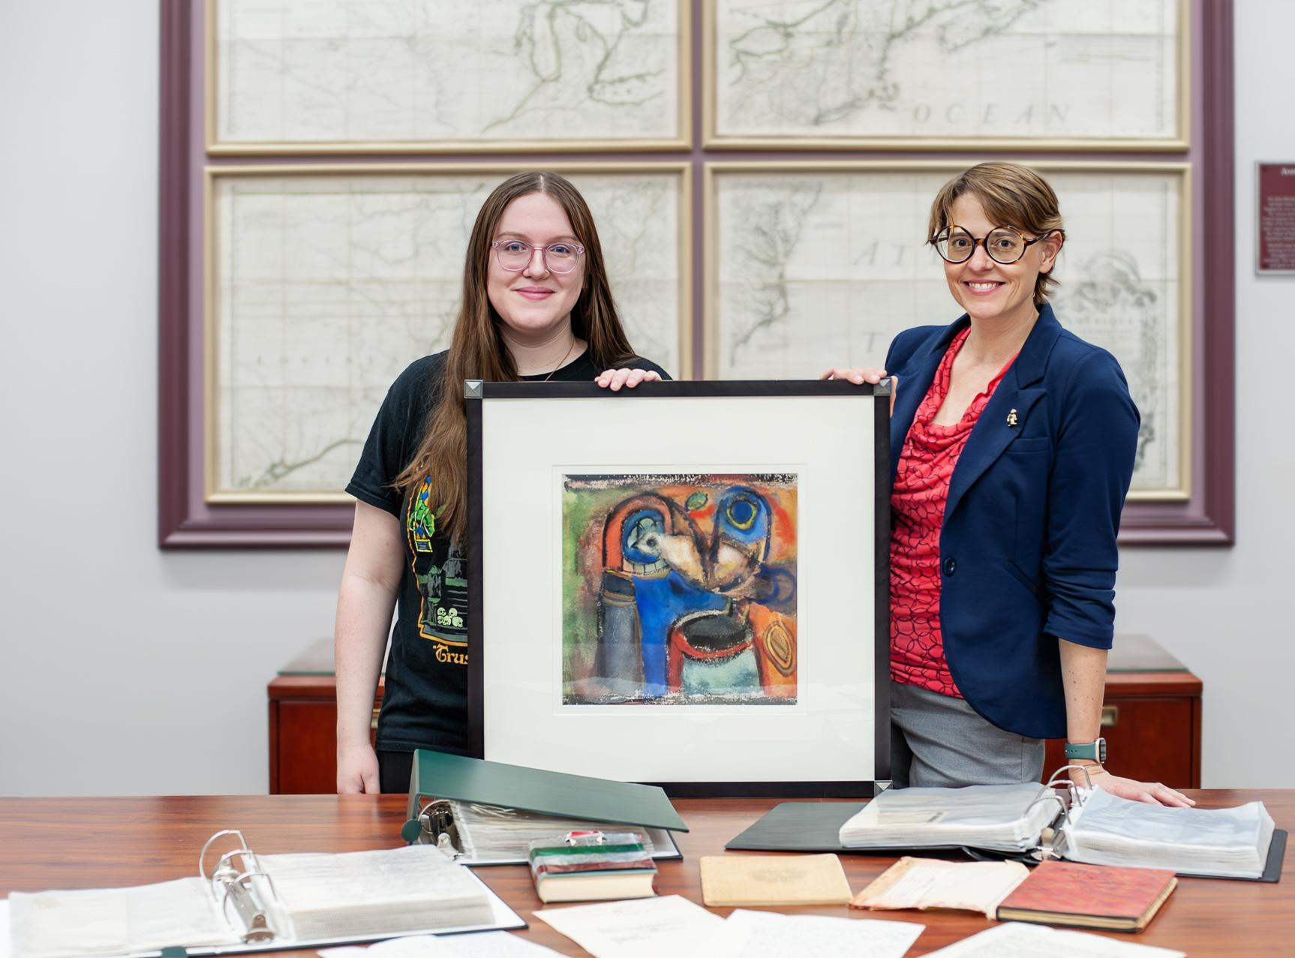

Scholarship & Creative Production: Faculty & Student Publications

Slide 28
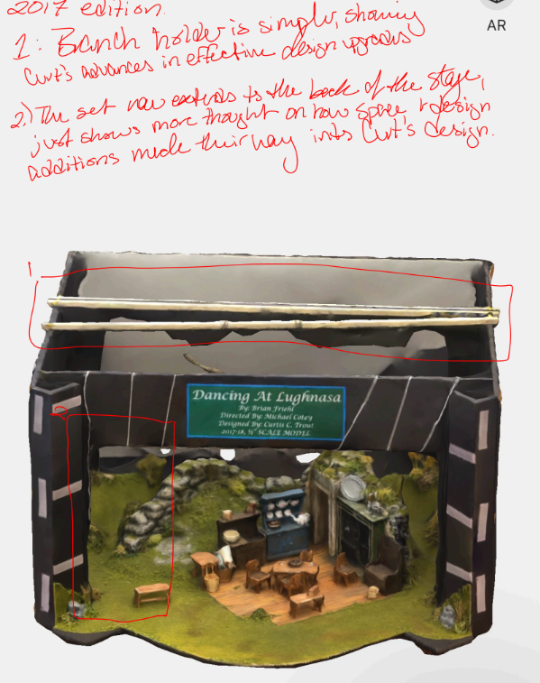
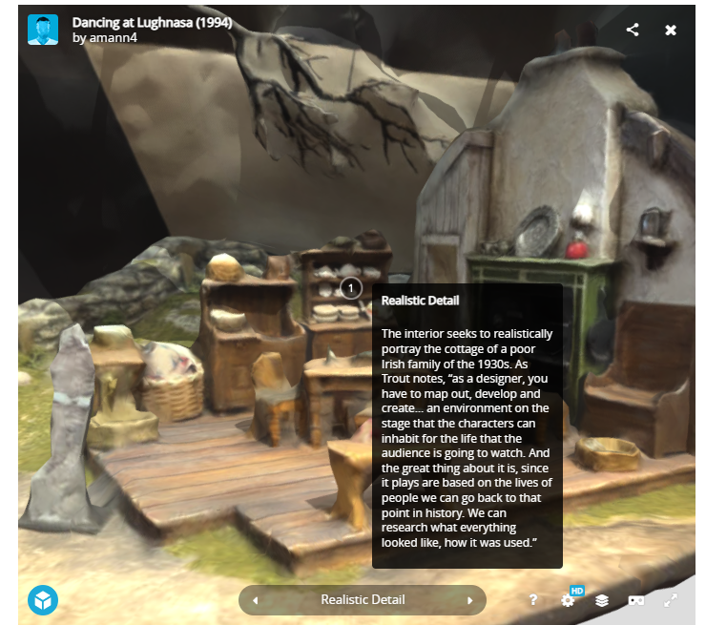
Scholarship & Creative Production
Curtis Trout Collection

Slide 29




The Best Ideas Come From Students
Students Suggest SpongeBob Squarepants Exhibit after animation cels arrive

Slide 30
Questions? Success Stories or Struggles to Share?
Liz Bloodworth - ebloodwo@iwu.edu
Libby Tronnes - ltronnes@bradley.edu
Ching Zedric - czedric@bradley.edu

