Slide 1

Application of 3D Printing Services in the Library
Part 1: Learn about the hardware and software
Professional Development Alliance
Elisandro Cabada, Assistant Professor
October 6th, 2021

Slide 2

Introductions
Elisandro Cabada
  University of Illinois Library since 2000
  Medical and Bioengineering Librarian
  Interim Head, Mathematics Library
  Assistant Professor, University Library
  Assistant Professor, Carle Illinois College of Medicine
  Director, Grainger Engineering Library IDEA Lab
  VR@Illinois Campus Steering Committee
  Health Maker Lab Campus Network Mentor
  Chair, ACRL Digital Scholarship Section, 2021-22
  Awarded 2021 ALA RUSA ETS Best Emerging Technology Application (BETA) Award

Slide 3

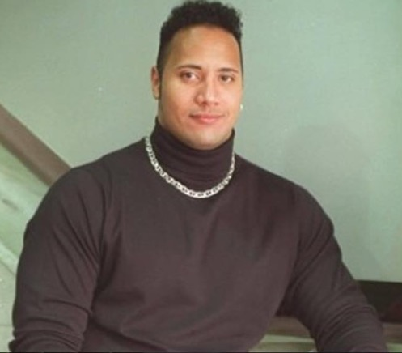
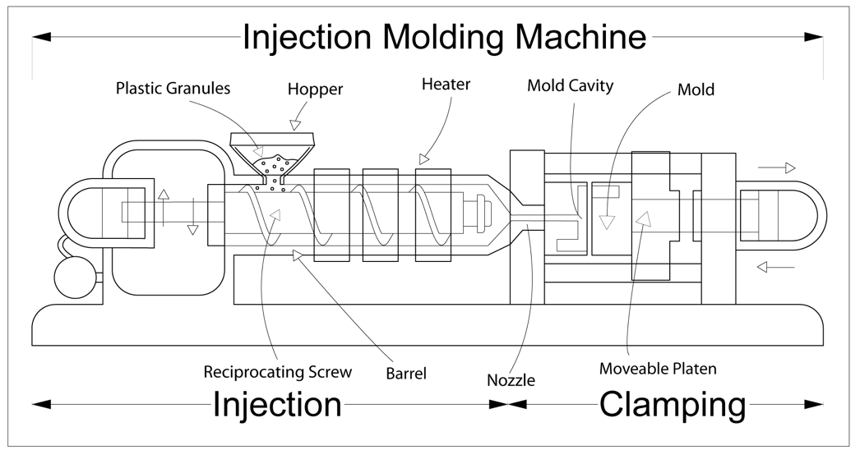
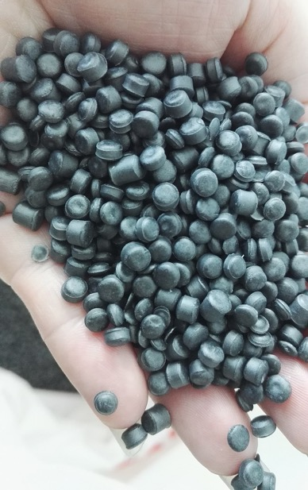
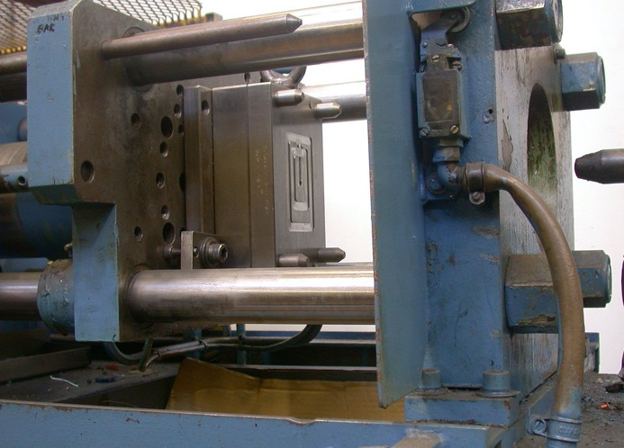
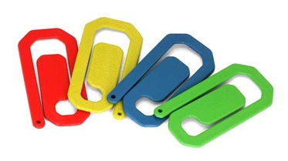
Picture it… Chicago, late 1990’s
Injection mold plastic “Printing”
Who wore it better? ☺

Slide 4
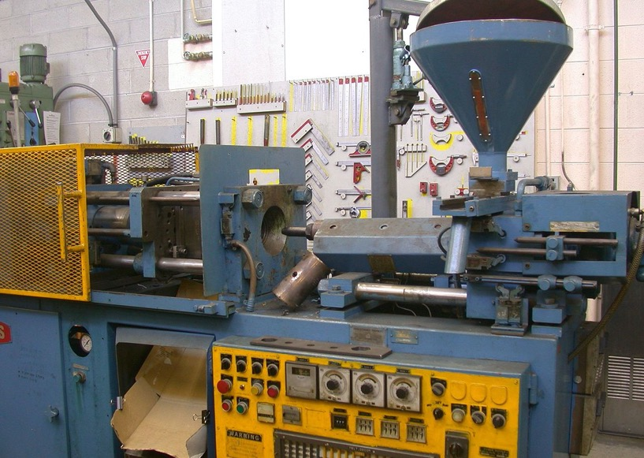
Injection mold plastic manufacturing
Typically only used for commercial uses
Room-scale machines
Requires significant investment in space, equipment, and staff expertise
Related costs out of scope for most academic uses
Academic units with access focused on manufacturing-related disciplines

Slide 5
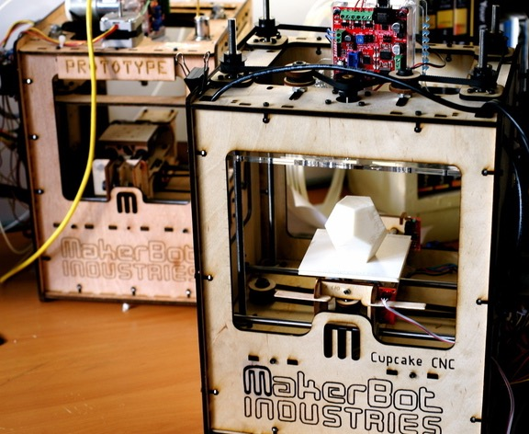
What is 3D Printing?
“Additive Manufacturing”
Most common are:
  FDM (Fused Deposition Modeling)
  SLA (Stereolithography)
Made widely accessible in late 2000’s
Started with MakerBot but…

Slide 6
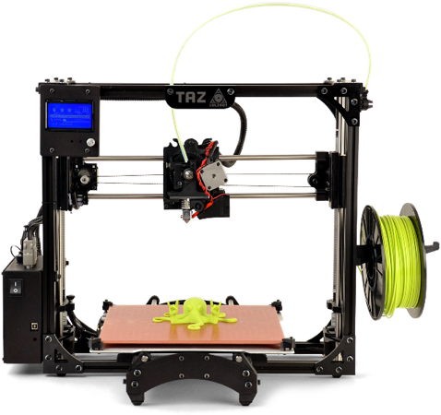
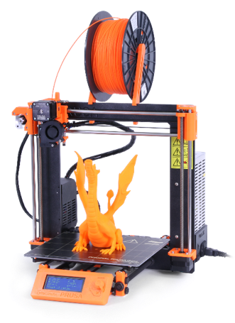
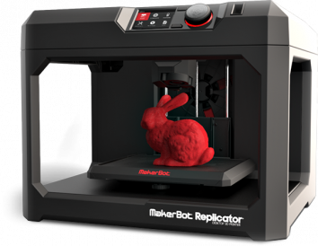
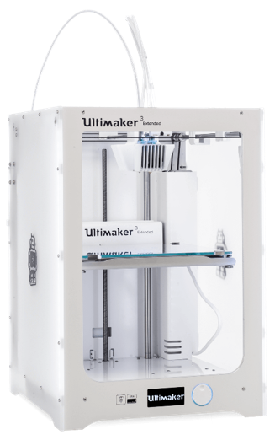
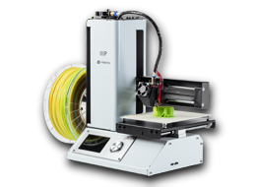
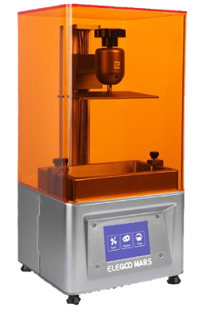

Slide 7
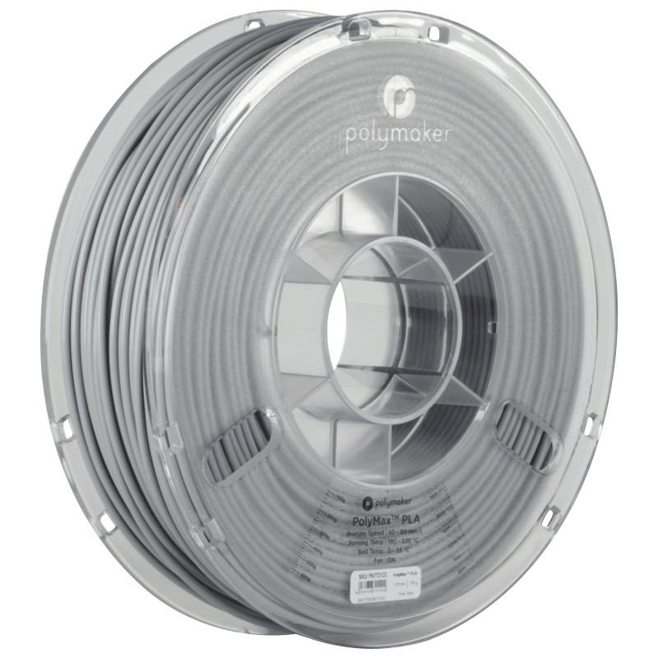
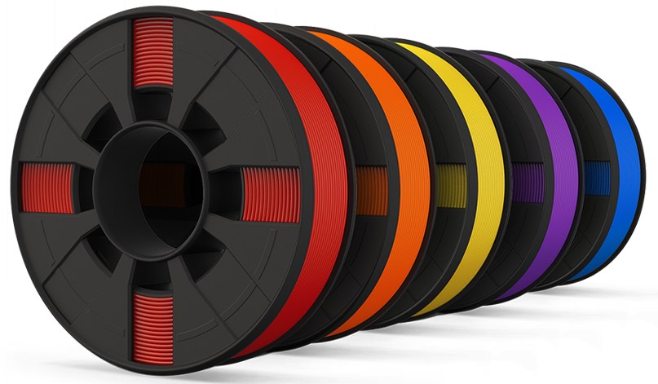
What is 3D Printing?
FDM most common tech
Uses solid plastic filaments
Thermoplastic (150-160 C)
PLA, ABS, HIPS, NinjaFlex, T-Glase (PETT), LayWood, etc…
Many filaments are biodegradable

Slide 8
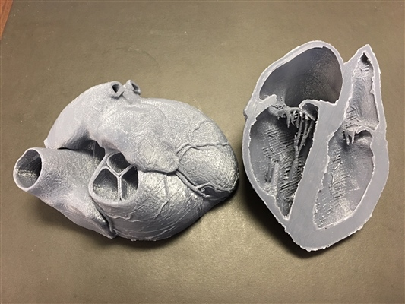
What is 3D Printing?
PLA (Polylactic Acid)
Most commonly used plastic
$19 to $29
Good for rapid prototyping
Requires minimal amount of ventilation when printing
PLA compatible with almost all FDM printers
PLA spools typically come in 1KG
Most PLA prints use less than 200g of material with “standard” settings

Slide 9
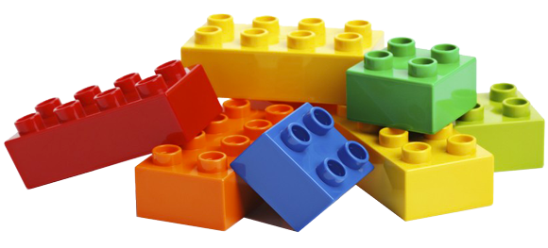
What is 3D Printing?
ABS (Acrylonitrile Butadiene Styrene)
Cost is comparable to PLA
Stronger and more flexible
Can print more with ABS but harder to handle
Higher melting point, can warp if cooled during printing (210°C vs. 230°C)
Can produce fumes during printing

Slide 10
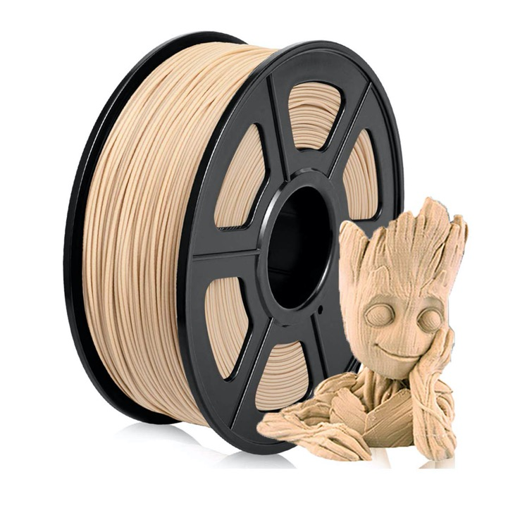
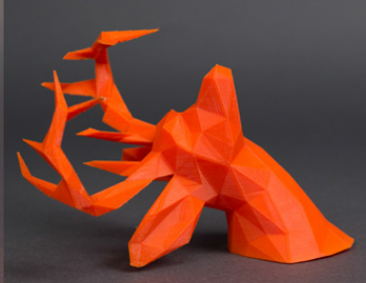
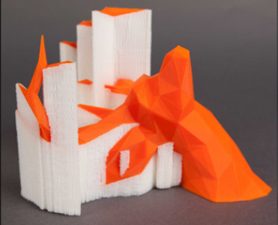
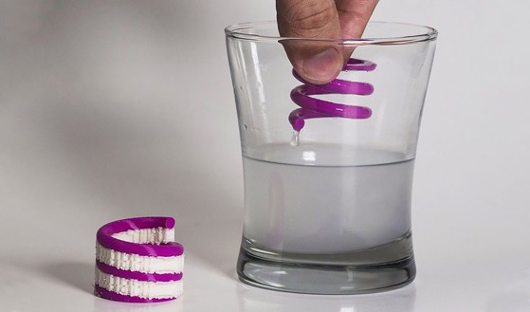
Other materials

Slide 11
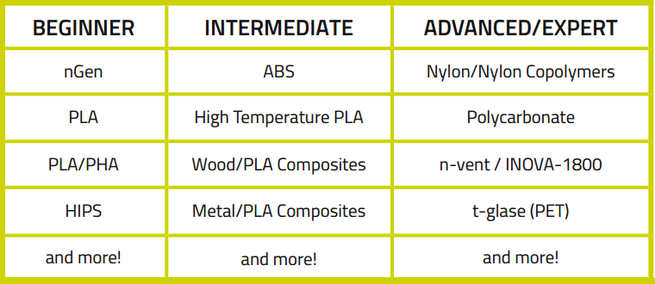
Most common FDM Plastic Filaments

Slide 12
How it works (hardware)…
Filament is fed into the extruder head
Material is heated to melting point
Filament is extruded on bed based on precise plot points
Filament fuses with antecedent layers and hardens as it cools
When used properly, 3D Printers are considered safe, your personal computer gets even hotter

Slide 13
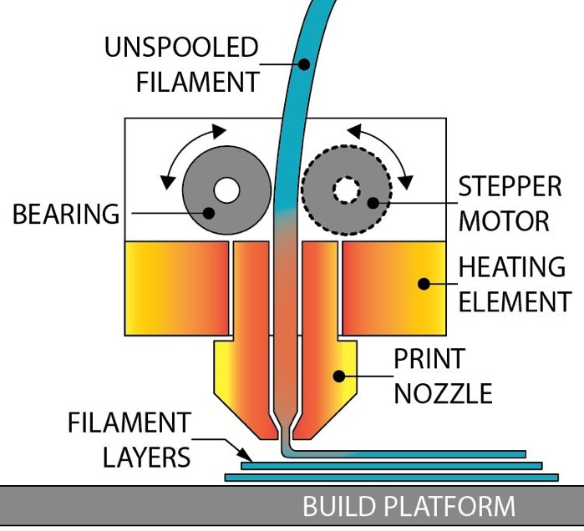
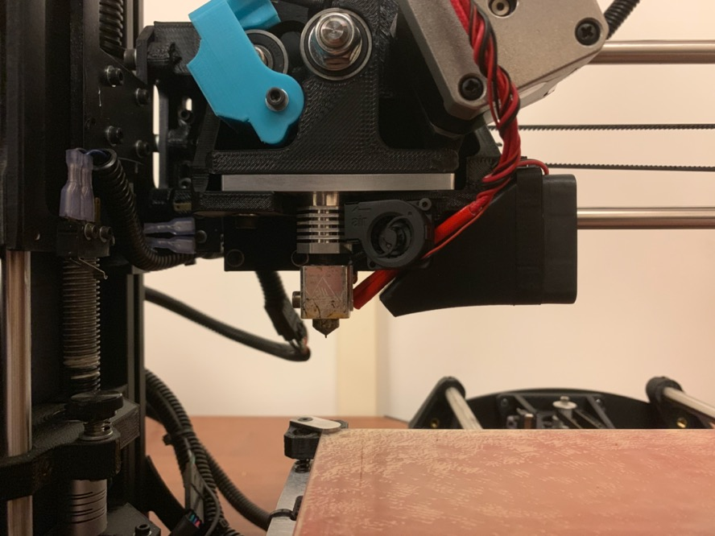
How it works (hardware)…

Slide 14
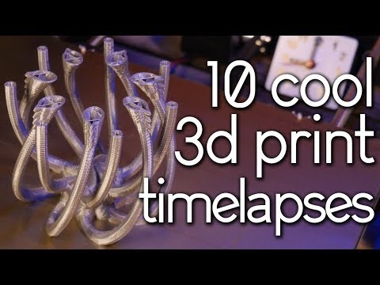

Slide 15
How it works (software)…
3D modeling has been around for decades
  Maya, Fusion 360, SolidWorks, MatLab, Unity
Many of these free to students/education licenses
Also free cloud based
  TinkerCad, OnShape
Several “How to” videos/courses on Linkedin Learning, Coursera, and YouTube

Slide 16
How it works (software)…
.STL and .OBJ most common files for 3D Printing
Can Save or Export 3D models for 3D Printing from most design software
You can also download free printable 3D objects online
  Thingiverse (demo), Pinshape, etc…

Slide 17
How it works (software)…
Import .STL file into 3D printing software known as a ‘Slicer’
  Cura, Slicer, Octoprint, MakerBot, etc…
They are all very similar, you usually end up using the one made by same company as your printers
Most are compatible with most printers

Slide 18
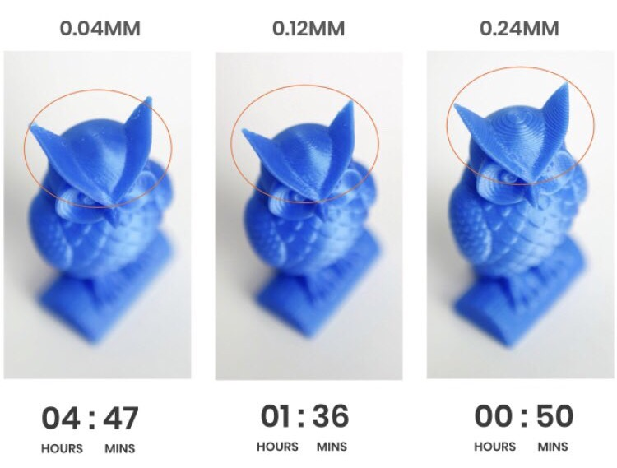
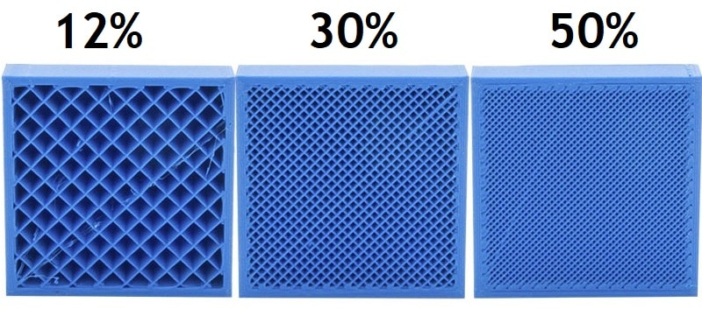
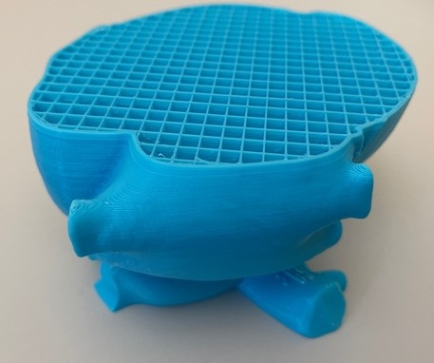
How long will it take?
It depends… 3D printing is an art form
Ultimately depends on how much material is extruded at any one point
  Size of your object
  Detail of your object (aka resolution or print quality)
  How filled (aka solid) do you want?
Question: What is important to you?
Lets see how it works (Demo)
Notes:
Load Cura

Slide 19
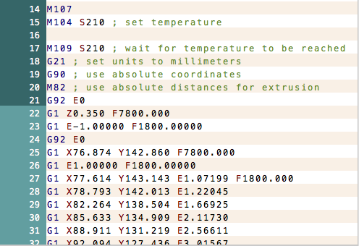
How it works (software)…
The magic is in the .gcode
Simple text file
When you “slice” your 3D model, all of the settings and extrusion plot points are generated
These settings and values (aka printing instructions) are read by the 3D printer
Notes:
The magic of 3D Printing is largely with the generation of .gcode.

Slide 20
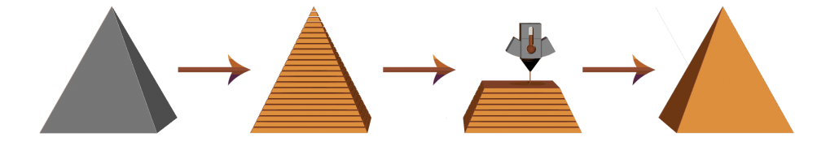
How it works (software)…
3D Object (.STL)
Sliced Object (.gcode)
3D Printing
Physical Object

Slide 21
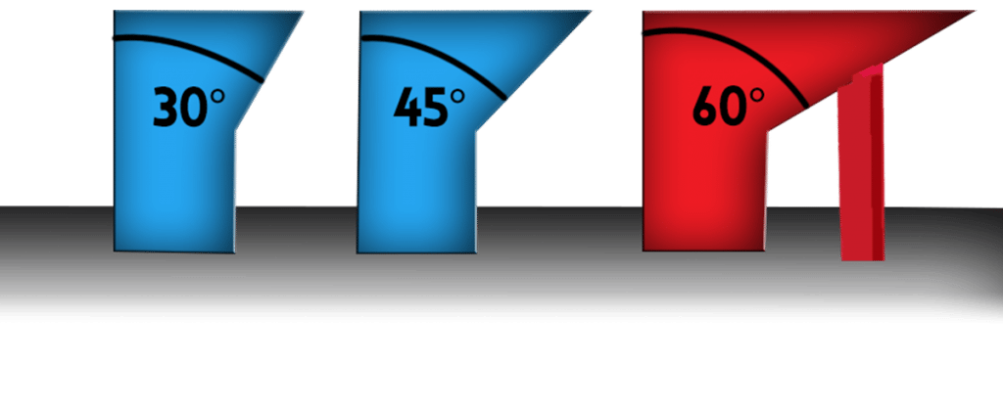
Other things to consider
Are you using supports?
SUPPORT
PRINT BED

Slide 22
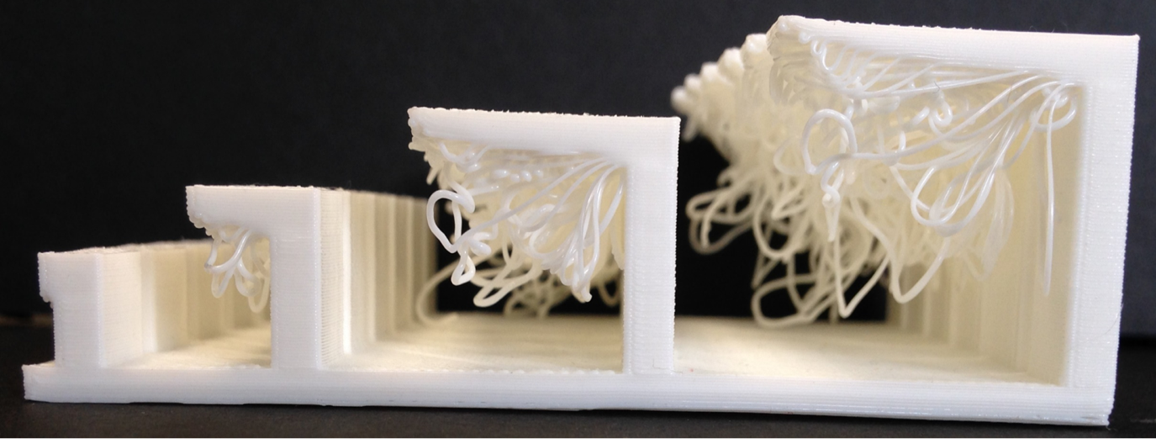
Other things to consider
Are you using supports?

Slide 23
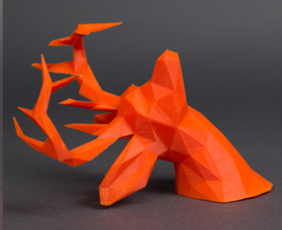
Other things to consider
Are you using supports?
Remember: The more material you are printing, the longer the print will take.

Slide 24
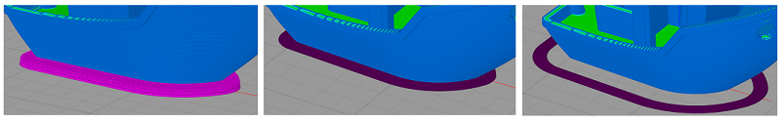
Other things to consider
Are you using adhesion?
It is important that your object not move while printing
  Remember: Precise extrusion plot points in .gcode
Types of adhesion: Raft, Brim, Skirt
3D OBJECT
RAFT
BRIM
SKIRT

Slide 25
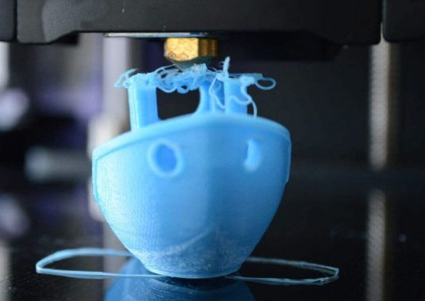
Other things to consider
Print bed is heated to help
Other tips: Use hairspray or glue stick
Adhesion increases surface area of object as it prints
The more material that touches the print bed, the more the object will adhere
Not all print objects need adhesion

Slide 26
Again: The more material that needs to print—including adhesion—the longer your print will take.

Slide 27

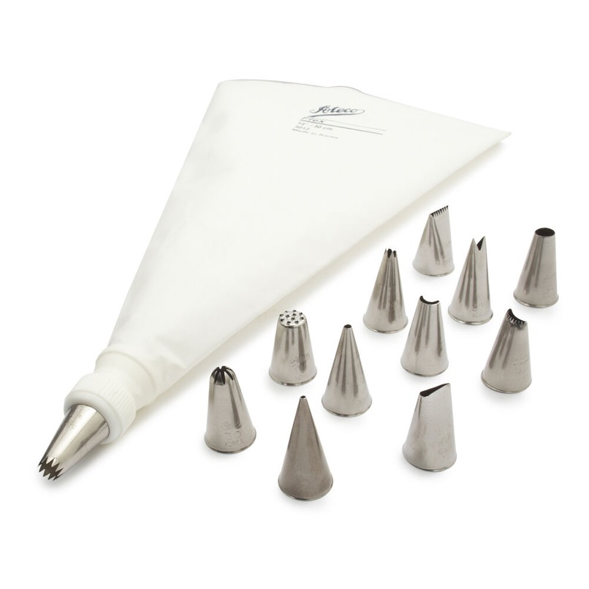
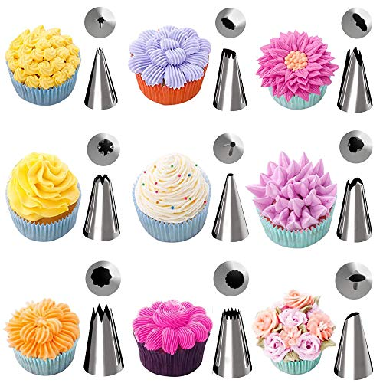
Think of cake frosting…

Slide 28
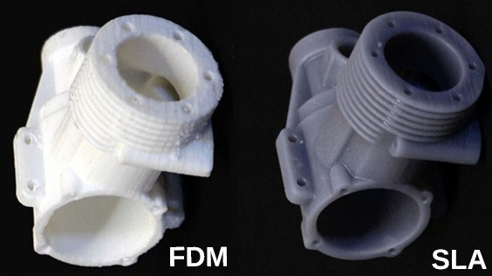
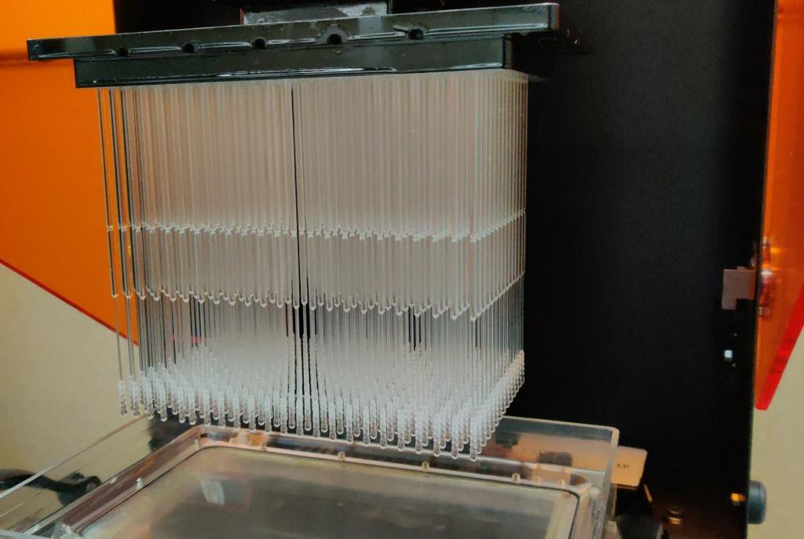
What about SLA printing?
SLA increasingly popular
Uses ultraviolet photocuring liquid resin
Resin used in many applications such as medicine
UV Photocuring is faster and more accurate than FDM
Better for smaller, complex, and high detailed models

Slide 29
What about SLA printing?
SLA printers can be cheaper (Elegoo Mars: $199 vs. $3k) but…
  resin is more expensive ($80+) with;
  more post processing (wash in 99% alcohol + more UV curing)
Resin material requires more care in handling, can irritate skin
Disposal of resin is tricky, will need to coordinate with organization facilities department

Slide 30
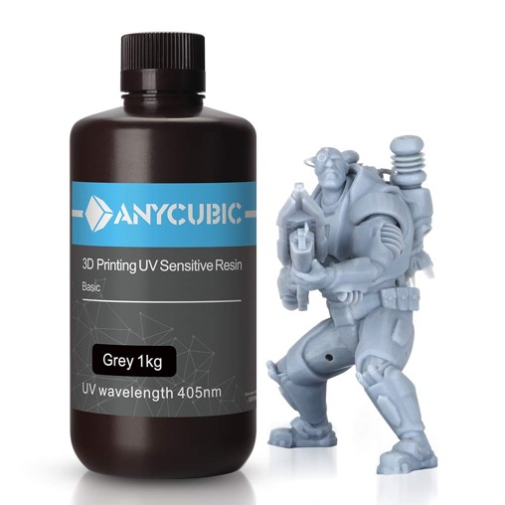
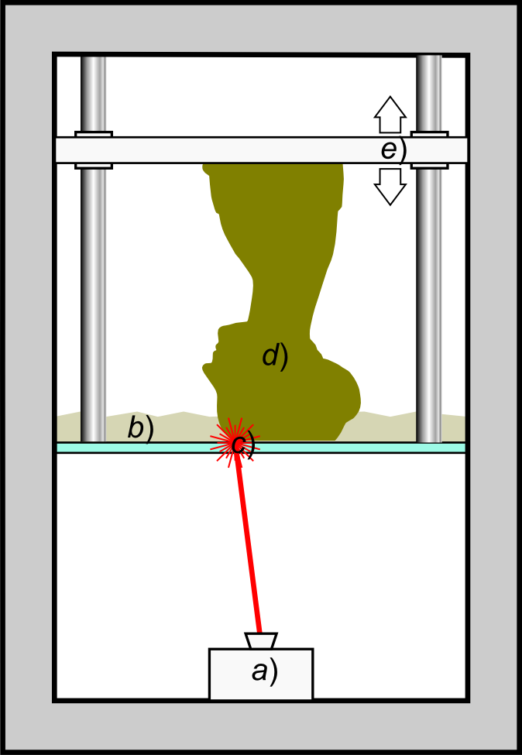
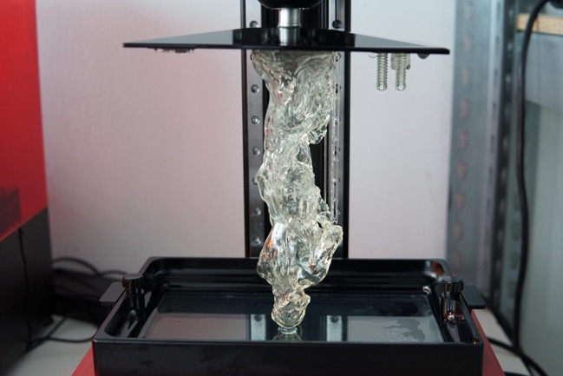
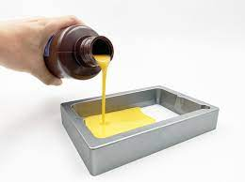

Slide 31
SLA vs. FDM
FDM printers can print larger objects from stronger materials
  4.53” x 2.56” x 5.9” (SLA) vs. 11.7” x 10.8” x 9.8” (FDM)
FDM plastic suitable for majority of 3D print needs
Ventilation not as much of an issue with SLA, self-enclosed chambers

Slide 32
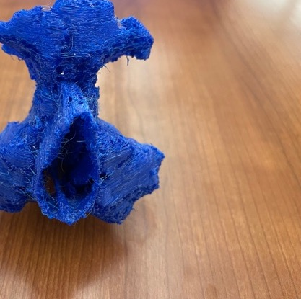
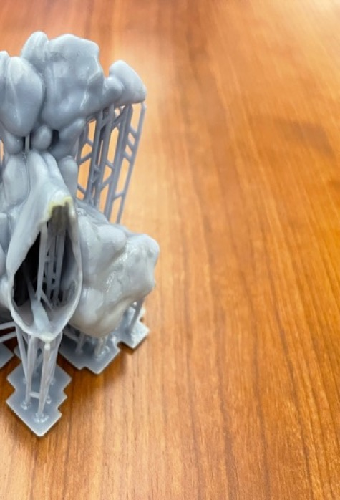
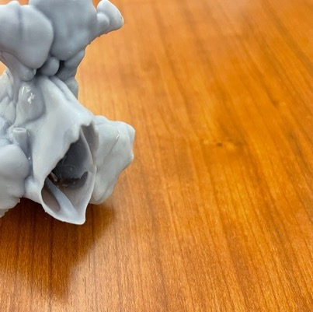
Sent from my iPhone

Slide 33
What is emerging about 3D Printing?
Traditional Design Method:
  Research -> Design -> Build -> Test -> Iterate
Rapid prototyping: Design, build, test, and iterate in real time
Print a prototype fast economically
Iterate and re-print as much as needed
Do not need industrial size manufacturing equipment

Slide 34
What is emerging about 3D Printing?
Build on history of 3D modeling
No major expertise needed
Learning curve for 3D printing is accessible to most with 1 hour of training
3D Printing is discipline-neutral
Can be applied to most subject areas
Traditional manufacturing only available to certain labs or programs
3D Printing helps democratize access to design learning

Slide 35
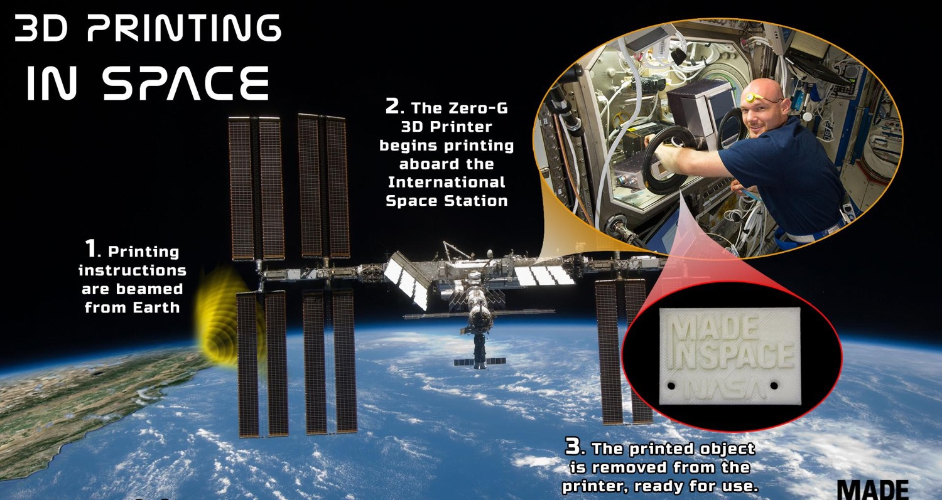

Slide 36
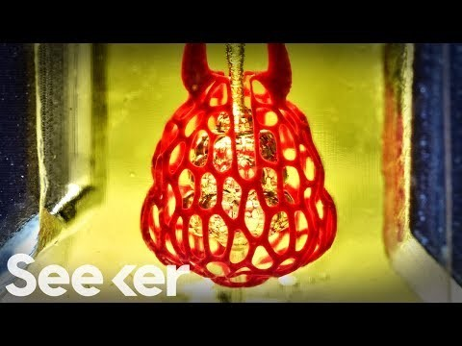
Bioprinting

Slide 37
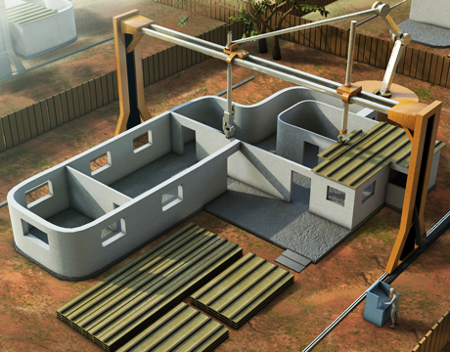

Slide 38
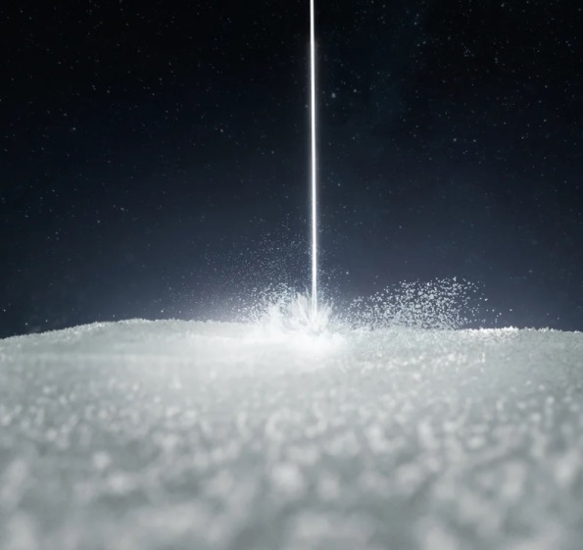

Selective Laser Sintering (SLS)

Slide 39
Remember to register for part 2 of the “The Application of 3D Printing Services in the Academic Library” series.
October 20, 2:00 p.m. CST: Learn about the role of 3D Printing in the Academic Library, see examples from across the nation, and learn tips for how to implement your own 3D Printing service.
Notes:
https://illinois.zoom.us/meeting/register/tZEsduyhpz0pEtEx8wI_St17JKX48uisbQ-g

Slide 40


Thank you

