Slide 1

Application of 3D Printing Services in the Library
Part 2: Role of 3D Printing in the Academic Library and tips for piloting your own 3D Printing service
Professional Development Alliance
Elisandro Cabada, Assistant Professor
October 20th, 2021

Slide 2

Introductions
Elisandro Cabada
  University of Illinois Library since 2000
  Medical and Bioengineering Librarian
  Interim Head, Mathematics Library
  Assistant Professor, University Library
  Assistant Professor, Carle Illinois College of Medicine
  Director, Grainger Engineering Library IDEA Lab
  VR@Illinois Campus Steering Committee
  Health Maker Lab Campus Network Mentor
  Chair, ACRL Digital Scholarship Section, 2021-22
  Awarded 2021 ALA RUSA ETS Best Emerging Technology Application (BETA) Award

Slide 3


Slide 4
The Application of 3D Printing Services in the Academic Library
Part 1: Learn about the hardware and software that drives 3D Printing and learn about what technologies are currently available.

Slide 5
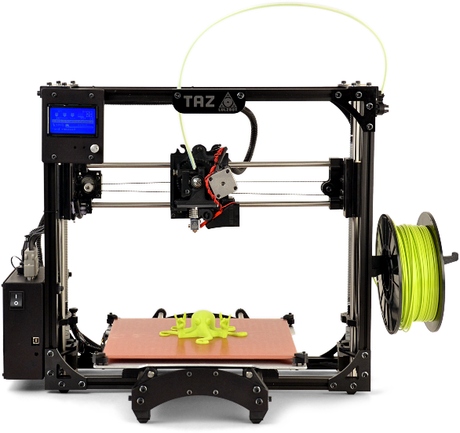
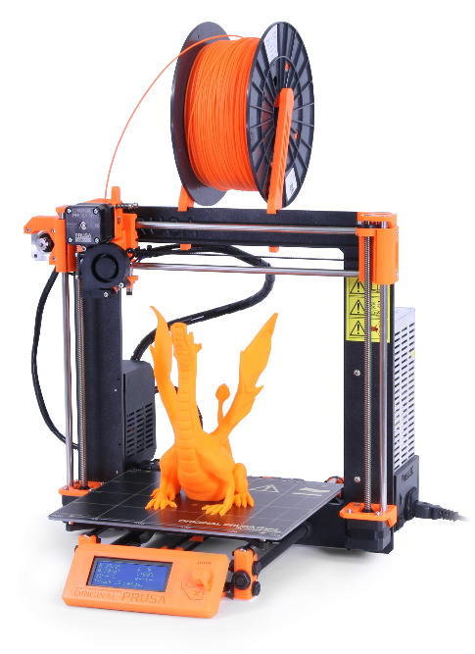
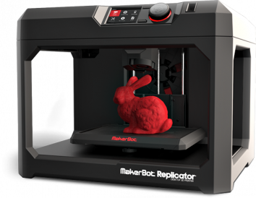
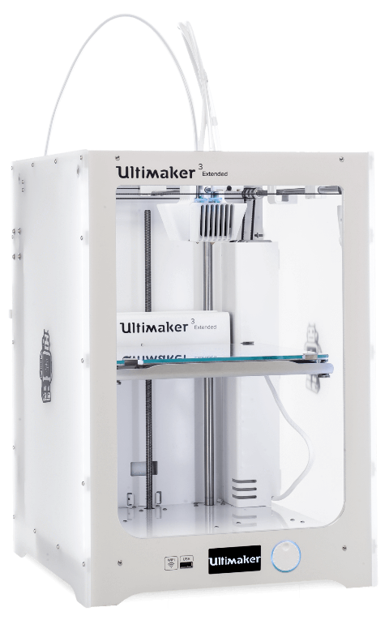
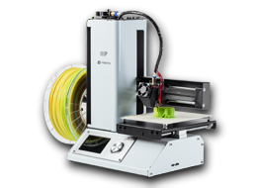
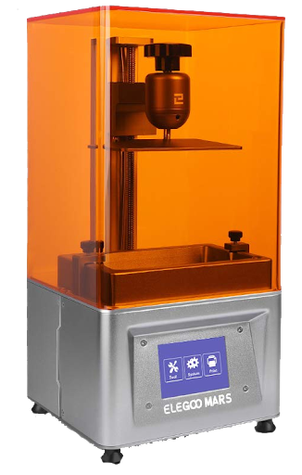

Slide 6
Recap: What is 3D Printing?
FDM most common tech
Uses solid plastic filaments
Thermoplastic (150-160 C)
PLA, ABS, HIPS, NinjaFlex, T-Glase (PETT), LayWood, etc…
Many filaments are biodegradable

Slide 7
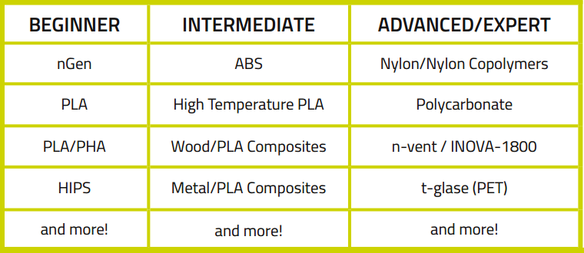
Recap: Most common FDM Plastic Filaments

Slide 8
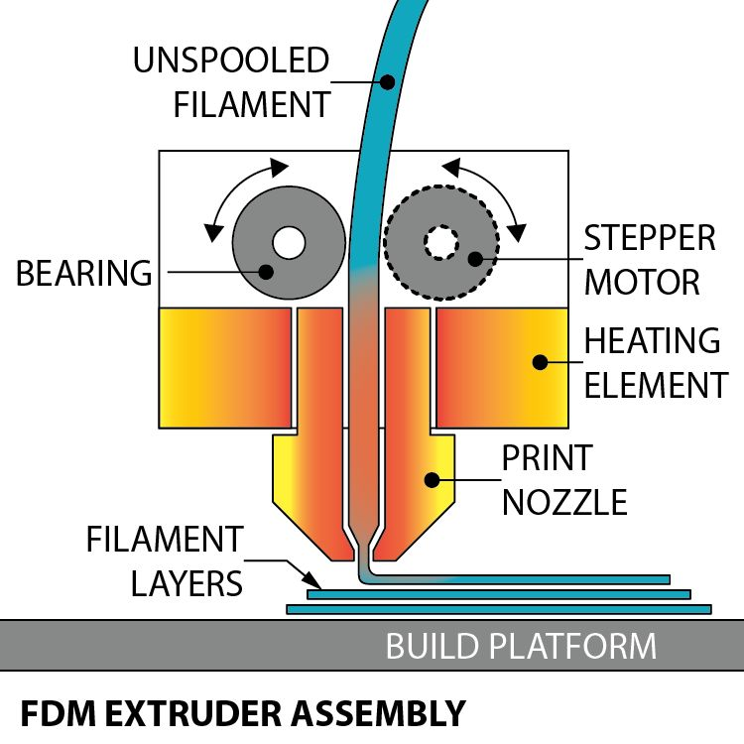
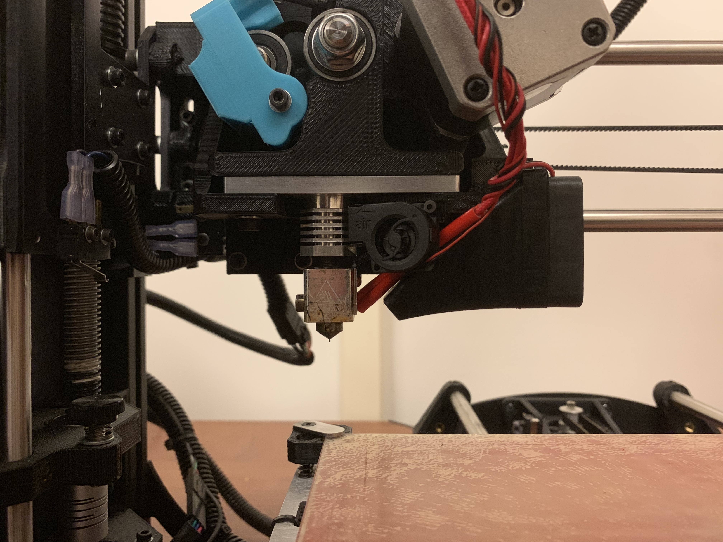
Recap: How it works (hardware)…

Slide 9
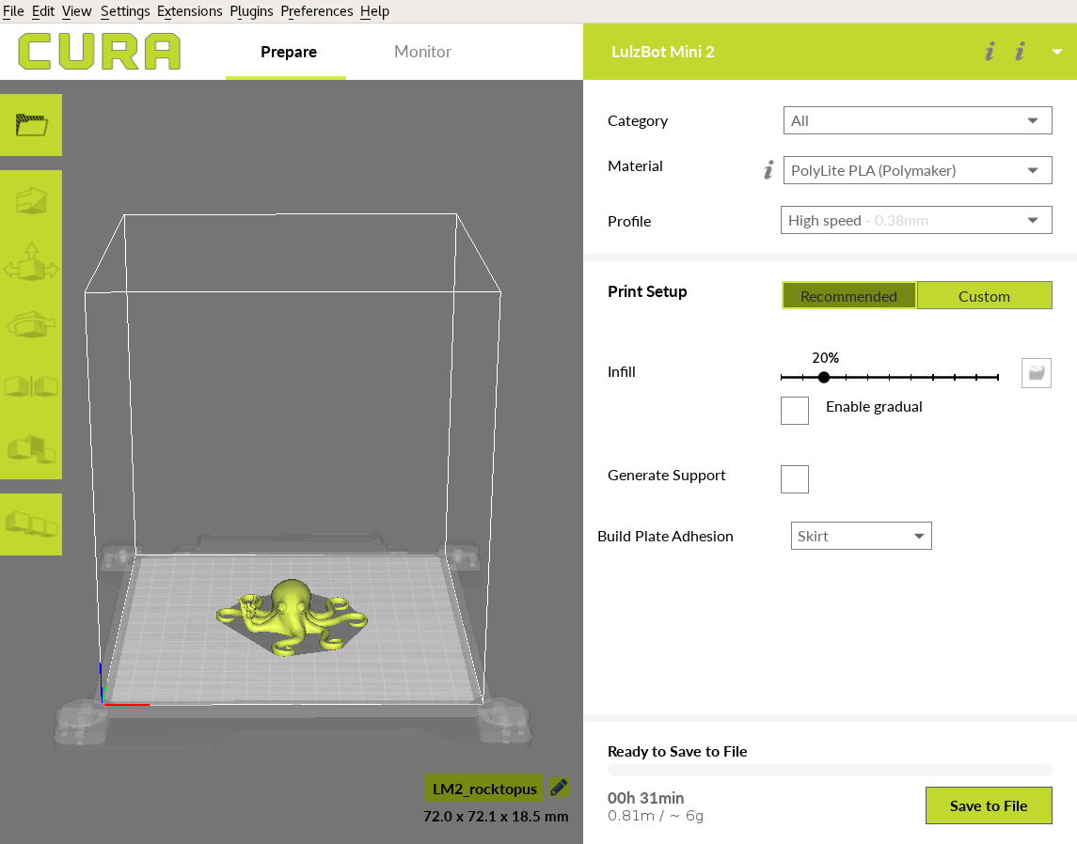
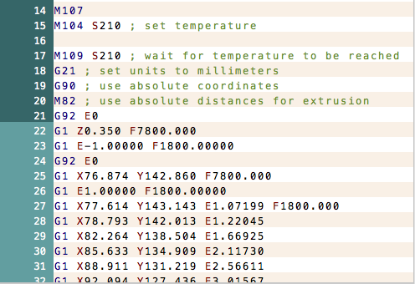
Recap: How it works (software)…

Slide 10
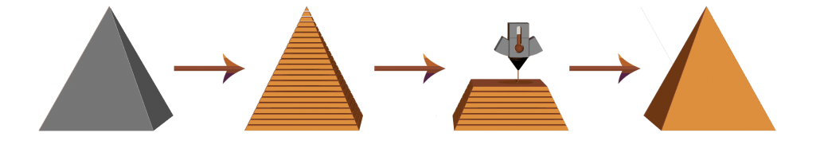
Recap: How it works (software)…
3D Object (.STL)
Sliced Object (.gcode)
3D Printing
Physical Object

Slide 11
Recap: What is emerging about 3D Printing?
Traditional Design Method:
  Research -> Design -> Build -> Test -> Iterate
Rapid prototyping: Design, build, test, and iterate in real time
Print a prototype fast economically
Iterate and re-print as much as needed
Do not need industrial size manufacturing equipment

Slide 12
Recap: What is emerging about 3D Printing?
Build on history of 3D modeling
No major expertise needed
Learning curve for 3D printing is accessible to most with 1 hour of training

Slide 13
Recap: What is emerging about 3D Printing?
3D Printing is discipline-neutral
Can be applied to most subject areas
Traditional manufacturing only available to certain labs or programs
3D Printing helps democratize access to design learning

Slide 14
The Application of 3D Printing Services in the Academic Library
Part 2: Learn about the role of 3D Printing in the Academic Library and learn tips for how to implement your own 3D Printing service.

Slide 15



Why the Library?

Slide 16
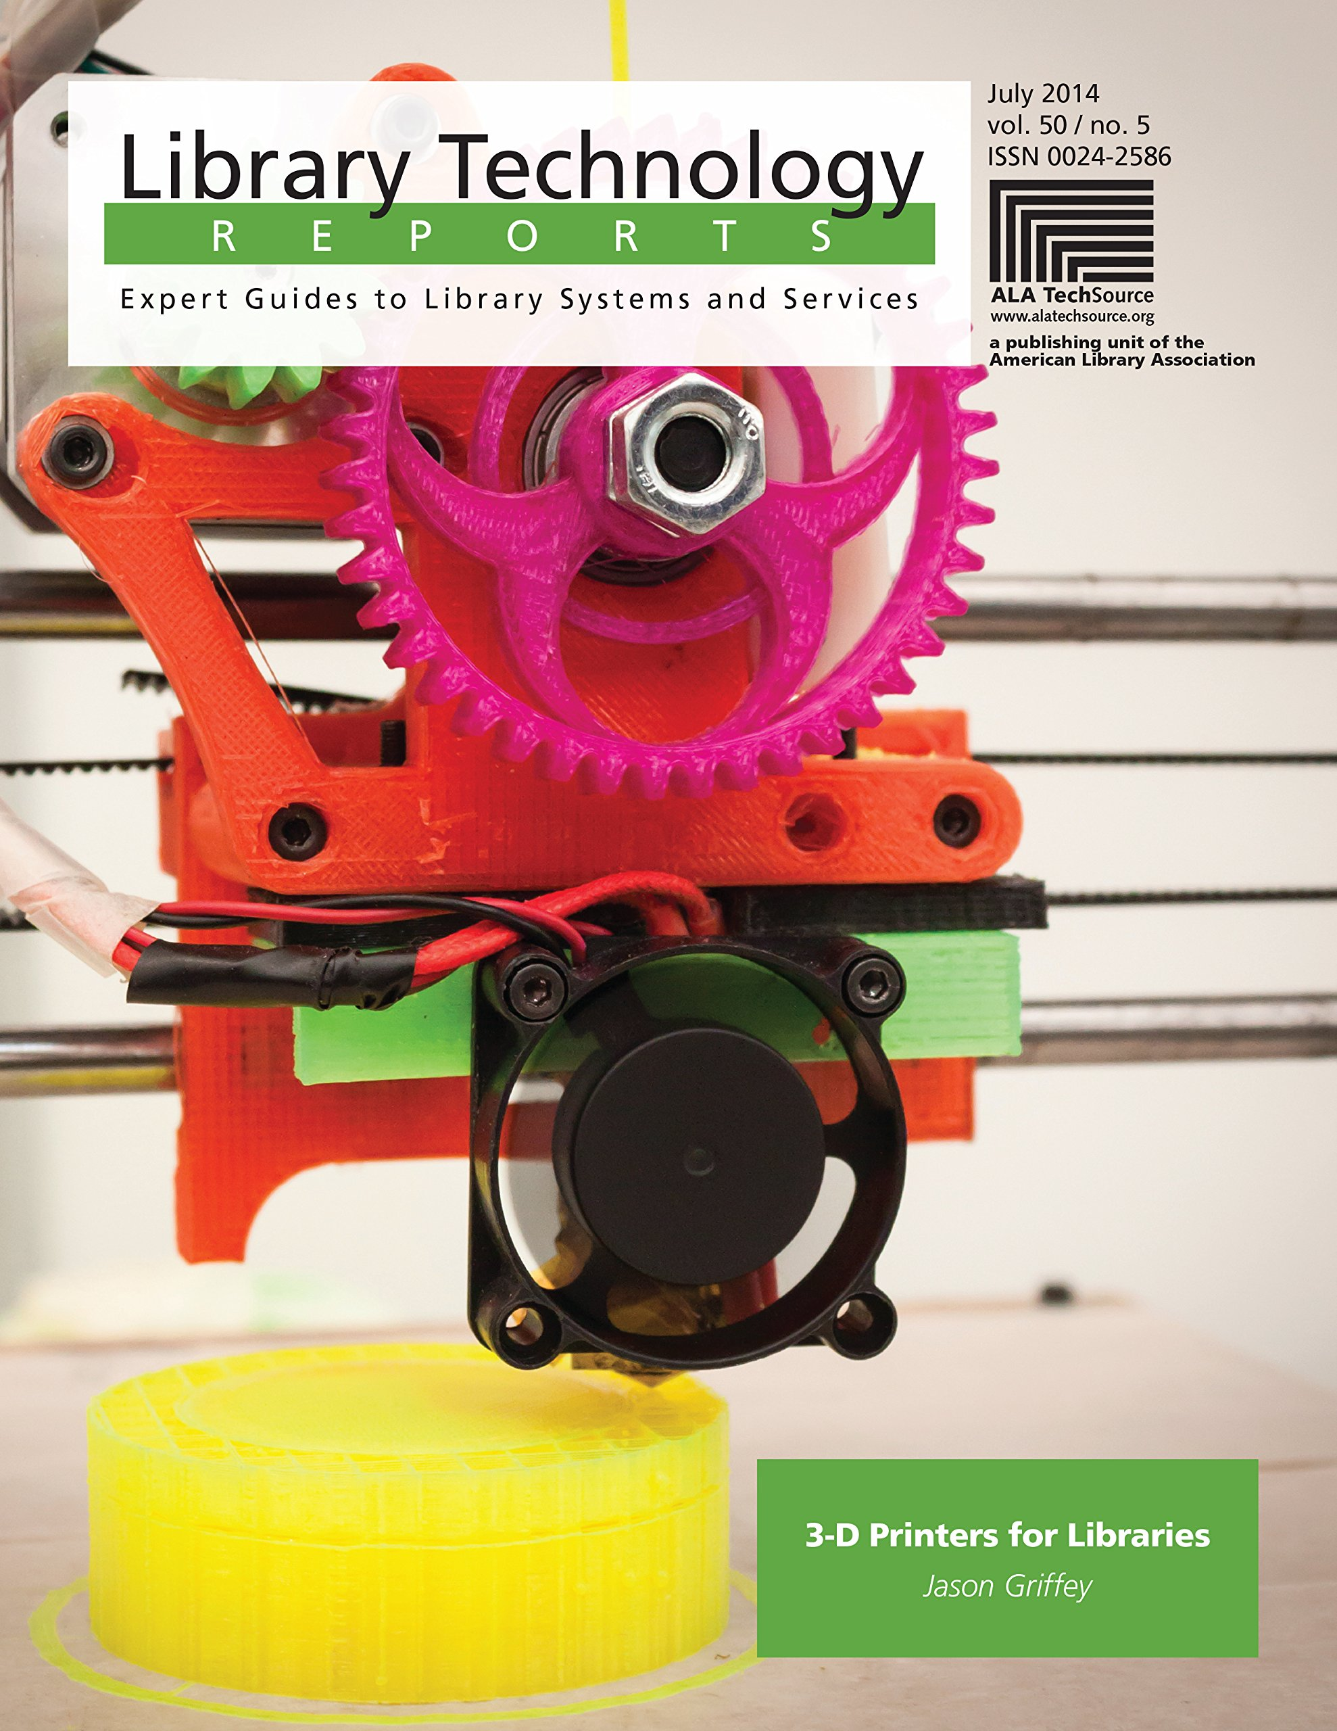
“Why the Library…?”
It is important to be able to articulate why the Library should offer 3D Printing services
Convincing library colleagues as much as anyone else
People will be skeptical about scope creep, succumbing to fads, costs involved, use of space and resources
https://www.alastore.ala.org/content/3-d-printers-libraries

Slide 17

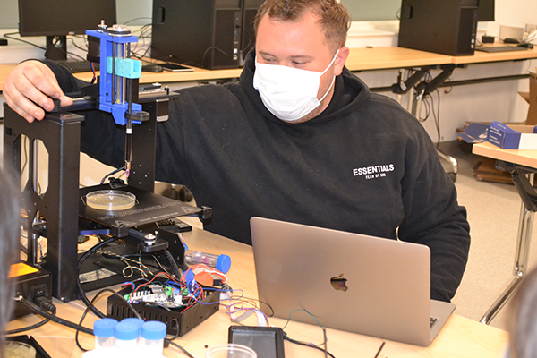
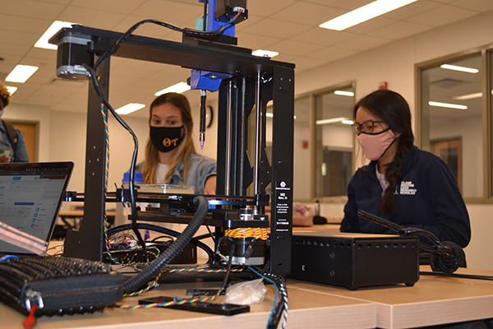
“Why the Library…?”
Most tech-rich spaces embedded in specific academic departments
Some incur costs
Hard to learn equipment without help
Lack of belonging
Many barriers to access

Slide 18
Criticisms of the Maker Climate
Participation in the Maker movement has largely been driven by majority, cis male populations with high levels of undergraduate/advanced degrees and socio-economic statuses
Maker movement has largely been focused on manufacturing, STEM and reaching industry
Without intentional outreach, [maker communities] run the risk of exacerbating a cultural divide
Britton, L. (2014). Examining the maker movement through discourse analysis.

Slide 19
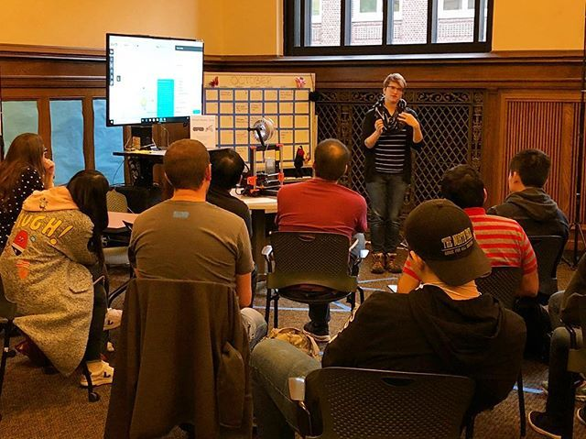
“Why the Library…?”
Library always involved with providing early access to tech (i.e., first public computer labs)
Professional values: Democratizing access to technology
Library last discipline-neutral space for informal learning
Library is safe space to learn out in the open

Slide 20

“Why the Library…?”
Scholarship increasingly borne digital and reliant on emerging tech
Library now involved in full cycle of knowledge creation
Understanding of emerging tech is information literacy
https://doi.org/10.1080/01616846.2015.1106888

Slide 21

The following are recommendations based on my own experiences.
Please learn from my mistakes.

Slide 22
There are three pillars to every successful technology space or service
Technology
“the stuff”
Expertise
How to use
“the stuff”
Community
Who uses and has
access to “the stuff”

Slide 23




Recommendations
Start small
Remember, it will take time
  … so celebrate the small victories.
Find early partners and start with the easiest cases
The more innovative opportunities will come in time
Contact your campus curriculum & instruction program, campus IT department, college & department IT groups

Slide 24
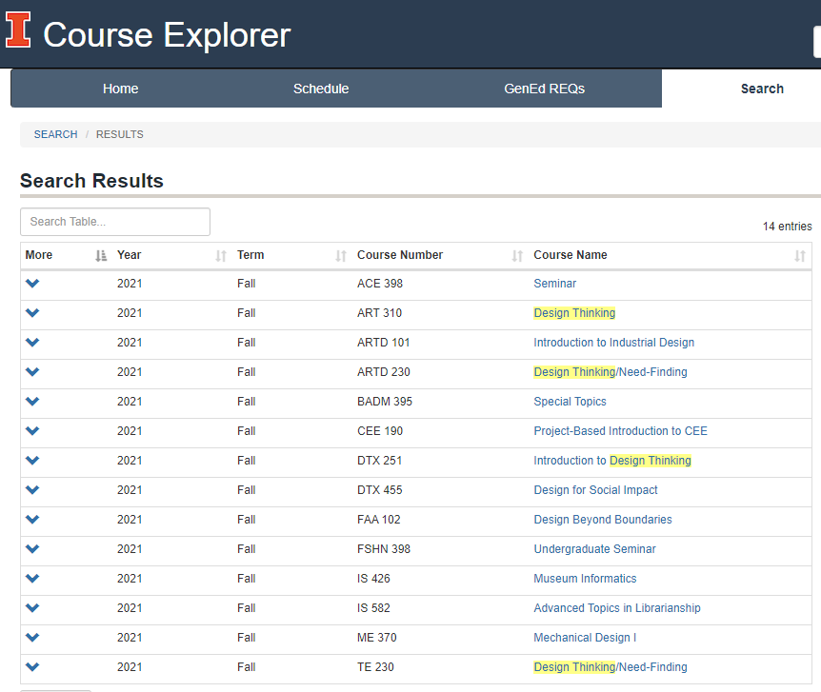
Recommendations
Search your course catalog for easy use cases:
  Senior Design or Capstone
  Design Thinking
  3D Printers/Printing
  Additive Manufacturing
  Prototyping
  Design, Innovation, or Entrepreneurship

Slide 25

Is it a fad?
Search for 3D Printers at your institution, you will be surprised how wide spread they are.
30 out of 40 Community Colleges in CARLI had 3D printers available to students

Slide 26
What about costs?
3D Printers are self-contained, no additional equipment is necessary. Most range in cost from $200 to $3000.
No structural changes needed to accommodate most 3D printers
Material cost about $20-$30+
Most institutions already have access to 3D modeling or design software
Can get free 3D models online (i.e., Thingiverse, Thangs, Pinshape)

Slide 27
Equipment Recommendations
Look for a 3D Printer with:
  ease of use
  (relatively) affordable cost
  adequate print size volume
  light and portable
  auto leveling
  good reputation

Slide 28
Equipment Recommendations
Meet the Original Prusa i3 MK3S+
MSRP: $999 (pre-assembled) or $749 (kit)
Get pre-assembled, don’t start your relationship off on wrong foot
Meets all criteria for a good printer
Build volume: 9.84"×8.3"×8.3"
https://shop.prusa3d.com/en/51-original-prusa-i3-mk3s

Slide 29
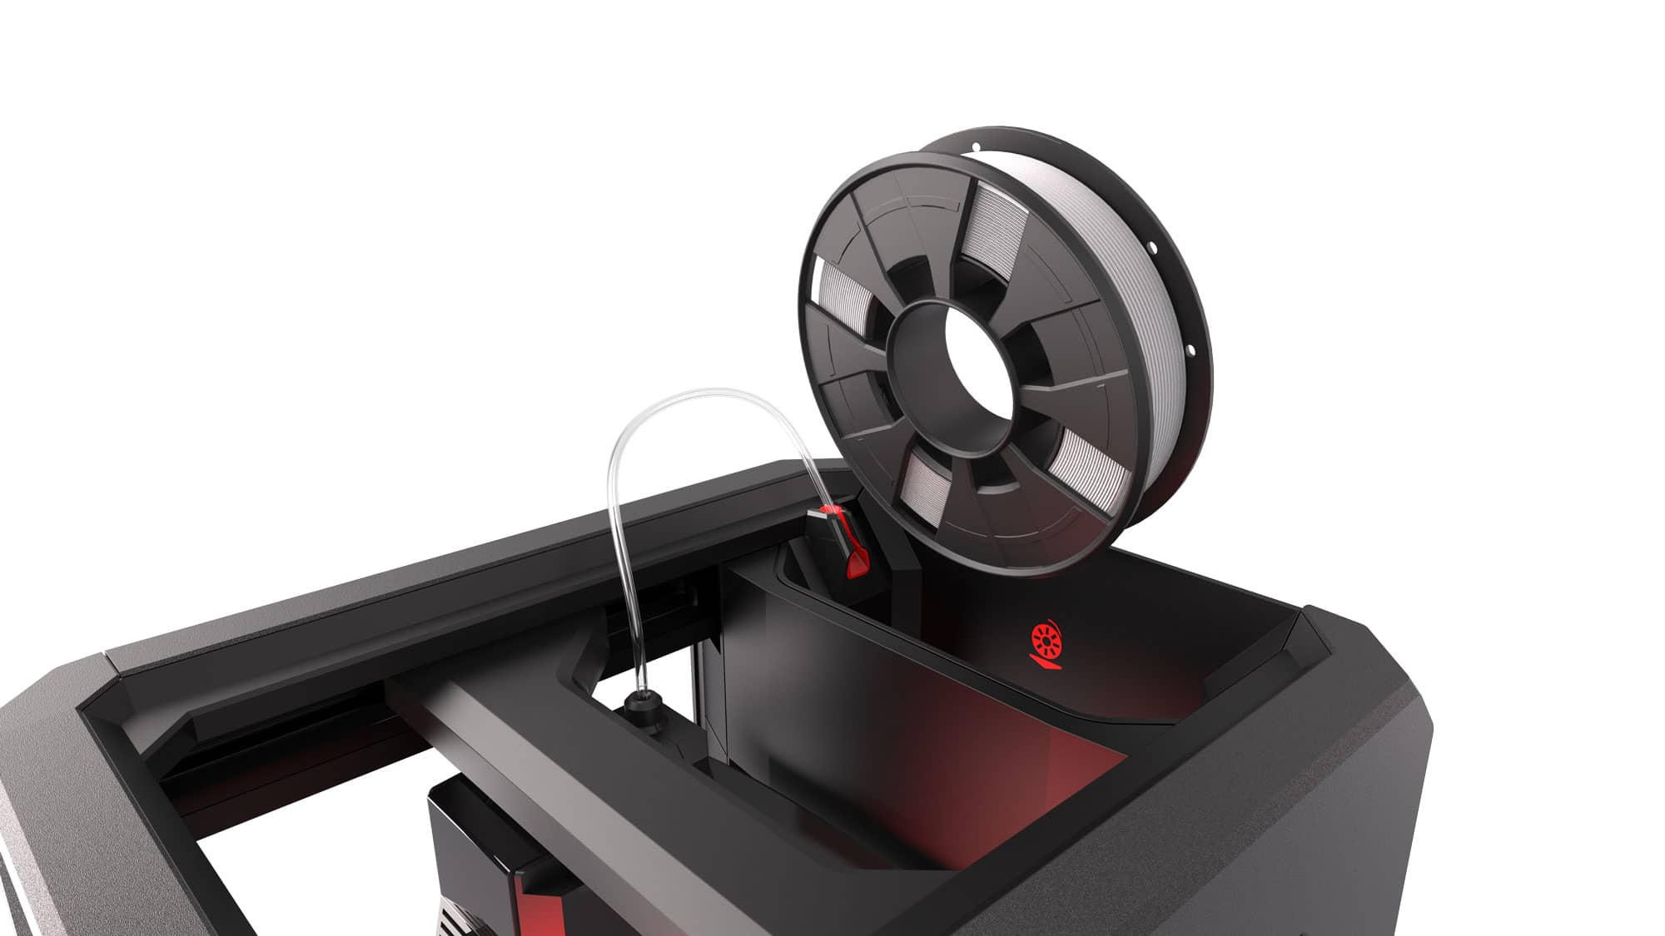
Equipment Recommendations
Be careful with upsells
Machines with dual/multiple material extrusion
Machines that can print exotic/more advanced materials
Machines that require proprietary filament spools

Slide 30
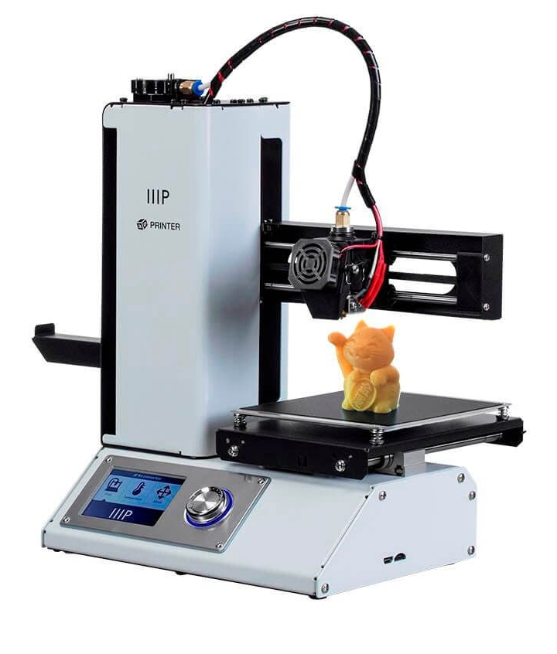
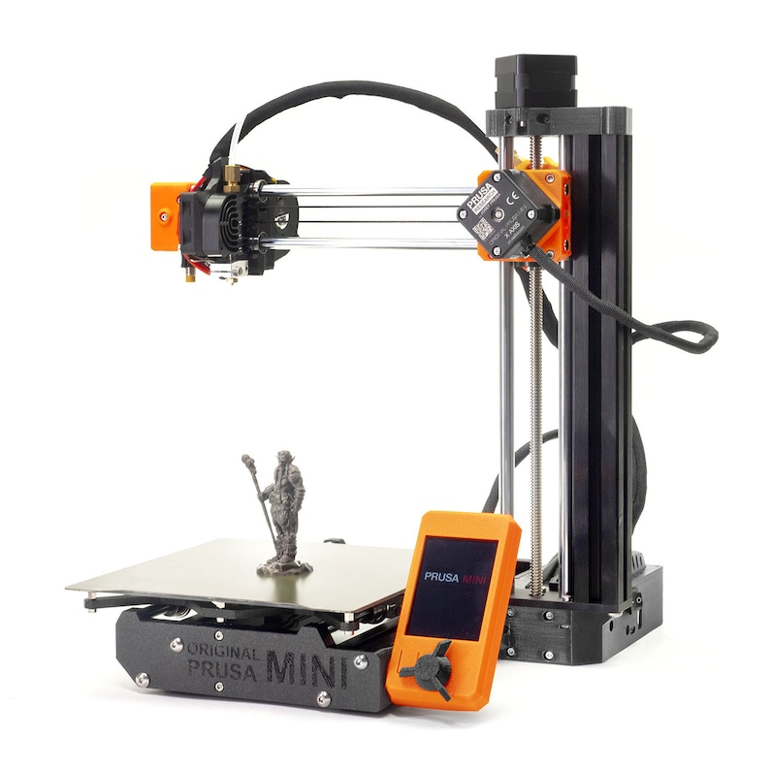
Equipment Recommendations
Most are nice features but you will not need them for several years or for most use cases
Do not settle for a small form factor printer, they are recommended for beginners
Price is nice ($149 to $399)
But build volume much smaller
Not meant for production, lower end of hobby level, take a lot of hands on time to keep running

Slide 31
Equipment Recommendations
In a year after you wish you had a larger print volume or better printer, you will thank me
Remember to start off small… get 1 printer at beginning.
The more your initial investment, the more stress or pressure you will place on yourself
1 good printer offers you plenty of capabilities to start with
You will want to add 2 or more within a year if you are printing more, spread out wear and use amongst several

Slide 32
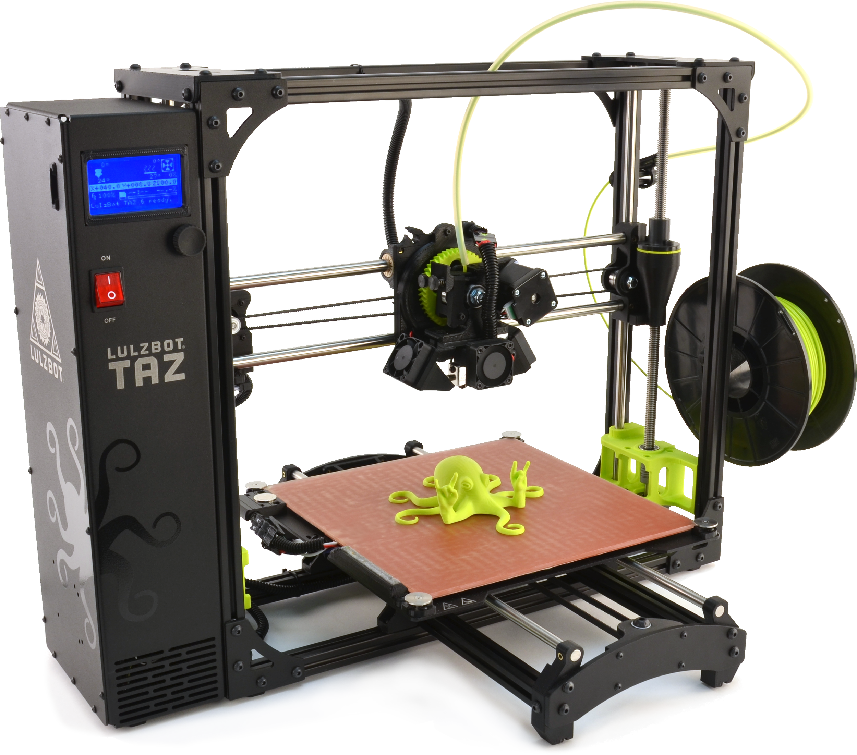
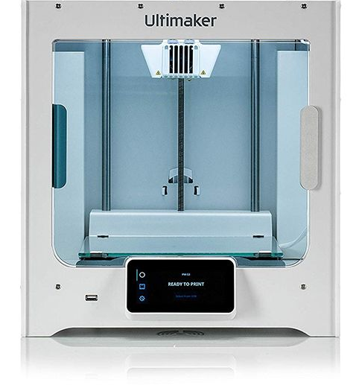
Equipment Recommendations
Plenty of other good printers out there (but will cost more)
Features that cost more will not used for most use cases at beginning
Chances are someone else on campus already has these
You want to fulfill the ease of use and low cost of access needs at your institution
Taz 6: $2500
Ultimaker S5: $6355

Slide 33
Materials Recommendations
Can get plenty of filament on Amazon
Go with a reputable supplier like Sunlu, Hatchbox
Aim for PLA in $25-$30 range
You get what you pay for, cheaper may mean lesser quality
Buy enough supply to test and offer free prints for a semester (to get buy in)
$300 will get you about 10 spools or 10 kg’s of material
Enough for 50+ prints using standard settings

Slide 34
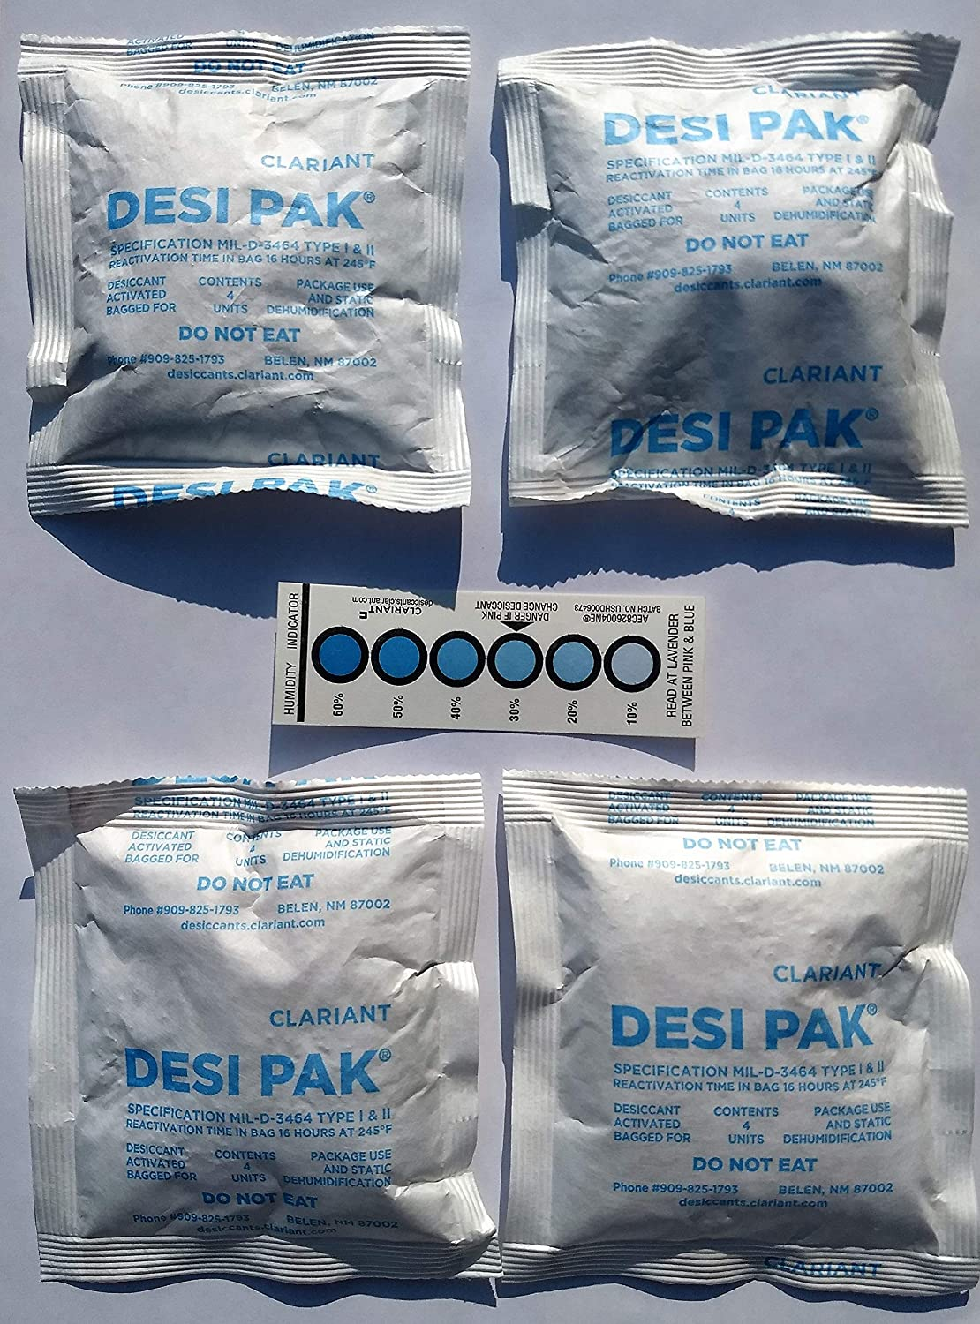
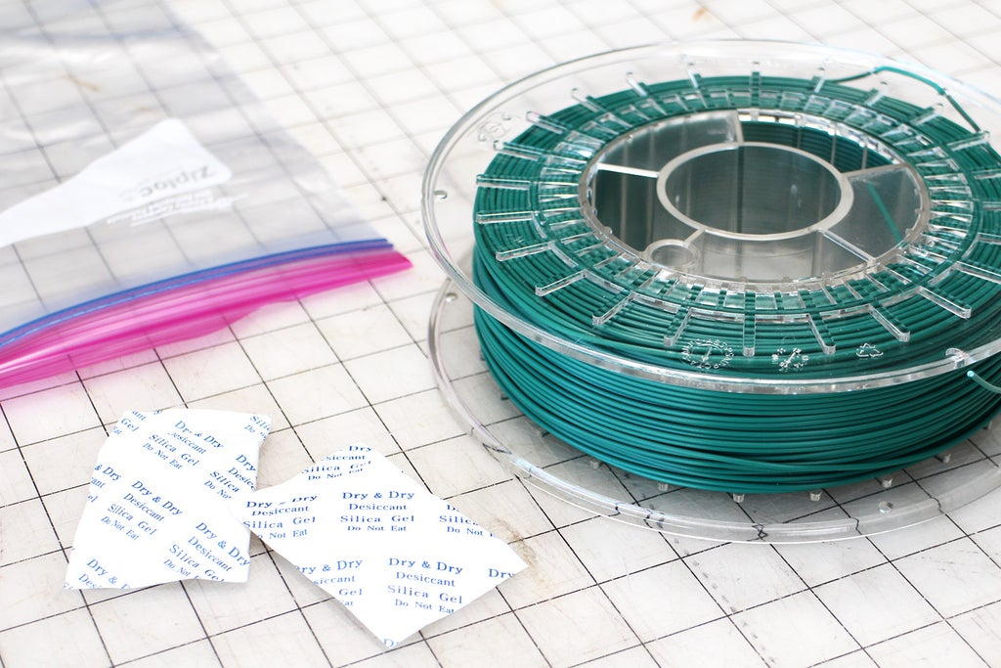
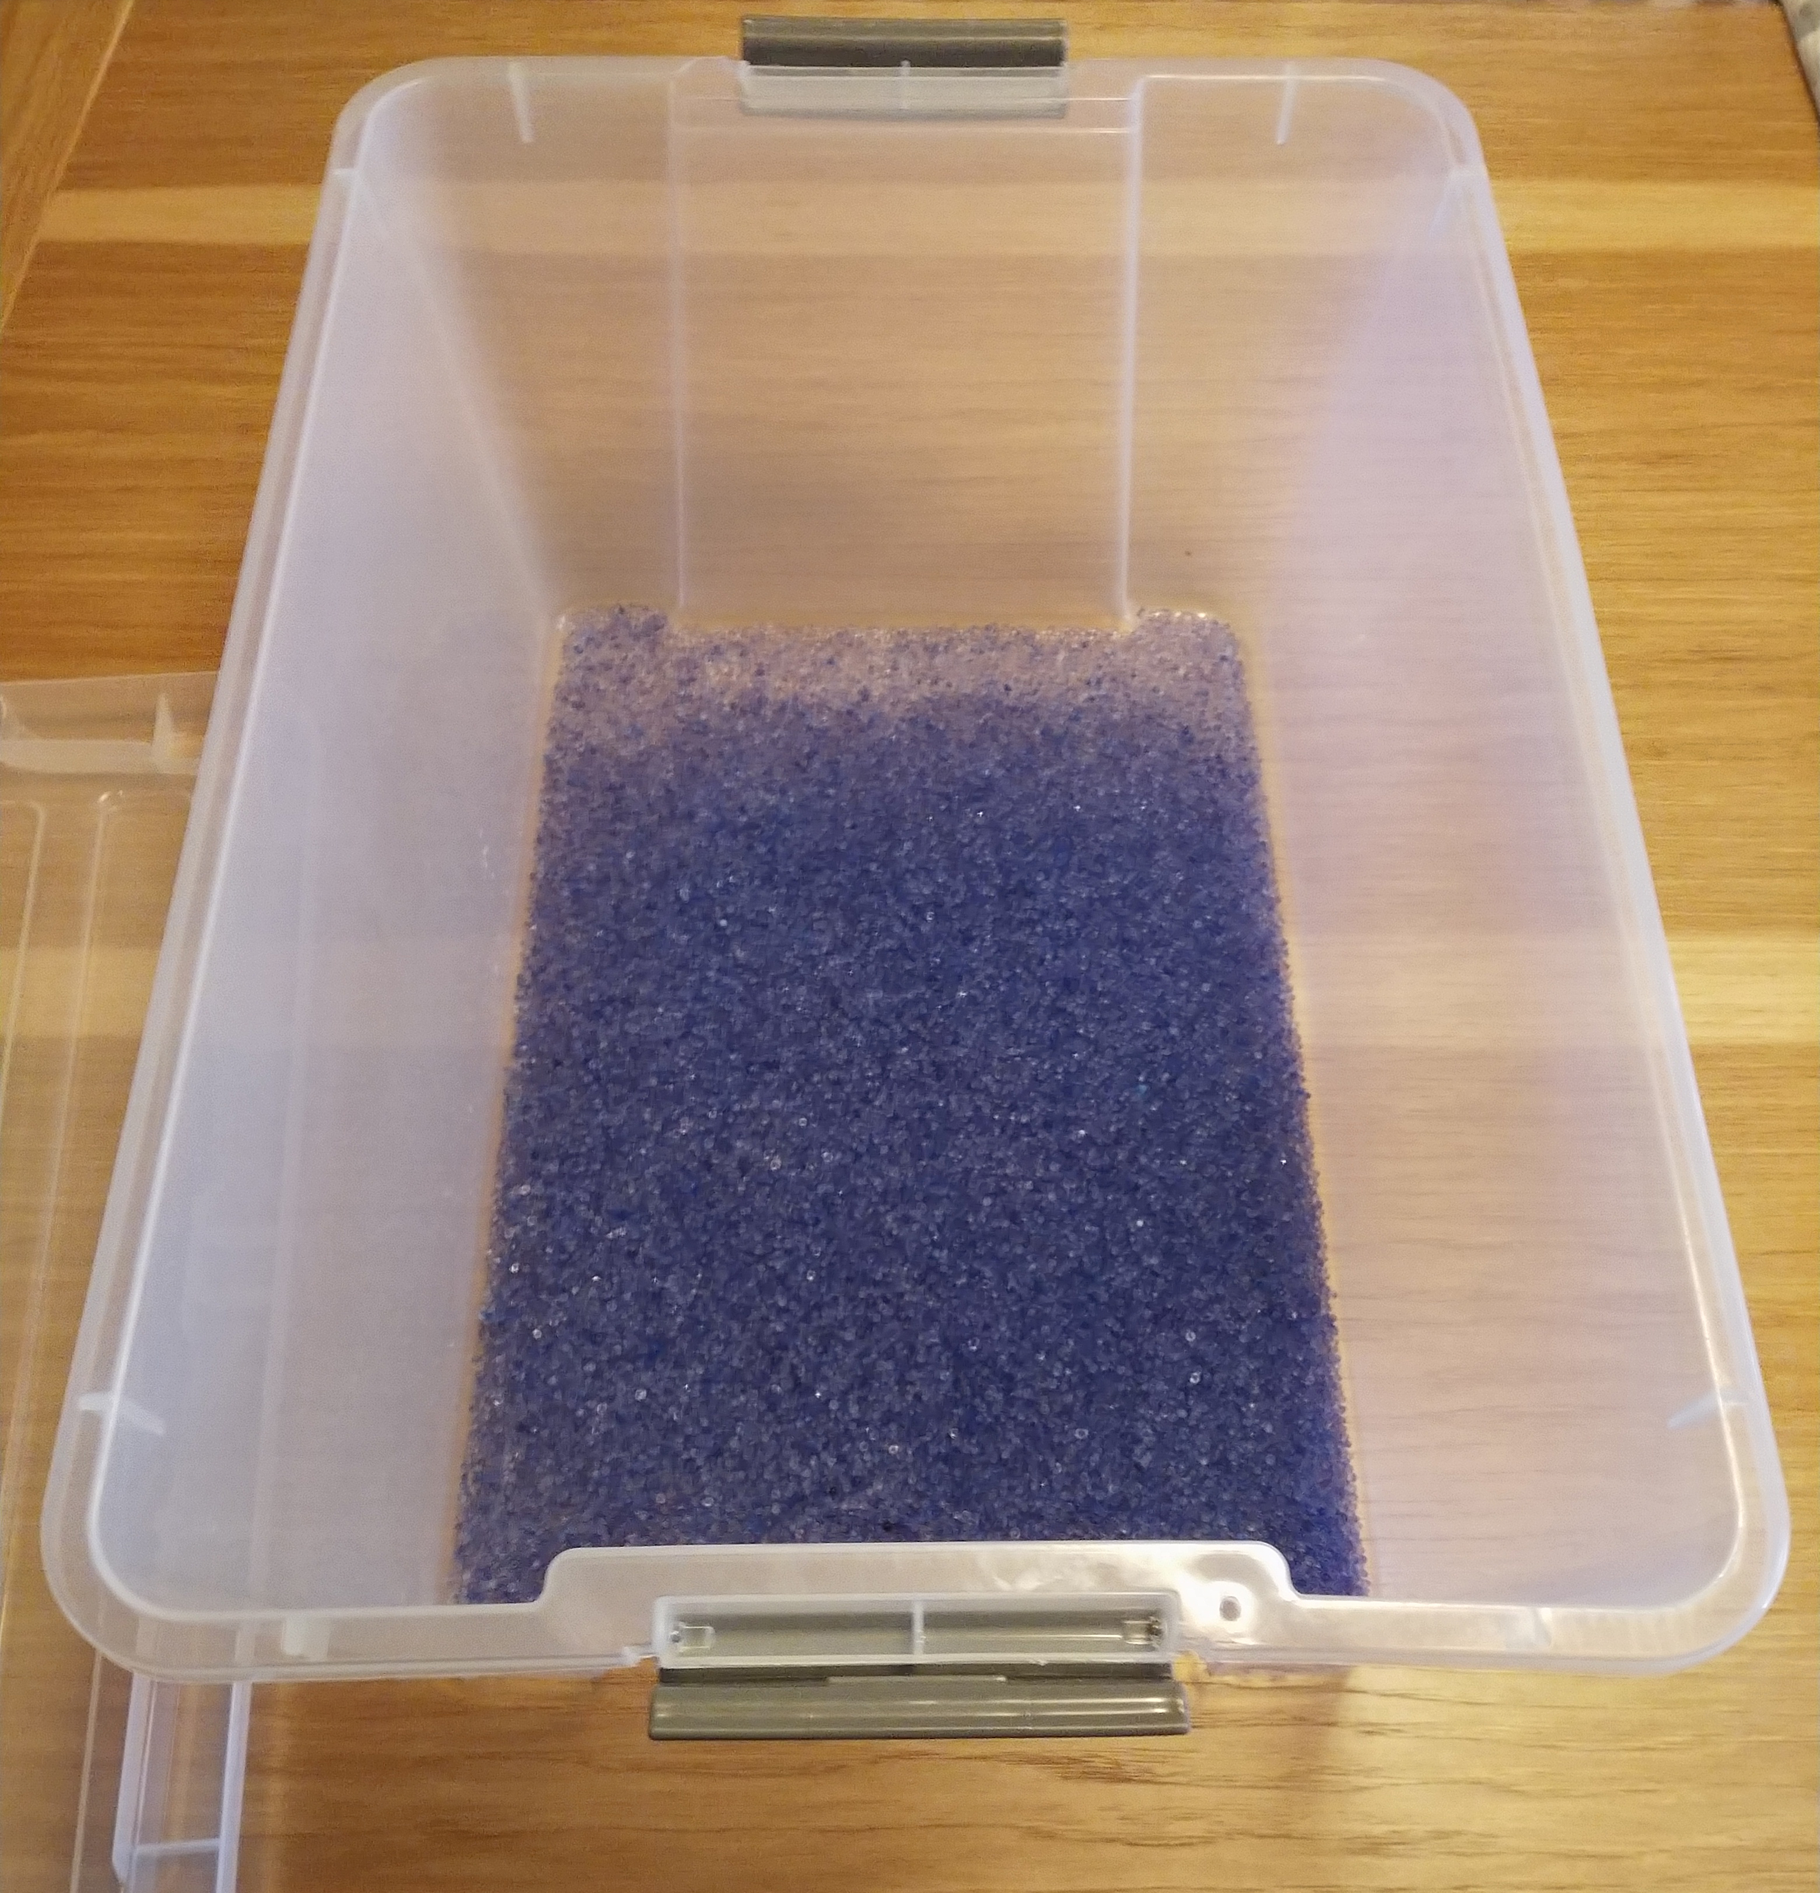
Materials Recommendations
Filament does not react well to humidity
Keep filament in sealed storage bags or sealed bins filled with desiccant

Slide 35
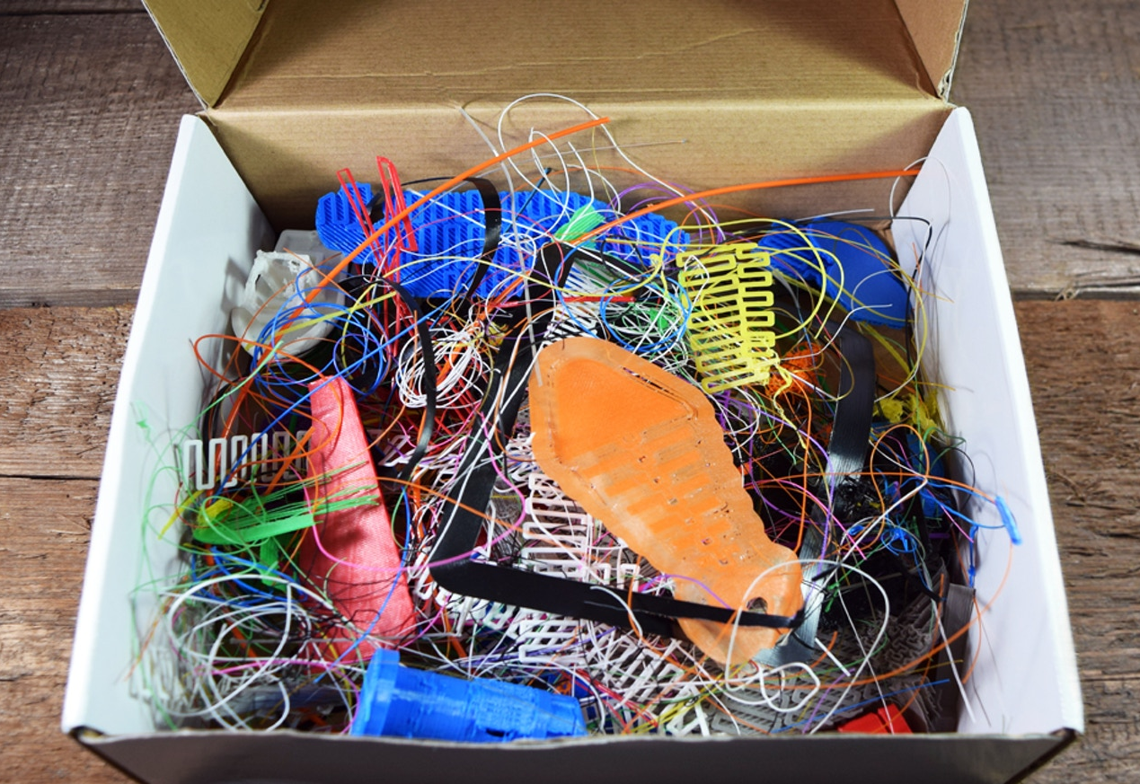
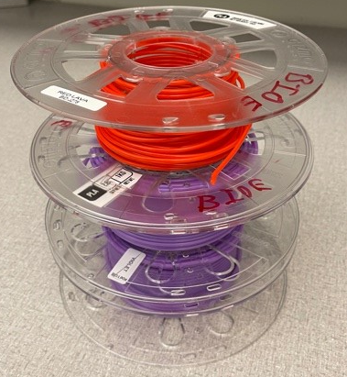
Materials Recommendations
There will be a lot of waste per spool (i.e., failed prints)
Usually do not end up using entire spool
Be prepared to waste 20%-30% of a spool
Really no way of avoiding it

Slide 36
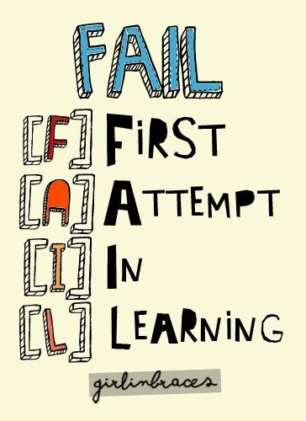
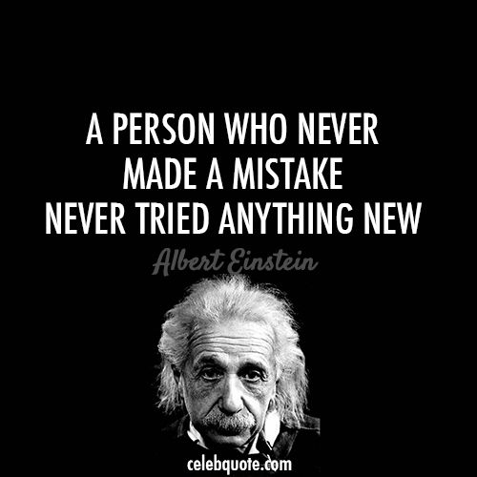

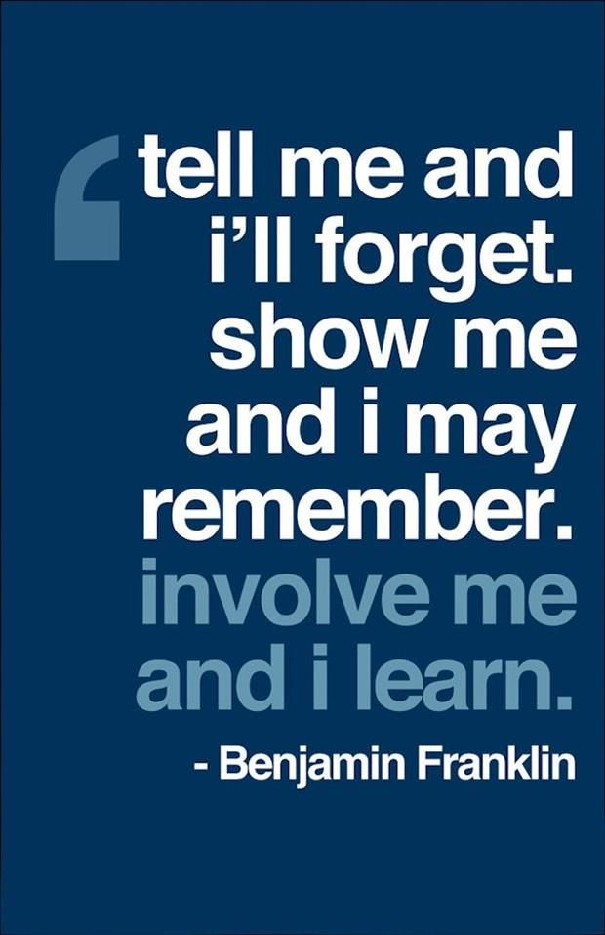
… about failing.
3D Printing is an art form.
Some variables out of your control
You can print same thing twice with same settings and get different results!
Celebrate your failures, no great idea happened without a lot of failing happening first so fail forward.

Slide 37
Pricing Model
Many pricing models when you are ready to charge
Revenue generating or cost recovery?
Sample: $4 base cost + .10 per gram of material per printed object
  Adjust this until you are comfortable with what you are charging
  Are you wanting to recover costs of materials or staff time also? (That is primarily what “base cost” is for).
  150g – 200g printed object would cost: $19 - $24
  1kg spool would generate >$100

Slide 38
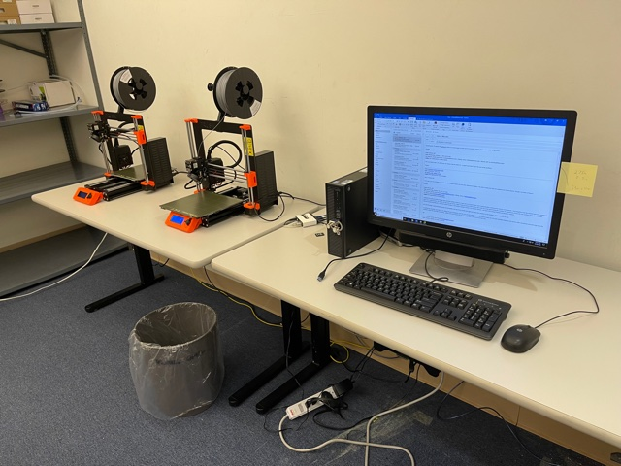
Space needs
3D printers are largely self-contained, you only need a simple workstation to load the slicing software
By sticking with PLA, you don’t need any infrastructure changes
More advanced materials may require fume hoods
Need a table with power available nearby and some space for your filament

Slide 39
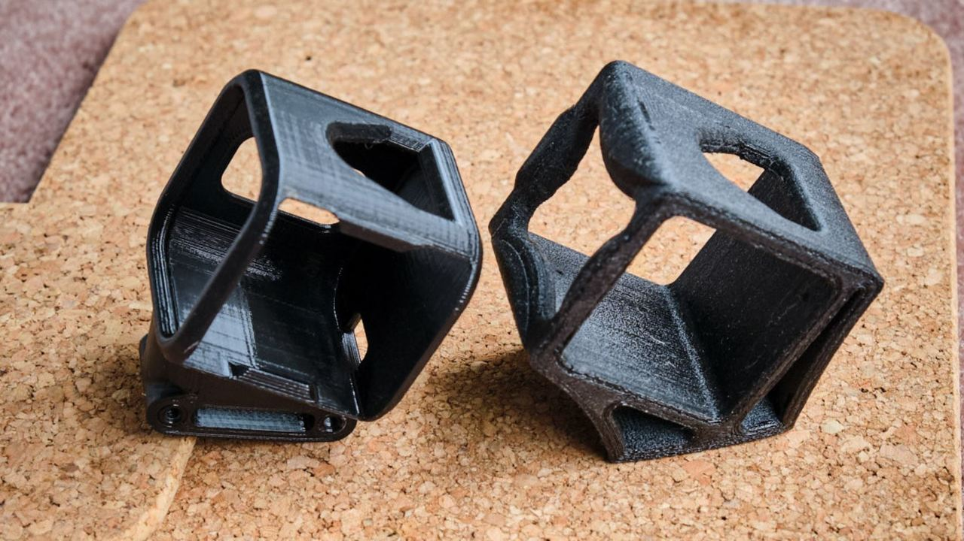
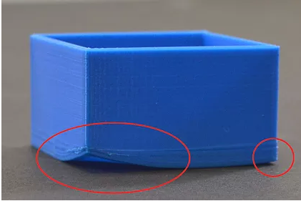
Space needs
You can keep printers in an enclosed room or open space
Need to keep printers at comfortable room temperature (62-68F)
  Too hot = humidity causes filament to swell
  Too cold = 3d print comes off print bed prematurely

Slide 40
Space needs
Most printers not “loud” but make constant noticeable sounds
Best to keep them in enclosed rooms or in spaces with a lot of ambient noise

Slide 41
What about staffing?
Learning how to use a 3D printer for first time?
Figuring it out on your own can be overwhelming, equipment manual wants to tell you EVERYTHING
3D Printer looks and feels very complicated
Best to find someone to guide you through using it
They can tell you what you absolutely need to know at beginning
Everything else comes slowly overtime and as you need it
Can learn machine in about an hour this way

Slide 42
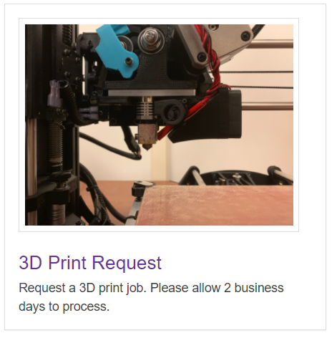
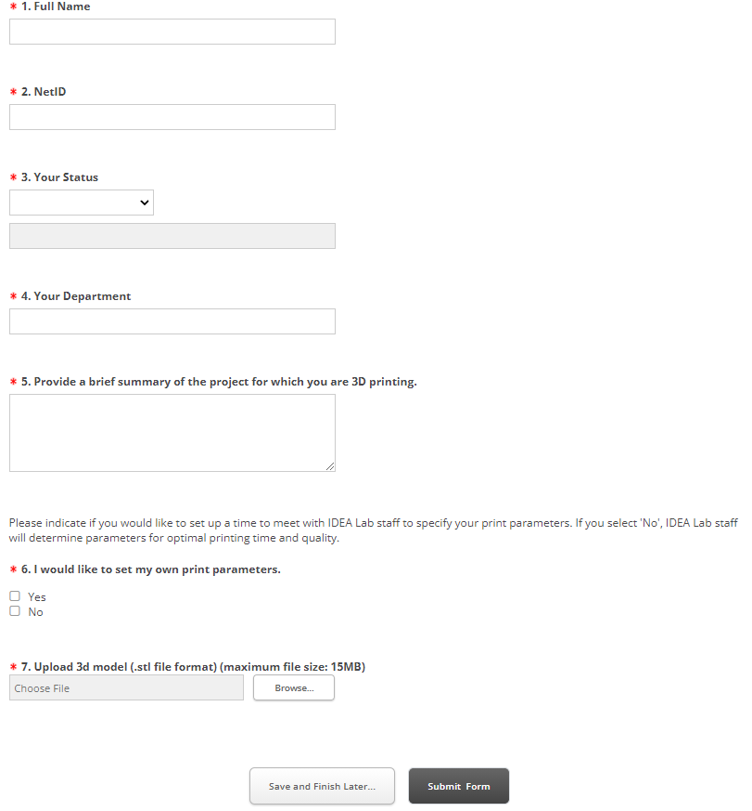
What about staffing?
Use a simple web form for users to submit print jobs
Use a simple sharable spreadsheet to track what is being printed
Don’t make it too complicated, just adds more steps without giving you much more benefit

Slide 43
What about staffing?
Maintaining and processing print jobs can take about 2-3 hours a day, 2+ days a week on a bad day or week
Usually about 3-4 hours a week at most at beginning
Once you learn equipment, teach others! Encourage them to print something fun, best way to learn
Have student workers? They are a great resource for 3D printing
Consider peer-to-peer learning, students may be more comfortable learning new tech from their peers

Slide 44
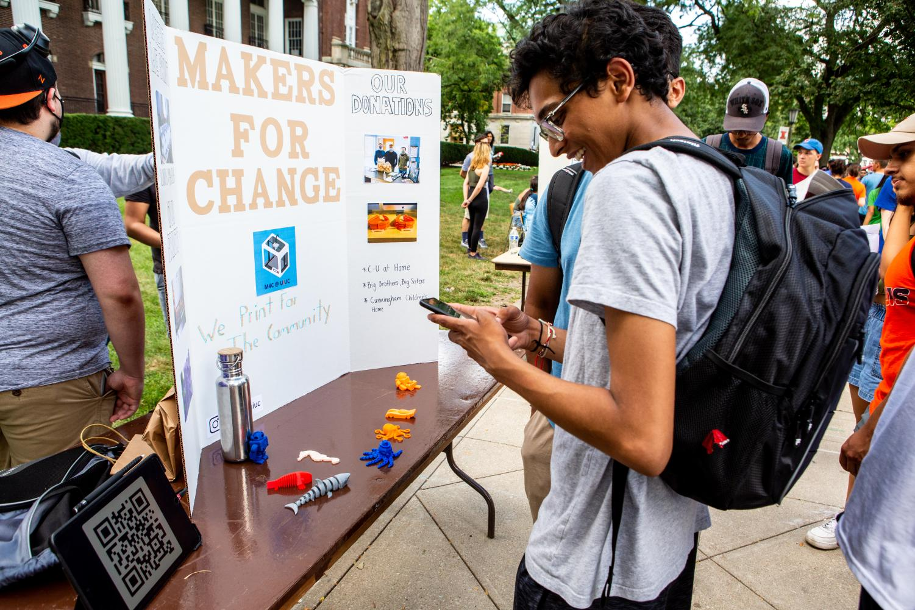




Don’t forget Community
Look for student organization partners
Students love using library space
Sell that the library is high traffic space, usually open longer hours than other campus buildings

Slide 45
Don’t forget Community
Student groups can help staff your space, help walk-ins use equipment
Help promote your space/services, become your champions
Nothing beats word of mouth marketing

Slide 46
Programming
Partner with student groups to put workshops together on 3D printing
Market these specifically for beginners:
“Come and learn how 3D printing works, get hands on experience with the equipment, and see examples of objects printed with our 3D printers. This session is for beginners with little or no prior experience with 3D printing.”

Slide 47
Programming
Promote sessions for fun as well as for class projects
Market sessions on social media and email newsletters
Prepare for a class
Just to learn
Work on a project
Have fun
Add skill to resume

Slide 48
Programming
Give participants surveys at beginning of workshop
Will give you much needed data and an idea of who you are reaching

Slide 49
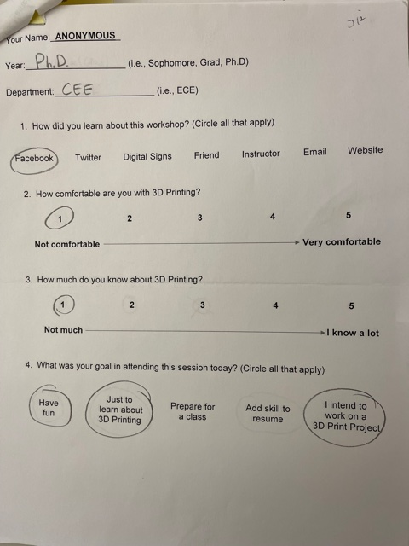
Sample Surveys
Give survey before workshop begins
You are usually busy setting up or are waiting on late comers anyway
Best to have someone help you pass them out so you can do other things
Email same survey questions after session and compare results

Slide 50
Programming
Have a sign in sheet including name, department affiliation, status, and email address
Gives you attendance data but you can also use it to send after session survey
Consider giving participants free print job as a reward, you can use attendance sheet as a log of who attended to track who got their free print job
Good way of getting participants to come back

Slide 51
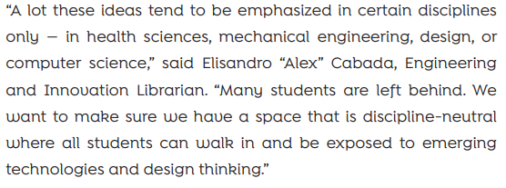
Programming
Promote values of space and service
  Democratizing access to emerging technologies
  Breaking barriers to access
  Engagement and outreach to underserved and underrepresented communities

Slide 52
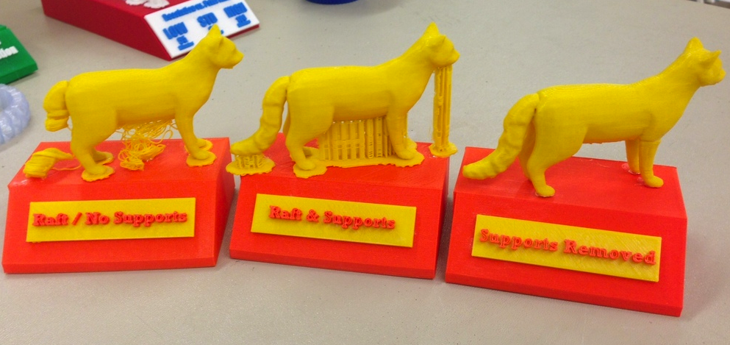
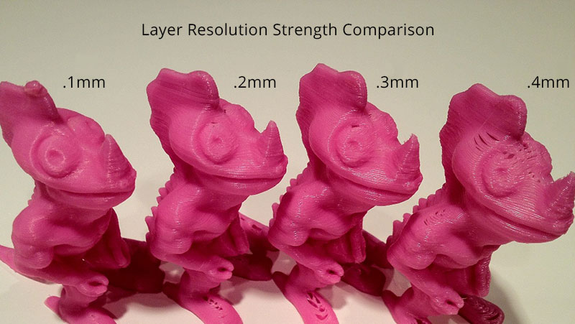
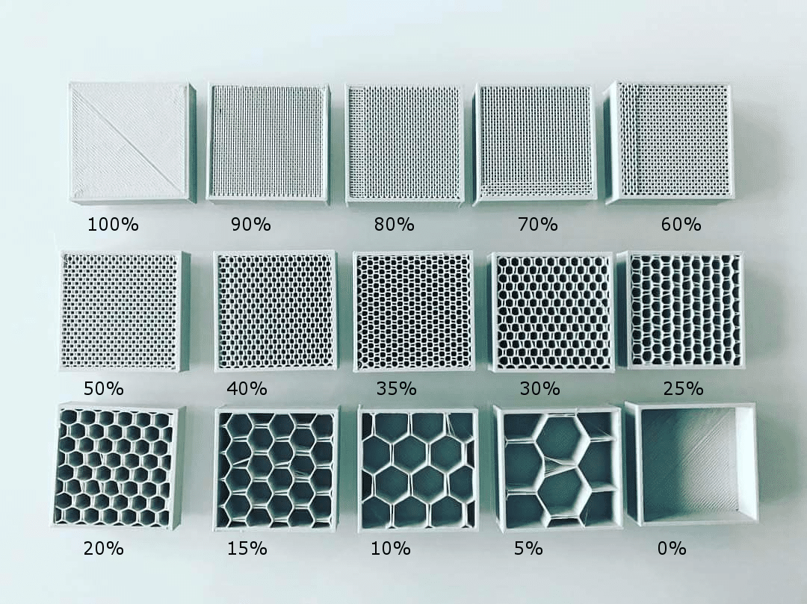
3D Print Examples for Workshops
Makes teaching some 3D printing concepts so much easier
  Infill
  Supports
  Adhesion
  “Quality”

Slide 53
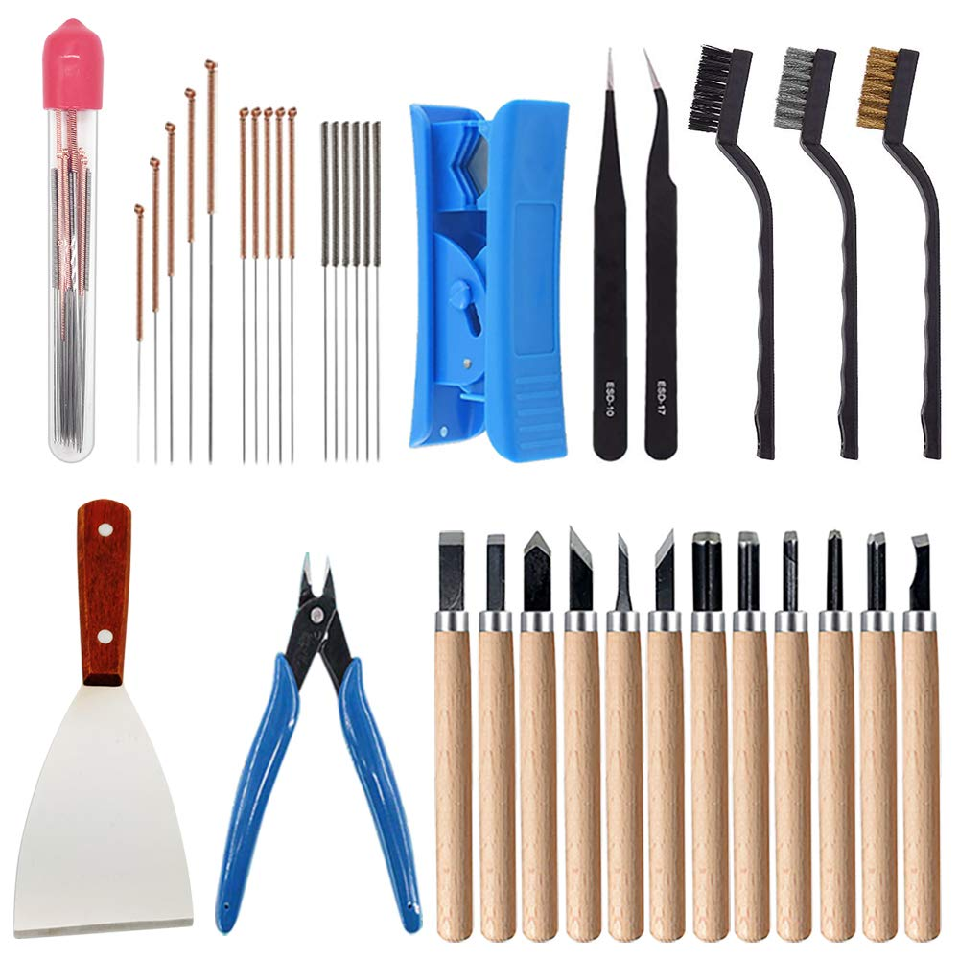
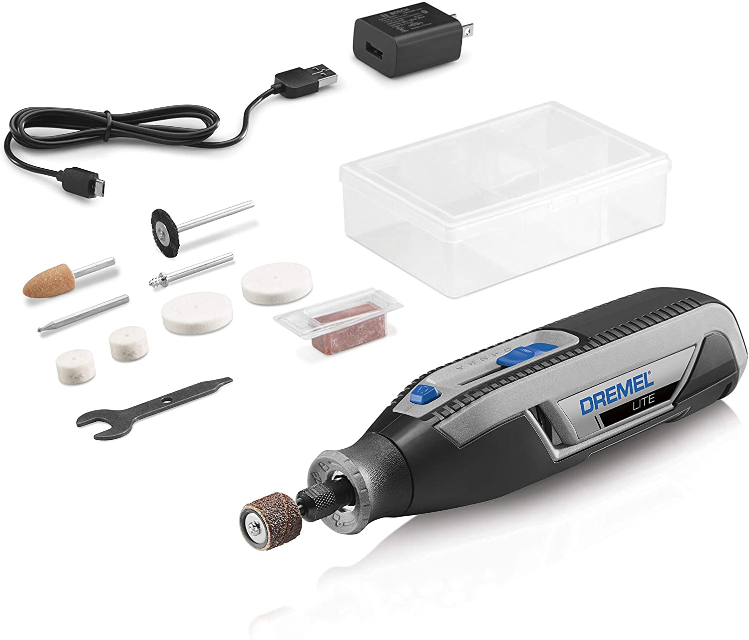
Lastly… some other things to get
Finishing tools
Dremel

Slide 54

Remember

Slide 55
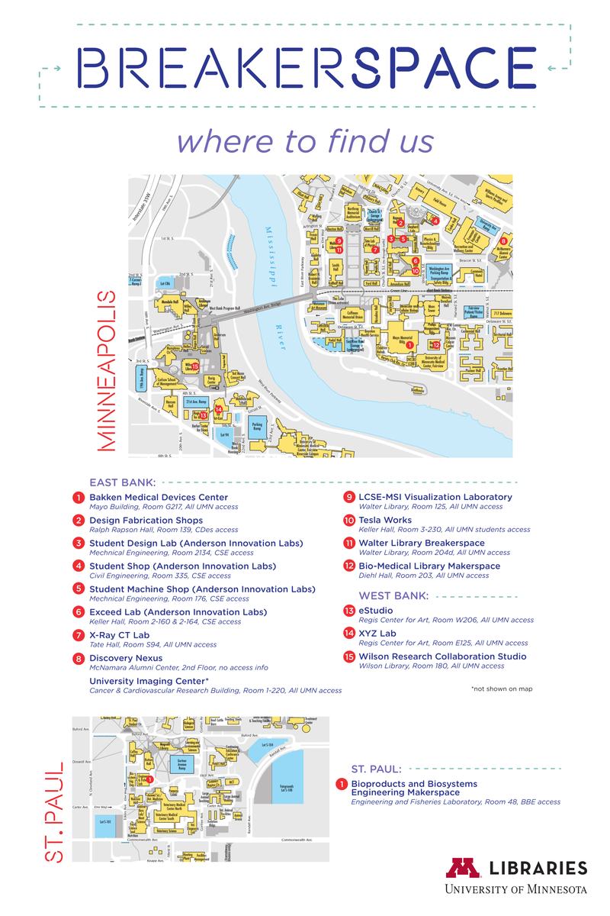
Building networks
Reach out to other makerspaces at your institution, in your community or in higher education across the nation
We love to help each other
Find the experts so you can find help and refer your patrons
Having too much is as bad as not enough if you cant find resources easily (think of the misshelved book)
Build networks to de-silo your institution

Slide 56
Feel free to use my two presentations to build your workshops
Need help building a slide deck or lesson plan?
Email me for free help! cabada@Illinois.edu

Slide 57
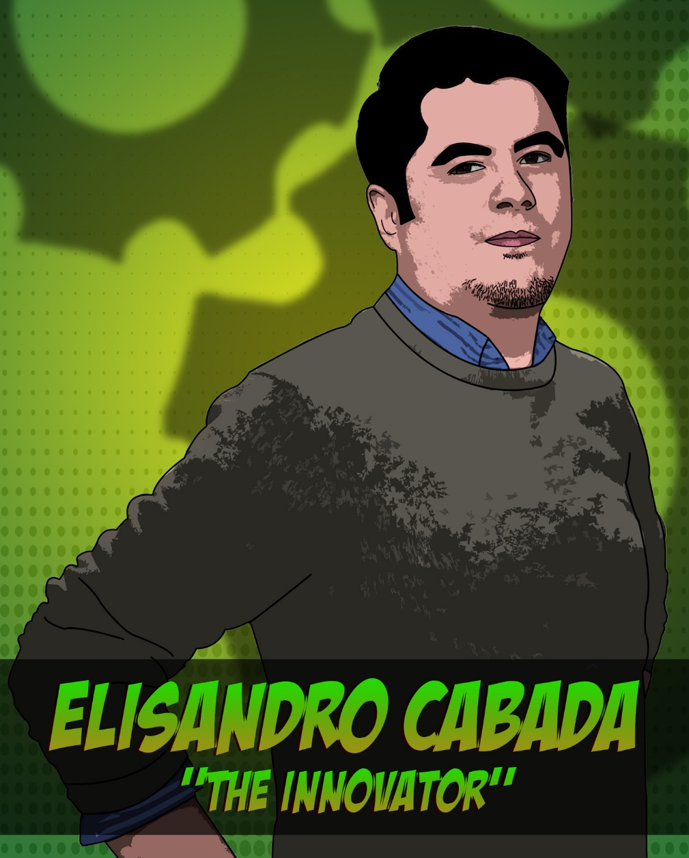
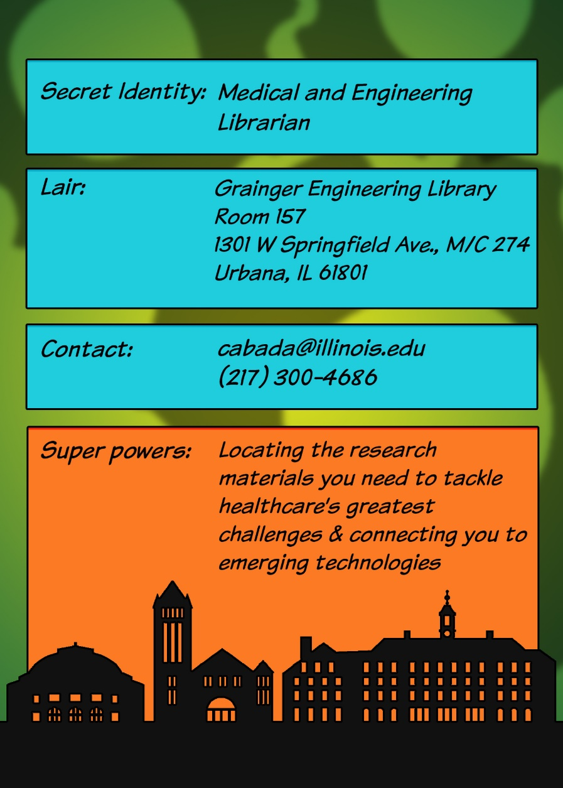
Thank you

