Slide 1
Annual meeting
November 16, 2023

Slide 2
9:00–10:00 a.m. Buffet Breakfast
10:15–10:25 a.m. Welcome and introduction of the Governance Board
-Matt Ostercamp, Chair, CARLI Governance Board
10:25–10:35 a.m. Welcome from the University of Illinois System
-Sarah M. Zehr Gantz, PhD
10:35–11:20 a.m. Keynote Address
-Elaina Norlin
11:20–12:30 a.m. CARLI Update
-Anne Craig, Elizabeth Clarage, Jen Masciadrelli, and Michele Leigh
-Recipients of the CARLI Scholarships: Amanda Helm and Kaitlyn Mae Weger
12:30–1:15 p.m.: Buffet Lunch and CARLI Counts Poster Discussion
1:15-1:30 p.m.: Digital Equity Funding
-Regional Library System representatives Monica Harris, Ellen Popit, and Anne Slaughter
1:30–2:30 p.m. Topical Table Talks
2:30–2:45 p.m. $3 million State OER Funding for Academic Libraries and compliance with PA103-0100
-Greg McCormick, Director, Illinois State Library
2:45-2:55 p.m. Wrap Up

Slide 3
University of Illinois System leadership
Sarah M. Zehr Gantz, PhD
Senior Assistant Vice President for Academic Initiatives and Policies
Office of the Executive Vice President/Vice President for Academic Affairs
University of Illinois System

Slide 4
CARLI Governance Board FY24
Chair: Matt Ostercamp
Past Chair: Sharon Silverman
Chair-Elect: Pattie Piotrowski
Name | Constituency | Term | Institution
Jo Cates | Private Institutions | 2022-2024 | Columbia College Chicago
Carolyn Ciesla | Private Institutions | 2023-2026 | Elmhurst University
Anne Craig | Ex Officio | permanent | CARLI Director
Stephanie Davis-Kahl | Private Institutions | 2022-2025 | Illinois Wesleyan University
Dennis Krieb | Community Colleges | 2022-2025 | Lewis and Clark Community College
Dallas Long | Public Universities | 2021-2024 | Illinois State University
Greg McCormick | Ex Officio | permanent | Illinois State Library Director
Matt Ostercamp, chair | Ex Officio | 2023-2024 | North Park University
Geoff Pettys | Public Universities | 2023-2026 | Southern Illinois University School of Medicine
Pattie Piotrowski, chair-elect | Public Universities | 2022-2025 | University of Illinois Springfield
Shannon Pohrte | Community Colleges | 2021-2024 | Elgin Community College
Devon Powell | Community Colleges | 2023-2024 | South Suburban Community College
Morgann Quilty | Community Colleges | 2023-2026 | Parkland Community College
Sharon Silverman, past chair | Ex Officio | 2023-2024 | City Colleges of Chicago
Claire Stewart | Public Universities | 2023-2024 | University of Illinois Urbana-Champaign
Nathan Thebarge | Private Institutions | 2023-2024 | Trinity International University

Slide 5


Thank you to our Gold sponsors

Slide 6
Our Keynote Address
Are 'Lazy Girl Jobs' the Future of Work, or a Silent Rebellion Against Productivity?
Elaina Norlin
Association of Southeastern Research Libraries
Program Coordinator for Professional Development

Slide 7
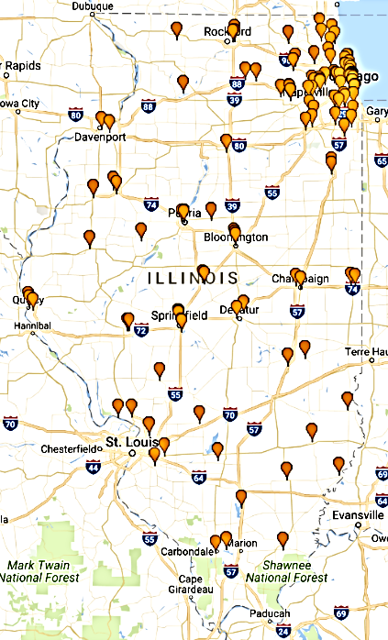

About CARLI
The Consortium of Academic and Research Libraries in Illinois (CARLI)
128 Governing Member libraries
    All Illinois public universities : 13
    All Illinois community colleges: 39
    Private colleges and universities: 67
    Special research libraries: 9
CARLI member libraries serve 90% of Illinois undergraduate students,
41% are minorities
Member libraries serve 90% of higher education students, faculty, and staff

Slide 8


Slide 9
CARLI Staff
Anne Craig, Senior Director
MEMBERSHIP AND COMMUNICATIONS
Margaret Chambers, Director and Advisor,
Membership and Communications
Michelle Haake, Senior Coordinator Membership and Communications
Ed Schell, Web Developer
Nicole Swanson, Senior Coordinator, Library Services and Outreach
BUSINESS AND FINANCE SERVICES
Diane Day, Fiscal Officer
Tim David, Accounting Specialist
Katrina Little, Invoicing Specialist
COLLECTIONS SERVICES
Elizabeth Clarage, Director, Collections Services
Michele Leigh, Senior Coordinator, Open Illinois
E-RESOURCES
Jenny Taylor, Associate Director, Electronic Resources
Denise Green, Senior Library Services Coordinator
Nicole Ream-Sotomayor, Senior Electronic Resources Coordinator
Marisa Tolbert, Library Services Coordinator
SYSTEMS SERVICES
Jessica Gibson, Assistant Director, System Services
Christopher Delis, Application Support Specialist
Todd Pavlik, Data Coordinator
Megan Pearson, Visiting Library Services Coordinator
Annie Serrano, Senior Library Application Coordinator
Bradley Woodruff, Library Application Support Consultant
USER SERVICES
Jennifer Masciadrelli, Assistant Director, User Services
Debbie Campbell, Senior Library Services Coordinator
Amy Enberg-Aravena, Graduate Assistant
Martin Kong, Library Services Coordinator
Amy Maroso, Senior Digitization Coordinator
Sara Mercurio, Graduate Assistant
Adrienne Radzvickas, Library Services Coordinator
Ted Schwitzner, Senior Library Services Coordinator

Slide 10
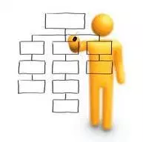

Staffing changes
Welcome to Our New Staff!
Amy Enberg-Aravena, Graduate Assistant
Sara Mercurio, Graduate Assistant
Megan Pearson, Visiting Library Services Coordinator
Annie Serrano, Senior Library Application Coordinator

Slide 11

Committee and Task Force members
Are dedicated and and knowledgeable
Work on spectrum of projects/services
Represent diverse institutions
Unite member libraries’ staff
Thank you!
Committees and Task Forces

Slide 12

CARLI Scholarship
CARLI Grows. . .
Teaching
Learning
Innovation
Research
Scholarship
CARLI Grows the Profession
Celebrating library resource sharing since 1980

Slide 13
How you can support the carli scholarship
The CARLI Scholarship:
Provides financial assistance to current employees of CARLI Governing Member Libraries
Employees pursuing graduate studies leading to a Master’s Degree in Library and Information Science at the University
of Illinois Urbana-Champaign
https://www.carli.illinois.edu/give

Slide 14

Two scholarship recipients this year
Amanda Helm, Abraham Lincoln Presidential Library
Kaitlyn Mae Weger, Olney Central College,
Illinois Eastern Community Colleges
https://www.carli.illinois.edu/membership/carli-scholarship-apply

Slide 15

Building Diversity Graduate Assistantship Program
Recipients AY 23-24
Elizabeth Ayorinde
Victor Lopez
Funded by System Office and CARLI
AY 22-23 and AY 23-24
Two positions; each works 10 hours/week
Pays salary and tuition
Locations
Columbia College Chicago
North Park University
Southern IL University College of Medicine
University of Illinois Springfield
CARLI is seeking grant funding for Academic Years 24-25, 25-26
https://www.carli.illinois.edu/products-services/prof-devel/carli-building-diversity-graduate-assistantship-program

Slide 16
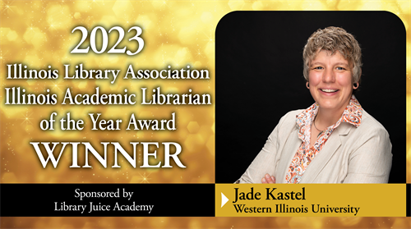
CONGRATULATIONS!
Illinois Academic Librarian of the Year Award

Slide 17
Carli mission and values
CARLI Mission
We empower our academic and research libraries to build and sustain an accessible, diverse, and responsive knowledge environment that promotes excellence and innovation in teaching, learning, and research. CARLI adds value for all member libraries by sharing costs, collections, expertise, programs, products, and services.
CARLI Statement of Values
We are committed to:
Diversity, equity, inclusion, and accessibility
Intellectual freedom, privacy, and open access to information resources
Careful stewardship of all CARLI resources
Advocacy for academic and research libraries at the local, state, regional and national levels
Supporting cooperation and engagement among academic and research libraries
Being responsive to member needs
Identifying and implementing collaborative solutions to shared challenges and reducing barriers

Slide 18
New Strategic plan
Diversity, Equity, Inclusion,
and Access
Innovation and access to information
Careful Stewardship
Advocacy
Cooperation and Engagement
Responsiveness and Commitment
Ensure organization-wide commitment to an environment of inclusiveness and openness
Encourage innovation in skills, services, programs, and all aspects of CARLI operations and its members
Align funding, staff, time, and expenditures with operations to exemplify CARLI’s mission, values, and strategic priorities
Establish and communicate the value proposition for academic and research libraries in Illinois
Enhance collaboration among libraries by identifying, nurturing, and supporting services and programs that can best be provided at scale
Provide Resources, Services, and Tools for Discovering and Optimizing Information, Resources, and Collections
https://www.carli.illinois.edu/about/priorities

Slide 19

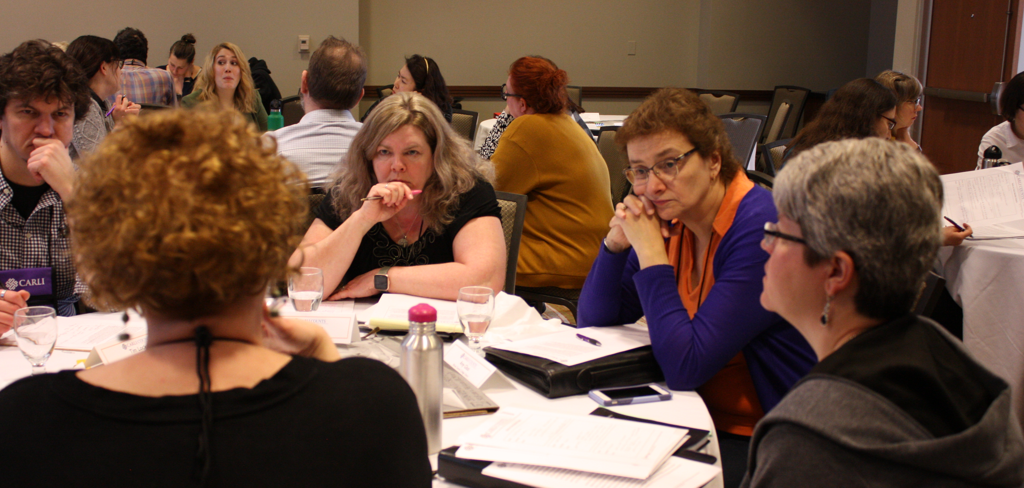
CARLI COUNTS UPDATE
Cohort 5 plans for 2024!
Apply by December 1 to participate!
  https://www.carli.illinois.edu/products-services/prof-devel/carli-counts
Can be alumni or new to CARLI Counts
In-person meeting dates:
  February 27-29, 2024
  August 6-8, 2024

Slide 20
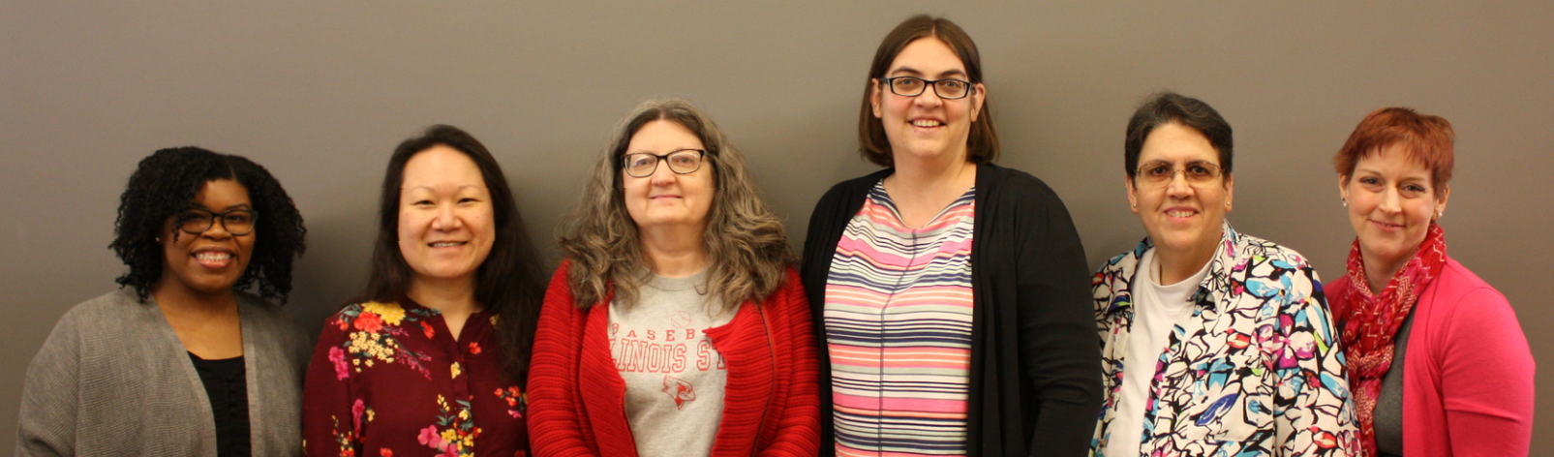
What is carli counts?
Continuing education program
Year-long
Team-based
Immersion through two in-person and virtual monthly sessions
Each participant works on an assessment project for their own institution
Program pays for your staff member’s lodging and food for in-person sessions

Slide 21
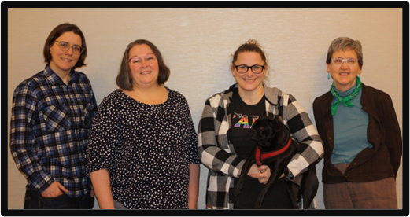
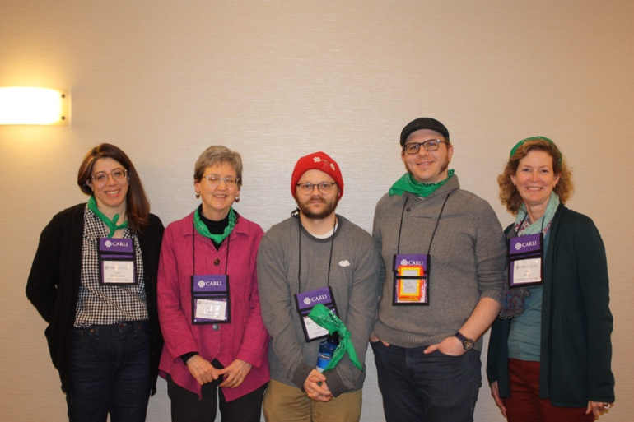
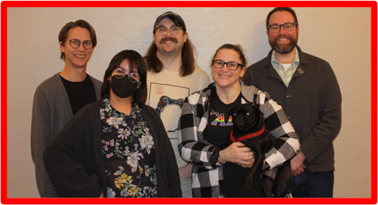
Why carli counts matters
How do I advocate for my library?
Can I use assessment data to design services and programs?
Context
Intense competition for dollars at your institution
Data-driven decisions at your library
Vision
Grow assessment skills locally and in CARLI
Members can talk to stakeholders about student success and retention in relation to their
library’s contribution
CARLI Counts helps your organization build assessment skills

Slide 22
What’s next?
Consortial Collaboration for Academic Library Leadership Success (CCALLS)
Application to the Institute of Museum and Library Services, Laura Bush 21st Century Librarian Planning Grant ~$140,000
Extends a planning project for CARLI Counts to other library consortia

Slide 23
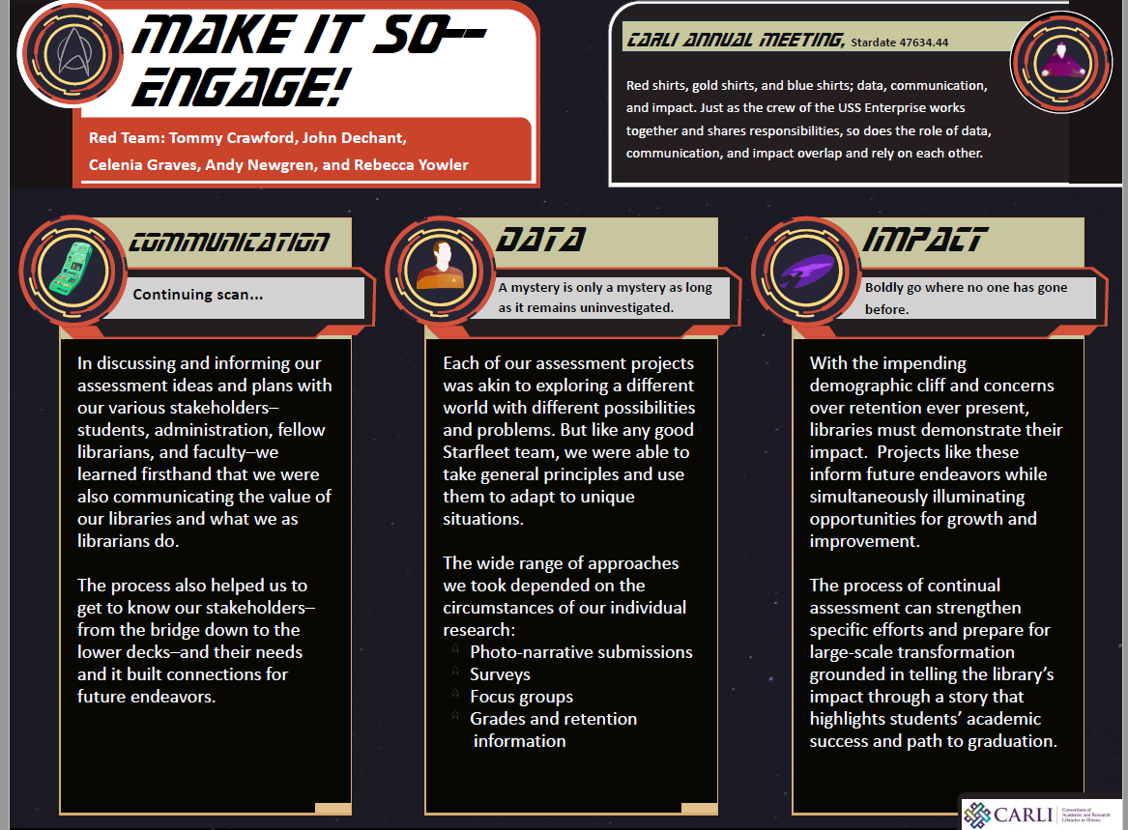
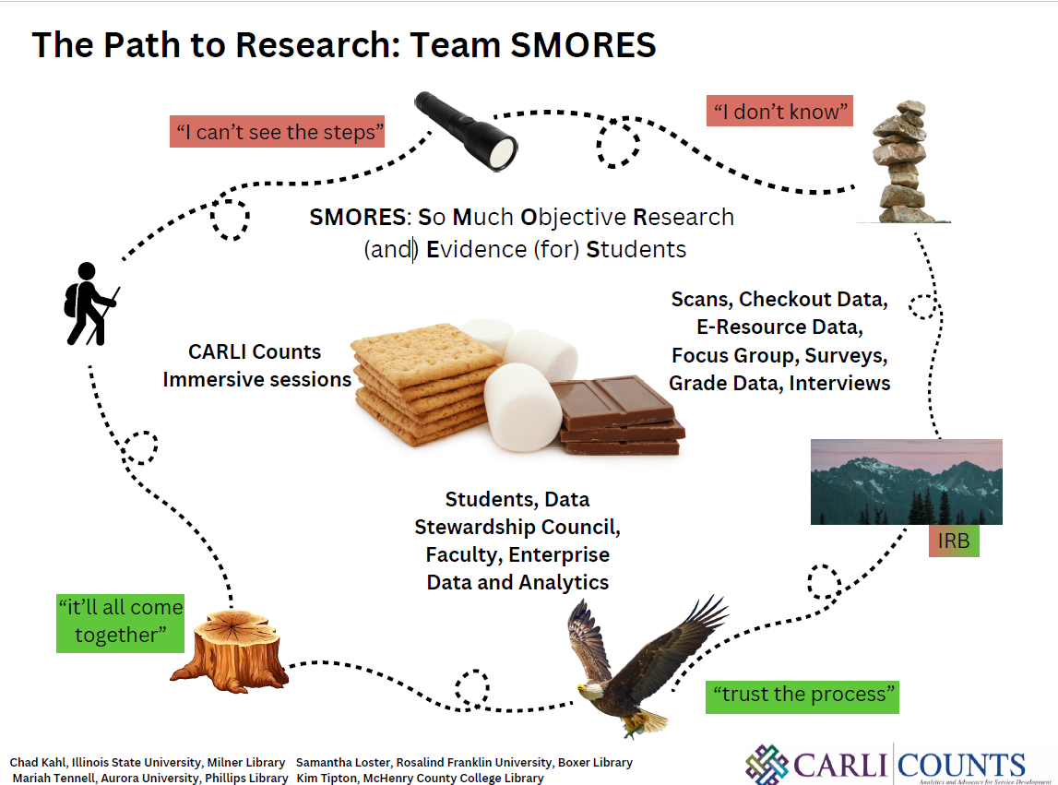
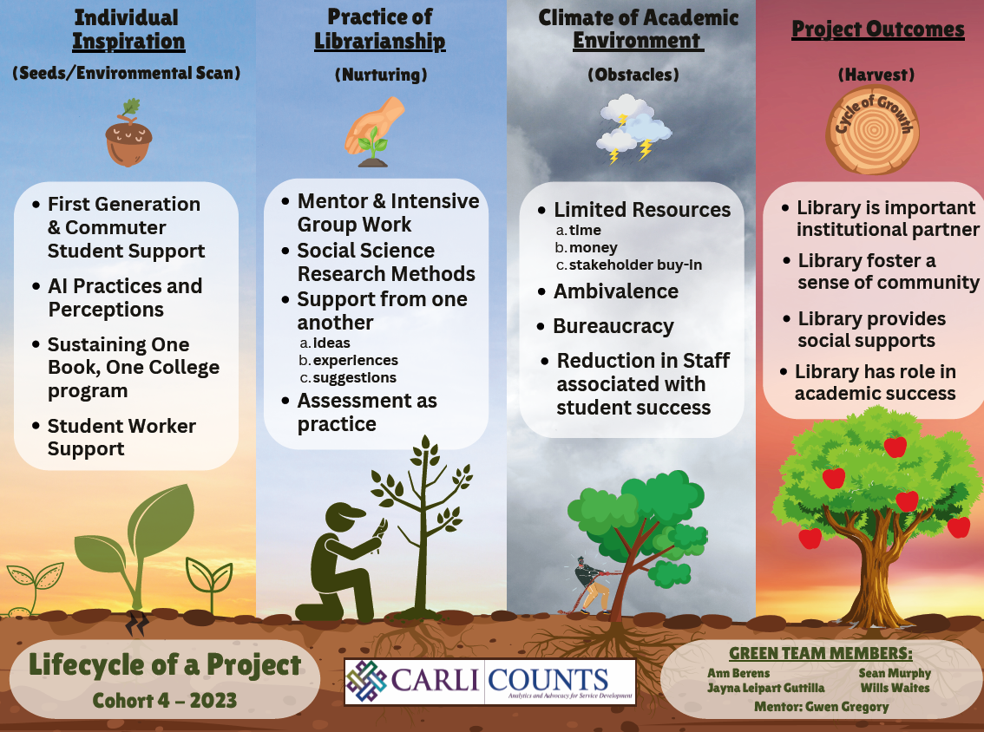
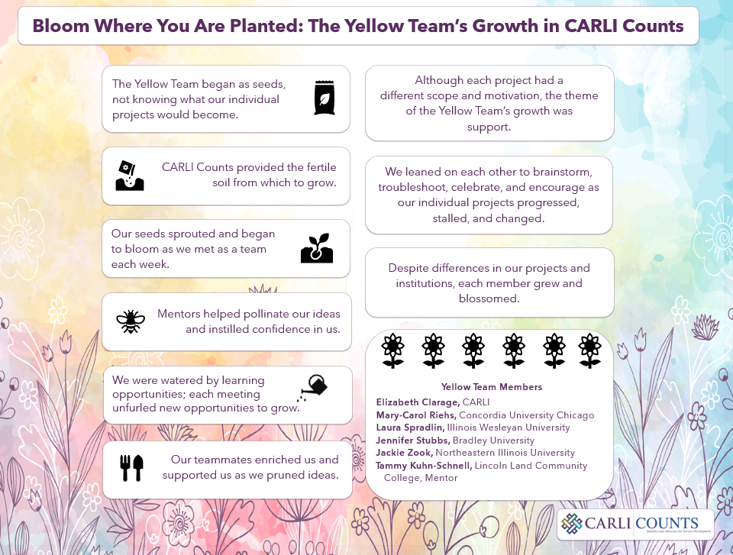
CARLI counts cohort 4 posters
Visit the Cohort 4 posters during our lunch break!

Slide 24



Libraries as Partners for Emergency Preparedness and Response in Times of Crisis
Libraries as Partners for Emergency Preparedness and Response in Times of Crisis, is a preliminary investigation into library-community partnerships during public crises, especially the scope and nature of partnership, library role in partnership, and how emergency type effects partnership.
https://imlsgrant.web.illinois.edu/

Slide 25

Upcoming notable events

Slide 26

GLAM Virtual career jam: February 23, 2024
CARLI support for all member institutions to attend
CARLI institutions must register by November 28
Participation from library schools across the nation

Slide 27
FREE PEOPLE READ FREELY Symposium: Literacy, Privacy, and Democracy
August 20 and 21, 2024
A celebration of scholarship and the role of education in our democracy.
Initiative of University of Illinois System President Timothy Killeen
In partnership with the University of Illinois Press
Two-day, in-person event on the campus of UIUC
Will feature speakers and panel discussions, addressing issues around book banning, censorship, and the importance of reading and books to inclusion and citizenship.
Watch for information soon!

Slide 28
CARLI Revenue sources FY24
 | FY2023 | FY2024 | change
University of Illinois System Office | $3,640,722 | $3,740,100 | $99,378 | 2.7%
Membership Fees | $486,659 | $507,360 | $20,701 | 4.1%
Pass-through revenue | FY2023 | FY2024 | change
I-Share Assessments | $1,883,349 | $1,976,873 | $93,524 | 4.8%
Subscriptions to databases estimated for FY24 | $15,158,407 | $15,418,667 | $260,260 | 1.7%
ILDS (Illinois Library Delivery Service) Grant (IL State Library) estimated for FY24 | $939,215 | $975,181 | $35,966 | 4.0%

Slide 29
Carli’s funding principles
Ensure that CARLI members have at least 24 months’ notice for their individual fee/assessment rates.
Recalculate rates every three years to avoid drastic changes in rates.
Use data that are easily obtainable from reliable sources.
Buffer members’ increases with escalating periods to reach any new amount gradually.

Slide 31
Where to find your fees/assessments
CARLI Membership Fees for FY23–FY27: https://www.carli.illinois.edu/sites/files/files/MembershipFees.pdf
I-Share Assessments for FY23–FY27: https://www.carli.illinois.edu/sites/files/files/I-ShareAssessments.pdf

Slide 32
E-resources news
University of Illinois Press: access to their journal collections for all CARLI members
New contract with Kanopy for the Kanopy Base collection
Working on contracts with Wiley and Ithaka (JSTOR/ArtStor) which expands access
for two-year schools and interested four-year schools
Staying on top of new open access models that will benefit CARLI members
  Example: Wiley agreement will include article publishing charges (APCs) for faculty
  to publish open access at subscribing institutions.
We advocate for our libraries:
  Look for vendors and products that will meet the needs of our membership
  Seek low price increases, pricing transparency, equitable pricing, and accessibility
  Educate vendors about the academic library landscape in Illinois

Slide 33

CARLI Digital Collections
Over 360 collections provided by
50 different institutions
Over 3.5 TB of images and metadata
https://collections.carli.illinois.edu

Slide 34


Illinois digital Heritage Hub (IDHH)
Illinois digital heritage hub
Collaborative venture started by CARLI, ISL, CPL & UIUC
CARLI staff coordinate the project, including support of REPOX harvester, metadata review, outreach and promotion, and maintaining digital curation sites
IDHH currently contributing over 541,000 metadata records from:
  CARLI Digital Collections
  DePaul University
  Illinois State University
  Northern Illinois University
  University of Illinois Urbana-Champaign
DPLA information page for CARLI members: https://www.carli.illinois.edu/products-services/contentdm/dpla
IDHH portal: https://idhh.dp.la/
  Chicago Public Library​
  Des Plaines Public Library​
  Illinois State Library’s Illinois Digital Archives​
  Madison Historical (online encyclopedia & digital archive for Madison County)

Slide 35
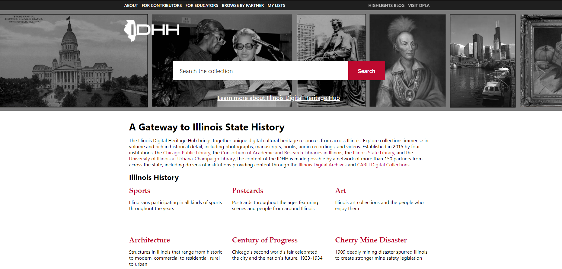
Illinois digital heritage hub
Screenshot of IDHH Website Homepage
IDHH Website: https://idhh.dp.la/
Illinois Highlights Blog: https://www.library.illinois.edu/idhh-highlights/
IDHH Digital Exhibits: https://omeka-s.library.illinois.edu/s/idhh/page/welcome
IDHH Primary Source Sets: https://guides.library.illinois.edu/idhh/pss

Slide 36

PROFESSIONAL DEVELOPMENT ALLIANCE
CARLI partners with ten other library consortia to create the
Professional Development Alliance
No-cost continuing education opportunities
Webinars every month; on the CARLI Event Calendar
PDA is growing:
  Colorado Alliance of Research Libraries
  LibraryLinkNJ
Find recordings and slides from past programs at https://www.carli.illinois.edu/professional-development-alliance
We are eager for your suggestions! support@carli.illinois.edu

Slide 37
PROFESSIONAL DEVELOPMENT ALLIANCE
PDA by the Numbers, FY21 to date
401 total programs offered to CARLI Members from all PDA Consortia
64 CARLI-Sponsored Programs
7,119 registrants for CARLI-Sponsored Programs
Upcoming on December 5: “A Gentle Introduction to ChatGPT”
Presented by UIUC’s Mary Borgo Ton, PhD
https://www.carli.illinois.edu/professional-development-alliance

Slide 38

ILDS: Illinois Library Delivery Service
Funded by the Secretary of State/Illinois State Library
Service providers:
  Illinois Heartland Library System
  Reaching Across Illinois Library System
24-hour turnaround dock-to-dock
354,099 items delivered through ILDS in FY23
  Approximately two-thirds of the volume before the COVID-19 pandemic in FY20

Slide 39
NC Live website design service
One-time fee of $500
Built on LibGuides
Helps libraries in need of clean, easy website design
Register now for the information session, February 28, 2024, 10-11 a.m.
https://www.carli.illinois.edu/nc-live-website-service-webinar-0

Slide 40
Consortial Ebook program: Values and Benefits
Resource sharing is highly valued
Member funded projects can work!
Member support provides continued access
  List price of perpetual content: $1,233,118
  More than what members can individually purchase
  Maximum contributed by any member: $109,912 (over three years)

Slide 41
Consortial ebookS
Access to Wiley and Oxford Ebooks
Access began July 2020
Unlimited access for All CARLI Governing Member
May be used for course materials or for course reserves
Direct links may be embedded into course management systems
Member Funded
CARLI suggested amounts – increasing for FY25
  Average Ebook list price has increased
  Can we grow the program? Can we add publishers?
Members contribute as they are able
https://www.carli.illinois.edu/products-services/collections-management/carli-ebook-program
We need you!

Slide 42
ebook proGram: Content
 | FY21–FY23 | FY24 | FY25
Content available | Perpetual Access to: 4,622 Wiley Online Books 2,565 Oxford University Press Ebooks 364 OUP Partner Press Ebooks | Access to: Wiley Online Books Published between 2019–June 2024 Oxford University Press Ebooks Published between 2019–March 2024 Six Subject Collections: Biology, History, Law, Music, Political Science, and Religion | Growing the Program: Publishers: Wiley Oxford University Press If funding permits: University of Illinois Press (on JSTOR)
 | Perpetual Access to: 7,551 Ebooks | Access Collection Size: ~5,000 Ebooks

Slide 43
Western Regional Storage Trust (WEST): sHared Serials Storage
Western Regional Storage Trust (WEST)
Hosted by the California Digital Library, University of California
Participating libraries consolidate and validate print journal backfiles at major library storage facilities and at selected campus locations.
Shared print archives ensure access to the scholarly print record and allow members institutions to optimize campus library space.
CARLI’s website has more information including an informational webinar.
WEST Serials Shared Storage will be available for members to select in the
FY25 Selection System.
https://www.carli.illinois.edu/products-services/collections-management/shared-serials-storage

Slide 44
I-Share Update
Cataloging Maintenance Center
FY2023 “By The Numbers”
New I-Share Libraries
Named Users Update

Slide 45
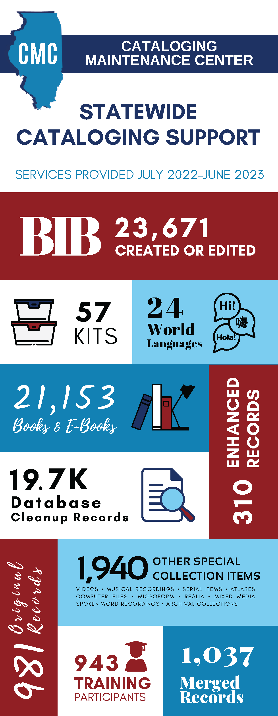
Cataloging maintenance center
Specialty cataloging services available at no cost
(paid for by grant from the SOS/ISL)
CMC Zoom information session on November 30
for I-Share members; register here: https://www.carli.illinois.edu/special-cataloging-services-cataloging-maintenance-center
Complete the nonbinding interest indicator by
November 29: https://www.surveymonkey.com/r/CARLI_CMC

Slide 46
I-Share FY2023: By the numbers
CARLI staff resolved 1,650 support inquiries from our I-Share libraries about Alma and Primo VE between July 1, 2022-June 30, 2023.
CARLI staff opened over 75 Cases with Ex Libris to address Alma and Primo VE related issues for I-Share member libraries.
CARLI staff presented nearly 30 topical webinars between
July 1, 2022-June 30, 2023, on Alma and Primo VE including:
  Open Office Hours
  Tech Services Q&A
  Let’s Talk about Fulfillment (LTAF)
CARLI provided over 250 paid registrations to ELUNA Learns 2023 sessions for members.
Notes:
First off is I-Share “By the Numbers”

Slide 47
I-Share: Named Users Update
Reducing the number of Named Users is last "housekeeping" with Ex Libris
to align practices with our contract
CARLI has held 3 informational sessions in October and November
"Certification" of the number of Named Users your institution requires is
due by December 8.
  The online certification form has been shared with I-Share Directors and I-Share Liaisons.

Slide 48
I-Share 2023: New Libraries
I-Share: New Libraries update
January – July 2023: completed the addition of 3 new I-Share libraries:
  St. John's College of Nursing
  Illinois College of Optometry
  University of Illinois Law (formerly John Marshall Law)
  added to University of Illinois Chicago's Alma instance
Work has begun on adding 5 more I-Share libraries, with a local go-live date of late June 2024:
  Chicago Theological Seminary
  City Colleges of Chicago
  College of Lake County
  Elgin Community College
  Prairie State College

Slide 49


Slide 50
OPEN ILLINOIS
Open Illinois = All things CARLI and OER
“Illinois SCOERs: Support for the Creation of Open Educational Resources,”
US Department of Education Open Textbooks Pilot Grant
CARLI OER Commons Hub
CARLI’s Open Education Network membership
OER Committee activities
Education and information
https://www.carli.illinois.edu/products-services/collections-management/open-ed-resource-overview

Slide 51
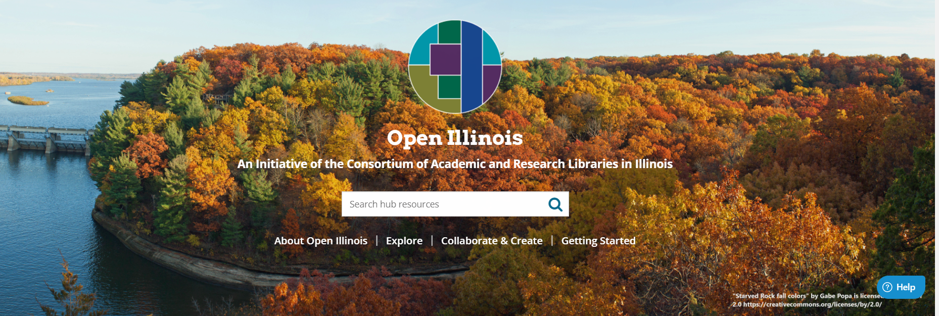
CARLI’S OER COMMONS HUB
Launched September 2021
A customized, branded space on OER Commons - a digital library and collaborative platform
Showcases OER resources from CARLI Member and other Illinois stakeholders into a publicly accessible location to find OER created and used within the state.
Governing members may have a presence on the Open Illinois Hub by submitting a form from the CARLI website:
https://www.carli.illinois.edu/products-services/oer-commons
Open Illinois OER Commons Hub: https://www.oercommons.org/hubs/openillinois

Slide 52
CARLI’S COURSE MATERIALS SURVEY
Illinois Course Materials Survey: Student Perspective
Goal: Identify Illinois students’ needs for affordable course materials
and interest in Open Educational Resources
THANK YOU! Over 3,500 students have participated across
29 institutions
Institutions can still participate!
Survey closes December 31.
Learn more:
https://www.carli.illinois.edu/illinois-course-materials-survey-student-perspective

Slide 53


ILLINOIS SCOERS
$2,000,000
Three rounds of competitive sub-awards
OER textbooks/ancillary materials are being developed
September 1, 2021 - August 31, 2024
OER textbooks/ancillaries in use Fall 2023
SOS/IL State Library grant for $25,000 for 3D printers

Slide 54
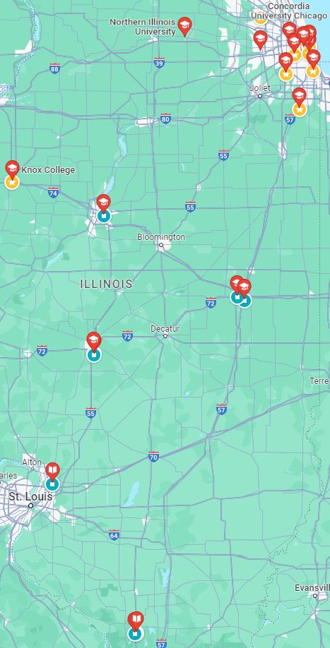
Illinois SCOERs
23 Subgrant Awards
23 institutions
Statewide representation
27 OER

Slide 55

3D PRINTER DELIVERY
Special Thanks to the Secretary of State, the Illinois State Library and the U.S. Department of Education

Slide 56
TWENTY-THREE SUBGRANT AWARDS
Arts
Northern Illinois University, "Teaching Photography: Critical Literacies for Creative Practice"
Southern Illinois University Carbondale, “Foundational Courses in the Theory and Practice of Media Arts”
Business
Concordia University Chicago, "Preparing College of Business students for the post-pandemic world by updating required content in two core courses with open access materials"
Chemistry
Roosevelt University, DePaul University, and Harper College, “Development and Implementation of Open-Access Problems and Activities for Health-Focused Chemistry Courses”
  Triton College, “Development of Open Educational Resources for the Laboratory in Foundational Chemistry Course"
Humanities
Columbia College Chicago, "Authoring Culture: The Foundations of Twenty-first Century Writing”
Southern Illinois University Edwardsville, "The OER Guide to Media Writing"

Slide 57
TWENTY-THREE SUBGRANT AWARDS
Nursing/Health Professions
College of DuPage, "OER Accelerator for an Addictions Counseling Course”
Illinois Central College, “Nurse Assistant Training OER”
Lincoln Land Community College, “Lessening Financial Barriers and Increasing Inquiry and Community Engagement for Health Professions and Science Students: An OER for Human Nutrition“
Moraine Valley Community College, “Pharmacology-Principles/Application for Medical Assistants”
Roosevelt University, “Development of Ancillary Teaching Materials and Labs for Anatomy and Physiology”
Southern Illinois University Carbondale, “Anatomy and Physiology for Allied Health Professions”
Southern Illinois University Edwardsville, "Creating an Interactive Textbook and Ancillaries for Nurse Anesthetist Students”
University of Illinois Chicago, “Advancing Open Educational ReSources and Visual Pedagogy for DIverRse StudEnts: ASPIRE”
University of Illinois Urbana-Champaign Carle College of Medicine and Knox College, “The Female Reproductive System and Women’s Health Through a Multidisciplinary Lens”

Slide 58
TWENTY-THREE SUBGRANT AWARDS
Psychology/Development
City Colleges of Chicago, Olive-Harvey College, “Institutional Strategies for Increasing Student Success: Equity and Open Educational Resources”
Morton College, “Diverse Approach to Language Development”
University of Illinois Springfield, “The Psychology of Exceptional Children”
Public Administration
National Louis University, “Cultural Humility in Public Administration”
Science and Engineering
College of DuPage, "College of DuPage OER Accelerator for Physics Courses”
Illinois Institute of Technology, “Freshman Experience in Virtual Reality/Augmented Reality in Engineering Graphics Using Open Educational Resources”
Social Sciences
Governors State University, “Human Sexuality from A Sex Positivity Perspective”
Parkland College, “Traces: An Open Invitation to Archaeology”

Slide 59
ILLINOIS SCOERs WORKSHOPS
Instructional Design
  Exploring the Basics of Instructional Design
  Instructional Design and OER
  Creating H5P Interactions
3D Printing
  Getting Started with Your 3D Printer
  Review of 3D Printing
  3D Printing Using Models
Copyright/Creative Commons
  Copyright Basics and Creative Commons Licensing
  Permissions and Fair Use
Accessibility
  What is Accessibility
  Incorporating Accessibility into Your OER
LibreTexts
  Getting Started with LibreTexts Conductor
  Using LibreTexts to Create, Edit, And Remix

Slide 60
Next up Beginning at 1:15 p.m.
BROADBAND FOR LIBRARIES
Monica Harris, Reaching Across Illinois Library System Executive Director
Ellen Popit, Illinois Heartland Library System Associate Director

Slide 61



Broadband for Libraries
2023 CARLI Annual Meeting
November 2023

Slide 62
$1.3 BILLION
Federal Funding for Illinois
Broadband Equity and Deployment (BEAD)
Digital Equity Act
(DEA)
$1 Billion
$300+ Million
Laying fiber for construction across the state
Connecting ALL anchor institutions (including libraries)
Support digital inclusion projects
Access affordable internet service, devices, and training
Focus:
Focus:
Comment Period ended October 2023 | Comment Period (expected) January 2024

Slide 63
Why are broadband access and digital equity important?
Its about increasing access to broadband, access to devices, and the development of digital skills
Digital skills ensure participation in education, telehealth, business development, agriculture, community safety, and more
Many libraries throughout Illinois don’t currently have broadband or adequate technology equipment
We’re concerned about the availability of funding to get them connected, other barriers and resource gaps that libraries might face as all this work accelerates.

Slide 64
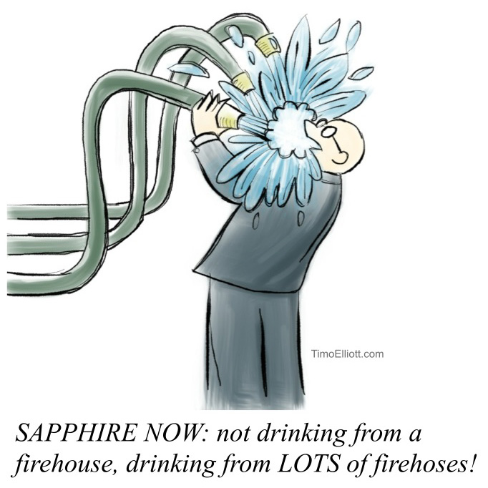
Too many libraries…
Lack adequate technology support staff
Are unable to afford new ongoing monthly subscription costs
Are looked to for technical expertise while struggling to set aside time to learn new skills themselves

Slide 65
Why is it important for Academic libraries to take notice?

Slide 66
Academic libraries
Broadband and digital skills are critical for access to education at any level
  Colleges and universities are generally considered bandwidth-rich but this can’t be a universal assumption, especially for community colleges in rural areas
  Many institutions are located in communities that have been subject to digital redlining and serve students who have resource and access gaps
  Digital skills of incoming students, first generation students

Slide 67
Academic libraries
Critical role of ALL libraries in digital equity
  Importance of a unified voice
  Grant funding gives us opportunities to connect academic research and lived experience, on the ground public library services, etc.

Slide 68
Academic libraries
Potential programming and services that might affect Academic Libraries:
  Grant funding through Connect Illinois and multiple federal programs
  Broadband is an expressed priority of IMLS
  Broadband READY and digital navigator programs through Illinois Broadband Lab (IBL) and university partnerships
    IBL is actively revving this program up, and have increased staff dedicated to community engagement and program coordination

Slide 69
CARLI, IHLS, & rails are working together to approach solutions – what’s next?

Slide 70
Why work together?
Statewide library voice is important in these state-level broadband decisions
  Library prioritization and resources needed
  CARLI, IHLS, RAILS coalition
Immediate goal: support library attention and responses to BEAD and DEA plans
  BroadbandForLibraries.com
  Open letter from Executive Directors as public comment
    Supported by Illinois State Library and Illinois Library Association
  Promoting awareness and responses to public comment periods

Slide 71
Looking ahead
  Digital Equity Act plan release (expected January 2024)
    Similar process with the benefit of more lead time
    Articulates role of library services and programming
  Additional community engagement through Illinois Broadband Lab
    Also watch for more local efforts through counties, economic development regions, etc.

Slide 72
Longer term goals
Help support library access to grant funding
  Multi-agency impact and multitype collaboration are needed
  Supporting libraries with admin overhead and project coordination – partnership, fiscal agency, project leadership – systems in a position to help with this but need to maximize limited resources with collective efforts
  Academic libraries are strong partners in grant projects

Slide 73
Longer term goals
  Identified “pillars” – domains for potential grant projects
    Technology infrastructure
    Workforce development
    Community outreach and partnerships
    Support for resident access to ACP & other programs
    Data visualization / accessing and working with public and research data

Slide 74
How can you get involved?

Slide 75
Getting involved
This is an opportunity for all libraries in Illinois to come together.
  Working together will be so much more effective and impactful then splinter efforts.
    Our organizations have successfully collaborated on resource sharing projects like ILDS (Illinois Delivers) and eRead Illinois.
  Stay tuned for future opportunities at CARLI, IHLS, and RAILS for conversation and collaboration to discuss what broadband and digital equity projects are most important to YOU
  Visit Broadband for Libraries for more background information and updates related to the Digital Equity Plan

Slide 76
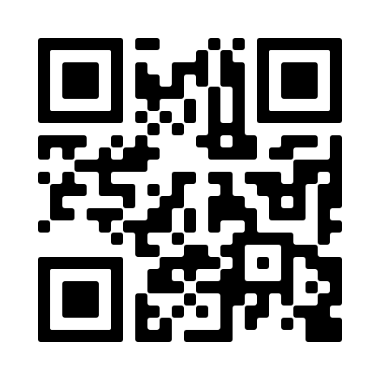
Broadband For Libraries

Slide 77
TALK TABLES
Identify opportunities from the strategic plan. What programs and/or services should we take on? https://www.carli.illinois.edu/sites/files/carlidocs/CARLI2023StrategicPlanActions.pdf
Broadband Equity and Deployment and Digital Equity Act funding: ideas for services and programs: how might your library expand its use of broadband? https://www.carli.illinois.edu/broadbandforlibraries; Hosts: Leslie Bednar, IHLS; Monica Harris and Anne Slaughter, RAILS
How have you experimented with AI tools, either for yourself or at your library? What has surprised you about the tools you've tried?
What about AI is keeping you up at night? What AI education topics should we be looking at?
What DEI programming or collections work is your library working on this year? What kinds of programming would be helpful from CARLI?
What assessment measures are you using at your library, and how have you used assessment to improve services, collections, or instruction?
CARLI’s e-resources acquisition process; Host: Jenny Taylor, CARLI
Share your biggest preservation challenges; Hosts: Preservation Committee members Jade Kastel, Shelby Strommer, and Bradley Wiles
OER in Illinois: What’s next?
Explore the Illinois Digital Heritage Hub

Slide 78
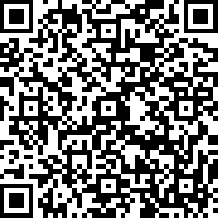
CONTRIBUTE TO THE ANNUAL MEETING TABLE TOPICS SURVEY
https://www.surveymonkey.com/r/CARLI_Ann_Mtg2023

Slide 79
Update from the Illinois State Library
Greg McCormick, Director

Slide 80
Funding in the FY24 appropriation bill, signed June 7, 2023

Slide 81
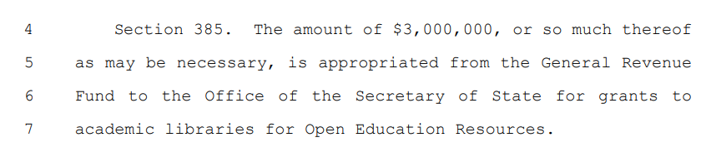
The appropriations language: what to see
$3 million for academic libraries:
https://www.ilga.gov/legislation/103/SB/PDF/10300SB0250eng.pdf see page 203
Added to the omnibus appropriations bill the day before introduction by a House sponsor in collaboration with the Illinois Federation of Teachers
Importantly, this is it—that’s all! Definitions and restrictions not included:

Slide 82
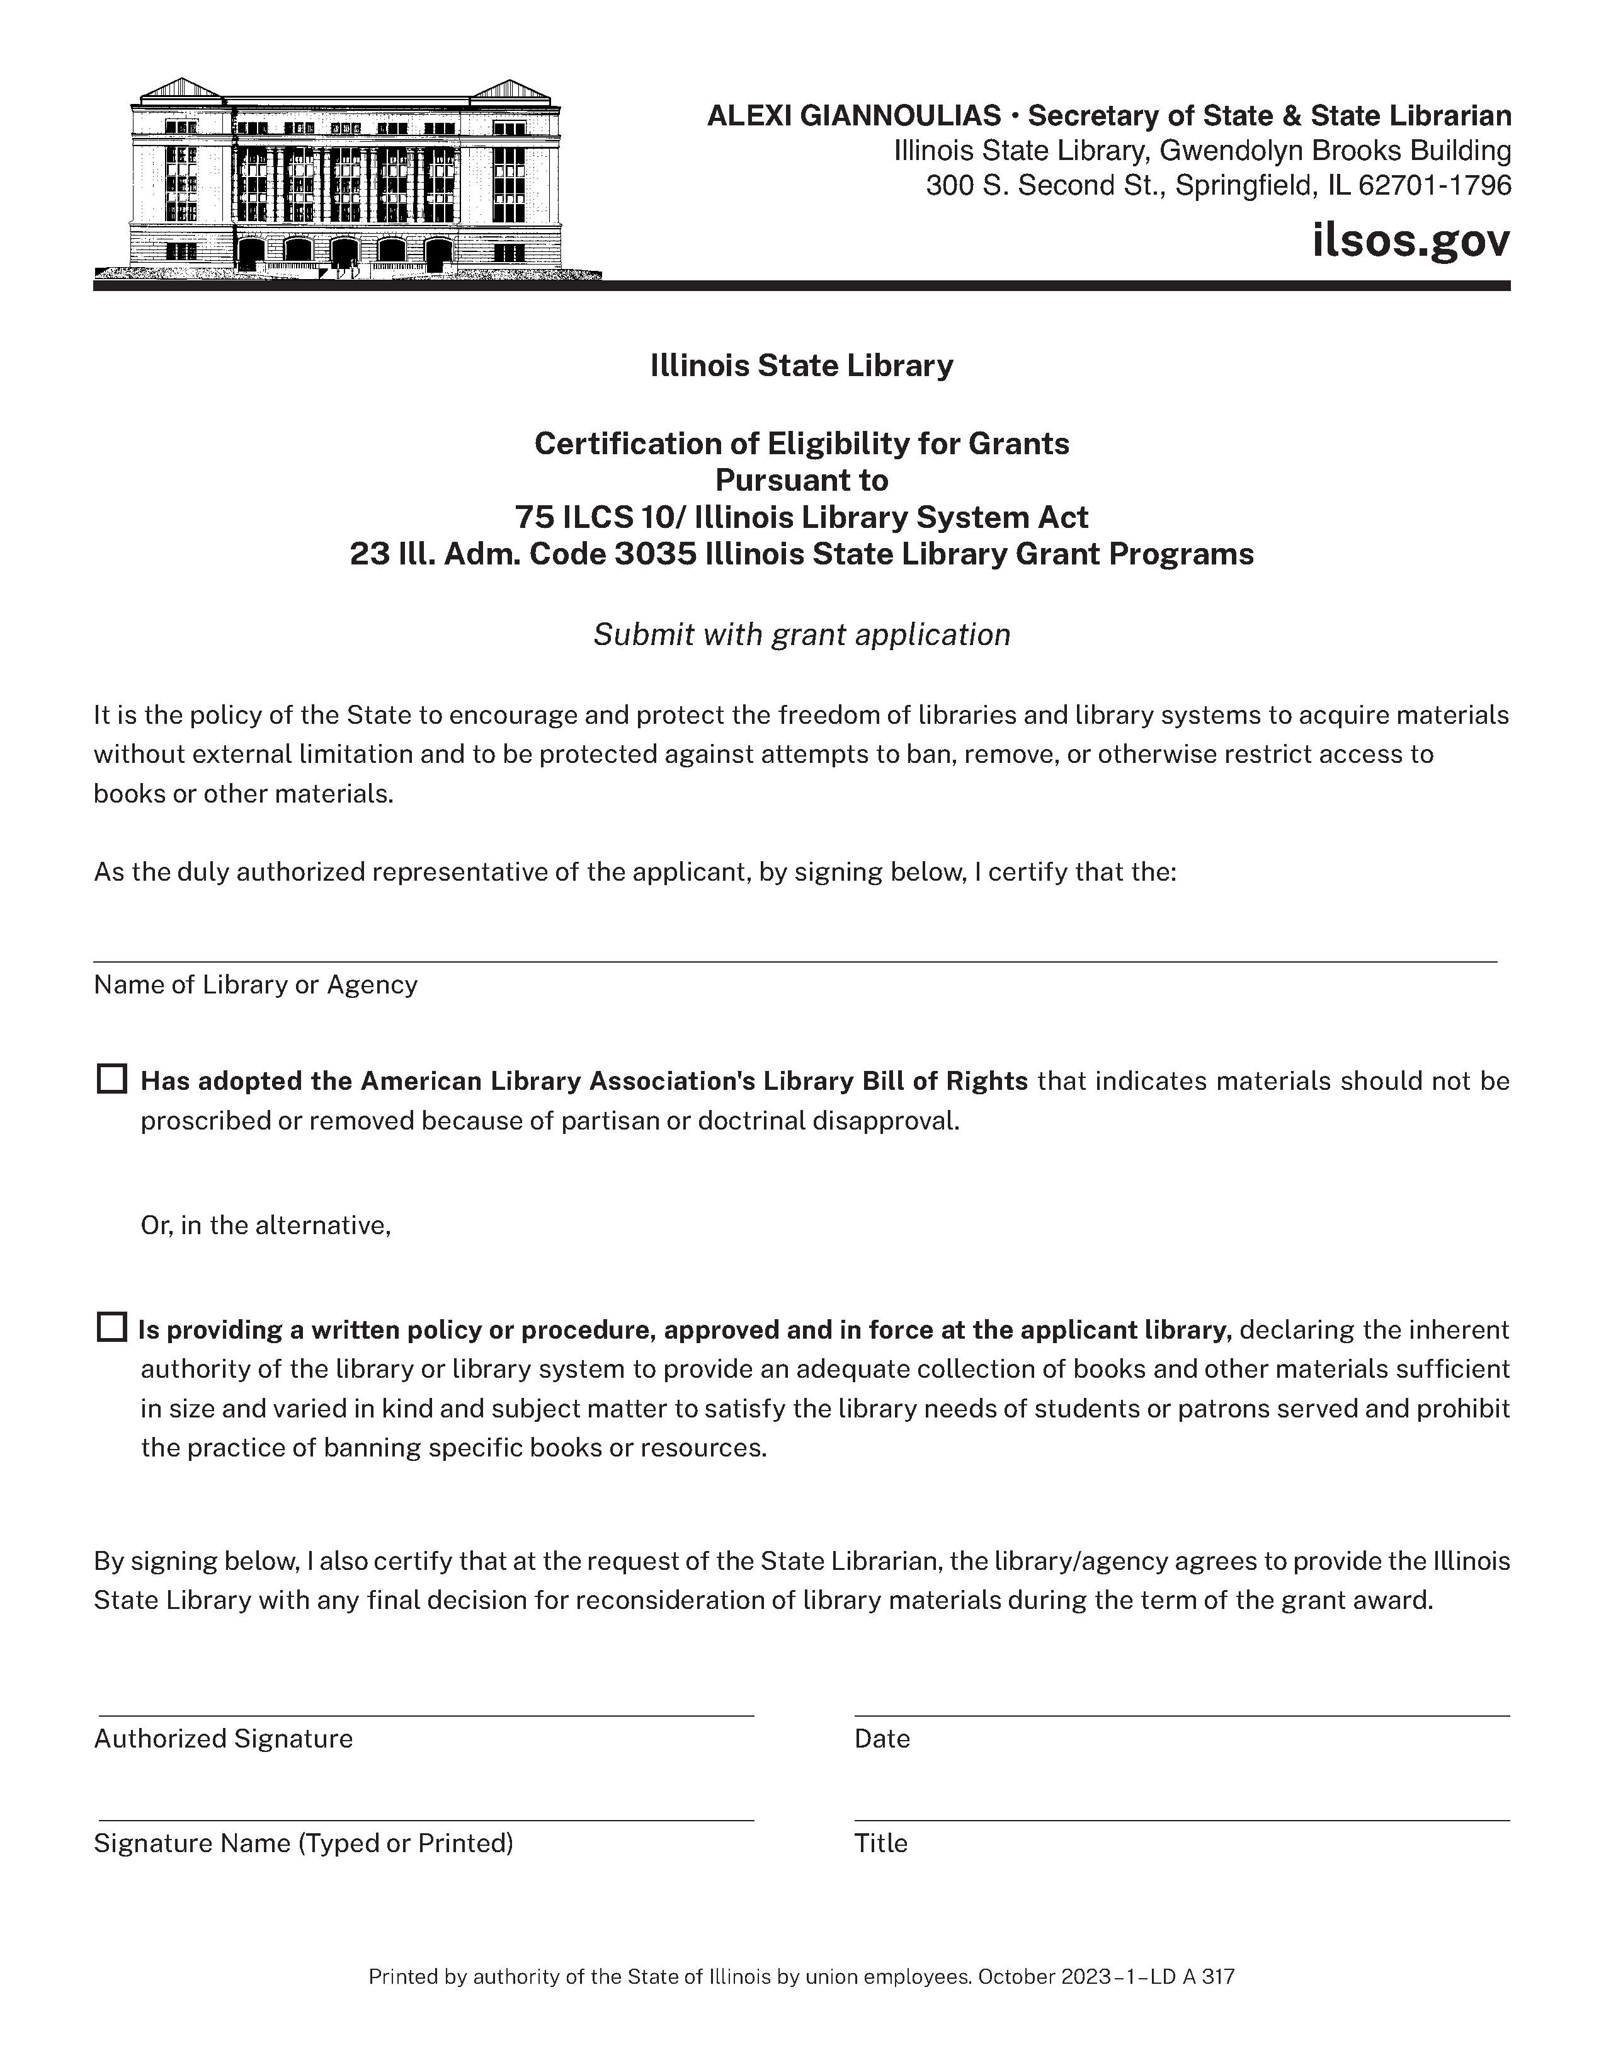

Slide 83
STAY IN TOUCH WITH US!
Email lists: https://www.carli.illinois.edu/email-lists
Website: https://www.carli.illinois.edu/
CARLI Support Email: support@carli.illinois.edu
Toll-free phone: (866) 904-5843
Monthly Newsletter https://www.carli.illinois.edu/newsletter
Annual “Value Letter” for each member sent to the Director in November
Board / Committee / Task Force minutes: https://www.carli.illinois.edu/governance/reports
CARLI Calendar: registration info listed ASAP: https://www.carli.illinois.edu/calendar

Slide 84
THANK YOU FOR JOINING US TODAY!!

