Slide 1
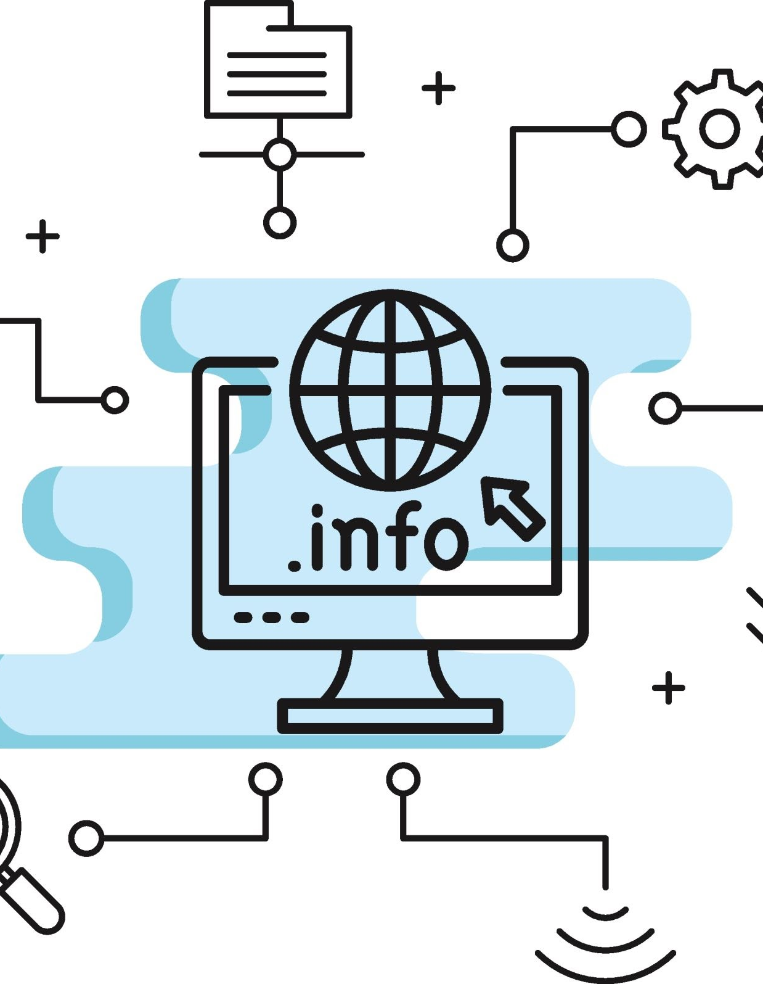
Un-Faking the Future: Restoring Trust in a Post Truth Information Age
Melissa Chomintra, Assistant Professor
Purdue Libraries and School of Information Studies

Slide 2
Introduction
When librarians say "trust us," it isn’t a passive plea. It is a profound responsibility. In a world drowning in misinformation and skepticism, library instruction is the anchor.

Slide 3
We’ve been trying to solve a crisis of the care with a checklist... In an infodemic, the most dangerous thing isn't a lie; it’s the belief that the truth doesn't need a human face.

Slide 4


The Logic of Facts
The Logic of Care
Defines the relationship between the truth of a statement (what is real) and the structural validity of an argument (how we reason).
Instead of treating information literacy as a purely technical, competitive task—like finding the best source to win an argument—it reframes research as a relational, ethical, and collective practice.

Slide 5
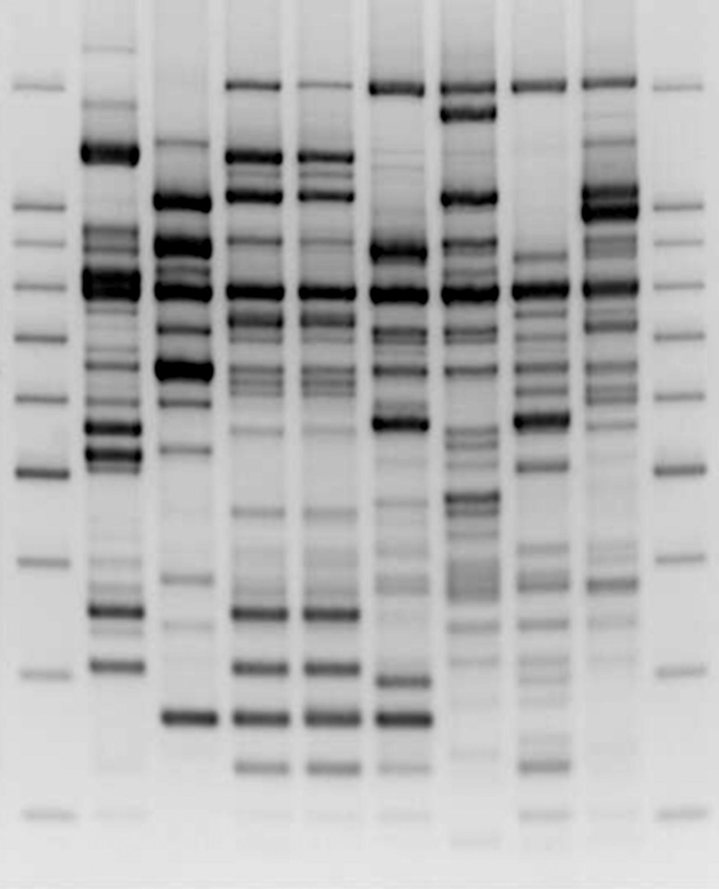
Mis/disinformation
Countering today's sophisticated disinformation requires educational approaches rooted in history, society, culture, and ethics.

Slide 6

Pedagogical Shift
Librarians must now teach metaliteracy rather than simple source verification, training students to see research as continuous, critical engagement within a volatile digital ecosystem instead of a hunt for a single correct answer.

Slide 7
Pillars of TRUST IN INFORMATION LITERACY
Librarian Student Rapport
Trust in the Information Ecosystem
Self Efficacy and Epistemic Trust

Slide 8
Librarian student rapport
Vulnerability
Guide v. Gatekeeper
foundation of safety

Slide 9
Trust in the information ecosystem
Decline of Proxies
Cynicism
erosion of traditional institutional authority

Slide 10
Self efficacy and epistemic trust
Combatting Checklists
Fostering Metaliteracy
trust in discernment

Slide 11
Application of theory

Slide 12
Critical race pedagogy
Intersectionality of race and racism
Challenge to dominant ideology
Commitment to social justice
Experiential knowledge
Interdisciplinary perspectives

Slide 13
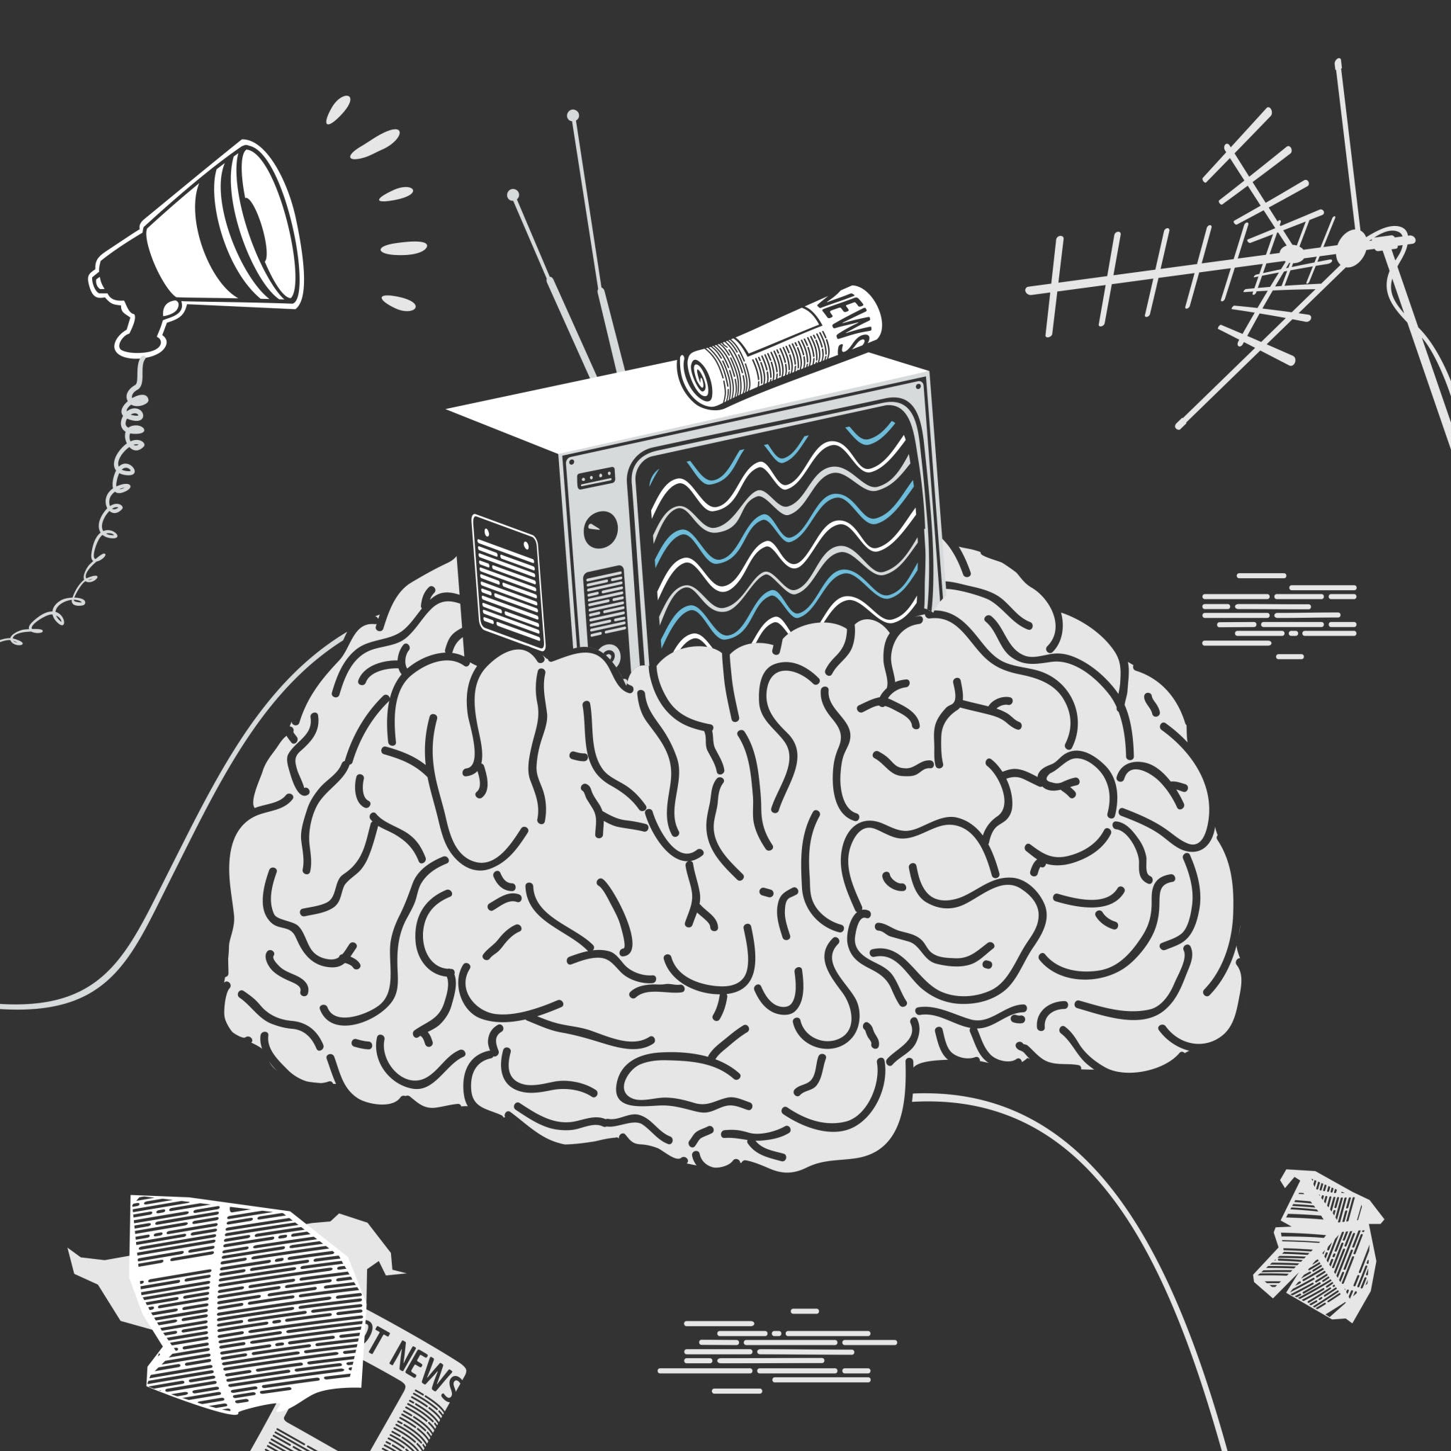


Critical race digital literacy
Offers a historical connection to its long-standing use as a tool for marginalization
Provides a lens to analyze how misinformation and disinformation are created, spread, consumed, and subscribed
Functions as a mechanism for rebuilding the "social contract" between information consumers and sources

Slide 14
Critical Race Digital lITERACY rUBRIC

Slide 15
Rubric Objectives
The objective of the rubric is not to establish an impractical standard that every librarian must meet, but rather to establish a resource that nurtures, empowers, and calls in those librarians who are enthusiastic about participating in this work.
It encourages educators interested in incorporating anti-racist practices into their teaching to participate in continual pedagogical and self-introspection, fostering a culture of deconstruction and reflection that shifts the focus from scoring to meaningful reflection and growth.

Slide 16
CRDL Rubric Categories
1
2
3
4
Historical and contextual understanding
Recognizing intersectionality
Challenge dominant perspectives
Commitment to social justice

Slide 17

Crdl Rubric categories
5
6
7
Experiential knowledge
Interdisciplinary approach
Reflection

Slide 18
CRDL Rubric & Trust
When an instructor uses the CRDL rubric to change how they teach, it alters the information environment the students experience
By moving away from binary "truth vs. falsehood" teaching and leaning into Lenker's (2023) relational approach, the instructor stops presenting information as a fragile, absolute construct that can be easily shattered. Instead, they show students how information is built, contested, and connected.
As a result of implementation the instructor designs lessons where students see "how ideas and accounts relate to each other." Trust shifts from who said it to how it connects to the broader web of knowledge. Students learn to trust information because they can trace its lineage, compare it to counter-arguments, and see its structural integrity. They develop trust in the scholarly and journalistic process of knowledge production rather than blind faith in a brand or gatekeeper.

Slide 19
Conclusion
We cannot transform information landscapes by standing at a distance or relying solely on institutional authority. We do it by engaging directly with the complexities, the skepticism, and the systemic challenges of our current moment, guiding our communities with empathy and critical insight.

Slide 20
References
Crilly, J. (2019). A reflexive lens: Critical librarianship at UAL. Art Libraries Journal, 44(2), 83–91. https://doi.org/10.1017/alj.2019.9
Lenker, M. N. (2023). Dwindling Trust in Experts: A Starting Point for Information Literacy. Communications in Information Literacy, 17 (2), 554–572. https://doi.org/10.15760/comminfolit.2023.17.2.12
Kuo, R., & Marwick, A. (2021). Critical disinformation studies: History, power, and politics. Harvard Kennedy School Misinformation Review, 2(4). https://doi.org/10.37016/mr-2020-76.
Marwick, A., Kuo, R., Cameron, S.J., & Weigel, M. (2021). Critical disinformation studies: A syllabus. Center for Information, Technology. & Public Life (CITAP), University of North Carolina at Chapel Hill https://citap.unc.edu/critical-disinfo
Pew Research Center. (2022). Americans’ trust in scientists, other groups declines. https://www.pewresearch.org/science/2022/02/15/americans-trust-in-scientists-other-groups-declines/
Tynes, B. M., Stewart, A., Hamilton, M., & Willis, H. A. (2021). From Google searches to Russian disinformation: Adolescent critical race digital literacy needs and skills. International Journal of Multicultural Education, 23(1), 110–130. doi:10.18251/Ijme.v23i1.2463
Solorzano, D.G. (1998). Critical race theory, race and gender microaggressions, and the experience of Chicana and Chicano scholars. International Journal of Qualitative Studies in Education, 11(1), 121–136. https://doi.org/10.1080/095183998236926

Slide 21
Thank
You!

