Slide 1
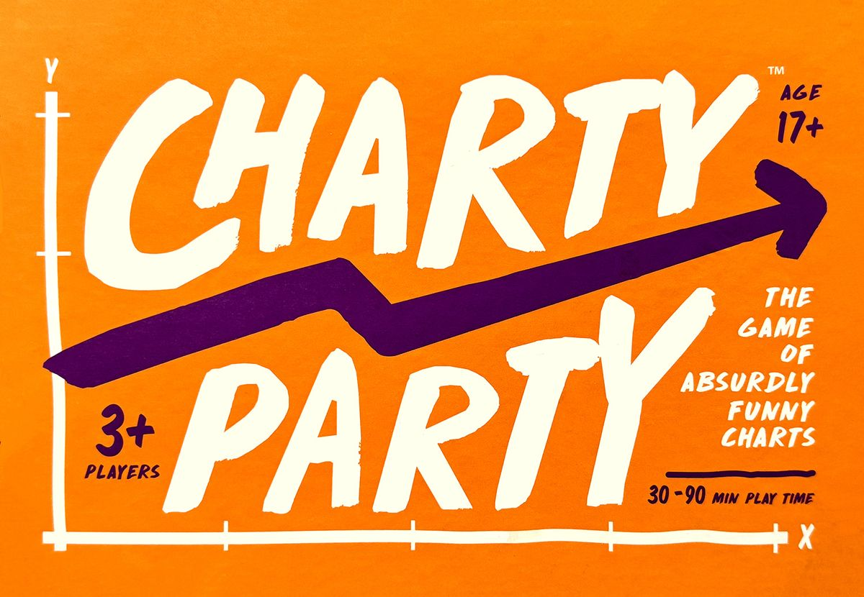
Trust Built Through Games-Based Methods
Jennifer Stubbs
Bradley University
CARLI Showcase
June 4, 2026
Notes:
Image: Chalk-style letters around a dynamic upward arrow as the cover art of Charty Party; reads Ages 17+, 3 or more players, plays for 30 to 90 minutes. Tag line, "The game of absurdly funny charts."

Slide 2
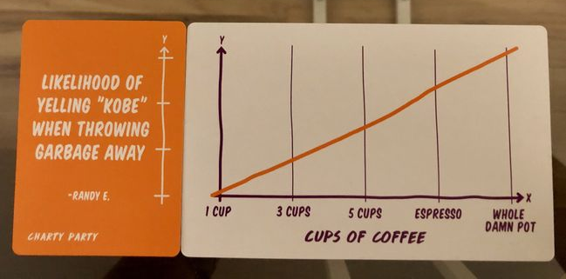
Notes:
Image shows two cards. One is a chart with a positive correlation of something in relation to the x-axis for cups of coffee from 1 cup to 5 cups to espresso to the whole pot. The other card reads, “Likelihood of yelling ‘Kobe’ when throwing garbage away.” to label the y-axis.

Slide 3
Agenda
Invitation, Consent, Lines and Veils: Safety tools
Empathy, disagreement, & affective response
1st round of Charty Party and a debrief
Metacognitive skills and techniques to expand windows of tolerance
Trust, authority, & empowerment
2nd round of Charty Party and debrief
Civic discourse, polarization, & agency
3rd round and debrief
Games today: collaborative, critical thinking, experiential learning, iteration
4th round and debrief
Questions from the audience
Notes:
In applying for this showcase, one application question was: How do we guide learners through AI, algorithms, and other powerful technologies responsibly? My response was:
By reminding everyone: people matter most. Algorithms are subject to us, our critical thinking, which is still unknown and cannot be replicated or replaced by any marketing hype or business over-promise. The zero session of role-playing games can introduce parameters for civil conversation, how to mediate miscommunications, and balancing extrovert-introvert dynamics through non-verbal cues, alternative pacing of content, and escape valves.

Slide 4
An Invitation to Play
Games are voluntary.
Coercion is not play. [This makes educational games murky.]
Consent is enthusiastic, vocal, ongoing, and freely given.
How would libraries change if we seek consent, and attend to our visitors’ agency in the information seeking process?
Notes:
Another question of this showcase’s organizers: How do we foster collaborative relationships with faculty and campus stakeholders while asserting our expertise as information professionals? My response:
Games! This may be my answer to everything. Modern games are collaborative/cooperative, foster strategic thinking without bogging down in long historical essays, and activate personality evaluation (who can you trust) without interrogation.

Slide 5
Round 1: Pages Deep in a Google Search
0 5 10 15 20
Notes:
This chart shows a steady negative slope from high on the Y axis to near zero in relation to the x axis counting number of pages deep in a google search, starting at zero and ending at 20 pages.

Slide 6
An Introduction to Lines and Veils
Lines and Veils are a safety tool in role playing games (Edwards, 2004).
Each player may disclose topics, events, objects that are a hard line “no.” They are asking the game manager to avoid using them in game scenarios.
A veil is a soft “no” of a situation, historical reference, or other noun which may be mentioned “off-screen” or in passing, but hopefully is not the center of a long, drawn-out scene.
You may type line or veil in chat or use the reactions ⛔ 🟡to alert me and the moderators if any slides, images, text, or voice catches you off guard.
Notes:
Any emoji that denotes stop (or something red) or slow down (caution or something yellow).
Ron Edwards, 2004 hosts a Google Spreadsheet of topics. Bee Zelda's blog explains how to use it.

Slide 7
Round 1: Your choice to label the Y (vertical) axis
Self-doubt
Appeal of a boring yet surprisingly lucrative factory job
Likelihood of participating in a pyramid scheme
How close you are to realising your complicated murder fantasies
Chance of actually getting something productive done
Notes:
I’ll copy these into the chat so you can see them while looking at the chart.
Self-doubt
Appeal of a boring yet surprisingly lucrative factory job
Likelihood of participating in a pyramid scheme
How close you are to realising your complicated murder fantasies
Chance of actually getting something productive done

Slide 8
Debrief 1
Oof. Was anyone expecting applied statistics?
Called up any negative memories?
These affective responses open doors of connection for us with students.
Do we disagree about the answers?
Can we locate evidence to support our nomination?
What kind of evidence would matter? Which wouldn’t?
If you were derailed: how to authentically share that discomfort or vulnerability to initiate empathy?
Notes:
Another question of this showcase application: How do we create inclusive learning environments in various modalities that recognize and respond to students? varied experiences of trust with authority, institutions, and information? And my response:
Games have explored these very issues for over a decade: X-card had problems; critical growth led to Safety Toolkit: students expect more agency and vocal, active, enthusiastic consent. If like me you are from a generation that is still a little uncomfortable with "consent" that's a learning opportunity for you: to empathize with students experiencing discomfort. Do you run from it? Suppress it? Act out? Space out? Example one: using AI (play pause rewind vs x-card response). Talking about the tool and the process can build trust, establish authority, through conversation with fellow (if new) adults.

Slide 9
Round 2: Pages Deep in a Google Search
0 5 10 15 20
Notes:
This chart shows a steady positive slope from near zero on the Y axis to as high as possible in relation to the x axis counting number of pages deep in a google search, starting at zero and ending at 20 pages.

Slide 10
Round 2: Your choice to label the Y (vertical) axis
Strong feelings about the pronunciation of GIF
Loneliness
Appeal of a boring yet surprisingly lucrative factory job
Likelihood of participating in a pyramid scheme
Reasons not to go out doors
Notes:
Strong feelings about the pronunciation of GIF
Loneliness
Appeal of a boring yet surprisingly lucrative factory job
Likelihood of participating in a pyramid scheme
Reasons not to go out doors

Slide 11
Debrief 2
Since the mid-90s games offer collaborative win conditions or cooperative play modes. Players must work together to unlock the winning conditions for completing a game successfully.
I find I can learn more about a person through playing a game. For example, trustworthiness, ability to lie or mislead, and flexibility in thinking or rule-bending.
Students are asking for ways to meet other students, to learn how to make groups. Party games (short, silly) can offer structure around which to meet new people and decide whom to follow up with as a potential friend.
Perhaps you share similar dislikes, quirky humor, or attention to detail.
Games in libraries (or one-shots) can contribute to a sense of belonging.

Slide 12
Round 3: Age
10 25 40 55 70

Slide 13
Round 3: Your choice to label the Y (vertical) axis
Ability to keep a secret
Excitement over your birthday
Success rate of "finger guns" as a pickup technique
Desire to own a pony
Interest in explosions

Slide 14
Debrief 3
Building further on windows of tolerance & empowerment:
During election years, such as 2026, information searching can feel polarizing. How to acknowledge the affective response of uncertainty, disagreement, or outright hostility?
Self-awareness and witnessing sensation, reaction, while modeling consciousness, patience, and measured or paced response can be empowering metacognitive tools to introduce students and faculty to during a one-shot or consultation.
Self-awareness becomes a foundation for competence upon which to build confidence.

Slide 15
Round 4: Age
10 25 40 55 70

Slide 16
Round 4: Your choice to label the Y (vertical) axis
Time spent talking about pooping
How many drug dealers you know
Interest in explosions
Being comfortable picking your nose
Disdain for youths

Slide 17
Debrief 4
Playing to the judge games, party games, or social deduction games are divisive.
Love / hate
Depends on the group, setting, specific game
Just like research: scholarship is a conversation, research as inquiry, strategic search
And there are options to explore unfamiliar topics, well-worn topics but from a new angle, assigned or personal
Agency in choice (topic and strategy) = affective response = adulting

Slide 18
Recap
Light party games as bell ringer to connect with vulnerability, empathy, and agency
Metacognitively discuss the affective element of information literacy: the discomfort of self-awareness, self-advocacy, and ways to self-regulate
Lines and veils as invitation to push own’s comfort zone while also exploring one’s consent
Self-awareness, agency, and consent build our windows of tolerance, which we can also close for stormy weather
I invite you to explore with another instructor how to play-test safety tools in a discussion or sharing a game to meet our students as adults.

Slide 19
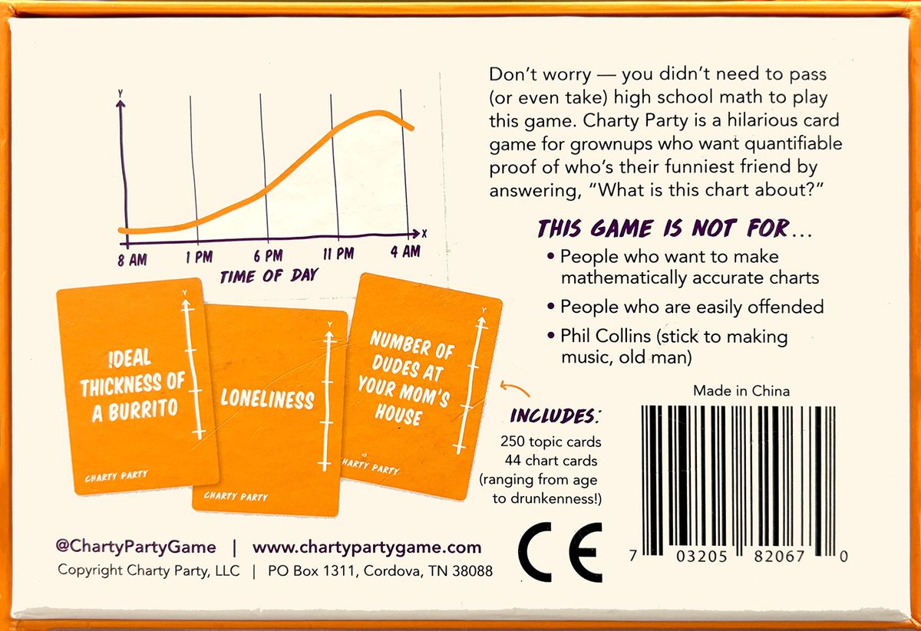
Questions?
Jennifer Stubbs
jastubbs@bradley.edu
Notes:
Image of the game's reverse. An example chart of time of day on the x axis, 8am, 1pm, 6pm, 11pm, and 4am. The response options are: ideal thickness of a burrito, loneliness, or number of dudes at your mom's house.
The rest of the box reads: "Don't worry—you didn't need to pass (or even take) high school math to play this game. Charty Party is a hilarious card game for grownups who want quantifiable proof of who's their funniest friend by answering, 'What is this chart about?' This game is not for … people who want to make mathematically accurate charts; people who are easily offended; Phil Collins (stick to making music, old man)." Copyright Charty Party, LLC in Cordova, TN
The box includes 250 topic cards, 44 charts, ranging from age to drunkenness.

