Slide 1

Introduction to Name Authorities
CARLI Technical Services Q&A, June 20, 2024
Brent Eckert, Technical Services Librarian

Slide 2
Session Description
This session is intended to cover basic, practical issues regarding name authority records in basic cataloging. It will include some theory and emphasize how to formulate name headings (authorized access points). Copy cataloging examples using OCLC Connexion client will be used.
Please note: All references to RDA are to original RDA. Much of the content of this presentation is taken, with permission, from a presentation by Felicity Dykas and Tammie Busch given at the Missouri Library Association Annual Conference, 2018.

Slide 3
Purpose and Value of Authority Records
One unique access point for each entity
Differentiate/disambiguate and collocate
Document information about the access point
Saves time of the user by bringing together all works of an author under one uniform name heading and separating works by different authors with the same name.

Slide 4
Types of Authority Records in OCLC
Name Authority Records
Personal names
Corporate/Conference names
Geographic names
Title Authority Records
Series titles
Uniform titles
Subject Authority Records
LCSH, LCSH Subdivision Headings, Children’s Subject Headings
Genre Authority Records
LCGFT

Slide 5
RDA Principles (0.4.3)
Differentiation
  Different people using the same name:
  Simon, Paul, 1928-2003 (the politician)
  Simon, Paul, 1941- (the musician)
  And one person using more than one name (pseudonyms):
  Suess, Dr. vs. Geisel, Theodor Suess, 1904-1991
Representation
  Use most common form of name for person:
  Starr, Ringo, not Starkey, Richard

Slide 6
RDA Principles (0.4.3)
Common Usage or Practice
  Follow rules of person’s language or country
  Gogh, Vincent van, 1853-1890 (Dutch artist)
  Van Gogh, Anna, 1931- (American author)
Uniformity
  Use RDA guidelines to achieve uniform appearance of headings
  King, Mitchell C. (Mitchell Campbell), 1815-1901
  King, Martin Luther, Jr., 1929-1968

Slide 7
Authority Guidelines and Standards
RDA Section 3. Recording attributes of agents
Chapter 8. General guidelines on recording attributes of agents
Chapter 9. Identifying persons
Chapter 10. Identifying families
Chapter 11. Identifying corporate bodies
LC-PCC PS
Policy statements (included in RDA) that record cataloging practices of Library of Congress and Program for Cooperative Cataloging
NACO guidance: https://www.loc.gov/aba/pcc/naco/index.html

Slide 8
Program for Cooperative Cataloging
NACO=Name Authority Cooperative Program
SACO=Subject Authority Cooperative Program
BIBCO=Monographic Bibliographic Record Cooperative Program
CONSER=Cooperative Online Serials Program

Slide 9
CARLI NACO Full Members
University of Illinois, Urbana-Champaign
University of Illinois, Chicago
University of Chicago
Northwestern University
Illinois State University
Newberry Library
Wheaton College

Slide 10
Other Illinois NACO Full Members
Cooperative Computer Services
Arlington Heights Memorial Library
Barrington Area Library District
Chicago Public Library
Art Institute of Chicago
Illinois Heartland Library System
Center for Research Libraries
Follett School Systems
Highland Park Public Library
Cook Memorial Public Library
Mount Prospect Public Library
Indian Trails Public Library District

Slide 11
CARLI Illinois NACO Funnel Members
Rock Valley College
Joliet Junior College
University of St. Mary of the Lake Mundelein Seminary
Pritzker Military Library

Slide 12
How to Become a NACO Library
Application
Training
Review period
Optional additional training for title authority records

Slide 13
Basic Steps of Authority Work
Search for authority record
Determine the preferred name
Establish the form of the name (authorized access point)
Document your work in an authority record (if applicable)

Slide 14
Scenario 1
Authority record found in LC NAF (OCLC or LC)
Use 1XX field from authority as authorized access point in bib record

Slide 15
Scenario 2
No authority record found (and no conflict with other names in LC NAF)
RDA 8.6 Authorized Access Points Representing Agents
When constructing an authorized access point to represent an agent, use a preferred name for a person (see 9.2.2), a preferred name for a family (see 10.2.2), or a preferred name for a corporate body (see 11.2.2) as the basis for the access point.
RDA 9.2.2.3 Choosing Preferred Name for Person
When choosing a preferred name for person, generally choose the name by which the person is commonly known. The name chosen can be the person’s real name, pseudonym, title of nobility, nickname, initials, or other appellation.

Slide 16
Scenario 2 cont’d
If preferred name is not clear (RDA 9.2.2.5)
If no form predominates, choose the latest form as the preferred name. In case of doubt about which is the latest form, choose the fuller or fullest form.
Record another form of the name as a variant name for person

Slide 17
Scenario 2 cont’d
Search WorldCat and the Internet to establish by which name or form of name a person is commonly known
Helpful websites:
  Wikipedia
  Wikidata
  Imdb.com
  Author’s personal website, employer’s website
  LinkedIn
  Any other credible website
If there is no other authority record using the same form of name, use preferred name for authorized access point

Slide 18
Scenario 3
No authority record found and preferred name conflicts with an access point in an existing authority record. (Same name used by more than one person)
RDA 9.19 Constructing Access Points to Represent Persons
Use a preferred name for person as the basis for the authorized access point.
Include the additional elements specified at 9.19.1.2-9.19.1.8 if they are needed to distinguish access points representing different persons with the same name.

Slide 19
Scenario 3 cont’d
RDA 9.19 Additional Elements Used to Differentiate Name
9.19.1.2 Title or other designation
9.19.1.3 Date of birth and/or death
9.19.1.4 Fuller form of name
9.19.1.5 Period of activity of person
9.19.1.6 Profession or occupation
9.19.1.7 Other term of rank, honour, or office
9.19.1.8 Other designation

Slide 20
Scenario 3 cont’d
RDA 9.19.1.2 Title or other designation associated with the person
Title of person=A word or phrase indicative of royalty, nobility, ecclesiastical rank or office, or a term of address for a person of religious vocation
Always add:
A title of royalty: Catherine, Duchess of Cambridge, 1982-
A title of nobility: add if it commonly appears with the name: Barresi, Matteo, machese di Pietraperzia, -1531 or 1532
A title of religious rank: John Paul I, Pope, 1912-1978
The term Saint: add unless the access point represents a pope, emperor, king, or queen: Francis, of Assisi, Saint, 1182-1226
The term Spirit: Presley, Elvis, 1935-1977 (Spirit)
Add if needed to differentiate: other designation associated with person; for persons names in sacred scripture, term Fictitious character, term indicating type, species, or breed: e.g., Biblical figure, Cat, Fictitious character

Slide 21
Scenario 3 cont’d
RDA 9.19 Additional elements used to differentiate name (common order of preference)
9.19.1.3 Date of birth and/or death
9.19.1.4 Fuller form of name
9.19.1.6 Profession or occupation
9.19.1.7 Other term of rank, honour, or office
9.19.1.5 Period of activity of person
9.19.1.8 Other designation

Slide 22
Scenario 3 cont’d
RDA 9.19.1.3 Date of birth and/or death
Take from any source
Include date of birth and/or death if needed to distinguish one authorized access point from another. Record year alone, unless additional information is needed for differentiation.
LC-PCC PS
  Add a date of birth and/or date of death to new authority records, even if not needed to distinguish between access points

Slide 23
Scenario 3 cont’d
Examples:
Richardson, Alan, $d 1949-
Richardson, Alan, $d 1905-1975
Richardson, Anne, $d 1942-
Richardson, Anne, $d 1942 December 22-
Richardson, Anne, $d -1803
Richardson, Albert, $d approximately 1906-
Aguilar, Manuel Marques, $d 1767-approximately 1816

Slide 24
Scenario 3 cont’d
RDA 9.19.1.4 Fuller form of name
A name or names … that includes the fuller form of a part of any name represented only by an initial, abbreviation, or shortened or otherwise modified variant in the form chosen as the preferred name and/or a part of the name not included in the form chosen as the preferred name.
Take from any source
LC-PCC PS
  Apply the option to provide a fuller form of name if part of the forename or surname used in the preferred name is represented by an initial or an abbreviation, if the cataloger considers it important for identification. Add unused forenames or surnames only if needed to distinguish one access point from another.

Slide 25
Scenario 3 cont’d
Examples:
Smith, Beth $q (Alice Elizabeth)
Smith, Beth A. $q (Beth Ann)
Smith, T. $q (Trevor)
Smith, T.A., $q (Theresa A.)
Smith, T.A., $q (Thomas Alan)

Slide 26
Scenario 3 cont’d
RDA 9.19.1.6 Profession or occupation
A person’s vocation or avocation
Take from any source
LC-PCC PS
  When adding a profession or occupation term to an access point in 100 $c use a singular form of the term
  Generally do not apply option to add when not needed
  Applicable guidelines from 9.16
  Use term from controlled vocabulary
  Do not record terms qualified by gender, nationality, ethnicity, religion, sexual orientation, or other characteristics that are not strictly occupational. However, inherently gendered occupation terms (e.g., Nuns) may be used if nothing else is suitable.

Slide 27
Scenario 3 cont’d
Examples:
Adams, David $c (Family historian)
Smith, A. W., $c (Suspense fiction writer)
Smith, A. W., $c (Telegrapher)
Smith, Alison, $c (Personal coach)
Smith, Alison, $c (Writer on youth services)
Smith, Abby, $c (Art educator)
Smith, Abby, $c (Beauty expert)

Slide 28
Scenario 3 cont’d
RDA 9.19.1.7 Other term of rank, honour, or office
Include if the term appears with the name (see 9.4.1.9) and if needed to distinguish one authorized access point from another
Record the term in the language in which it was conferred or in the language used in the country in which the person resides. (9.4.1.9)
LC-PCC PS
  In addition to differentiation, apply if the cataloger considers it important for identification.

Slide 29
Scenario 3 cont’d
Examples:
Anderson, Lara, $c Ph. D.
Lee, Fiona, $c Reverend
Saunders, Cicely M., $c Dame
Arthur, Allan, $c Sir

Slide 30
Scenario 3 cont’d
RDA 9.19.1.5 Period of activity of person
A date or range of dates indicative of the period in which a person was active in his or her primary field of endeavor (9.3.4.1)
Take from any source
In RDA, there are no restrictions on time period in which this can be used.

Slide 31
Scenario 3 cont’d
Examples:
Abbott, Sarah, $d active 1690-1701
Abbott, William, $d active 19th century
Baker, T., $d active approximately 1835-1845
Bao, Jingyan, $d active 3rd century-4th century

Slide 32
Scenario 3 cont’d
RDA 9.18.1.8 Other designation
Include an appropriate other designation if needed to distinguish one authorized access point from another. Include the element when the person’s date of birth or date of death is not available and another designation associated with person is not applicable.
LC-PCC PS
  When recording an Other designation associated with person for RDA 9.6.1.6-9.6.1.9, choose a term that is sufficiently specific to distinguish the person from other persons with the same name. Prefer a controlled vocabulary, when appropriate.

Slide 33
Scenario 3 cont’d
Examples:
Allison, Marcia $c (Contributor to Jokes for all the family)
Chopin, Isabelle $c (Of the Migration Policy Group)
Gibson, Bob $c (Spouse of Doll Gibson)
Harris, Rebecca $c (Member of Parliament)
Little, Tony $c (Chair of the Liberal Democrat History Group)
Wang, Dong $c (Wife of Chih-tsing Hsia)
White, Emma $c (Author at the Rosen Publishing Group)

Slide 34
Undifferentiated Name Authority Records
No longer valid under RDA
Can use “Other designation” to create authorized access point

Slide 35
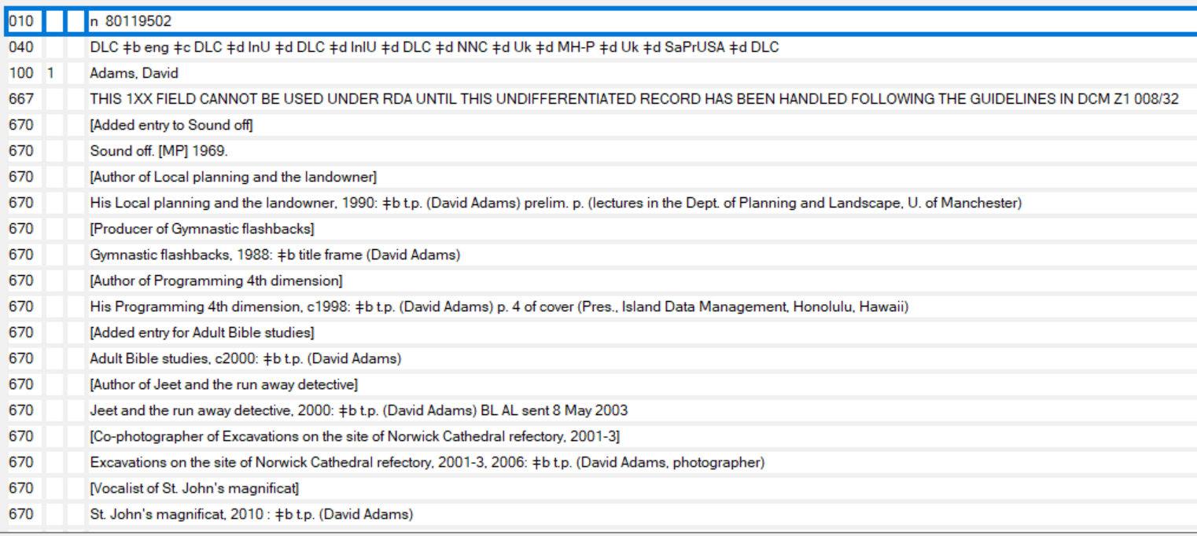
Undifferentiated NAR

Slide 36
Tips for Dealing with Name Authorities in Copy Cataloging
If name authorized access point is controlled in WorldCat record, assume it is correct, unless suspect otherwise.
If name authorized access point is not controlled in WorldCat, check it. If correct NAR found, control heading and replace bib record. But don’t control heading if you are not sure it is the same person.
If no authority record found
  Create NAR, if NACO library
  Ask OCLC to create NAR: authfile@oclc.org
  Ask NACO library/cataloger to create NAR (directly or on Autocat or OCLC-CAT)
  Don’t worry about NAR, just be sure authorized access point is formulated correctly

Slide 37
Summary of Formulating Name Authorized Access Points
Use form of name person most commonly known by
Always add birth and/or death dates, if readily found
If needed to differentiate identical access points, add element such as fuller form of name or occupation (e.g., $c (Actor))

Slide 38
Cataloging Examples in Connexion
Questions and Discussion
Contact information
  Brent Eckert
  B.Eckert@rockvalleycollege.edu
  (815) 921-4604

