Slide 1
Prediction Patterns and Serial Check-in
Yoel Kortick Senior Librarian
https://www.visitspokane.com/media/photo-gallery/

Slide 2
Introduction
The prediction pattern
Opening the predicted items
Receiving (check-in)
https://slidemodel.com/templates/animated-rainbow-business-powerpoint-template/
http://image.shutterstock.com/z/stock-photo-business-hand-writing-blank-agenda-list-130255148.jpg

Slide 3
Introduction
In order for prediction patterns to be used there must be
An acquisitions order
An 853/4/5 captions and pattern field in the holding record
Information registered in the ‘Next predicted item’s information’

Slide 4
Introduction
The acquisitions order is needed because information must be taken from the vendor
For example the issue’s “Expected Date of Arrival” will be taken from a combination of
The vendor “Subscription interval” in the order record
The “issue date” of the expected issue
Expected date of arrival = ‘issue date’ + ‘Subscription Interval’

Slide 5
Introduction
The 853/4/5 captions and pattern field in the holding record is needed because this is where information such as publication frequency and publication dates will be taken from.
The captions and pattern field must reside in the holding record which is associated with the specific order

Slide 6
Introduction
The “Next predicted item’s information“ is needed because this will determine the dates for the start and remainder of the specific issue cycle

Slide 7
Introduction
The prediction pattern
Opening the predicted items
Receiving (check-in)
https://slidemodel.com/templates/animated-rainbow-business-powerpoint-template/
http://image.shutterstock.com/z/stock-photo-business-hand-writing-blank-agenda-list-130255148.jpg

Slide 8
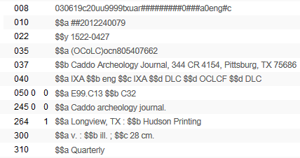
The prediction pattern
We have bibliographic record MMSID 99137610800121
Title “Caddoan archeology journal”
This is a quarterly journal

Slide 9
The prediction pattern
Library makes purchase order line POL-44785 for this record
It will begin with: Volume 12 Issue 1 Year 2018
The order is made using vendor ‘J and S Ltd.’
The “Subscription interval” is “30”

Slide 10
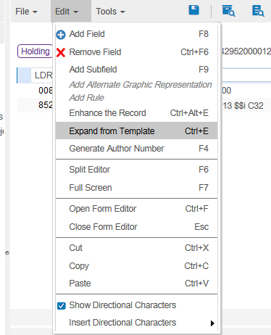
The prediction pattern
In the holding record (which gets created automatically when the order is created) the librarian adds field 853 for a quarterly journal.
The librarian can use a predefined template when adding field 853, and make only the necessary changes if needed.

Slide 11
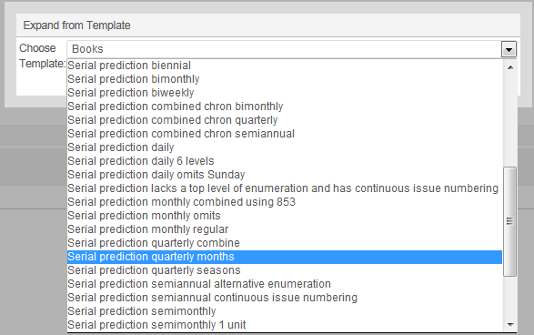
The prediction pattern
‘Out of the box’ there are many prediction patterns – one for nearly every possible situation. These contain 853 captions and pattern fields as well as 590 note fields.
We will choose ‘Serial prediction quarterly months’

Slide 12
The prediction pattern
The 853 (and 590) get added to the holding record from the template

Slide 13
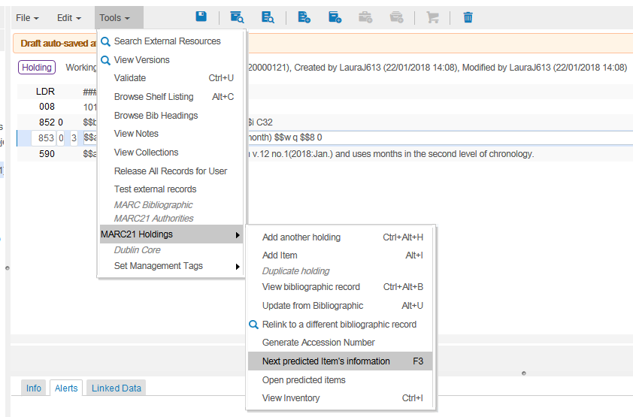
The prediction pattern
Put cursor on 853 field and choose ‘Tools > Marc21 Holdings > Next predicted item’s information’

Slide 14
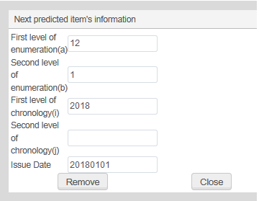
The prediction pattern
Fill in as desired
Starts with Vol. 12 Issue 1 Year 2018. First issue date is Jan.01 2018

Slide 15
The prediction pattern
In order for the predication pattern mechanism to work the ‘issue date’ of the expected items must be within the range of the subscription ‘from’ date and subscription ‘to’ date within the order.
The issue dates of the predicted items must be within this range

Slide 16
The prediction pattern
After the next predicted item’s information has been entered the 853 field will have a link to this information
Link to the Next predicted item’s information

Slide 17
The prediction pattern
The 853 captions and pattern field contains standard MARC information
Prefix for enumeration a
Published 4 times a year
The issue repeats each cycle
Enumeration i will be in parentheses
Prefix for enumeration b
Quarterly publication

Slide 18
Introduction
The prediction pattern
Opening the predicted items
Receiving (check-in)
https://slidemodel.com/templates/animated-rainbow-business-powerpoint-template/
http://image.shutterstock.com/z/stock-photo-business-hand-writing-blank-agenda-list-130255148.jpg

Slide 19
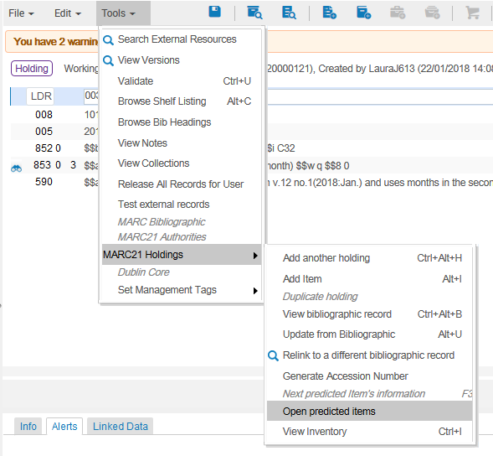
Opening the predicted items
Now we can ‘Open predicted items’

Slide 20
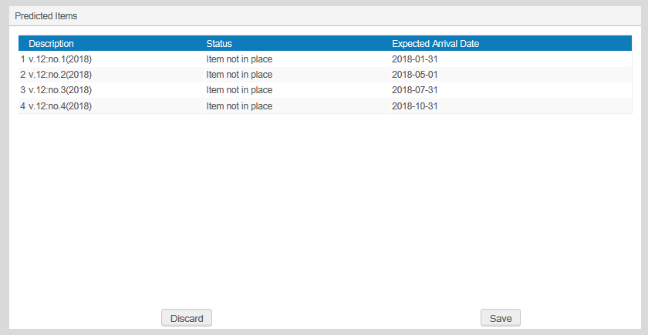
Opening the predicted items
The information for the predicted items of the cycle appears and the user can ‘save’ or ‘discard’
This information appears in accordance with the 853 field: $$a v. $$b no. $$i (year)
The expected arrival date is the ‘Issue date’ + the ‘Subscription Interval’
We will click “Save”

Slide 21
Opening the predicted items
In our example, we saw that the
1st issue has expected arrival date 2018-01-31
2nd issue has expected arrival date 2018-05-01
3rd issue has expected arrival date 2018-07-31
4th issue has expected arrival date 2018-10-31
The first ‘issue date’ was 20180101 and the order ‘subscription interval’ was ‘30’ therefore the first expected arrival date is 20180131 (which is 20180101 + 30)
853 subfield u had ‘4’ and subfield w had ‘q’ so it is quarterly with 4 issues per cycle: therefore ~90 days between each issue

Slide 22
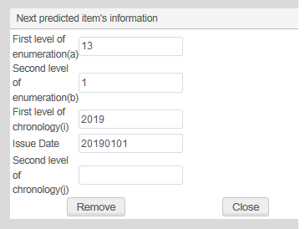
Opening the predicted items
After the cycle of issues is opened the ‘Next predicted item’s information’ automatically ‘jumps’ to the next cycle
Now it is Volume 13 year 2019. Previously it was volume 12 year 2018.

Slide 23
Introduction
The prediction pattern
Opening the predicted items
Receiving (check-in)
https://slidemodel.com/templates/animated-rainbow-business-powerpoint-template/
http://image.shutterstock.com/z/stock-photo-business-hand-writing-blank-agenda-list-130255148.jpg

Slide 24
Receiving (check-in)
All four predicted items of the cycle have been created with no receiving date (because they have not yet been received)

Slide 25
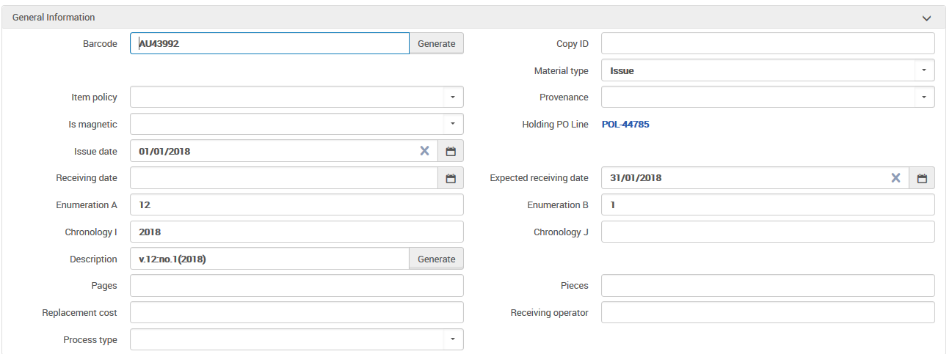
Receiving (check-in)
Each item has an expected receiving date
The description (as previously stated) is in accordance with 853 pattern field

Slide 26
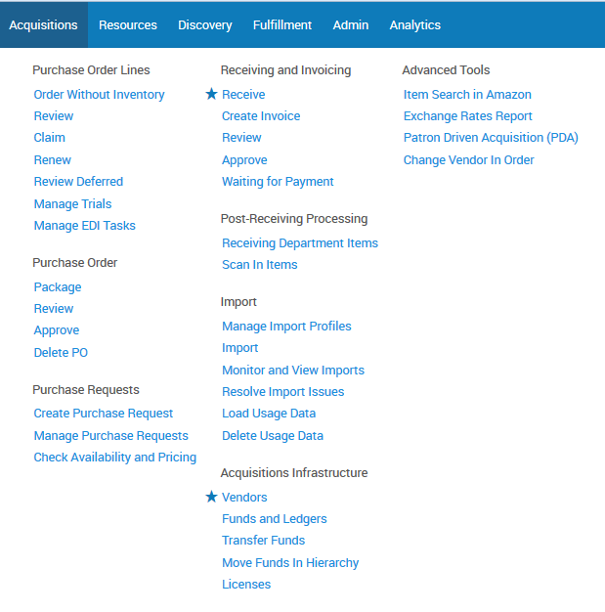
Receiving (check-in)
The staff user is at the acquisitions department (or a circulation desk which is defined to also function as an acquisitions desk) and does “Acquisitions > Receiving and Invoicing > Receive”

Slide 27
Receiving (check-in)
In the receiving workbench we retrieve the journal

Slide 28
Receiving (check-in)
We will choose “Actions > Manage Items”

Slide 29
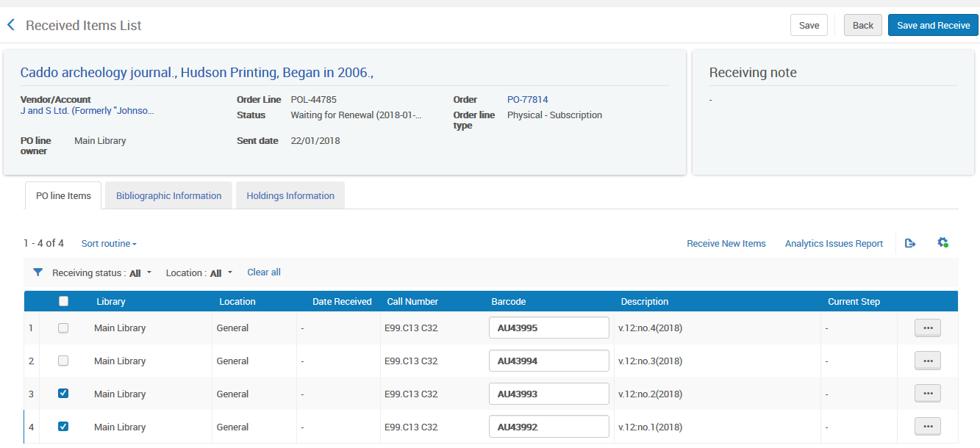
Receiving (check-in)
Now we receive the items.
We can click the checkbox(es) on the left and then click “Save and Receive” or we can do “Actions > Receive” per item
We will now receive Volume 12 numbers 1 and 2

Slide 30
Receiving (check-in)
The user now sees which items have already arrived and which items have not yet arrived

Slide 31
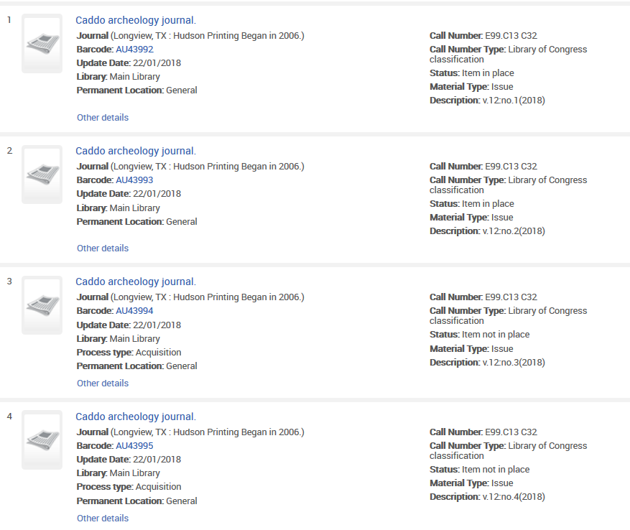
Receiving (check-in)
When doing a physical item search we see that Vol. 12 issues 1-2 are in place but issues 3-4 are not in place (not arrived)

Slide 32
Receiving (check-in)
When we did “Receive” the items immediately became “in place”. We could have set it up so that the items would have remained in the acquisitions department for further processing until scanning them into the circulation desk.

Slide 33
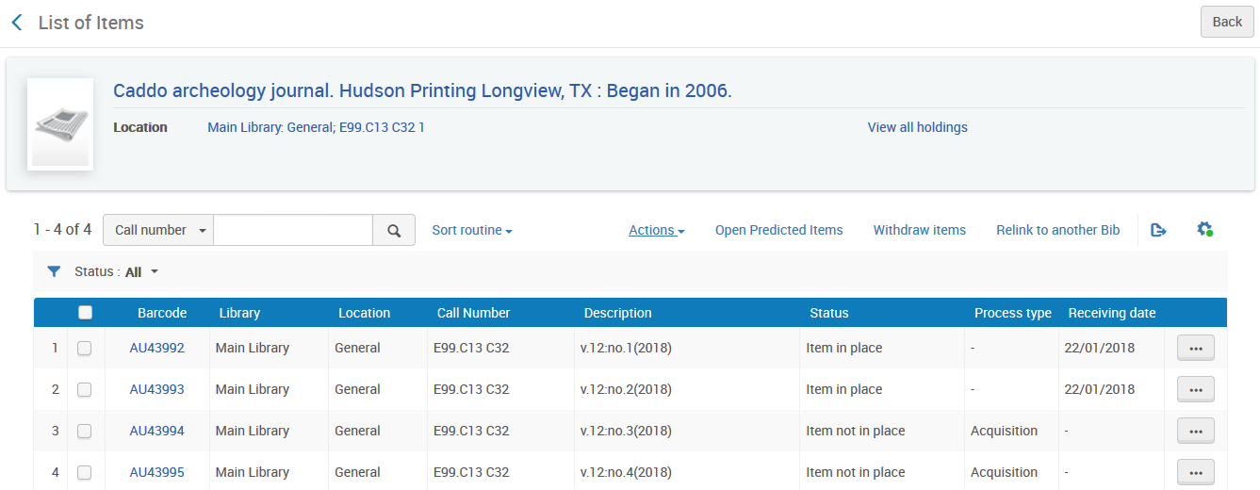
Receiving (check-in)
We can also see from the items list what has and has not arrived.
We will click here now to open the next cycle of predicted items
Here we see what did and did not arrive and when

Slide 34
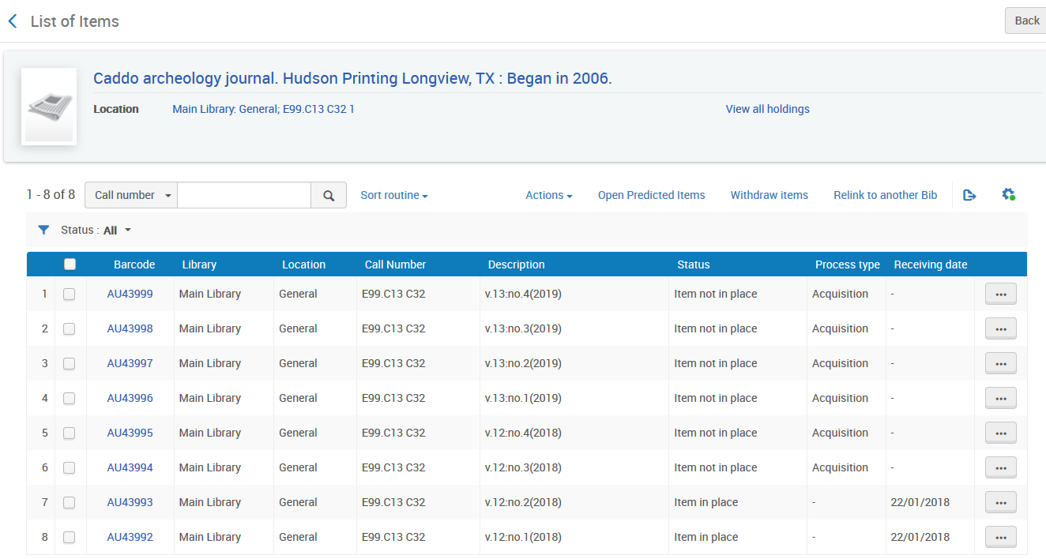
Receiving (check-in)
Now the next cycle has opened (Vol. 13).
We continue the process: Receive and open new items as needed

Slide 35
Thank you

