Slide 1
SIUE's Inventory project
Tammie Busch and Stacey Haas
Southern Illinois University Edwardsville

Slide 2
Backstory
Discrepancy in WorldCat holdings versus actual holdings
OCLC's streamlined holdings update
Weeding project
Alma Shelf Report Tool pilot
Alma Interactive Inventory Scanning Tool pilot and implementation

Slide 3
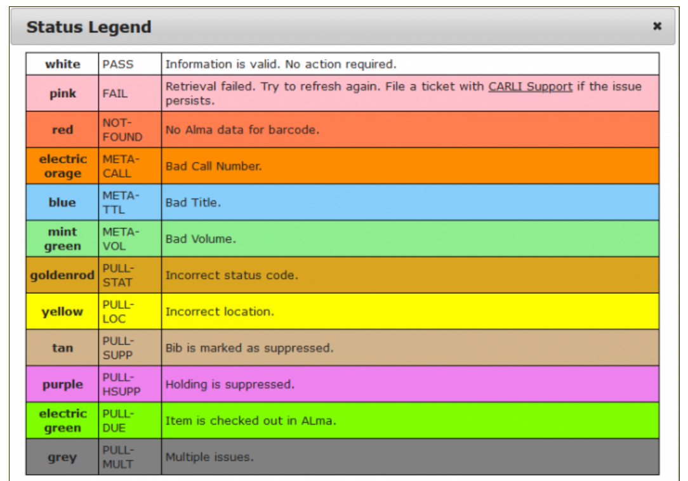
Interactive inventory scanning tool statuses

Slide 4
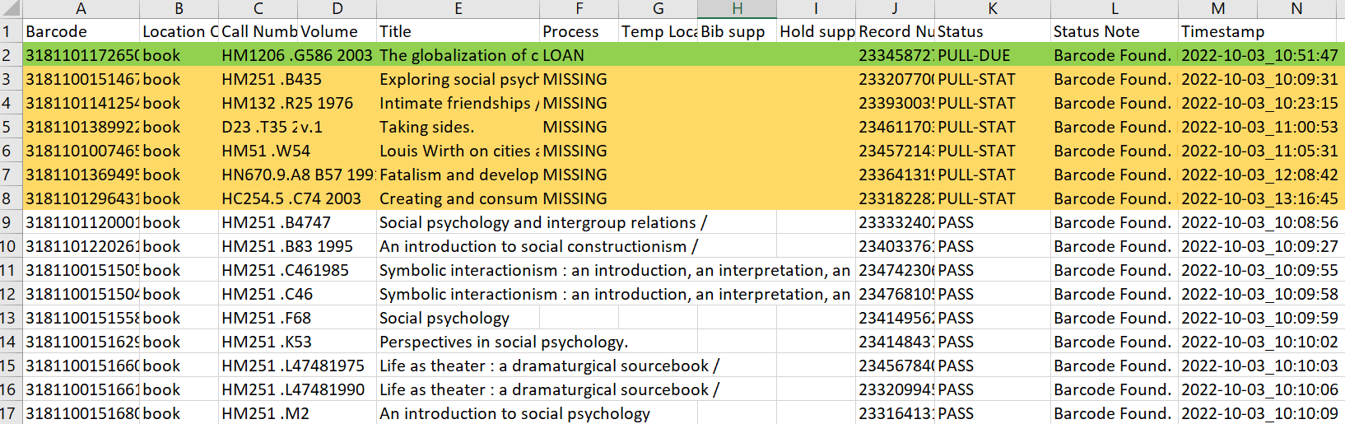
Interactive inventory
Session download

Slide 5
Inventory tools
Shelf report
Interactive inventory
Pros
Fast
Minimal training
No decision making
Cons
Satan's List
Pros
Identify issues in real time
No Satan's List
Cons
More training
Items missing from shelf

Slide 6
General obstacles
More in-depth training and documentation
38888 barcodes
Outdated circulation data

Slide 7
My Steps
Hire Students
Fix Pre-inventory Issues
Teach Students Scanning
Post inventory clean up

Slide 8
Student onboarding
Created a training module for students
Ex Libris’ Physical Resources in Alma https://knowledge.exlibrisgroup.com/Alma/Training/AlmaEssentials/Alma_Essentials_-_English/A_Terminology_and_Inventory_Models/A_Physical_Resources_in_Alma
Library of Congress Classification System https://www.youtube.com/watch?v=Vdh3O5PdEiw
Georgetown University Library's Inventory Process for the Alma Library System https://www.youtube.com/watch?v=PW_hdI65h10

Slide 9
scanning
The students were shown how to scan and what to do with problem items

Slide 10
Pre-inventory
Paving the way for the students to scan with fewer interruptions

Slide 11

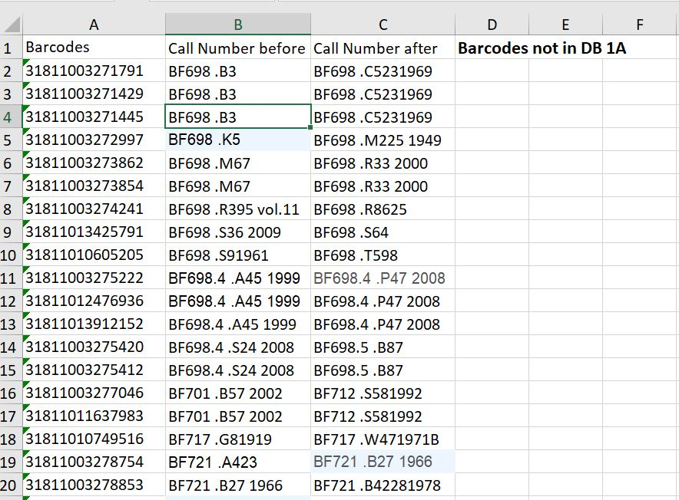
Barcodes not in Database (Satan’s List)
This Photo by Unknown Author is licensed under CC BY-NC

Slide 12
Real time scanning benefits
More efficient
Faster
No “Satan’s list”

Slide 13
THANK YOU
Please feel free to contact us with questions!
Tammie Busch
tabusch@siue.edu
Stacey Haas
shaas@siue.edu

