Slide 1
Making lemonade out of lemons -
Alma’s Electronic Resource Activation Task List
Andrea Imre, Southern Illinois university Carbondale
CARLI open office hours presentation
November 10, 2022

Slide 2

Where is the Lemon?
Resources menu → Manage Inventory section → Manage Electronic Resource Activation
When a new POL is created for an e-resource, Alma automatically populates the task list and adds the resource to the Activation Task List.
Typically you activate a resource, verify access, and then remove a resource from the task list by selecting Done using the ellipses.
Small technical services departments are less likely to find this Alma feature valuable than larger ones.
Notes:
If you are in a small school, you might find this feature annoying as you probably already took care of all activation steps without ever touching this task list which means that the task list creates an additional step for you.

Slide 3
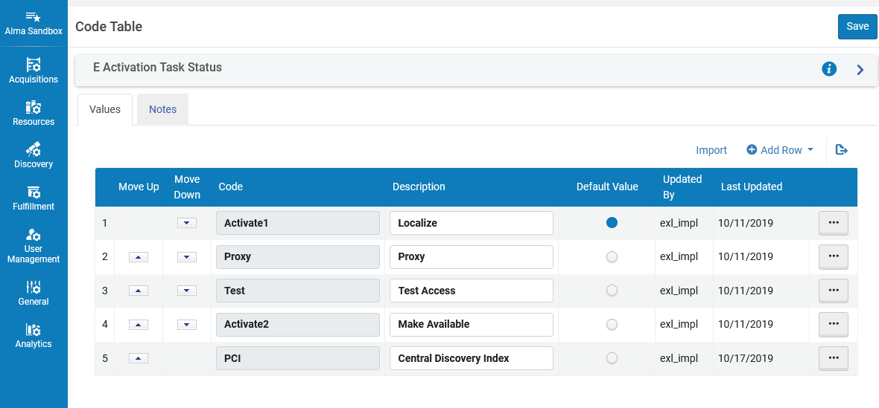
Default settings in Alma
Configuration → Resources → General → E Task Statuses

Slide 4
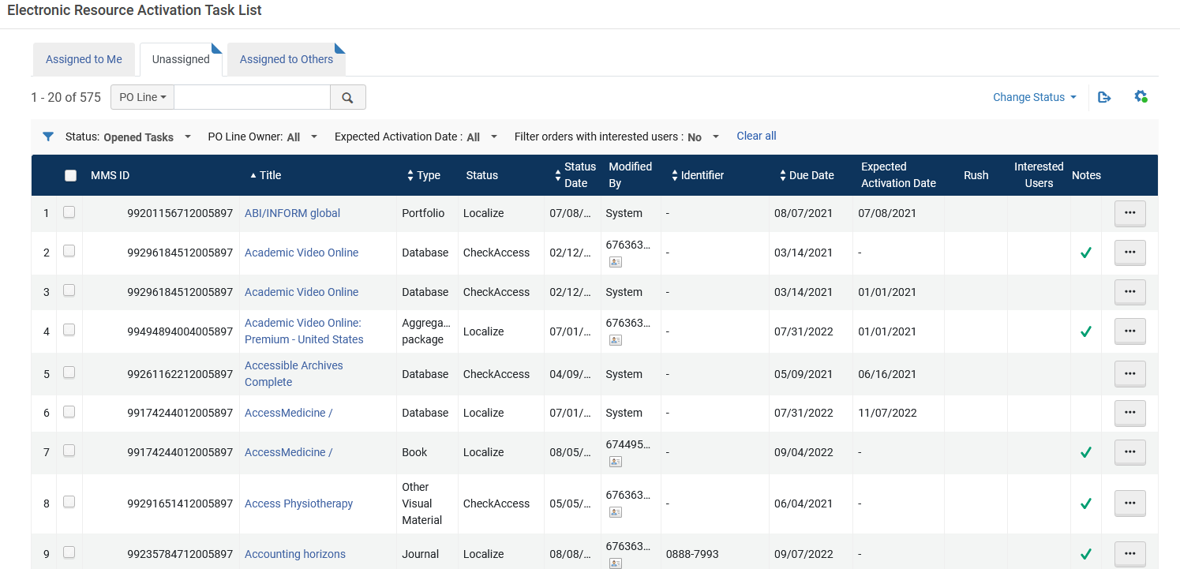
Resources are added to the Task list based on Alma’s default settings
Notes:
This example is from the sandbox. As we can see, many of the due dates and expected activation dates a in the past.

Slide 5
Make Lemonade out of Lemons
Customize Task Statuses to improve your workflows. Examples:
  Title(s) to be cancelled for next subscription year
  Upcoming publisher changes
  Upcoming platform changes
  Upcoming title changes
  Upcoming content changes in packages (e.g., eDuke, Project Muse)
  Resources that require manual harvesting of usage stats
  Problematic titles where access needs to be checked periodically
Notes:
No need to keep sticky notes on your desk, create outlook reminders or rely on other tools to keep track of upcoming e-resource tasks when you can use Alma to do all those things for you.

Slide 6
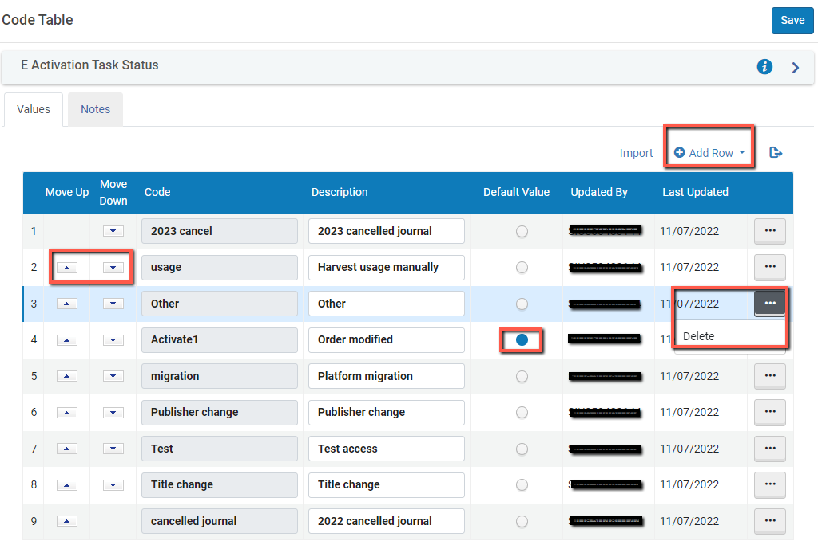
Customizing E Task statuses
Notes:
Delete existing tasks
Add New Tasks
Designate default value
Change order of tasks

Slide 7
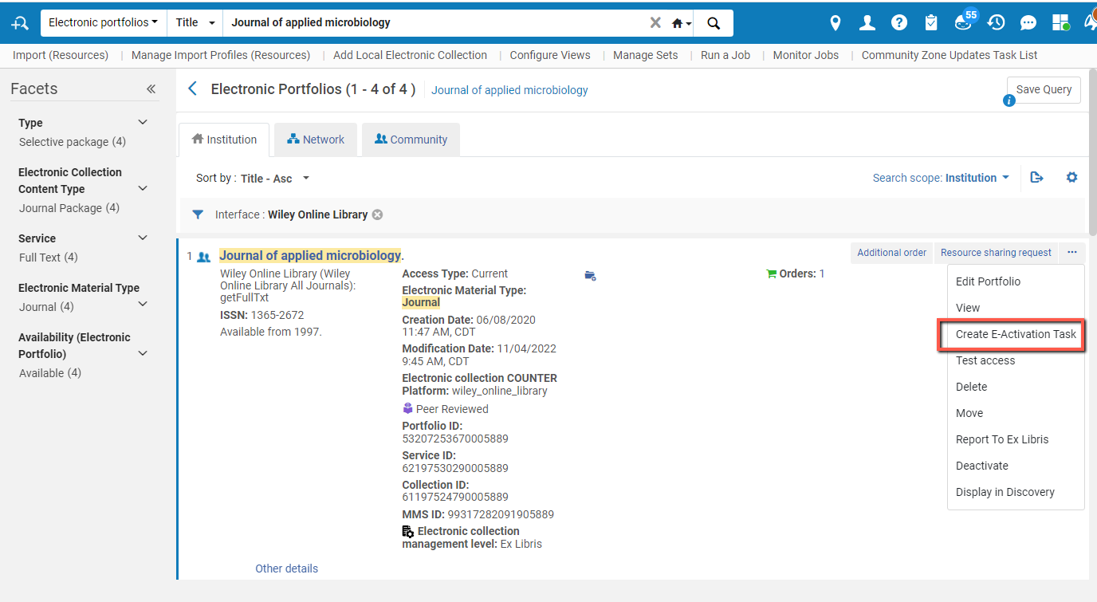
Manually add portfolios or collections to your Activation Task List

Slide 8
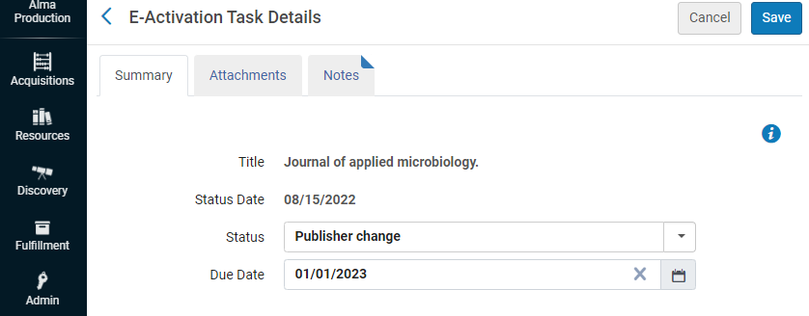
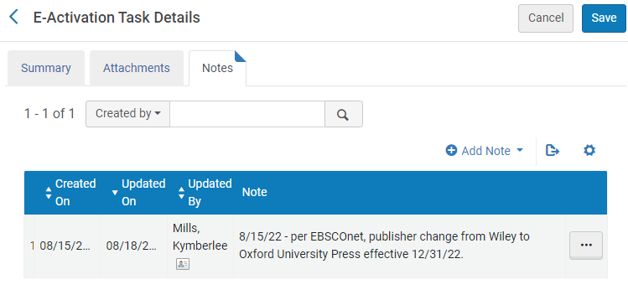
Customize task status and add notes

Slide 9
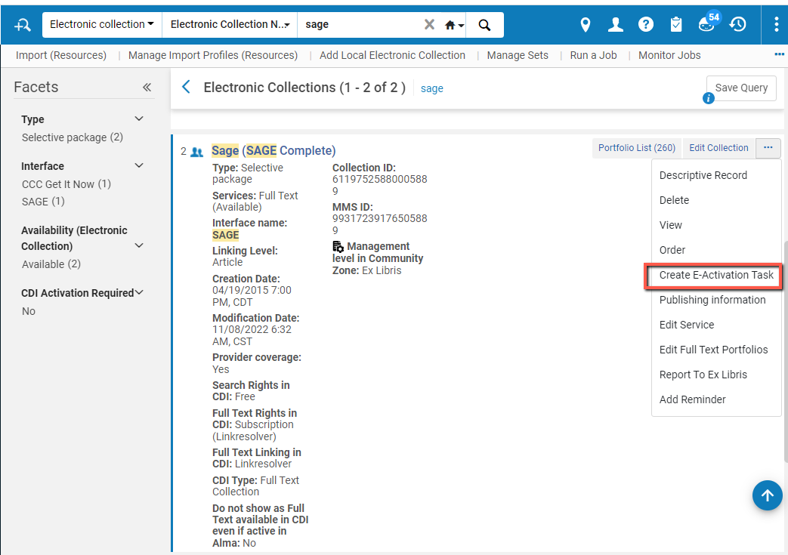
Manually add a collection

Slide 10
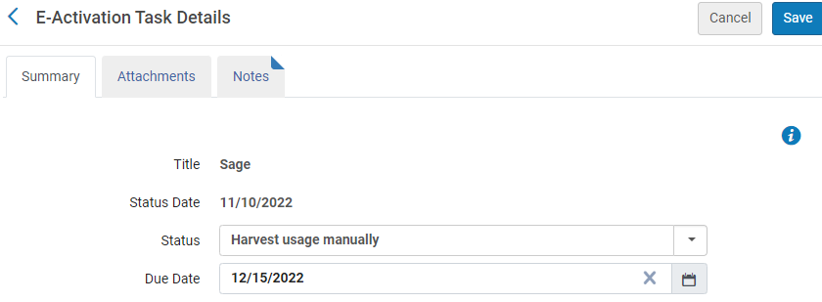
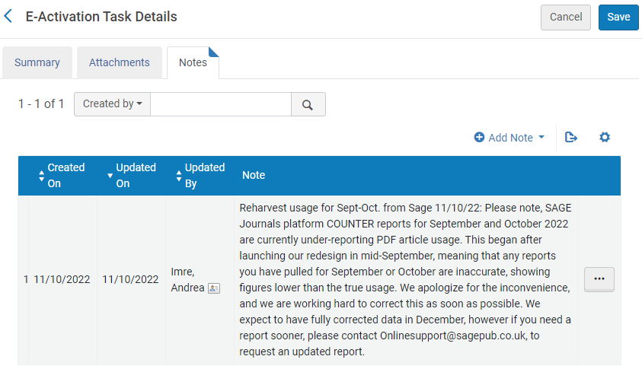
Customize task status and add notes

Slide 11
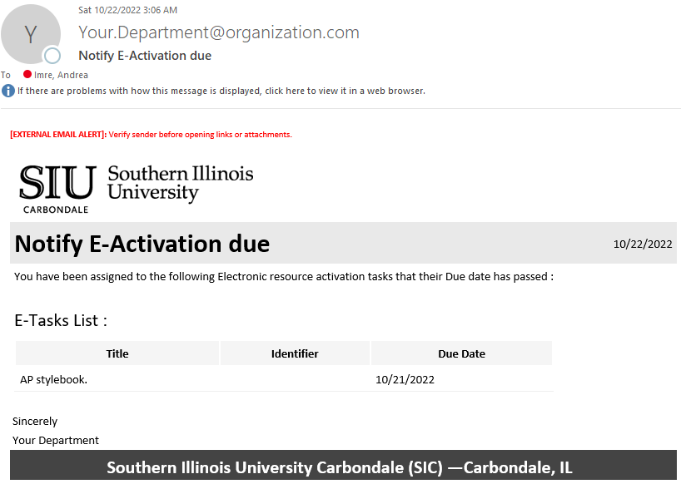
Alma generates an email notice to the user assigned to the activation task

Slide 12
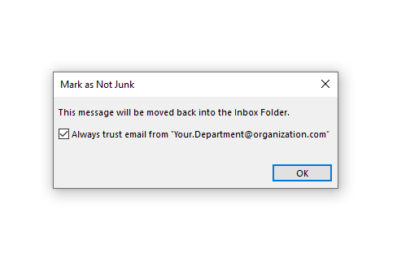
Check your Spam/Junk Folder and change settings as needed
Notes:
You May need to change email rules so Alma notifications don’t end up in your spam/junk folder

Slide 13
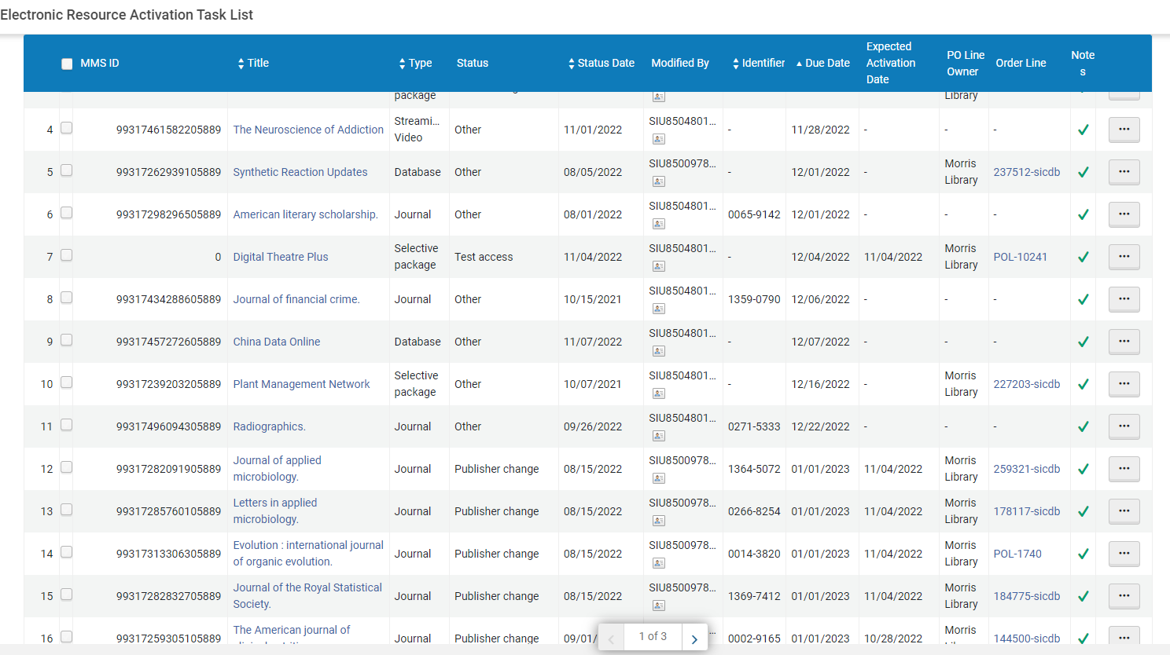
Our current task list

Slide 14
Ex Libris documentation
https://knowledge.exlibrisgroup.com/Alma/Product_Documentation/010Alma_Online_Help_(English)/Electronic_Resource_Management/030_Working_with_Local_Electronic_Resources/015Managing_Electronic_Resources/Activating_Electronic_Resources_and_Activation_Task_List
https://knowledge.exlibrisgroup.com/Alma/Product_Documentation/010Alma_Online_Help_(English)/050Administration/050Configuring_General_Alma_Functions/070Configuring_Alma_Letters - under Alma Letters → Notify E-Activation due Letter
https://knowledge.exlibrisgroup.com/Alma/Product_Documentation/010Alma_Online_Help_(English)/040Resource_Management/080Configuring_Resource_Management/060Configuring_Other_Settings - under Other Settings → activation_due

Slide 15

Questions?
Andrea Imre
aimre@lib.siu.edu

