Slide 1
Reserve Usage Statistics
Gretchen Schneider Coordinator of Access Services Oakton College

Slide 2
Difﬁculty in Creating Reserve Usage Statistics
Course Reserves have citations attached at the bib level, so item data is not attached
There are two different report subject areas where data is stored
Course Reserves
Fulﬁllment
Multi-Subject analytics only works if they have common ﬁelds
Merged reports only work if you can use an unique identiﬁer as a ﬁlter

Slide 3
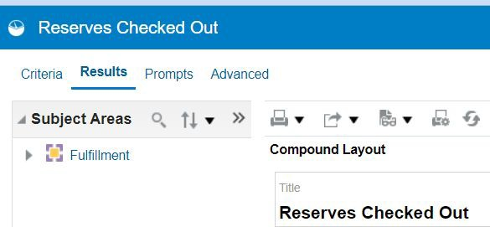
Current Solution
Since I want usage data, I currently only pull data with a Fulﬁllment Analysis

Slide 4
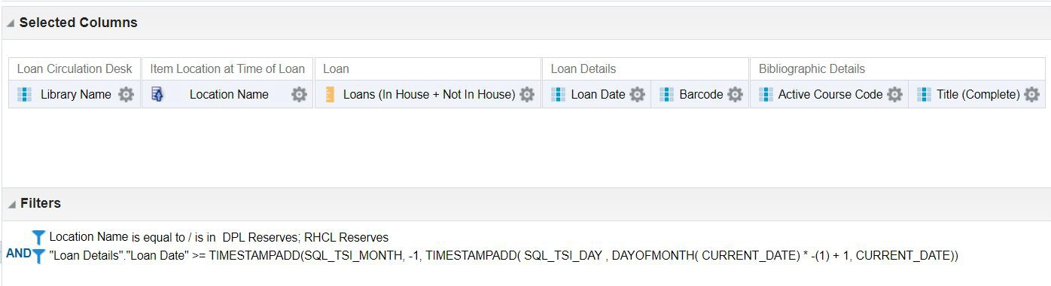
My Current Criteria

Slide 5
Selected Columns
Library Name
Location Name (in Item Location at Time of Loan folder)
Loans (In House + Not In House)
Loan Date
Active Course Code
Title (Complete)
Barcode

Slide 6
Filters
Location Name is equal to / is in DPL Reserves; RHCL Reserves
This limits the data to items checked out from the item location of reserves at the time of the loan.
"Loan Details"."Loan Date" >= TIMESTAMPADD(SQL_TSI_MONTH, -1, TIMESTAMPADD( SQL_TSI_DAY , DAYOFMONTH( CURRENT_DATE) *
-(1) + 1, CURRENT_DATE))
This limits data to the previous month only.

Slide 7
Documentation for the SQL Statement
Common Analytics Procedures
Filtering Procedures
Relative Dates https://knowledge.exlibrisgroup.com/Alma/Product_Documentation/010 Alma_Online_Help_(English)/080Analytics/050Common Analytics_Pr ocedures#Relative_Dates
Alma Analytics SQL Filter Examples Date Fields
https://developers.exlibrisgroup.com/blog/alma-analytics-sql-filter-exam ples/

Slide 8
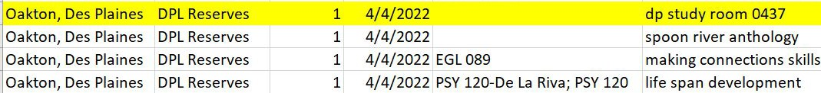
Why Monthly?
If an item is taken off reserve before I run the report, the Active Course Code Field will be blank.
Report run in 5/11/2023 for April 2022
Report run 12/1/2023 for April 2022

Slide 9
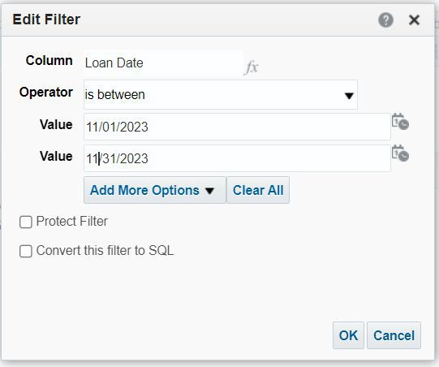
What If I Forget To Run the Report?
Change the filter for Loan Date to:
Operator: is between
Value: Start Date
Value: End Date

Slide 10
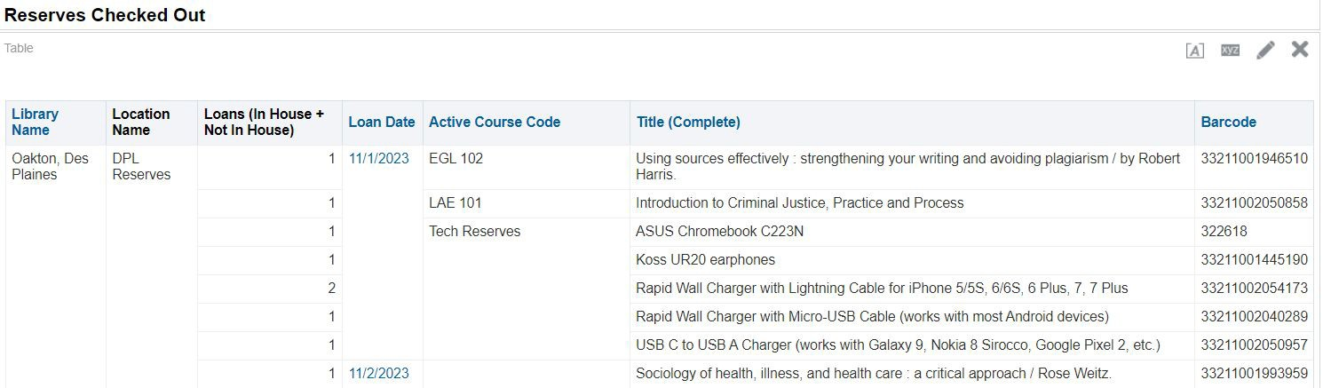
Report

Slide 11
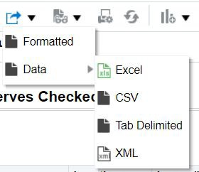
How I Export
To Export:
Click the Export this analysis Button
Select Data
Select Excel

Slide 12
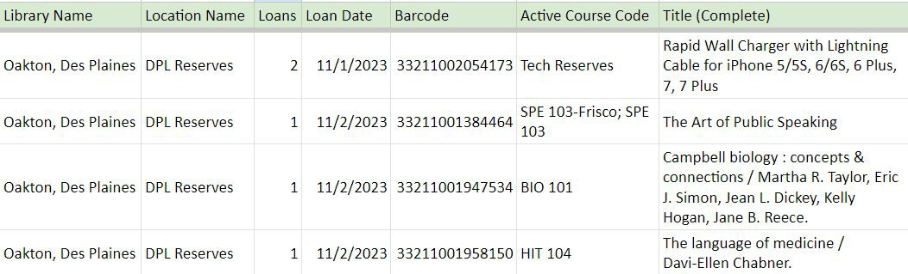
Report Example

Slide 13

Questions?
My Contact Information:
Gretchen Schneider Coordinator of Access Services Oakton College
gschneid@oakton.edu

