Slide 1
Resource Management Training
Session 4
Managing Physical Inventory

Slide 2
Session Logistics
This webinar is being recorded.
  Attendees will receive a link to the recording later for 30 days of access.
  An edited version of the recording will be posted for broader use later.
Captions and transcript are enabled for the webinar.
Use chat to share questions and comments as they come to you.
Work along in a sandbox or your own IZ as you prefer.

Slide 3
Learning Objectives
Gain practice in techniques for adding and managing physical inventory.
Learn to create and use templates for creating physical inventory.
Become familiar with requirements for MARC holding records and call numbers.
Apply practices for using temporary locations with item records.
Review processes for receiving inventory associated with purchase order lines.
Learn practices for relinking inventory.
Gain practice in techniques for withdrawing physical inventory

Slide 4
Physical Inventory Models
Title 1
852 $b LIBRARY $c location $h X123 $i .R345
31234002503081 Copy 1
31234002503082 Copy 2
852 $b BRANCH $c branchloc $h X123 $i. R345
31234012503083 Copy 3
Bibliographic
Holding
Item
Notes:
Let’s start out with some basics of physical inventory and set the table for why we will follow the practices shared today. First off, while bibliographic records are the foundation for discovery and description of your collections, inventory is the foundation for fulfillment. The more data you provide, the more Alma can point patrons to the resources available. Physical inventory in Alma consists of two types of records, holding records and item records. Holdings describe where to find the resource in your collection, and the item describes what the item is and whether it is on the shelf or not.
Holding records are used to describe where patrons may find resources in your collection. Where consists minimally of a library and a shelf location, commonly includes a call number and may be extended with details on the number of copies or volumes. Holdings are coded according to the MARC 21 Format for Holdings Data, as this offers portability of inventory data between different systems.
When a bibliographic record has one or more holding records linked to it, then Alma recognizes physical inventory being present. A holding may exist with no items, but Alma really works much better when item records are present for each actual item on the shelf. In general, you should have no more than one holding record per shelf location for a given title. That holding will have each of the item records for that shelf location linked to it.
Item records contain the details that identify each unique item on the shelf. Minimally, items should have a barcode, along with other details to make the item unambiguous to users and the system. Commonly, these details could include the material type, item policy, copy number, number of pieces, and when applicable, enumeration and chronology for multi-part resources. The item record also includes a status that states whether the item is on the shelf or not.

Slide 5
Physical Inventory Basics
Inventory is key to fulfillment
  Holdings describe where: library, location, call number, copies, summaries
  Items describe what: barcode, material type, item policy, pieces, status
Alma fulfillment rules for loans and requests are based on locations first
  Locations assigned to fulfillment units—groups of rules for loans and requests
  More granular options and exceptions within rules
    Item-based details: Location, Item Policy, Material Type, Process Type
    Patron-based details: User Group, User Statistical Category
Fulfillment rules applied at the point of a transaction
  Circulation desk
  Primo VE request screen
Notes:
All of these elements are essential for fulfillment rules, which set the conditions for who may use what items. Fulfillment rules in Alma begin at the location level. Locations are assigned to fulfillment units which are groups of rules that apply to the items in those locations. In general, items held in the same library and location will be handled by the same fulfillment rules. Rules also allow a library to set more granular options for processing based on either item details or patron details. Item-based details that may be evaluated include the item location, item policy, material type, and process type, the last of which is an extension of the item’s status. Rules also may incorporate details about the patron, such as the user group and user statistical category.
These all come together when a user begins a transaction. For instance, when a patron presents an item for checkout at the circulation desk, Alma reviews the item and user data and applies a policy based on the loan rules present. Similarly, if a patron finds an item in Primo VE and places a request, Alma consults the rules for requests to see if the item is eligible for to be requested by this particular user.

Slide 6
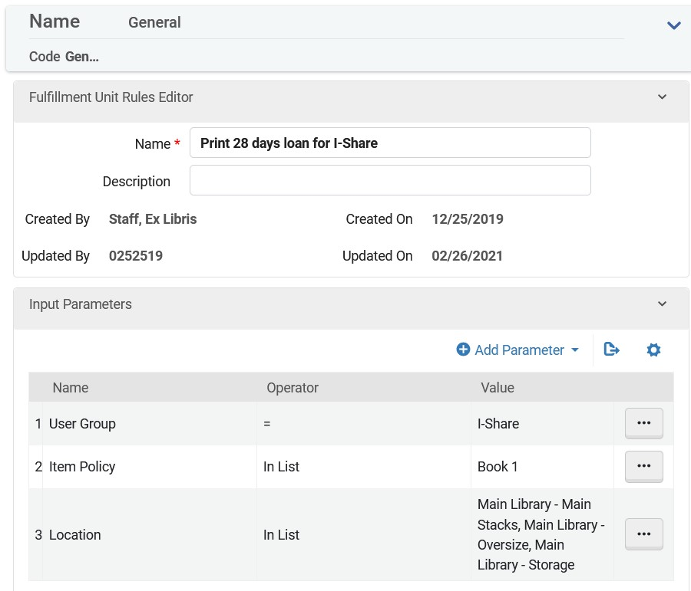
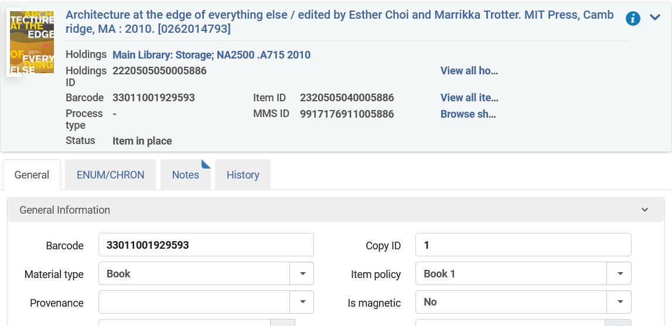
Item data and fulfillment
Notes:
[Demo] For example, let’s look at the General fulfillment unit in this IZ. The General unit includes an on-shelf request policy that lets items be requested for pick-up anywhere. We also see that this unit covers 16 locations, including 5 locations in the Main Library and 11 locations in the Special Collections library. On the Fulfillment Rules screen, we see 8 rules that cover different combinations of user groups and resources. Also note that the type of rule is Loan, there are distinct rules for Loan, Request, and Booking.
The Print 28 days loan for I-Share is the first rule on the list in this group, and it enables materials to be loaned to other institutions patrons. Those patrons are added to your IZ with the I-Share user group. Alma then looks at the item for two details, the item policy, which in this case is set for Book 1, and the shelf location, which is one of three locations here.
Let’s take a look now at this item, barcode 33011001929593. Is this book eligible for borrowing by an I-Share patron?
My colleague Debbie Campbell recently delivered training sessions on Fulfillment Workflow training. So if you’d like a deeper dive on these aspects of the system, please consult our website for the recordings, or watch for future sessions.<https://www.carli.illinois.edu/products-services/i-share/alma/fulfillment/CARLI-Alma-Fulfillment-Training>

Slide 7
Roles for physical inventory
Primary Roles, may be scoped to a library
  Physical Inventory Operator – create and modify holding records and item records
  Physical Inventory Operator Limited – same as above without access to sets or relinking
  Physical Inventory Operator Extended – delete item record and holding records
  Purchasing Operator – create and modify inventory through POLs
Related Roles, scoped to library and work unit
  Receiving Operator – may modify items and item status
  Circulation desk operator – may modify item status

Slide 8
Adding physical inventory
Create a purchase order line (POL) using a physical inventory type
  E.g., Print Book – One Time; Physical – One Time; Physical – Subscription; etc.
  POLs create one item per copy ordered, with a Process Type of “Acquisition”
Add holding(s) and item(s) to a bibliographic record
  Open bibliographic record in metadata editor; create holding in metadata editor
  Add item to existing holding
Resources > Create Inventory > Add Physical Item
  Reading Lists “Add Brief” citation function uses similar screen
Import profile with physical inventory
  Imported data must include the details to create holdings and items
Notes:
Now we’re clear on why we add inventory, we can dig into how to create inventory. As usual, Alma provides several options, a few of which we’ll explore more carefully in a few minutes.
[Demo]
For libraries using acquisitions functionality, the item record is created when you create the purchase order line. This is initiated when you select an order type related to physical inventory, such as print book one time, physical one time, print journal subscription, or physical subscription. A POL will create a holding record and one item. That item will also have a process type of Acquisition.
For libraries not using acquisitions or doing maintenance on older materials, you will use a combination of the metadata editor and the physical item editor to add inventory. Search for a bib record and open it in the MDE. Then create and save a holding record. With the holding in place, you may create an item record using the metadate editor menu or a menu on the list of holdings screen. The Add item function opens the physical item editor screen.
Alma provides a quick cataloging screen that can add bibliographic records on the fly, and that can add holdings and items to existing bibs. This screen may also appear to staff that create reading list citations for Course Reserves. Though it isn’t required to catalog items going on course reserves, it’s useful to be aware that records may be created this way.
[Demo (SAI) Load OCLC Local File - Physical Bib with Inventory or (RMC)
Finally, import profiles may be used to create holdings and items, provided that the data needed to create those records is in the imported data. In the case of MARC data, the records should contain tags and subfields with the library, location, call number, barcode, and other details for the item. The import profile may provide some default values, but full details should really be included in the incoming data to save you time later. For instance, if you’re getting shelf-ready cataloging from a vendor, you need to work with them on the profile settings so that they put data in the right fields for your profile.

Slide 9
Templates: PO lines, holdings, items
PO Line templates
  Use an existing PO Line, Save as template
  Saves material type, library, location, item policy; applies these to created inventory
Holding templates
  Created in metadata editor using an existing holding record
  Set placement options for Local; Save > Save as Template.
  Editing holding templates: Right click > Edit
Item templates
  Created in physical item editor using an existing item record
  Modify the item as desired, then select Save as Template.
Notes:
Those are the basic ways of creating physical inventory. We have some options available for streamlining inventory creation in the form of templates. Templates may be created using existing records as a base, then modified further to meet different needs.
I’ll start with the PO Line template. We can create a PO Line template using any existing PO line, or we can create one from scratch that has our desired values. This template is capable of saving more than 20 data elements for a POL, but it only covers 4 elements pertaining to inventory creation. These are material type, library, location, and item policy.
To get the template, we open the actions menu on the POL and choose Save as Template. Alma presents us a screen where we enter the template name. I recommend using an explicit name that tells you what to expect. “Amazon main stacks book 1 general fund” is going to help you and others more than “ted template 2.” Templates may also be shared or private. You may also save changes to an existing template, or delete existing templates.
Next, we have holding record template. These are real time savers, given that you can create templates that include most of the fixed field and location data up front. Holding templates are created in the metadata editor using an existing holding. In part, this is because Alma doesn’t let you create a holding without a bib already involved.
You may search for an existing holding—say with a Physical Holdings search for a specific location—or search for a title you have handy. Edit the holding in the metadata editor. First, open the New menu, then go to Placement Options. This is important to save your holding template to your IZ. With that done, go back to the holding. Then choose Save > Save as Template. Create a template name, again the more descriptive the better, and decide whether the template is private or shared. My tip is to make them all shared. You may also select whether to make the template the default that is automatically applied whenever you create a new holding record.
After you’ve created the template, you may need to edit the values so that there are openings where you want to fill things in, such as the call number, and that the values you want in place elsewhere are saved for you. There’s a trick to editing templates, however. If we select the Templates tab on the navigation pane, then just click the template we want, the default action for the editor is to use the template to create a new record. This typically happens if the record we used for the template is still in the editing pane.
To avoid this situation, when you want to edit a template, scroll down the list, and right click the template name. Then select Edit. Notice, there are also options to duplicate a template, modify the properties, and create a new record.
Holdings templates need not be used to create new records. The metadata editor also allows templates to be used to add or format data in specific ways. The Editing Actions menu includes a function, Expand from Template, that pulls in details from a template that will save you time.
Finally, item templates may be created from an existing item records. The item template could theoretically include data in every item record field. So you will want to remove any data from the item that shouldn’t be retained in the template. For example, Receiving Date and Receiving operator are often filled in for items received through acquisitions. These might not apply for every item, and you’d rather not have to manually change those later. So delete those values before selecting Save as template. As before, when you save as template, you’re prompted to provide a name for the template, modify an existing template, set the template as public or private, or delete an existing template.

Slide 10
Applying Templates: Orders
Search for a bibliographic record. Select Order.
Select PO Line type; e.g., Physical – One Time
Select PO Line owner; e.g., Main Library
Load from template: select from recently used or public templates
Click Create PO Line.

Slide 11
Applying Templates: Holdings
Search for bibliographic record. Edit Record.
Add new holdings via:
  Add Inventory > Add MARC21 Holdings > [listed templates]
  New > MARC21 Holdings > [listed templates]
  Ctrl+Alt+H (create using the default holding template)
  Templates > scroll to template > Right click > New record from template
New > Templates Display Configuration
  Control which templates appear on the menus

Slide 12
Applying Templates: Items
After creating holding record
  Use Ctrl+I to show inventory, then select edit to choose the holding
  With holding in editor, select Add Inventory > Add Item from template (Alt+L)
  Select template, optionally tick box to create multiple items (up to 99)
  Select Create Item.
From the list of items screen
  List of items accessed when you see the View Items menu option
  Select Add Item from Template
  Select template, optionally tick box to create multiple items (up to 99)
  Select Create Item.

Slide 13
MARC holding record requirements
MARC 21 Format for Holdings Data
Required data for Alma
  852 Location
    First indicator: Shelving or classification scheme
    $b Alma Library – use the library code
    $c Shelf Location – use the location code
  Leader
    06 type of record
  005
  008
Notes:
I want to pause over the values in the holding records. As I mentioned earlier, holding records should be coded for the MARC 21 format for holdings data. This format is as well defined as the bibliographic format that we’re familiar with using, and I it’s largely underutilized, in my opinion. The holding format has a lot more ways to capture and analyze local data than we generally get from Alma or other systems, so a lot of cataloging tends towards minimalist approaches that include just the data needed to get items on the shelf. But if you have time, I encourage libraries to provide more depth in their data and look for ways to use these details elsewhere.
As for Alma’s minimum requirements, each holding record must have at least these details. First, an 852 field that includes a library and location in subfields b and c, and a shelving or classification scheme listed in the 852 first indicator. Blank is a valid value. Second, the record Leader, will always be present, and the type of record will be one of four values that specifies the type of holdings described. An 005 field that Alma uses to capture data about the date when holdings are updated, and an 008 field that you may use to elaborate on coded holdings details.

Slide 14
MARC holding record standards
Recommended data (Required by CARLI when practical)
  852 Location – used to establish uniqueness of a holding record
    $k call number prefix
    $h classification number
    $i item part
    $m call number suffix
  Summary Holdings: 866-867-868
  Detailed Holdings: 853-854-855-863-864-865
ANSI/NISO Z39.71 Holdings Statements for Bibliographic Records
Notes:
Beyond the requirements, there are fields that are strongly recommended for use whenever practical. First and most obvious are the fields for a call number. These include 852 subfields h and I for the classification and item number, as well as subfields k and m for prefix and suffix. The 852 field includes positions for notes and copy numbers as well, which should be used when possible, to share information to staff viewing Alma and to patrons viewing Primo VE.
Earlier, I mentioned that in general, you should have no more than one holding record per shelf location for a given title. Just as with bibliographic records, Alma has a duplicate matching routine for holdings. This routine is based on the contents of the 852 field. Whenever a holding uses more than subfields b and c, the rest of the 852 must be unique within Alma as well. Subfields that contribute to uniqueness are b, c, k, h, I, m, and t. The notes subfields, x and z, do not contribute to uniqueness.
When a bibliographic record has more than one holding with the same call number in the same location, Alma will at least post a warning, if not an error, in the metadata editor. The best practice is to maintain all copies within the same location on a single holding record. There are practical benefits to this approach as well. In Primo VE, there is no sorting applied to holding records in the same location. They will appear in a random order. If you have copies 1 2 and 3 in the stacks on separate holdings, they may display randomly. However, if all three copies are on a single holding, then the item sorting routines will take effect, and items should appear 1-2-3.
Additionally, holding records provide ways to summarize extensive holdings of serials and multi-part works. These details also may appear in Primo VE and they may be used to help simplify display of information, particularly when there are a large number of item records present. Notably, Alma will attempt to help create some of this data for you, particularly if you plan to use predictive serials receiving. So, learning the standards for holdings statements and for MARC coding will be useful to you.

Slide 15
Using Alma shelf list
Resources > Cataloging > Browse Shelf Listing
  or Alt+C in the metadata editor
Select type of browse
  Call number: holding, item, or item temporary
  Scheme: LC, DDC, NLM, SuDoc, Other
  Library
  Location – selection of a location is optional
Enter the number to browse
  Include any prefixes needed for the location
Notes:
This leads nicely into the use of Alma’s shelf list browse. As we just discussed, Alma uses the contents of the 852 to uniquely identify each holding record. This is the official call number of your item in Alma as well. Even if you prefer to store call number data in a bibliographic record, Alma uses the holding call number first.
These data are browsable using the Alma shelf list. The shelf list is a browse search that is built into the metadata editor. It can also be a little temperamental. Select Resources > Cataloging > Browse Shelf Listing; or if you’re already in the metadata editor, typing Alt+C or using the Search & Browse menu will get you there too.
Start by selecting the type of call number to search. This will almost always be the holdings call number. Then select the classification scheme involved. Next, you select which library’s shelf list to browse. Selecting a shelf location is optional, which can be good news if you have interfiled locations or if your policy is to never re-use a call number.
Once you’ve made your selections, enter the call number that you want to browse. Remember that 852 subfield k is included in the unique call number. So if a given location typically includes a prefix, be sure to add that at the beginning of the search entry.

Slide 16
Advanced Searches for Holdings
Search by Call Number
  Permanent Call Number Type – Select from list, matches to 852 1st indicator
  Permanent Call Number – Enter a number, matches to 852 $h $i
  When used with Physical Holdings or Physical Items, call number sorting available
Search by library/location
  Library (Holdings) – Select from a list of libraries
  Permanent Physical Location – Select from a list of libraries and locations
Search by suppression
  Tag Suppressed (Holdings) Equals Yes
Notes:
The shelf list browse isn’t the only option for finding holdings and items. Alma’s persistent search bar also chips in a few helpful options that makes it easy to find data. The search options also make it possible to compile sets of records that you can export to Excel or manipulate using jobs and rules. Here are a few useful searches for holding records.
These are advanced searches that may be used with any of the Physical search types. The results that display will depend on what type you searched, and that will also affect sorting and set creation options.
First off, a complementary search to the shelf list browse. To search call numbers effectively, we may want to select the call number type we want as well as the call number. In part, this is because different call number schemes are normalized differently, which affects how they are sorted if they were all retrieved together. Searching by just a permanant call number type can be useful in finding errors too.
We might be interested in seeing an entire location or library at once, particularly if we’re looking to do some publishing or exporting of records. For that, we could do a library or a location search. These search options give us controlled lists to select which values to include or exclude, which is nice when you may not remember if a location is Stacks or Main Stacks.
We can also look for holdings that are suppressed from discovery. You might have suppressed holdings for previously withdrawn resources, or for acquisitions data that couldn’t be deleted. There may also be holdings that you choose not to display. Finding these records requires the Tag Suppressed field under holdings, and select Yes. You could combine this with searching the bib level version of tag suppressed to see if there are any mixed values.

Slide 17
Advanced Searches for Items
Search by Status
  Base Status equals Item in place / Item not in place
  Process Type – select one process type from a list
Search by Work Order
  In Process Type – select one work order from a list
Search by Temporary Location
  In Temporary Location equals Yes
  Temporary Physical Location – Select from a list of libraries and locations
Notes:
There are also some useful item level details that we may want to search. As the physical items search user interface hasn’t been updated yet, the look for some of these will feel dated, or comfortable, depending on your experience. The search terms may also be applied to any of the physical search types, but these are particularly useful in finding items that might need attention.
When tracking a problem or trying to create a report in analytics, it can be useful to find items that are on or off the shelf. For that, we can search by Base Status, then select either item in place or item not in place. Items with a not in place status may have additional process types, such as loan, missing, acquisition, and so on. We can combine the process type in the search as well.
If your institution uses acquisitions or other work order units, you may want to locate the items that are assigned to those units. For that, the search index is “In Process Type.” This can be a little confusing with the Process Type field, both from the name, and the fact that Acquisitions Technical Services is one of the work order units, while Acquisition is a process type. One does not necessarily imply the other.
It’s also useful to find the items assigned to temporary locations. As we’ll see in a moment, temporary locations data are a little finicky. So there are a couple ways to find these items. First, there’s the In Temporary Location setting, which is a yes or no option. Second, there as search by specific locations, or the Temporary Physical Location. This is the same list we saw earlier for permanent physical location, and it finds item records where that location is in the item record.

Slide 18
Using Temporary Locations
Use case: Items are moved from their normal shelf location. As a result, the items should be governed differently than usual.
  Help patrons and staff find the items.
  Control lending and requesting
  Transition items without losing permanent details.
Examples:
  Display cases and shelves
  Course reserves
  Storage (e.g., for renovation)
Notes:
That’s a useful segue into how temporary locations may be used and practices for using them effectively.

Slide 19
Item Record: Temporary Locations Information
Records may be assigned manually or using Change Physical Items Information job.
Item is in temporary location
  No: Any data in temporary location fields is informational only
  Yes: Values in temporary location fields overrides other item record values
Temporary location fields
  Temporary location – may be any valid location
  Temporary call number type & Temporary call number
  Temporary item policy – use in conjunction with fulfillment rules
  Due Back Date
Notes:
A reasonable question to ask is whether it’s useful to retain the temporary location data after the item has been restored to its permanent location. We definitely see that here in this sandbox, and we have seen that in other IZ’s as well. In general, if you’re only trying to track that an item was once in a temporary location, then no. The Item History tab will keep track of these changes. There are also data in analytics that also track an item’s entry to and exit from a temporary location, though the Physical Items Historical Events subject area is probably the most challenging area to understand.
However, if you have items that routinely are assigned to the same temporary location, then possibly keeping the data in the record makes sense. An example I was given previously was a library had a women’s history month display. Some items routinely were included every year. Maybe some others they wanted to keep track that they had been used, so that new titles could be used instead. Though I’ll add that this example came to us because the library was finding that the historical data were throwing off searches, as we saw a few minutes ago. You would need to judge for yourself if this works for you.

Slide 20
Receiving inventory for purchase order lines
Acquisitions > Receiving and Invoicing > Receive
  Requires Receiving Operator role, scoped to library and order unit
  Receive New Material screen has tabs for One Time and Continuous orders
Keep in Department
  Select this option to retain the Item not on shelf status
  Creates a work order request for the item
  Requires that items are transited into the work order unit via Scan in Items.
  Transit out with “Done” status.
  Use Scan in Items at circulation desk for shelf location as last step: Item on shelf.

Slide 21
Receiving inventory for one time orders
One Time receiving screen
  Displays POLs with status “Sent”
Row actions
  Manage Items
    Allows receiving and editing of item through several screens.
  Receive
    Marks Received Date on item record
    Places request and item into transit (circ desk, or work order if Keep in Department selected)
    POL Status > Waiting for invoice
  Print interested users list
    When present, shows list of users that might be contacted about item

Slide 22
Receiving serial items
Continuous receiving screen
  Displays POLs with status “All (Except Closed)”
Row actions
  Manage Items
  Receive
    Use last received item as template for new item.
    Duplicate copies data to new item record; edit to update according to the item in hand.
    Generate revises the description according to description templates.
    Receive and set barcodes – Mark the item record received, open a screen to add a barcode.
    Create and receive – Mark the item record received, leave other values as is.
  Print interested users list
Notes:
In the case, of serial, or continuous items, the receiving process is a little more interesting. The options for each title are the same as for one time POLs, and manage items pretty much works the same way.
The receive option is special here, in that Alma employs the last received item as a template for creating the new item. Here, we see the last item, and its enumeration, chronology, and description. If we click Duplicate, the existing item data are copied into the form section of the record, and we can edit the values as needed. Generate updates the description field according to a set of templates that map enumeration and chronology data into a consistent format.
From there, we can click Receive and Set Barcodes or Create and Receive. The latter completes the receiving process for the newly created item. The former does the same with an extra step of displaying a pop-up window allowing us to apply a barcode to the item.
After the item is received, we’re back at the manage items screen. If we need to do so, we could receive more issues for the same title here, or we could go back to the receiving screen.

Slide 23
Relinking inventory: Selecting a new bib record
Use case: Record used for an item at time of order doesn’t match the item in hand.
Use case: Record in use for an item is no longer the best choice for the item in hand.
Relinking options
  Holding: Relink to another bibliographic record.
    Opens a record search within the metadata editor.
    Search IZ or NZ for bib. Selecting Relink, then saving, changes the link between holding and bib.
  Item: Relink to another bibliographic record.
    Opens Relink items to another bibliographic record screen.
    Search IZ, NZ, or CZ. Select from choice from results.
    If holdings are present, select whether to add item to existing holdings.
    Alma will prompt for what to do with older records.
Notes:
From time to time, we find that the record we’re using for an item isn’t really the best record available. Could be we used a brief record for ordering, or just needed a on-the-fly bib to let something circulate. Maybe a record was chosen thoughtfully in the past, but changes in WorldCat or elsewhere indicate that a different record is more appropriate.
It’s common to think, well, I should find the better record and overlay what I’m using. As we’ve seen in other training sessions, the merge and overlay options can be cumbersome. A more direct resolution exists, which is relinking records.

Slide 24
Relinking inventory: Items to another holding
Use case: Need to consolidate items onto a single holding in one location.
Use case: Need to move items for serials for retention or withdrawal
Change Holdings (i.e., relinking items to another holding)
  Use the List of Items screen
    View items in the metadata editor or from list of holdings screen
    View all items from an item record
  Select one or more rows; Manage selected > Change holdings.
  Select one of the other holding records for the same bib record; click Select.
  If moving the last item on a holding, Alma will prompt for actions on the old record.

Slide 25
Why Withdraw Inventory
Withdrawing inventory: Deleting records
  Delete items, then holdings, then bibliographic records.
  IZ repository should contain only your active collection metadata.
Data in your IZ remains available through the network
  Alma does not have an item process type for suppressed or withdrawn.
  Items may be targeted by loan and request processes.
  Holdings and bibs may appear on Held By lists and last copy reports.
Notes:
Given that we’ve added, updated, and relinked inventory records today, it’s fitting that we wrap up by withdrawing inventory. Withdrawing is an important clean-up process for physical inventory, in that it deletes records that are no longer in the collection beginning at the item level. If the last item on a holding is deleted, then the holding may also be deleted or suppressed. If the last holding on a bib is deleted, then the bib may be deleted or suppressed.
CARLI recommends deleting all three levels, item, holding, bib, if they are empty, in order to keep your collection clean. Deleting all three levels will send corresponding deletions to WorldCat, removing your holdings there as well.
Alma does not have a process type for suppressed or for withdrawn. An item in the system is a potential target for requests and loans, including accidentally scanned items. Deleting item records removes a target for requests from other libraries. Similarly, removing the holdings and bibs removes the appearance that such items may remain in your inventory when someone views the Held By detail in the network, or when CARLI creates reports for last copies or title counts.
Analytics retains the data on your materials from when they were added to when they were deleted. Unless you have a compelling functional reason to retain data on withdrawn materials, then you should follow any of these options. Additionally, Alma maintains a Deleted Repository, an archive of the data that was deleted, and from which data could be restored if needed. The Deleted Repository is only searchable using record identifiers that you would get from Analytics, or details about how records were deleted.

Slide 26
Withdrawing Inventory Conditions and Effects
Conditions that prevent deletion
  Item linked to POL that is not closed.
  Base status = Item not in place
Effects of deletion
  Items, holdings, bibs, archived into Deleted Repository.
  Deletion date is last recorded modification date on each record, stored in Analytics.
  PO Lines are unlinked from inventory; POL description (a copy of bib data) left intact

Slide 27
Withdrawing Inventory Options
Search for items > Withdraw from actions menu
Search for titles > Select title, scroll to Items, actions menu > Withdraw
Create items set from search or report > run Withdraw Items job
  Job parameters may check if requests exist on items
Alma prompts for resolution of empty records when last item withdrawn:
  Keep holdings and bibliographic records
  Delete holdings, Delete bibliographic records that have no other holdings
  Suppress holdings, Suppress bibliographic records that have no other holdings
  Delete holdings, Suppress bibliographic records that have no other holdings

Slide 28
Item Record Extras: Notes
Functional Notes
  Public Note – displays in Primo VE within the item level detail.
  Fulfillment Note – displays as pop-up note during check-out and check-in screens.
    Useful as a complement to the Pieces field, which also pops up during fulfillment activities.
Internal Notes
  Only displayed on this screen
  Internal note 3 may contain Voyager-era data
Statistics Notes
  Useful for reporting different details not covered by bibs, holdings, or other item details
  May use as free text fields or as controlled lists (each list is independent)

Slide 29
Item Record Extras: Inventory and Retention
Inventory Information section
  Useful for libraries performing an inventory.
  Capture the sequence and date an item was handled; optionally add a price for reference.
  Capture Weeding number and date before withdrawing items for analytics
Retention Information section
  Useful for capturing collection development decisions separately from weeding
  Select Committed to Retain: No/Yes
  Select a Retention Reason; e.g., Consortia last copy, faculty publication, rare item

Slide 30
Item Record Extras: Replacement and Condition
Replacement Cost
  When present, Alma will use Replacement Cost value when overdue loan becomes lost.
    Fulfillment Terms of Use rely on a default value otherwise
  May configure to have PO Line copy price into this field.
  Possible workflow: Review overdue loans before they reach lost threshold; search price.
Physical Condition
  Controlled list of types of damage; list may be modified.
  Informational only: not a status, and not checked by fulfillment rules.
  Possible workflow: Use in conjunction with fulfillment note or other notes to record damage when noticed

Slide 31
Item Record Extras: Describing Volumes and Parts
Description field
  For multi-part resources, will be visibly unique identifier for an item
  Appears in Primo VE, letters to patrons, etc.
  May enter manually or generate from enumeration and chronology
Enumeration & Chronology fields
  Enum A & B, Chron I & J—first two levels of each—on General tab
  Enum A-H, Chron I-M, on ENUM/CHRON tab
  Fields collectively used to sort items in list of items and in Primo VE
Description Templates (in configuration)
  Map use of fields to description pattern with punctuation; e.g., v.1,no.2 (2025 March)

Slide 32
Questions?
Please respond to the training survey: https://go.uillinois.edu/cattrain2025
Registration remains open for other sessions.
Contact support@carli.illinois.edu with follow-up questions.
Notes:
https://go.uillinois.edu/cattrain2025

