Slide 1
Resource Management Training
Session 2
Editing MARC Records

Slide 2
Session Logistics
This webinar is being recorded.
  Attendees will receive a link to the recording later for 30 days of access.
  An edited version of the recording will be posted for broader use later.
Captions and transcript are enabled for the webinar.
Use chat to share questions and comments as they come to you.
Work along in a sandbox or your own IZ as you prefer.

Slide 3
Learning Outcomes
Learn to navigate the Alma Metadata Editor.
Gain practice in editing MARC bibliographic and holding records.
Understand CARLI policies and practices for editing bibliographic records.

Slide 4
Bibliographic Records in Alma
Bib record describes a resource as manifested in the world
  Titles, authors, editions, publishers, series, ISBNs, etc.
  MARC elements: Record numbers, fixed fields, suppression, etc.
  E.g., Book – Physical, Projected medium – Electronic
Titles: Bibliographic record in a repository or zone
  Predominantly MARC data (stored as XML)
  Alma may contain other data: Dublin Core, MODS, BibFrame, etc.
Alma Metadata Editor (MDE)
  Edit MARC data (bibs, holdings, authorities), Dublin Core, MODS
  Edit templates and rules
Notes:
A bibliographic record describes a resource as it is manifested in the world. As catalogers, we’re used to thinking about the areas of description, titles, editions, publishers, and so on from the general to the specific. MARC records also have their own elements that identify how they were created, how they may be used, and how they should be displayed. Some of these details tell us explicitly what kind of resource the record describes.
Bibliographic records for physical and electronic resources begin as MARC records. Though Alma actually stores all data in XML format, the system will represent records in their familiar MARC look and feel. Alma also supports other descriptive standards, such as MODS and Dublin Core for digital formats.
[Search for MARC Bibliographic Record, 9937493510405886
Edit the record to add 5XX fields:

Slide 5
Accessing the Metadata Editor
Search for a title, select Edit Record.
Search for a title, select Push to MDE*; later, select Show MDE.
Search for any record, click to view bib record, select Edit.
Push to MDE from a set
Select Resources > Cataloging > Open Metadata Editor…
  Search and Browse > Browse Shelf Listing
  Search and Browse > Browse Bibliographic Headings
  Search and Browse > Browse Authority Headings
  Search and Browse > Search Resources > WorldCat or Library of Congress
Notes:
Given that we need the metadata editor to interact with most kinds of bibliographic data, it’s useful that Alma provides several ways to open the editor. When you are editing your own records, you’ll probably start with a search of your repository. Begin with a titles search, then locate the record you want to work with further. From the results screen, you may select Edit Record or Push to MDE, which is usually deeper on the actions menu.
Edit record switches the Alma into the metadata editor screen and attempts to open the selected record.
Push to MDE sends the record into the metadata editor in the background. When you are ready to switch into the editor, you show the MDE and should find the records listed. There are exceptions for records being pushed. A record that is locked by another user will not be pushed as open. Community Zone records frequently are not pushed directly either. We’ll see how this works a little later.
Frequently, clicking the linked title field of a record will open a record display screen that shows the MARC record in read only form. At the top of the screen, you may expect to see an Edit button and a Push to MDE button.
If you create sets of records—we’ll talk about this a bit in session 8—it is possible to push a group of records into the metadata editor from that set. These records show as a set in the MDE, though they are not edited as such.
Finally, it is possible to open the metadata editor without having searched a record. There are some specific searches that the editor supports directly. The editor has a Search and Browse menu that lets the cataloger look for records in a different way than the main search bar.
Browse shelf listing supports a search of a particular portion of the library collection using the call numbers assigned in holding records. There are some quirks to this search that bear mentioning, so we’ll look at that in a couple minutes.
Next there are the headings searches. Browse bibliographic headings is an index of the authorized access points that appear in bib records. The counterpart, Browse Authority Headings searches the authority records that are found in the Community Zone and the Network Zone, and it includes a partner list of headings found in bib records.
Last but definitely not least, we find the Search Resources option, which I would bet some of you already use frequently. This tool offers Z39.50 searching of other catalog repositories, namely WorldCat and the Library of Congress. It is possible to configure other sources with the appropriate connection detail, though some configuration will require CARLI and Ex Libris support. We’ll cover this tool in more depth during session number 3.

Slide 6
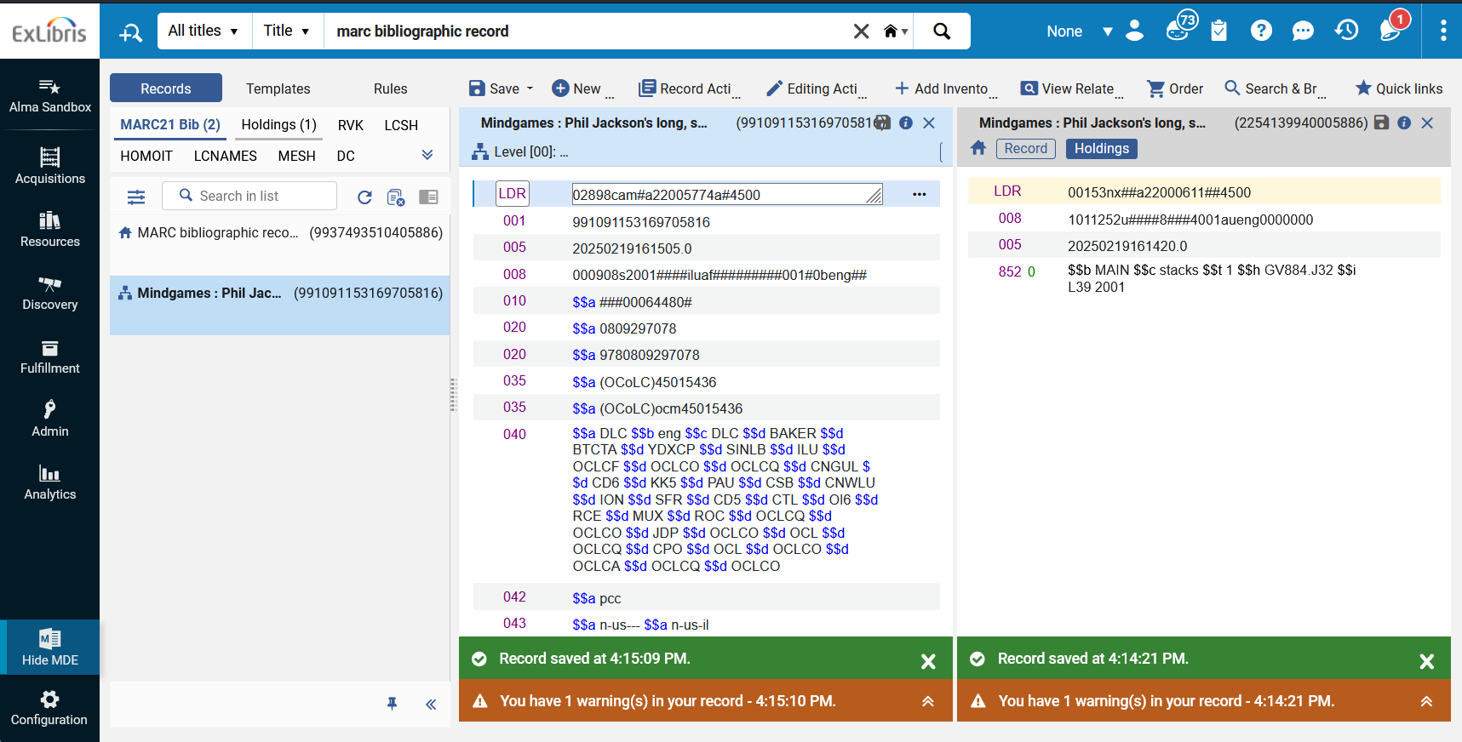
The Metadata Editor

Slide 7
Navigating the Metadata Editor: Navigation Pane
Records
  Open records counted by their types
  List may be filtered by zone and info
Templates
  Private: available to user only
  Shared: available to all users
Rules
  List of rules available for use
Release displayed records button
Pin bar
  May show “Load community records”

Slide 8
Navigating the Metadata Editor: Editing Pane
Edit records, templates, and rules
  Supports split (F6) into two windows
Menu bar
  Functions available to user and record
  Quick Links for favorite functions
Editing header
  Details on open object
  Blue: in focus; Gray: not in focus
Alerts area
  Presents warnings and errors
  Click to expand for details
https://knowledge.exlibrisgroup.com/Alma/Product_Documentation/010Alma_Online_Help_(English)/Metadata_Management/014Navigating_the_Metadata_Editor_Page

Slide 9
Editing MARC records
Editing in the Institution Zone
  Copy cataloging: Copy a record from an available source, update description
  Equipment, temporary collections, course reserves, order records, ILL
  Special collections that utilize description not shared by every copy
Editing in the Network Zone
  Cooperative cataloging: Record modifications shared with all linked institutions
  Enhance and update data
  Local details in local fields (a.k.a. local extensions) or in inventory
Cooperative Cataloging Policies for I-Share

Slide 10
Editing MARC records
Form editing
  Available for fixed fields in bibliographic and holding records
  Also available in the holding 852 field
  Place cursor in field, type Ctrl+F
  Field positions may have lists of values
Field information
  Place cursor in field, type Alt+F
  MARC formats page opens in split pane

Slide 11
Undoing Changes
While editing/before saving:
  Undo most recent change: Editing Actions > Undo Remove, Cut, Paste Field
  Undo all changes: Record Actions > Reload Original Record
After saving:
  Restore previous saved version using one of two options
  View Related Data > View Versions
  View Related Data > View Versions of Original Record (present when linked to NZ)
  Restore Metadata

Slide 12
Institution Zone-Network Zone relationships
NZ MMS ID: 9912345678905816
035 (OCoLC)###########
100 Author
245 Network zone bibliographic record
Etc.
Suppress from Discovery: No
Export to OCLC: Publish Bib
IZ MMS ID: 991120021105886
090 $$a ZA695.98 $$b .C123 2025
590 Local extension note
690 Local extension subject heading
Suppress from Discovery: No
Export to OCLC: Publish Bib

Slide 13
Institution Zone-Network Zone relationships
Local Extensions
  Eligible fields: 009, 09X, 59X, 69X, 77X, 78X, 9XX
  Type Ctrl+L or Editing Actions > Add Local Extension
Locking and releasing records
  Records open in the MDE are locked by that user
  Release records
    Save > Save and Release Record
    Record Actions > Release Record (Alt+Shift+R)
    Release displayed records button on navigation pane
  Record lock will time out after 4 hours (consortial default)

Slide 14
Administrative Metadata
Suppress from Discovery
  May apply to bibliographic and holding records
  Record Actions > Suppress from Discovery (Alt+Shift+S)
  Icon appears on navigation pane and record if suppressed
Export to OCLC
  Controls whether record updates are published to WorldCat Data Sync
  Data Sync sets or deletes holdings automatically
  Record Actions > Set Management Tags > Publish Bib
When to set Don’t Publish?
  Equipment, course reserves, temporary bib records

Slide 15
Editing Community Zone Records
How catalogers may not edit CZ records:
  May not modify (add, edit, remove) 022 ISSN
  May add but not remove 020 ISBN and 776$z ISBN
  May not add or modify 9XX fields in the CZ bib (local extensions allowed)
  No 856 fields
  No batch editing, no merge/overlay
  Records may not be identical to the source record

Slide 16
Editing Community Zone Records
How catalogers may edit CZ records:
  Enhance and correct data: add description, update incorrect details
    260/264, 33X, 500, 505, 520, 6XX
  Records should follow provider-neutral guidelines
    E.g., 260/264 describes the producer rather than the platform
About the OCLC Number:
  Ex Libris encourages “the addition of OCLC numbers” to records
  OCLC numbers in the 035$a may complicate matching and duplication in IZ and NZ
  Some providers may include OCLC number for the physical format
  Prefer 776$w for OCLC numbers over 035$a or 035$z

Slide 17
What if the record I need isn’t in Alma yet?
Could I create a brief record in my IZ? Yes
Could I create a brief record in the NZ? No
Could I modify an existing record to match my needs? No
Could I copy an existing record and modify it in my IZ? Yes…
Could I import a copy of a record from OCLC? *Yes*
More on this topic in Session 3

Slide 18
Questions?
Please respond to the training survey: https://go.uillinois.edu/cattrain2025
Registration remains open for other sessions.
Contact support@carli.illinois.edu with follow-up questions.

