Slide 1
Resource Management Training
Session 1
Alma Inventory Models and Searching

Slide 2
Session Logistics
This webinar is being recorded.
  Attendees will receive a link to the recording later for 30 days of access.
  An edited version of the recording will be posted for broader use later.
Captions and transcript are enabled for the webinar.
Use chat to share questions and comments as they come to you.
Work along in a sandbox or your own IZ as you prefer.

Slide 3
Learning Outcomes
Recognize data in Alma zones and understand relationships between zones.
Gain understanding and practice the Alma inventory models
Gain familiarity with the practice of searching bibliographic and accessing records using titles searches.

Slide 4
Topics
Alma Zones: Institution, Network, Community
Alma inventory model: titles, physical, electronic
Searching by zone and inventory
Search results, user interface, record functions
Adding inventory
  Via metadata editor
  Via purchase order lines
  Via community zone collections

Slide 5
Alma Zones
Institution Zone (IZ)
Institution Catalog
Bibliographic records for an institution’s collections
Institution Inventory
Physical and electronic resources and their availability
Community Zone (CZ)
Global Authorities
Authority records from multiple vocabularies (e.g., LCSH, MESH)
Community Zone Catalog
Bibliographic Records for electronic resources
Central Knowledge Base
Administrative data for electronic collections and portfolios
Network
Zone (NZ)
CARLI Network Catalog
Bibliographic records for I-Share member libraries
CARLI Shared Collections
Bibliographic records and electronic inventory for consortially-provided collections
CARLI Authorities
Authority records for I-Share member libraries not included in global authorities
Notes:
The Alma consortial environment consists of three zones. Each zone is a repository of certain types of data. The diagram here is adapted from the typical arrangement that Ex Libris uses in its documentation.
The institution zone is the starting point for everything. This is where you work, this is the repository for your bibliographic records, your inventory, physical and electronic, and of course, your users, circulation desks, fulfillment rules, discovery layer, and so on. It is entirely possible to run your library in Alma without considering the other two zones, though we hope that’s not anyone’s choice to do so.
The network zone exists to enable your institution to scale upward and connect services and collections to your patrons from across CARLI. In the context of resource management, the NZ contains a repository of bibliographic records shared by institutions, with emphasis on the sharing, as I’ll demonstrate in a few minutes. These shared records may be used by institutions for their own cataloging, and changes made to these records are shared with all linked institutions.
The NZ also includes consortially-provided collections of e-resources, such as the collections covered by the CARLI Ebooks program and the EBSCOhost packages. These data, bib records and portfolios, are managed centrally and shared out to each institution through inventory groups that enable the collections to appear in your IZ without action from the institution. Finally, the NZ includes a small set of local authority records that we expect to grow in the near future. CARLI authorities will complement the global authorities found in the Community Zone, providing access to some vocabularies not offered by Ex Libris, as well as establishing preferred subject terminology that is reparative in nature.
The community zone is provided by Ex Libris, and it serves a similar function to the network zone. The CZ helps institutions scale upward and incorporate metadata on electronic collections that are managed by Ex Libris and resource providers. The CZ includes a catalog of bibliographic records for electronic resources only, and these records are related to portfolios and collections managed as part of the central knowledge base. This central knowledge base contains details on electronic resources at the collection and title level. In your institution or in the NZ, you will provide institution data, such as customer IDs and proxy strings. Alma’s link resolver then combines the CKB data and your data to provide a link from a user’s citation to the electronic content that your institutions license. Like the NZ, CZ data is shared among all Alma customers. Updates to CKB data reach institutions automatically.

Slide 6
What is a Title?
Titles: Bibliographic record in a repository or zone
  Predominantly MARC data (stored as XML)
  Alma may contain other data: Dublin Core, MODS, BibFrame, etc.
Bib record describes a resource as manifested in the world
  Titles, authors, editions, publishers, series, ISBNs, etc.
  MARC elements: Record numbers, fixed fields, suppression, etc.
  E.g., Book – Physical, Projected medium – Electronic
Notes:
That’s the overview of all three zones, and we can begin to discuss the inventory models.
Alma is intended to be a unified resource management system, where an institution manages collections for physical, electronic, and digital resources alongside each other, using the nature of each type of inventory to describe what is present.
Bibliographic records for physical and electronic resources begin as MARC records. Though Alma actually stores all data in XML format, the system will represent records in their familiar MARC look and feel. Alma also supports other descriptive standards, such as MODS and Dublin Core for digital formats.
[Search for MARC Bibliographic Record, 9937493510405886
Edit the record to add 33X fields
336 $a computer dataset $b cod $3 rdacontent
337 $a computer $b c $3 rdamedia
338 $a online resource $b cr $3 rdacarrier]
A bibliographic record describes a resource as it is manifested in the world. As catalogers, we’re used to thinking about the areas of description, titles, editions, publishers, and so on from the general to the specific. MARC records also have their own elements that identify how they were created, how they may be used, and how they should be displayed. Some of these details tell us explicitly what kind of resource the record describes.

Slide 7
Institution Zone Titles
Titles: bibliographic records created, imported, or linked into IZ
  Will have unique MMS ID for the institution (last 4 digits is IZ code)
  May be used for orders, inventory, collections, reading lists
May or may not have inventory
  Physical inventory
    Holding record – 1 MARC holding per physical location*
    Item record - 1 or more items per holding (typically)**
  Electronic inventory
    Portfolio – 1 record for each instance of an accessible electronic resource
    Collection – set of portfolios organized by provider and package
Notes:
The bibliographic record is the basic requirement for just about everything Alma does. Having inventory of any kind depends on a bib record being present, as does having order records. Discovery and fulfillment are also dependent on bibliographic data.
Beginning with the institution zone, we can start looking the inventory models supported by Alma
[all titles kw studio ghibli
--modify sort order
--modify display of details]
When a record has been added to your IZ, Alma will assign that record a unique metadata management system identifier, or MMS ID. The first two digits describe the type of record, and the last four digits are specific to your institution. MMS IDs are not your typical, sequential identifier, where you can see the incrementing from one record to the next. The sequential part happens in the middle of the ID, and the larger your institution is, the more digits you’ll have in an ID.
[search physical titles title artistic citizenship]
[search electronic titles title celestial shadows]

Slide 8
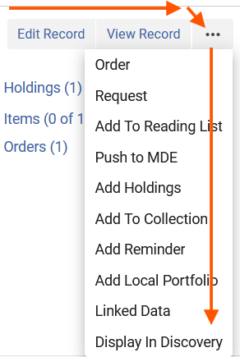
Record Actions Menu
Lists all actions that a user is authorized to take.
Lists actions relevant to record.
Most actions found under “…”
When viewing a specific record, sections have other actions.
The Record Actions menu on the “records” screen appears left to right, then down.

Slide 9
Institution Zone Architecture
An institution may have multiple “libraries”
  One or more libraries organize active collections and service desks
    E.g., Main Library, Fashion Resource Center, Oak Street Storage
    Library contains locations for holdings and items
    Library contains the service desk (i.e., circulation)
  A Resource Sharing Library automates lending and borrowing in I-Share
    Two locations
      Borrowing Resource Sharing Requests (OUT_RS_REQ)
      Lending Resource Sharing Requests (IN_RS_REQ)
    Records in this library are managed by Alma: Do not use for cataloging.
An institution may also inherit network inventory
Notes:
[all titles title wonder of wonders or ISBN 9780805092608; 0805092609
--presence of borrowing request data
--don't use these records for cataloging, because Alma cleans these up after requests and/or loans are resolved.]
[search all titles: Theatre and metatheatre (991154781296805816)
Toggle combined results]

Slide 10
Network Zone Titles
Titles: bibliographic records created, imported, or linked into NZ
  Will have unique MMS ID for the network (last 4 digits: 5816)
  Records shared with network from IZs
  NZ-linked records show NZ-record content first, then IZ-level content
May or may not have inventory
  Electronic inventory
    Collections – set of portfolios organized by provider and package
    Available for – list of institutions that receive access via network sharing
  Held By
    Indication of institutions that have inventory in IZs and sharing (linking) a record in IZ
Notes:
[search all titles title Die Hard
[search physical titles title Die Hard
IZ only results
[search electronic titles isbn 9781118891490
or title python

Slide 11
Community Zone Titles
Titles: bibliographic records created, imported into CZ
  Will have unique MMS ID for the CZ (last 4 digits varies by source)
  Common record prefix (CKB)
  Records provided by ProQuest and other vendors
  Electronic resources only
Basic electronic inventory
  Collection – set of portfolios organized by provider and package
  Portfolio – settings necessary to connect to an electronic resource
Searches show resources that exist in the CZ
  Indications if title, collection, portfolio are linked to an IZ
Notes:
[Search for titles, portfolios, and collections that show
--titles may appear in multiple collections
--collections may be active or not
--portfolios are linked to IZ or not
[search electronic collections title die hard]
[search electronic collections institution advanced Availability (collection) available
[search electronic portfolios ISBN 9781625840073]
[search electronic titles dear evan hansen]

Slide 12
Inventory Models and Search Modes
Type of Search | Institution | Network | Community
All Titles | X | X | X
Physical Titles | X
Physical Holdings | X
Physical Items | X
Electronic Titles | X | X | X
Electronic Portfolios | X | X | X
Electronic Collections | X | X | X

Slide 13
How do I find…
Records that describe physical resources…
  That my institution already cataloged? Physical Titles
  That my institution needs to catalog the first time? All Titles
Bibliographic records that describe electronic resources…
  That my institution already cataloged? Electronic Titles
  That my institution needs to catalog the first time?
Use advanced search and/or facets to narrow results

Slide 14
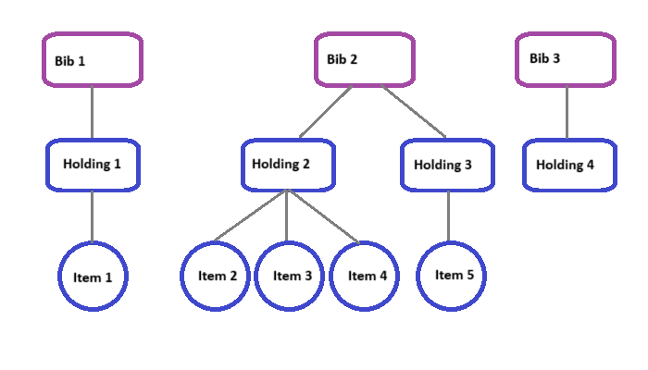
Physical Inventory Models

Slide 15
Adding Physical Inventory without acquisitions
Search
Edit record
Add holding
Add item(s)
Notes:
[search for Mindgames, 0809297078
Edit record / save
Add holdings via template
Add item via template 31234588602181

Slide 16
Adding Physical Inventory with acquisitions
Search
Create order (i.e., PO line)
[time passes]
Receive item
Update holding and item
Implementing Acquisitions in Alma webinar series
Notes:
Search

Slide 17
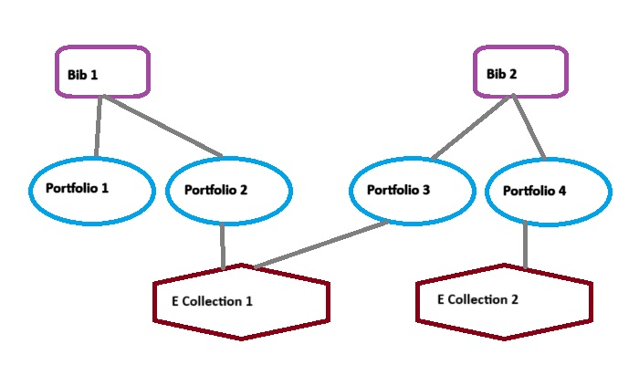
Electronic Inventory Models

Slide 18
Adding electronic inventory via CZ collection
Search CZ
Locate title within active collection
Activate portfolio

Slide 19
What if the record I need isn’t in Alma yet?
Could I create a brief record in my IZ? Yes
Could I create a brief record in the NZ? No
Could I modify an existing record to match my needs? No
Could I copy an existing record and modify it in my IZ? Maybe
Could I import a copy of a record from OCLC? *Yes*
More on this topic in Session 3
Consider reviewing Cooperative Cataloging Policies for I-Share

Slide 20
Questions?
Please respond to the training survey
https://illinois.qualtrics.com/jfe/form/SV_3g5SVoYRPgWk2Wy
https://go.uillinois.edu/cattrain2025

