Slide 1
February 2026 Alma Primo Update
January 29, 2026
Notes:
(Debbie)

Slide 2
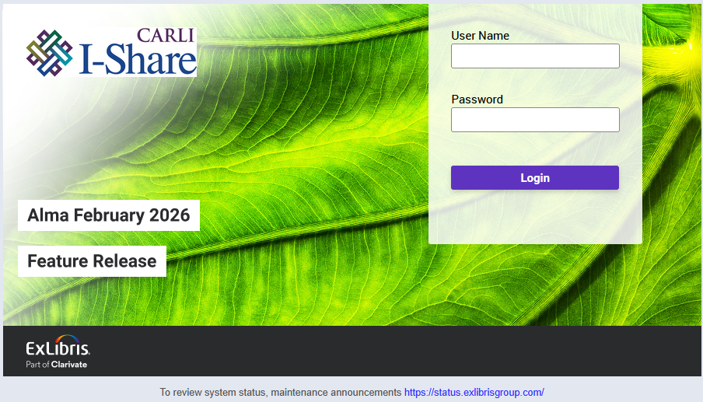
Today’s Agenda
Announcements, Events, and Reminders
February 2026 Quarterly Release Features
  Alma features
  Primo VE features
Q&A
Today’s session is being recorded and will be posted to the CARLI website.
The Alma Login screen beginning with the February 2026 release.
Notes:
(Debbie)

Slide 3
Events Calendar
ERMC Presents on Using COUNTER Statistics
  February 9, Understanding COUNTER Stats and Transition to 5.1
  March 16, Interpreting COUNTER Stats & Storytelling
  April 13, Using Analytics to Pull Your Data and SUSHI without Analytics
Technical Services Q&A
  March 5, DEI Options for Alma & Primo VE
CARLI Calendar
CARLI News, January 29, 2026
Notes:
(Debbie)

Slide 4
Release Notes Highlights
Today’s presentation will cover the updates that have the most impact on the I-Share environment.
The full release notes are available from the Alma and Primo VE Support pages:
  Alma Release Notes, 2026
  Primo VE Release Notes, 2026
Use audience tags on slides to get information to the right staff.
Notes:
(Debbie)
In today’s presentation, we are highlighting those updates in Alma and Primo VE that are the most important to the I-Share environment. In the interest of time, we’re not covering everything, so we encourage you to review the release notes yourself. You may find something that is practical to your local uses, though you will also encounter some updates that don’t apply in I-Share at all. If you have any questions about updates, please contact us at support@carli.illinois.edu.
Our slides are available for sharing with your colleagues from the event page where you registered. Slides have been marked with audience tags to help you get information to the right people at your institution.
With that, let’s get into our first set of Alma updates, and leading us of is Adrienne Radzvickas.

Slide 5

Course Reserves Viewer Can View Courses
A user with the Course Reserves Viewer role can now view the list of courses in Alma.
You must contact Ex Libris to get this functionality turned on.
A screenshot of the Course Reserves Menu with Viewer Role Selected
Everyone
Circulation
Notes:
Fulfillment (Adrienne)

Slide 6
Search Changes
In the Advanced Search for Physical Items, the following searches were added:
  Has Orders: Yes|No
  Received: Received|Not Received
Users can search order lines for relative dates. This is available for:
  Creation date
    Is Within the Last (days)
    Is Older Than (days)
  Sent date
    Is Within the Last (days)
    Is Older Than (days)
  Renewal date
    Is Within the Last (days)
    Is Older Than (days)
    Is Within the Next (days)
Everyone
Notes:
Everyone (Adrienne)

Slide 7
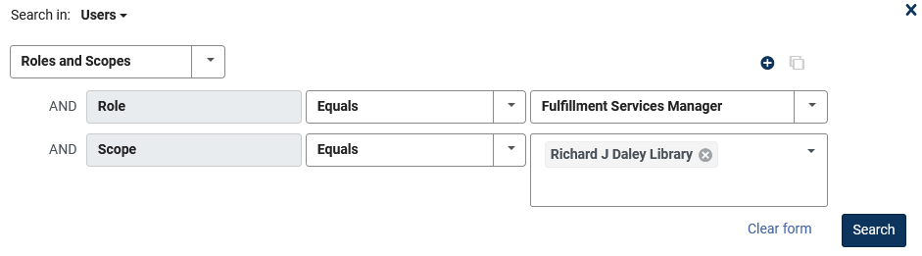
Search Changes Continued
In the Advanced Search, you can now search for users by role and scope.
A screenshot of the Roles and Scopes selection in the Advanced Search
Everyone
Notes:
Everyone (Adrienne) For example, to search for users with a circulation desk operator role in the scope of the Main Library. This new option enhances search options and enables the creation of user sets based on their roles and scopes.

Slide 8
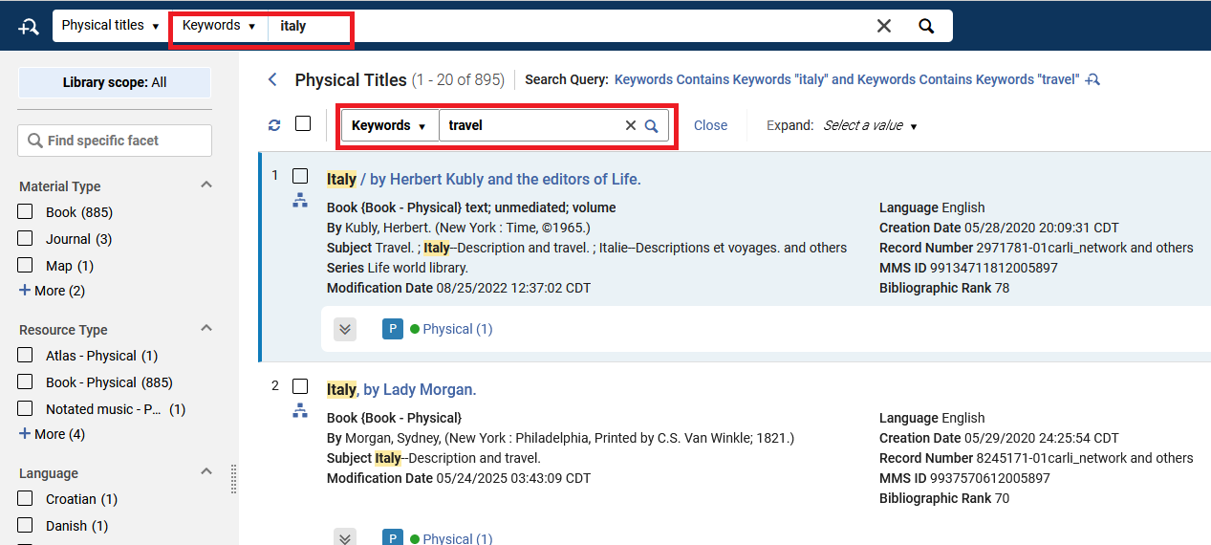
Secondary Search
When searching for titles, holdings or PO lines in Alma, you can now perform a secondary search within the search results.
This secondary search is also available when viewing logical set content
A screenshot of Physical Titles search for keyword “Italy” with a secondary search of “travel” selected
Everyone
Notes:
Everyone (Adrienne) allowing for easy location of specific set members. This is especially useful for users who want to quickly or temporarily refine their search query, without having to update an advanced search with additional search criteria.

Slide 9
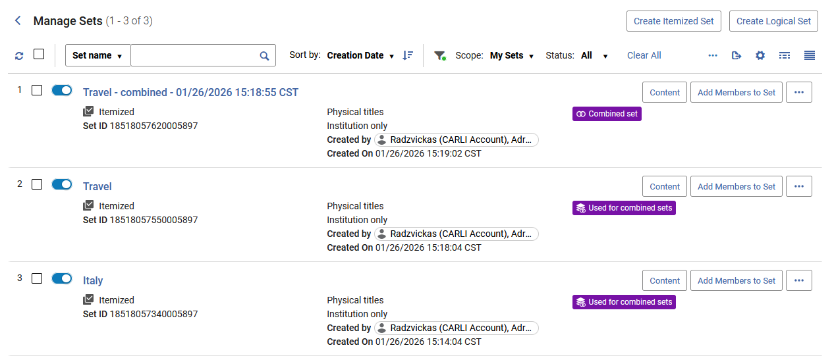
Manage Sets Interface
You can now customize the display and order of the actions in the Manage Sets list.
The Related Sets description in the Related Sets section in the Manage Sets interface was updated to be more meaningful and improve clarity and consistency as follows:
  New badges were introduced to indicate the type of relationship:
    Used for combined sets
    Combined set
    Used for filtered sets
    Filtered Set
The Manage Sets interface showing Combined Set badges
Everyone
Notes:
Everyone (Adrienne)

Slide 10
Manage Sets Interface Continued
The Related Sets section in the Manage Sets page was enhanced to be more informative and improve clarity and consistency:
  Set IDs are now displayed at the end of each set name.
  The related sets display logic has been updated to better handle scenarios where sets are deleted or updated, ensuring an accurate representation of relationships. Filtered sets whose "parent" was deleted are now indicated as such.
  Additional relations are now included, showing related set details for actions like Create Titles Set and Itemize.
  Additionally, the Manage Sets list now includes the Set ID information displayed in the first column of set information in the list, in addition to its current display in the right panel.
Everyone
Notes:
Everyone (Adrienne)
Next, Debbie Campbell will have some circulation and fulfillment updates.

Slide 11
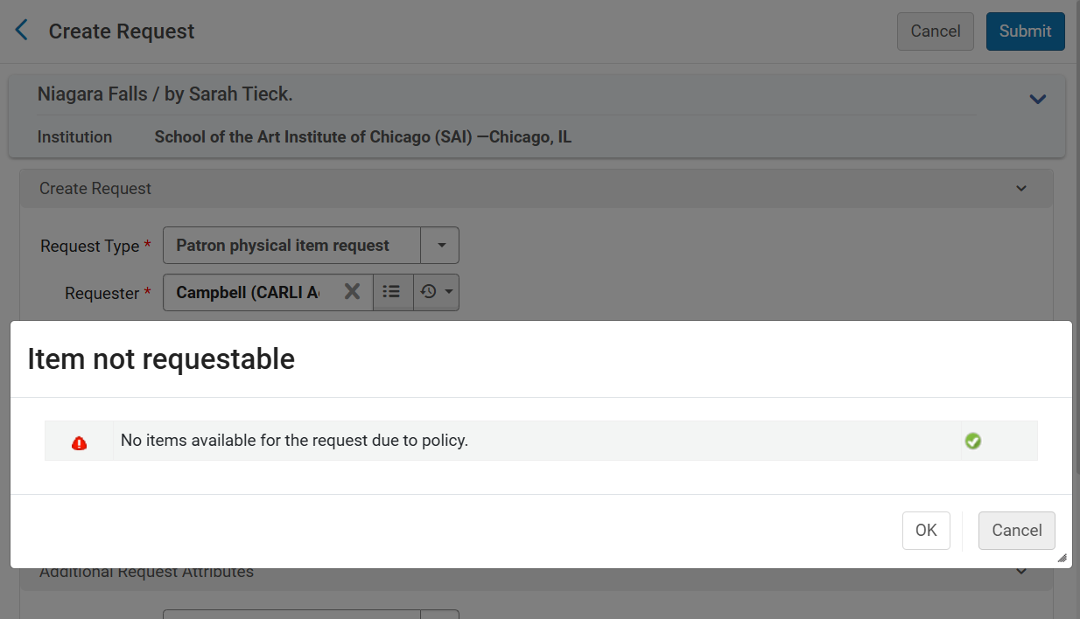
Override Hold Policies
This screenshot shows the "Item not requestable" pop-up message, with the reason "No items available for the request due to policy." This is the current configuration, where the only two options for staff are "OK" or "Cancel."
Acquisitions
Circulation
ILL/ Resource Sharing
Notes:
Debbie
Circulation; Interlibrary Loan/Resource Sharing; Acquisitions
While staff have been able to decide to do an override to permit a loan to a patron, there previously was not a way to do an override to place a local request through Alma on behalf of a patron, when the request was not permitted by the settings in the corresponding fulfillment unit request rules. Currently, if you try to place a local “patron physical item request” for an item set as not requestable in Alma, you receive two buttons on the pop-up alert to acknowledge with “Ok” and return to the request screen, or “cancel” and return to the item record.

Slide 12
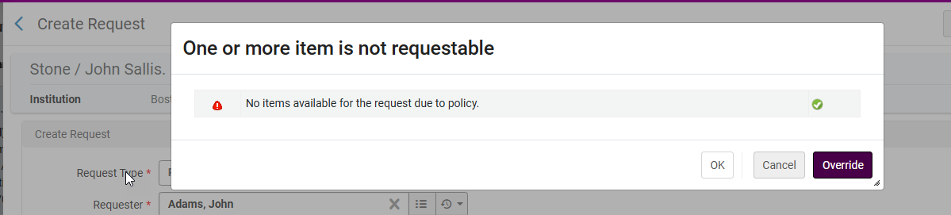
Override Hold Policies, continued
This screenshot shows the "Item not requestable" pop-up message, with the reason "No items available for the request due to policy." This is the February configuration, where there are three options for staff with appropriate roles, "OK," "Cancel," and "Override."
Acquisitions
Circulation
ILL/ Resource Sharing
Notes:
Debbie
Circulation; Interlibrary Loan/Resource Sharing; Acquisitions
With the February update, CARLI will be contacting Ex Libris to enable the override setting for all I-Share libraries to permit staff to do an override to place a local request for a patron through Alma. Ex Libris will enable the privilege for the Circulation Desk Manager and Fulfillment Services Manager roles, so staff with those roles assigned will be able to place the request by override.

Slide 13
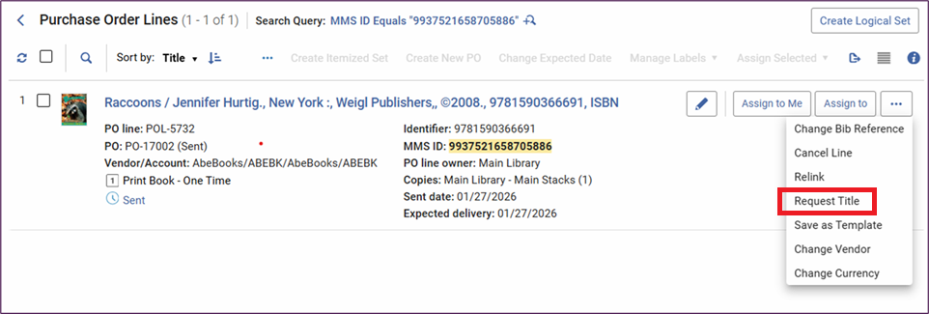
Option to Place Patron Requests from PO Line, part 1
This Alma screenshot shows a sample purchase order line for the print book title "Raccoons." The row action ellipsis has been expanded to show all of the available options, and the new for February 2026 option of "Request Title" is highlighted.
Acquisitions
Circulation
ILL/ Resource Sharing
Notes:
Debbie
Circulation; Interlibrary Loan/Resource Sharing; Acquisitions
Also new with the February release is the ability to place a local hold request for a patron on an item in the acquisitions workflows, using the new “Request Title”, or “Request Item” option in the row action ellipsis. Shown here on screen is the new option highlighted for a book that is on order. Selecting that “request” option should take you to this next screenshot…

Slide 14
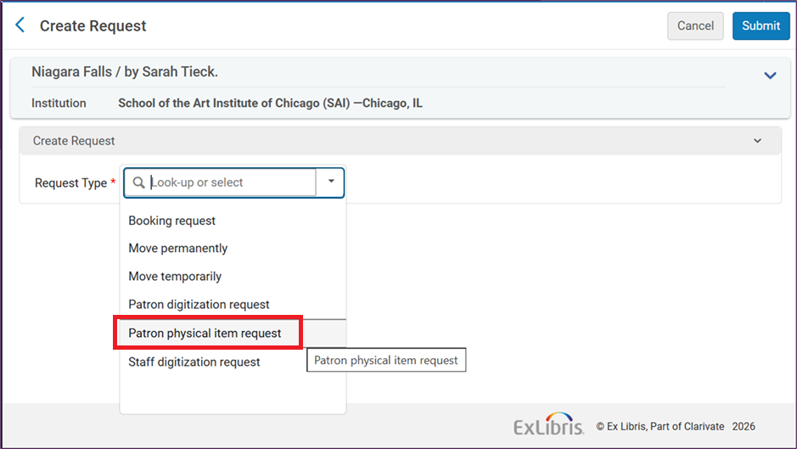
Option to Place Patron Requests from PO Line, part 2
This screenshot shows the "Create Request" drop-down menu screen, with the "Patron physical item request" option highlighted. This is the option staff should select when placing a request from the PO.
Acquisitions
Circulation
ILL/ Resource Sharing
Notes:
Debbie
Circulation; Interlibrary Loan/Resource Sharing; Acquisitions
Where you will choose the “Patron physical item request” option, and then complete the local hold request for the patron for whom the item should be put on hold for as soon as the item arrives and is scanned in as available at your library. With some quick testing, the hold will linger for the patron until the item is scanned in at the circulation desk, and then the hold will function as a normal local hold in Alma.
Now, your library might have Alma configuration set so that patrons cannot place their own requests on items with certain process statuses, including the Acquisitions workflow process. This new setting to allow staff to place local hold requests for local items through the PO Line, is probably why that override button was developed (a few slides ago). If you have any questions about the settings at your library, please email CARLI Support and we’d be happy to do a review of them with you.

Slide 15
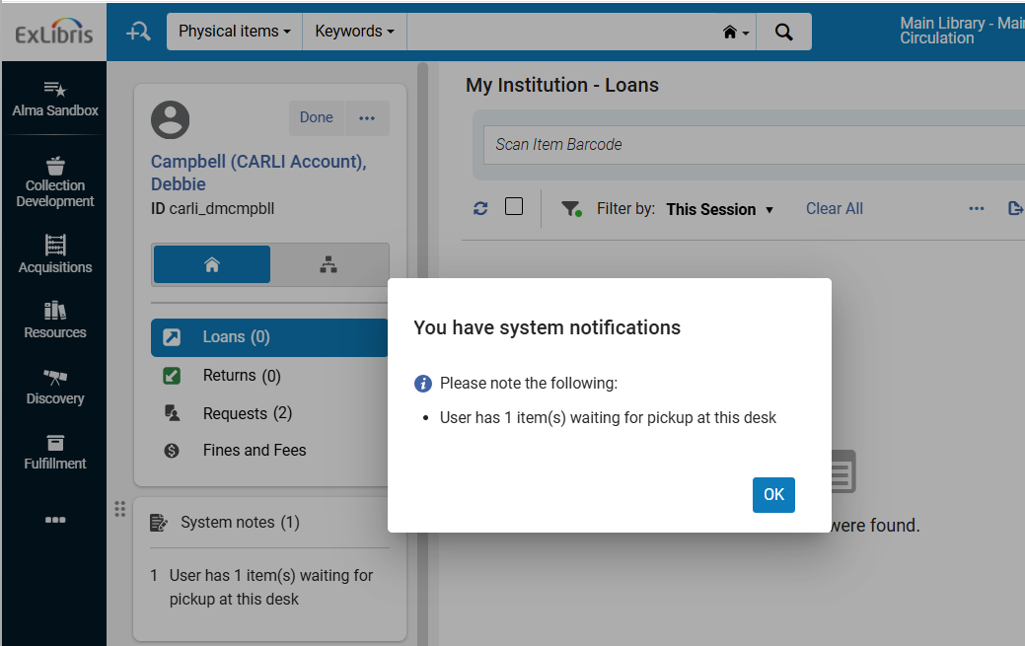
Pop-Up Notification for Hold Shelf Items
This screenshot of the Alma Manage Patron Services screen shows the "You have system notification" pop-up enabled.
Circulation
Notes:
Debbie
Circulation
While we are still discussing placing items on the hold shelf, there is a third enhancement coming with the February release that is at least a little related to items on the hold shelf. Ex Libris has added a new pop-up alert that institutions can optionally enable for their circulation desks (this is an all or nothing setting for the institution; you cannot decide by library).
While in the Release Notes it is called “Pop-Up Notifications for Hold Shelf Items” the setting would be more accurately called “Pop-Up System Notes,” as the pop-up message contains the full contents of the System Notes box (which, is also visible in the left bar of the manage fulfillment screen, with the patron’s other information).

Slide 16
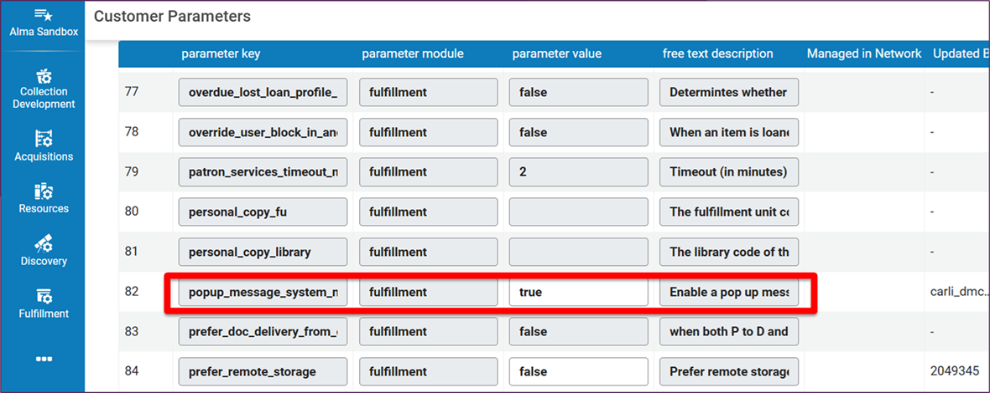
Pop-Up Notification for Hold Shelf Items, Configuration
This screenshot is of the Configuration at the institutional level> Fulfillment> General> Other Settings with the popup_message_system_notes parameter highlighted; this setting can be set to “true” to enable the pop-up alerts.
Circulation
Configuration
Notes:
Debbie
Circulation; Configuration
Each I-Share library can decide if they would like to have this pop-up enabled. If yes, this is a decision that can be made by the library, and configuration can be changed to enable the feature. Please feel free to email CARLI Support if you would like us to make the change. Also, your institution’s Alma SysAdmin can do it as well. The setting is at the institutional level of configuration> Fulfillment> General> Other Settings, the Midwestern junk drawer of configuration.
It is the popup_message_system_notes parameter. The value can be changed from “false” to “true” to enable the setting.
The parameter number in your Alma;s list may or may not be number 82; that depends on the sort, so double-check the full parameter key name, which may fully display the name when hovering (if you have that feature enabled on your computer), or it may be fully readable depending on your screen’s display zoom percentage.
PLEASE MAKE SURE TO NOT EDIT ANY OTHER PARAMETERS; MANY HAVE CONSORTIAL IMPLICATIONS.

Slide 17
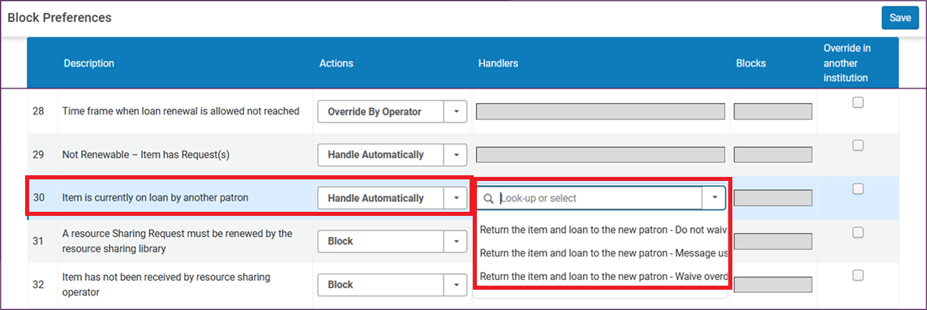
Automatic Waiver of Overdue Fines for Re-loaned Items
Screenshot shows Configuration at the institutional level> Fulfillment > Physical Fulfillment > Block Preferences, with the "Item is currently on loan by another patron" preference highlighted, and the three available configuration choices.
Circulation
Configuration
Notes:
Debbie
Circulation; Configuration
This setting won’t affect too many of our libraries, as overdue fines are only charged for a very limited subset of collection materials- such as equipment and reserves. Also, many I-Share institutions have decided that, when the “item is currently on loan by another patron” condition is met, that staff should do a manual review of the loan (aka, why is the item in the hand of this second patron when it is still on loan to the first), rather than having Alma automatically handle the transaction.
But! If your library does charge overdue fines, AND you want Alma to automatically return the item from the first patron, and loan it to the second patron, you can now decide how the overdue fines are handled.
The setting is in configuration at the institutional level> Fulfillment > Physical Fulfillment > Block Preferences, then “Item is currently on loan by another patron”. The new options are available for the “handle automatically” choice.

Slide 18
Location Level Best Copy for Fulfilling a Request
Ex Libris has added functionality to use the “transit time rules” to have Alma determine which copy of an item is the best to fulfill a patron’s request.
We have not yet tested or used this functionality in Alma; we’ve been using a default transit setting since migration to Alma in 2020.
Testing opportunity:
If your library has multiple branch libraries, and you’d like to test whether we can get Alma to prioritize sending the initial request to one branch over another branch, or,
If your library tends to have multiple copies of some titles, and you’d like to test whether we an get Alma to prioritize sending the initial request for one location’s copy over another location’s copy.
Please email CARLI Support so that we can schedule to work with you on this testing.
We want to make sure nothing breaks in I-Share/AFN if institutions/libraries begin customizing this functionality.
Circulation
ILL/ Resource Sharing
Notes:
Debbie
Circulation; Interlibrary Loan/Resource Sharing
Ex Libris has added functionality to use the “transit time rules” to have Alma determine which copy of an item is the best to fulfill a patron’s request.
We have not yet tested or used this functionality in Alma; we’ve been using a default transit setting since migration to Alma in 2020.
Testing opportunity:
If your library has multiple branch libraries, and you’d like to test whether we can get Alma to prioritize sending the initial request to one branch over another branch, or,
If your library tends to have multiple copies of some titles, and you’d like to test whether we an get Alma to prioritize sending the initial request for one location’s item over another location’s copy.
Please email CARLI Support so that we can work with you on this testing.
We want to make sure nothing breaks if libraries begin customizing this functionality.

Slide 19
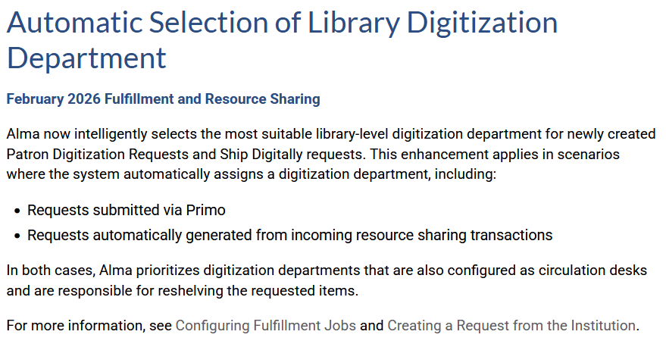
Library Digitization Department / Prioritizing Locations for Fulfilling Digitization Requests
Screenshot is from the Ex Libris February Release Notes.
Circulation
ILL/ Resource Sharing
Notes:
Debbie
Circulation; Interlibrary Loan/Resource Sharing
If you use document-delivery digitization in Alma, and you have multiple libraries or digitization departments, there is a new setting in this February release that you will want to be aware of, and that I’d like to hear back from you how it will seem like it is going, as the available information from Ex Libris about it is limited at this time. Here is what the release notes say; with saying “intelligently selects the most suitable” that’s what we’ll want you to watch.
Next up with some technical services enhancements, here’s Ted Schwitzner.
Automatic Selection of Library Digitization Department
February 2026 Fulfillment and Resource Sharing
Alma now intelligently selects the most suitable library-level digitization department for newly created Patron Digitization Requests and Ship Digitally requests. This enhancement applies in scenarios where the system automatically assigns a digitization department, including:
Requests submitted via Primo
Requests automatically generated from incoming resource sharing transactions
In both cases, Alma prioritizes digitization departments that are also configured as circulation desks and are responsible for reshelving the requested items.

Slide 20
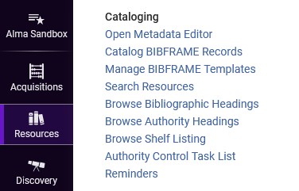
BIBFRAME and Linked Open Data Support
Editor for BIBFRAME records
Enabled in sandboxes
Institutions may enable locally
  Activate Linked Open Data Formats
Once enabled in configuration, the Resources menu includes new functions to work with BIBFRAME records.
Cataloging
Configuration
Notes:
[Cataloging]
(Ted)
BIBFRAME and Linked Open Data present new options for libraries to describe their collections. Ex Libris has slowly added linked open data functionality over the last several releases. This release marks a milestone with the addition of a linked open data editor for BIBFRAME records within Alma, so that libraries that want to experiment with cataloging this format don’t need an external editor.
CARLI is enabling linked open data support in our premium sandboxes, and libraries may choose to enable this locally in configuration. There is no obligation to catalog using these tools, but we hope that their availability will help catalogers looking to expand their practice and expertise.

Slide 21
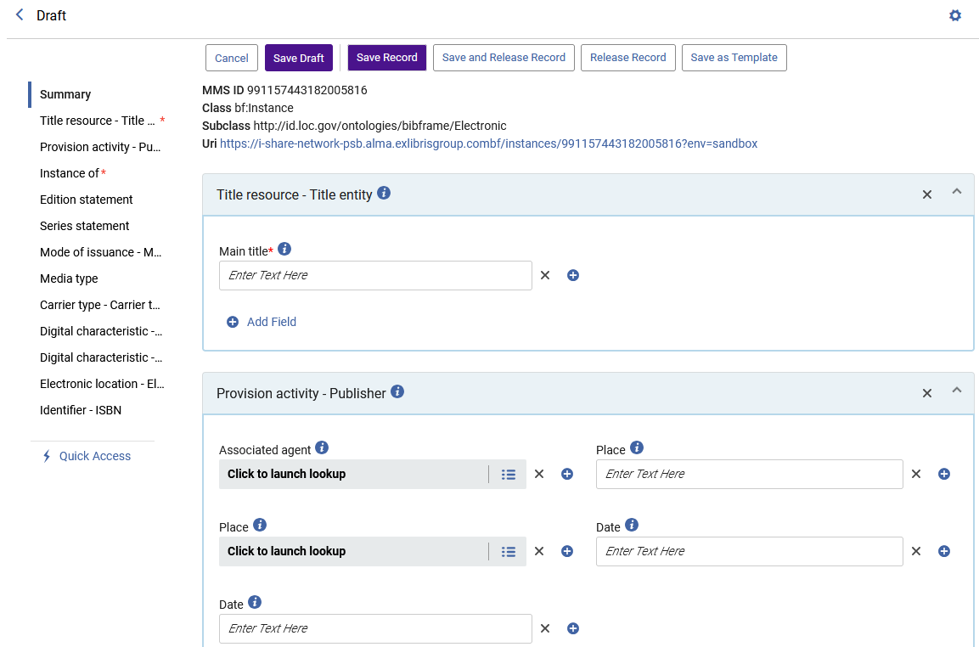
Sample BIBFRAME Editor Screen
The BIBFRAME editor includes sections for different elements, and fields may be entered manually or from predefined lists.
Cataloging
Notes:
[Cataloging]
(Ted)
Here is a sample screen that appears when creating a BIBFRAME record from a template. The sections for descriptive elements appear in the main area of the screen, and a navigation pane appears on the left to move between sections. Catalogers will enter some data manually, and for some fields, data may be selected from lists or existing values.

Slide 22
Additional BIBFRAME Support
BIBFRAME Support documentation
API Support for BIBFRAME records
  BIBFRAME records may be retrieved by bibs API, edit in Sinopia.
  BIBFRAME URIs are valid endpoints for works and instances.
BIBFRAME records appear in All Titles searches and sets.
BIBFRAME records may be used for POLs, inventory, analytics.
Cataloging
Notes:
[Cataloging]
(Ted)
Alma has included support for BIBFRAME records for several releases, and we’re listing some of the highlights of that support here. BIBFRAME records may be used in the same way as any MARC format records, used for PO lines, and physical, electronic, or digital inventory. BIBFRAME records will also appear in titles searches, may be added to sets, reported on in Analytics, and discoverable in Primo VE.

Slide 23
Bibliographic Search Indexes on MARC Fields
Define custom Alma search indexes on MARC fields 010-899.
  Indexes full content of a tag, including subfield codes.
Improved Analytics local parameters for MARC fields 010-999.
  May include indicator values and specific subfields.
  Consortial ability to customize without a support case.
Improved index of languages for MARC codes.
  Unifies the MARC21 and ISO-639-3 languages lists.
  Should improve index and facet displays.
Analytics/Statistics
Cataloging
Notes:
[Cataloging]
(Ted)
Alma already has a robust list of search indexes on MARC records and other record formats, but a number of MARC record fields have been either omitted or grouped into indexes with other fields. Beginning in February, CARLI and institutions will have the ability to create custom search indexes on MARC fields from 010 to 899. These custom indexes include the full content of a field as a string, including subfield codes.
Along with this improvement to indexing, the ability to create custom local parameters for analytics is improved as well. In addition to using the full content of a field, it will be possible to create local parameters for bibliographic or holding tags to consider specific indicator and subfield values. For example, we have an analytics field for the whole MARC 300 tag. One could choose to create a field to focus on 300 subfield a or 300 subfield c.
Another indexing improvement that catalogers will see is a unified language codes list that covers codes used in the MARC 008 field and the MARC 041 field. This improvement should improve the options for languages found in search indexes and in the facets pane of search results.

Slide 24
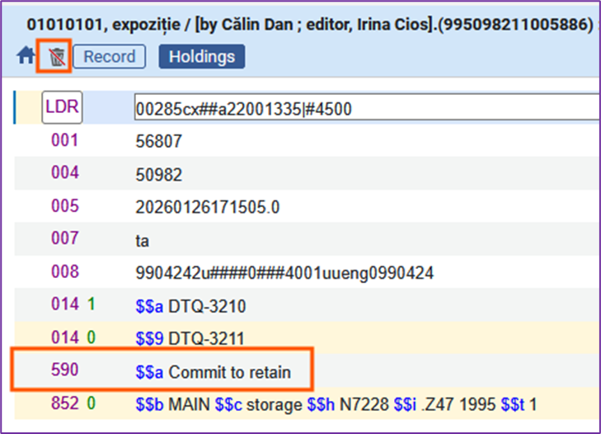
Collection Retention in Bib, Holding, or Item
Collection Development menu includes retention analysis.
May mark bibliographic, holding, or item records for retention.
  Retention should be reportable across IZs.
  Retention blocks record deletion.
New this release: Holding record retention.
  Fits CARLI cataloging recommendations about local details in holdings.
The presence of 590 $$ Commit to retain marks the record for retention, flagged with the icon of a red slash over a trash can.
Cataloging
Configuration
Acquisitions
Notes:
[Acquisitions][Cataloging][Collections]
(Ted)
Alma’s Collection Development workflows, which stem from the functionality introduced through Rialto, include data and analyses to support shared collection management. One such mode is resource retention, where an institution may indicate that it has committed to retain a resource, for example as a last copy or as part of a cooperative collection project. Marking a record as committed to retain blocks the record from being deleted from Alma.
Retention may be marked in the bibliographic, holding, and item records, and the holding record is the new functionality coming in this release, an option that will work best with existing consortial practices. CARLI or institutions may specify a MARC tag that will contain details on record retention decisions. This field will then be copied into fields in analytics that flag retention for collection reports. The presence of this field and text will also block the record from deletion.

Slide 25
Collection Development Role and Reports
A new role to access workflows: Collection Development Manager
  Moves workflows and analyses from administrator roles to special role.
  Existing Rialto libraries may need to review roles for users.
Workflows for retention and deselection report on collection data.
  Local collection data compared with other institutions data.
Requires acceptance of Data Sharing Profile for collection analysis and development.
Acquisitions
Cataloging
Notes:
[Acquisitions] [Collections]
(Ted)
A new role, Collection Development Manager, is being added to handle the retention and deselection workflows, one that separates out the privileges from existing administrator roles. Staff at existing Rialto institutions should check that their roles are updated accurately.
Once a user has the Collection Development Manager roles, they will have access to workflows for organizing retention and deselection projects in Alma. These projects help identify resources that analyze physical inventory across institution zones. The projects may generate reports that contain detailed recommendations from the project and data for matching titles.
Access to these reports requires that an institution agree to the Data Sharing Profile for Collection Analysis and Development, so that their data may be visible to other institutions via these workflows. Shared data are limited to bibliographic and inventory data and loan counts. No personal or acquisitions data are shared.

Slide 26
Alma AI Assistant for Acquisitions Funds and Ledgers – Preview Mode (Beta)
FYI about this new AI Assistant available in this release.
The latest area with an AI Assistant is Acquisitions - Funds and Ledgers. Staff users with the Fund/Ledger Manager role can ask questions about their institution’s funds and ledgers and receive immediate, natural-language responses.
View a short video about the Assistant
Administrators can choose to activate the feature in Configuration > Acquisitions > AI Features > AI Usage Profile set to Yes
Ex Libris encourages feedback during this “Preview Mode” if your institution is interested in experimenting.
Acquisitions
Configuration
Notes:
[Acquisitions][Configuration]
(Ted)
Alma is being infused with artificial intelligence tools, and the latest addition is an AI Assistant for funds and ledgers. Staff users with the fund/ledger manager role can ask the assistant questions about funds and receive immediate responses as well as charts and summaries. This feature is available in beta during this preview period, and Ex Libris is interested in receiving feedback.
Now, Marisa Tolbert will describe some improvements for electronic resources management.

Slide 27
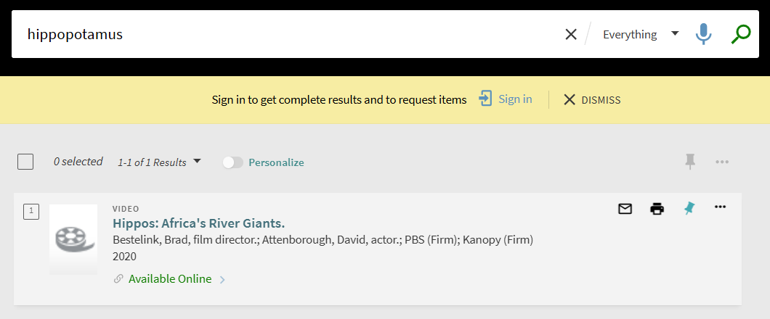
Link Resolver Improvement
The Alma Link Resolver will now identify video records.
  Previously, video records were falsely identified as book records, and/or not distinguished as records for videos.
  Now, when patrons do Primo VE searches for videos, it will only return video records.
  Book links are prevented from display in these searches.
Screenshot of a video search result in Primo VE.
Electronic Resources Management
Primo VE/ Discovery
Notes:
(Marisa) Electronic Resource Management, Primo/Discovery – Primo Searching
Hello! This is Marisa Tolbert from CARLI’s E-Resources unit here to share the electronic resource management feature release updates.
This first one changes the way the Alma Link Resolver handles searches for video records in Primo VE. Previously, video records would be falsely identified as books and results for book records would be mixed in with video record results.
Now, when patrons do video searches, only video records will display! In the slide image it shows a keyword search for “hippopotamus” where the search result is a video called, “Hippos: Africa’s River Giants.” This was after the Resource type facet for video was applied.

Slide 28
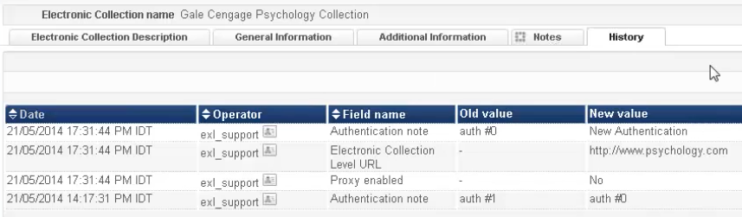
History tab: Complete Record of All Changes
Electronic collections, electronic services, and electronic portfolios will contain a complete record of all changes made. These changes are in the Alma history tabs.
You can watch a video that shows different types of changes that will be recorded on the history tab to learn more.
  General Notes changes are now recorded!
  As seen in the video, they add an authentication note that is later recorded in the history tab.
Screenshot of the electronic collection history tab in Alma.
Electronic Resources Management
Notes:
(Marisa) Electronic Resource Management
This change is one of my personal favorites…as all changes made to electronic collections, their services, and/or their portfolios are now all included in the history tab. Changes made to General notes, as well as Community Zone Updates Task List aka CZUTL are now included! The link in the chat will take you to the video tutorial demonstrating this updated feature.

Slide 29
Autoholdings Vendor Added
Oxford University Press (OUP) monographs and serial holdings can now be managed by automation aka automatic upload of electronic holdings aka autoholdings.
Information about setting up the OUP Autoholdings can be found in Ex Libris’ “Upload Electronic Holdings from Oxford University Press.”
Cataloging
Electronic Resources Management
Notes:
(Marisa) Electronic Resource Management
OUP – Oxford University Press monographs and serial holdings can now be managed by automation. For those of you who are already using autoholdings aka automatic upload of electronic holdings, you know that this will help simplify your workflow. For more information about how to set up autoholdings for OUP, visit the link in the chat.
This change is one of my personal favorites…as all changes made to electronic collections, their services, and/or their portfolios are now all included in the history tab. Changes made to General notes, as well as Community Zone Updates Task List aka CZUTL are now included!

Slide 30
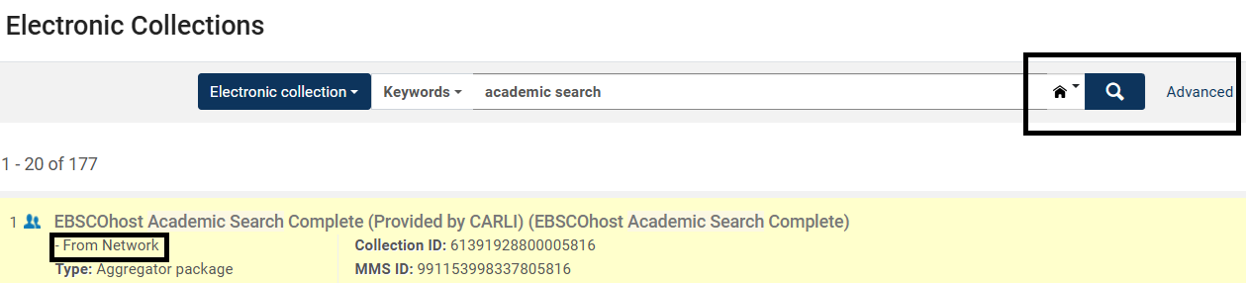
Online Services Order Updates
You can search by IZ and NZ collection/interface in Online Services Order now.
  Ex: you have a subscription to EBSCO Academic Search Ultimate and want it to be top of the order (prioritized over) the EBSCO Academic Search Complete collection provided by CARLI from the Network Zone.
  With this new feature release, you can now prioritize collections or interfaces provided from the IZ over those provided from the NZ.
Note: the search scope makes it appear that only the IZ is being searched for basic and advanced searches. This is not the case. It is doing a combined result search across the IZ and NZ. NZ collection results will be marked with text that reads “- From Network” pictured below the electronic collection name in the search results list.
Screenshot of the Alma search in the Online Services Order Configuration.
Electronic Resources Management
Primo VE/ Discovery
Notes:
(Marisa) Electronic Resource Management, Primo/Discovery
With the online services order configuration, you can now search the IZ and NZ for collections and interfaces. An example of where the online services order comes in handy is when a library has a subscription to Academic Search Ultimate from EBSCO, but also has access to Academic Search Complete provided by CARLI. In this instance, this library may want their subscription prioritized in the Primo VE delivery services display over the collection provided by CARLI. This is one way this new feature comes in handy.
I do want to note that when I was testing this in one of the sandboxes that it appears you are only searching with the IZ search scope. If you try to change the search scope you will find that access is prevented. It is also the same if you click on Advanced. It displays radio buttons for the IZ, NZ, and CZ that are grayed out. The good news is that despite this design, it is a combined result search, meaning that it searches the IZ and the NZ. Any search results for the NZ will display the text “From Network” beneath the electronic collection name in the list of search results. This is what the screenshot in the slide is showing.

Slide 31
Unpaywall Improvements
Unpaywall PDF links are now handled by the “Get PDF” service in Primo VE brief record results and the expanded record view.
These links are coming directly from the CDI, instead of the Ex Libris/ProQuest API as they were previously.
  These changes make it easier and more efficient for the Ex Libris Content Team to better align linking for Unpaywall Collections to the Unpaywall PDFs.
Electronic Resources Management
Primo VE/ Discovery
Notes:
(Marisa) Electronic Resource Management, Primo/Discovery – Primo Searching
Unpaywall linking has been improved. The “Get PDF” service will now link directly to Unpaywall PDFs as the links are now coming from the CDI, instead of the Ex Libris/ProQuest API.
Here’s Yanira Cruz with one additional enhancement involving electronic resources and acquisitions.

Slide 32
PO Line Cancellation: Enable Deletion of Related Inventory Even if Linked to CZ
Until now, when cancelling PO line, the portfolio would only be deleted if it was a standalone local portfolio and inactive.
A new customer parameter (delete_linked_portfolio_upon_pol_cancellation) was added.
When set to true, inactive portfolios that are linked to Community Zone or that are part of an electronic collection will now also be deleted, in addition to the local portfolio.
The parameter is set to false by default. It can be accessed from Configuration > Acquisitions > Other settings.
Acquisitions
Electronic Resources Management
Notes:
PO Line Cancellation: Enable Deletion of Related Inventory Even if Linked to CZ (Yanira)
Next, Martin Kong has an update on analytics behavior.

Slide 33
New Encryption Method for “User ID Encryption” field
The “User ID Encryption” field in the Alma Analytics Fulfillment subject area is now calculated using a new encryption method.
  The “User ID Encryption” field is used to obtain counts by user ID in Analytics reports after the anonymization job is run.
  The “User ID Encryption” field is utilized instead of the Primary ID field, because the Primary ID field is deleted after the anonymization job is run.
CARLI has anonymization enabled in Alma for I-Share institutions.
Alma Analytics reports used at your institution that retrieve data from the Fulfillment Subject area will need to be reviewed to confirm if the “User ID Encryption” field is present.
  For those existing reports that contain the “User ID Encryption” field, it is important to verify that those reports are functioning and/or need to be updated.
Link to Ex Libris documentation about the “User ID Encryption” field.
Analytics/Statistics
Circulation
Notes:
Analytics/Statistics
Martin
Moving on to Primo VE improvements, here’s Jessica Gibson.

Slide 34
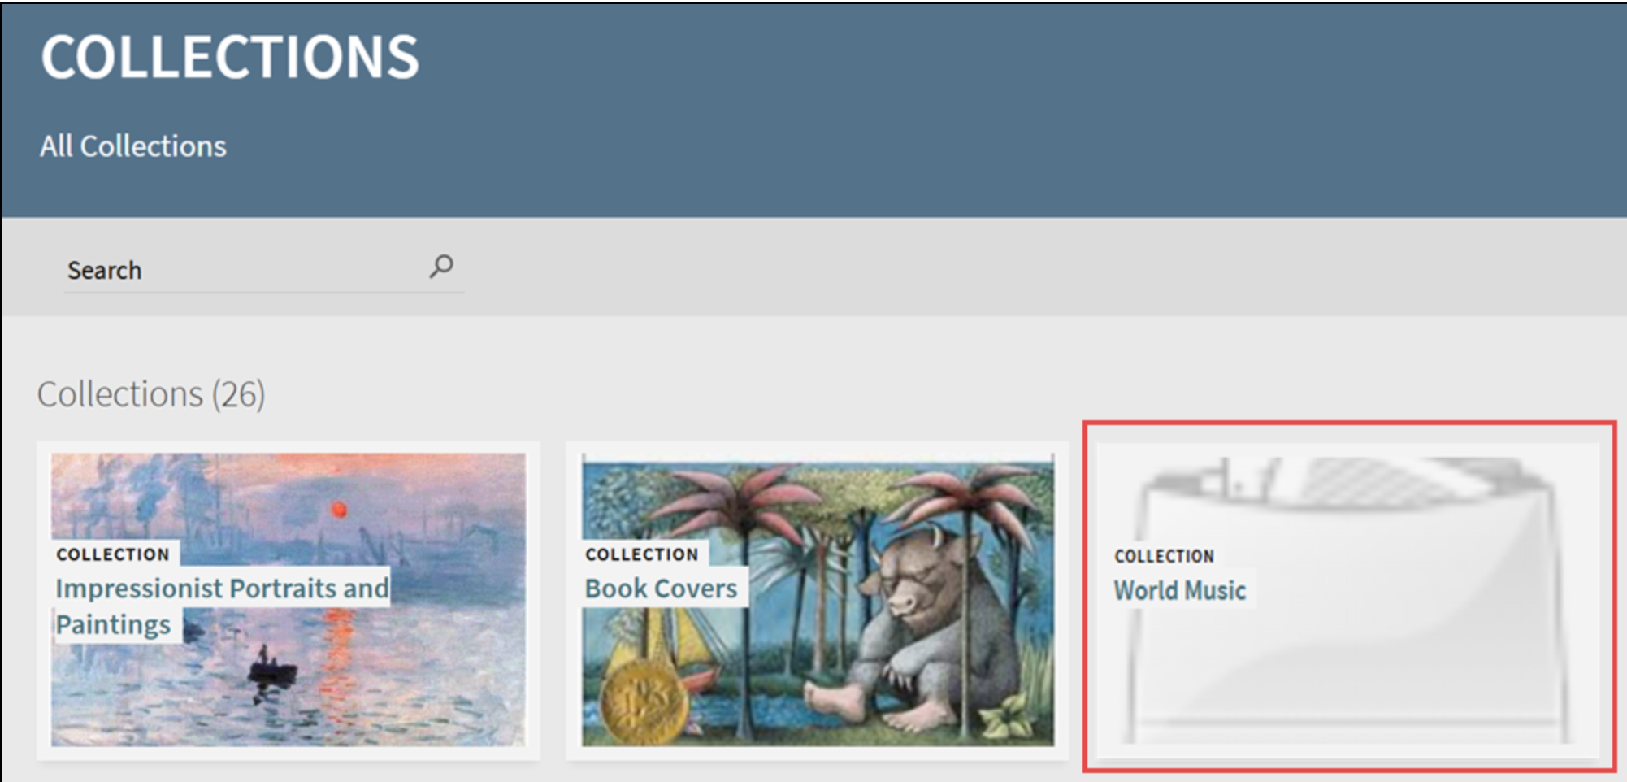
Reminder: Thumbnails for Collections in Alma
Change occurred in January 2026: Collections without a defined thumbnail will now appear without an image in Primo VE.
Add specific thumbnails to Collections and Subcollections in Alma in the Collection Resource Editor’s Discovery tab.
See Managing Collections
Default thumbnail image displayed for a Collection
Primo VE/ Discovery
Notes:
[Jessica] Primo VE/Discovery
One final reminder that if your library has Collections in Alma, as of the January update, Collections without a defined thumbnail will appear without an image. You can define thumbnails explicitly for Collections and Subcollections, using the Manage Collections tool in Alma, see Ex Libris’s documentation.

Slide 35
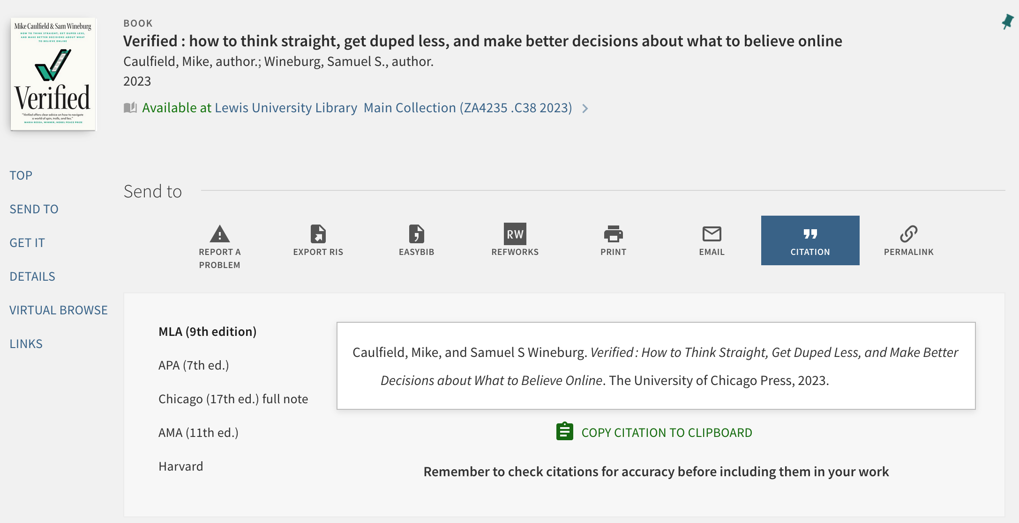
Citation Style Language (CSL) styles will update monthly
Ex Libris has moved to a monthly update schedule for CSLs beginning in Jan. 2026.
Details will be published in the monthly release notes.
See Managing Citation Styles for Primo VE
Full record in Primo VE with the Citation Action selected
Primo VE/ Discovery
Notes:
[Jessica] Primo VE/Discovery
Starting in January 2026, Ex Libris has moved to a monthly update schedule for Citation Style Languages or CSLs to reduce the gap in time between new editions being available and customers being able to use them in Primo VE. They will publish this information in the monthly release notes.
In case you didn’t know, the Citations feature in Primo VE uses the open-source GitHub CSL Style Repository for its formatting. Some citations are available out of the box, and library can add or update the citations. For more information, see Ex Libris’s documentation ”Managing Citation Styles for Primo VE.”

Slide 36
Primo VE NDE UI Update
Ex Libris moving back to a quarterly release schedule; see 2026 plans.
The NDE UI is available to all customers for testing.
CARLI staff and the CARLI Discovery Primo VE Committee are testing and preparing materials for I-Share libraries.
I-Share libraries should NOT go live with Primo NDE until CARLI has announced that all consortial features are functioning correctly.
With that caveat, I-Share libraries can tentatively plan go live with Primo NDE after July 1, 2026, though CARLI staff feel that summer 2027 may be a better target date.
Watch for more information over on CARLI’s Primo VE NDE UI for I-Share webpage and via email to I-Share Liaisons and the CARLI pve-ig list!
Primo VE/ Discovery
Notes:
[Jessica] Primo VE/Discovery
Throughout 2025, Ex Libris was making monthly releases to the NDE UI only but is scaling that back to quarterly releases in 2026. You can see their 2026 plans on their “Available Features, Functionality and Release Plan for NDE UI” webpage.
A reminder that the NDE UI is available to all customers for testing and planning and CARLI staff and the CARLI Discovery Primo VE Committee have begun testing.
I-Share libraries should not go live with NDE until CARLI has announced that our testing is complete and that we have confirms all necessary functionality for I-Share is present.
With that caveat, I-Share libraries can make tentative plans to go live with NDE after July 1, 2026. However, given the current state of the NDE UI, which is still missing some basic functionality that Primo VE has, CARLI staff feel that summer 2027 may be a better target date for I-Share libraries
I-Share libraries should make plans to migrate to NDE UI no later than January 2028.
Watch for more guidance, documentation, and support for I-Share libraries emerging over the next few months on CARLI’s Primo VE NDE UI for I-Share webpage and via email announcement to I-Share Liaisons and the CARLI pve-ig email lists.

Slide 37
Q&A

