Slide 1
I-Share Alma Primo VE Office hours will start shortly
Welcome!
Office Hours will start at 2pm and run until 3pm. Please mute your microphone. As time permits, we will respond to questions typed in the chat box, and offline afterwards, as needed.
This session will be recorded and made available on the CARLI website.
CARLI Logo

Slide 2
I-Share quarterly alma primo ve update: November 2025 Feature release highlights nov. 3, 2025

Slide 3
Today’s Agenda
Announcements and Reminders
August Quarterly Release Features
Alma
Primo VE
Q&A

Slide 4
Announcements
Nov. 5, Getting Started with LibreTexts, 3:00 pm
Nov. 12, Ask a Preservation Expert, 1:00 pm
Nov. 12, Using LibreTexts to Remix, Adapt, and Create OER, 2:00 pm
Nov. 18, CARLI Community Conversation on Student Employee Supervision, 1:00 pm
CARLI News October 29, 2025
Notes:
Check the CARLI Calendar for upcoming events like those listed here! Register today!
In addition, the monthly CARLI newsletter provides a summary of things going on across CARLI.

Slide 5
Reminders
CARLI is changing the way that all EBSCO e-collections are managed in Alma for I-Share libraries.
Until now, EBSCO e-collections provided by CARLI or the Illinois State Library have been managed centrally in the Network Zone (NZ).
In future, EBSCO e-collections will be managed in each Institution Zone (IZ).
I-Share libraries may activate these e-collections locally in their IZs or request assistance from CARLI staff to facilitate this process.
I-Share Liaisons were emailed the requirements and details of this project.
For more information see CARLI’s Managing EBSCO E-Collections in the Institution Zone webpage
Notes:
CARLI is changing the way that all EBSCO e-collections are managed in Alma for I-Share libraries. Until now, EBSCO e-collections provided by CARLI or the Illinois State Library have been managed centrally in the Network Zone (NZ); from now on, EBSCO e-collections will be managed in each Institution Zone (IZ). I-Share libraries may activate these e-collections locally in their IZs or request assistance from CARLI staff to facilitate this process. I-Share Liaisons were emailed the requirements and details of this project.

Slide 6
Release Notes Highlights
CARLI Staff are sharing the updates we feel are most important to the I-Share environment.
Staff at I-Share libraries can review the full set of release notes available from the Alma and Primo VE Support Pages:
Alma Release Notes
Primo VE Release Notes

Slide 7
New
Tags now added to slides
CARLI staff are trying something new!
This new feature is based on feedback from the Annual Meeting Talk Tables
We will apply audience “tags” in the bottom left corner of each Release Notes slide
Each tag described below corresponds to a possible audience for that slide’s content
These are suggestions from CARLI staff! You know your library best.
We are open to suggestions to improve this new feature.
Everyone – may apply to everyone
Configuration – IZ level settings, libraries, locations, letters
Acquisitions - purchase order lines, invoices, funds, receiving and invoicing
Analytics/Statistics – Alma and Primo VE Analytics
Reference/ Instruction – patron interactions with Alma/Primo VE
Cataloging- metadata editor, manage collections, import records, publishing profiles
User Management – SIS Load, authentication, user roles
Circulation – loaning/returning of physical materials, course reserves, I-Share workflows
ILL/ Resource Sharing – I-Share workflows/configurations, integrations with 3rd party ILL services
Electronic Resources Management – CDI, linking, date coverage, P2E cleanup, proxy
Systems – FTP changes, API functionality
Primo / Discovery – Primo searching, NDE, Research Assistant
Everyone
Notes:
(Annie)

Slide 8
Recent Entities
Recent Entities
The Recent Entities list is a helpful way to find the records you have recently worked on and saved, either by creation or editing of a record. It also allows you to easily view your recent changes to your records.
You can display the Recent Entities sidebar by clicking the “clock with an arrow icon”, marked in red. It will list any items that you have added. When I click the item in the sidebar, the second window appears. It shows title, holding, and item information.
Everyone
Notes:
General or Everyone (Adrienne) You can display the Recent Entities sidebar by clicking the clock with an arrow around it icon, marked in red. It will list any items that you have added. In this example, I have added a book called How to Train Your Human. When I click the item in the sidebar, the second window appears. It shows title, holding, and item information.
The Holdings link in an All Titles or Physical Titles
search operates in a similar manner.

Slide 9
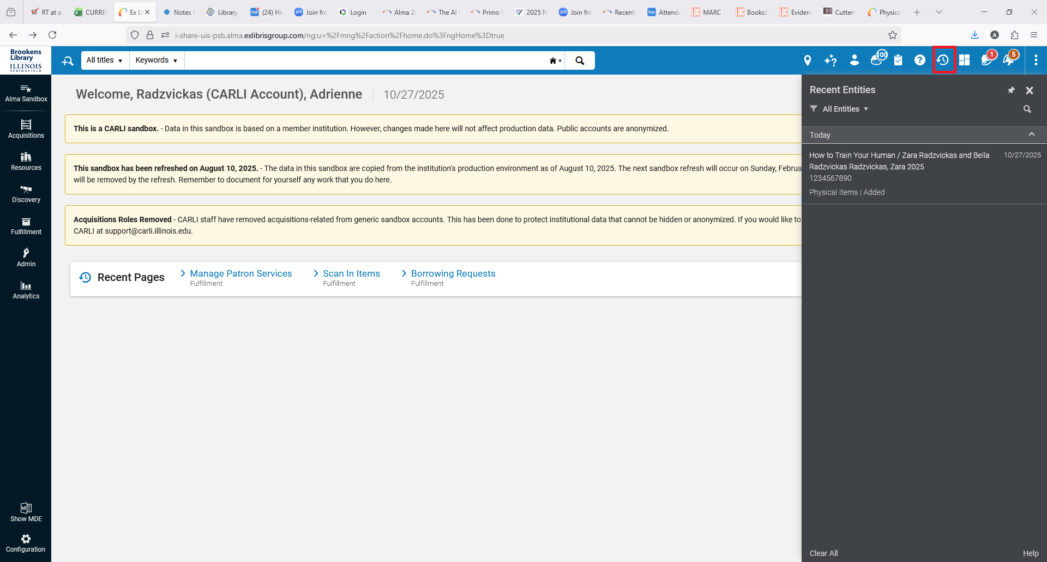
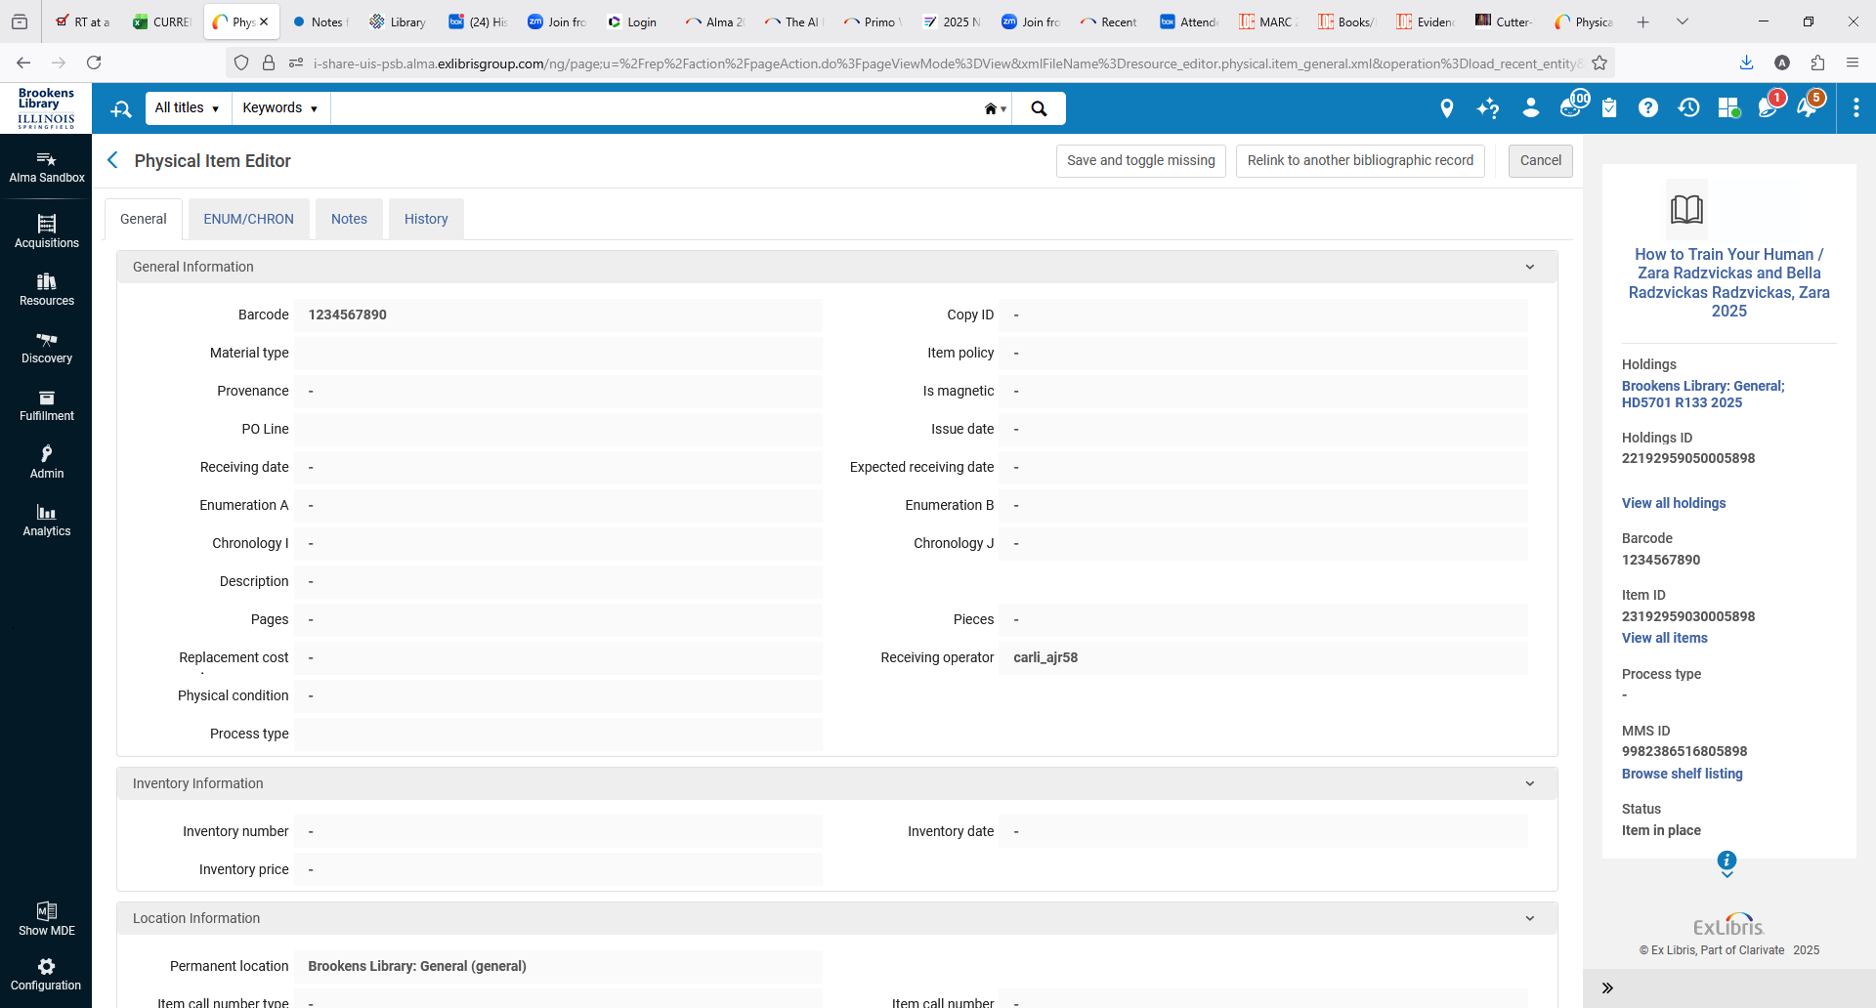
Recent Entities
Alma Welcome Screen with the Recent Entities icon in the persistent
search bar highlighted with a red square. The Recent Entities sidebar
is currently enabled and is displaying a recently added title. Clicking
on that title will open the Physical Item Editor (see next screenshot).
The Alma Physical Item Editor is showing the details for a title that was
recently added. This was the item that was previously displaying
in the Recent Entities sidebar of the previous screenshot.
Everyone
Notes:
General or Everyone (Adrienne) You can display the Recent Entities sidebar by clicking the clock with an arrow around it icon, marked in red. It will list any items that you have added. In this example, I have added a book called How to Train Your Human. When I click the item in the sidebar, the second window appears. It shows title, holding, and item information.
The Holdings link in an All Titles or Physical Titles
search operates in a similar manner.

Slide 10
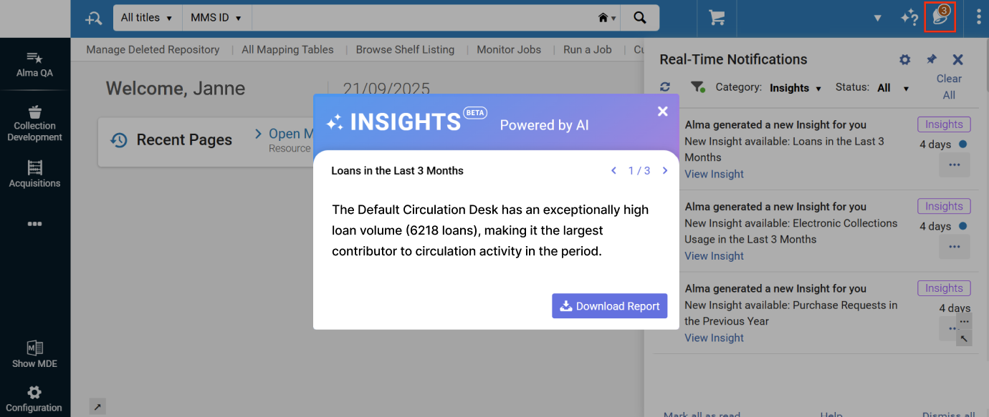
AI-Powered Insights in Alma
Alma now includes an AI Insights feature that periodically displays analytics-based insights.
The initial insight types include the following:
Loans in the Last 3 Months – for users with the Circulation Desk Manager role
Electronic Collections Link Resolver Usage in the Last 3 Months – for users with the Electronic Inventory Operator role
Users must opt-in.
The Alma welcome screen with AI insights pop-up window displayed. In the right corner of the persistent search bar, the Alma real-time notifications icon is highlighted with a red square. Click this icon to access these AI insights.
Everyone
Notes:
Everyone (Adrienne) The opt-in requires General System Administrator privileges and is done from Configuration > General > AI Features > AI Usage Profile. (note on double-checking any data from report generated by AI to make sure it is accurate)

Slide 11
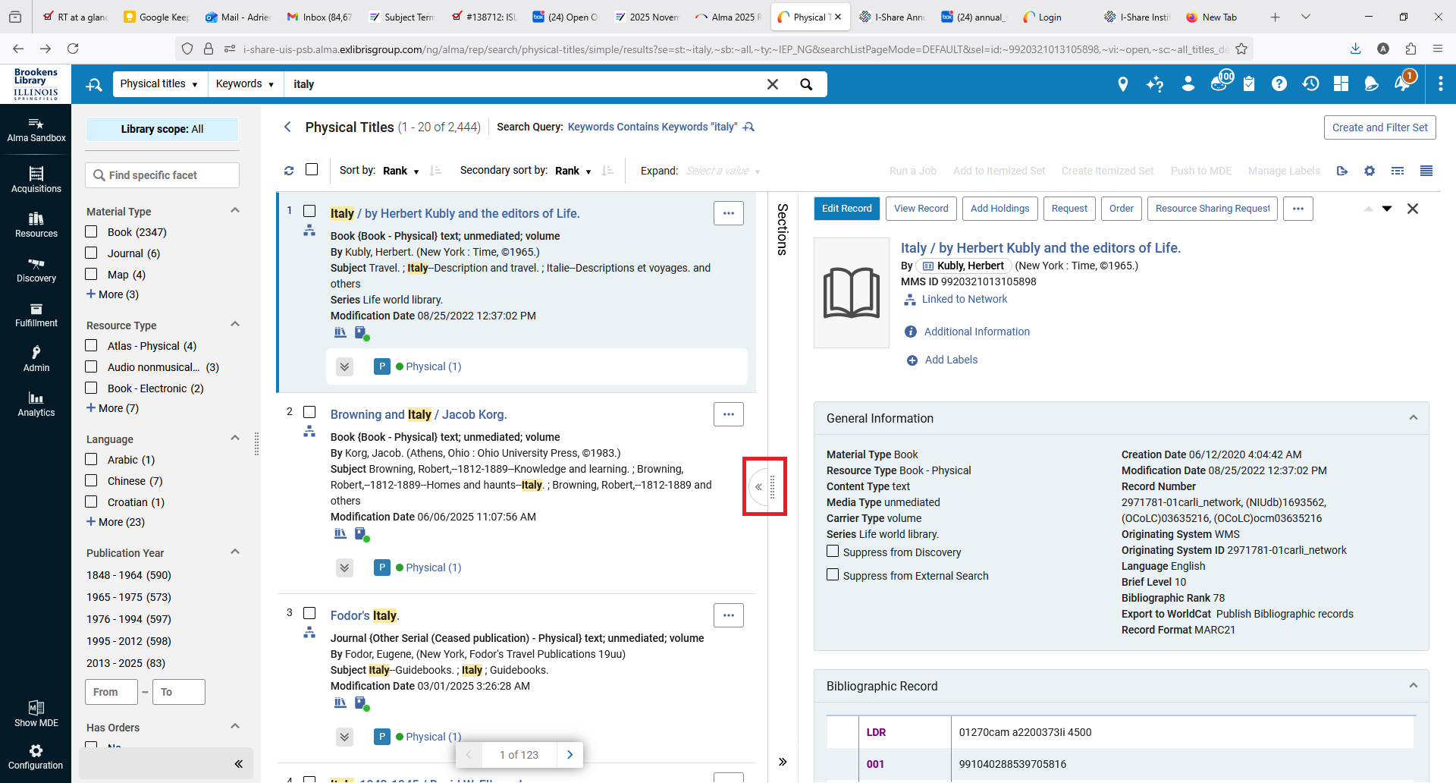
Full Page Control for Sliding Panel
You can select the “Full Page Control” (marked in red) on some sliding panels
You can also resize the panel
You can now use the keyboard to navigate to and focus on the width resize icon and adjust the panel's width using the ← (left) and → (right) arrow keys.
Alma Physical Titles screen with the Full Page Control button highlighted with a
red square
Everyone
Notes:
Everyone (Adrienne)

Slide 12
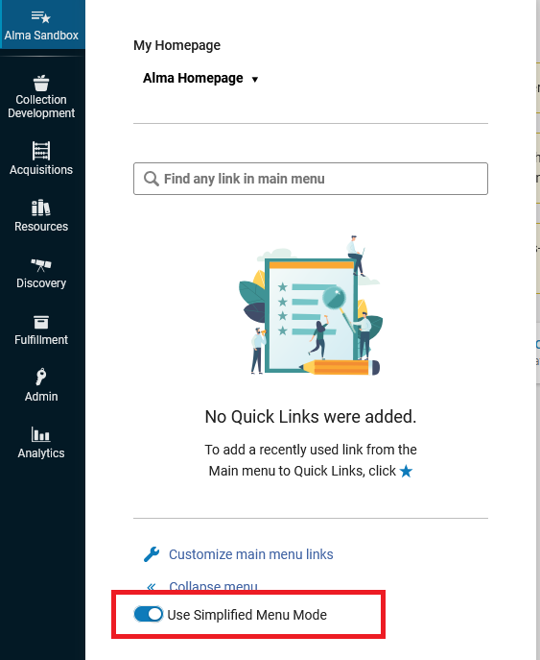
More Layout Changes
You can now select the title area, instead of the entire row, to open a record’s right panel view.
Selecting the Use Simplified Menu Mode toggle button in the navigation panel presents a streamlined menu containing only the most widely and commonly used menu entries. Menu entries marked by a user as favorites also appear in the simplified view.
The “Use Simplified Menu Mode” toggle button is highlighted
with a red rectangle in the Alma navigation panel.
Everyone
Notes:
Everyone (Adrienne)

Slide 13
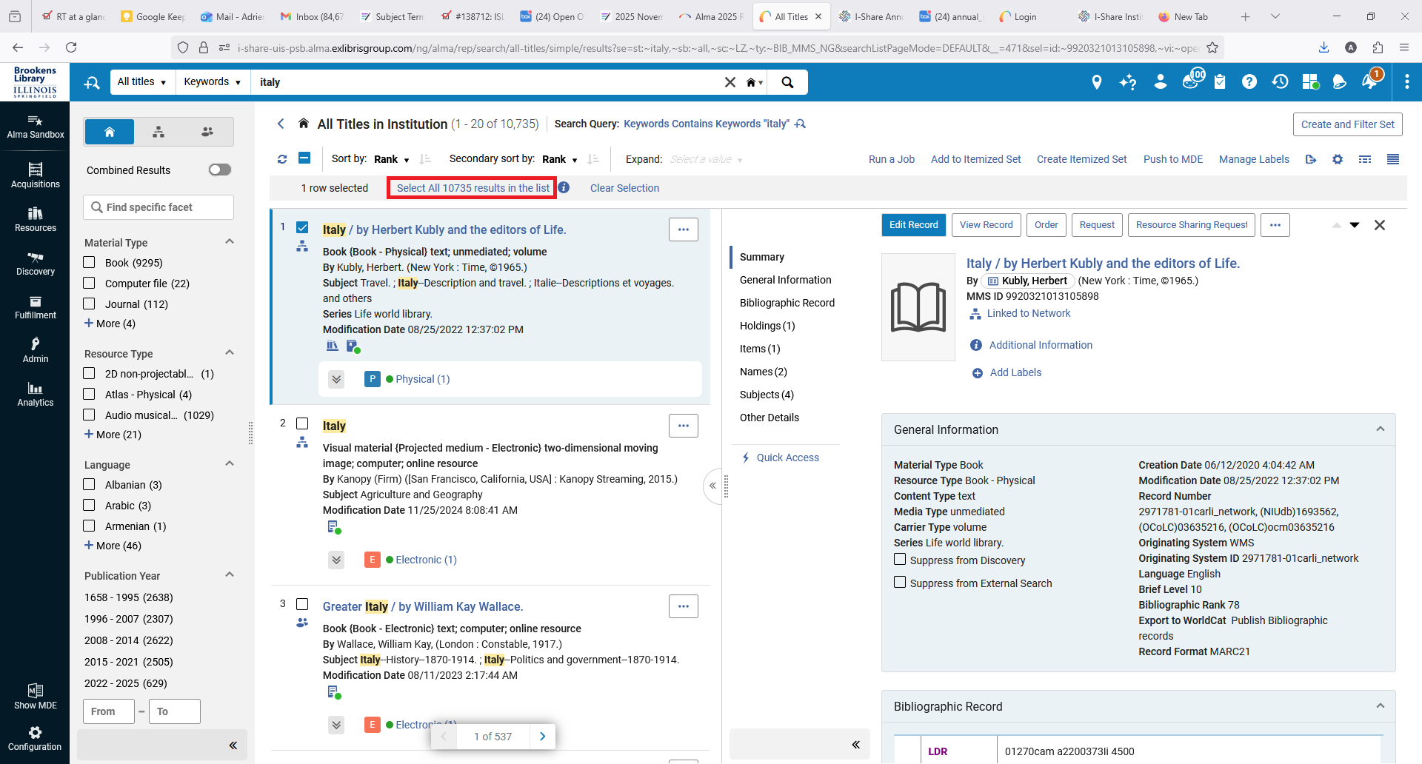
Select All Search Results for Bulk Job Sets
If you are using a logical set for a job, you can select a link to select all results across all result pages (in red).
Then you can apply the Run a Job option.
Alma Logical Set results with the “Select All 10735 results in the list” link highlighted with a red rectangle.
Everyone
Notes:
Everyone (Adrienne)

Slide 14
Searching by Relative Dates
Search for records according to the date of creation or update.
Relative date options:
Is within the last (days)
Is within the next (days)
Is older than (days)
Any “Titles” search, holdings, items, portfolios, collections
Courses and Reading Lists (course start/end dates)
Everyone
Notes:
Ted, Audience: Everyone
Speaking of searching and sets, several search indexes get a boost with new search operators that should help with set creation and management.
Users who search for records using system dates, for example the date a record was created or modified, have been limited to searching for an explicit date or an explicit range of dates. The November release includes three new search operators enabling you to find dates relative to the present day. The new operators are listed here: Is within the last, is within the next, and is older than.
You’ll find these when you use an advanced search on any Titles searches, holdings, items, portfolios, and collections. Additionally, these are enabled for status dates on items and portfolios, such as expected receiving date, due back from temporary location date, and activation date.

Slide 15
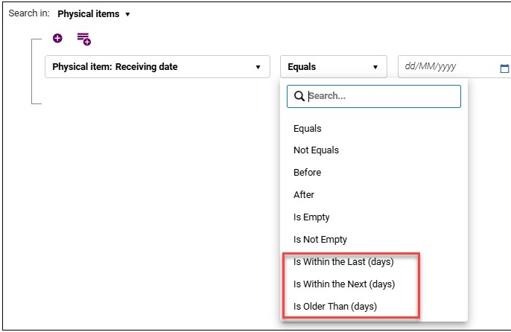
Searching by Relative Dates, Continued
The Alma advanced search screen for a physical items search. The Receiving date field is shown with the search operators of “Is Within the Last (days)”, “Is Within the Next (days), and “Is Older Than (days)” highlighted with a red rectangle.
Everyone
Notes:
Ted, Audience: Everyone
Here we see an example of the advanced search for Physical Items. The Receiving Date index is selected and the search operator list is expanded to show the new indexes.
These new options should allow you to create logical sets based the dates records were processed or will be processed. Moreover, the use of a relative date means that these sets could be used in scheduled jobs without anyone needing to manually modify the dates in a set definition.

Slide 16
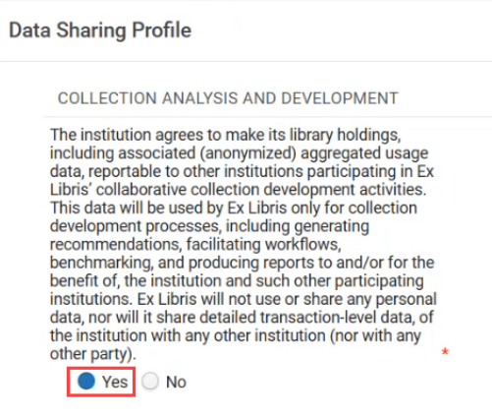
Collection Development Workflows
Built on the Rialto Platform, the Collection Development Workflows are available for all Alma Users (not just Rialto Customers).
Initial Workflows include Deselection and Retention Workflows
Workflows will allow users to compare collections to other opted in institutions in the network. Opting in to "Collection Analysis and Development" Data Sharing is required to use this functionality.
A data sharing profile with the “Yes” option highlighted with a red rectangle
More information about the Data Sharing Profile can be found on the Ex Libris Documentation website
Acquisitions
Cataloging
Notes:
Jen
Acquisitions Cataloging
The new Collection Development Workflows are built on rialto functionality, but will be available for all Alma Users, not just rialto customers.
Initial Workflows include Deselection and Retention Workflows that will allow a user to create a list of items for consideration based on multiple factors (publication date, classification area (all the HZs for example), and bibliographic data). A note here that while these are called "Workflows" and have actions you CAN take on the results, you are not required to do so once a title appears in a result list.
Workflows will also allow users to compare collections to other OPTED IN institutions in the network. Opting in to this Data Sharing Profile shown on the right is required to utilize these new features.
More information on the Data Sharing Profile can be found at this website including FAQs about what is and is not shared.

Slide 17
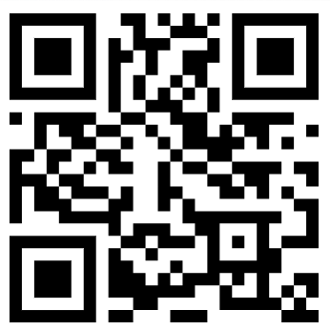
Collection Development Workflows, Continued
Ex Libris is holding a webinar next week where CARLI Staff will learn more about the possibilities and limitations of this new functionality.
Some of our questions:
What users in an institution will have access to this functionality if it is turned on?
How quickly is data shared if an institution "opts in" to sharing?
Watch for more information about implementing this feature including what other workflows are planned for the future.
If you are interested in learning more by attending the upcoming webinar, registration is still open.
QR code
Acquisitions
Cataloging
Notes:
Jen
Acquisitions Cataloging
Ex Libris is holding a webinar next week where CARLI Staff will learn more about the possibilities and limitations of this new functionality.
Some of our questions:
What users in an institution will have access to this functionality if it is turned on?
How quickly is data shared if an institution "opts in" to sharing?
Registration is still open for the Webinar which is being held next Wednesday.
Watch for more information about implementing this feature including what other workflows are planned for the future.

Slide 18
Analytics Updates
Number of Unique Titles added to multiple subject areas, e.g.:
Borrowing Requests, Requests
Course Reserves
E-Inventory, Physical Inventory
Fulfillment
Funds Expenditure
Documentation improvements to Alma Analytics Subject Areas
Portfolio and Portfolio Details for Consortia Members
Check that existing reports using updated subject areas still work.
Analytics/Statistics
Notes:
Ted, Audience: Analytics
A new measure is being added to several subject areas across Analytics, the Num of Unique Titles. This improvement looks related to the rollout of collection development dashboards and workflows. You may find this field in subject areas such as borrowing requests, course reserves, e-inventory, fulfillment, funds expenditure, physical items, physical items historical events, purchase requests, and requests. There is limited information on how unique titles are being calculated; CARLI will be exploring this aspect more, and we encourage you to do the same.
Documentation reports that the field name may vary depending on the subject area. For example, the field may be num n-u-m, or numb n-u-m-b.
Speaking of documentation, Ex Libris and the Analytics Community of Practice are taking efforts to improve the data dictionary for analytics subject areas. These improvements include expanding the tables with details that describe the contents of fields, as well as their data types and sizes. Additionally, the tables identify how the field appears in the Alma user interface.
This month, updates have been applied to the Portfolio and Portfolio Details for Consortia Members dimensions under E-inventory.
As a reminder, when subject areas and dimensions are updated with new fields, it is possible for existing analyses to break. You may want to review any routine reports that you use to make sure they continue to function as expected.

Slide 19
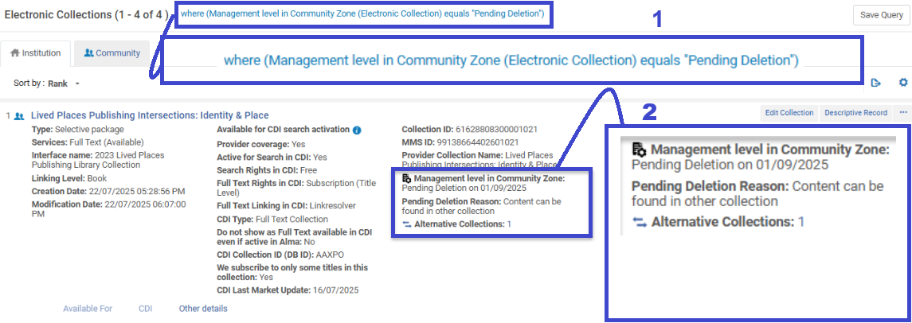
Electronic resources management – CZ E-Collections pending deletion
Collections that are marked with Management level in Community Zone as Pending Deletion now display the following additional information: Pending Deletion Reason and Alternative Collections.
View of Alma advanced search results using search query Electronic Collection > Electronic Collection > Management Level > equals > Pending Deletion.
Electronic Resources Management
Notes:
Electronic Resources Management – CZ E-Collections Pending Deletion (Marisa)
New this November is a new way to identify IZ e-collections being deleted from the CZ. This can be done as an advanced search in the persistent search bar of Alma as seen in the zoomed in rectangle labeled with a number one in the screenshot of Alma results. The search query being used here is Electronic Collection > Electronic Collection > Management level in Community Zone > equals > Pending Deletion.
Once, the search results are displayed, it will show three possible new data points in the information about the e-collection. In the screenshot, that has a rectangle labeled with number two, where it says, “Management level in Community Zone” it will now read “Pending Deletion on” and the date the e-collection will be deleted from the CZ. It will also provide a “Pending Deletion Reason.” In this example screenshot the reason is: Content can be found in other collection. If this reason is given, the Alma user will be provided the number of Alternative Collections and the number of alternative are hyperlinked to the Alternative CZ e-Collection.

Slide 20
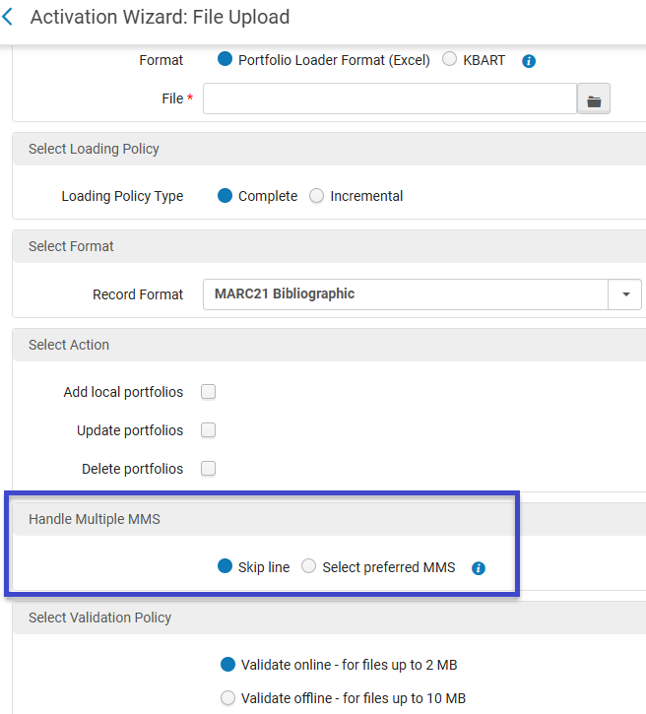
Electronic resources management – portfolio loader
Portfolio Loader is enhanced with a slight change. Where it used to “skip line” when handling multiple MMS IDs, you now have the option of choosing “Select Preferred MMS” as seen inside the blue rectangle in the image to the right.
Note: Multiple matching portfolios still need to be resolved manually.
Visit Managing Electronic Resources to learn more.
View of Alma Portfolio Loader with a blue rectangle highlighting the section with the added option to “Select preferred MMS.”
Electronic Resources Management
Notes:
Electronic Resources Management – Portfolio Loader (Marisa)
Portfolio Loader previously would “skip line” when handling multiple MMS IDs. Alma users now have the option when loading portfolios to select a radio button for “Select preferred MMS.” Ex Libris notes that multiple matching portfolios still need to be resolved manually with this enhanced added option.
The URL being shared in the chat will link to more information about this new enhancement.

Slide 21

Shared Blocks Across the Fulfillment NEtwork
Shared Blocks Across the Fulfillment Network = Not Ready for Primetime
Vintage yellow TV on top of a wood plank with blue background. The image of the television is covered with a red "nope" symbol, the
circle with the diagonal line through it.
ILL/ Resource Sharing
Reference/ Instruction
Circulation
Notes:
Audience: Circulation; Interlibrary Loan/Resource Sharing; Reference/Instruction
Debbie:
With the November release, Ex Libris has announced a much-anticipated-by-at-least-Debbie feature, “Shared Blocks Across the Fulfillment Network.”
We’ve heard about this planned functionality for some time, through the development roadmap plan put out by Ex Libris, and with the November release notes, have learned more about how they’ve designed it to function.
This is described in the release notes as, “Previously, patron blocks could only be shared from the patrons' home institution to the institutions where the patron had linked accounts. With this new feature, it is possible to share blocks from any institution with any other institution where the patron has an active account, regardless of whether the institution is the home institution or the target institution. This enables patron blocking across the entire network more easily and efficiently.”
This means, if I place a specific type of “FROM_TARGET” block on an I-Share patron, that patron is then blocked in all I-Share libraries AND their home library.
Anddddd… after some initial testing last week in the Alma sandboxes, I managed to block one of my colleagues in multiple I-Share libraries, anddddddddd then not be able to remove the block… so… I’m not sure that this functionality is quote, “ready for prime time.” We will be doing more testing, reaching out to other consortia as appropriate, talking with Ex Libris Support. Once we are confident in the functionality behaving as anticipated, we’ll then work with the CARLI Resource Sharing Committee to do a final review of the functionality, a workup of best practices for if, when, and how this block should be used, and to plan the rollout if we decide to move forward with the functionality.
So for now, you can be aware that this functionality was announced, and trust that the CARLI Office will let libraries know more as we know more.

Slide 22
Purge Users Based on Set
November release includes ability to “purge users by set.”
Newly-developed job
CARLI Office staff currently testing this functionality:
Will update our Alma User Purge documentation and send an email announcement once confident, and updated directions are ready.
Alma User Purge: https://www.carli.illinois.edu/products-services/i-share/user-management/user-purge
Circulation
Systems
User Management
Notes:
Audience: Circulation; User management; Systems
Debbie:
With exciting new functionality, the November release includes the ability to purge user records by “set.”
This uses a newly-developed “job” in Alma, rather than the more traditional purge functionality that is available under the Admin> User Management> Purge User Records function.
The CARLI Office staff are still in the middle of testing this functionality to make sure the newly developed job functions as anticipated.
Assuming testing goes as anticipated, we plan to update our Alma User Purge documentation to include more information about this option, and, then will send an announcement once updated.

Slide 23
Pendo Reminder
Pendo is a digital adoption tool within Alma since 2023 that Ex Libris can use to identify usage trends and behavioral analytics to support features like in-app guides, walkthroughs, and feature announcements.
No personal information is shared with Pendo. It does not collect or process any personal data.
Institutions may choose to opt out of digital adoption features entirely at the organizational level in Alma Configuration Menu > General > Digital Adoption. See Ex Libris’s Configuring Digital Adoption documentation.
Individual Alma users can opt out by rejecting functional cookies in their browser.
Configuration
Notes:
[Jessica] Configuration
Ex Libris has a note in the November release notes about their continued use of Pendo. Pendo is not new—it was first introduced two years ago in November 2023—but this is a reminder about it in case your institution would like to reevalute whether it is on or off in your Alma IZ.
What is Pendo?
“Pendo is a Digital Adoption tool used by SaaS (Software as a Service) software companies like Ex Libris in their products to identify usage trends and behavioral analytics.” It “supports features such as in-app guides, walkthroughs, and feature announcements aimed at improving usability and onboarding.”
No personal information is shared with Pendo. It does not collect or process any personal data.
Institutions may choose to opt out of digital adoption features entirely at the organizational level if preferred. See Ex Libris’s Configuring Digital Adoption documentation.
Individual users can always manage their cookie preferences, including rejecting functional cookies, regardless of the institutional settings.

Slide 24
DEI Controls for Discovery
Replace problematic terminology in discovery with alternatives
Configuration > Discovery > DEI list of terms to exclude
Applies to Subject fields in MARC records and CDI data.
Match based on an exact term or a phrase.
May include an informational note on the local replacement.
Technical Services Committee preparing recommendations
Cataloging
Electronic Resources Management
Primo VE/ Discovery
Notes:
Ted, Audience: Catalogers, Discovery, Electronic Resources
Libraries who are working on reparative cataloging efforts receive improvements to an existing discovery tool. The DEI list of terms to exclude is not a new feature, but it has been enhanced with additional functionality to improve how it matches and replaces or masks offensive, inaccurate, and/or obsolete terminology. Previously, this functionality had limited options for matching specific terms and substituting replacement text. The updates in this release enable exact and phrase matching, allow both replacement and removal of the problematic term, as well as an option to retain the term but add an informational note.
CARLI’s Technical Services Committee is presently working on a set of recommendations for performing DEI work across the network catalog, and they will be reviewing this new functionality as part of that work. As these controls are local to your institution zone, you may find this a useful option to apply changes that are relevant to your communities.

Slide 25
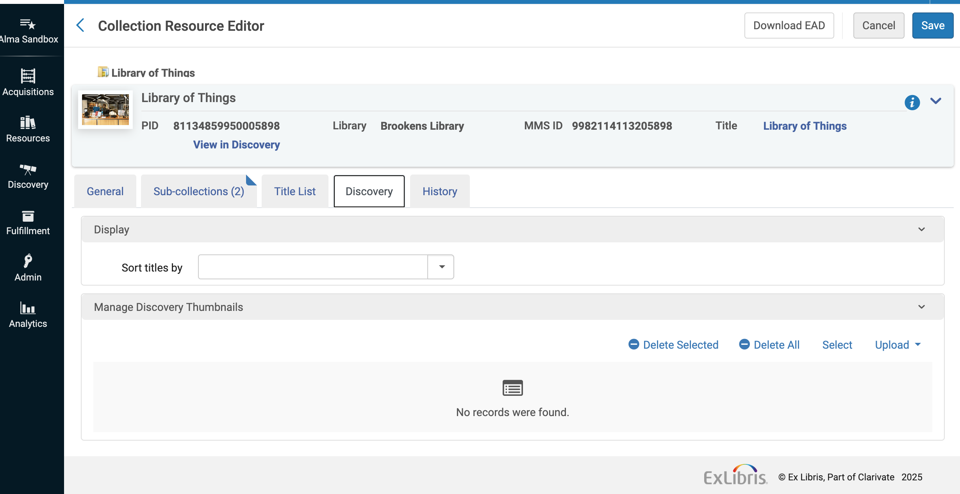
Change in January 2026 to Thumbnails for Collections in Alma
Before January 2026: Libraries should add specific thumbnails to Collections and Subcollections in Alma to display in Primo VE.
Manage thumbnails in the Collection Resource Editor’s Discovery tab.
Alma “Collection Resource Editor” with the “Discovery” tab shown.
Primo VE/ Discovery
Notes:
[Jessica] Primo/Discovery
If your library has Collections in Alma, this is a reminder about the change coming in January 2026 to thumbnails. To ensure optimal display, you will need to define thumbnails explicitly for Collections and Subcollections, using the Manage Collections tool in Alma (see Managing Collections https://knowledge.exlibrisgroup.com/Alma/Product_Documentation/010Alma_Online_Help_(English)/040Resource_Management/050Inventory/050Managing_Collections#Managing_Images_for_the_Collections_Lobby in the Alma documentation).
Until January, if no specific thumbnail is defined, Primo VE automatically displays an image taken from the first level below the collection. Starting January, 2026, this fallback behavior will no longer be applied, and collections without a defined thumbnail will appear without an image.

Slide 26
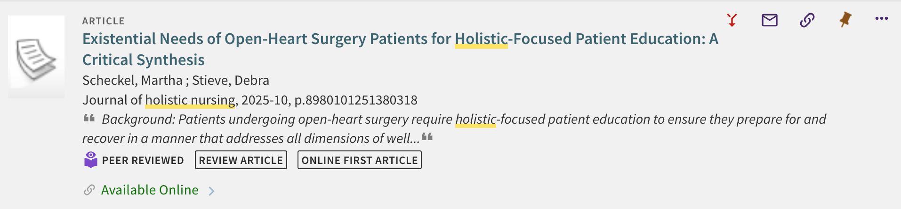
CDI Document Insights in Primo
Primo VE search result with CDI document attribute indicators highlighted with an orange rectangle.
Attributes provide information about the type of record and complement existing resource types.
Can be selected as facets in search results
Display based on metadata in CDI records
Configured per View in Alma Configuration > Discovery > Display Configuration > Configure Views > Edit view > General tab > Display CDI document attributes
Primo VE/ Discovery
Notes:
[Jessica] Primo/Discovery
Originally introduced to Primo VE in August 2023, the CDI Document Insights feature is disabled by default. However, Ex Libris continues to add additional attributes for display in Primo, so your library may want to revisit this option in your View configurations.
“CDI document attributes provide more information about the type of record and complement the existing resource types. When enabled, they display as a flag (Regular and Warning types) in the brief and full displays of the CDI record. In addition, users can select these attributes as additional resource types in facets and search queries.” These attributes display based on metadata in the CDI records.
This feature can be enabled per Primo VE View with a single checkbox for “Display CDI document attributes”, so you can try it in a Test View first, if preferred. The checkbox configuration will take effect immediately.

Slide 27
List of CDI Document Attributes
Online First Article
Review Article
Primary Source
Preprint
Retracted Publication
Retraction Notice
Publication with Addendum
Publication with Corrigendum
Withdrawn Publication
Open Educational Resource - coming in December 2025
Publication with Expression of Concern
Withdrawal Notice (not currently used)
For more information and to enable this feature, see Ex Libris documentation.
Primo VE/ Discovery
Notes:
[Jessica] Primo/Discovery
There are 12 document attributes defined and 10 are currently in use. A new attribute for OER is coming in December. For more information, see Ex Libris Documentation - https://knowledge.exlibrisgroup.com/Primo/Content_Corner/Central_Discovery_Index/Documentation_and_Training/Documentation_and_Training_(English)/CDI_-_The_Central_Discovery_Index/CDI_Document_Attributes
Online First Article
Review Article
Primary Source
Preprint
Retracted Publication
Retraction Notice
Publication with Addendum
Publication with Corrigendum
Withdrawn Publication
Open Educational Resource (coming in December 2025)
Publication with Expression of Concern (present but very little content in CDI)
Withdrawal Notice (not currently used)

Slide 28
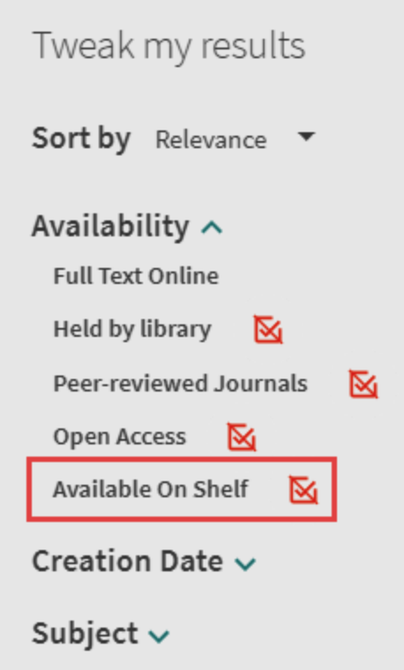
New Top-Level Facet: “Available On Shelf”
"Available On Shelf" facet will allow users to filter search results to physical items that are currently Available in the IZ.
Libraries can choose to exclude specific locations from this facet.
In contrast, the existing "Held by Library" facet displays all IZ physical inventory.
Disabled by default; requires configuration and reindexing.
Facet options on Primo VE search results with “Available on Shelf” highlighted with a reddish orange rectangle
Primo VE/ Discovery
Notes:
[Jessica] Primo/Discovery
A new top-level facet, Available On Shelf, enables users to filter search results based on the resources' current physical availability in your IZ. This is an optional facet that is not activated in Primo VE by default. When enabled, Libraires can choose which of their locations should be considered physically available in this facet by excluding specific locations, if desired.
This facet is, I think, what many I-Share libraries have always hoped the “Held By Library” facet was! The “Held by library” facet displays content that you hold physically in the library. This new facet will display only physical inventory that is Available.
Because this setting requires complete reindexing of bib records, CARLI staff have not been able to fully test this new feature, but in our experience, remember that physical item AVAILABILITY in Primo VE does not necessarily mean the item is REQUESTABLE or LOANABLE to a particular user. Typically, users must be logged into Primo VE and viewing a particular physical item in order for the system to determine if it is requestable or loanable to that user.
To enable this facet, it will require some configuration and reindexing…

Slide 29
To Configure “Available On Shelf” Facet
In Alma Configuration Menu > Discovery > Other > Customer Settings > set enable_available_on_shelf_top_level_facet to true. (All locations will be treated as available by default unless you exclude them in step 2 below.)
Optional: In Alma Configuration Menu > Discovery > Other > Exclude libraries and locations from Available On Shelf facet – Here you can set any libraries in your IZ you wish to exclude from this facet for Availability calculations.
Complete reindexing of records is required
Contact Ex Libris Support to file a Case to request this reindexing; CARLI can file the Case on your library’s behalf if you contact us at support@carli.illinois.edu
Wait for the next automatic Primo VE semi-annual reindexing coming in January 2026
Primo VE/ Discovery
Notes:
[Jessica] Primo/Discovery
To configure, someone with the Discovery Admin role should:
Go to Alma Configuration Menu > Discovery > Other > Customer Settings > set enable_available_on_shelf_top_level_facet to true. (All locations will be treated as available by default.)
OPTIONAL: Go to: Alma Configuration Menu > Discovery > Other > set any libraries you wish to exclude from this facet in the “Exclude libraries and locations from Available On Shelf facet” configuration menu. For example, you might want to exclude
Complete reindexing of Primo records is required to fully implement this new facet.
Contact Ex Libris Support to file a Case to request this reindexing; CARLI Support can file the Case on your behalf if you let us know at support@carli.illinois.edu.
Wait for the next automatic Primo VE semi-annual reindexing coming in January 2026.

Slide 30
Rules for Hiding Local Resources from the Network
Institutions can now set up rules in Alma Configuration > Discovery > Search Configuration > Hide From Network Definitions to hide specific local records from cross-network search results in Primo VE.
May be based on Location, Inventory has Course, or a Local Field in bib, etc.
Rules are applied to all resource records owned by the institution whether bib records are local to IZ or shared in NZ.
I-Share libraries are strongly encouraged to share information on their physical and electronic holdings with all members of the network. However, this might be useful for local items like laptops, room keys, markers, cameras, and other local equipment.
This feature should NOT be used to try to prevent requesting or circulation; proper Fulfillment Configurations prevent such activities!
See Ex Libris documentation on Hiding Local Resource from the Network
Primo VE/ Discovery
Notes:
[Jessica] Primo/Discovery
With this November 2025 release, member institutions in a network like I-Share can now configure rules to hide specific local records from search results retrieved by the rest of the network based on their inventory properties, local fields, or metadata. When a resource meets the specified conditions, it is hidden from other institutions in network search results in Primo and but remains visible within the institution's Primo. Rules are defined in Alma Configuration Menu > Discovery > Search Configuration > Hide From Network Definitions
The rules can be based on things like Location, if the inventory is on course reserve, if a Local Field is present in the bib record with specific metadata, etc. Circulation staff and Cataloging staff may need to collaborate to identify local practices for this feature and work with the Discovery Administrator to configure them.
These rules are applied in the institution zone and affects how records in use are shared to other libraries through discovery; this includes bib records in both the institution zone and network zone, along with inventory records in the institution zone. [This does not affect how your patrons view records shared from other institutions.]
In general, please remember that I-Share libraries are encouraged to make their physical and electronic collections discoverable to all members of the network, regardless of whether a resource may be requested or loaned; however, this new feature might be useful for locally cataloged non-bibliographic items like laptops, room keys, markers, cameras, and other local equipment.
Please note that this feature should NOT be used to try to prevent requesting or loaning of items; proper Alma Fulfillment Configurations prevent such activities.
CARLI staff have not had time to fully test this new option, so if you think you have a use case, please do reach out to us to share what you would like to accomplish!
See Ex Libris documentation https://knowledge.exlibrisgroup.com/Primo/Product_Documentation/020Primo_VE/Primo_VE_(English)/Collaborative_Networks/0100Searching_in_Collaborative_Networks?mt-draft=true#Hiding_Local_Resources_from_the_Network

Slide 31
Primo NDE UI General Release
Primo NDE UI is now available to all customers for testing.
It does not yet have all consortial functionality included. Ex Libris expects to complete consortial features in the next few months.
CARLI staff will thoroughly test consortial functionality for I-Share once it is available, so I-Share libraries should NOT go live with Primo NDE until CARLI has announced that it is ready for I-Share libraries.
I-Share libraries can tentatively plan go live with Primo NDE as soon as summer 2026; migration must be completed no later than January 2028.
Watch for more information from CARLI and the CARLI Discovery Primo VE Committee in early 2026!
CARLI has established a Primo VE NDE UI for I-Share webpage.
Primo VE/ Discovery
Notes:
[Jessica] Primo/Discovery
In the November release, the NDE UI is available to all customers for testing and planning; however, please note that the NDE UI does not yet have all consortial functionality in it. Ex Libris expects to complete consortial features in the next few months and CARLI will thoroughly test it to be sure it works as expected for I-Share.
I-Share libraries should not go live with NDE until CARLI has announced that our testing is complete and that we have confirms all necessary functionality for I-Share is present.
I-Share libraries can go live with NDE as soon as summer 2026.
I-Share libraries should make plans to migrate to NDE UI no later than January 2028.
CARLI and the Discovery Primo VE Committee will provide more guidance, documentation, and support for I-Share libraries beginning in early 2026.
CARLI has established a Primo VE NDE UI for I-Share webpage that we will update with more information as it becomes available in addition to sending email announcement to our relevant email lists.

Slide 32
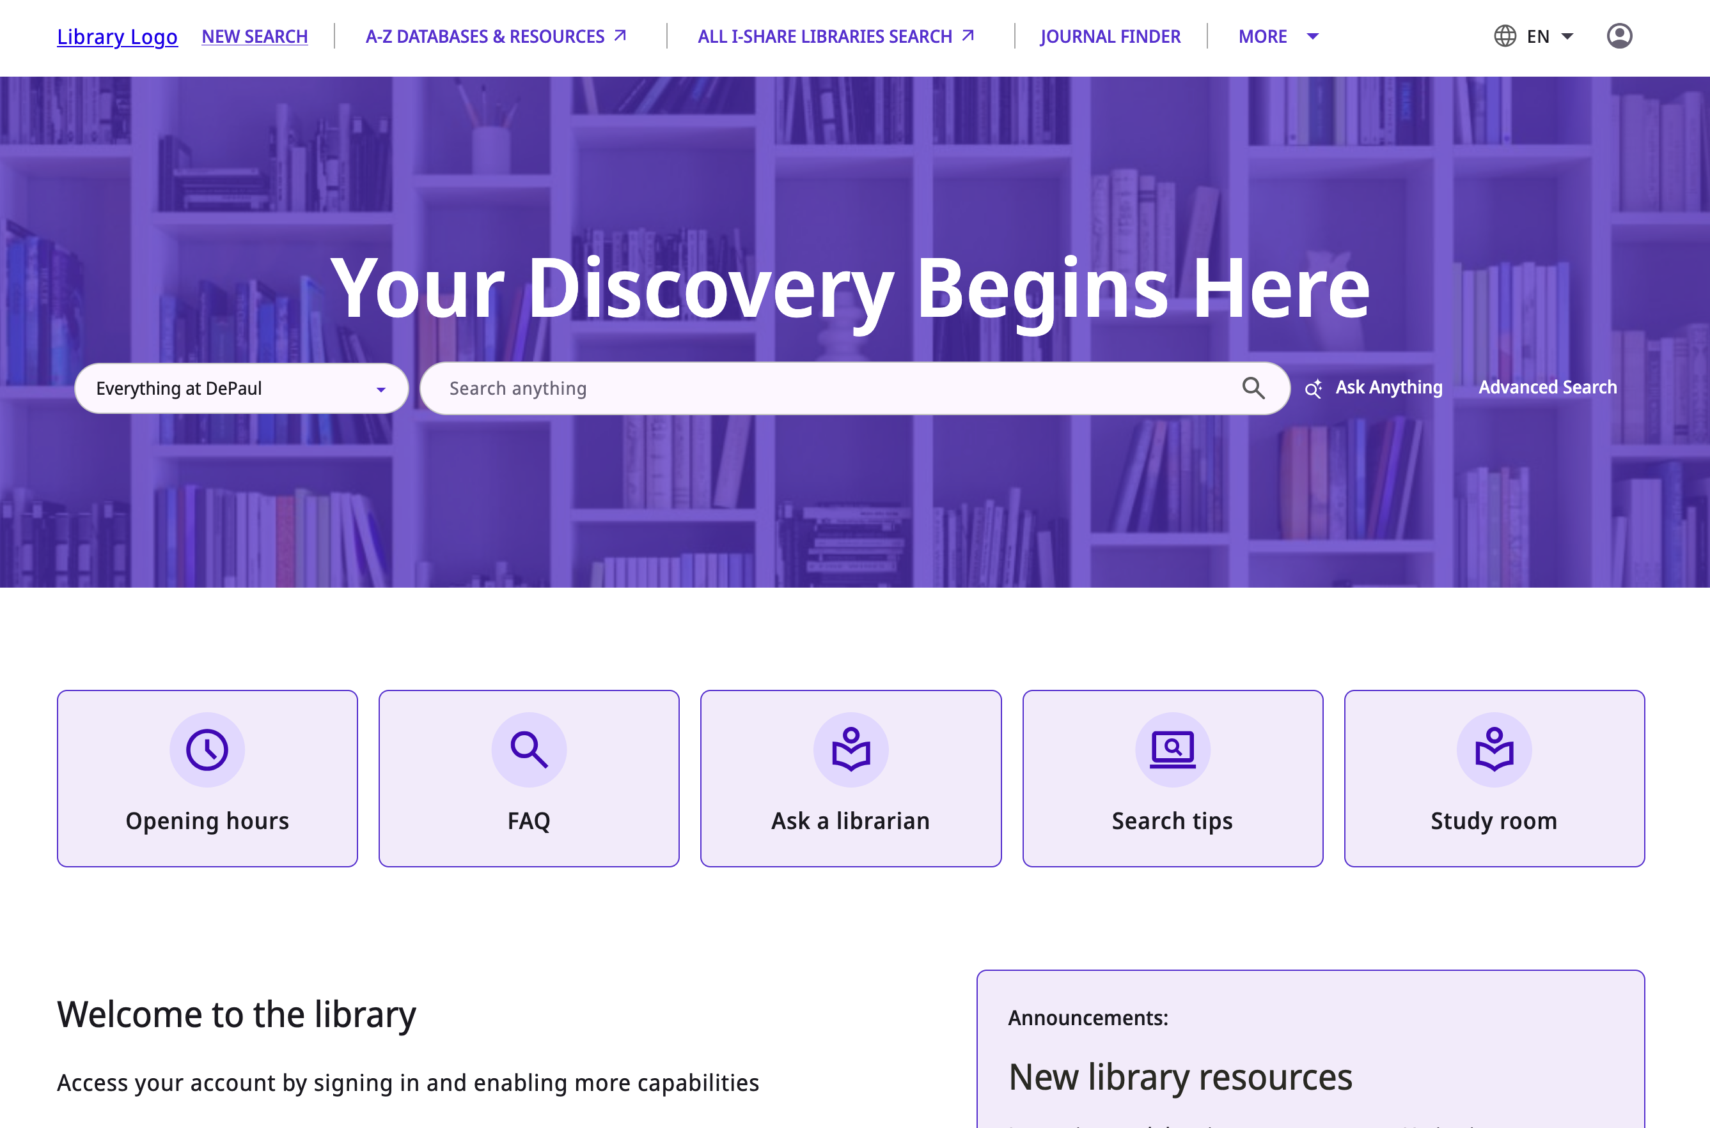
Primo NDE UI Broad Highlights
A new, updated and modern user interface with better accessibility!
Existing Primo VE View configurations will be conveniently copied from your existing View to your new NDE View with one click.
Note that existing Primo VE Customizations with JavaScript will need to be rewritten because NDE will use a different advanced customization framework.
All existing URLs will be automatically redirected upon go live to NDE.
Primo VE NDE UI front page
Primo VE/ Discovery
Notes:
[Jessica] Primo/Discovery
CARLI staff and the CARLI Discovery Primo VE Committee have had early access to review what is in the NDE UI already, and it looks very promising! Here are some very broad highlights:
New, updated and modern user interface with better accessibility!
Existing Primo VE View configurations will be conveniently copied from your existing View to your new NDE View with one click.
Note that existing Primo VE Customizations with JavaScript will need to be rewritten because NDE will use a different advanced customization framework.
All existing URLs will be automatically redirected upon Migration.

Slide 33
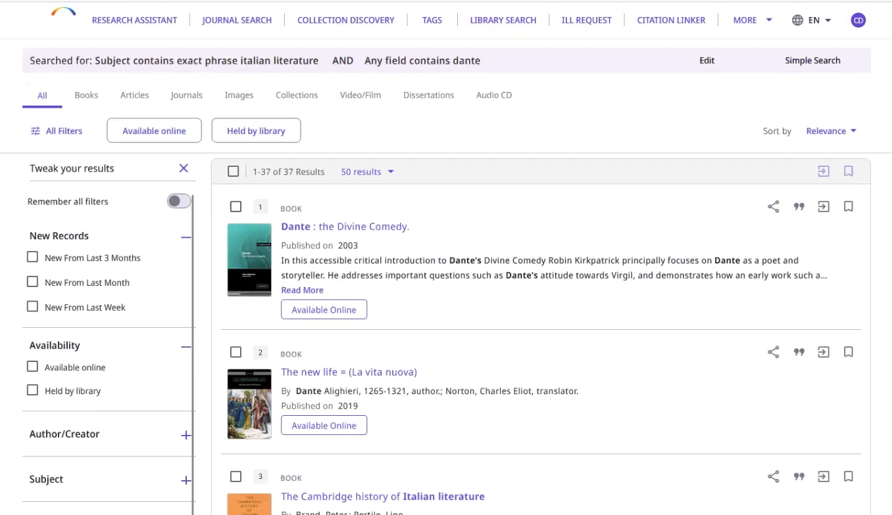
Primo NDE UI Broad Highlights, continued
New Analytics coming with NDE in a new third-party platform called Mixpanel.
New, easier method to enable add-ons created by vendors to seamlessly integrate external functionality like chat widgets, StackMap, and ThirdIron.
Ex Libris Primo VE NDE Next Discovery Experience webinar recording
Primo VE NDE UI search results
Primo VE/ Discovery
Notes:
[Jessica] Primo/Discovery
New Analytics coming with NDE in a new third-party platform called Mixpanel, which will be similar to Google Analytics. Not only will more analytics be included, but they should also be more accurate!
There will be a new, easier method to enable add-ons created by vendors to seamlessly integrate external functionality like chat widgets, StackMap, and ThirdIron.
And much more!
If you haven’t seen anything about the NDE, Ex Libris gave a useful overview webinar a few month ago that compared the existing Primo VE to Primo VE NDE that you might want to take a look at. There have been more developments since this video was recording, but it will give you a high level preview of what NDE will look like!
While this kind of change can feel overwhelming, don’t worry, Ex Libris has provided a lot of information and documentation already, and CARLI staff and the CARLI Discovery Primo VE Committee will be here to help!

Slide 34

Questions & Answers
A brown and white dog with brown eyes.
Notes:
(Rotating nice picture) ☺

