Slide 1
I-Share Alma Primo VE Office hours will start shortly
Welcome!
Office Hours will start at 1pm and run until 2pm. Please mute your microphone. As time permits, we will respond to questions typed in the chat box, and offline afterwards, as needed.
This session will be recorded and made available on the CARLI website.

Slide 2
I-Share quarterly alma primo ve update: August 2025 Feature release highlights July 31, 2025

Slide 3
Today’s Agenda
Announcements and Reminders
August Quarterly Release Features
Alma
Primo VE
Q&A

Slide 4
Announcements and Reminders (1 of 2)
The August Alma and Primo VE Quarterly Release Update will take place on Sunday, August 3, 2025.
The semiannual Alma and Primo VE sandbox refresh occurs on Sunday, August 10, 2025.
On Monday, July 28, loans to I-Share patrons were enabled for auto-renewals.
More information is available on the “Alma- Automatic Renewals for Local and I-Share Patrons” webpage: https://www.carli.illinois.edu/products-services/i-share/alma-config/alma-auto-renew

Slide 5
Reminders (2 of 2)
CARLI Staff are sharing the updates we feel are most important to the I-Share environment.
Staff at I-Share libraries can review the full set of release notes available from the Alma and Primo VE Support Pages:
Alma Release Notes: https://knowledge.exlibrisgroup.com/Alma/Release_Notes/2025/Alma_2025_Release_Notes?mon=202508BASE
Primo VE Release Notes: https://knowledge.exlibrisgroup.com/Primo/Release_Notes/002Primo_VE/2025/010Primo_VE_2025_Release_Notes?mon=202508BASE

Slide 6
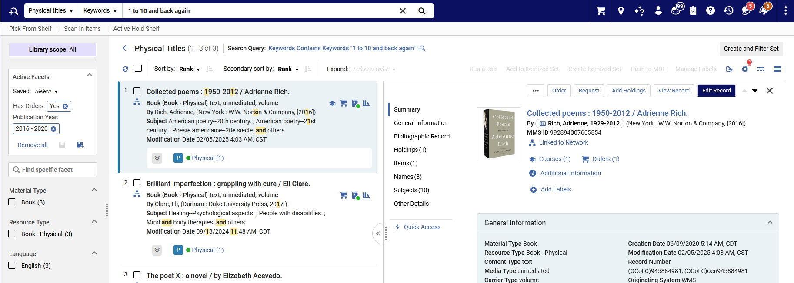
Title Search New UI
In this release, the new UI for title searches is automatically set as the default for all users, with no option to opt-out.
Physical titles search in Alma with the new user interface.

Slide 7
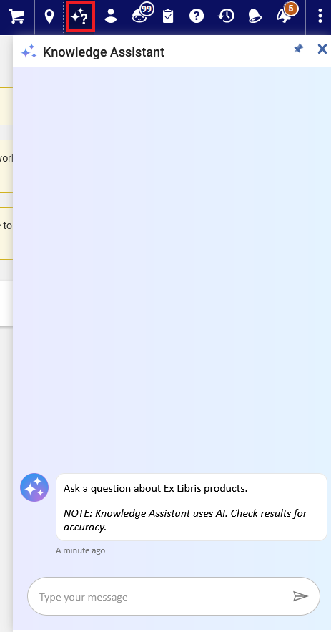
Knowledge Assistant
Alma’s AI Assistant, the Knowledge Assistant, is available from the top menu
Click the icon with the question mark and stars
Clicking on the “sparkles” icon highlighted with the red square will open Alma’s Knowledge Assistant.
Notes:
(Adrienne) Note that it comes with a caveat to doublecheck the output.

Slide 8
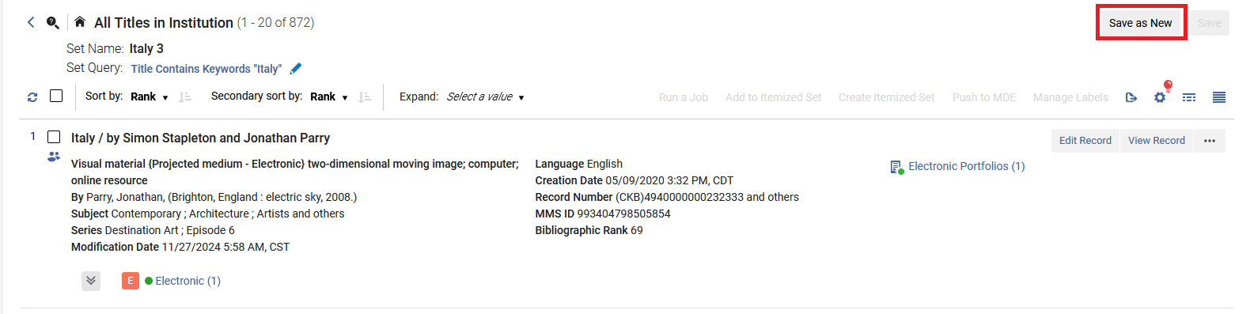
Save as New
You can create a new set from a logical set by using the Save as New button
An example of the contents of a logical set with the new “Save As New” button highlighted with a red rectangle.

Slide 9
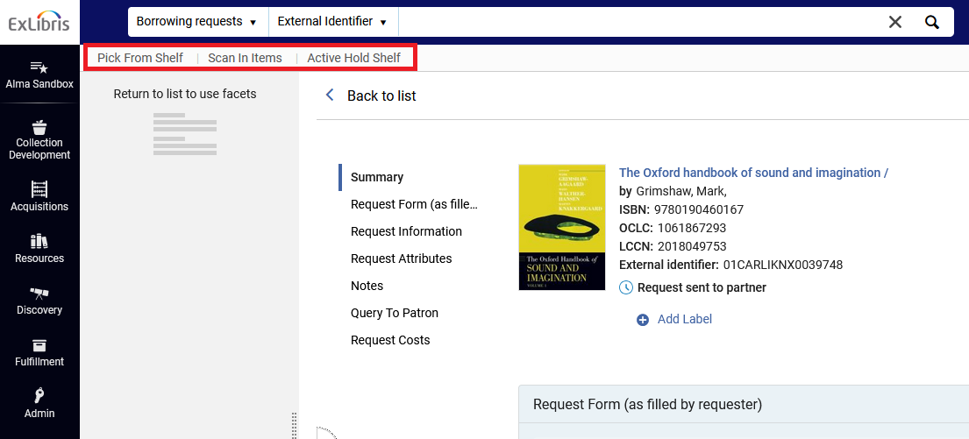
Quick Links Menu Remains Visible When Displaying Sliding Pane
If your Quick Links menu is pinned, it will remain visible when you display a sliding pane
The Alma interface with the Quick Links menu highlighted with a red rectangle.

Slide 10
Improved Digital Adoption Pop-ups
Previously, when users enabled functional cookies, Alma guides and new feature pop-ups showed repeatedly when clearing the browser cookies. Now, notifications will not show again after the user dismisses them, even if cookies were cleared.

Slide 11
Additional UI Changes
The Has Orders facet in Alma has been enhanced from a single-select to a multi-select facet through the addition of checkboxes.
The label indicating that there are no items in a holding now reads No items.
The Additional Information button available in the record view is now included in the title and holdings details pane in the new search UI.
The add and duplicate rule buttons in the new UI advanced search and the Metadata Editor's indication rule form now always show.

Slide 12
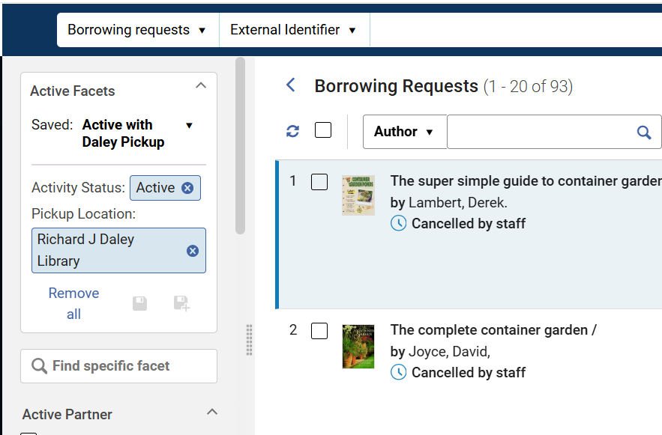
Save Facets Option in Resource Sharing Task Lists
Resource Sharing related pages now include the ability to save facets for easy re-application.
This enhancement is in: Fulfillment> Resource Sharing> Borrowing Requests
Caption: Image shows the Fulfillment> Resource Sharing> Borrowing Requests area, with a sample saved facet set.
Notes:
[Debbie]

Slide 13
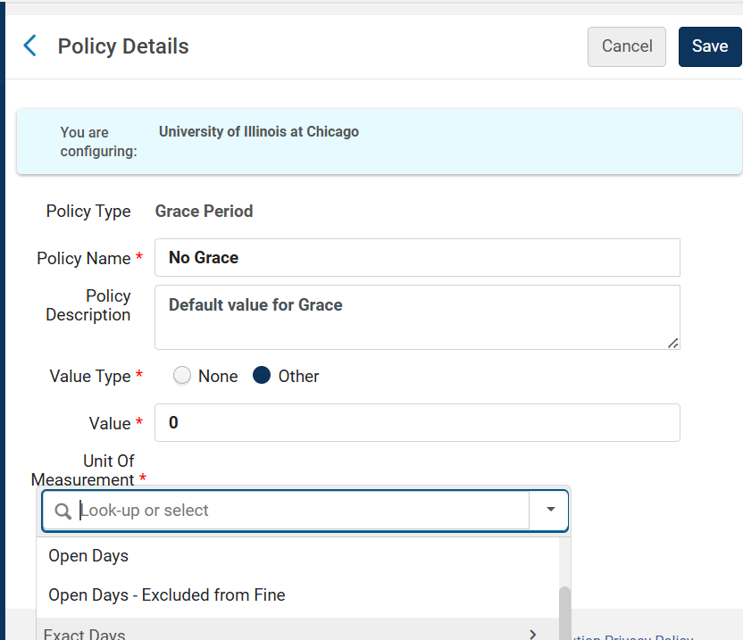
Grace Period for Open Days
If your library charges overdue fines, Alma now offers more options on whether closed days should be included in the grace period, or not.
Remember, overdue fines may only be assessed on specialized collections, such as reserves.
Caption: Image shows a sample Advanced Policy Definition for the policy type of “Grace Period”, with the new units of measurement field selected and showing “Open Days”.
Notes:
[Debbie]

Slide 14
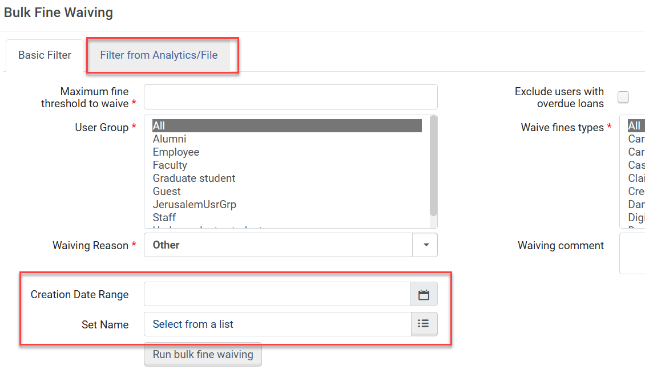
Additional Options for Bulk Fine Waiving
Alma has the ability for staff to waive user fines in bulk.
New functionality in the August release includes additional ability to waive:
By fine creation date
Using an Alma User set
From Analytics report
Using a User file
Caption: Image shows the “Bulk Fine Waving” screen, with the new developments highlighted with red rectangles.
Notes:
[Debbie]

Slide 15
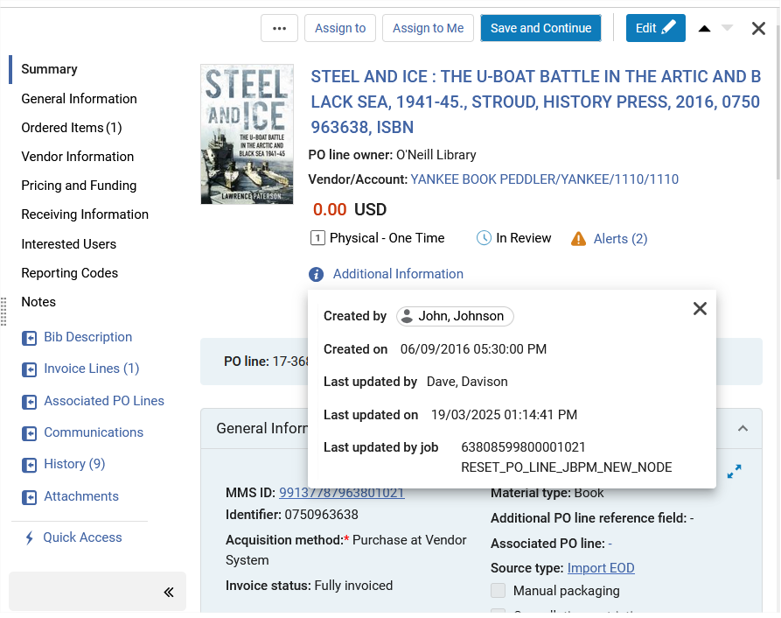
Acquisitions Workflow Improvements
PO Line Information
Link to Additional Information from PO Lines.
Example PO Line with direct link to Additional Information, highlighted with a red rectangle.
Notes:
Jen

Slide 16
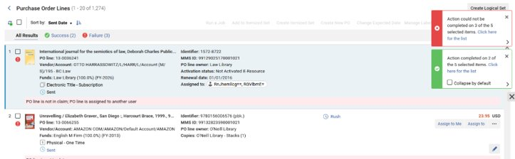
Acquisitions Workflow Improvements – PO Lines List
Exclude Facets – Allows the use of facets to exclude criteria​
"Not equals" option added to search​
Set options added to PO Lines:​
Create Itemized Set, Add to Itemized Set, Run a Job - Run a job on the list of results.
Indications for Success and Failure of Bulk Actions (Change Expected Date and Assign Selected)
An example of Purchase Order lines with the display of indications of Success (with a green rectangular box) and Failure (with a red rectangular box) of Bulk Actions.
Notes:
Jen

Slide 17

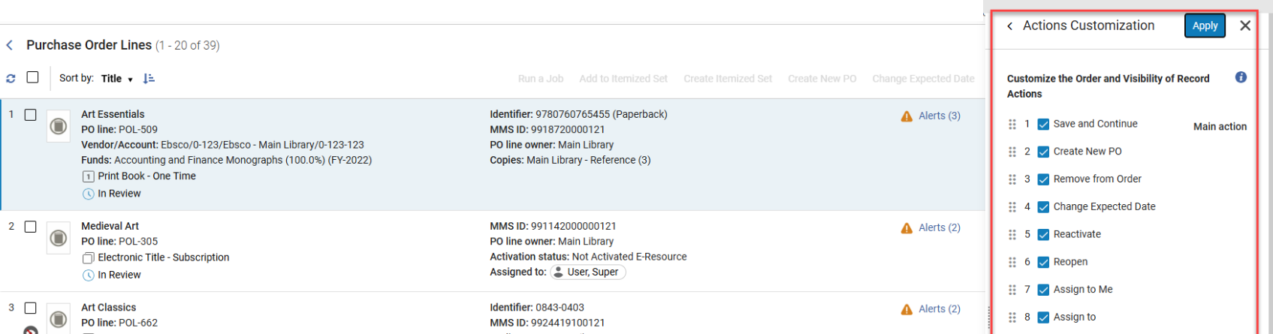
Acquisitions Workflow Improvements
Customization for Actions on the Customize Menu
In the Actions Customization area, users can now re-order the actions of the PO lines and hide irrelevant actions (select Customize > Action Customization)
Users will see actions in the customization menu per their roles/privileges.
Only the relevant actions are displayed for each PO line type/workflow step.
“Purchase Order Lines” screen with the Actions Customization menu pane on the right highlighted with a red rectangle.
Notes:
jen

Slide 18
Acquisitions
Bulk Deletion of Purchase Orders
It is now possible to delete multiple Purchase Orders (PO) at once. You can delete a PO when it does not contain PO lines that have been received, activated, or linked to an invoice. When deleting a PO, all of its associated PO lines are also deleted. The full list of POs that were successfully deleted or not can be found in the job report.
PO Lines Information - Advanced Job
Additional enhancements to February 2025 where cross-continuity and cross-inventory type options were added.
changes the PO line type cross inventory and/or cross continuity, even when the PO line is linked with an invoice in status "In Review" or "Closed".
Option to not send a cancellation letter to a vendor in cases where the POL is cancelled
When updating the ‘Standing Order’ continuity type to ‘Subscription’, we now move the PO line out of the PO, as this is not consistent with the packaging rules.
Notes:
jen

Slide 19
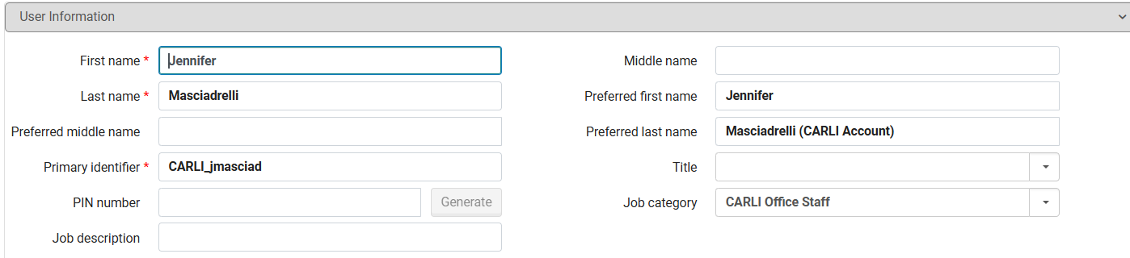
Alma User Record Updates – Removal of Gender field and data
With the August release, Ex Libris has removed all Gender data recorded in user records and will no longer permit the addition of Gender field data. Highlighted here is the space the Gender data used to be stored in the User Record. All Data will be removed from Analytics as well.
Example of a user record with a red rectangle highlighting where the now removed Gender field was previously located.
Notes:
Jen
To be in compliance with the European General Data Protection Regulation (aka the GDPR), Ex Libris will remove all gender information from the user records in Alma in the upcoming August release, for all countries.
Ex Libris explains that “Since gender is not essential for product functionality, retaining it poses unnecessary compliance risks according to GDPR requirements that personal data be collected and processed only when there is a clear legal basis and business need.”

Slide 20
API Security
API keys are defined in the Developer Network for each institution.
API keys unused for a year will be disabled automatically.
Developer Network includes reports on API usage
Review usage and keys to keep services secure.
Contact CARLI Support to get an account or review details.
Notes:
[Ted]
The Ex Libris Developer Network provides technical information on connecting Alma to external applications, along with a dashboard for managing the API keys that handle those connections. Each I-Share institution has a developer network instance with API keys for its instance of Alma; for example, CARLI’s interactive inventory tool and batch inventory tool both use an API to retrieve data from Alma.
Beginning in August, Ex Libris will improve security over APIs by automatically disabling any API keys that have not been used for more than one year. If you have any infrequently used API keys, you could be surprised later if your application does not function.
The Developer Network dashboard includes a reporting tool that tracks API activity. A good practice for your I-Share Liaison and your technology team would be to periodically review activity and access. If you do not have a Developer Network account, contact CARLI support to request an account or reports on API usage.

Slide 21
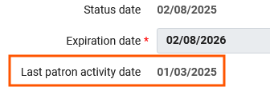
Last Patron Activity Date
Login to Alma or Primo VE updates Last Patron Activity Date
Other actions that update date: requests, loans, renewals, returns.
Last patron activity date (below) appears on user record and in Analytics.
Tracking of last patron activity date is configurable.
Tracking is enabled for most institutions.
Config > User Management > General > Record Last Patron Activity Date
The “Last patron activity date” field from an Alma user record is highlighted with an orange rectangle.
Notes:
[Ted]
Alma user records contain a field to track the Last Patron Activity Date. Up to now, activities that updated this field included requests of any kind, loans, renewals, and returns. Beginning in August, this field will also receive updates when a patron logs in to Primo VE. This field also updates when users log in to Alma, for example, staff and student assistants.
If your institution analyzes patron activity as part of assessment and engagement, this new behavior may provide useful information.
Tracking of this date is already enabled for most institutions from when you migrated. If you prefer not to collect this data, you may disable the setting in Configuration under User Management, General, Record Last Patron Activity Date.

Slide 22
Metadata Editor Enhancements
View Items
Added to the View Related Data menu.
Keyboard shortcut: Alt+T
Previously required View Inventory, then select Items from list.
Insert Unicode Character
Added to the Editing Actions menu.
Keyboard shortcut: Ctrl+Alt+P
Opens a hovering window for selection of characters.
Click the character to add to the record.
Notes:
[Ted]
The Metadata Editor receives a pair of efficiency-improving enhancements in the August Release.
First, items for a bibliographic or holding record will become one click closer to retrieval, with a View Items option added to the View Related Data menu. Previously, retrieving items from the metadata editor required selecting the View Inventory option, then selecting items from the holdings that were listed.
The new View Items option will switch the view from the metadata editor to the list of items screen, where you may select the record you want to view or modify.

Slide 23
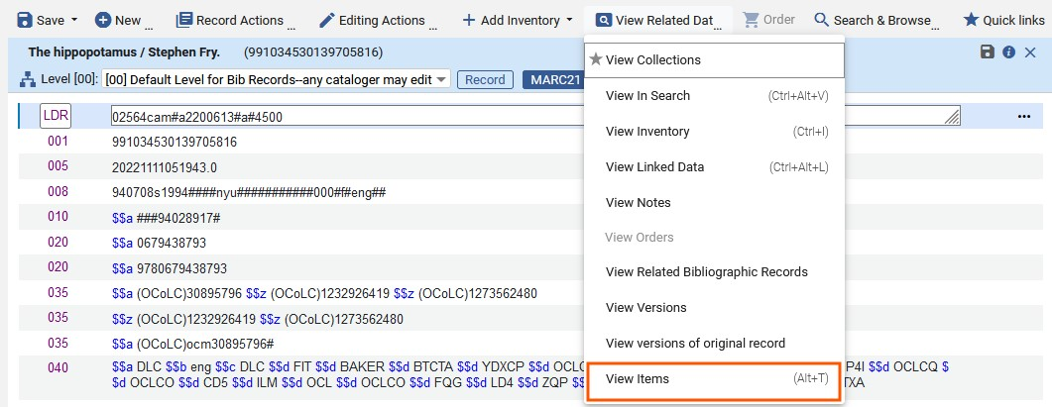
View Items Menu
The “View Related Data” menu of the Alma metadata editor is displayed, with the “View Items” option highlighted with an orange rectangle.
Notes:
[Ted]
Here is a sample screen showing the new View Items option and its shortcut of Alt+T. Selecting this option switches the view from the metadata editor to the List of Items screen.

Slide 24
Metadata Editor Enhancements
Insert Unicode Character
Added to the Editing Actions menu.
Keyboard shortcut: Ctrl+Alt+P
Opens a hovering window for selection of characters.
Click the character to add to the record.
Notes:
[Ted]
The next item is a long-standing wishlist item from many catalogers: an in-application character map for inserting Unicode characters to MARC records. This function is added to the Editing Actions menu as Insert Unicode Character, though Alma documentation calls it a virtual keyboard. Using this tool takes a little extra knowledge of how the Unicode character set is organized. Once the correct code chart is displayed, locate and click the character you want to add.

Slide 25
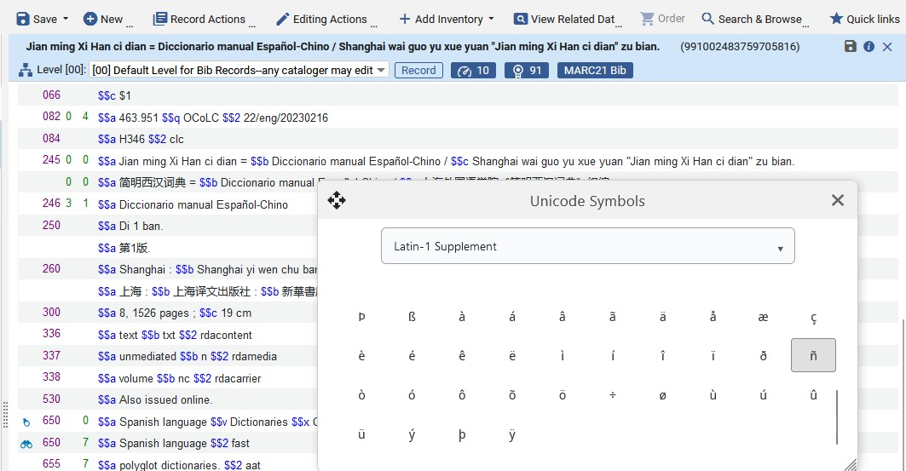
Metadata Editor Virtual Keyboard
A new Unicode character selection pane is hovering over the MARC record editor of the Alma metadata editor.
Notes:
[Ted]
In this screenshot, I have a MARC record open for a Chinese-to-Spanish dictionary.
I have already opened the character map, then I selected the Latin-1 supplement chart that contains many of the special characters used in Western European languages. Then I could click the n with tilde to insert the character.
The modal window hovers over the record and may be moved or resized, and you may click back into the record to resume typing or other editing actions.

Slide 26
Rebuild Physical Item Description Job
Rebuild Physical Item Description job
Concatenate item enumeration and chronology according to templates.
Config > Resources > General > Description Templates
New options:
Delete existing description
Set custom description with conditions
Notes:
[Ted]
Next, we have an enhancement to an existing batch process that could enable some bulk corrections to item record data. This job already has the ability to create a new item description field based on existing enumeration and chronology fields. However, not all item record descriptions use enumeration, chronology, or captions to be unique, and some records may lack data in either fields.
The improvements to this job includes an option for deleting existing descriptions, which may be useful in clearing data that are incorrect or obsolete. There is also an option to set a custom description, which could be useful to make bulk corrections that don’t fit a particular template.
In case you’re wondering about how this might be useful, the item description field is important for identifying a given item within a set of holdings, for example volume 1 1990. Having a clear and consistent item description makes it possible to do item-level requesting. However, item description practices across I-Share vary a lot, and clean-up could be time-consuming without a tool like this. We’re looking forward to what might be possible here.

Slide 27
Overlap Analysis Tool Matching Options
Option to run tiered matching on up to three identifiers
Matches run in tiers
Only records not matched on first identifier considered for second.
Only records not matched on second identifier considered for third.
Example:
First: 035 Other System Identifier Match Method
Second: ISBN Match Method
Third: Title Match Method
Notes:
[Ted]
The overlap analysis tool allows you to compare one electronic collection in your institution zone against one or more other collections that may be in the institution, network, or community zone. This comparison typically uses identifiers such as the ISBN, ISSN, or OCLC number to match records in each collection. However, these data may not be present in all records being compared.
Starting in this release, the Overlap Analysis tool support up to three match methods, which are applied in tiers. You might use your most reliable match point for a collection as the first method, then use broader methods as you continue to catch any records not matched by the first match point.

Slide 28
Search for Electronic Collections by Provider Collection Name
To help simplify the identification of your purchased and subscribed collections in the Community Zone, Alma now has the ability to display a collection’s unique name and identifier as provided and maintained by the content provider.
This enhancement introduces two new collection-level parameters:
Provider Collection ID
Provider Collection Name
These fields improve collection identification, particularly when the collection appears in the Community Zone under a different name than the one used by the provider.
Once these values are defined for a Community Zone electronic collection, they become searchable in the Community Zone, Institution Zone, and Network Zone tabs.
Notes:
[Yanira]
The Provider Collection Name and Provider Collection ID fields have been partially populated for some collections starting early 2025. These fields will only be included in new collections going forward, so not all existing collections will have this information.
Additionally, it is now possible to include the Provider Collection Name/ID fields in Analytics reports. These fields appear in the e-inventory subject area in the folders Portfolio Details for Consortia Members and Electronic Collection.

Slide 29
New Metric Types in Usage Data Details - Release 5
New measures were added to the Usage Data Details - Release 5 folder in the Usage Data (COUNTER) Subject Area.
DR_D1 - Unique Item Investigations
DR_D1 - Unique Item Requests
IR_M1 - Unique Item Requests
For more information, see Usage Data Details - Release 5.
Notes:
[Yanira]

Slide 30
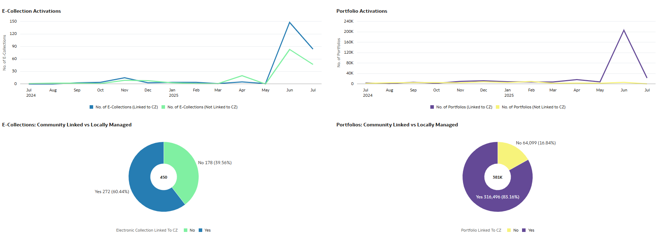
New Electronic Resource Data Visualization for Electronic Collections Activations
This dashboard displays the electronic collection and portfolio activations over the past year. It also shows a breakdown of electronic resources that are Community linked versus the ones that are locally managed. It highlights the opportunity to increase the usage of Community resources, saving time and lowering costs by reducing the need for local record maintenance.
New Electronic Resources Data Visualization Dashboard
Notes:
[Yanira]

Slide 31
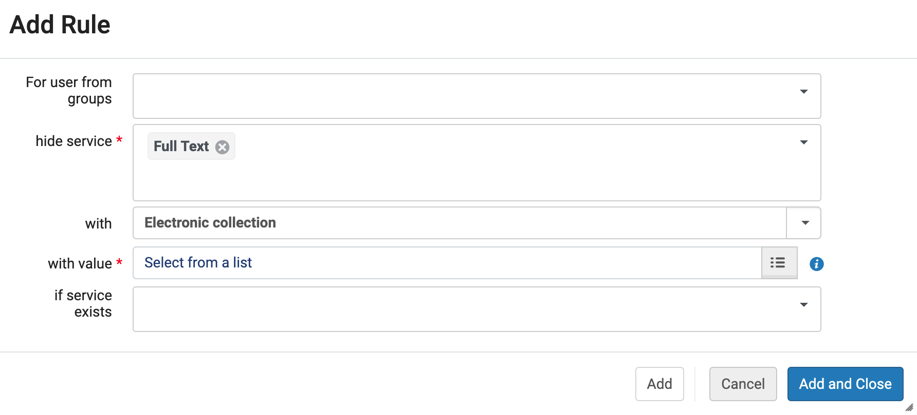
Display Logic Rules can use e-Resources activated in Network zone
E-collections shared from the Network Zone are now available to be used in Display Logic Rules in your IZ! The “with value” list previously showed the choice of e-collections in the IZ but will now present a search box where you can choose from IZ or NZ .
“Add Rule” pop-up in the Display Logic Rule configuration with an orange rectangle highlighting the “with value” field.
Notes:
[Jessica]
Previously, only E-collections from the Institution Zone were able to be selected for IZ Display Logic Rules. This new feature in the August 2025 release allows Alma administrators to select from e-resources activated at either the Network Zone or the Institution Zone in Display Logic Rules.

Slide 32
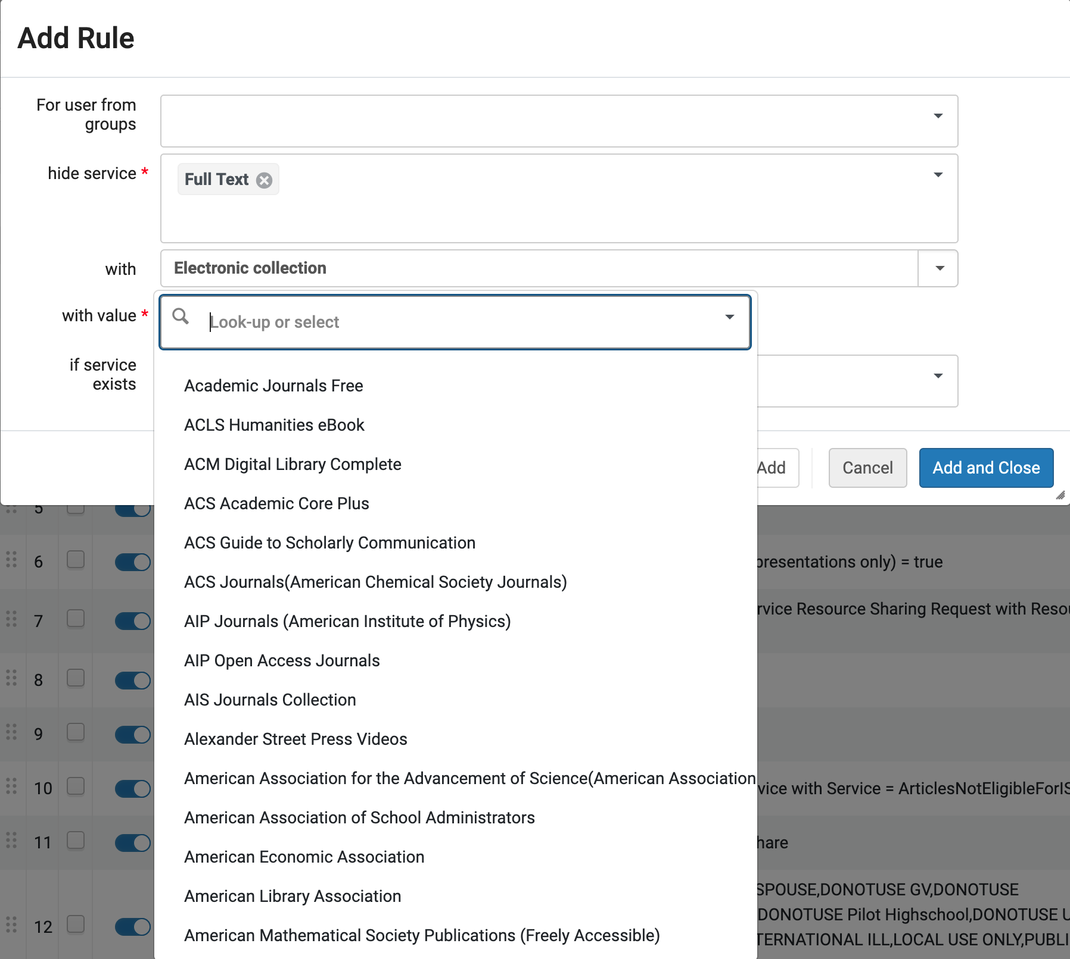
Pre-August 2025 Display Logic “With Value” Dropdown box
The “Add Rule” pop-up showing the existing dropdown menu of “with value” options when adding Display Logic Rules in Alma
Notes:
[Jessica]
The Display Logic Rule options today for the “with value” field give you a dropdown of the e-collections in your IZ.

Slide 33
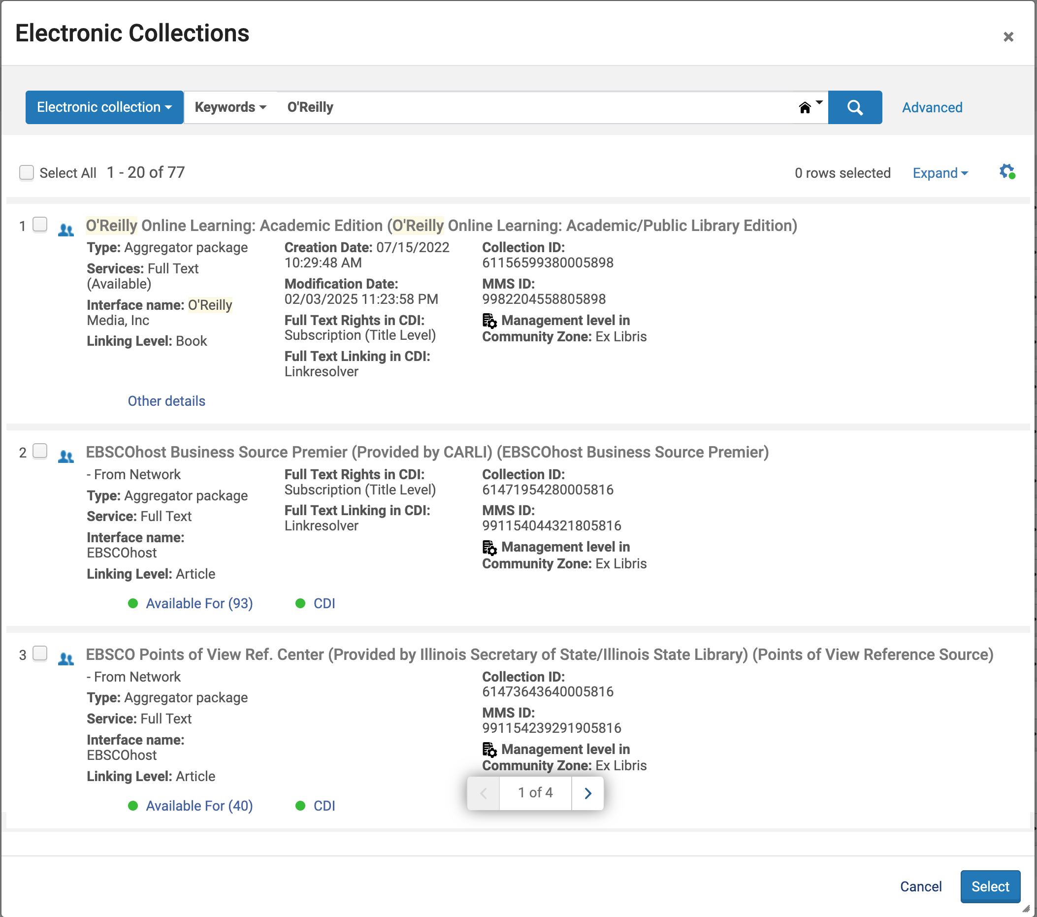
New August 2025 Display Logic “With Value” Search Box
New “Electronic Collections” search box to add e-collections from NZ or IZ to Display Logic Rules in Alma
Notes:
[Jessica]
The new Display Logic Rules option will pop up a search box for your search for e-collections in either the NZ or the IZ.
Tips: You can tell where the e-collection is by looking at the last four digits of the Collection ID and MMS ID numbers (-5816 is the Network Zone) and also if you see the ”Available for (#)” indication you’ll know it is an NZ e-collection.

Slide 34
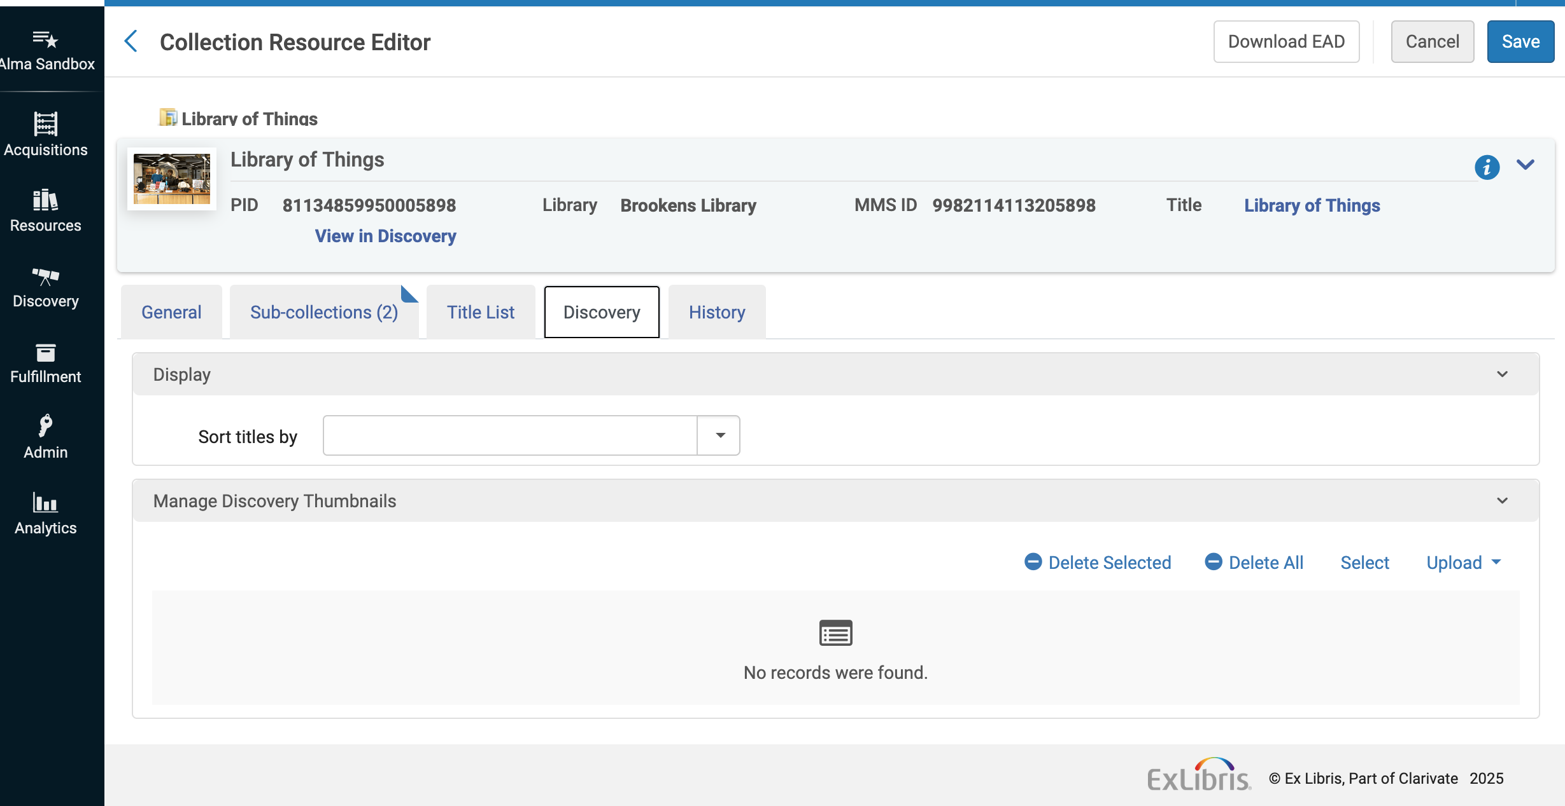
Change in January 2026 to Thumbnails for Collections in Alma
Before January 2026: Libraries should add specific thumbnails to Collections and Subcollections in Alma to display in Primo VE.
Manage thumbnails in the Collection Resource Editor’s Discovery tab.
Alma “Collection Resource Editor” with the “Discovery” tab shown.
Notes:
[Jessica]
If your library has Collections in Alma, you’ll want to be aware of this change coming in January 2026. To ensure optimal display, you will need to define thumbnails explicitly for Collections and Subcollections, using the Manage Collections tool in Alma (see Managing Collections https://knowledge.exlibrisgroup.com/Alma/Product_Documentation/010Alma_Online_Help_(English)/040Resource_Management/050Inventory/050Managing_Collections#Managing_Images_for_the_Collections_Lobby in the Alma documentation).
Until January, if no specific thumbnail is defined, Primo VE automatically displays an image taken from the first level below the collection. Starting January, 2026, this fallback behavior will no longer be applied, and collections without a defined thumbnail will appear without an image.

Slide 35
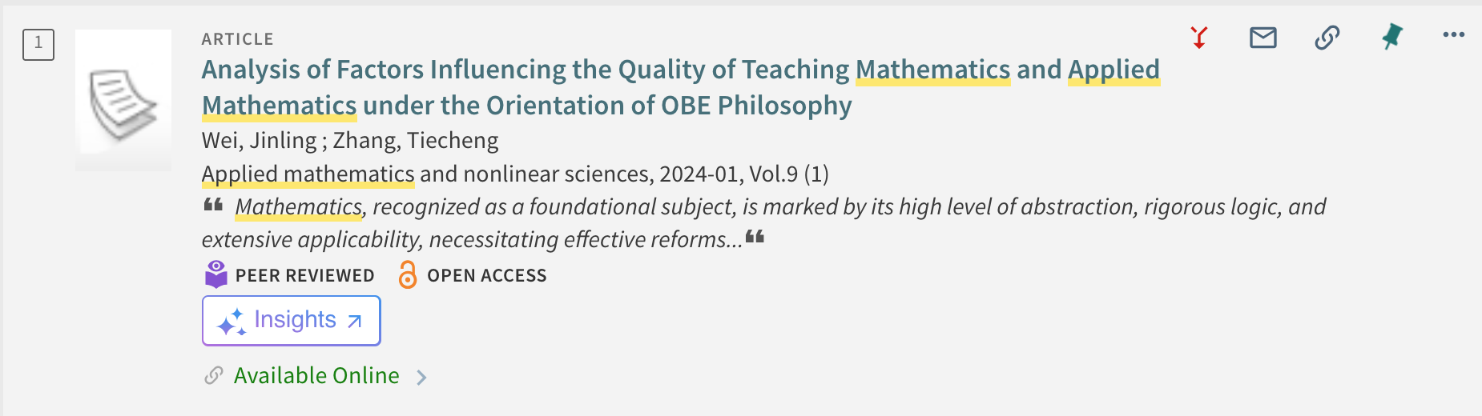
Add a link to “Document Insights” in Primo VE for ProQuest resources
Available August 8, 2025: Document Insights, an AI-powered feature that can link users from Primo VE into the ProQuest platform and provide additional information about the resource.
OPTIONAL; Can be activated per Primo VE View
Only for active ProQuest subscriptions (see list in EXL documentation)
See also ProQuest Research Assistant
Search result in Primo VE with red arrow pointing to new “Insights” button
Notes:
[Jessica]
This new feature is called Document Insights and it is for active ProQuest subscriptions only. It is entirely OPTIONAL and coming on August 8, 2025 with the CDI Update:
According to Ex Libris, Document Insights is an AI-powered feature that provides users with additional information about resources appearing in search results. It offers general context about the content of each resource, enabling users to review, analyze, and extract information from documents, and quickly and effectively assess their relevance for research.
When enabled, an Insights button appears in both the brief results and full record pages of electronic resources. Selecting the button opens a new window/tab displaying the Document Insights for the resource on the ProQuest platform.
The Document Insights feature is activated per view in the View Configuration page (Discovery > Display Configuration > Configure Views > [Add View or Edit an existing view]), by selecting Display AI Insights links. For additional information, see Links to Document Insights in Primo VE. https://knowledge.exlibrisgroup.com/Primo/Product_Documentation/020Primo_VE/Primo_VE_(English)/030Primo_VE_User_Interface/Links_to_Document_Insights_in_Primo_VE
See also ProQuest Research Assistant. We at CARLI don’t know anything about the ProQuest Research Assistant but wanted to point out this new option to you as Ex Libris and ProQuest continue to add AI features to their products.

Slide 36
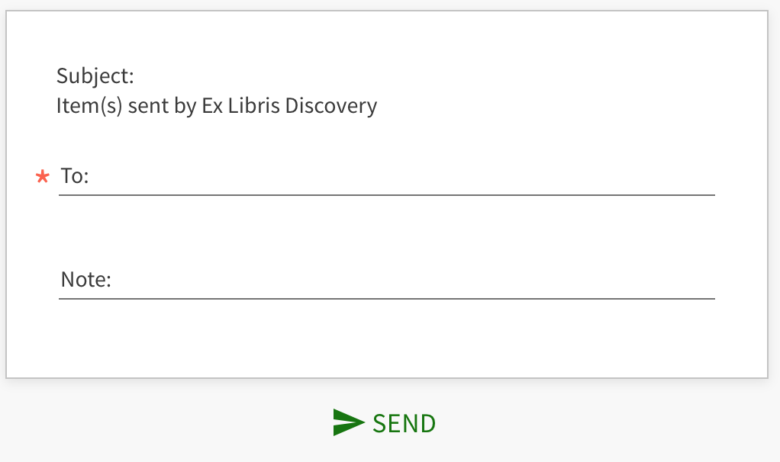
New Email Security Setting – April 2025
New customer parameter enable_email_client
If set to true in Alma Configuration > Discovery > Other > Discovery Customer Settings in your Alma IZ, Primo VE will use the device's default email client.
If there is no default email client, a blank window will open.
If enabled, the Email action is limited to single records at a time.
Option to send an email from Primo VE using the Email action box.
Notes:
[Jessica]
A security improvement slipped past us in April 2025 that we wanted to bring to your attention.
By default, when made available as an Action, the Email option in Primo VE provides users with the option to email records to an email address the user types in. This feature allows the user to put in any email address, which may allow for abuse of this feature. It is not attached to the email address associated with the user’s account and does not require a user be logged into send a message. Several Alma customers have noted the security risks associated with this feature, and some libraries have disabled the option to prevent spam.
When the new customer parameter enable_email_client is set to true in Alma Configuration > Discovery > Other > Discovery Customer Settings) in your Alma IZ, Primo VE will use the device's default email client (such as Outlook, Gmail, and so forth). If there is no default email client, a blank window will open, and nothing will be executed.
When this new setting is enabled, the Export to Email action is limited to single records only, but records can still be exported in bulk with the Export to Excel action and the Export All option.

Slide 37
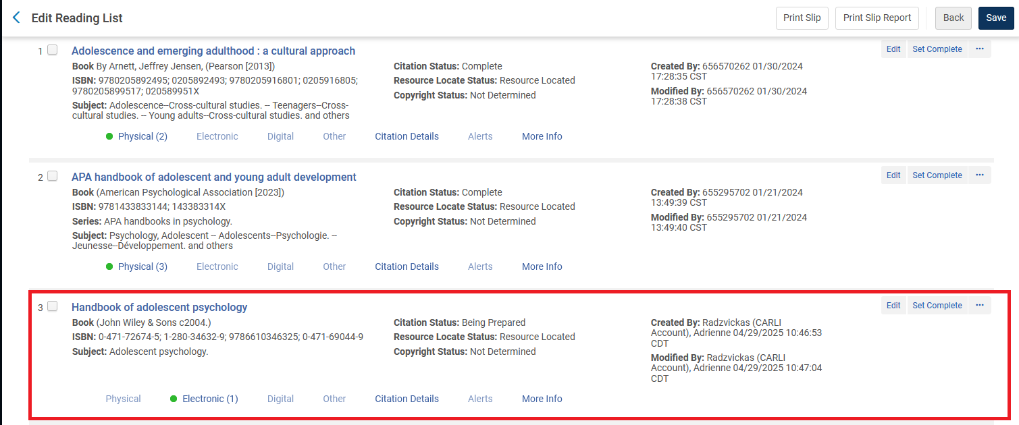
CORRECTION: Titles from NZ cannot be added to Course Reserves Lists
In the May 2025 Release Update Webinar, we had shared that NZ Records can now be added to Course Reserves Reading Lists in your IZ.
This is still true; however, NZ titles will not display in your library’s Primo VE as a Course Reserve item.
A red rectangle highlights a Network Zone record that has been added to a Course Reserves Reading List.
Notes:
[Jessica]
And we have one correction from earlier this year: In the May 2025 Release Update Webinar, CARLI staff had shared that NZ Records can now be added to Course Reserves Reading Lists in your IZ.
This is still true; however, NZ titles will not display in your library’s Primo VE as a Course Reserve item, so there is really no point in adding them to the Reading List in Alma. We are still hoping for a future Alma enhancement that will allow NZ titles such as ebooks to be added to IZ reading lists.

Slide 38
Primo VE Next Discovery Experience UI (NDE UI) Reminder
I-Share libraries will be able to switch to Primo NDE UI in summer 2026 or later
NDE UI scheduled to be ready for consortia in late 2025 but will require testing before switching.
CARLI will provide more guidance, documentation, and training beginning in spring 2026.
I-Share libraries may choose when to go live with Primo NDE, e.g. summer 2026, Jan. 2027, or summer 2027.
If your library would like to be in the summer 2026 “cohort,” please email CARLI Support to let us know!
Notes:
[Jessica]
And finally, just a reminder about the Primo VE Next Discovery Experience or NDE
I–Share libraries will be able to switch to the new Primo NDE UI starting in summer 2026, and CARLI will start providing more information about that next year. You won’t have to go live in summer 2026; your library may choose to go live over holiday break, or summer 2027, or even in the middle of the year if that’s what you really prefer to do! If your library would like to be in the first cohort of I-Share libraries to go live in summer 2026, please contact CARLI to let us know. We are keeping an informal list right now, but CARLI will put out a formal survey, probably later this year, for libraries to indicate when they would like to plan to migrate.
For libraries with few extra customizations to your Primo VE View—that is custom CSS and JavaScript--this should be a straightforward migration; however, if your library has heavily customized your Primo VE View, you should plan to dedicate some staff time to migration and plan a timeline accordingly.

Slide 39
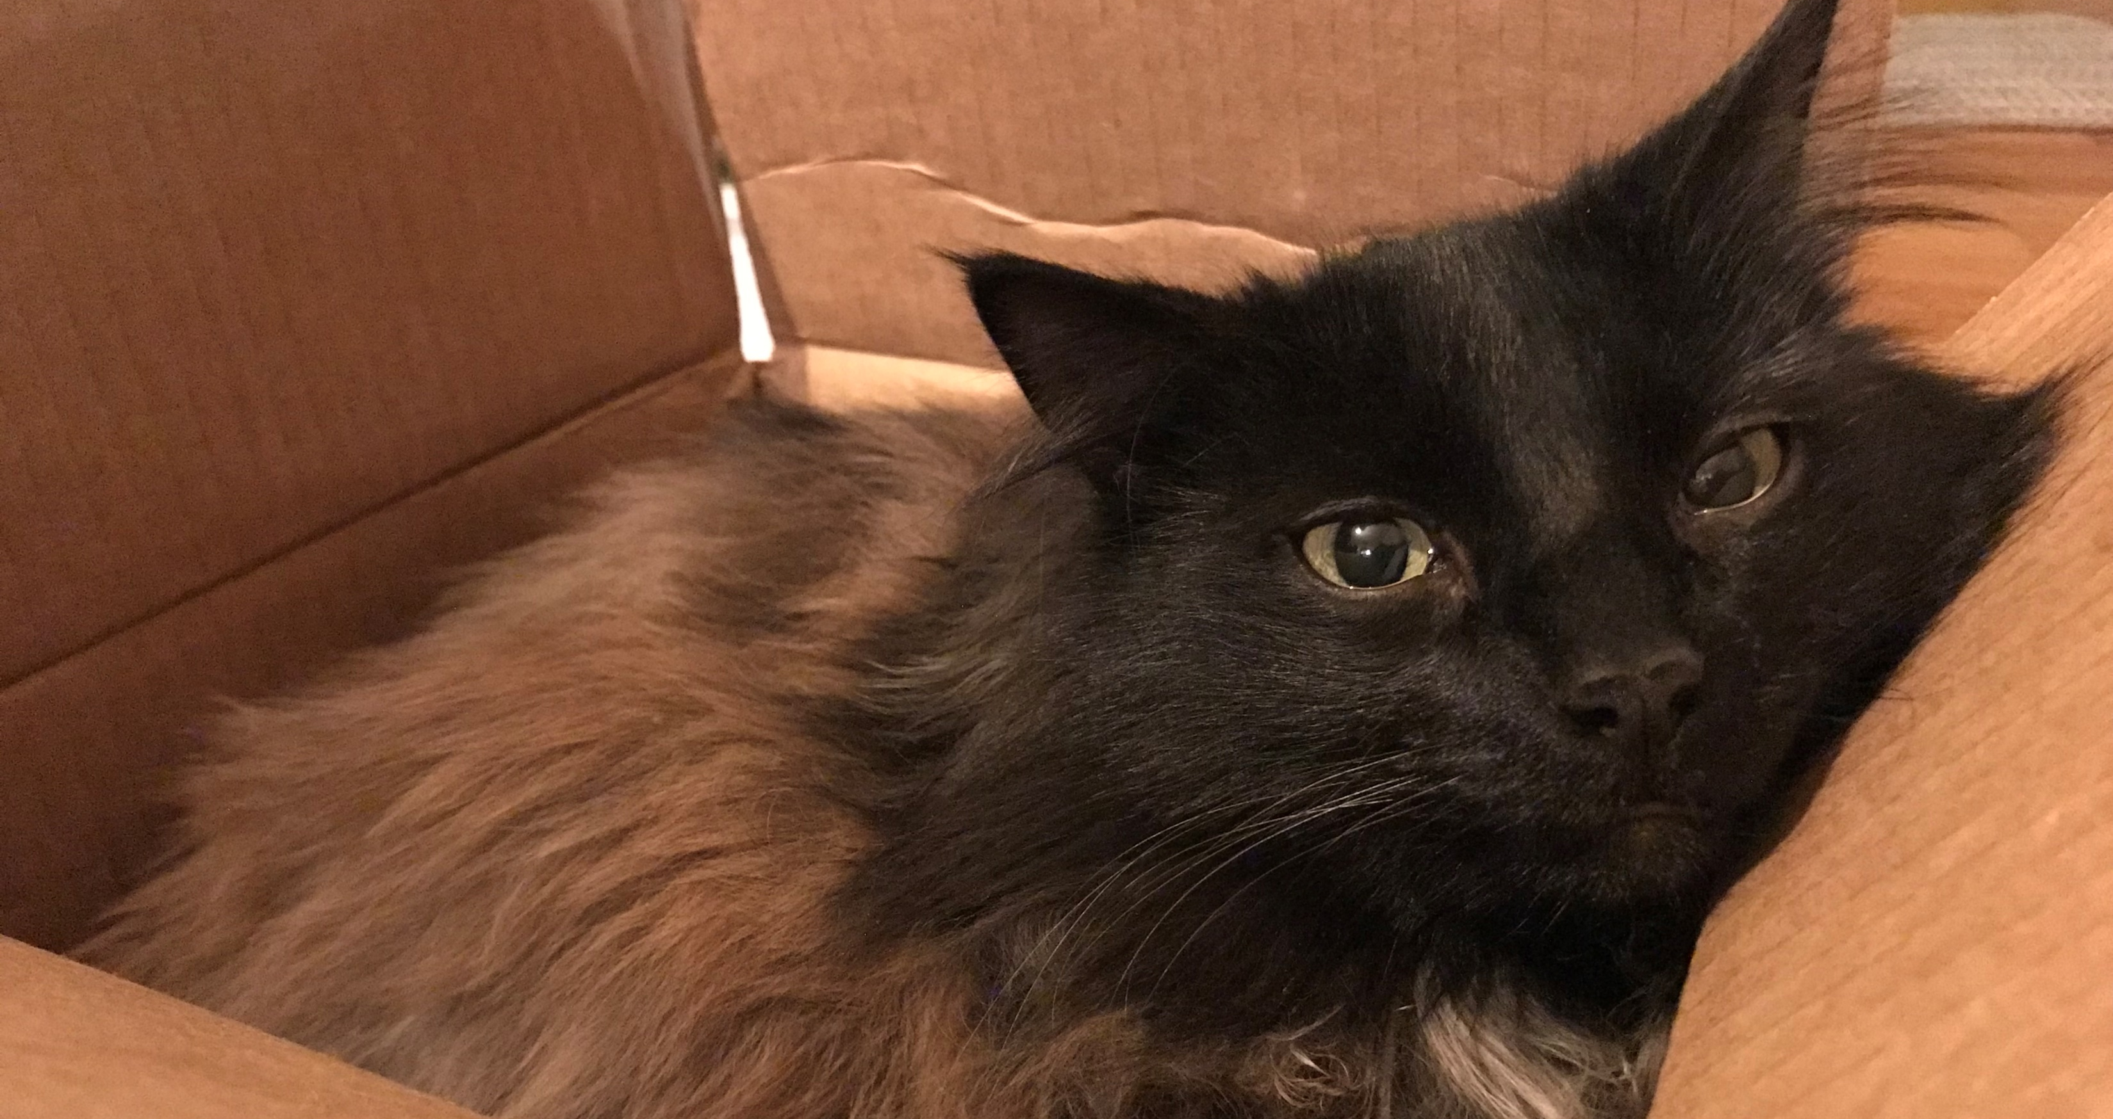
Questions & Answers
Notes:
(Rotating nice picture) ☺

