Slide 1
From the Back of the House to the Front of the Classroom
Pete Steadman
Electronic Resources and Systems Librarian
The Ames Library
Illinois Wesleyan University
psteadma@iwu.edu
Inviting Students into Library Instruction without Overwhelming

Slide 2
Background
Library technical services
Some reference experience
First year of instruction

Slide 3
Student
Experience
100-200 level courses
Preference for interactive learning*

Slide 4
Setting
Faculty
Expectations
Pair sessions with a relevant
assignment
Set realistic goals
Share out your agenda early

Slide 5
The Session
Itself
Know your tools
Teach toward the assignment
Emphasize what is unique
to libraries
Make time for interaction and personalized attention

Slide 6
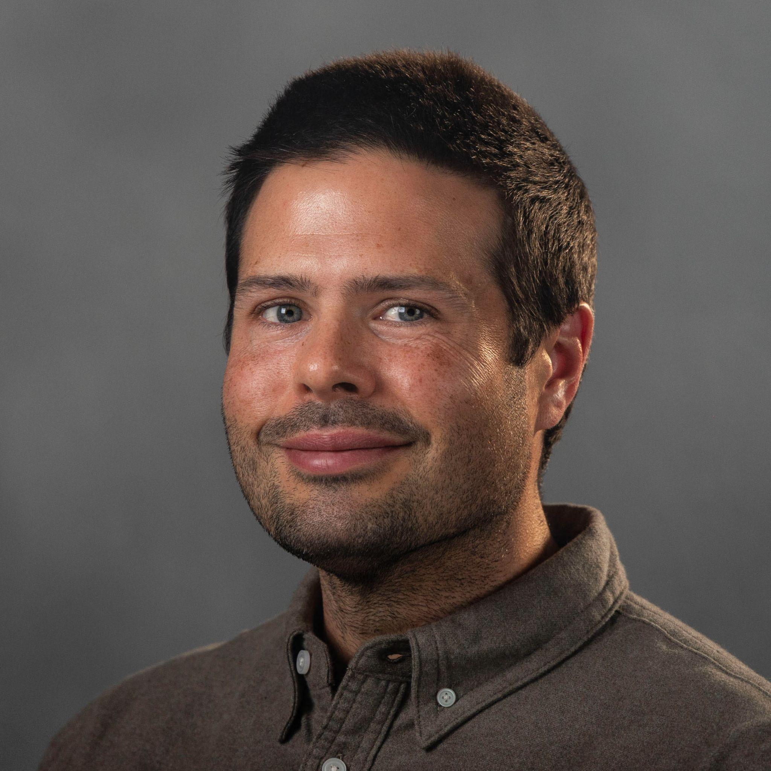
Thank You!
Example Course Guide
Citation: Flaherty, Colleen. “Survey: The College Student Academic Experience.” Inside Higher Ed, 3 July 2024 www.insidehighered.com/news/student-success/academic-life/2024/07/03/survey-college-student-academic-experience.
Email: psteadma@iwu.edu

