Slide 1
I-Share Alma Primo VE quarterly update will start shortly
Welcome!
Office Hours will start at 2pm and run until 3pm.
Please mute your microphone.
As time permits, we will respond to questions typed in the chat box, and offline afterwards, as needed.
This session will be recorded and made available on the CARLI website. Slides and references for today are available at
https://www.carli.illinois.edu/alma/primo-ve-quarterly-release-update

Slide 2
I-Share quarterly alma primo ve update:
August 2024 Feature release
August 1, 2024

Slide 3
Agenda Office Hours
Agenda – 8/1/2024
Announcements and Reminders
Upcoming events
Today’s Topic: August 2024 Feature Release

Slide 4
Announcements and reminders
Announcements and Reminders
Sandbox update
Sandbox Refresh will occur on August 11.
An email with details about backing up your work and ceasing work on third party integrations was shared last week.
New I-Share Libraries are live in Alma, Primo VE, and AFN!
(Chicago Theological Seminary, City Colleges of Chicago, College of Lake County, Elgin Community College, and Prairie State College)

Slide 5
Upcoming events
Upcoming Events
https://www.carli.illinois.edu/calendar
8/15/24 - Newberry Library Tour Invitation for those attending SAA annual meeting
8/20/24 – 8/21/24 – Free People Read Freely Symposium https://www.carli.illinois.edu/Free-People-Read-Freely
[Image Description: Free People Read Freely logo]
Notes:
But first, a few friendly reminders:
You can always check the CARLI calendar for all CARLI events, including those related to Alma and Primo VE.
For the latest news in and around all of CARLI, check out the CARLI newsletter online! The newsletter is published monthly on our website. Here’s the link to the latest!

Slide 6
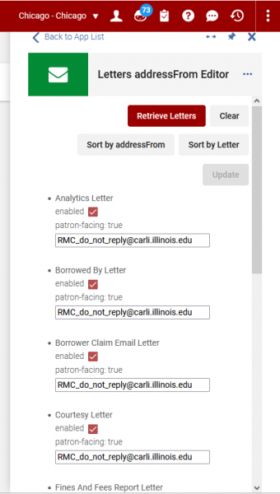
Enable Cloud App Activation per Role
Cloud Apps are applications written by members of the Alma community that run inside Ex Libris products such as Alma, Primo VE, and Leganto. These apps add features beyond the core functionality found in the products themselves.
[Image Description: A screen capture of CARLI’s Letters addressFrom Editor cloud app]
Notes:
Bradley –
Cloud Apps are applications written by members of the Alma community that run inside ExL products, such as Alma, Primo VE, Leganto, etc. They usually add features beyond the core functionality.
For example, some of you may have used a cloud app created by CARLI called the Letters addressFrom Editor, which makes editing the “From” address in Alma Letters easier. Editing in bulk vs entering each individual letter to change one field.

Slide 7
Enable Cloud App Activation per Role CONTINUED
Cloud App config now includes two new options for controlling usage of cloud apps in the institution. Admins can configure one, both, or neither of these options.
  The admin can configure cloud apps to be available for activation only by users with the relevant role/s required by that cloud app.
  The admin can control which users can activate and use cloud apps by giving specific users the new Cloud App Operator role.
Additional Information
Configuring and Working with Cloud Apps (ExL Knowledge Center)
  https://knowledge.exlibrisgroup.com/Alma/Product_Documentation/010Alma_Online_Help_(English)/050Administration/050Configuring_General_Alma_Functions/Configuring_Cloud_Apps
Cloud Apps in Alma (CARLI Documentation)
  https://www.carli.illinois.edu/products-services/i-share/external-system/cloudapps
Notes:
Bradley –
In the upcoming feature release, configuration for Cloud Apps now has 2 new options for controlling usage of cloud apps. Administrators can configure one, both, or neither of these options.
Admins can configure cloud apps to be available for activation ONLY by users with the relevant roles required by that cloud app. For example, the CARLI app I mentioned, Letters addressFrom Editor, requires the role “General System Administrator.” If the admin chooses configuration option, only users with the General System Administrator role will be able to activate CARLI’s Letters addressFrom Editor cloud app.
The admin can give a user the new role of Cloud App Operator, which will give that user the ability to activate and use cloud apps.
Additional information about this is available in the Ex Libris Knowledge Center on their page for Configuring and Working with Cloud Apps, or in CARLI’s documentation under Cloud Apps in Alma, which also has information about CARLI’s Letters addressFrom Editor if you would like to know more.

Slide 8
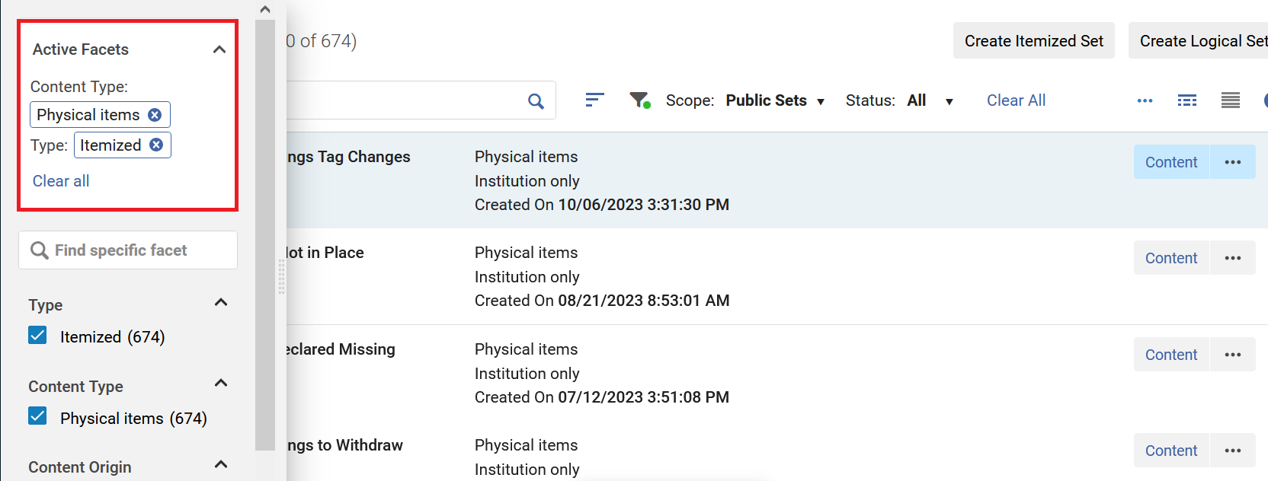
Active Facets Displayed IN left-hand Corner
[Image Description: A screen capture of the search facets showing active facets]
A section was added to the facets for certain searches that displays the actively selected facets. This applies to PO lines, resource sharing requests, sets and relevant searches such as physical holdings.
Notes:
Adrienne -- .Note that it doesn’t apply to all searches.

Slide 9
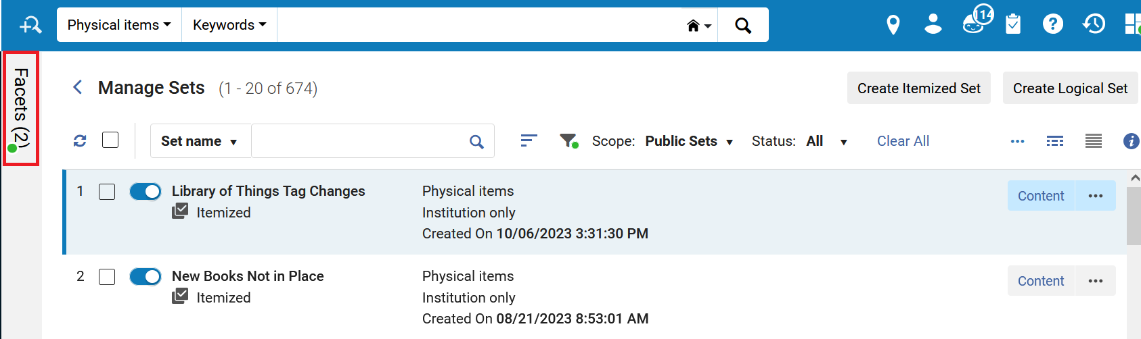
Active Facets in Collapsed Pane
[Image Description: Screen capture of active facets in collapsed pane]
When you collapse the facets pane with active facets, it will show an indicator that there are active facets and the number of them.
If you hover over the indicator, a tooltip shows which facets are selected.
Notes:
Adrienne -- This helps to remind you that there are active facets in your search.

Slide 10
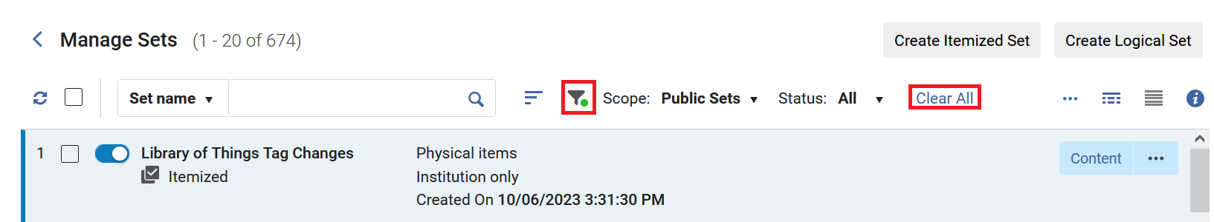
Filtering Sets
[Image Description: Screen capture of the Filter icon with a green dot and the Clear All link in the Manage Sets window]
When you have selected a non-default filter, such as My Sets in the Manage Sets window, a green dot is displayed by the Filter icon.
Also, the Clear All link is provided to easily clear all filters.
Notes:
Adrienne

Slide 11
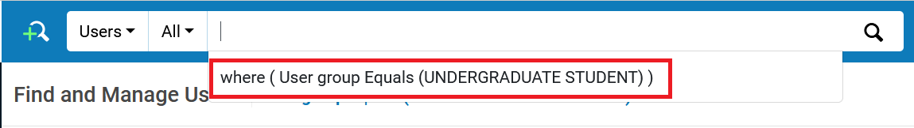
Searches retained
[Image Description: Screen capture of dropdown in search box.]
The simple and advanced searches contain recent searches in the dropdown from the search box.
Notes:
Adrienne

Slide 12
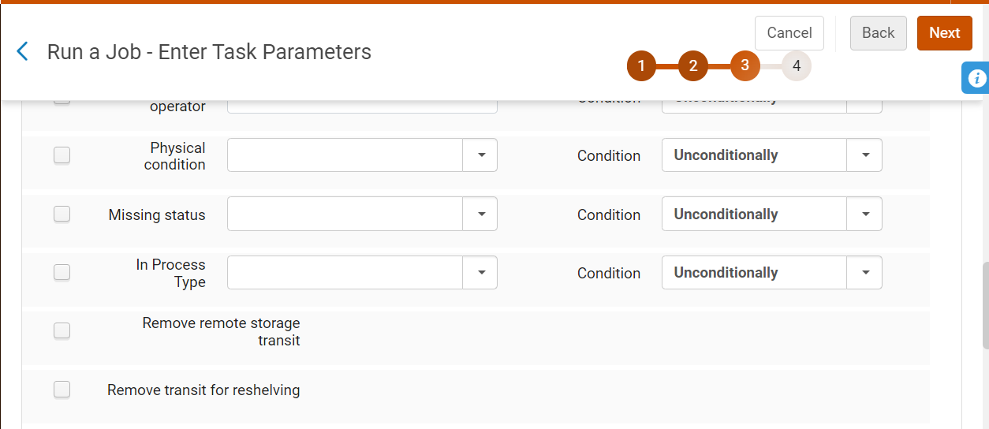
Change Physical Items Job adds “Remove Transit for Reshelving” Option
New setting will be tested in sandboxes, then in production.
If all goes as planned, the “How To: Request Maintenance” page will be updated.
Fall webinar TBA on reviewing the request maintenance steps in Alma.
[Image Description: Screenshot shows the Alma parameters screen of the Change Physical items information job.]
Notes:
Debbie
With the August release, Ex Libris has added a new option to the Change Physical Items information job that should allow library staff to, in bulk, remove the “in transit for reshelving” status.
The CARLI Office will be reviewing this new functionality with the help of one of our I-Share libraries, to make sure the functionality works as anticipated in the sandboxes, and then also in production.
Assuming all goes well, we’ll update the “How To Request Maintenance” page linked on this slide to include steps for using this functionality as and optional part of your periodic review workflows.
Please wait to use the functionality until you see the How To Request Maintenance webpage has been updated; the updating of the page with information about the job will mean that it worked as anticipated.
In the fall, we’ll be holding an updated webinar on Alma request maintenance; the date is tba, and the session will be recorded.

Slide 13
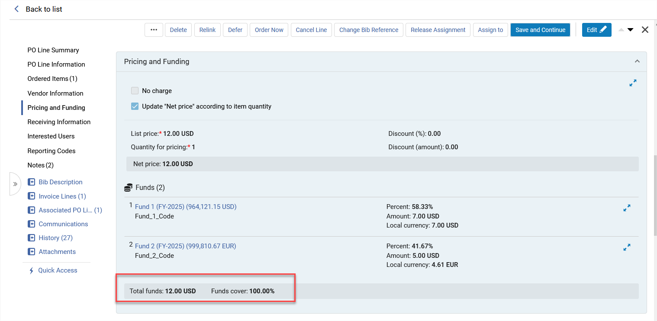
Acquisitions POL Update
[Image Description: The Summary bar for funds.]
When using multiple funds for a POL, the total for the funds will be displayed in the "Funds and Pricing" section.
Notes:
(Ted )
When adding multiple funds to a POL the total for the funds will be displayed in the funds and pricing section of the Purchase Order Line.

Slide 14
Acquisitions Job Update
New Fields Added to "Update PO Lines Information" Job
Additional PO line reference field
Cancellation Restriction
Cancellation Restriction Note
Add labels from list
Remove labels
Create new label
Reclaim interval
Subscription interval
Note to vendor
Vendor reference number type
Routing during receiving
Binding during receiving
Activation note
Renewal date
Subscription from
Subscription to
Renewal reminder period (days)
Renewal note
Internal note
Notes:
(Ted)
19 new fields have been added to the "Update PO Lines Information" Job. These are listed on this slide. For example, If there are multiple POLs you'd like to update with the same "Note to Vendor" this can now be accomplished in batch.

Slide 15
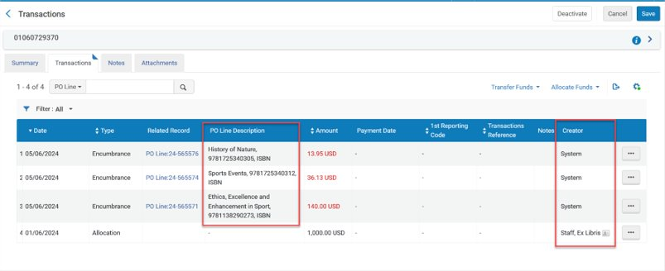
Acquisitions Funds and Ledgers Update
New Fields added to Transactions Tab of Funds and Ledgers
  PO Line Description
  Creator
To display these fields select the "Table Customization" gear on the right and tick the field names.
[Image Description: The PO Line Description and Creator fields.]
Notes:
(Ted)
Two New Fields can be viewed on the transaction tab of funds and ledgers: PO Line Description (i.e. title) and Creator. To display these fields select the "Table Customization" gear on the right and tick the field names. The Fields can be dragged to display in the order the logged in user desires.
Important Note: The creator "Information Card" will only display for transactions added since the August 2023 update.

Slide 16
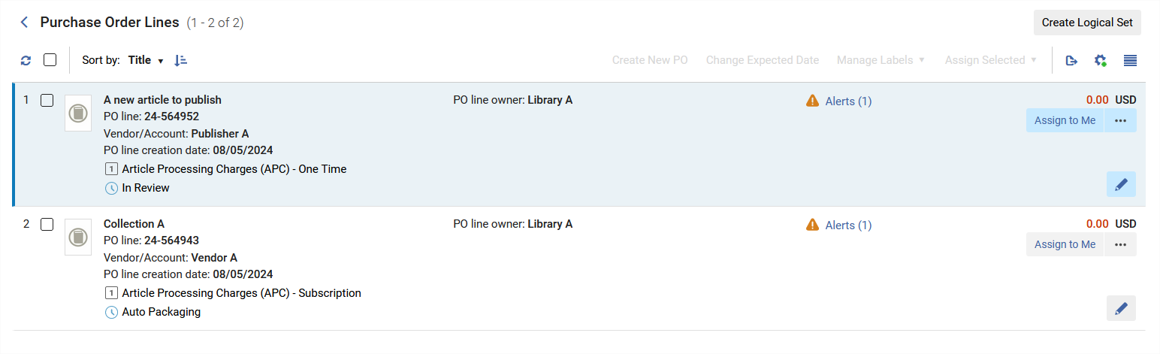
Acquisitions New POL Types
Two new POL Types to support Open Access Workflows:
  Article Processing Charges (APC) – One Time
  Article Processing Charges (APC) – Subscription
These new POL types are without inventory. They can be linked to the appropriate vendor, relevant license, price, and funding source.
[Image Description: Two APC PO Lines.]
Notes:
(Ted)
Two new Purchase order line types have been added in support of Open Access Workflows. "Article Process charges – one time" and "article processing charges - subscription". These new pol types can be used without inventory since they represent the request to publish articles. They can be linked to the appropriate vendor, license, and include price and funding.
Future releases will add other open access elements such as transformative agreement.
These POL Types are active with no action required.

Slide 17
Acquisitions Copy PO Line Price to Replacement Cost
When creating a new POL Alma can copy the POL price to the replacement cost field.
This can happen when:
  A new POL is created
  A POL list price is edited
  The quantity ordered is changed
To activate:
  Configuration > Acquistions > General > Other Settings > replacement_cost_copied_from_POL
    0 – False (DEFAULT)
    1 - Copy the price from the PO line's List price field
    2 - Copy the price from the PO line's Net price field and divide by number of items in the Ordered Items section.
Notes:
(Ted)
A new configuration setting to automatically copy the list price from the POL to the Replacement Cost field of the Item. This copy can happen when you create a new POL, edit the POL list price, or change the quanity ordered.
This new setting is OFF by default. To change someone with Alma certification can navigate to Configuration > Acquistiions > General >other Settings and search for "replacement" to find the "Replacement_Cost_copied_from_POL" setting.
0 is the default setting (OFF)
1 copy the price from the PO Line List price field
2 copy the price from the NET PRICE field and divide by number of items (this would take into account any discounts that may be applied to your POL).

Slide 18
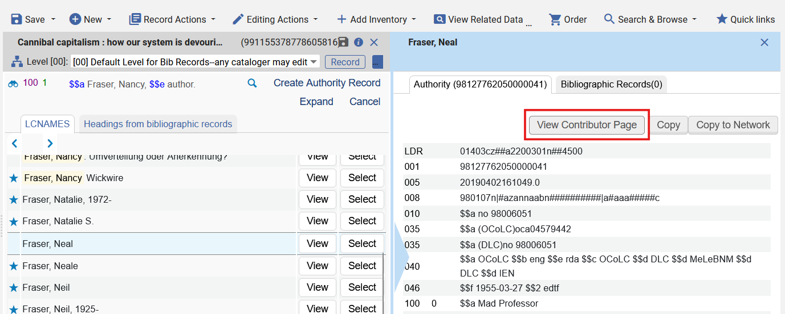
Contributor Pages for Name Authorities
[Image Description: A screenshot of the Alma metadata editor displaying a list of name headings and a single name authority record. The name authority record includes a button for View Contributor Page.]
When linking or validating name authorities in the metadata editor (F3), the authority record view may link to a Contributor Page.
Notes:
(Ted)
Ex Libris has added some linked data functionality that will help catalogers. Some of those improvements, such as functions related to BibFrame, require more consideration by CARLI. Here’s one that should be useful right away.
When editing a record in the metadata editor, the cataloger may attempt to link a heading in the bib record to an authority record using the F3 key. This opens a list of indexed headings which may lead to authority records in the community zone. When viewing an authority record, a button may appear for View Contributor Page.

Slide 19
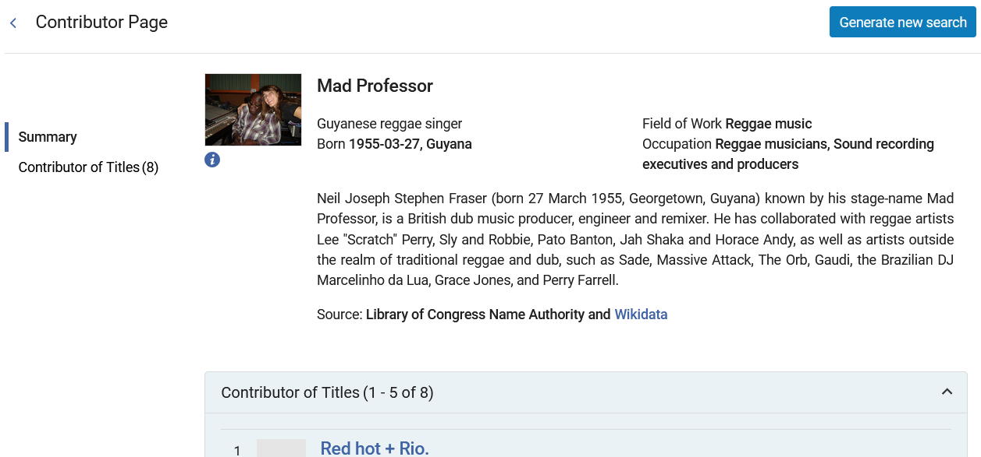
Contributor Pages for Name Authorities (continued)
[Image Description: A screenshot of Alma's Contributor Page for an individual. The page includes a brief description of the person, a button to generate a new search, and a list of titles if they are available.]
Notes:
(Ted)
Clicking the View Contributor Page button opens a new screen showing details from various linked data sources. The page may also show a list of associated titles, and there is a Generate New Search button present. Ex Libris notes that this search button will be fully functional after the November release and associated indexing, but it does return some results now.

Slide 20
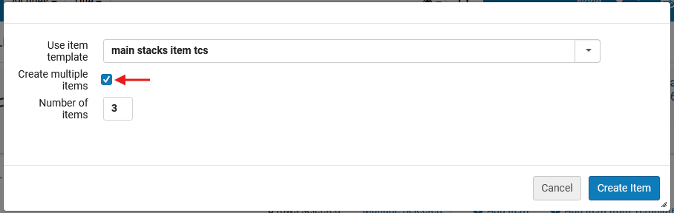
Create Multiple Items with Item Template
[Image Description: A screenshot of Alma's add item from template window, with the new Create multiple items option selected and a number of items box filled in.]
The Add item from template window now includes an option to create multiple items.
Notes:
(Ted)
Item templates were added to Alma earlier this year, streamlining the creation of new item records. In August, the functionality is expanded to enable creation of multiple items on the same holding. This will be valuable for catalogers adding multiple volumes or multiple copies at the same time.
When adding new items using the Add from Template option, select the template, then tick the Create multiple items box. This opens a prompt for the number of items needed. Select Create Item, and Alma kicks off a job to create several new duplicate items, which may be edited further by staff.

Slide 21
Fields for Physical Items Results Screens
New fields added to Physical Items search results screen
  Receiving Date
  Receiving Operator
  Public Note
  Fulfillment Note
  Internal notes 1-3
  Statistical notes 1-3
To activate and arrange these fields, click the “table customization” gear icon above the list of results.
Notes:
(Ted)
The search results screen for physical items includes a lot of details to help staff review item data in one place. Starting in August, this display will include 10 more fields that could previously only be seen on the item record itself. These include the received date and receiving operator, as well as all of the fields from the Notes tab of the item record.

Slide 22
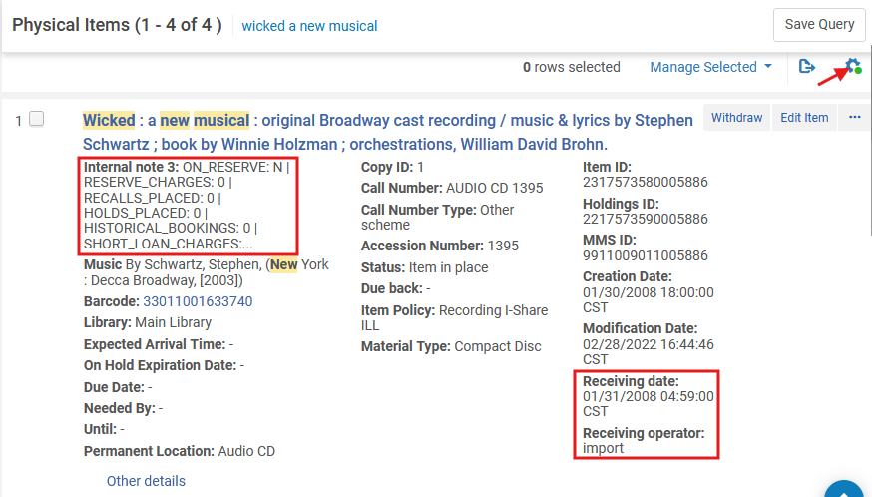
Fields for Physical Items Results Screens (continued)
[Image Description: A screenshot of Alma's physical search results screen showing an item record. The customization gear appears above and right of the results list, and the item in the result includes details for Internal Note 3, Receiving Date, and Receiving Operator.]
New fields—if activated with the gear icon—appear only when data are present.
Notes:
(Ted)
Any user may customize the results screen and the location of different fields. Click the gear icon to customize the list. Tick the box for fields to activate or deactivate those fields. Drag and drop the fields between columns.
These new fields will only appear in the results display when data are present. In the example shown here, Internal Note 3 appears in the first column since it contains some migration data, but the other notes fields are empty, so they don’t appear.

Slide 23
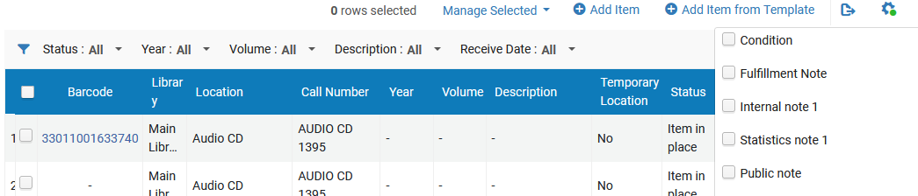
Fields Available for List of Items Screen
[Image Description: A screenshot of Alma's list of items table showing two items for a resource, and showing the configuration list expanded to show the new fields: condition, fulfillment note, internal note 1, statistics note 1, and public note.]
Click the gear icon to customize the columns shown in the list of items table; scroll to the bottom of the list and click Done to save changes.
Notes:
(Ted)
Some of these same fields are also available to be added to the list of items table. The list of items is usually reached by the Items button on the actions menu, or by clicking View All Items from an item record.
As before, a staff user may click the gear icon to customize the display for themselves. Tick the boxes to activate or deactivate columns. Columns may be dragged left or right by clicking on the column headings.

Slide 24
Enhanced Role selection for Analytics Objects
In Analytics Objects, the feature to select the Alma roles that have access to an analytics object were enhanced.
  You can now open a dialog box and select the roles with which you want to share the analytics object.
  The roles are categorized to make it easier to find specific roles.
  You can select all of the roles in the category or select specific roles within a category.
The next slide will show a side-by-side comparison between the previous Analytics Objects method of selecting a role in comparison to the new enhanced method.
Notes:
(Martin)
In Analytics Objects, the feature to select the Alma roles that have access to an analytics object were enhanced.
You can now open a dialog box and select the roles with which you want to share the analytics object.
The roles are categorized to make it easier to find specific roles.
You can select all of the roles in the category or select specific roles within a category.
The next slide will show a side-by-side comparison between the previous Analytics Objects method of selecting a role in comparison to the new enhanced method.

Slide 25
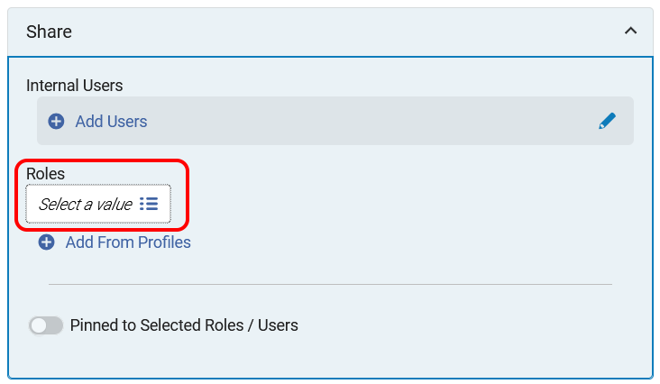
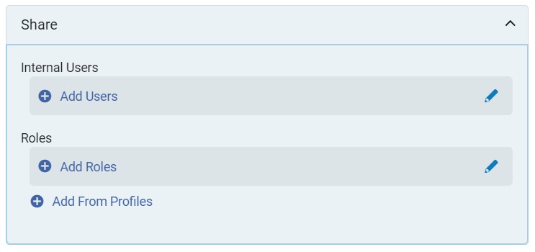
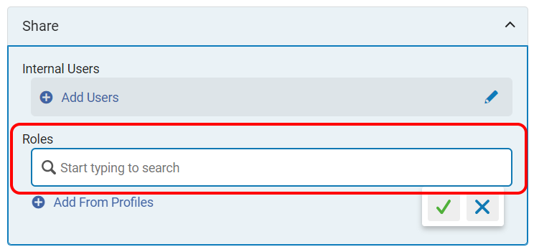
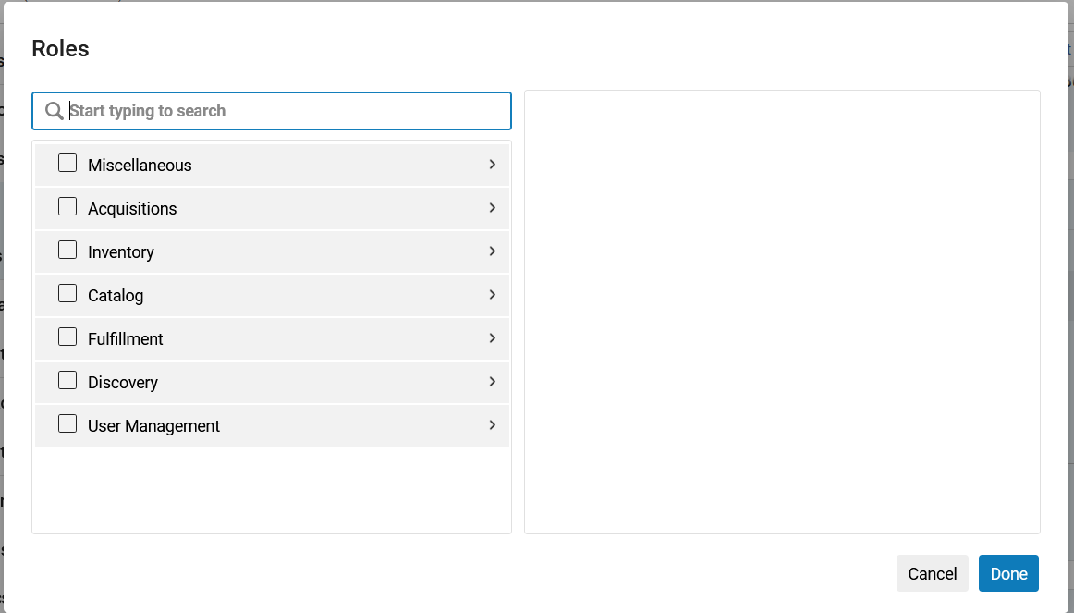
Enhanced Role selection for Analytics Objects (continued)
Below displays the “share” pane after an Analytics object is selected, in a side-by-side comparison between the previous Analytics object and the enhanced Analytics object
Previous Analytics Object view
Enhanced Analytics Object view
[Image Description: Previous Analytics Object's "Share" pane.]
[Image Description: Enhanced Analytics Object's "Share" pane. The new Roles selection is enclosed in red.]
[Image Description: Previous Analytics Object's "Share" pane after clicking into the Roles field. The Roles field is enclosed in a red rectangle. ]
[Image Description: Enhanced Analytics Object's Roles pop-up window allows for enhanced selection of the Alma roles to share this object. ]
Notes:
(Martin)
On the left side, the top image shows what the Share pane looks like from the previous Analytics object interface for an analytics object.
On the right side, the top image shows what the Share pane will look like in the enhanced Analytics object interface for an analytics object. Note the new Roles selection option highlighted in red.
On the left side, the lower image shows what the Share pane looks like after clicking into the Roles field. The only option for choosing a role previously was to begin “typing” the letters for the name of the role into that box, for example, “A” “C” “Q” for Acquisition.
On the right side, the lower image shows what the Share pane will look like after clicking into the Roles selection area. This new Roles pop-up window will appear, allowing for enhanced selection of the Alma roles of the users with whom you want to share this analytics object.
The next few slides will highlight the new Roles selection features.

Slide 26
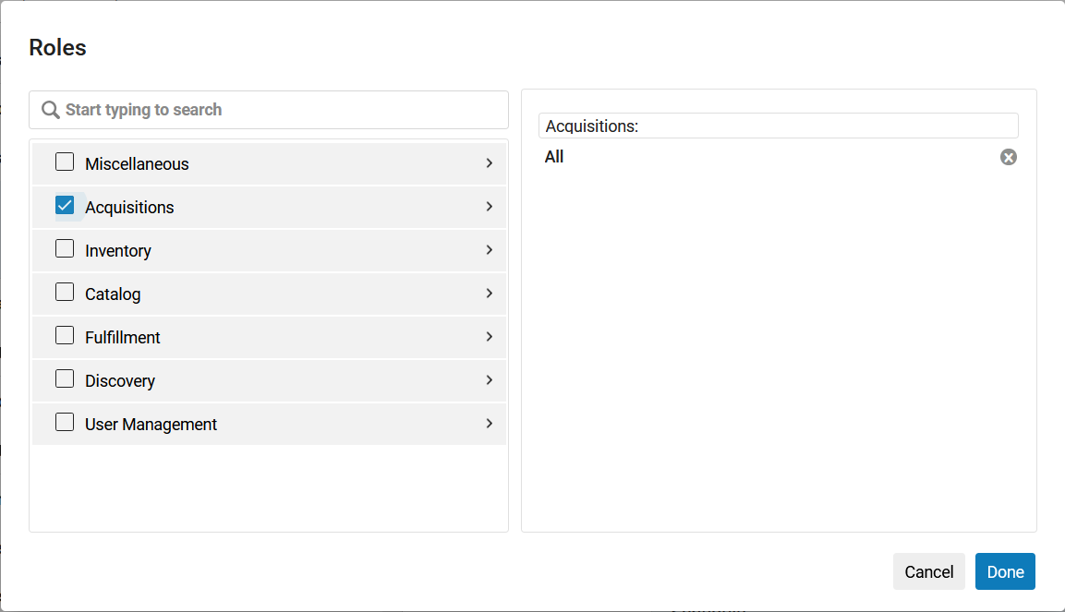
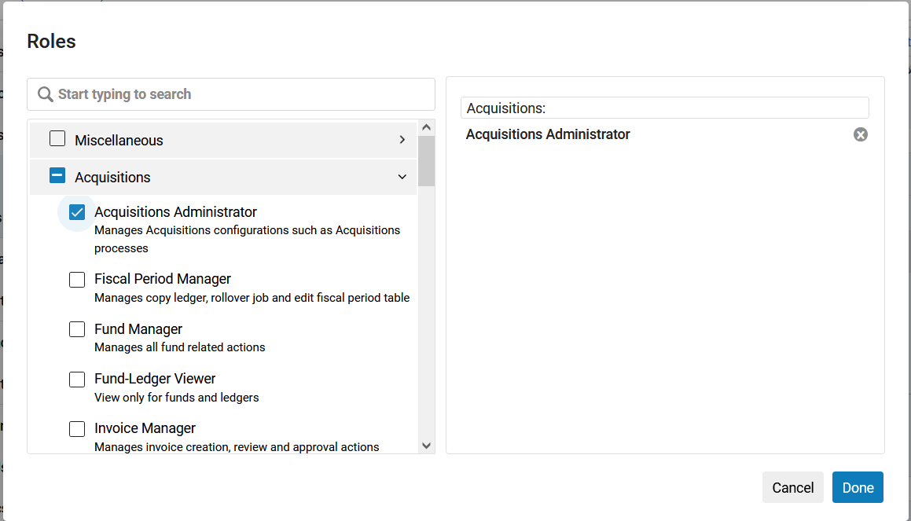
Enhanced Role selection for Analytics Objects (continued 2)
One possible option, selecting all of the Alma roles in a particular category, i.e. all of the acquisitions related roles in Alma are selected.
A second possible option, choosing just a single Alma role, i.e. just “Acquisitions Administrator” is selected.
[Image Description: The roles pop-up window showing the entire category of "Acquisitions" is selected.]
[Image Description: The roles pop-up window showing only the role of "Acquisitions Administrator" is selected. ]
Notes:
(Martin)
In the new enhanced role selection feature, there are two possible options for selecting the role or roles that you want to share this Analytics object with.
On this slide, the top image shows the new enhanced Roles pop-up window with the entire category of “Acquisitions” selected, which means that all of the Alma “Acquisitions” roles will be selected as indicated with the checkbox to the left of “Acquisitions”.
The bottom image shows the new enhanced Roles pop-up window with just the “Acquisitions Administrator” role selected as indicated with the checkbox to the left of “Acquisitions Administrator”

Slide 27
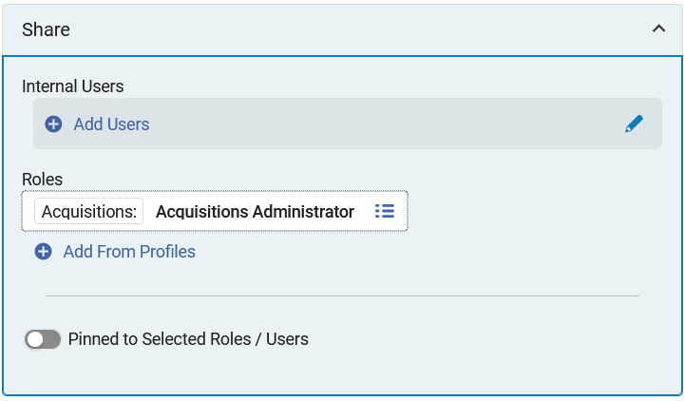
Enhanced Role selection for Analytics Objects (continued 3)
In this new enhanced role selection feature, the role of “Acquisitions Administrator” has been selected for this analytics object.
  This Analytics object will be shared with all Alma users at this institution who have the role of Acquisitions Administrator.
  Note the “Pinned to Selected Roles / Users” toggle can now be toggled. This toggle is only enabled after roles or users are selected.
[Image Description: Enhanced Analytics Object's "Share" pane showing the role of "Acquisitions Administrator" is selected. ]
Notes:
(Martin)
This image shows that the role of “Acquisitions Administrator” has been selected as the role upon which this Analytics object will be shared with. This Analytics object will be shared any Alma user who has the role of Acquisitions Administrator at this institution.
Note: there is a Pinned to Selected Roles / Users” toggle at the bottom of this “Share” pane. This toggle will only become functional after a roles or users are selected above.

Slide 28
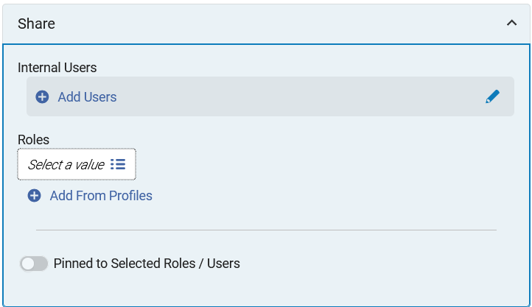
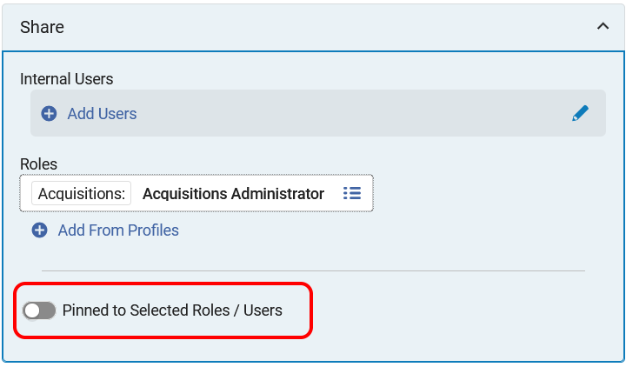
Pin Analytics objects to Selected Roles and Users
In addition to being able to more easily select the Alma user roles that you want to share an Analytics object with, it is now also possible to pin that particular Analytics object for those specific roles (or users) with whom you shared the object.
In the previous example, the Analytics object was shared with all users who have the role of Acquisitions Administrator at this institution.
Toggling the “Pinned to Selected Roles / Users” button will “pin” this Analytics object for all Alma users who have the Acquisitions Administrator role.
[Image Description: Enhanced Analytics Object's "Share" pane with no roles or users selected, thus the "Pinned to Selected Roles / Users" toggle is inactive.]
[Image Description: The "Acquisitions Administrator" role is selected. The "Pinned to Selected Roles/Users” (highlighted in a red rectangle) is now active and can be enabled. ]
Notes:
(Martin)
In addition to being able to more easily select the Alma user roles that you want to share an Analytics object with, it is now also possible to pin that particular Analytics object for those specific roles (or users) with whom you shared the object.
In the previous example, the Analytics object was shared with all users who have the role of Acquisitions Administrator at this institution.
Toggling the “Pinned to Selected Roles / Users” button will “pin” this Analytics object for all Alma users who have the Acquisitions Administrator role.
As noted in the previous slide, this toggle is not active if there are no roles or users selected above it. On the lower left image, you see that there are no roles or users selected, thus the toggle is inactive. On the lower right image, you see that the toggle becomes active once roles (or users) are selected for the sharing of this Analytics object.

Slide 29
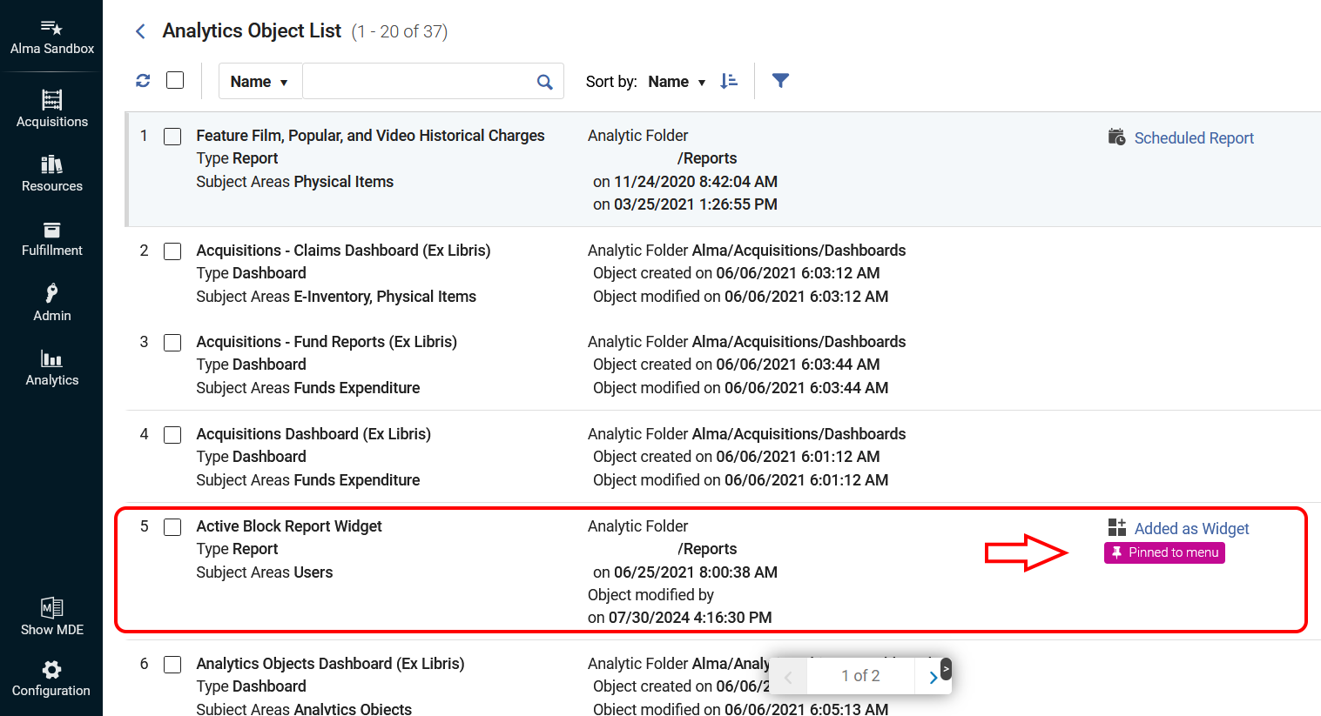
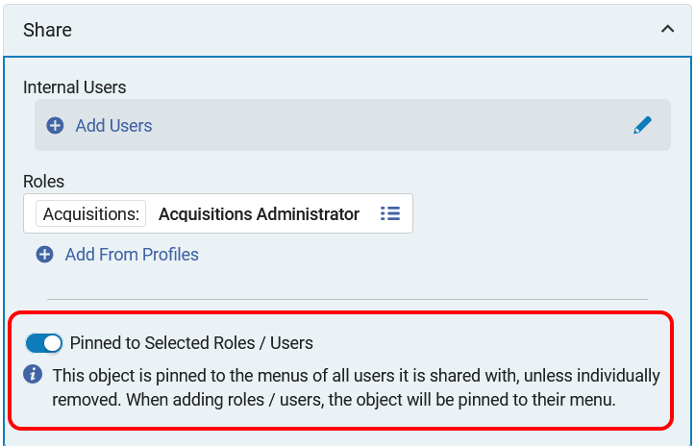
Pin Analytics objects to Selected Roles and Users CONTINUED
In this example, toggling “Pinned to Selected Roles/Users”, pins that specific Analytics Object for all users with the Acquisitions Administrator role.
  The object is pinned to the menu of all users it is shared with, unless individually removed by that user.
  When roles or users are added, the object will be pinned to their Analytics menu.
  Users are able to remove pinned items that were shared by an administrator.
  Below is an image (left) of the toggle enabled and an image (right) of the Alma Analytics Object List that shows the “Active Block Report Widget” pinned for this user by the administrator.
[Image Description: The "Acquisitions Administrator“ role is selected. The "Pinned to Selected Roles / Users" toggle is enabled and is highlighted with a red rectangle. ]
[Image Description: The "Active Block Report Widget" is highlighted with a red rectangle. A red arrow is pointing to the purple "Pinned to menu" indicator.]
Notes:
(Martin)
The object is pinned to the menu of all users it is shared with, unless individually removed by that user.
Additionally, when roles or users are added, the object will be pinned to their Analytics menu.
As noted above, users are able to remove pinned items that were shared by an administrator.
Below is an image (left) of the toggle enabled and an image (right) of the Analytics Object List that shows the “Active Block Report Widget” pinned for this user by the administrator.
It shows up in their Analytics Object List with the purple “Pinned to menu” indicator.

Slide 30
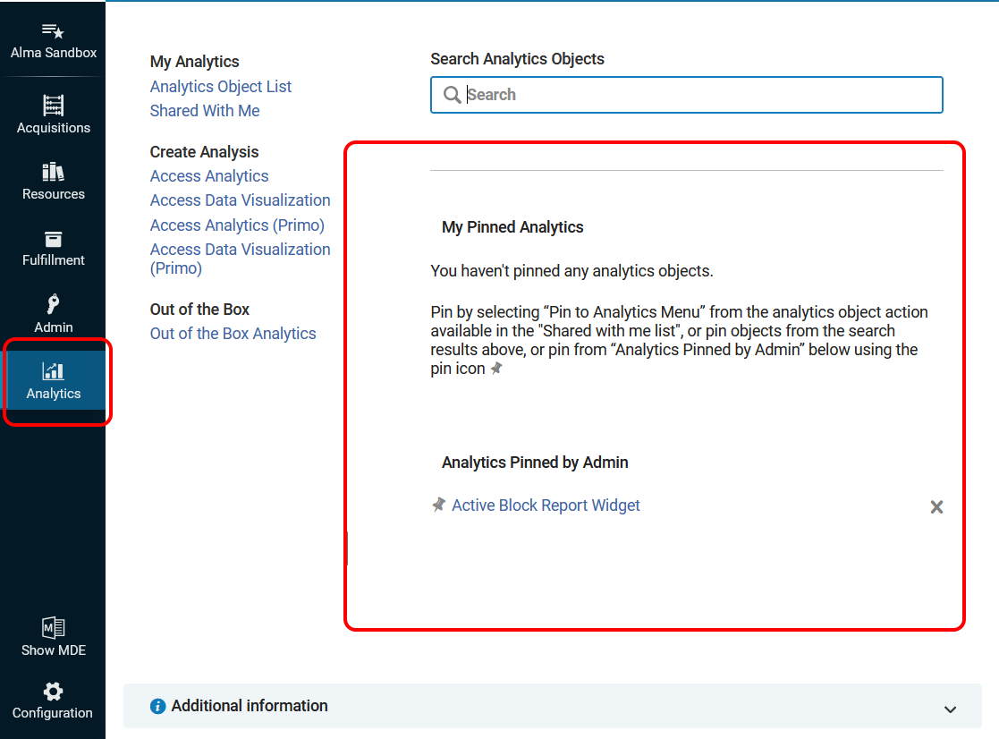
Pin Analytics objects to Selected Roles and Users CONTINUED 2
Below is an image of the Alma Analytics menu that shows the new sections for pinned objects.
  The Analytics Object titled “Active Block Report Widget” has been pinned for this user.
  To unpin it, you would click the small X to the far right of the Analytic object name.
  To move the pinned object to the “My Pinned Analytics” section, click on the thumbtack icon that is found immediately to the left of the Analytic object name.
[Image Description: Alma Analytics menu with the new "My Pinned Analytics" and "Analytics pinned by Admin" sections highlighted with a red rounded rectangle.]
Notes:
(Martin)
Below is an image of the Analytics menu that shows the new sections for pinned objects.
You see that the Analytics Object titled “Active Block Report Widget” has been pinned for this user.
To unpin it, you would click the small X to the far right of the Analytic object name, “Active Block Report Widget”.
To move the pinned object to the “My Pinned Analytics” section, click on the thumbtack icon that is found immediately to the left of the Analytic object name, “Active Block Report Widget”.
I will now hand it off to Jessica…

Slide 31
Multi-Factor Authentication (MFA) for Alma Login
IZs can now enable Multi-Factor Authentication (MFA) for users who sign in to Alma with a local-to-Alma login.
  Username and password are both stored directly in Alma
  Not for users authenticating with single sign-on systems
Relies on the email address in the Alma user record to receive a message (Alma Letter) with a link to log in.
Three configuration options in: Configuration Menu > User Management > General > Other Settings > mfa_for_alma_hep
  none - the default; means it is disabled
  suggest – Alma recommends MFA every time user logs in; allows the user to choose to opt in/out to MFA
  force – all users will be forced to use MFA and log in with a link received in email
Notes:
(Jessica)
You can now enable Multi-factor Authentication (MFA) for users who sign in to your Alma IZ with a local Alma login. This is where the username and password are both stored directly in Alma. it is known in Ex Libris’ documentation as a login that uses the “Ex Libris Identity Service.” This new feature only applies to Alma logins and is NOT for single sign-on authentication methods using OpenAthens or your campus identity service provider.
This feature relies on the email address in the Alma user record because, when it is enabled, Alma will send the user an email with an Alma Letter that contains a link they must click through to log in to Alma.
There are three options for this feature:
None - the default, which means the setting is OFF
Suggest multi-factor authentication – this allows users to choose to enable MFA or not. They are prompted each time they log in to Alma with a small reminder box and given the opportuning to Enable it. Once enabled, anytime a user logs into Alma with their credentials, they will see a message telling them a link was sent to their email address and they should click the link to sign in. Under this “suggest” model, users can also opt back out of MFA using a checkbox in their Alma user record.
Force multi-factor authentication – this option forces all users signing in with a local-to-Alma login to receive the MFA email in order to sign in to Alma
The Ex Libris documentation https://knowledge.exlibrisgroup.com/Alma/Product_Documentation/010Alma_Online_Help_(English)/090Integrations_with_External_Systems/060Authentication/Ex_Libris_Identity_Service#Recommending_MFA
on this new setting walks through the user’s experience for both the “suggest” and the “force” options with handy pictures!

Slide 32
Considerations Before enabling Multi-Factor Authentication (MFA)
How many and what kinds of users will be affected?
  Does not affect single sign-on
  Will affect any Backup Administrators in your IZ
  Will affect all CARLI Staff
The email address in the user record must be correct in order for the user to receive the login link.
  PLEASE DO NOT ENABLE this setting in our shared Sandboxes
The email is sent by Alma Letter (Login Using One Time Token Letter); email configurations must be working with Alma; may wish to customize the Letter and addressFrom email address.
If you do decide to investigate this feature in your IZ, start with “suggest” to see how it works and coordinate with some staff for hands-on testing.
Notes:
(Jessica)
In general, more security and more layers of authentication are A Good Thing. However, there are some important things to consider BEFORE enabling this new feature:
First: How many of your staff users will be affected? If your library staff primarily log on to Alma via single sign-on, this will not have much benefit. But, if you do not have single sign-on for accessing Alma, it will affect your staff. Keep in mind it will also affect any local Backup Administrator accounts that your library has in case your single sign-on system goes down. And, it will also affect all CARLI staff (vut that’s ok, don’t worry, we keep our own email addresses up to date!) All that to say, consider your user base first.
Next: The email address in the user record must be kept up to date. Therefore, DO NOT turn this on our Premium Sandboxes as those users do not have accessible email addresses!
Also, keep in mind that the link to sign into Alma is sent by an Alma Letter, specifically the Login Using One Time Token Letter. If there is an issue with your staff or users receiving email from Alma, or Alma emails are sent to Spam or Quarantine, this may prevent them from logging into Alma. Also, you may wish to customize this letter, including the addressFrom address, which comes with the default Your.Department@organization.com
Finally: If you do decide to investigate this feature in your IZ, CARLI recommends starting with the “suggest” level and then coordinate some hands-on testing with your staff before making any final decisions.

Slide 33
Primo VE
Two Primo VE Items
Support Bulk Export of All Search Results
Improvements to Linked Data
  Improved display of thumbnails
  Link to copyright information on person page
Full Primo VE Release notes can be found at:
  https://knowledge.exlibrisgroup.com/Primo/Release_Notes/002Primo_VE/2024/010Primo_VE_2024_Release_Notes?mon=202408BASE

Slide 34
Primo VE – Bulk export of search results
Support Bulk Export of All Search Results
Uses can now export all (or almost all) search results
  Limit of 5,000 records exported from local searches
  Limit of 10,000 records when using a blended search that includes CDI records
User must be signed into Primo VE to use
Export formats of Excel/CSV, RIS, or BIBTEX only
Not supported on mobile devices
Functionality enabled by default
  Disable from Brief Record Display tab - clear the Enable Export All option check box.
Labels may be changed. See Primo VE release notes for all label codes.

Slide 35
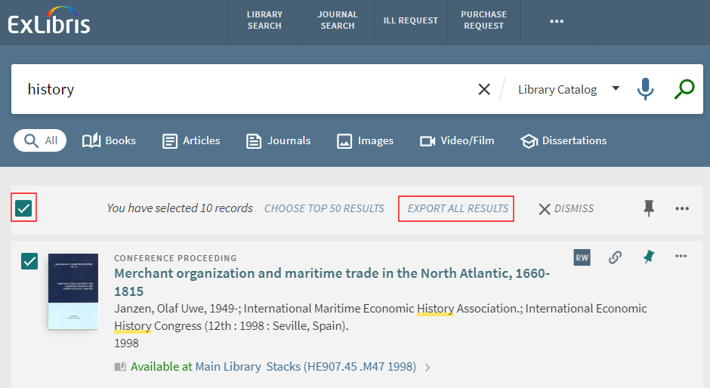
Primo VE – Bulk export of search results continued
When a user is logged in and has performed a search in Primo VE, select at least one search result. The new option of "Export All Results" will appear at the top of the results list. Click on the link to display options.
[Image Description: Screen capture of Primo VE search results with new Export All Results option highlighted]

Slide 36
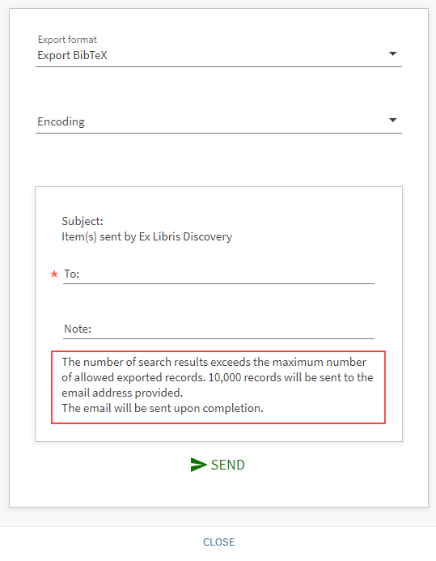
Primo VE – Bulk export of search results continued 3
After clicking "Export All Results" user then chooses export format, encoding, and email address for results.
A warning is also displayed about the maximum number of results that will be sent.
[Image Description: Screen capture of search results email options, including format, email address, and warning about records]

Slide 37
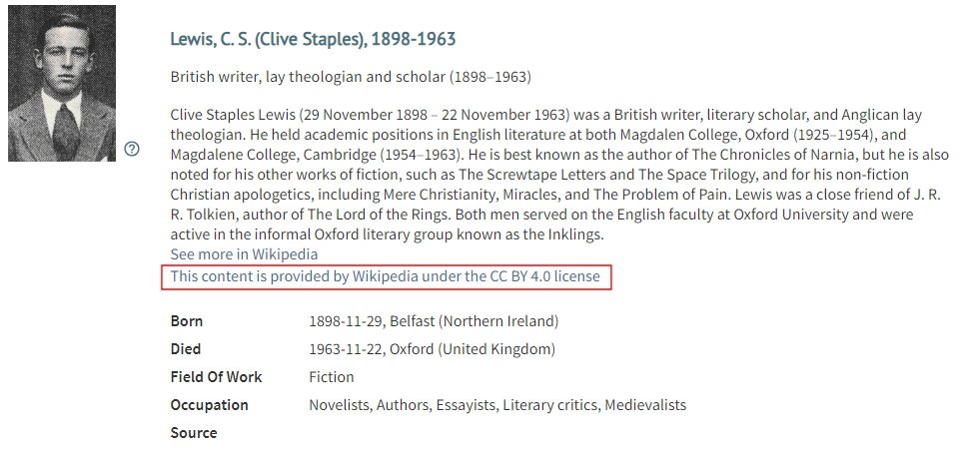
Primo VE – Person Page Linked data improvements
Improved thumbnails
Link to copyright information on Person page
[Image Description: Screen capture of C. S. Lewis person page from Primo VE]
For more information about the Person page, see Ex Libris documentation:
https://knowledge.exlibrisgroup.com/Primo/Product_Documentation/020Primo_VE/Primo_VE_(English)/150End_User_Help/Searching_Linked_Open_Data_-_Person_Entity#Person_Page

Slide 38

Q&A
Questions?
[Image description: A fuchsia long stem flower grows next to a white wall.]
Notes:
That completes our formal presentation. Now we’ll open the floor to your Questions! Feel free to unmute your microphones or type into the Chat.

