Slide 1
I-Share Alma Primo VE Office hours will start shortly
Welcome!
Office Hours will start at 2pm and run until 3pm.
Please mute your microphone.
Your questions will be answered during the presentation. To ask a question or comment, use the chat. If you’d like to get on the microphone, use the “raise hand” reaction, and we will ask you to unmute.
This session will be recorded and made available on the CARLI website.
Notes:
<Turn on captioning.>
<Click Record.>
Hello and welcome to the March 2024 Alma Primo VE Office Hours! Ted Schwitzner and I, Marisa Tolbert, will be your co-hosts for today’s session.
The structure for this month’s Office Hours is slightly different from what you are accustomed to, if you direct your attention to the third paragraph in blue text on this screen that reads: Your questions will be answered during the presentation. To ask a question or comment, use the chat. If you’d like to get on the microphone, use the “raise hand” reaction, and we will ask you to unmute. Let’s all practice this right now. Locate the Reaction button on the bottom of your screen and click it, then select “raise hand.” Great! Now, to lower your hand click on the text/button that says, “lower hand”. Looks like everyone has got the hang of it.
This is a deviation from the standard procedure during Office Hours where we save Q & A/Questions & Answers until the very end. My colleague, Ted Schwitzner and I are running this as a discussion because we have three sets to cover, and we understand there may be a lot of questions along the way. Please do interact with us throughout the presentation – myself, Ted, and the CARLI staff that are on this call will answer your questions.

Slide 2
Back 2 P2E Clean-up
Alma/Primo VE Open Office Hours
Date
Notes:
In today’s Office Hours we are covering, “Back 2 P2E Clean-Up.” You may recognize images throughout the presentation from pop culture movies and TV shows that are about time travel. This is intentional as we will be traveling back in time together focused on the P2E process and recommended clean-up from migration to your current Alma and Primo VE environments. Rest assured; we will not be traveling at light speed.

Slide 3
Today’s Agenda
Upcoming Events and Announcements
Overview, History, Context, and Discussion of P2E sets in your Alma IZs
Notes:
But first, let’s look at Today’s Agenda. We will be sharing upcoming events and announcements. Then, we will dive into overview, history, context, and a discussion of P2E sets in your Alma Institution Zones aka IZs.

Slide 4
Upcoming events
CARLI Calendar
https://www.carli.illinois.edu/calendar/2024-03
Wednesday, March 20 - EBSCO Experience Manager, New EBSCOhost interface and EBSCO Admin
Every Wednesday in March - OER Grants Weekly Office Hour
March 15, 19, 25, 27 - Professional Development Alliance (PDA) Events
Wednesday, March 21 - Shared Serials Storage! A WEST Information Session
Notes:
Here are a few CARLI calendar events listed, you can also access the CARLI calendar from the link being provided in chat. This month there is an EBSCO Experience Manager webinar on the new EBSCOhost interface and the EBSCO Admin module;
every Wednesday this month are the weekly OER Grants Office Hours;
there are four upcoming Professional Development Alliance events aka PDA with one occurring tomorrow;
and there is an information session on the Shared Serials Storage from WEST.

Slide 5
announcements
Ex Libris Users of North America (ELUNA) annual conference, Developer’s Day, and Knowledge Days registration is live
https://el-una.org/meetings/eluna-2024-annual-meeting/
Notes:
We have one announcement. Registration for the Ex Libris Users of North America or ELUNA Annual Conference and related events are now live. You can register at the link in the chat.

Slide 6
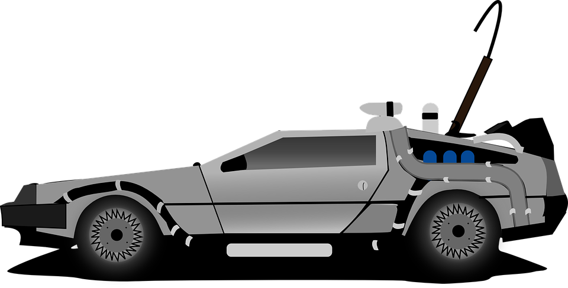
Back 2 P2E Overview
What is/was “P2E”?
What is there to clean up and why?
What are the sets in my IZ and why?
The DeLorean time machine from the movie, Back to the Future.
This Photo by Unknown Author is licensed under CC BY-NC-ND.
Notes:
Alright, now we will get into our DeLorean time machine and go “Back to the Future” into P2E Overview. Right now, you might be asking yourself “What is P2E?” if you were not around at the time of your library’s migration from Voyager or your former ILS or if you were working in your library at the time of migration, you might be asking yourself “What was P2E?” P2E is an acronym for Physical to Electronic and is the process where you or someone at your library supplied Ex Libris with a file containing Bibliographic IDs for items in your library that were records for physical items being transformed to records for electronic items once in Alma. More about these records will be discussed shortly.
You may be also asking yourself “What is there to clean up and why?” Currently, each IZ has one to three sets. These sets in Alma are Bibs with no inventory, Physical items with an ER location, and Electronic portfolios standalones. We will be describing the types of records found in these sets in a moment and why you will want to review and clean them up.
You may also be asking yourself “What are the sets in my IZ and why?” Each IZ is going to be different as to which of these sets is there and how many records are in each. Some of this has to do with procedures your library has when dealing with these types of records, some of it may have to do with turnover and information getting lost in the process, and some of it may have to do with this clean-up work being lower in priority. Whatever the reason, we are here to help guide you.

Slide 7
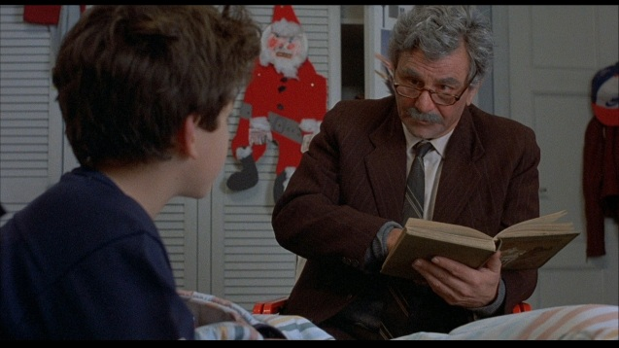
Back 2 Bibs with no inventory
P2E scenarios and their orphaned bibs
Bound-withs
The scene in Princess Bride when grandpa is reading to the grandson.
This Photo by Unknown Author is licensed under CC BY-NC-ND.
Notes:
Our first set to discuss is Bibs with no inventory. Here we have the scene from Princess Bride where the grandfather is reading the story to his grandson. Like the grandfather is trying to preserve the story and art of storytelling, this set also is about preservation in libraries and the applicable procedures with relation to bound-withs which Ted will be discussing shortly. First, I will cover a few scenarios that could have resulted in Bibs with no inventory post P2E.
In the first scenario, at the time of migration and P2E, a library had only bib records for their e-resources in the catalog because having an 856 and the bib were thought to be sufficient. These records would still be present, if the library did not include bib record IDs for these bib-only records in their P2E file.
In the second scenario, the library had a bib record for an e-item reserve. Voyager had a not-so-savvy way of hosting URLs for e-items. If these records were present and were not listed in the P2E file, the bib could be in Alma with no inventory.
In the third and final scenario, a library may have gone through and cleaned up portfolios through deletion. However, when doing these deletions was timid about selecting the “Are you sure you want to delete this record with no other inventory?” and subsequently the library is left with a bib that has no inventory. Additionally, your library could have cleaned up portfolios and/or deleted those with CZ or NZ bibs. Bibs from the CZ and NZ can be sticky in the IZ, and it is possible that there are some orphan bibs hanging around from this. If a sticky CZ or NZ bib is the case, these can be copied to catalog and deleted, or you can delete these by a job.
Before Ted speaks about bound-withs, are there any questions?

Slide 8
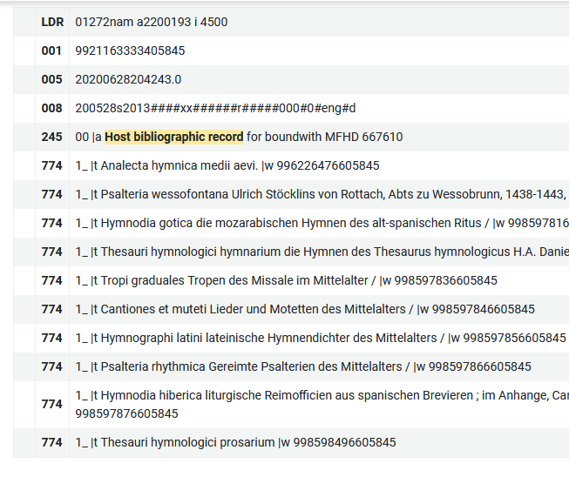
Back 2 Bibs with No Inventory: Bound-Withs
Finding records involved in Bound-Withs
  Look at the set “Bibs with no inventory”
  Compare with host bibliographic records
  CARLI shared analysis, “Bibs with 774 data - bound withs and host bib records”
Making records involved in Bound-Withs easier to find (and keep)
  Add data pointing back to the host record: 773 Host entry note
  Add a note (501 or 591) “With” note for public display
  Use the 774$w IDs to create a set of Bibs used in Bound Withs.
A sample "bound-with" host bibliographic record with 10 component titles.
Notes:
Those are some reasons why bound-withs might exist in your catalog. Let’s look at ways to identify if the bibs with no inventory are involved in bound-withs.
The Bibs with No Inventory is your starting point, and you may find it useful to export the set into Excel so that you can have the record IDs handy. Next, you’ll find and review the bound-with records themselves.
These records have a 245-title field that begins with the words “host bibliographic record for boundwith.” These words are followed by either “MFHD or “item barcode” and finally a number. In each host record, there will be two or more 774 fields, which indicate the constituent parts of the whole item represented by the host record. Each 774 will contain the title and the MMS ID for another record. You may use these data points to compare back to records in the Bibs with no Inventory set.
If looking at individual records isn’t your thing, you may also use the analysis, “Bibs with 774 data – bound withs and host bib records.” This report is available from Shared Folders > CARLI Network >Resource Management, and it provides the same title and record ID data as the host records. You might find it useful to process this report in another tool, like Open Refine, in order to have a clean list of titles and MMS IDs that may be compared to the set. One could even take the list of 774$w MMS IDs and create another bibliographic record set.
Once you have found these records, you’ll want to make it easier to find them again. Adding some notes to these bibliographic records will help make it clear why they remain in the catalog. Fields such as the 773 host entry note, or the 501 with note will assist patrons and other staff in seeing the relationships between records. If you decide to clean these records up in the future, these notes may also remind you of other loose ends.

Slide 9
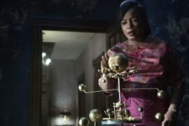
Back 2 Physical titles with ER location*
*This set applies to Voyager Migration Libraries only.
VOYAGER LOCATIONS to ALMA LOCATIONS
Bib records for print that had 856 field and/or a URL in other fields
Alma locations with a mix of electronic resources and physical items, Ex: “migration e-review”
Hippolyta in the show, Lovecraft Country with Hiram’s Orrery – a key to the time machine.
This Photo by Unknown Author is licensed under CC BY-SA-NC
Notes:
How’s everyone doing so far? If you feel like sharing, you can use the chat to type or select an emoji to share a reaction.
In this next set, we will discuss Physical titles with ER location. ER stands for electronic resource. Please note that this set is only applicable to the libraries that migrated from Voyager to Alma in 2020. So, if you are a library that migrated post-2020 from a different ILS, you can sit this one out.
On this slide, you will see an image from the show Lovecraft Country where Hippolyta is attempting to figure out Hiram’s Orrery which holds the key to the time machine. Remembering how we cataloged items in Voyager is the key to opening our memories on how this differs in Alma.
When we went from Voyager to Alma, there were some records that contained a print format and an electronic format on the same record. Your library may have created a unique location called ereview, migration e-review, or something similar to group these records together for later review and clean-up. This group may also contain an 856 or another field with a URL to the content the record was describing. Cleaning these up will help reduce dead links, clutter in your IZ, and help make collection description analytics more accurate.
Ted will explain further.

Slide 10
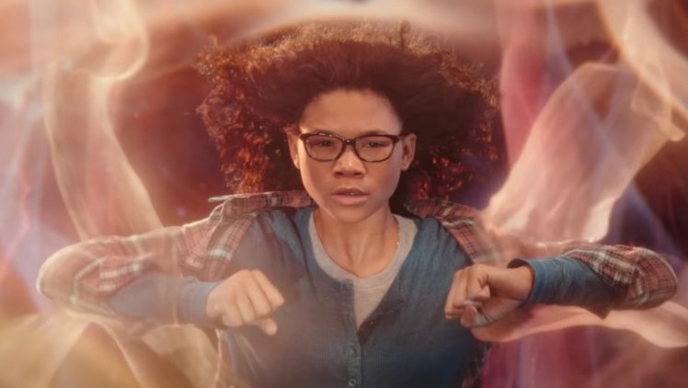
Back 2 Electronic portfolios standalones
Checking for record duplication
Checking that access and entitlements are correct
Government Documents
Meg from the movie, A Wrinkle in Time traveling through multi-dimensions.
This Photo by Unknown Author is licensed under CC BY-NC
Notes:
In the third and final set, we are discussing Electronic portfolios standalones. The character, Meg from the movie, A Wrinkle in Time is pictured here while traveling through multi-dimensions. There are also multiple dimensions or reasons as to why your IZ has electronic portfolios standalones. These standalone portfolios, may reflect portfolios you already have active in an electronic collection or portfolios that need to be linked to an already active electronic collection, so checking for duplication is good housekeeping for reducing clutter in your IZ and multiple links showing. These standalones may also reflect portfolios for entitlements you had in the past but have since cancelled or lost access to that potentially will lead to dead links in Primo VE. The standalone portfolios may also represent Government Documents. If your library is a government document repository, you have probably noticed that the community zone/CZ collection for Government Documents is unreliable and messy. Many of your libraries may have a higher count in this set due to having to catalog your own individual gov docs to account for what you and your patrons have access to.
Ted will say a little about government documents, but before he does are there any questions?

Slide 11
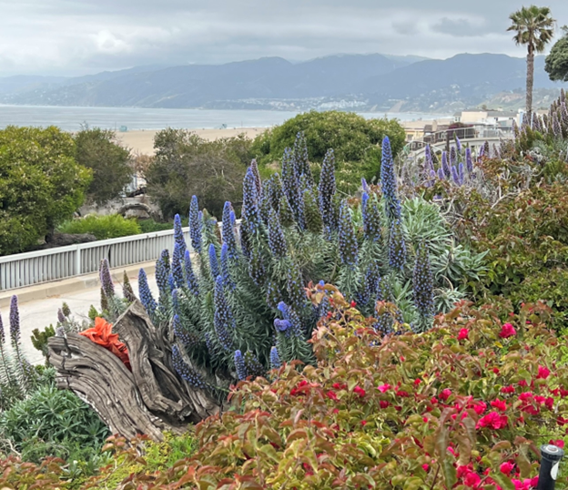
CARLI DOCUMENTATION
Cleaning up P2E
https://www.carli.illinois.edu/products-services/i-share/electronic-res-man/p2e-cleanup
How-To Withdrawing Inventory and Deleting Records
https://www.carli.illinois.edu/products-services/i-share/physical-res-man/withdraw-delete
Follow up questions and/or concerns?
Email support@carli.Illinois.edu.
Springtime in Santa Monica, CA
Notes:
We have made it through all three sets—while giving an overview, history, and context of each. We have also had great discussion of the P2E process and its implications--one to four years since your migration to Alma and Primo VE. We have learned some things in that time and hope that from today’s session you are better prepared to tackle these sets in your Alma IZ. An email will be getting sent out to the I-Share Liaisons, Tech Services Interest Group, and E-Resource Contacts about what was covered in today’s Office Hours. So, if you have colleagues that could not attend today, but this is work they are responsible for there is a forthcoming email as well as a recording of this session. Before wrapping up, we want to share a couple links to CARLI’s documentation pages and ask if there are any last questions or comments.
<stop recording>

