Slide 1
I-Share Annual Statistical Package: Find the Right Report
Alma/Primo VE Open Office Hours
January 26, 2024
Notes:
(Ted)

Slide 2
Today’s Agenda
Announcements
I-Share Annual Statistical Package
Open Q&A
Notes:
(Ted)

Slide 3
Reminder: Premium Sandboxes Refresh
Premium Sandboxes (PSB) Refresh – February 2024
Refresh will occur on February 11 as part of Alma quarterly release update
After the refresh CARLI staff will prepare the sandboxes for use
Refreshing the user accounts
Configuring AFN between the sandbox IZs
Watch for an announcement from CARLI once the sandboxes are ready for use again in February.
If you are currently using the PSB for testing be aware that any examples you’ve set up will need to be recreated after the refresh.
More information on the PSBs
Notes:
(Ted) CARLI’s six Premium Sandboxes were refreshed on Sunday, August 8 as part of the Alma monthly release updates. The Sandboxes are refreshed twice a year in February and August. If you are doing any current testing in the sandboxes, you will want to either finish up your work by the end of January, and/or document how to re-create your testing scenarios after the sandboxes are refreshed. Following the refresh on February 12, the CARLI Office staff will refresh the generic user accounts and perform some configurations so that AFN will work between the six Sandbox IZs, and send an email to let you all know when the sandboxes are again available for use.

Slide 4
I-Share Annual Statistics Package
Finding the Right Report
Notes:
(Ted) Let’s move now into today’s topic, the I-Share Annual Statistics Package: Finding the Right Report. If you’ve been around CARLI for a while, you might be aware that we typically share a lot of information about these reports when they are generated in July of each year. However, we typically receive support requests for these data throughout the year, as institutions have many reporting obligations with different requirements and deadlines. Whether you may be answering IPEDS or ACRL, replying to the ILLINET Interlibrary Loan survey, or just providing data on your collection to your institutional research department, these reports provide statistical snapshots of your institutions’ I-Share data.

Slide 5
Today’s Outcomes
Introduction and Background: The 5 W’s of I-Share Annual Statistics
What & When: Circ & AFN stats
What & When: Collection and Electronic Collection stats
How & Where: Report Download Locations
You & Why: Report Descriptions and Mapping to Surveys
Notes:
(Ted) Here’s a quick look at our goals for today’s presentation. We’ll start with some background on the stats package, then begin to highlight the reports that might best answer your pressing survey needs. We’ll cover how to retrieve your reports when they’re generated, talk about how you can learn more about each report in the package.

Slide 6
The 5 W’s of I-Share Annual Statistics
Why: Libraries have many reporting needs
Who and How: CARLI Staff
CARLI automated scripts and APIs
What: 29 reports covering Fiscal/Academic Year ending June 30, 2023
When: Reports generated on July 1* or July 16
* Reports for institutions with a different fiscal calendar run differently
Where: 22 reports shared to libraries’ secure FTP folders
10 reports posted to CARLI website
I-Share Statistical Package folder in Analytics
Notes:
(Ted)
The reports in the I-Share Statistics Package have grown over the history of I-Share as a platform. In fact, many of the report definitions are historically rooted in the questions that used to be asked by survey agencies, as well as the ways in which previous I-Share platforms recorded data. Since coming onto Alma, we’ve been focusing on learning to leverage the analytics system to make sure our data comparisons to the past are reasonable, that is comparing apples-to-apples, but also making sure that data are accurate and identifying the sources of discrepancies. Later on, we’ll talk about how we’re planning to update the package to better answer the questions that libraries see on surveys in the present.
Collectively, CARLI staff work on 29 reports in total. Some reports are generated and distributed automatically by scripts, while other reports are generated and compiled by hand. As noted, these reports are typically created each July in conjunction with CARLI’s new fiscal year. If your institution has a different fiscal calendar, we work to time report creation and delivery to those dates. Most of these reports are shared directly to members via the secure FTP server, files dot carli dot Illinois dot edu; in fact, many of these same reports have versions that get generated monthly as well. A separate set of reports, which tend to be consortium-level analyses and comparisons, are posted exclusively to the CARLI website. Along with the reports that are distributed in Excel or text formats, we provide as many of the definitions as possible in the CARLI Network folder of Alma Analytics.

Slide 7
Circulation and Automated Fulfillment- FTP Directory
Circulation Files uploaded to your CARLI FTP directory:
I-Share Circulation Stat 1: Circulation by Item Location at Time of Loan
I-Share Circulation Stat 2: Circulation by Circulation Desk
I-Share Circulation Stat 3: Circulation by User Group and Home Library
I-Share Circulation Stat 4: Serial Title Circulation and In-House Use
I-Share Circulation Stat 6: Circulation by User Group and Item Policy and Location at Time of Loan
AFN files uploaded to your CARLI FTP directory:
I-Share AFN Stat 1: Network Lending Counts (aka, Outgoing ILL)
I-Share AFN Stat 2: Network Borrowing Counts (aka, Incoming ILL)
I-Share AFN Stat 3: Titles Borrowed from Other I-Share Libraries
Notes:
(Debbie)

Slide 8
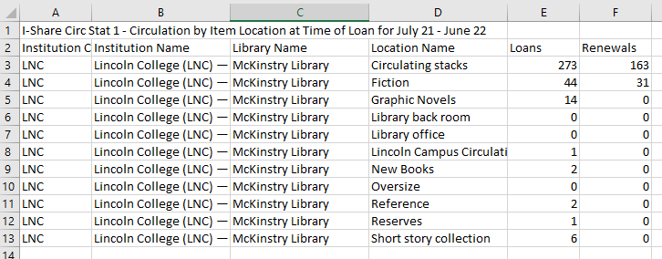
I-Share Circulation Stat 1: Circulation by Item Location at Time of Loan
Notes:
(Debbie)

Slide 9
I-Share Circulation Stat 2: Circulation by Circulation Desk
Notes:
(Debbie)

Slide 10
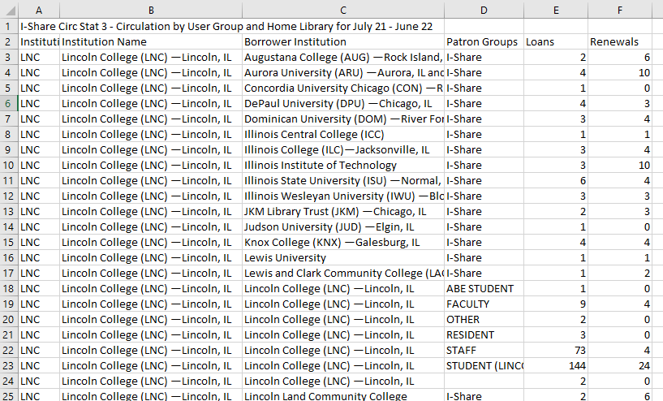
I-Share Circulation Stat 3: Circulation by User Group and Home Library
Notes:
(Debbie)

Slide 11
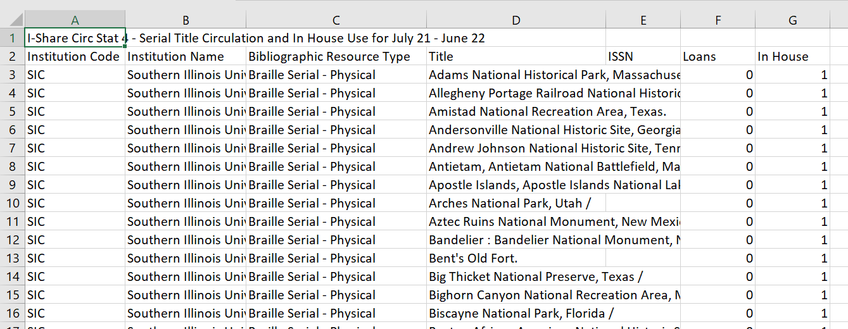
I-Share Circulation Stat 4: Serial Title Circulation and In-House Use
Notes:
(Debbie)

Slide 12
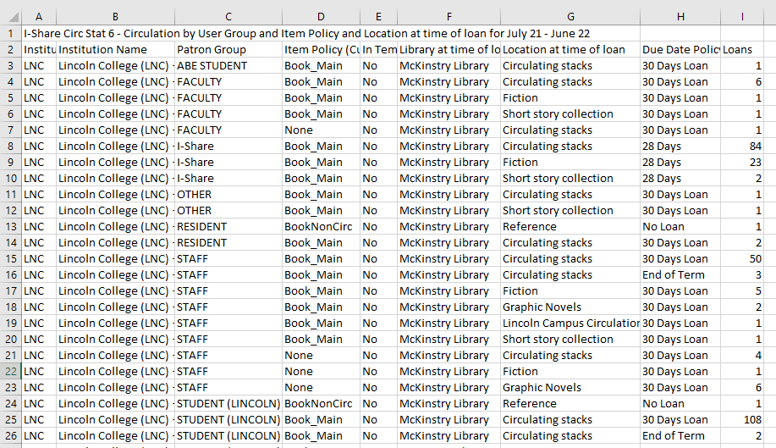
I-Share Circulation Stat 6: Circulation by User Group and Item Policy
Notes:
(Debbie)

Slide 13
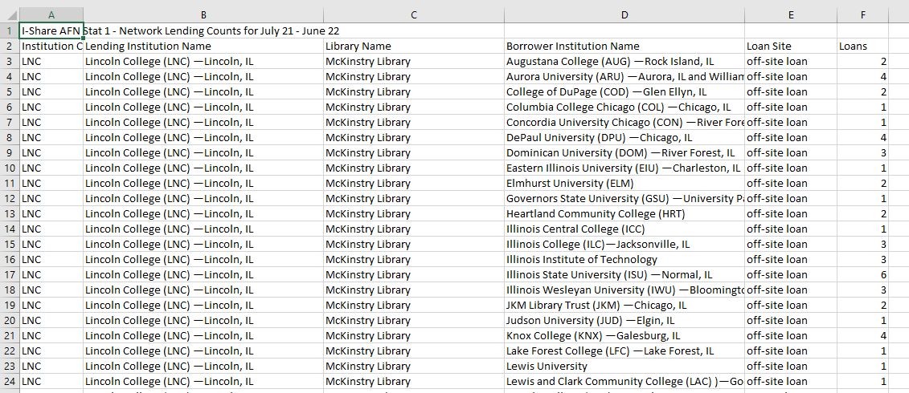
I-Share AFN Stat 1: Network Lending Counts (aka, Outgoing ILL)
Notes:
(Debbie)

Slide 14
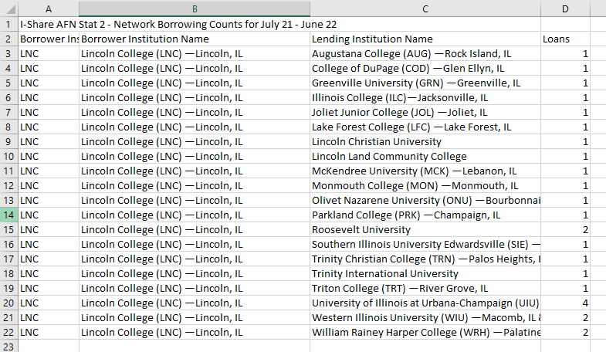
I-Share AFN Stat 2: Network Borrowing Counts (aka, Incoming ILL)
Notes:
(Debbie)

Slide 15
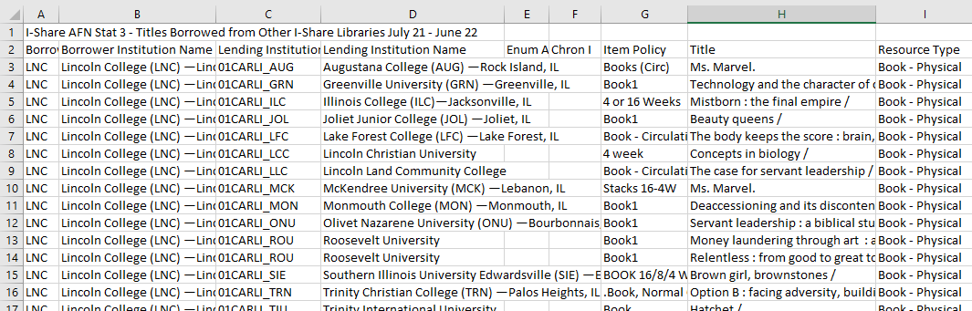
I-Share AFN Stat 3: Titles Borrowed from Other I-Share Libraries
Notes:
(Debbie)

Slide 16
Circulation and Automated Fulfillment- CARLI Website
Consortially collated statistics available on the CARLI website:
I-Share AFN Stat 1 FY 2023
I-Share AFN Stat 2 FY 2023
I-Share AFN Stat 4 FY 2023
I-Share AFN Stat 5 FY 2023
Library Patron Record Counts FY 2023
Borrowing and Lending Comparison FY 2023
Circulation Transactions Comparison FY 2023
Reciprocal Borrowing to I-Share Patrons FY 2023
Notes:
(Debbie)

Slide 17
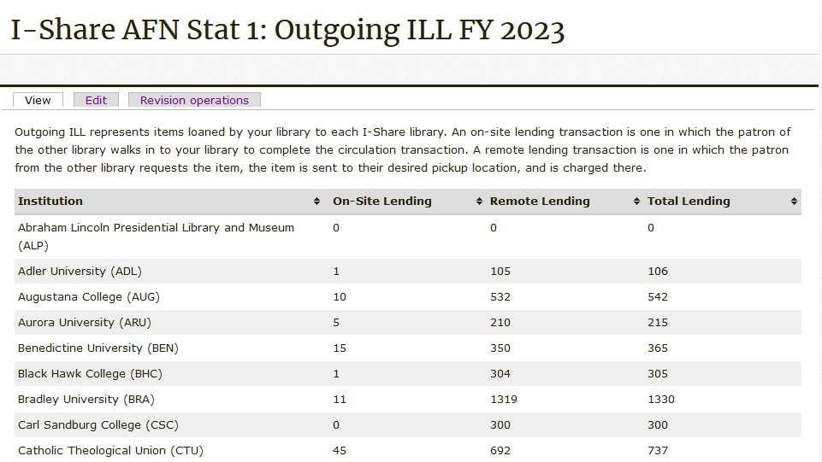
I-Share AFN Stat 1: Network Lending Counts
Notes:
(Debbie)

Slide 18
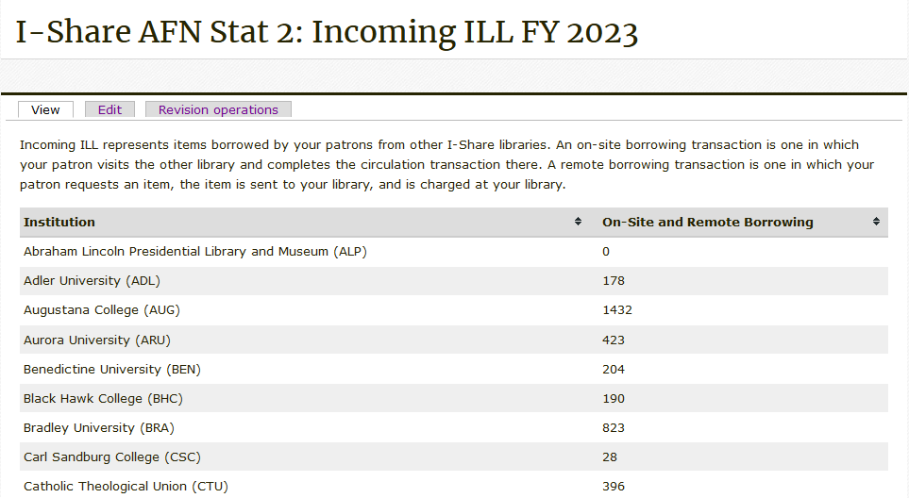
I-Share AFN Stat 2: Network Borrowing Counts
Notes:
(Debbie)

Slide 19
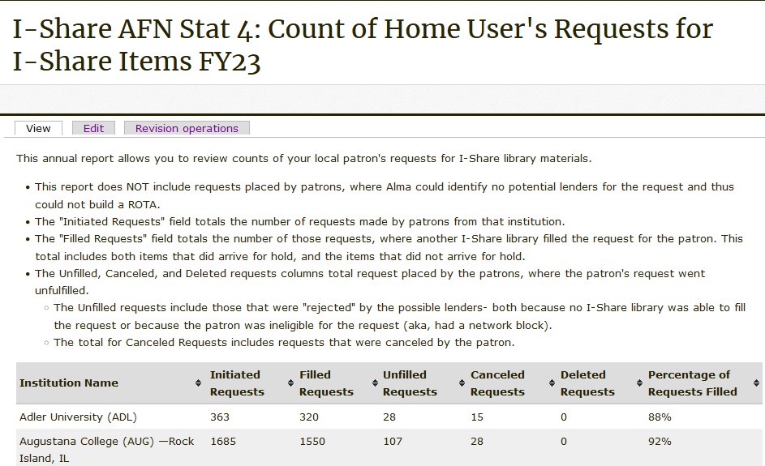
I-Share AFN Stat 4: Count of Home User's Requests for I-Share Items
Notes:
(Debbie)

Slide 20
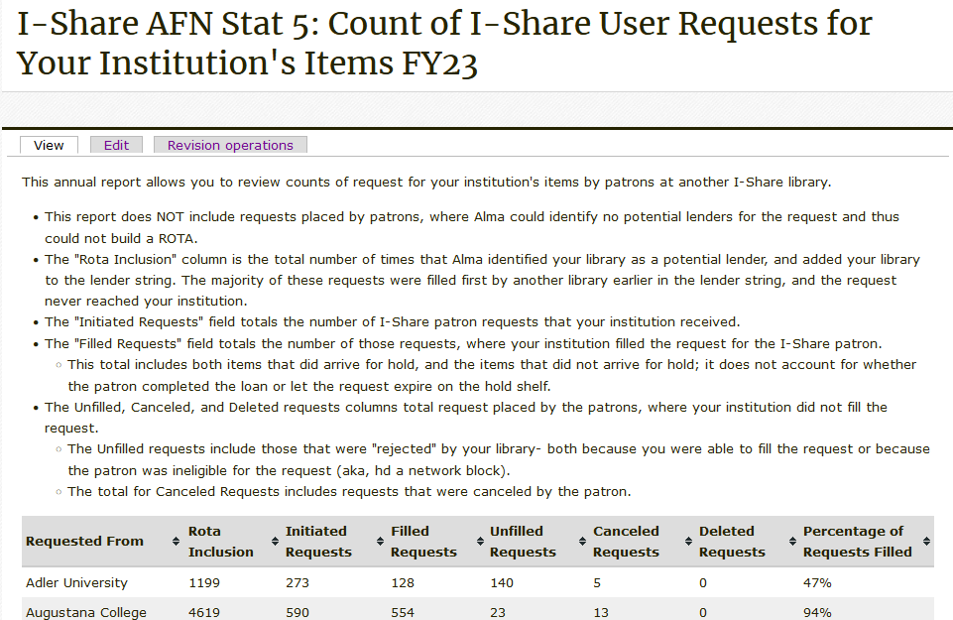
I-Share AFN Stat 5: Count of I-Share User Requests for Your Institution's Items
Notes:
(Debbie)

Slide 21
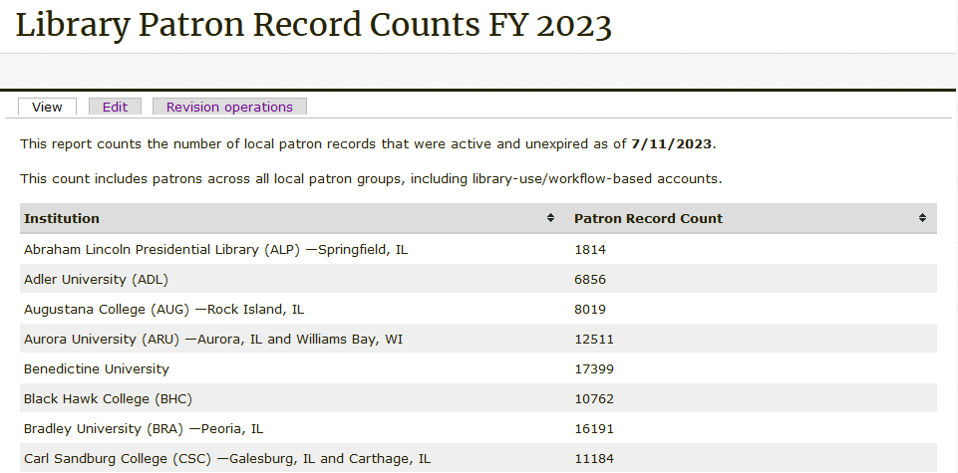
Library Patron Record Counts
Notes:
(Debbie)

Slide 22
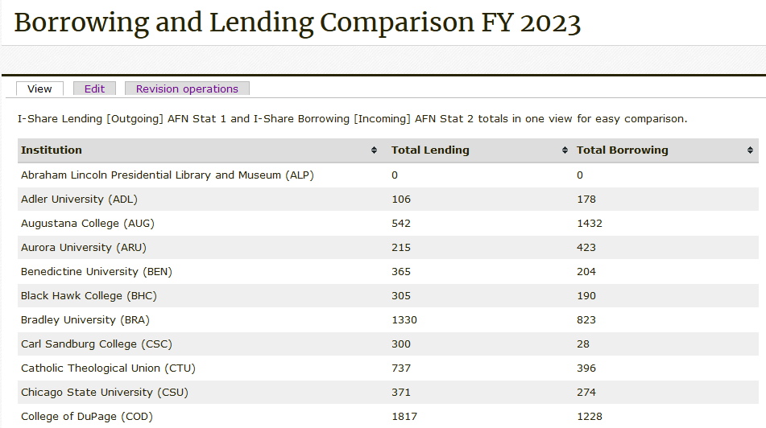
Borrowing and Lending Comparison
Notes:
(Debbie)

Slide 23
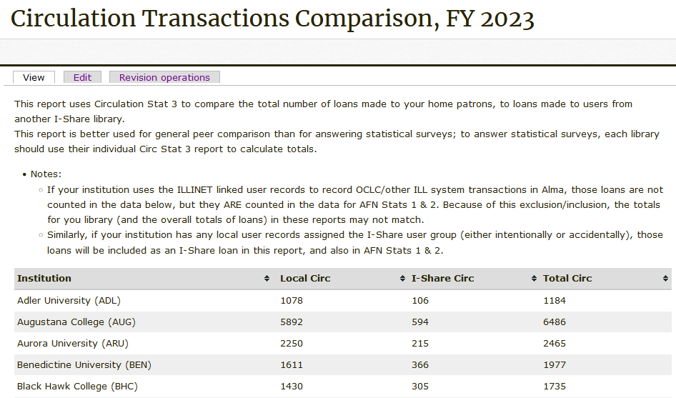
Circulation Transactions Comparison
Notes:
(Debbie)

Slide 24
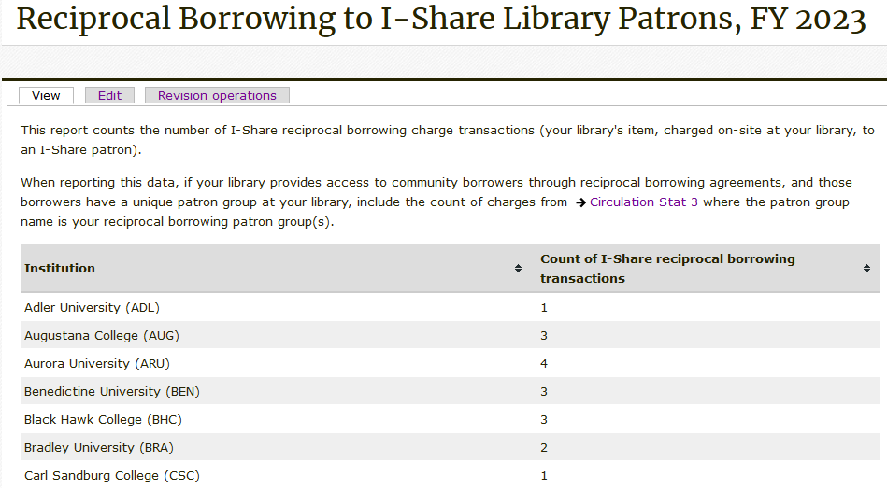
Reciprocal Borrowing to I-Share Patrons
Notes:
(Debbie)

Slide 25
Print Collections
Counts of items, holdings, and bibs in different perspectives
Most reports are snapshots
Collection stats 3 and 4, measuring collection changes, use date ranges
Reporting to Surveys
Item records approximate volumes: use Collection Stat 1 or 5
Bib records approximate titles: use Collection Stat 6 or 11
Notes:
Ted

Slide 26
Collection Stat 1: Item Count by Format and Location
Inventory snapshot
No of Items (In Repostory) is items in a location.
Notes:
Ted
Here’s a brief look at Collection Stat 1, which is an inventory snapshot of the items that you have present in each location. Collection Stat 1 does not account for suppression or any other conditions. If the lifecycle of the item is active, then the item is counted.

Slide 27
Collection Stat 5: Item Count by Location and Policy
Inventory snapshot
Count by item policy rather than bibliographic material type
Notes:
Ted
Collection Stat 5 is also an inventory snapshot, but rather than group items by location and bibliographic record material type, this report counts by location and item policy, which your institution may have defined more narrowly than bibliographic format.

Slide 28
Collection Stat 3: Fiscal Year Items Added by Format and Location
Count items added according to item record creation date
Does not include items withdrawn
Notes:
Ted
While we’re talking about item counts, we’ll look briefly at a report that might help you answer questions on the growth of your collection. Collection Stat 3 provides totals on the number of items added to each location according to the item record creation date.
As a bit of trivia, this is one of the few collection reports that looks specifically at the dates when records were created and/or modified, rather than a snapshot that is run on a specific date to capture data.
We’re sorry to say this doesn’t address items withdrawn from collections, so that you can get a true net change. That’s a challenge we haven’t quite solved yet.

Slide 29
Collection Stat 6: Title Count by Format
Counts bibliographic records active with physical inventory
Titles are not deduplicated
Notes:
Ted
Next up, we have Collection Stat 6, which is a title count snapshot report that you may use to respond to IPEDS and other surveys. This report is a basic count of all of the bibliographic records active in your repository *and* associated with physical locations. Titles are not deduplicated, and suppression or item statuses aren’t considered. Each record present and active is counted once, even if the title has holdings in multiple locations.

Slide 30
Collection Stat 11: Title Count by location and Resource Type
Counts bibliographic records active with physical inventory
Counts bibliographic record once for each location with inventory
Notes:
Ted
Collection Stat 11 is a refined variation on Collection Stat 6. At the basic level, it is also a title count that totals up active MARC records in your repository for physical resources. However, this report goes further in a few ways, as it was designed to help institutions that have multiple libraries with different reporting requirements, for example law libraries that operate separately from the main library.
With that in mind, this report shows the title count per each location where inventory is present. This report also takes into account whether bibs or holdings are suppressed. If your institution has a need to separate title counts by different operational groups, this report may be your better choice.

Slide 31
Electronic Collections
Counts of portfolios and collections available to your institution
Includes your IZ activations
Includes NZ activations shared to your institution
Reports are snapshots
Reporting to Surveys:
Digital/Electronic Books and Media: use Electronic Stat 4.
If you don’t duplicate electronic titles, you may use Electronic Stat 1 to report portfolios
Digital/Electronic Serials: use Electronic Stat 3: Unique E-Journal Title Report
CARLI Staff must run:
CARLI-Owned Ebooks Statistics
Electronic Stat 4: Unique Electronic Titles Deduplicated with Network
Notes:
Ted

Slide 32
Electronic Stat 1: Active Portfolios by Collection
No of Portfolios (In Repostory) is titles in a collection.
Titles are not deduplicated across collections
Report does not include NZ-shared electronic resources
Notes:
Ted
Here is a closer look at Electronic Stat 1, which provides a title count of electronic resources at the collection level. The copy of this report that you receive contains only the portfolios that are active in your institution zone. Details of collections shared from the network zone are found on the CARLI website, but they may also be viewed in the Analytics version of Electronic Stat 1.
This view also requires that you know a little more about what kinds of resources are in each collection. For instance, BMJ Journals is an electronic journal collection, but Filmmakers Library contains streaming videos.

Slide 33
Electronic Stat 4: Electronic Titles Deduplicated with Network
Electronic Resource Type is based on the bibliographic record data
Title count shows bib records deduplicated on title and author
Notes:
Ted
Here is a closer look at Electronic Stat 4, which provides a deduplicated title count of electronic resources that are active in your institution zone *and* that are shared to your institution from the network zone. NZ titles will include CARLI collections, open access titles, and if applicable to your institution, group collections like eRead Illinois.
The Electronic Resource Type column groups broader sets of Resource Types into the categories you see here.

Slide 34
How & Where: Report Download Locations
CARLI Files Server - Secure FTP (SFTP)
https://www.carli.illinois.edu/products-services/i-share/external-system/SSHSecureShell
Box.com
https://www.carli.illinois.edu/products-services/i-share/external-system/box-folders
Notes:
(Bradley)

Slide 35
How & Where: Report Download Locations - SFTP
When the statistics are run by CARLI staff, they are deposited as Excel files in the CARLI ftp account belonging to your institution.
The I-Share Liaison at your institution should know the username and password for your institution's CARLI ftp account. There is only one username/password per institution for the CARLI ftp account.
Files are deleted from the ftp directory after 60 days.
Additional Instructions for SFTP:
https://www.carli.illinois.edu/products-services/i-share/external-system/SSHSecureShell
Notes:
(Bradley)

Slide 36
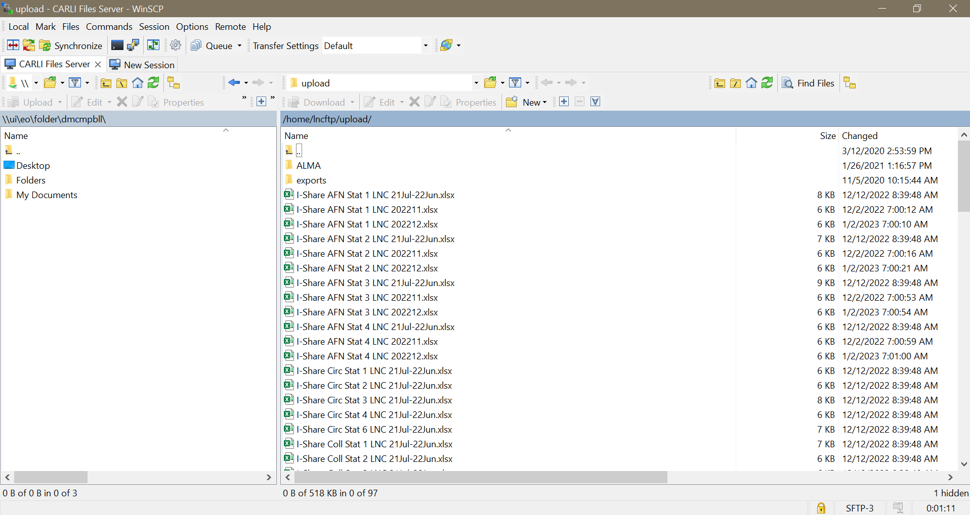
How & Where: Report Download Locations
Notes:
(Bradley)

Slide 37
How & Where: Report Download Locations – Box.com
Annual Statistics files are also deposited to your institution's shared folder on Box.com
CARLI provides each I-Share institution with access to a shared folder on the University of Illinois' Box.com file-sharing platform.
If your institution uses Box.com, you should have an account and login privileges through them. If not, you will need to create an account as an external user.
If you do not have access to your institution's Box folder, request access via support@carli.illinois.edu and copy your library's I-Share Liaison on the message.
Additional Instructions for Box.com:
https://www.carli.illinois.edu/products-services/i-share/external-system/box-folders
Notes:
(Bradley)

Slide 38
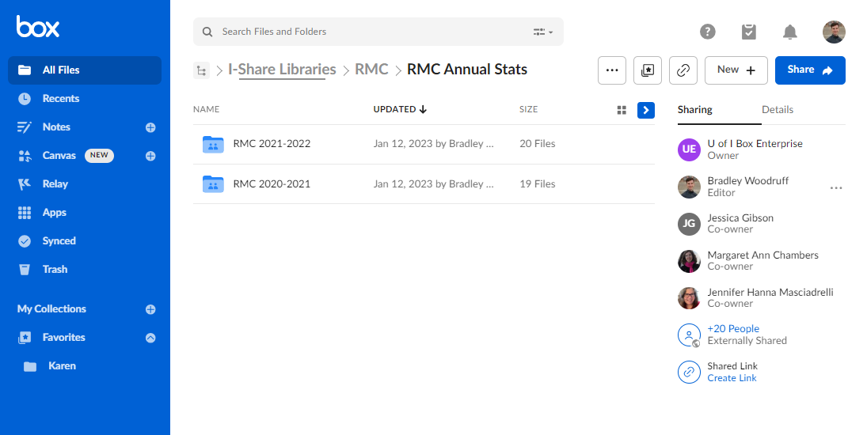
How & Where: Report Download Locations
Notes:
(Bradley)

Slide 39
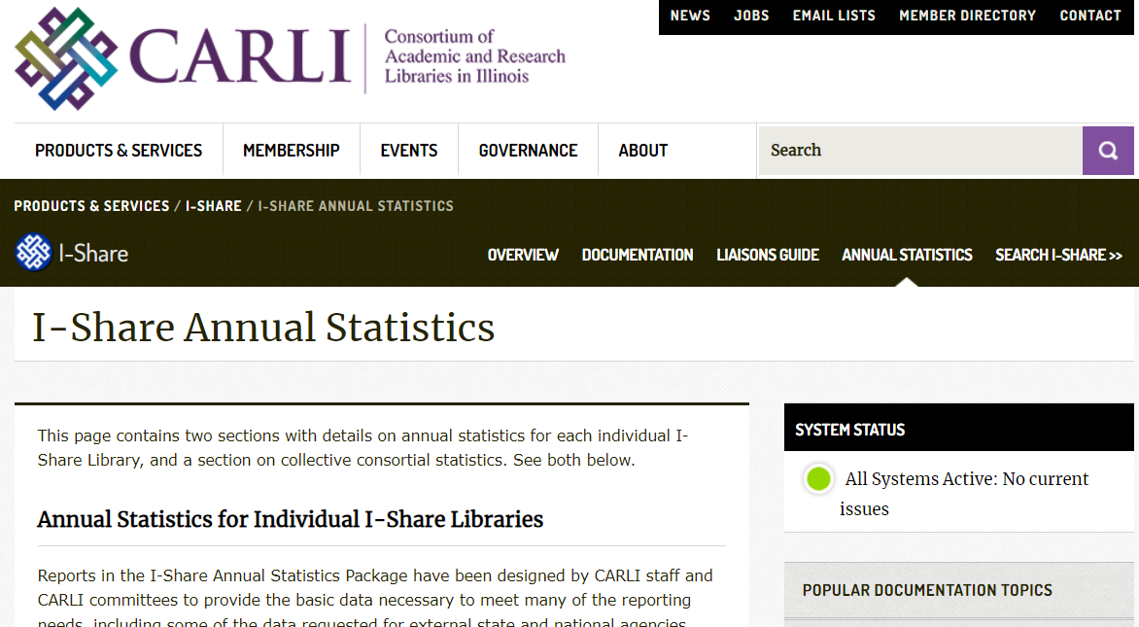
How & Where: Reports on the CARLI Website
https://www.carli.illinois.edu/products-services/i-share/stats
Notes:
(Bradley)
Some of the reports are run on a consortial level and are posted on the CARLI Web site. The I-Share Annual Statistics page contains links to the reports for the current year and past years. Share link: https://www.carli.illinois.edu/products-services/i-share/stats There also is a page that contains descriptions of the reports: https://www.carli.illinois.edu/products-services/i-share/stats/almastatspck

Slide 40
Finding More on Analytics Reports
CARLI Website documentation: https://www.carli.illinois.edu/products-services/i-share/alma-analytics
Training Examples:
Ex Libris 2021 Analytics Master Class recordings and handouts
How-To: Getting Started with Analytics
Accessing files through Secure FTP: https://www.carli.illinois.edu/products-services/i-share/external-system/SSHSecureShell
Connecting to Box.com: https://www.carli.illinois.edu/products-services/i-share/external-system/box-folders
Notes:
(Bradley)
CARLI has a general Web site page that links to Web pages about Alma Analytics (share link). It also contains a link to the Ex Libris Master Class on Analytics, which is quite useful if you want to learn more about analytics (share link). CARLI also has a “Getting Started with Analytics” Web page (share link). CARLI also has instructions on how to access your reports through the FTP site (share link) and how to connect to Box (share link).

Slide 41
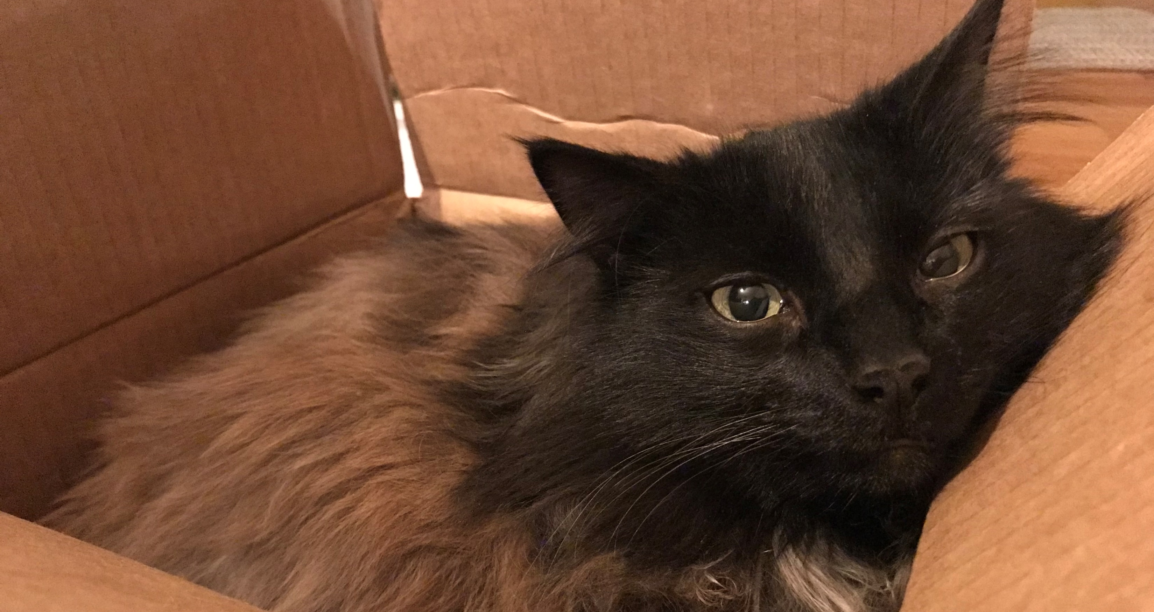
Questions & Answers
Notes:
(Debbie)

