Slide 1

I-Share Alma Primo VE Office hours will start shortly
Welcome!
Office Hours will start at 2pm and run until 3pm. Please mute your microphone. As time permits, we will respond to questions typed in the chat box and offline afterwards if needed.
This session will be recorded and made available on the CARLI website: https://www.carli.illinois.edu/products-services/i-share/alma/CARLIOfficeHours

Slide 2
springshare a-Z list Primo VE integration and decluttering Primo VE view online OCTOBER 12, 2023

Slide 3
Agenda
Today’s Agenda
Announcements and upcoming events
CARLI’s Discovery Primo VE Committee discusses integrating a Springshare LibGuides A-Z list with Primo VE
Decluttering the Primo VE "View Online” section

Slide 4
CARLI EVENTS
Upcoming CARLI Events
https://www.carli.illinois.edu/calendar
Weekly Professional Development Alliance (PDA) sessions
Weekly Support for the Creation of Open Educational Resources (SCOERs) office hours and sessions
"Let’s Talk About Fulfillment" is back and occurs every other Tuesday. The next session will be October 24.
FOR MORE INFORMATION VISIT THE CARLI CALENDAR
Notes:
All upcoming CARLI events are listed on the CARLI calendar. Here is a small list of ongoing events that might be of interest. I'd also like to note that again, as in past years, the CARLI office will have funds available to pay registration fees for the annual ELUNA Learns webinar sessions. Watch for an email announcement with more information very soon.

Slide 5
Volunteers Needed to Share your Experience and Expertise!
December 14, 2023 Open Office Hours – “Lab Reports”
Please consider sharing an informal presentation or demonstration!
Example topics include:
How your institution features or manages New Books
Using generic Alma User accounts for circ desk workers/workstations
How your library does inventory
Setting up EDI with a specific vendor
Send in your topic to support@carli.illinois.edu by 5pm, Monday, November 6, to claim your "Lab Reports" time slot. Thank you!

Slide 6
Springshare LibGuides A-z List
Springshare LibGuides A-Z List + Primo VE Integration
Lindsey Skaggs (Illinois State University) and Colin Koteles (College of DuPage) will discuss and demo integrating a Springshare LibGuides A-Z list in Primo VE.
Instructions are available on the CARLI website's Shared Documentation Depository page: https://www.carli.illinois.edu/products-services/i-share/i-share-documentation/shared-documentation
Notes:
Instructions are available on the CARLI website's shared documentation depository page list on the slide. This page contains other content created and submitted to us by other CARLI members libraries for the benefit of others. If you have internal documentation at your own library you feel could be included, please submit it! Instructions on how to submit an item for the shared document depository are available on the webpage.

Slide 7
declutter Primo VE’s View Online section
How to Improve “View Online” or Linking to Full Text Options in Primo VE: Part I
Display Logic Rules
Use to show fewer full text options/to declutter
Can prioritize e-collections or interfaces
Order matters for Display Logic Rules
Notes:
How to improve “View Online” or linking to full text options in Primo VE

Slide 8
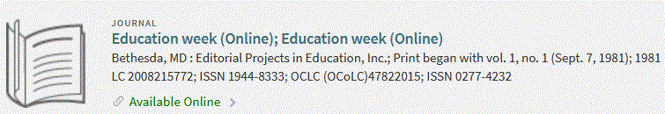
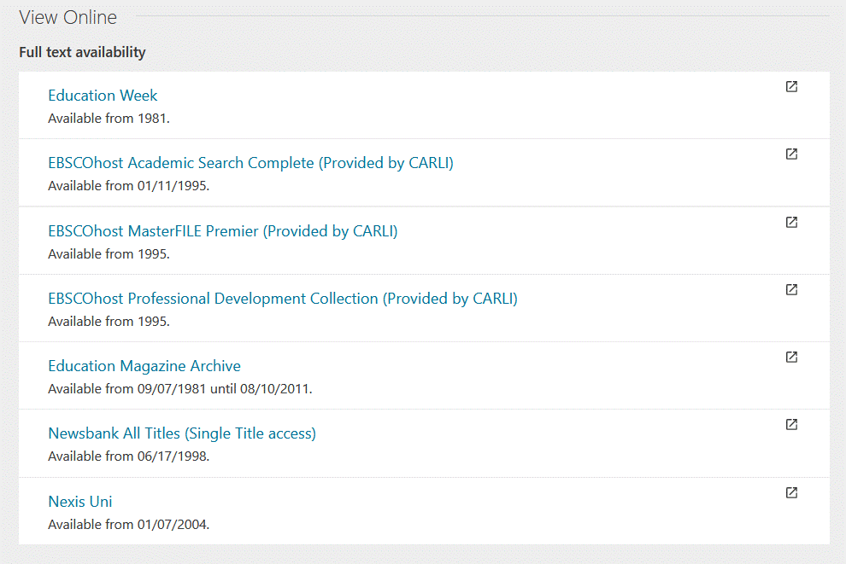
declutter Primo VE’s View Online section
Display Logic Rules
Use to show fewer full text options
Notes:
For example, here’s a long list of possible full text options for this periodical “Education Week”. Which one are your patrons most likely click on? The first one. If indeed that’s the e-collection your library thinks is best, then consider a DLR.

Slide 9
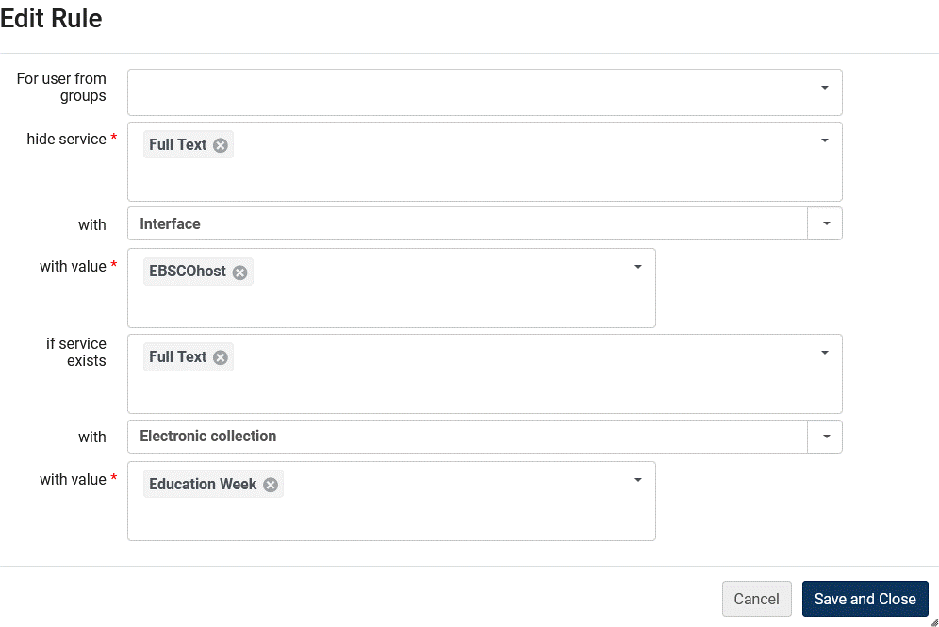
declutter Primo VE’s View Online section
Display Logic Rules
Add a rule like:
Notes:
Let’s read this as a logic exercise, BUT from bottom up. If… implicit is checking for date coverage, if…. Could add more “With interface” Newsbank, Nexis, etc. so that you could have display like next slide

Slide 10
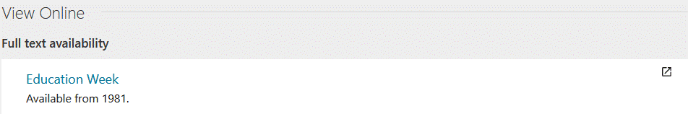
declutter Primo VE’s View Online section
Use to show fewer full text options
Let’s look at “Display Logic Rules for Electronic Resources” documentation and more examples
See also Alma/Primo VE documenation
Notes:
The 7 long list of possible full text options for this periodical “Education Week” is now one.

Slide 11
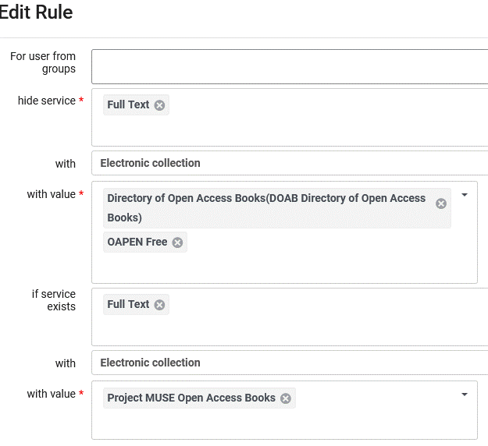
declutter Primo VE’s View Online section
Display Logic Rules To Consider
Prioritize more reliable Open Access sites
Example: Publishers over aggregators
Notes:
Librarians decided publisher Open Access/free site was more uptodate and reliable in general than DOAB. So if in Project MUSE’s own site, don’t show these other two more compilation Open Access/free ebook sites.

Slide 12
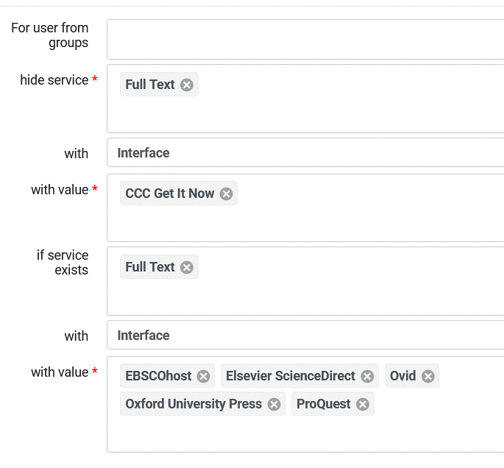
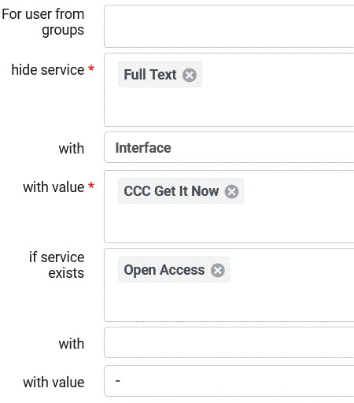
declutter Primo VE’s View Online section
Prioritize less expensive e-collections
Example: Copyright Clearance House Document Delivery – pay per article.
Notes:
So if in other e-collections listed, don’t show the “on demand” CCC type collection(s). (Pay per article type e-collection) Potentially save $$ and less clutter, remember tend to click on first in the “View Online” display. Remember DLRs are in priority order.

Slide 13
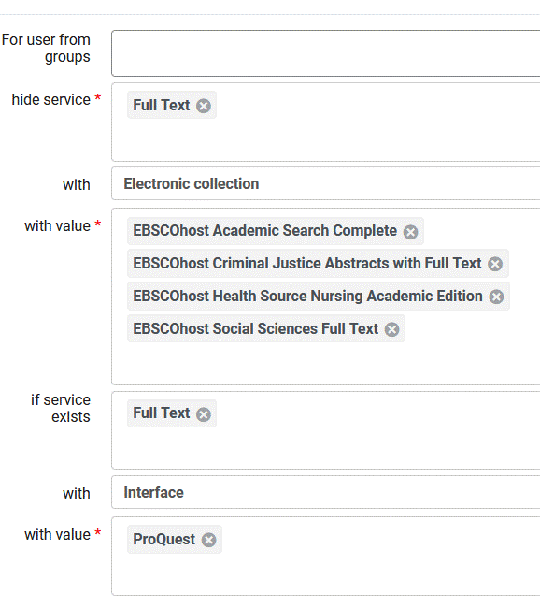
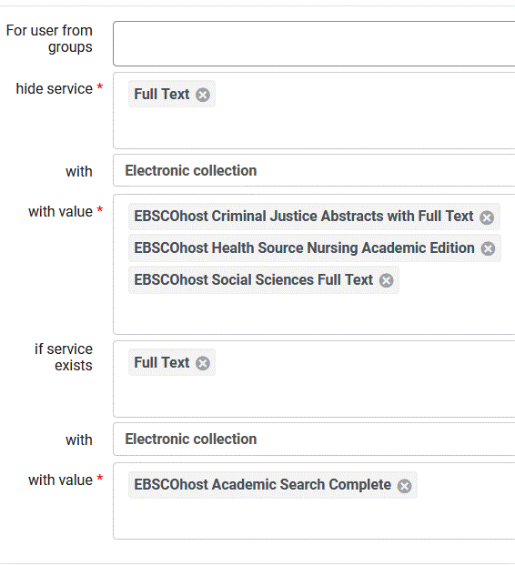
declutter Primo VE’s View Online section
Remember: Order Matters in Display Logic Rules
Example: applies #13 before #14
Notes:
Remember DLRs are in priority order. Rule 13, for this IZ, says if this article or journal is available from any ProQuest e-collection, hide any links from these 4 EBSCOhost e-collections. Rule 14 is applied next in effect saying, if the article or journal isn’t in any ProQ e-collections and is available from EBSCOhost Academic Search Complete, don’t show links from these 3 EBSCOhost e-collections.

Slide 14
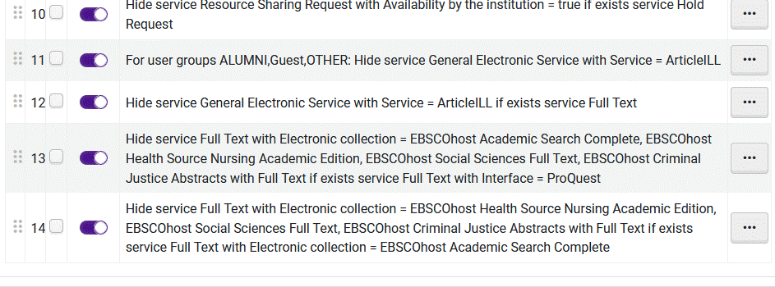
declutter Primo VE’s View Online section
Remember: Order in Display Logic Rules in Fulfillment Configuration Matters.
Example: applies #13 before #14
Notes:
Here’s how this looks in the roster of DLRs in Fulfillment configuration. They are in priority order in list in your IZ Configuration Fulfillment, Display Logic Rules (DLRs).

Slide 15
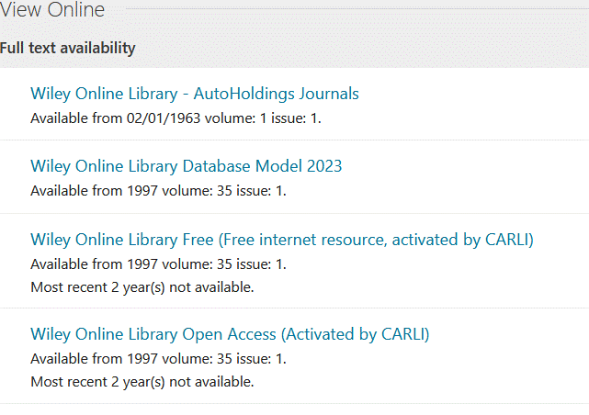
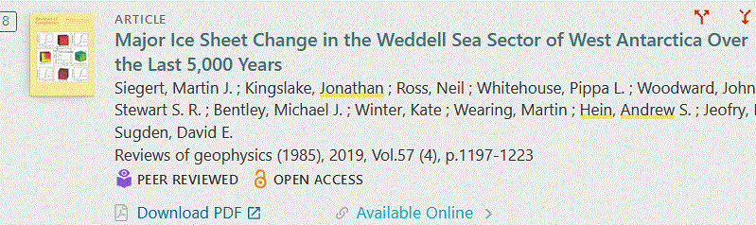
declutter Primo VE’s View Online section
Other Techniques for Improving
“View Online/Get Full Text” type Displays
Link Order/Configuring the Order of Online Services
Alma Link Order Documentation
Direct Linking - pros and cons
Alma Direct Linking Documentation
Notes:
We don’t have time to go into these in any detail today. Default link order is alphabetical as this example shows. Can change that. Direct Linking offers the full text links in the brief results list. Like this example . For information see these links. These are not mutually exclusive. Can use mix of Link Order, Direct Linking, DLRs, etc. One or more can work together. Would you like more presentations about improving “View Online”… displays in Primo VE?

Slide 16

QUESTIONS?
Contact CARLI at:
support@carli.illinois.edu
The next Alma Primo VE Office Hours are Thursday, November 9, 2023.
Multicolored wildflowers.

