Slide 1
I-Share Annual Statistical Package:
Find the Right Report
Alma/Primo VE Open Office Hours
January 12, 2023
Notes:
(Ted)

Slide 2
Today’s Agenda
Announcements
I-Share Annual Statistical Package
Open Q&A
Notes:
(Ted)

Slide 3
Reminder: Premium Sandboxes Refresh
Premium Sandboxes (PSB) Refresh – February 2023
Refresh will occur on February 12 as part of Alma quarterly release update
After the refresh CARLI staff will prepare the sandboxes for use
  Refreshing the user accounts
  Configuring AFN between the sandbox IZs
Watch for an announcement from CARLI once the sandboxes are ready for use again in February.
If you are currently using the PSB for testing be aware that any examples you’ve set up will need to be recreated after the refresh.
More information on the PSBs
Notes:
(Ted) CARLI’s six Premium Sandboxes were refreshed on Sunday, August 8 as part of the Alma monthly release updates. The Sandboxes are refreshed twice a year in February and August. If you are doing any current testing in the sandboxes, you will want to either finish up your work by the end of January, and/or document how to re-create your testing scenarios after the sandboxes are refreshed.
Following the refresh on February 12, the CARLI Office staff will refresh the generic user accounts and perform some configurations so that AFN will work between the six Sandbox IZs, and send an email to let you all know when the sandboxes are again available for use.

Slide 4
E-Resources Updates
Time to update your Alma Electronic Resources to keep aligned with current purchases.
End of Calendar Year 2022
  If your library has added or cancelled/not renewed subscriptions to e-resources, plan to update your Alma Institution Zone.
  More “how to” documentation at https://www.carli.illinois.edu/products-services/i-share/electronic-res-man
Notes:
(Ted) CARLI staff will send emails out this week about any such adds or “not renewals” from the CARLI Calendar Year Selection Cycle.

Slide 5
I-Share Annual Statistics Package
Finding the Right Report
Notes:
(Ted) Let’s move now into today’s topic, the I-Share Annual Statistics Package: Finding the Right Report. If you’ve been around CARLI for a while, you might be aware that we typically share a lot of information about these reports when they are generated in July of each year. However, we typically receive support requests for these data throughout the year, as institutions have many reporting obligations with different requirements and deadlines. Whether you may be answering IPEDS or ACRL, replying to the ILLINET Interlibrary Loan survey, or just providing data on your collection to your institutional research department, these reports provide statistical snapshots of your institutions’ I-Share data.

Slide 6
Today’s Outcomes
Introduction and Background: The 5 W’s of I-Share Annual Statistics
What & When: Circ & AFN stats
What & When: Collection and Electronic Collection stats
How & Where: Report Download Locations
You & Why: Report Descriptions and Mapping to Surveys
What’s Next for 2023?
Notes:
(Ted) Here’s a quick look at our goals for today’s presentation. We’ll start with some background on the stats package, then begin to highlight the reports that might best answer your pressing survey needs. We’ll cover how to retrieve your reports when they’re generated, talk about how you can learn more about each report in the package, and finish with a look ahead for the work we’re planning in order to bring the package up-to-date.

Slide 7
The 5 W’s of I-Share Annual Statistics
Why: Libraries have many reporting needs
Who and How: CARLI Staff
  CARLI automated scripts and APIs
What: 29 reports covering Fiscal/Academic Year ending June 30, 2022
When: Reports generated on July 1* or July 16
  * Reports for institutions with a different fiscal calendar run differently
Where: 22 reports shared to libraries’ secure FTP folders
  10 reports posted to CARLI website
  I-Share Statistical Package folder in Analytics
Notes:
(Ted)
The reports in the I-Share Statistics Package have grown over the history of I-Share as a platform. In fact, many of the report definitions are historically rooted in the questions that used to be asked by survey agencies, as well as the ways in which previous I-Share platforms recorded data. Since coming onto Alma, we’ve been focusing on learning to leverage the analytics system to make sure our data comparisons to the past are reasonable, that is comparing apples-to-apples, but also making sure that data are accurate and identifying the sources of discrepancies. Later on, we’ll talk about how we’re planning to update the package to better answer the questions that libraries see on surveys in the present.
Collectively, CARLI staff work on 29 reports in total. Some reports are generated and distributed automatically by scripts, while other reports are generated and compiled by hand. As noted, these reports are typically created each July in conjunction with CARLI’s new fiscal year. If your institution has a different fiscal calendar, we work to time report creation and delivery to those dates. Most of these reports are shared directly to members via the secure FTP server, files dot carli dot Illinois dot edu; in fact, many of these same reports have versions that get generated monthly as well. A separate set of reports, which tend to be consortium-level analyses and comparisons, are posted exclusively to the CARLI website. Along with the reports that are distributed in Excel or text formats, we provide as many of the definitions as possible in the CARLI Network folder of Alma Analytics.

Slide 8
Circulation and Automated Fulfillment- FTP Directory
Circulation Files uploaded to your CARLI FTP directory:
  I-Share Circulation Stat 1: Circulation by Item Location at Time of Loan
  I-Share Circulation Stat 2: Circulation by Circulation Desk
  I-Share Circulation Stat 3: Circulation by User Group and Home Library
  I-Share Circulation Stat 4: Serial Title Circulation and In-House Use
  I-Share Circulation Stat 6: Circulation by User Group and Item Policy and Location at Time of Loan
AFN files uploaded to your CARLI FTP directory:
  I-Share AFN Stat 1: Network Lending Counts (aka, Outgoing ILL)
  I-Share AFN Stat 2: Network Borrowing Counts (aka, Incoming ILL)
  I-Share AFN Stat 3: Titles Borrowed from Other I-Share Libraries
Notes:
(Debbie)

Slide 9
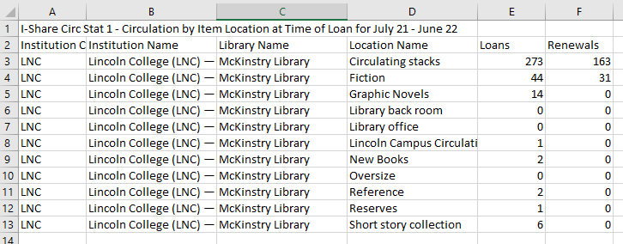
I-Share Circulation Stat 1:
Circulation by Item Location at Time of Loan
Notes:
(Debbie)

Slide 10
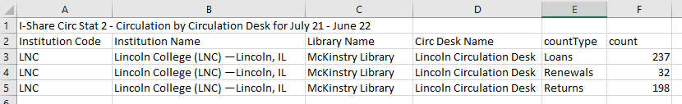
I-Share Circulation Stat 2:
Circulation by Circulation Desk
Notes:
(Debbie)

Slide 11
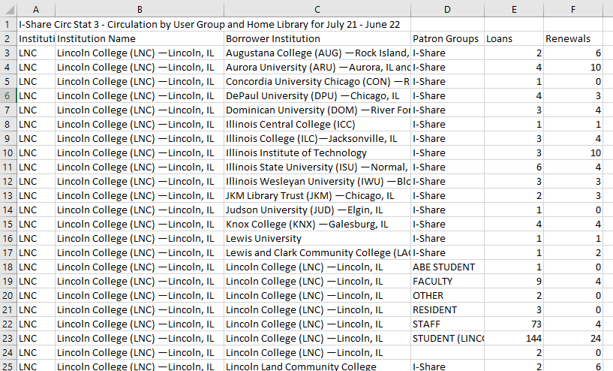
I-Share Circulation Stat 3:
Circulation by User Group and Home Library
Notes:
(Debbie)

Slide 12
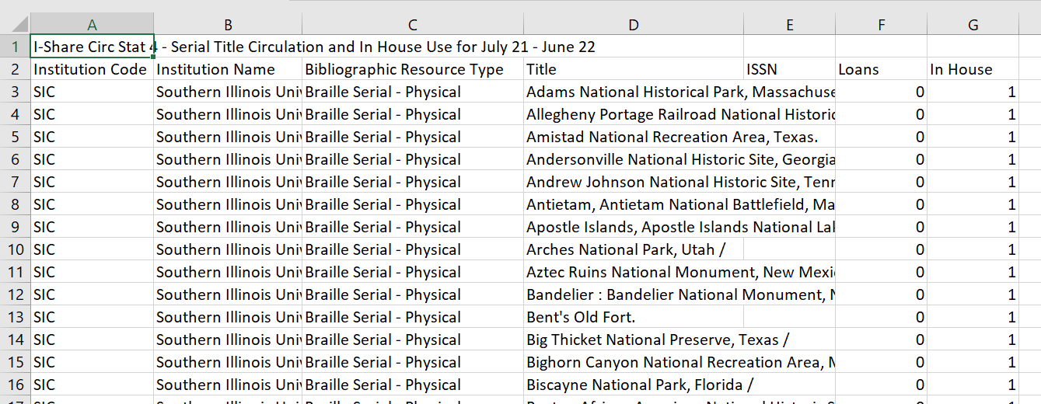
I-Share Circulation Stat 4:
Serial Title Circulation and In-House Use
Notes:
(Debbie)

Slide 13
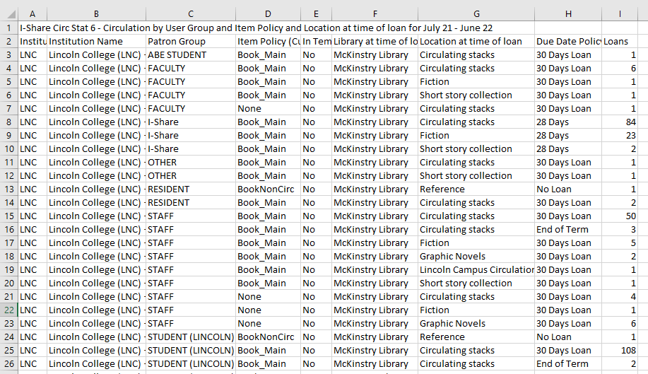
I-Share Circulation Stat 6:
Circulation by User Group and Item Policy
Notes:
(Debbie)

Slide 14
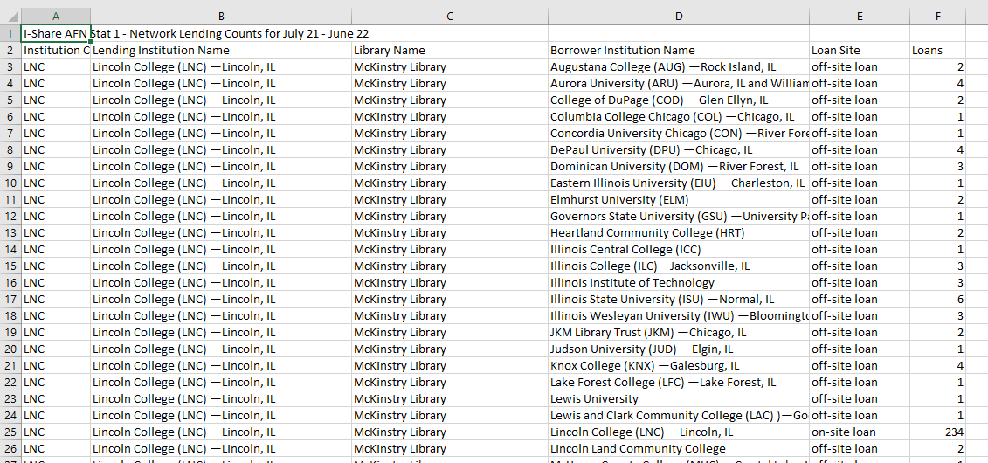
I-Share AFN Stat 1:
Network Lending Counts (aka, Outgoing ILL)
Notes:
(Debbie)

Slide 15
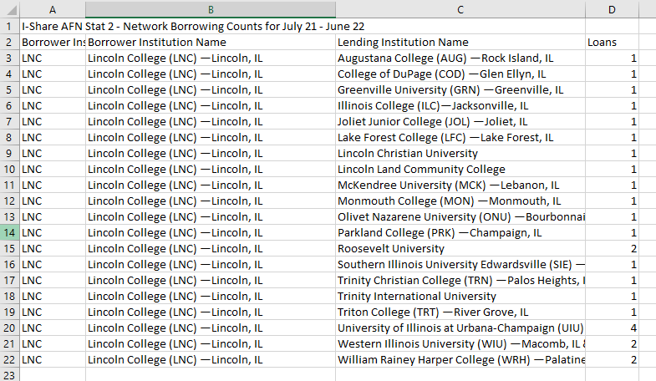
I-Share AFN Stat 2:
Network Borrowing Counts (aka, Incoming ILL)
Notes:
(Debbie)

Slide 16
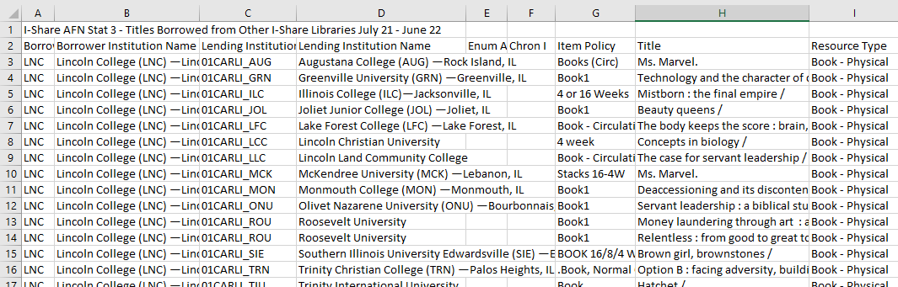
I-Share AFN Stat 3:
Titles Borrowed from Other I-Share Libraries
Notes:
(Debbie)

Slide 17
Circulation and Automated Fulfillment- CARLI Website
Consortially collated statistics available on the CARLI website:
  I-Share AFN Stat 1 FY 2022
  I-Share AFN Stat 2 FY 2022
  I-Share AFN Stat 4 FY 2022 (modified UB Stat 4)
  I-Share AFN Stat 5 FY 2022 (modified UB Stat 4)
  Library Patron Record Counts FY 2022
  Borrowing and Lending Comparison FY 2022
  Circulation Transactions Comparison FY 2022
  Reciprocal Borrowing to I-Share Patrons FY 2022
Notes:
(Debbie)

Slide 18
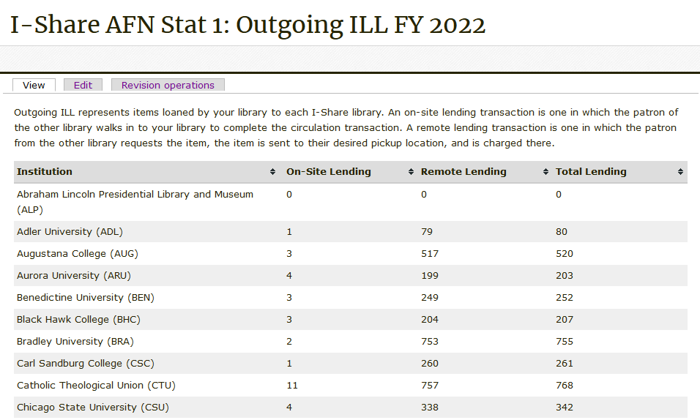
I-Share AFN Stat 1:
Network Lending Counts
Notes:
(Debbie)

Slide 19
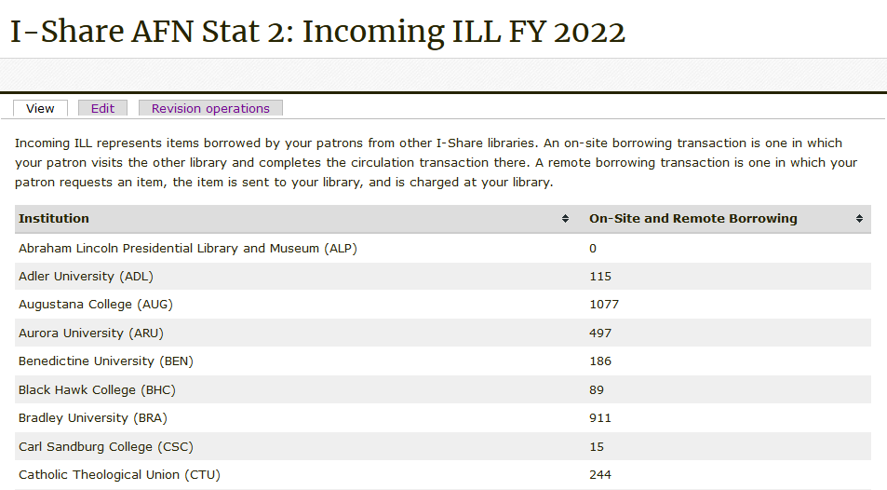
I-Share AFN Stat 2:
Network Borrowing Counts
Notes:
(Debbie)

Slide 20
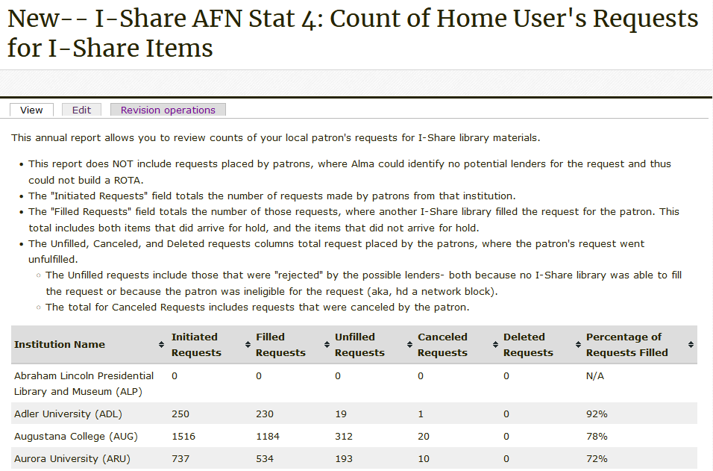
I-Share AFN Stat 4:
Count of Home User's Requests for I-Share Items
Notes:
(Debbie)

Slide 21
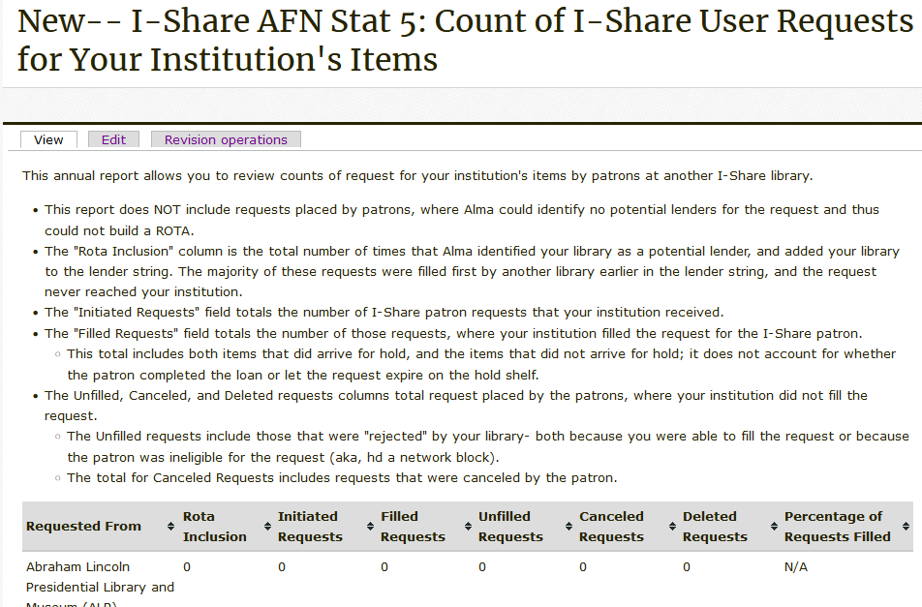
I-Share AFN Stat 5:
Count of I-Share User Requests for Your Institution's Items
Notes:
(Debbie)

Slide 22
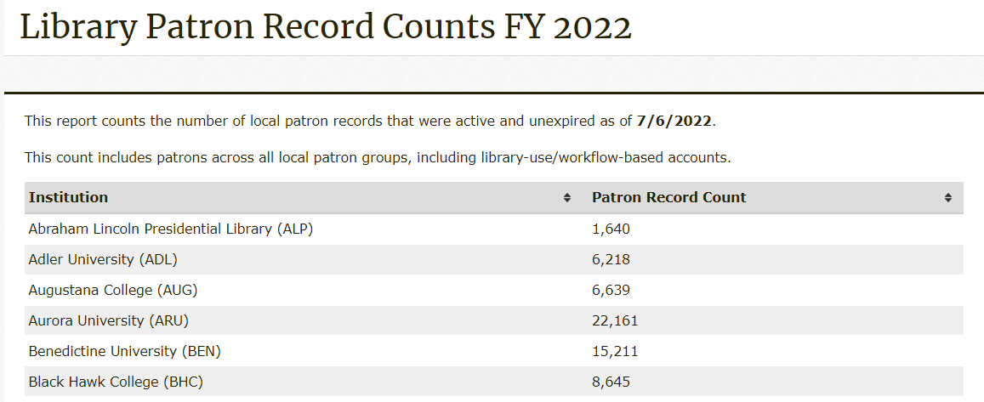
Library Patron Record Counts
Notes:
(Debbie)

Slide 23
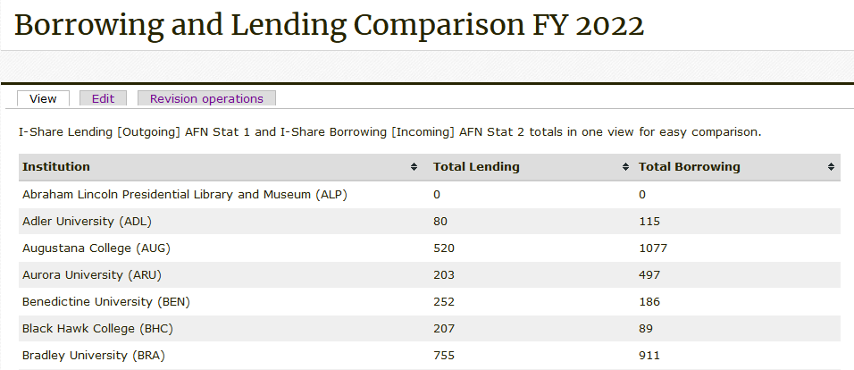
Borrowing and Lending Comparison
Notes:
(Debbie)

Slide 24
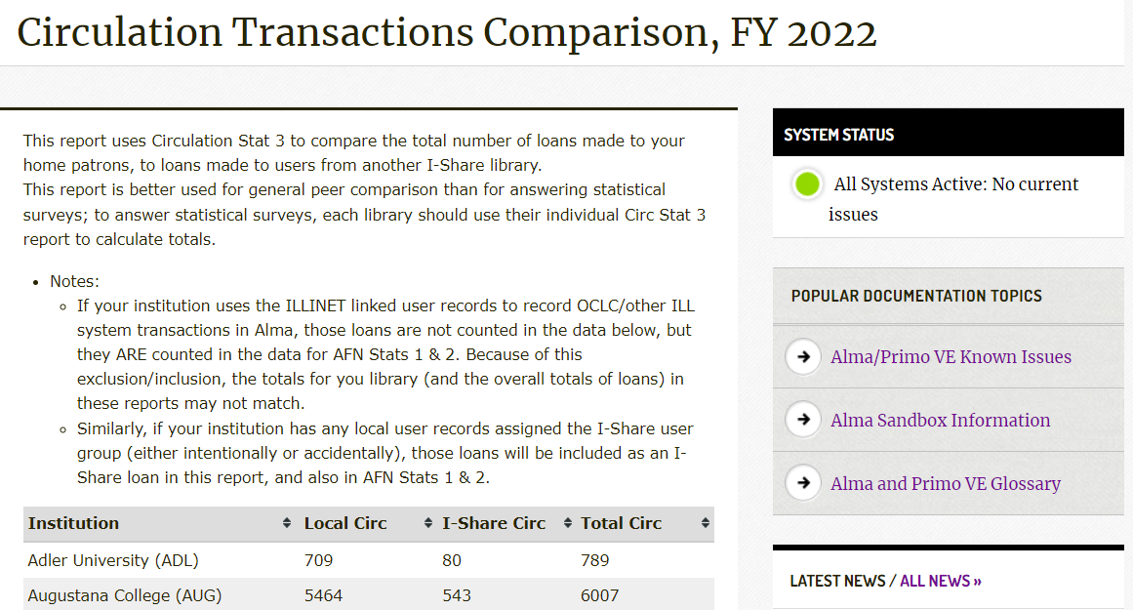
Circulation Transactions Comparison
Notes:
(Debbie)

Slide 25
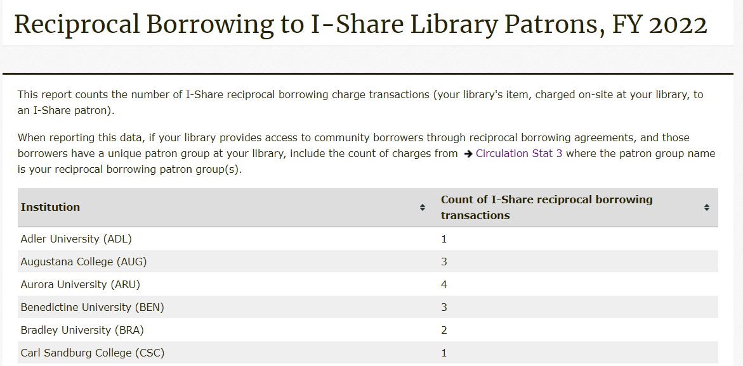
Reciprocal Borrowing to I-Share Patrons
Notes:
(Debbie)

Slide 26
Print Collections
Counts of items, holdings, and bibs in different perspectives
Most reports are snapshots
  Collection stats 3 and 4, measuring collection changes, use date ranges
Reporting to Surveys
  Item records approximate volumes: use Collection Stat 1 or 5
  Bib records approximate titles: use Collection Stat 6 or 11

Slide 27
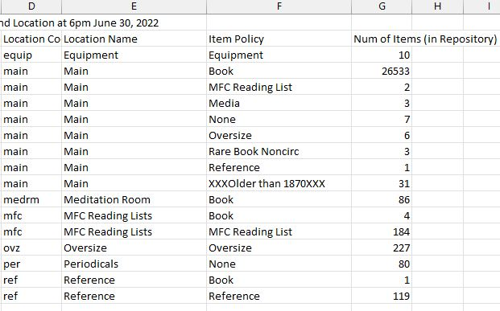
Collection Stat 5: Item Count by Location and Policy

Slide 28
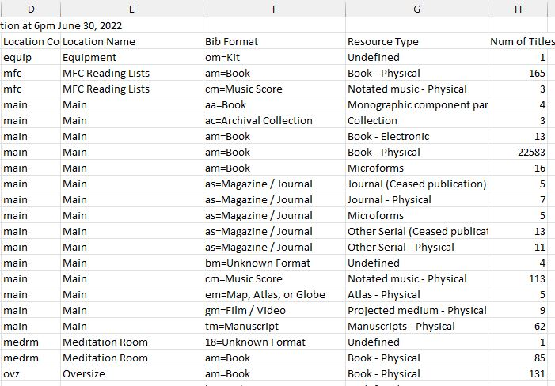
Collection Stat 11: Title Count by location and Resource Type

Slide 29
Electronic Collections
Counts of portfolios and collections available to your institution
  Includes your IZ activations
  Includes NZ activations shared to your institution
Reports are snapshots
Reporting to Surveys:
  Digital/Electronic Books and Media: use Electronic Stat 1 if you don’t duplicate titles
  Digital/Electronic Serials: use Electronic Stat 3: Unique E-Journal Title Report
CARLI Staff must run:
  CARLI-Owned Ebooks Statistics
  Electronic Stat 4: Unique Electronic Titles Deduplicated with Network

Slide 30
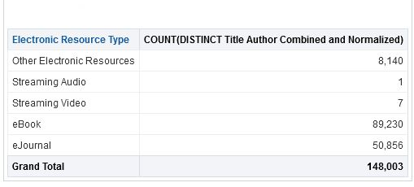
Electronic Stat 4: Electronic Titles Deduplicated with Network

Slide 31
How & Where: Report Download Locations
CARLI Files Server - Secure FTP (SFTP)
https://www.carli.illinois.edu/products-services/i-share/external-system/SSHSecureShell
Box.com
https://www.carli.illinois.edu/products-services/i-share/external-system/box-folders

Slide 32
How & Where: Report Download Locations - SFTP
When the statistics are run by CARLI staff, they are deposited as Excel files in the CARLI ftp account belonging to your institution.
The I-Share Liaison at your institution should know the username and password for your institution's CARLI ftp account. There is only one username/password per institution for the CARLI ftp account.
Files are deleted from the ftp directory after 60 days.
Additional Instructions for SFTP:
https://www.carli.illinois.edu/products-services/i-share/external-system/SSHSecureShell

Slide 33
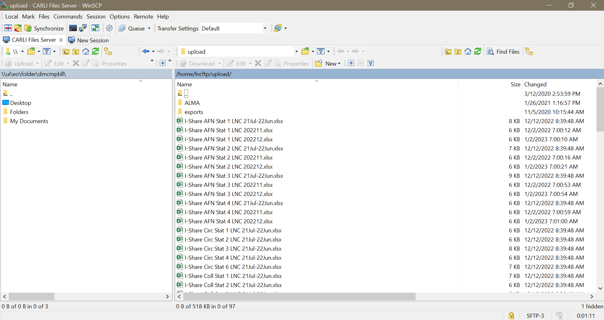
How & Where: Report Download Locations
Notes:
(Bradley)

Slide 34
How & Where: Report Download Locations – Box.com
Annual Statistics files are also deposited to your institution's shared folder on Box.com
CARLI provides each I-Share institution with access to a shared folder on the University of Illinois' Box.com file-sharing platform.
If your institution uses Box.com, you should have an account and login privileges through them. If not, you will need to create an account as an external user.
If you do not have access to your institution's Box folder, request access via support@carli.illinois.edu and copy your library's I-Share Liaison on the message.
Additional Instructions for Box.com:
https://www.carli.illinois.edu/products-services/i-share/external-system/box-folders

Slide 35
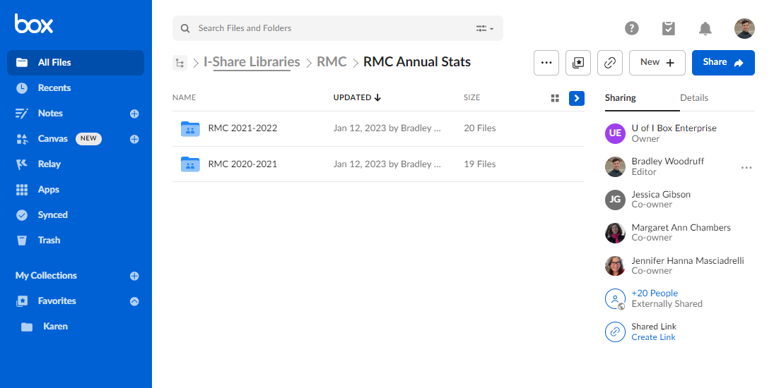
How & Where: Report Download Locations
Notes:
(Bradley)

Slide 36
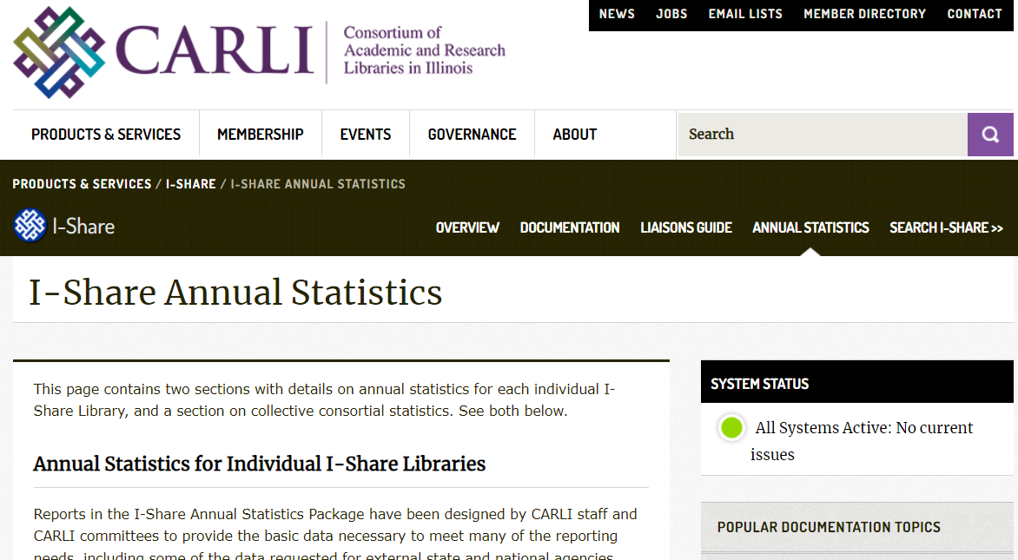
How & Where: Reports on the CARLI Website
https://www.carli.illinois.edu/products-services/i-share/stats
Notes:
(Adrienne)

Slide 37
Finding More on Analytics Reports
CARLI Website documentation:
https://www.carli.illinois.edu/products-services/i-share/alma-analytics
  Training Examples:
    Ex Libris 2021 Analytics Master Class recordings and handouts
    How-To: Getting Started with Analytics
Accessing files through Secure FTP:
https://www.carli.illinois.edu/products-services/i-share/external-system/SSHSecureShell
Connecting to Box.com:
https://www.carli.illinois.edu/products-services/i-share/external-system/box-folders
Notes:
(Adrienne)

Slide 38
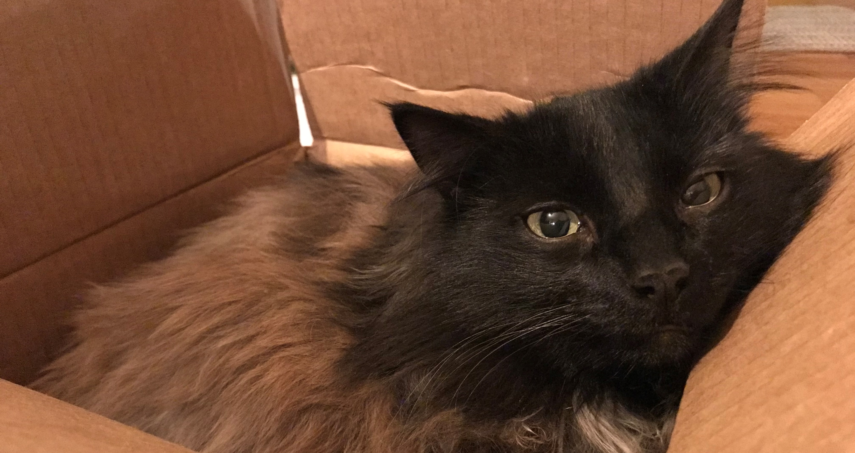
Questions
& Answers
Notes:
(Debbie)

