Slide 1
I-Share Alma Primo VE Office hours will start shortly
Welcome!
Office Hours will start at 2pm and run until 3pm. Please mute your microphone. As time permits, we will respond to questions typed in the chat box, and offline afterwards, as needed.
This session will be recorded and made available on the CARLI website.

Slide 2
I-Share Alma/Primo VE Office Hours: E-Resources Changes & troubleshooting Links December 8, 2022
Notes:
Marisa: Hello and welcome

Slide 3
Agenda Office Hours
Agenda – 12/08/2022
Announcements & Reminders
Today’s Agenda:
End of Calendar Year and Alma Electronic Resources
Troubleshooting Reports of Full Text Links that Don’t Connect
Questions
Notes:
We will have usual announcements and reminders, then…

Slide 4
Announcements
Let’s Talk about Fulfillment (I mean Alma, not life’s purpose)
Next Session on December 9 at 2:00 p.m.
Registration open and available on the CARLI Calendar
Technical Services Q&A
Tech Services Committee sharing advice on OCLC Connexion Client Training Modules
Sessions are scheduled for December 14 at 10 a.m., January 25 at 2 p.m., and February 22 at 2 p.m.
Registration open and available on the CARLI Calendar
More details about entire series available at https://www.carli.illinois.edu/carli-technical-services-committee-begins-connexion-client-training-qa-series

Slide 5
ELUNA Learns
ELUNA LEARNS
Diversity, Equity, and Inclusion. December 14, 2022. 1:00 pm to 4:00 pm eastern.
Copyright. February 1, 2023. 1:00 pm to 4:00 pm eastern
Registration for Dec. 14th still open for $25.00 per person at https://el-una.org/meetings/eluna-learns-2022/
Feb. 1 Registration coming soon.

Slide 6
E-Resources Updates
Time to review your Alma Electronic Resources to keep aligned with current purchases.
End of Calendar Year 2022 coming soon-
If your library has added or cancelled/not renewed subscriptions to e-resources, plan to update your Alma Institution Zone.
More “how to” documentation at https://www.carli.illinois.edu/products-services/i-share/electronic-res-man
Notes:
Review end of calendar year approaching soon.
CARLI staff will email I-Share libraries with reminders about changes via CARLI brokering for the Calendar Year cycle. .

Slide 7
Troubleshooting patron reports of e-resources linking problems.
The Link Didn't Work, Now What? Troubleshooting Patron Reports of E-Resources Linking Problems-
For I-Share Alma/PrimoVE Libraries
Learning Goals
Recognize typical e-resources linking problems
Know how to start investigating
Familiar with ways to reduce Alma/PrimoVE issues with
Authentication & Proxying
Resource Activation
Citation/Metadata Input
Notes:
Link in chat and at end of these slides for the event recording & slide deck . Presenting a briefer and more Alma focused version of PDA talk. Learning goals for today-

Slide 8



Troubleshooting patron reports of e-resources linking problems.
Always Start with a Do Over-
1.Re-create the search and find the problem linking again. Did you find the full text now?
If that doesn't work then,
2.Try another web browser than what the patron used.
Use an incognito or private window to clear cache and any proxy/login sessions. Avoid “sticky” data.
If the linking issue can be replicated, investigate further depending on error messages or the patron's story.
Notes:
So you get a report that some e-resources link didn’t work? Didn’t connect to full text or only got part way there:
1.Re-create the search and find the problem linking again. See if you can connect using the link. Sometimes linking issues are temporary, and you can't replicate the problem. If you are able to get the full text now, ask your patron to search again after clearing their browser cache and search history (or send them the full text file.)
If that doesn't work then,
2.Try another web browser than what the patron used. Preferably use an incognito (Chrome) or private (Firefox) window. Sometimes linking issues are related to a particular web browser or caching/cookies issue. The problem may not appear in a different browser. If this now works for you, ask your patron to search again after clearing cache and cookies and then opening a fresh browser window. Up to date browser can affect too.

Slide 9





Troubleshooting patron reports of e-resources linking problems.
Library e-resource
Google Scholar
Vendor’s interface
If Off Campus- Authentication/Proxying
APVE builds an OpenURL/ Context Object, etc.
Link Resolver- Alma
On to publisher, repository or vendor interface
Full Text: html/pdf/ streaming media, etc.
Notes:
In order to understand problems with authentication, collection activation and metadata, Here’s a simplified map of the usual process for e-resources discovery and access. So typically , your patrons or students or faculty /staff are looking for information in an index of some kind whether from Google or your library’s PrimoVE discovery tool or a Vendor’s interface like ACS Publications, EBSCOhost, ProQuest, etc. They find a promising citation and then we’re off to ….
Simple process right? , NOT!

Slide 10
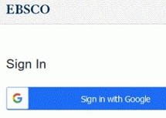
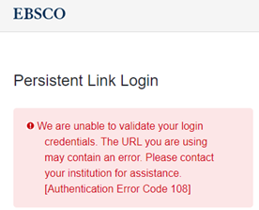

Troubleshooting patron reports of e-resources linking problems.
Authentication issues: On Campus/Off Campus
If it works on campus, but the off-campus patron is getting "Access denied" or "You must authenticate..." type messages like:
Time to check on the user’s campus login id: Do they have one? Is it active currently? Help them resolve any campus id/authentication issues?
Perhaps user was not going through library website?
Notes:
Help them get a working campus authentication login, Will often involve calling or sending the user to campus id office or the like. The lapsed or “not ready yet” campus account authentication issue is especially common at the beginning of an academic term when brand new students or students re-entering after a “stop out” are back as your library users but the authentication system hasn’t caught up yet. Ditto for new or returning faculty and staff. Try to know, if possible, when your organization loads patron data. And conversely when graduating students & employees are processed for auth loads.
Of course, the patron may have no valid claim to such an off campus login if graduated or otherwise separated from your university. I won’t go into more details here since providing a campus id will vary a great deal depending on your proxying system, if you use single sign on or not, how does your campus system interact with library resources and similar factors.

Slide 11


Troubleshooting patron reports of e-resources linking problems.
Authentication issues: E-Collection Issues
Can the patron can login to your library's e-collections in general, but not this particular e-collection? If yes, then it may be a problem with just this e-collection or its vendor.
Check for proxy settings for the problematic e-collection in your Alma IZ.
If the disconnect persists, check with the vendor.
IP ranges can get lost.
Some vendors change proxy settings from time to time.
Some use theIPregistry.com.
What if everyone gets "Access Denied" or "You Must Authenticate..." when On-Campus or Off?
Check with your campus IT. Is there a problem campus wide?
Check the vendor’s status web page.
For ex. https://status.proquest.com/
Is the vendor down in your geographical area?
Notes:
Other Authentication matters relate to e-collections themselves. If problems persist, contact the vendor and confirm they have up to date proxy IP ranges for your campus including any EZ Proxy or OpenAthens IP ranges. Vendors can lose IP ranges. Or due to human error or changes in the vendor's platform, your library's IP ranges and the proxy details can be incorrect. If you have access to your library's administrative account on vendor site, log in. Check if the account has the correct IP range for the institution. EZproxy IP or Open Athens IP must be included in the IP ranges. If needed, update the IP range on the library administrative account. If the account does not allow customers to update the IP ranges, contact your vendor. Note some vendors manage IP ranges using theIPregistry.com. You may also need to update the institution’s IP range at theIPregistry.com.

Slide 12
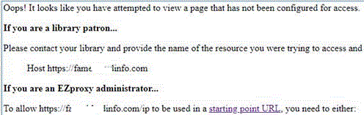

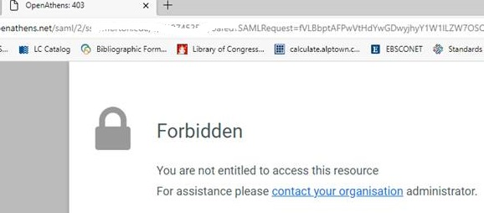
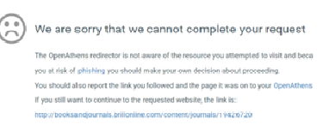
Troubleshooting patron reports of e-resources linking problems.
Library Proxy Error messages examples:
Check for proxy settings for the problematic e-collection(s) in your library systems. New stanzas? Or other settings?
Check with the vendor: IP ranges? Proxy settings?
Notes:
Error message examples related to library e-collection proxying issues. Here’s two from EZ Proxy, two from OpenAthens,

Slide 13

Troubleshooting patron reports of e-resources linking problems.
Resource Activation issues:
Could the wrong Community Zone e-title or e-collection be active for your users?
Example: "Homiletic," ISSN 0738-0534- can’t get to full text but our library bought access via EBSCOhost ATLA e-journals?
After investigating and checking invoices we found the library had activated wrong one from these available Alma CZ e-collections:
EBSCOhost AtlaSerials, Religion Collection
EBSCOhost ATLA Religion Database with ATLASerials
EBSCOhost AtlaSerials PLUS, Religion Collection
EBSCOhost Atla Religion Database with AtlaSerials PLUS
Notes:
Gee how’d they get confused on that choice? After activating the exact e-collection that matched their purchases, the linking worked. While these e-collections cover mostly the same journals and ebooks, the linking syntax and the library’s IP ranges were tied to a specific e-collection. You may have had the same experience with e-titles like “Science” or “New England Journal of Medicine” that are available from multiple vendors. Be sure you have the correct one for your library’s purchases. Use ISSNs, vendor codes or other customer info if possible. More in a moment.

Slide 14


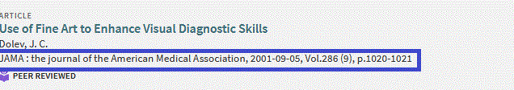
Troubleshooting patron reports of e-resources linking problems.
Resource Activation or Collection Description Issues
Was correct etitle/e-collection set up with required Customer ID/LOCID,EBSCO OPID, Library id, etc. done correctly?
See error messages about “Your library not have access to this content…” or similar.
Could also be error with a paywall coming up for materials library definitely purchased.
Date Coverage Issues- the dates available via a particular vendor or that free website have changed.
Notes:
Similarly, the date coverage for periodicals have changed but your KB or ILS are not up to date. Time to edit. Can be for a single title or for entire e-collections, ex. a current file type e-collection that has dates from 2005 to present suddenly has 1995- present due to a KB error.
And again was activated without proper customer ids. Will show some examples in a few minutes. Please remind me if I forget to show some examples of customer ids.

Slide 15



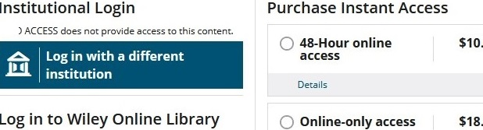
Troubleshooting patron reports of e-resources linking problems.
Resource Activation or Description Issues
Not really OpenAccess- the periodical or ebook is freely available according to your Alma CZ Knowledge Base. But your users keep encountering paywalls.
Notes:
One last resource activation/description issue: it’ not really free or OpenAccess. Happens frequently that what was OpenAccess is no longer so. Or perhaps never was but your knowledge base in your link resolver or ILS says it is. Time to edit or deactivate or possibly delete depending on what you find at the home page for the publication. In this example says _Sociological forum_... Raise your virtual hand if happen to you.

Slide 16
Troubleshooting patron reports of e-resources linking problems.
Is Article or Monographic citation accurate? Metadata issues.
Find a version of the citation in a different e-resource. Compare it to the information from the bad linking citation. Do any of these common metadata citation errors appear?
The journal/periodical is different.
Does the periodical have different versions/editions? Ex. “New York Times”
Could numbers have been flipped or typed incorrectly?
Is important information missing like date or ISSN/ISBN?
Is the article very new?
Goes to journal level not to article because Open Access/Free periodical.
No full text for just this article. Examples: “New Yorker” articles or Supplement not in aggregator full text.
Multiple articles on same page or very short articles grouped on same virtual page.
Notes:
Final area to examine are the citation just isn’t right, something’s off with this reference’s metadata. Happens with CDI citations frequently.
Look up the article or ebook/monographic citation in a different index or Google Scholar or Web of Science or a publisher’s website or what ever is available. Compare with the dud linking citation. Any of these errors?
Let me show you some examples of these common metadata snafus. Show Business Week example and others at
https://www.carli.illinois.edu/products-services/i-share/electronic-res-man/primove-broken-links , see section “Outside Citation Data Issues
“. In short the old “Garbage in, Garbage out” still applies.

Slide 17
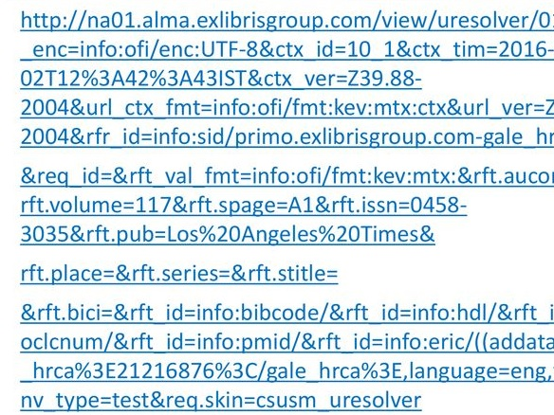
Troubleshooting patron reports of e-resources linking problems.
System builds an OpenURL/ Context Object, etc. ***
OpenURL construction quite complicated building on citation/metadata elements like ISSN/ISBN, title, author, date, pages, etc.
Error messages from citation issues:
404 Not found or other “/pageNotFound” responses.
“No exact match in our database. But based on the elements we could match, we have returned the following results... (JSTOR)
Or taken to a “Search this journal or vendor…” type page
Notes:
Why do these citation errors impact linking so much? Here’s a partial example Open URL. See how faulty metadata could lead to a “not found” 404 type message. If numbers flipped or just inaccurate, link won’t lead to anything. Or in some cases will take you to the journal level but not to the article. Or for ebooks and streaming media, to a search this vendor’s offerings type web page.

Slide 18
Wrap up & Questions
Resources for Further Learning
Introduction to OpenURL – see NISO or other web pages from DOI org or similar orgs.
Alma CTO see section “Advanced Troubleshooting & Documentation” on **
**CARLI Web Page on troubleshooting-https://www.carli.illinois.edu/products-services/i-share/electronic-res-man/primove-broken-links
Customer/Library IDs see https://www.carli.illinois.edu/products-services/i-share/electronic-res-man/electronic-collections-librarys-customer-and-location-ids
PDA November 1 Presentation- https://www.carli.illinois.edu/professional-development-alliance
Notes:
We could easily do an advanced version of this presentation on how to get more OpenURL details, how to see the underlying data from what Alma calls “context objects” use in the linking. Here’s link to the CARLI web page I showed you during the faulty metadata examples.
Also I urge you to dig a little into what OpenURL & CTO are see…

Slide 19
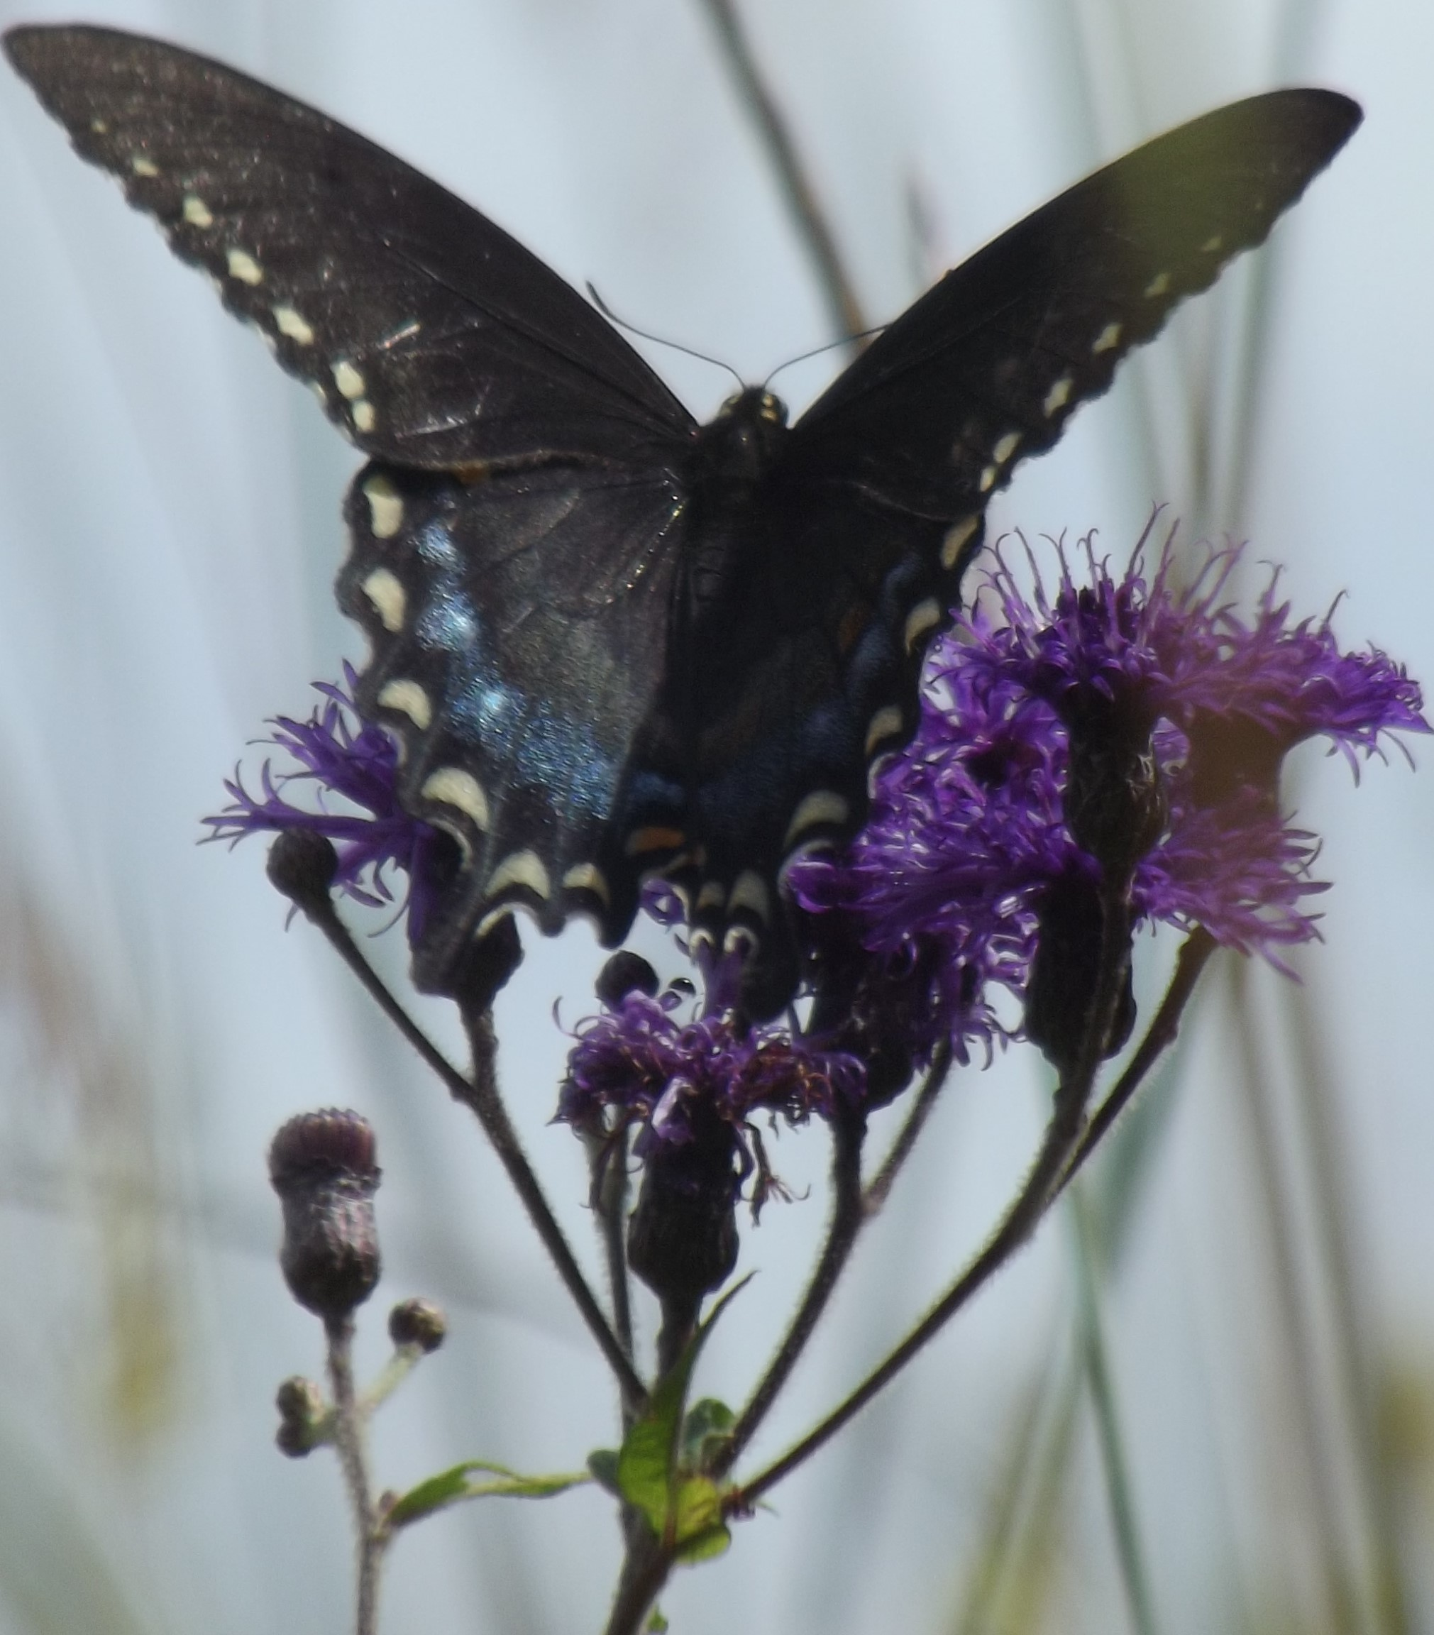
Now, Your Questions
Time for your Questions.
Join us January 12, 2023 at 2pm for
Our Next Open Office Hour
Contact CARLI at
support@carli.Illinois.edu

