Slide 1
I-Share Alma Primo VE Office hours will start shortly
Welcome!
Office Hours will start at 2pm and run until 3pm. Please mute your microphone. As time permits, we will respond to questions typed in the chat box, and offline afterwards, as needed.
This session will be recorded and made available on the CARLI website. PDF slides are posted on the event page:
https://www.carli.illinois.edu/carli-alma-primo-ve-open-office-hours-40

Slide 2
I-Share Alma/Primo VE Office Hours: Title Reduction Project Update October 13, 2022
Notes:
Jen

Slide 3
Agenda Office Hours
Agenda – 10/13/2022
Announcements & Reminders
Title Reduction Project Update
Open Q&A

Slide 4
Announcements
Announcements/Reminders
CARLI Electronic Resources
The CARLI E-resources Selection System is now open to libraries for their CY23 (January 1, 2023 – December 31, 2023) subscription commitments.
See https://select-library.carli.illinois.edu/login
For assistance, email support@carli.illinois.edu (with the subject line: CY2023 Selection Period)

Slide 5
Announcements
Let’s Talk about Fulfillment (I mean Alma, not life’s purpose)
Sessions are scheduled for alternating Friday afternoons at 2:00 p.m.
Registration open and available on the CARLI Calendar
Technical Services Q&A Sessions
Scheduled for Wednesday afternoons at 2:00 p.m.
Upcoming Dates: October 26, November 16
Technical Services Committee sharing advice on Connexion Client Training Modules
Registration open and available on the CARLI Calendar

Slide 6
November 2022 Office Hours
Next Month: Lab Reports
November 10th 2:00-3:00pm
Informal, quick, 5-10 minute lightning rounds. At the end of the sessions, we'll have time for Q&A of all presenters.
Submit your idea to support@carli.illinois.edu. Thank you to those who have already submitted!
Examples might include:
How you use an out-of-the-box, shared, or custom Analytics report to get interesting data or answer a question at your library.
Things your library likes about using OpenAthens with Alma and Primo VE.
A success story about how you are using Alma Work Orders at your library.
An example of a design or functionality change you made to Primo VE and why.
Your Alma workflow for acquisitions or cataloging in a small library.
How you teach a fulfillment or ILL workflow to new library student workers.
How you describe a particular Primo VE feature to your library users.
How your institution features or manages New Books or Special Collections with Primo VE.
How your library successfully uses generic Alma User accounts for circ desk workers/workstations to help keep the total CARLI I-Share Named User Count down.

Slide 7
ELUNA Learns
CARLI’s block of 400 ELUNA Learns registrations for I-Share member libraries was sold out in record time!
Remember that registration for these events is still open for $25.00 per person at https://el-una.org/meetings/eluna-learns-2022/

Slide 8
Title Reduction Project
Dr. Pamela Thomas, Cataloging Maintenance Center

Slide 9
Title Reduction Project
CARLI Open Office Hours
Dr. Pamela Thomas, IHLS/CMC
October 13, 2022, 2-3 p.m.
Notes:
Welcome to the CARLI Open Office Hours, where we will discuss the Title Reduction Project.

Slide 10


Agenda
A
Why This Project?
Project Recap
Tasks & Statistics
Improvements in Data & Processes
Contractual Resolutions
Post-project Outcomes
Ongoing Duplicate Clean-up
General Guidelines for CARLI Libraries
Notes:
This is the agenda for today.

Slide 11
Why this project?
Reduction of bibliographic titles
Cleaner database
Notes:
In early 2021, Ex Libris identified that I-Share libraries had exceeded the title count metric for our license. At the outset of project work in June 2021, CARLI’s title count (all bibliographic records minus electronic journal bib records) exceeded 66 million records (66,118,677). This count included the bibliographic records found in 91 institution zones and the CARLI network zone. The Network Zone (NZ) itself contributed over 16 million titles to that count. By removing duplicate bibliographic records, the database will be cleaner. The reduction of bibliographic records brings the I-Share libraries back under the title count limit for their license.

Slide 12
Project Recap
Tasks and Statistics
Improvements in Data & Processes
Notes:
Duplication of consortial e-resource titles in all Institution Zones (Izs) accounted for over 7 million total bib records. Shifting records for shared electronic resources, such as consortially-licensed Alexander Street Press collections, as well as open access resources, to the NZ and sharing elsewhere cut that number in half. Additional deletions of orphaned records in IZs and the NZ reduced another two-plus million records through December 2021.
On the topic of duplicate titles, when including the community zone (CZ) records, there are over 1 million duplicate records when matching on OCLC number. Excluding the CZ, the number of direct matches on OCLC was closer to 10,000 records.
CARLI staff have provided spreadsheets of duplicate records in the NZ based on the value of the 035 $a OCLC number. CMC staff can use two different processes to resolve these lists of duplicate records in the NZ:
One option is to compare the duplicate records in Alma’s metadata editor, manually select one NZ record to keep and then merge the other NZ records into the kept record. As a final step, WorldCat is searched for an updated version of the kept record which is then manually imported and also merged into the kept record to ensure that it reflects updated cataloging from WorldCat.
Alternately, CMC staff can bring up the duplicate records in the metadata editor and can then compare them side by side with the most recent version of the record in Connexion. If needed, the Connexion record is edited and replaced to bring it up to full level cataloging, including the most recent 3XX tags in RDA. Any appropriate tags found only in Alma, like added subject headings, contents notes, or summary notes, can also be added to the WorldCat record in Connexion when it is updated and replaced. The updated Connexion record is then exported to a MARC data file. As a final step, the MARC data file of updated WorldCat records is then imported as a batch into Alma. The Alma import profile handles any instances of matching duplicate records in the NZ, and all duplicates are automatically merged into a single record which then gets overlaid with the updated record from Connexion. One advantage of this batch importing process is that it will also identify and resolve additional NZ duplicates found in 019 / 035 $z tags.

Slide 13
Statistics
Notes:
During the first year of the Alma cleanup project, Sept. 2021-Sept. 2022, CMC staff deduped 174,269, deleted 2,951,376, and edited 25,862 bibliographic records for a total of 3,137,535 records. Along with the three temporary full-time staff, several CMC staff assist with this project.
At the beginning of the project, deleting duplicate electronic collections was the focus. Then, in January 2022, the CMC staff began working on the Spertus Institute Project, which involved editing records rather than deleting bibliographic records or electronic collections. The current phase of the Alma CMC Cleanup Project involves the merging of duplicate records in the CARLI I-Share database. Records with identical OCLC IDs are merged ensuring that the merged record that is retained includes the complete set of MARC tags. I-Share records without any network holdings are deleted either via a batch process or else individually after comparison with the retained I-Share record. CMC staff have refined their workflow processes through each different phase of the project.

Slide 14
Contractual Resolutions
3 employees contracted from Sept. 2021-June 30, 2022
Contract between CARLI & IHLS
Special Project Catalogers now paid out of CMC budget
Ongoing work
Notes:
The CMC interviewed and hired three temporary, full-time Special Project Catalogers to work on this project. CARLI bankrolled their salary. They all started in September 2021.
The initial contract between CARLI and IHLS was from September 2021-June 30, 2022, but can be renewed annually up to 10 years.
At the end of the initial contract period, July 1, 2022, the salaries have been paid out of the CMC budget. Each year, the CMC will discuss the project with Illinois State Library staff to determine if the salaries can continue to be paid through state funds.

Slide 15
Post-project Outcomes
Less duplicates
Cleaner database
Notes:
Ex Libris acknowledged the effort being done to reduce the record counts, and in conjunction with ongoing negotiations, we reached a new agreement on the title counts.
Title counts now emphasize the shared nature of the network environment: The count begins with the NZ records present, then adds any IZ records that are not linked to the NZ or CZ.
Any IZ records that are linked to the NZ are not counted again.
Any IZ records that are linked to the CZ are not counted again.
Ex Libris management hopes this agreement will open opportunities for I-Share members to implement new processes and explore efficiencies with new integrations.
While the pressure is officially off CARLI and members to reduce the title count, the project work reinforced the need to have ongoing attention paid to duplicate data in the NZ, as duplicates routinely hinder libraries from using Alma as well as expected as duplicates interfere with patron search results and automated fulfillment of I-Share requests.

Slide 16
Ongoing Duplicate Clean-up
Spertus Institute Project
Merging Duplicate Records
Notes:
Spertus Institute was identified as a special case with respect to record counts that were not linked to the network zone. A large percentage of their records lacked OCLC numbers as a result of having been an RLIN library before joining I-Share. OCLC could not provide a mapping of RLIN record numbers to OCLC numbers. CMC catalogers are preparing Spertus records for linking to the NZ by verifying titles and adding OCLC numbers to their records. The process is automated as much as possible, but the process does require review and mapping by staff.
Duplicate detection and merging has so far relied on direct matches on OCLC number, that is, two or more records have the same OCLC number in an 035$a field. There remain a large number of records that match on OCLC number when considering cancelled numbers, that is, records that have been merged in WorldCat. As the CMC team move on from the initial duplicates found, CARLI and the CMC will be working through lists of multi-match data and unlinked records found in IZs to prioritize additional merges.
Additionally, in the past year, more NZ records have been orphaned by different processes in IZs. NZ records may only be deleted once the system confirms there are no linkages to IZs. This requires identifying a set of records to examine, running a job to check the linkages, then deleting eligible records.
For the Spertus Institute, their bibliographic records are missing OCLC numbers which are needed to determine if any of their records are duplicated in their own institute or in the network.
Their records were organized by item type then searched in OCLC. If a number was located, it was added to the record then searched in their IZ and NZ to identify any duplicates. Current OCLC records were not imported into Spertus. Their records were not brought up to date.
For the De-duplicate project in the NZ, duplicate records were identified, resolved then a current OCLC record was imported into the NZ.
The Spertus project is managed through multiple spreadsheets. Comparisons are made with 100 (Author), 245 (Title), 250 (edition), 26X (publisher, publication date) and 300 (pages) fields. The 010 field has been very helpful when present.
A master spreadsheet was created where we “check out” a file and record the number of records in the file, the number of records updated, how many duplicate records in the IZ were found, how many duplicate records were found in the NZ and how many holdings were on the NZ record. The duplicates will be addressed after all the Spertus records with holdings have their OCLC numbers. This master spreadsheet helps us not work on each other’s files and keep track of the progress we are making.

Slide 17
General Guidelines for CARLI Libraries
Overall title count
Duplication of records remains a concern
Add bib records in permanent collections to the NZ
Notes:
General guidelines for I-Share libraries
As a result of the new understanding between CARLI and Ex Libris, libraries need not be concerned about the overall title count when adding collections, records, or services (e.g., auto-holdings, adding Rialto)
Duplication of records remains a concern, in that the presence of multiple records with the same OCLC number can prevent seamless importing and updating of records. Catalogers should remember to check the NZ for matching records before adding new records. The Technical Services Committee is redrafting the consortial cataloging guidelines for the NZ and will be emphasizing this more in the next few months.
In general, records representing the resources in your permanent collection should be added to the NZ. Recent webinars have described ways to improve linking, and more advice will be coming soon.

Slide 18
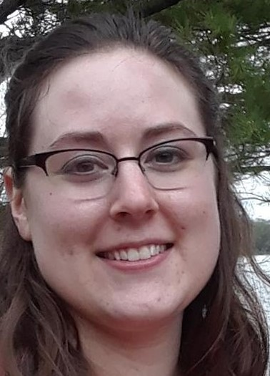
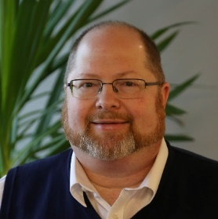
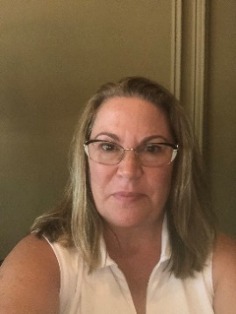
CARLI Team
Katie Roberts
Blake Walter
Bonnie Dauer
Special Project Cataloger
Special Project Cataloger
Special Project Cataloger
Notes:
One of our initial hires, Hanan Jaber, moved to Massachusetts in July 2022, so per IHLS’ employment policies, we needed to find a replacement, and hired Katie Roberts. Blake and Bonnie have been working on the Alma clean-up project since Sept. 2021 and Katie has been with us since August 15, 2022.

Slide 19
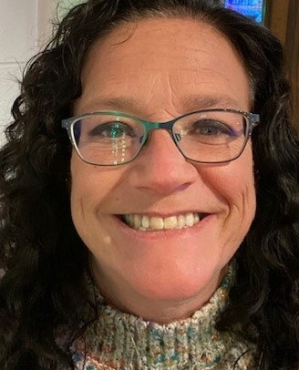

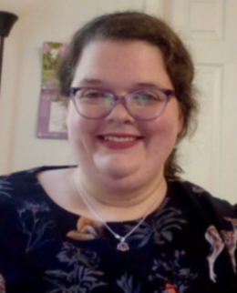

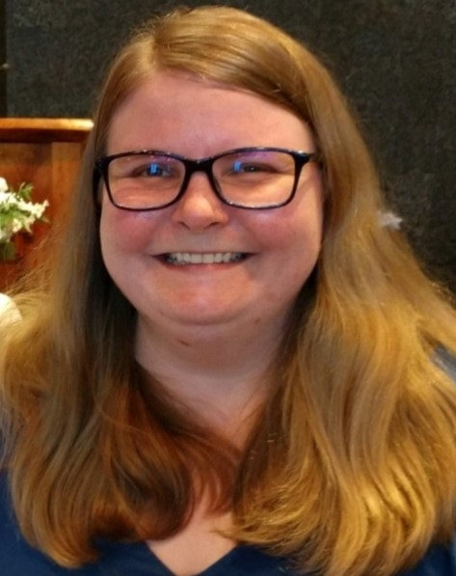
CMC Staff
Barb Scoby,
Cataloger
Dr. Pamela Thomas,
Bibliographic Grant
Manager
Mary Cornell,
Cataloger
Eric McKinney,
Cataloger
Katy Egts,
Metadata
Cataloger
Notes:
Currently, Mary and Eric are the only permanent staff working on the Alma clean-up project. We also have Shelley Stone (not pictured) who works 10 hours a week for us.

Slide 20
Summary
Value of cooperative cataloging
Understanding the NZ
Maintaining accurate and up-to-date metadata
Notes:
The work of this project has reminded us of the value of cooperative cataloging efforts and collaborative work on database maintenance. The project also continues contributing to our understanding of the Network Zone and how it should be used to improve efficiencies. Some of what we learn reinforces the values we place on maintaining accurate and up-to-date metadata, while other experiences will also transform how we might use the cooperative database to support our current values and goals.

Slide 21
Thank you
Dr. Pamela Thomas
pthomas@illinoisheartland.org or cmc@illinoisheartland.org
https://www.illinoisheartland.org/cmc

Slide 22
Where Does CARLI Stand Now with Title Metrics?
New Title Metrics (as of 10/12/2022):
Network Zone title count: 16,235,959
IZ not linked to NZ or CZ: 5,452,112
Unique eJournals combined: 459,988 (subtract from above)
Total: 21,228,083
More comfortable than 46.2 million records
Much more comfortable than where we were in early 2021
Notes:
Record Counts
Where we were in 2020 and 2021, each instance of a record was counted, IZ and NZ regardless of whether the IZ record was linked. NZ records + IZ records = record count
Beginning in 2022, Ex Libris uses a linked record count process to better reflect the consortial environment where there is value in using shared records. NZ records + IZ record that aren’t linked to the NZ = record count.

Slide 23
What CARLI Has Learned
The Network Zone is not…
A true union catalog
IZ records must be linked to NZ and have inventory to appear in Held By
The Newberry Library does not link bibs to the NZ
NZ data are not used by the automated fulfillment network for rotas
A subset of WorldCat
NZ is not independent the of Community Zone
Some NZ data supplied by vendors not using WorldCat records
Acquisitions processes may be more effective on IZ-NZ linked data
Supplied with all the tools needed for easy management of data
Finding bibs not used in network
Finding and merging bibs duplicated on values other than 035$a
Finding bibs used in bound-withs
Cataloging levels do not prevent changes in the ways that we might want

Slide 24
What CARLI Has Learned
The Network Zone is…
A shared repository of records from different sources
Not necessarily limited to WorldCat records
Records are in use by members, not necessarily held by members
Records may be present for future use
A tool for making shared data visible to members
The Held By tab shows most institutions using a bib
NZ data may be used by Rialto and other processes to enhance workflows
NZ Analytics allows CARLI to run data across all institutions and NZ
A tool for distributing some settings to institutions
CARLI can push some configuration tables and elements to members
Many configuration details still require institution-level modification
New opportunities exist for improving how we share records and efforts to maintain records in the NZ.

Slide 25

Now, Your Questions
Notes:
Please type any questions in the chat, or feel free to unmute to ask questions.

Slide 26
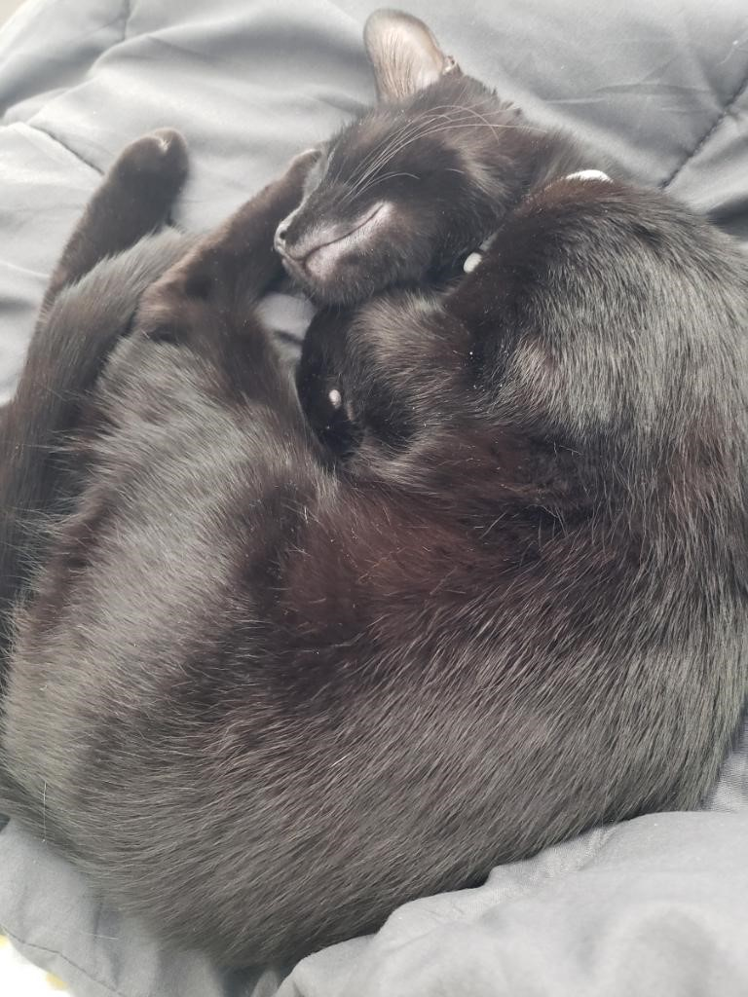
I-Share Alma Primo VE Office hours
Join us November 10, 2022 at 2pm for
Lab Reports @
Office Hours
Contact CARLI at
support@carli.Illinois.edu

