Slide 1
I-Share Alma Primo VE Office hours will start shortly
Welcome!
Office Hours will start at 2pm and run until 3pm.
Please mute your microphone.
As time permits, we will respond to questions typed in the chat box, and offline afterwards, as needed.
This session will be recorded and made available on the CARLI website.
CARLI I-Share logo

Slide 2
Alma and Primo VE
February Feature Release
Alma/Primo VE Open Office Hours
February 8, 2024

Slide 3
Today’s Agenda
Announcements, Reminders, and upcoming events
Alma and Primo VE February Quarterly Feature Release highlights

Slide 4
Announcements
The Ex Libris Users Group of North America (ELUNA) is holding an informational meeting about the upcoming ELUNA Annual Meeting conference in Minneapolis, MN, May 14-17.
  Register for the informational meeting that will be held on February 12 at 12pm Central time, and if you cannot attend you will be sent a link to the recording.
  More information about the event is available on the ELUNA Website

Slide 5
Reminder: Premium Sandboxes Refresh
Premium Sandboxes (PSB) Refresh – February 2024
Refresh will occur on February 11 as part of Alma quarterly release update
After the refresh CARLI staff will prepare the sandboxes for use
  Refreshing the user accounts
  Configuring AFN between the sandbox IZs
Watch for an announcement from CARLI once the sandboxes are ready for use again in February.
If you are currently using the PSB for testing, any examples you’ve set up will need to be recreated after the refresh.
More information on the PSBs
Notes:
() CARLI’s six Premium Sandboxes were refreshed on Sunday, August 8 as part of the Alma monthly release updates. The Sandboxes are refreshed twice a year in February and August. If you are doing any current testing in the sandboxes, you will want to either finish up your work by the end of January, and/or document how to re-create your testing scenarios after the sandboxes are refreshed.
Following the refresh on February 12, the CARLI Office staff will refresh the generic user accounts and perform some configurations so that AFN will work between the six Sandbox IZs, and send an email to let you all know when the sandboxes are again available for use.

Slide 6
Upcoming Events
Let's Talk About Fulfillment: Alma Configuration – every other Tuesday afternoon at 2pm.
  Next Session, Feb. 13: Alma Configuration - Linked User Records
  List of sessions: Let’s Talk About Fulfillment 2023-2024 Series on Alma Configuration
NC Live Service Informational Webinar – February 28 at 10am-11am.
Please check the CARLI Calendar for all upcoming events!

Slide 7
Alma February 2024 Quarterly Release Highlights

Slide 8
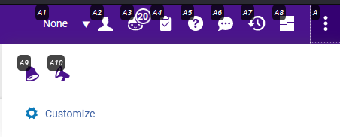
User Interface & Accessibility
New Alt-Key options to Top Right Menu bar
  Hold Alt key, then type A# to select one of the menus
  Type Alt+A to select the more menus (three vertical dots)
Top Right Menu also supports voice dictation
A screenshot of Alma's top right menu with global hot-keys highlighted as "A1" to "A10" and "A".
Notes:
Ex Libris has added another incremental accessibility update this month, expanding the use of keyboard shortcuts. In this update, the top right menu has been assigned hot keys A1 to A10. To use these functions, press and hold the Alt key, then type A and the number, A given combination will either open or close the selected menu. Typing Alt+A selects the more options part of the menu, indicated by the three vertical dots.
If you have customized the order of these menu icons, Alma adjusts the alt-key sequences accordingly.
[possible demonstration now or later]
If you weren’t aware, the Alma metadata editor and screens with tabs also support keyboard shortcuts for faster navigation.

Slide 9
Acquisitions: PO Line Task List and PO Lines
New Unified PO Line Task List rollout is final.
  A known issue with saving logical sets using facets will be fixed in March.
New functions in PO lines
  Sliding panel for Funds, Material Supplies in POL
    “Hamburger” menu opens search result.
    Slide out icon shows the selected fund or vendor.
  Save and Continue now visible when viewing POL in Task List.
Notes:
Beginning this week, the new PO Line Task list is the official and only interface in Alma for working with PO Lines. However, Ex Libris continues to improve the functionality in this area. First, the sliding panel approach found in the new task list will now be added within PO Lines for the material supplier and fund fields. This panel looks like an Alma search results screen, letting users view more information in selecting a fund or vendor.
Another quality-of-life improvement appears in the PO line action buttons that appear across the top of a POL. The Save and Continue button will now appear on the screen when you view a POL from the task list. Previously, one would need to select the POL for editing to get the Save and Continue button, which saves the order and approves it for auto-packaging.

Slide 10
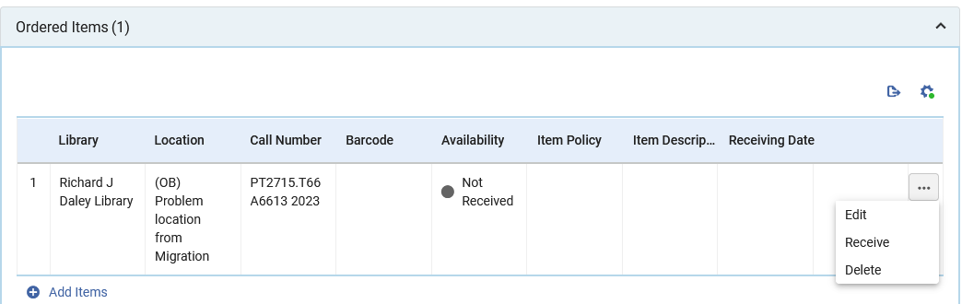
New Receiving from PO Line
Existing approach: Acquisitions > Receiving and Invoicing > Receive
New approach #1: Search POL, edit, receive from ordered items
A screenshot of the Ordered Items, or inventory section, for a PO Line in Alma. The actions menu for item is open showing choices of Edit, Receive, and Delete.
Notes:
Another quality-of-life improvement appears in several new modes of receiving ordered items. Up to now, users would go to the Receive screen and record receipt of new items. This release expands those options to include both the PO Line and the Item record. Receiving from the POL is something that people have requested for a while. Now, you may search for a specific order and begin to edit the POL. Under the inventory section, labeled as Ordered Items, the … actions menu now includes a Receive option. Clicking Receive opens a pop-up screen that includes the Keep in Department option and the received date.

Slide 11
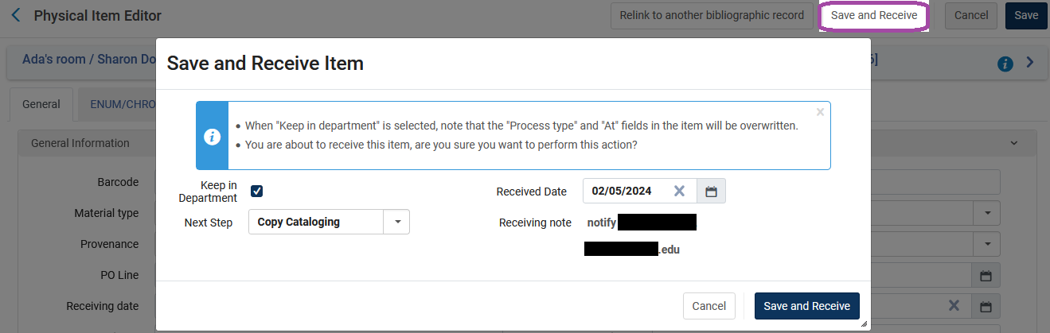
New Receiving from Item Record
New receiving approach #2: Receive from Item record
Save and Receive button sets received date, process type (if needed)
A screenshot of the Alma item record editor with the Save and Receive pop-up window displayed. The Save and Receive pop-up includes options to keep in department and set a process type, and to set the receipt date.
Notes:
That’s a nice improvement, but a better improvement still is the new receive function from the item record. Granted, the item record already contained a field for receiving date but entering that date manually did not fully mark an ordered item as received. Now, the item record editor includes a Save and Receive button at the top right. This will allow smaller technical services departments the ability to combine their work on receiving and processing items into fewer screens and steps. Clicking Save and Receive opens a pop-up that includes the Keep in Department option as well as the receiving date. Committing the save and receive includes any changes to the item as well as the receiving date. And if you’re a department that uses work orders or technical services processing, those values will be assigned automatically as well.

Slide 12
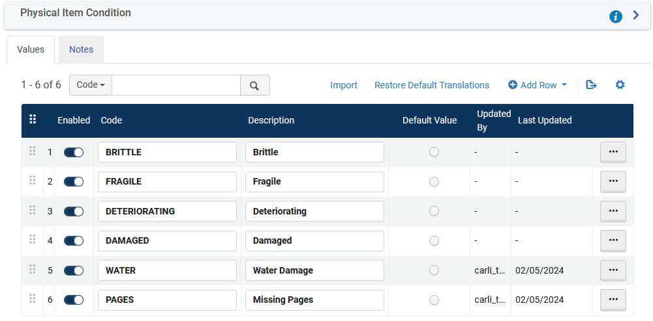
Item Record: Physical Condition List
List of physical conditions now configurable
Add options that you would like to track in items, searches, analytics.
A screenshot of Alma Physical Item Conditions configuration table with six rows displayed.
Notes:
Speaking of the item record and processing, the item record includes a field for recording the condition of an item. Up to now, one could only choose from four possible conditions, damaged, brittle, fragile, or deteriorating. With this release, the list of conditions may be modified by a configuration table. If your institution has preservation procedures for different kinds of damage, or you just want to standardize the categories for damage found better, then administrators may add new options to the list to account for the different kinds of damage you want to track in analytics or use to locate items in physical items searches.

Slide 13
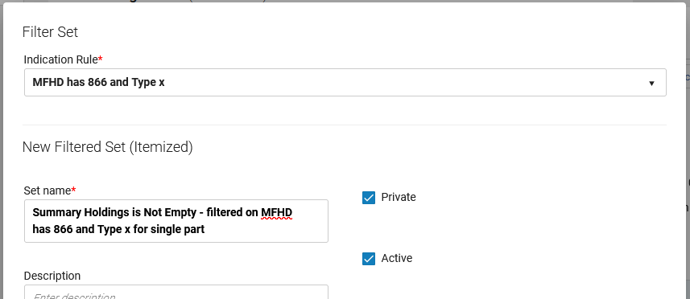
Filtering Holdings Record Sets
May now filter sets of holding records using indication rules
Useful for finding and correcting holdings record data (e.g., for LHRs)
A screenshot of Alma's Filter Set pop-up screen, with an indication rule selected to apply a filter against a set of holding records.
Notes:
Over the last year, Ex Libris has improved the ability to manage sets and added options to search for and create sets of holdings records. For an organization like ours, where MARC holdings have been important for a while, this has been a welcome improvement. This month, we get the next logical progression in that improvement, where sets of holdings records may be filtered by indication rules designed to work with holdings.
An example of how this may be useful is for a library that is looking ahead to possibly creating LHRs in OCLC, they may want to start finding the records that could have coding issues. One might start by creating a logical set of holding records where the summary statement, that is the 866 field, is not empty. From there, if you want to look at whether the leader values are correct for the type of holdings, then a filter that looks at the record type field may be applied to create a narrower set of records to review.

Slide 14
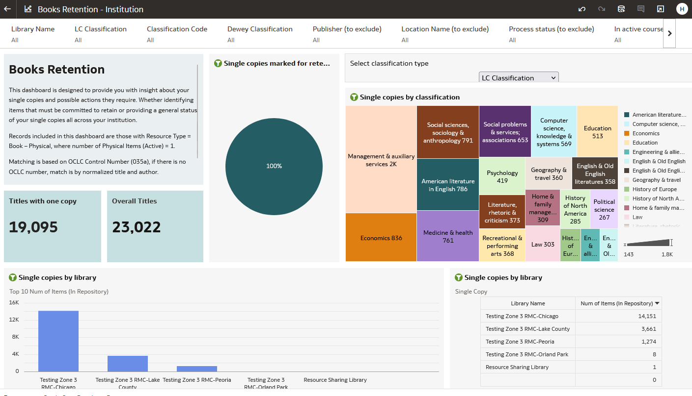
Analytics and Data Visualizations
New Data Visualization dashboards for collection management
  Shared Folders > Alma > Inventory
  Available as analytics objects
  Dashboards have documentation panels
A screenshot of Alma's Filter Set pop-up screen, with an indication rule selected to apply a filter against a set of holding records.
Notes:
Ex Libris has been working with a focus group on development of collection management reports, which they are beginning to rollout in this current release. Two new data visualization dashboards are available on Physical Books Retention and Physical Books Deselection. You may look for these in the Alma subfolder under shared folders in Analytics; be sure to copy the dashboards into your institution’s folder or your private folder before modifying these in any way.
These dashboards are available as analytics objects, meaning they can be featured on the home page or scheduled, and the default set of roles includes Analytics Administrator, General Systems Administrator, Designs Analytics, and Physical Inventory Operator.
My first looks at these dashboards indicate that they do some things very well. For instance, reports on the number of titles with a single copy, overall title counts, visualizations on classifications, and loan activity.
They also do some things less well. In part, this may be due to the reports attempting to measure data that aren’t present yet. For instance, if items haven’t yet been marked as “Committed to Retain,” then there won’t be much value in the comparisons on that data point. Another area where the reports will be less useful is on counts of copies, specifically as the analyses appear to be counting items per title. Sets with multiple volumes end up looking like multiple copies, at least in the first few looks I’ve had.
We encourage you to explore these further and learn what you can about them. More training on Data Visualizations is available from the Analytics Become an Expert series that ran in 2023.

Slide 15
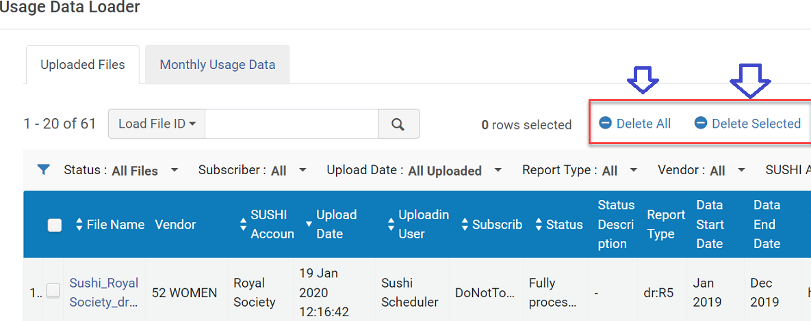
Electronic resources
Electronic Resources and Link Resolver Updates
Automatic Upload of Electronic Holdings now supported for Taylor & Francis journals
  More information at Upload Electronic Holdings from Taylor & Francis
Bulk Deletion of COUNTER Reports (must have “Usage Data Operator” role.)
A screenshot of the Alma Usage Data Loader screen with Delete All and Deleted Selected highlighted.
Notes:
(Denise) Alma has been adding vendors to the automatic uploads of electronic holdings option. Recently Taylor & Francis journals joined such publishers as Springer, Elsevier and Ovid in this option for monthly uploads of your library’s entitlements. There was already an option for Taylor & Francis ebooks. More information at this link.
Previously when deleting COUNTER reports, users needed to delete them one by one. Now, before deleting COUNTER reports, users have an option to select multiple reports for deletion. In addition, the Select All and Delete All options were added. Here’s an illustration of the new options from Alma documentation.

Slide 16
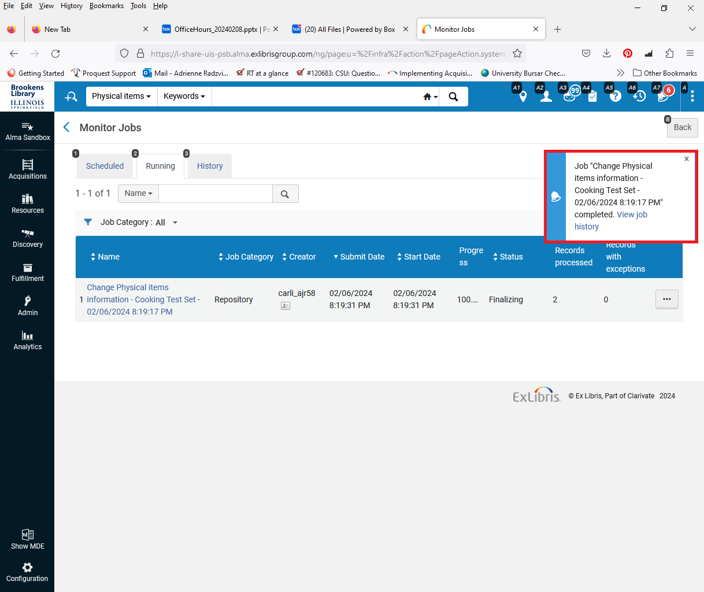
Real-Time Notification Upon Job Completion
When you run a job, instead of having to select Refresh over and over, or waiting for an email notification, Alma will display a message when the job finishes.
A screenshot of the Alma Monitor Jobs screen showing a highlighted pop-up window that will automatically display when an Alma job finishes.
Notes:
Adrienne/Jen

Slide 17
Course reserves
The Course Loader (Configuration > General > External Integrations > Integration Profiles) directory now supports Excel files in addition to .csv files.
You can configure Alma to include archived lists in the Demand in other lists calculation, which enables you to see which reading lists or courses use the same resource as you review and process citations.
Notes:
Adrienne/Jen

Slide 18
Primo VE February 2024 Quarterly Release Highlights

Slide 19
Primo VE – QuickLinks Major Change Coming
Automatically Enabled QuickLinks
  QuickLinks option is currently at Primo VE View level; will be moving to Institution level with this change in May 2024.
  In February optional to enable QuickLinks, HOWEVER Alma is making QuickLinks in brief results displays the _default_ in May 2024
  Can opt out of this new Institution level parameter.
  More information on QuickLinks
  QuickLinks’ cooperating vendors.
Notes:
(Denise) Alma is changing the default behavior of Primo VE QuickLinks for electronic full text option. (Read slide) They are advocating most libraries use QuickLinks.

Slide 20
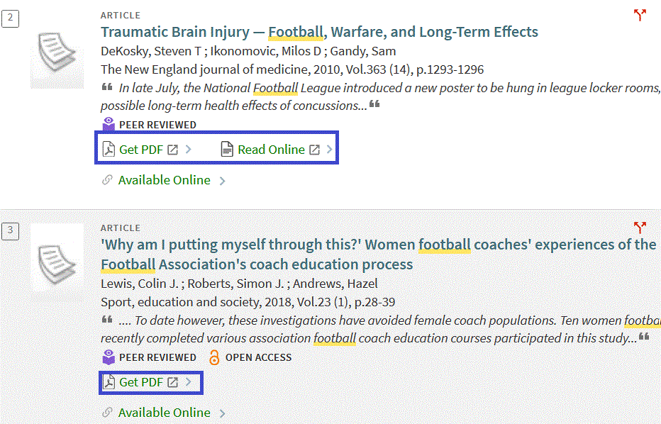
Primo VE – QuickLinks Examples
A screenshot of Primo VE article results with QuickLinks examples of “Get PDF” and “Read Online” highlighted.
Change in default setting in three months May 2024!
Notes:
(Denise) Here’s examples. QuickLinks appear on the brief result displays. Here for example, I looked up football in an “Articles” search slot and you can see this library has QuickLinks already enabled. That’s what supplies the “Get PDF” . QuickLinks works with bibliographic data from cooperating publishers & vendors to provide a one-click to full text option. My colleague will put the link to cooperating publishers & vendors in the chat.
Please begin discussing accepting (or not) the new QuickLinks default with your colleagues. The May 2024 switch is only three months off.

Slide 21
Primo VE – CDI records
CDI Subject Normalization and New Keyword Fields –
Incoming subject terms are now mapped to a controlled vocabulary, which is based primarily on LCSH and MeSH.
Has created indexed fields “Subject field (normalized)” and “Keyword field”.
Using normalized subjects is OFF by default - must enable in each Primo VE View’s General tab > Use normalized CDI subjects
For more details, see Using Normalized Subject Headings from CDI.
Notes:
(Denise) CDI Subject Normalization. Alma/Primo VE are trying to improve the quality of CDI subject terms. Subject terms are being received in CDI in various formats and styles from providers and aggregators leading to much duplication and inconsistencies. Now incoming subject terms are mapped to a much more controlled vocabulary, which is based primarily on LCSH and MeSH.
Normalized means making the subject terms more consistent and (to some degree) how subject terms are related to each other.
The outcome of this mapping is the following:
Subject field (Normalized) – This indexed field includes only subjects that match the CDI controlled vocabulary. They are deduplicated and normalized.
Keyword field – This new field includes all subjects that could not be mapped against the CDI controlled vocabulary. These subjects are considered keywords, which are also indexed and searchable.
Using normalized settings is OFF by default. To enable it, check the “Use normalized CDI subjects” box in the General tab of the Primo VE View.
When disabled, the existing Subject field for display, search, and facets is used.
For more details, see Using Normalized Subject Headings from CDI.

Slide 22
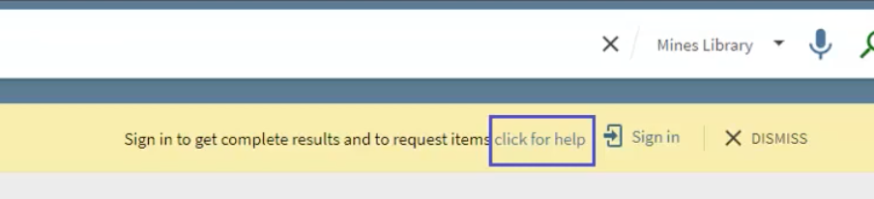
Primo VE – HTML Coding Possible in More Labels
Several more labels in Primo VE now support HTML coding
Includes the <href> tag for linking
Non-comprehensive list of labels that support HTML: https://knowledge.exlibrisgroup.com/Primo/Product_Documentation/020Primo_VE/Primo_VE_(English)/050Display_Configuration/030Configuring_Display_Labels_for_Primo_VE#Codes_that_Support_HTML_Formatting
If you’re not sure if a label supports HTML, try it in a Sandbox first
Screenshot of a Primo VE label with an embedded HTML link saying "click for help"
Notes:
[Jessica]

Slide 23
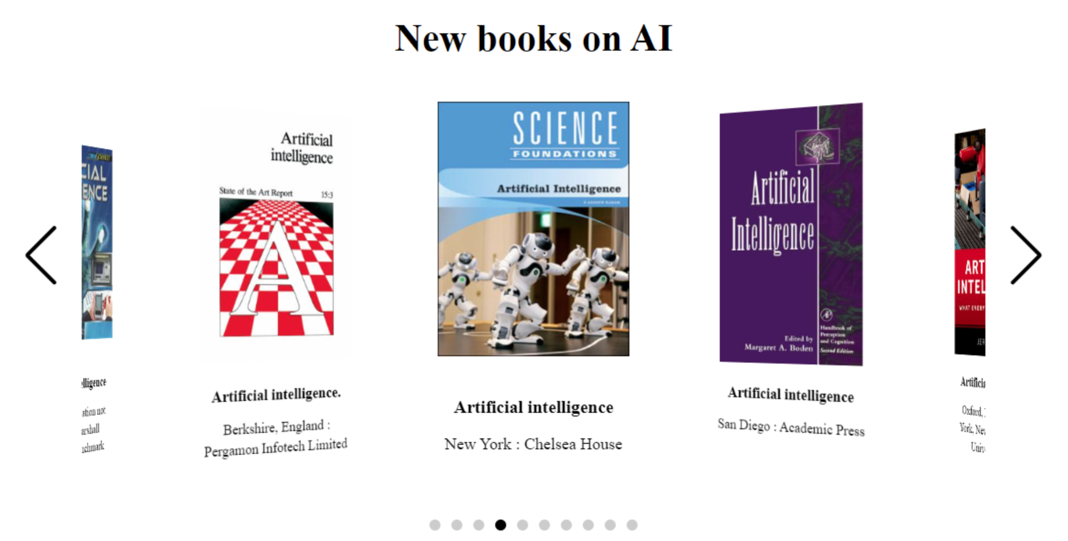
New Primo VE Showcase Widget
Embed a visual carousel on any website – Instructions on Ex Libris Developer Network
Contents are results from a Primo VE search
Limited to 10 results
Requirements:
  Configure website domains in Alma
  JavaScript file customization
  Host the JavaScript file on the website
Example Showcase Widget carousel
Notes:
[Jessica]

Slide 24

Questions
& Answers
This is a decorative image of a long-haired black cat resting inside a cardboard box.
Notes:
(Rotating nice picture) ☺

