Slide 1
I-Share Alma Primo VE Office hours will start shortly
Welcome!
Office Hours will start at 2pm and run until 3pm.
Please mute your microphone.
As time permits, we will respond to questions typed in the chat box, and offline afterwards, as needed.
This session will be recorded and made available on the CARLI website.
Today’s slides available at https://www.carli.illinois.edu/carli-alma-primo-ve-open-office-hours-41

Slide 2
Alma Cloud Apps &
Newsbank article-level-linking
Alma/Primo VE Open Office Hours
June 8, 2023
Notes:
[Ted – Start Recording and Transcript]
Welcome all to the June 8, 2023 CARLI Alma Primo VE Open Office Hours. This is Ted Schwitzner at the CARLI Office, and today my colleagues and I have two presentations for you.
Our slide deck for today, if you’d like to download a copy, is posted at the event page, https://www.carli.illinois.edu/carli-alma-primo-ve-open-office-hours-41.

Slide 3
Today’s Agenda
Announcements
Alma Cloud Apps
  How to Find and Use Cloud Apps
  A Few Helpful Apps
NewsBank Article-Level-Linking
  Brief Overview
  Two Methods: API Webhook and GES Configuration
  CARLI documentation
Open Q & A
Notes:
[Ted]
As is our tradition, we’ll begin in a moment with some announcements and reminders, then we’ll head into our content for the day.
Martin Kong and I will present information and a demonstration about Alma Cloud Apps.
Then Denise Green and Marisa Tolbert will share details on setting up article-level linking for the NewsBank electronic resource.
We should also have plenty of time for open questions and answers on any Alma or Primo VE topic.

Slide 4
CARLI Announcements/Upcoming Events
  Find More Illinois (FMI) - An Introduction for I-Share Members
    Tuesday, June 27 10:00-11:00 – registration open soon
  Technical Services Q&A
    Wednesday, June 28 10:00-11:30 – registration open
  Save the Date! CARLI Annual Meeting
    Thursday, November 16, 2023
    More information and registration as the date approaches.
Notes:
Find More Illinois – An Introduction for I-Share Members. Find More Illinois is an opt-in Interlibrary Loan platform offered to all Illinois libraries by the Reaching Across Illinois Library System (RAILS). All of CARLI's I-Share member libraries may choose to join FMI. This informational session presented by RAILS staff with the support of CARLI staff will introduce the service to interested libraries. More information can be found in the April CARLI News https://www.carli.illinois.edu/carli-news-april-26-2023. Registration will be shared soon for this session taking place Tuesday June 27 at 10:00. This session will be recorded.
Don’t forget to register for the upcoming Technical Services Q&A taking place on Wednesday June 28 at 10:00.
Also, in case you missed it in this month’s CARLI news, be sure to save the date for the 2023 CARLI Annual Meeting to be held Thursday November 16 at the iHotel in Champaign. More information and registration will be shared soon.
With those announcements handled, let’s head into today’s first topic.

Slide 5
What are Cloud Apps?
“An open framework which allows developers to write apps which run inside Ex Libris higher education products such as Alma, Primo VE backoffice, Esploro, Leganto and Rapido.”
“Cloud Apps can add new features beyond core Ex Libris functionality, can integrate with other sysems, or can provide shortcuts and efficiencies for institution-specific workflows.”
—Josh Weisman, Ex Libris, July 2020
https://developers.exlibrisgroup.com/blog/announcing-ex-libris-cloud-apps/
Notes:
[Ted]
For some of you, the term Cloud Apps may already be familiar. For others, this may be the first you’re hearing about them, at least from CARLI. Cloud Apps were introduced back in July 2020 and rolled out sometime after that. The idea is that developers from around the Alma community might improve the Alma user experience by developing custom applications to run inside Alma. These applications supplement and extend Alma functionality to accomplish task efficiencies.
Our focus today is on introducing the basics of cloud apps, such as how to enable them in your institution and for individual users. We won’t be discussing how to create any, though we are highlighting one Cloud App that CARLI staff developed.

Slide 6
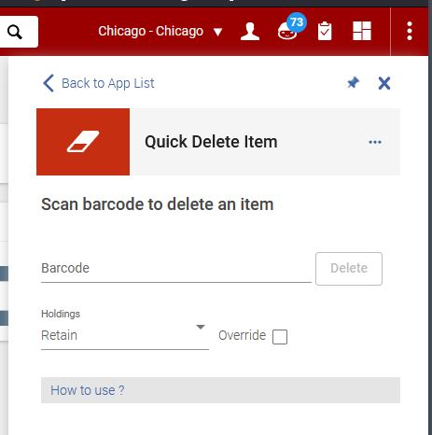
What Makes Alma Cloud Apps Unique from Other Apps?
Cloud Apps run within the Alma environment
  Apps work with existing user roles and privileges
  Accessed and run from a menu in the Alma UI
  No additional accounts or APIs needed
Extending functionality
  Enhance workflows with shortcuts
  Integrate with other systems and platforms
Notes:
[Ted]
The use of library-developed apps isn’t new for Alma. From early on, Alma users could use tools like the Spine-o-Matic to interact with Alma APIs. These programs had always existed separately from Alma, and had their own configuration and permissions controls.
What makes Cloud Apps unique is that these apps are part of the Alma cloud environment. They are already hosted on the platform, so they don’t require any specific installation instructions on staff workstations. Running within Alma means that the APIs to get data and perform actions is already present in the background, so library staff do not need to create new API keys, though some apps may require some extra configuration after activat. Also, they interact with the same user roles that assigned to staff accounts. If a staff member has roles and permissions to perform a function normally in Alma, they can also use the cloud app for the efficiencies; conversely, if a staff member does not have the right roles, they would not be able to use the cloud app.
The Quick Delete Item app shown on screen is a good example of this. Withdrawing and deleting an item record requires the Physical Inventory Operator Extended role. If a user already has that role, they could use the app to speed up the process of withdrawing items. However, a staff member that doesn’t have that role would find that they’re unable to use this app.
This app is also an example of a tool used to create efficiencies or short cuts. The process to withdraw items usually requires 3-5 clicks to navigate to the right screen with the withdraw option. The app reduces this to a single screen. Other apps exist that integrate with systems and platforms outside of Alma, for example, to get data from another service.

Slide 7
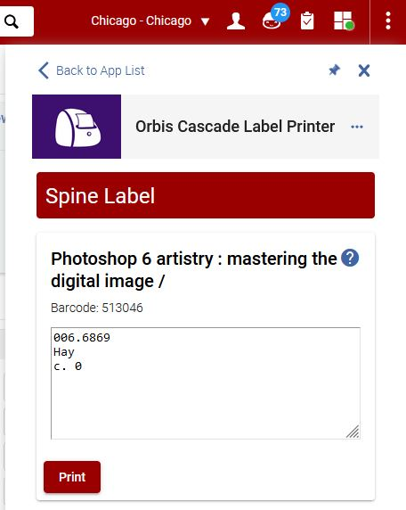
Who Creates and Supports Cloud Apps
Apps are developed by members of the Alma community
  Vetted by Ex Libris for security, consistency
    Ex Libris supports apps that they created
    Individual developers support their own apps
  Documentation provided by developer
    Expects familiarity with normal Alma workflows
    Identifies additional configuration options
Library staff are responsible for the uses of any Cloud Apps
  Research the apps and requirements before use
  Verify before sharing use among colleagues
Notes:
[Ted]
Cloud apps are developed by members of the Alma community, and several apps have been developed by Ex Libris as well. Ex Libris reviews each app submitted for security and consistency. However, App developers retain responsibility for documenting and maintaining the app, as well as providing support if any surprises crop up. Some apps are turn-key, in that activating them is all that’s necessary to begin using them. Other apps require additional configuration by the institution or user.
It’s fair to say that some responsibility also remains with the Alma user to know how the app fits with typical Alma workflows. The use of any application with Alma may carry risks to modify data in some way. CARLI strongly recommends that library staff should research apps before committing to their use. Identify whether they merely read data or make changes, and if so, what changes are made. When you’ve reviewed how the app works, share with co-workers how to use the app.

Slide 8
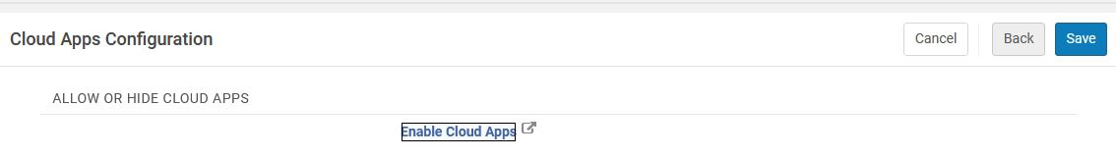
Initial Configuration
Alma Config: General > General Configuration > Cloud Apps Configuration
  Role needed: General System Configuration
  Select Enable Cloud Apps.
  Review and acknowledge the Cloud Apps agreement (on external site)
  Select Activate CloudApps for 01CARLI_XXX.
  Log out of Alma.
Notes:
[Ted]
To get started with using Cloud Apps, there is a one-time step to enable cloud apps for your whole institution zone. We’ll demonstrate this in a few minutes, so I won’t read the steps here, though it is important to mention that the enabling process includes approving a Cloud Apps terms of use agreement outside of Alma. Enabling Cloud Apps and clicking the agreement shouldn’t be done randomly or quickly. The process occasionally might also require you to log out of Alma and log back in before you see cloud apps enabled.

Slide 9
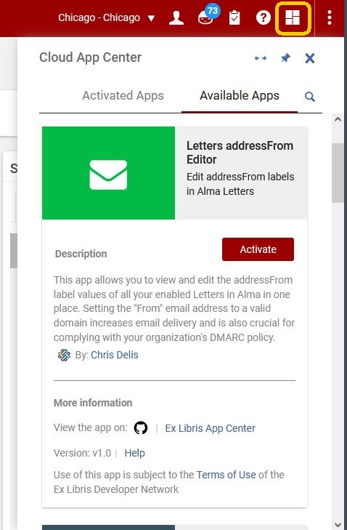
Accessing Cloud Apps
Once enabled, any staff may select an app from the Cloud Apps menu.
Search list of Available Apps, click the App tile for more information
  Information tile includes links to developer details, help documentation, and source code
  Click Activate to add to the Activated Apps list.
Activated Apps may have additional settings
  Settings—values that any user may change
  Configuration—values that administrators should set
https://knowledge.exlibrisgroup.com/Alma/Product_Documentation/010Alma_Online_Help_(English)/050Administration/050Configuring_General_Alma_Functions/Configuring_Cloud_Apps
Notes:
[Ted]
Once Cloud Apps are enabled, a new menu icon appears on Alma’s persistent menu bar. The cloud apps menu is associated with an icon of four overlapping rectangles. At first, apps will only appear on the list of available apps. You may search for an app, read its description, and activate if desired. After activation, the apps will be listed on the activated apps list. Both lists may be filtered to find apps more easily. Note also the thumbtack icon that shows the app menu may be pinned open in the user interface.
It is important to note that the Cloud Apps menu is user-specific at this point. Different users may have different apps activated for themselves, and there isn’t a way to automatically activate an app for everyone on your staff, though some apps may be configured initially by an administrator, that is someone with an admin role. Some apps also include settings that individual users may customize based on their workflows.
[https://knowledge.exlibrisgroup.com/Alma/Product_Documentation/010Alma_Online_Help_(English)/050Administration/050Configuring_General_Alma_Functions/Configuring_Cloud_Apps]
CARLI does not have a list of which apps require additional configuration, and we may not be able to fully support apps, though we’ll do our best to guide you.

Slide 10
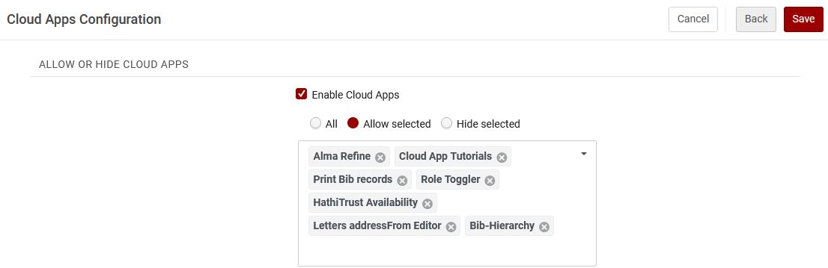
Configuration, Continued
Once enabled, any staff member may add a cloud app to their app menu
Local administrators may select which apps to allow or to hide
Best practice: research, allow selected, test, share with others
Notes:
[Ted]
As I’ve mentioned, once cloud apps are enabled, any user may select any cloud app for their app menu. Cloud apps are managed by user roles. If a staff member activates an app that their roles don’t let them use, the app will still appear, but they will get an error when they attempt to use the app.
Not all cloud apps are appropriate for every institution. There are some apps that are aimed at specific consortia and others that may interact with third party products not used by your institution. We suggest that you may want to simplify life for your staff by limiting the list of apps to those that you have vetted already and know are practical. This may be done on the screen where you enabled apps initially, and you may specifically allow certain apps or hide those that you know aren’t usable.
CARLI’s recommended best practice is to research apps initially, then allow selected apps, test them to verify that they do what you expect, and finally share with your co-workers that the apps are available.
With that, we’re ready to dive into a demonstration of the setup and use Cloud Apps. I’ll hand off to my colleague, Martin Kong.

Slide 11
More Information
Ex Libris YouTube channel: Cloud Apps in Alma (4:22)
Ex Libris YouTube channel: Getting More out of Alma with Cloud Apps (56:15)
Ex Libris Developer Network: Ex Libris Cloud Apps
Ex Libris Knowledge Center: Configuring Cloud Apps

Slide 12
Demonstration
Notes:
[Martin demo]

Slide 13
Questions on Cloud Apps
What are some of the Cloud Apps that CARLI libraries are using and find useful?
Notes:
[Ted – moderate Q&A from chat for up to 5 minutes]
Thanks Martin! We’ll take a few moments here to answer questions on cloud apps before moving into the next presentation.
…
If you have more questions on cloud apps, we’ll come back to those at the end of the session. Now, we’re ready to tackle our next topic, Newsbank Article-level Linking, with our colleagues Marisa Tolbert and Denise Green.

Slide 14
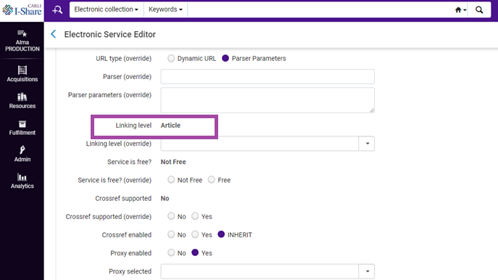
NewsBank Article-Level-Linking – What and Why?
What is it?
  The linking level refers to how patrons access content whether at the collection, portfolio, or article level.
  There are two methods to enabling access to articles in NewsBank.
Why do you want article-level-linking?
  Patron time saver.
  NewsBank collection usage increase.
Screenshot of linking level in Alma.

Slide 15

NewsBank Article-Level-Linking
Two Methods
By API Webhook
  Demo of Quincy University’s Primo VE search profile
  Special thanks to Katie Kraushaar and Susan Grant at QU for allowing us to share!
By General Electronic Service (GES) configuration
  Brief look at Knowledge Center documentation
NewsBank 50 years logo from Facebook.

Slide 16
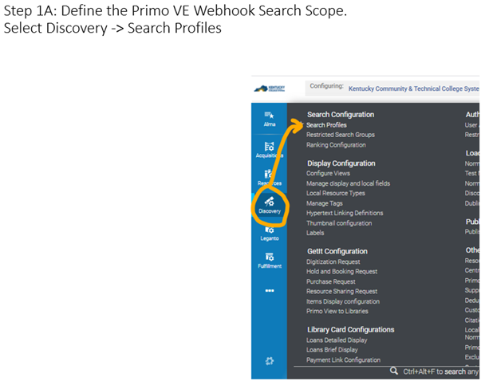
NewsBank Article-Level-Linking with API Webhook
NewsBank provides a 15 slide powerpoint document
  Demonstration of Quincy University’s Primo VE search profile
  Requires Discovery Administrator role
https://i-share-qcy.primo.exlibrisgroup.com/discovery/search?vid=01CARLI_QCY:CARLI_QCY&search_scope=NewDiscoveryNetwork
Screenshot of NewsBank documentation.

Slide 17

NewsBank Article-Level-Linking with GES Config
General Electronic Service for NewsBank
Knowledge Center Documentation
https://knowledge.exlibrisgroup.com/Alma/Knowledge_Articles/GES_for_Newsbank_Article_Linking
Requires the General System Administrator or Fulfillment Administrator role
Requires a “Dummy GES”
Requires configuration of DLR (Display Logic Rules)
  Enables more specified Primo VE display options
ExLibris and Clarivate Knowledge Center logo

Slide 18
NewsBank Article-Level-Linking CARLI Documentation
For the full versions of today’s methods, please refer to this CARLI webpage for the documentation:
NewsBank Article-Level-Linking
https://www.carli.illinois.edu/products-services/i-share/electronic-res-man/newsbank-article-level-linking

Slide 19

Questions
& Answers
Mushrooms and moss on a tree branch.

