Slide 1
I-Share Alma Primo VE Office hours will start shortly
Welcome!
Office Hours will start at 2pm and run until 3pm.
Please mute your microphone.
As time permits, we will respond to questions typed in the chat box, and offline afterwards, as needed.
This session will be recorded and made available on the CARLI website both as PDF slides and as a recording, with live links to all referenced resources.

Slide 2
I-Share Alma/Primo VE Office Hours
March 10, 2022
Notes:
Jen

Slide 3
Agenda Office Hours
Agenda – 3/10/2022
Announcements & Reminders
Open Q&A

Slide 4
Announcements
Announcements/Reminders
  Future Alma Primo VE Open Office Hours for 2022 have been scheduled for the 2nd Thursday of each month from 2pm-3pm.
  April 14 – Electronic Resources Management Task Force will present on setting up SUSHI harvesting in Alma for usage statistics.
  May 12 – Another Lab Reports session to share your successes with I-Share colleagues
  June 9 – User Management? (tentative)

Slide 5
Announcements
  Technical Services Q&A Sessions
  Scheduled for once a month from 10:30am-12:00pm
  Upcoming Dates: March 24, April 28, and May 26
  Registration open and available on the CARLI Calendar
Let’s Talk about Fulfillment (I mean Alma, not life’s purpose)
  Sessions are scheduled for every other week, alternating between Tuesday mornings at 10:30am and Friday afternoons at 2pm.
  Registration open and available on the CARLI Calendar

Slide 6
Announcements
Volunteer for a CARLI Committee
Annual call for volunteers will be going out soon!
Complete the Volunteer form on the CARLI website between April 4 and May 4 for consideration
The work of the CARLI committees and task forces is vital to the successful operation and continued evolution of CARLI.
List of CARLI Committees: https://www.carli.illinois.edu/governance/committee-directory

Slide 7

Now, Your Questions
Notes:
Please type any questions in the chat, or feel free to unmute to ask questions.

Slide 8
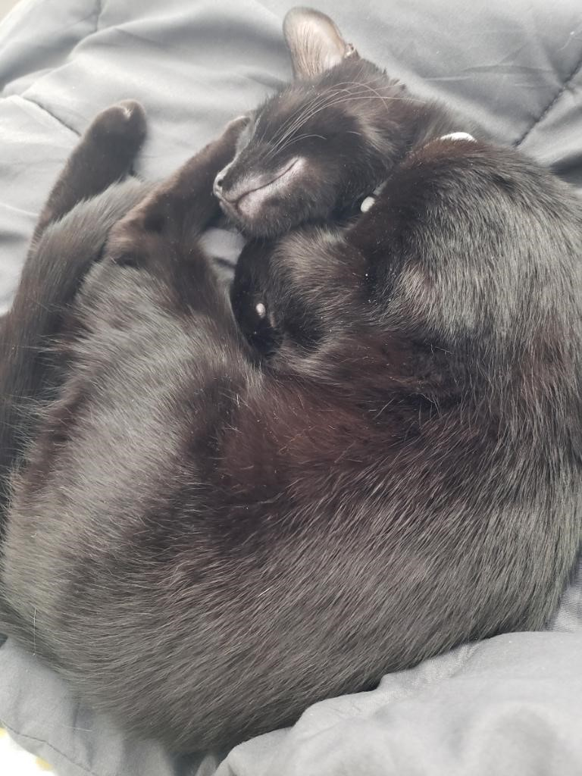
I-Share Alma Primo VE Office hours
Join us April 14, 2022
at 2pm for another
Office Hour.
Contact CARLI at
support@carli.Illinois.edu

