Slide 1
I-Share Alma Primo VE Office hours will start shortly
Welcome!
Office Hours will start at 2pm and run until 3pm.
Please mute your microphone.
As time permits, we will respond to questions typed in the chat box, and offline afterwards, as needed.
This session will be recorded and made available on the CARLI website both as PDF slides and as a recording, with live links to all referenced resources.

Slide 2
I-Share Alma/Primo VE Office Hours
Community Zone Update Task List
February 10, 2022
Notes:
Jen

Slide 3
Agenda Office Hours
Agenda – 2/10/2022
Announcements & Reminders
Alma Community Zone Update Task List (CZUTL)
Open Q&A

Slide 4
Announcements
Announcements/Reminders
  Upcoming Office Hours
  2022 Office Hours have been scheduled – 2nd Thursday of each month, 2pm-3pm.
  Look for another Lab Reports session later this Spring
  Technical Services Q&A Sessions
  Scheduled for once a month from 10:30am-12:00pm
  Upcoming Dates: February 24, March 24, April 28, and May 26
  Registration open and available on the CARLI Calendar
Let’s Talk about Fulfillment (I mean Alma, not life’s purpose)
  Sessions are scheduled for every other week, alternating between Tuesday mornings at 10:30am and Friday afternoons at 2pm.
  Registration open and available on the CARLI Calendar

Slide 5
Announcements
Other Upcoming Events
Sampling of Upcoming CARLI Events.
Please see the CARLI Calendar for all events and to Register!
  February 18, 11:00am-12:00pm CARLI Resource Sharing in our New Age: Two Libraries’ using Alma Analytics for IPEDS and ACRL Reporting Data. Sponsored by the CARLI I-Share Resource Sharing Committee. Registration is open.
  February 22, 6pm-7pm PDA Fair Use Game Show. Sponsored by the Professional Development Alliance. Registration is open.
  February 23, 11am-1pm CARLI OER Faculty Workshop: Supporting Academic Success: Open Educational Resources and Affordable Course Materials. Sponsored by the CARLI OER Committee. Registration is open.

Slide 6
czutl
Alma Community Zone Updates Task List
The Alma Central Knowledge Base (CKB) is the basis for the Community Zone (CZ) records in Alma and is updated every week on Sunday.
The Community Zone Updates Task List (CZUTL) in Alma provides a list of changes to records that are active in your Institution Zone (IZ). These changes may or may not require intervention by library staff.
This new CARLI Documentation outlines CZUTL and the types of changes that are of particular interest.
CZUTL Reviewing in Your IZ

Slide 7
CZUTL
CZUTL Demo and Discussion

Slide 8

Now, Your Questions
Notes:
Please type any questions in the chat, or feel free to unmute to ask questions.

Slide 9
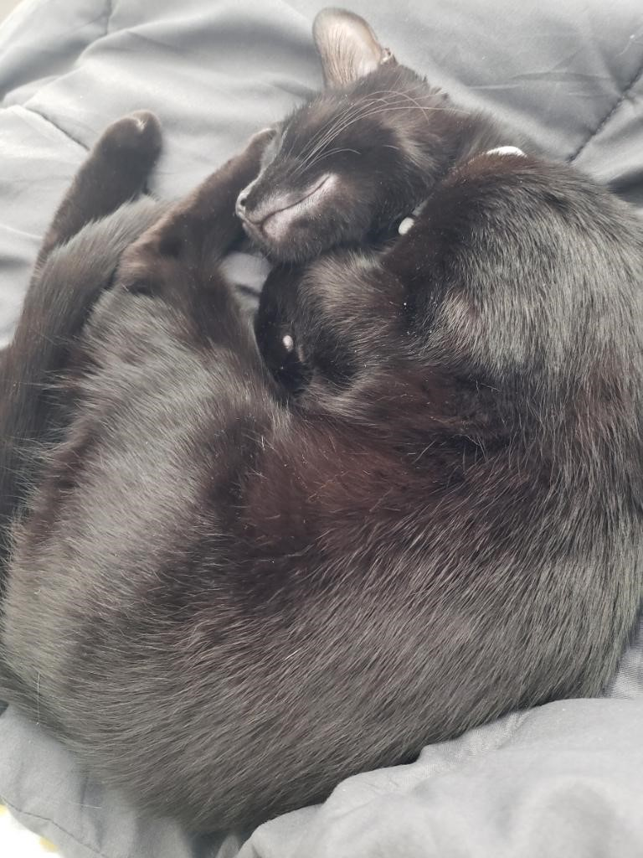
I-Share Alma Primo VE Office hours
Join us March 10, 2022
at 2pm for another
Office Hour.
Contact CARLI at
support@carli.Illinois.edu

